Slide 1
Oracle – PL/SQL
Dr. Lakshman Anumolu

Slide 2
Git & VSCode
https://git-scm.com/download/win
https://github.com/exaslate-courses/oracle-sql-plsql-b2
https://code.visualstudio.com/download
Extensions:
Gitlens
Oracle devtools

Slide 3
PL/SQL recap
Sample PL/SQL structure
DECLARE … BEGIN … EXCEPTION … END; /

Slide 4
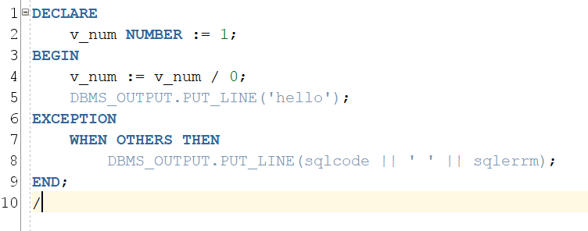
PL/SQL recap
Assignment operator
Variables
User assigned name to a memory location

Slide 5
PL/SQL recap
Variable
Declare in “DECLARE” section
Initialize in “DECLARE” or “BEGIN” or “EXCEPTION” sections

Slide 6
PL/SQL recap
String
v_str VARCHAR2(10) := ‘PLSQL’;
v_char CHAR(10) := ‘PLSQL’;

Slide 7
PL/SQL recap
CREATE a sample table to demo CHAR and VARCHAR2
CREATE TABLE tab_strings(…);
Difference in memory allocation
Using LENGTH or LENGTHB
Query all fields and display LENGTH

Slide 8
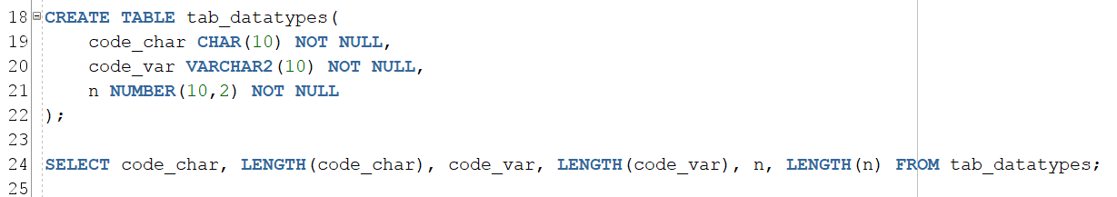
PL/SQL recap
Sample reference

Slide 9
Exercise
Clone oracle-plsql training repository
Modify anonymous pl/sql block from 1-vars.sql:
Add another variable of type VARCHAR2.
Initialize in “BEGIN” but not in “DECLARE” section.
Print length of the variable

Slide 10
Exercise
Clone oracle-plsql training repository
Modify anonymous pl/sql block from 1-vars.sql:
Add another variable of type VARCHAR2.
Initialize in “BEGIN” but not in “DECLARE” section.
Print length of the variable

Slide 11
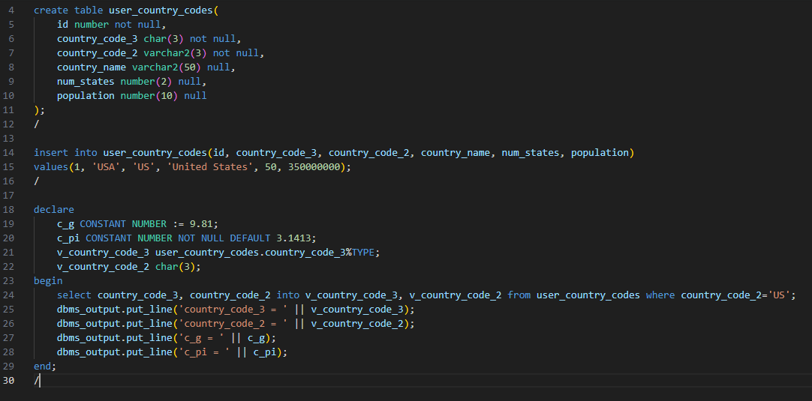
Variables-Constants-Anchor datatypes

Slide 12
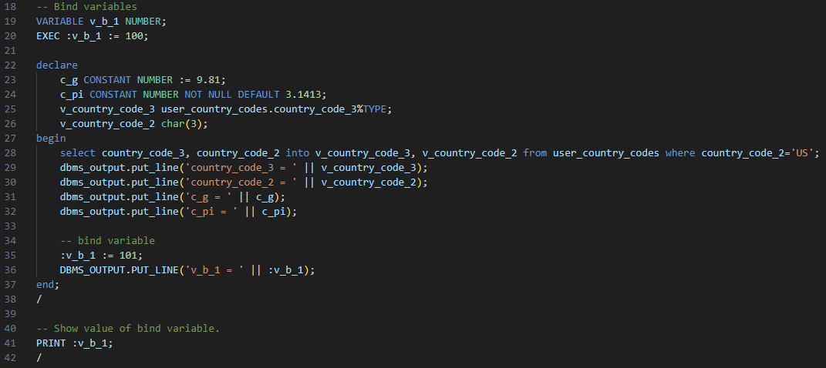
Bind variables

Slide 13
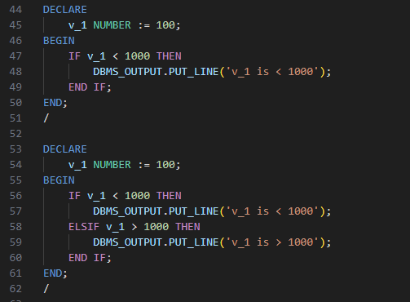
Conditions

Slide 14
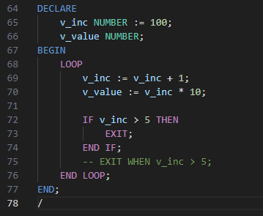
Loops

