Slide 1
Oracle – PL/SQL
Lakshman Anumolu

Slide 2
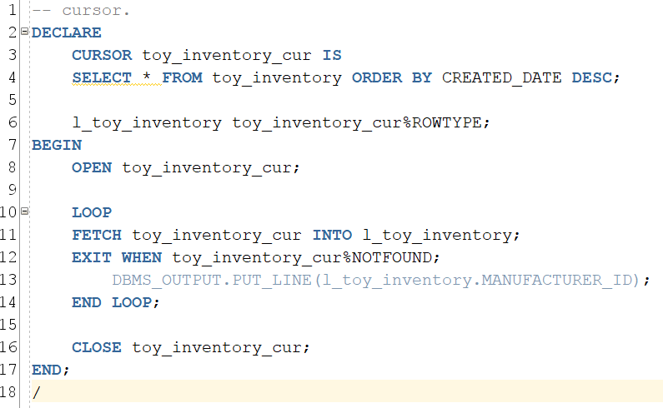
Cursor

Slide 3
Cursor
Cursor refers to as a pointer to a memory location – a context area that refers to memory segment in PGA
PGA: Process Global Area
Does hold the necessary information about a query
Rows returned
No. of rows
Pointer to parsed query in the shared pool
Query
SELECT * FROM TOY_INVENTORY
PGA
Server
Context area
(holds necessary information about a query)
Data

Slide 4
Cursors
Implicit
Created by Oracle server automatically for any SQL DML statement, if an explicit cursor does not exist.
Explicit
User defined

Slide 5
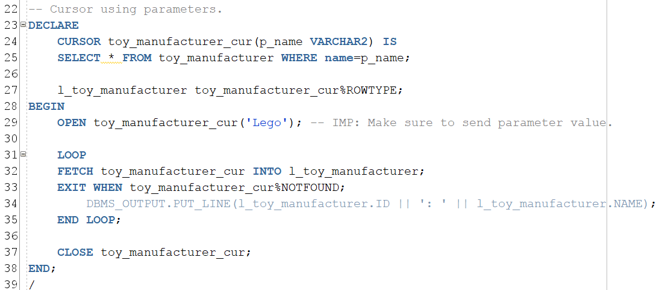
Cursors: With Parameters

Slide 6
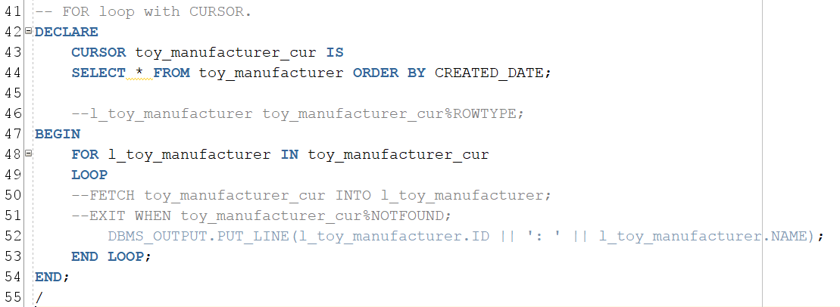
Cursors: using FOR loop

Slide 7
Reference cursors
Reference (Ref) cursors
Ref cursor holds value to a cursor.
It has ability to be associated with multiple SELECT statements.
Types
Strong
Weak
SYS_REFCURSOR
Weak reference cursor that is provided by Oracle as inbuilt data type.

Slide 8
Tomorrow
Ref cursors example
SYS_REFCURSOR example
RECORD TYPE
Introduction to bulk collect

Slide 9
Exercise (git)
Push your changes to 0-exercices and raise a PR

