Slide 1
Oracle – PL/SQL
Dr. Lakshman Anumolu

Slide 2
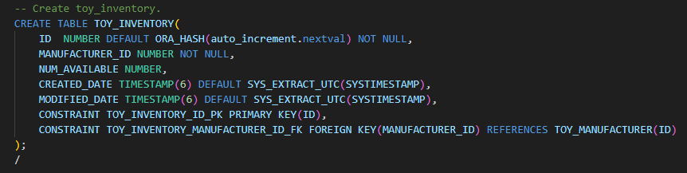
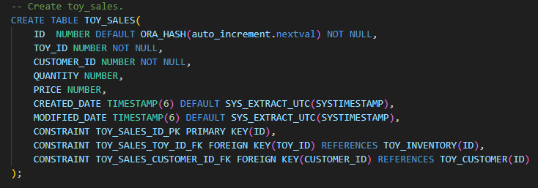
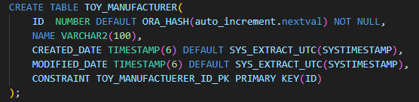
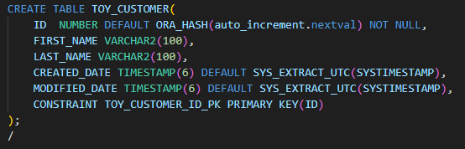
PRIMARY KEY, FOREIGN KEY
TOY_INVENTORY
TOY_MANUFACTURER
TOY_CUSTOMER
TOY_SALES

Slide 3
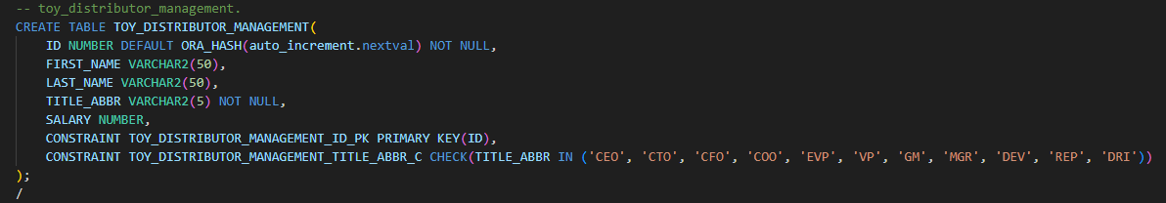
CONSTRAINT
TOY_DISTRIBUTOR_MANAGEMENT

Slide 4
CURRENT SESSION

Slide 5
TRIGGERS
Stored procedure invoked by Oracle DB upon the occurrence of a specific event an user specified while creating a trigger.
Triggers can be enabled or disabled
Types of Triggers
Conditional
INSTEAD OF
System trigger
DML trigger
…
Use cases
Audit
Statistics
Prevent invalid SQL transactions
…

Slide 6
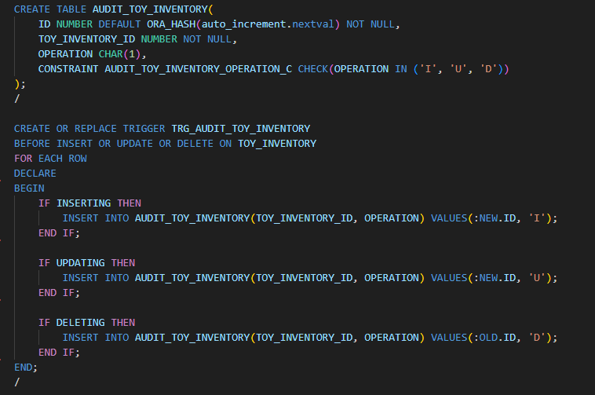
TRIGGER
Why trigger?

Slide 7
Exercise
Create DB for food delivery service
Table: FDS_RESTAURANTS
ID, NAME, CREATED_DATE, MODIFIED_DATE
Table: FDS_ITEMS
ID, RESTAURANT_ID, NAME, PRICE, CREATED_DATE, MODIFIED_DATE
Table: FDS_SALES
ID, ITEM_ID, CUSTOMER_ID, QUANTITY, PRICE, CREATED_DATE, MODIFIED_DATE
Table: FDS_CUSTOMER
ID, FIRST_NAME, LAST_NAME, CREATED_DATE, MODIFIED_DATE
Table: AUDIT_FDS_ITEMS
ID, ITEM_ID, OPERATION, NEW_PRICE, OLD_PRICE, CREATED_DATE, MODIFIED_DATE
OPERATION: must be one among ‘I’, ‘U’, ‘D’
Trigger: TRG_AUDIT_FDS_ITEMS

