Slide 1
Oracle – PL/SQL
Dr. Lakshman Anumolu

Slide 2
Git & VSCode
https://git-scm.com/download/win
https://github.com/exaslate-courses/oracle-sql-plsql-b3
https://code.visualstudio.com/download
Extensions:
Gitlens
Oracle devtools

Slide 3
Current session
Bind variables
Conditional statements
Loops (if time permits)

Slide 4
PL/SQL recap
Sample PL/SQL structure
DECLARE … BEGIN … EXCEPTION … END; /

Slide 5
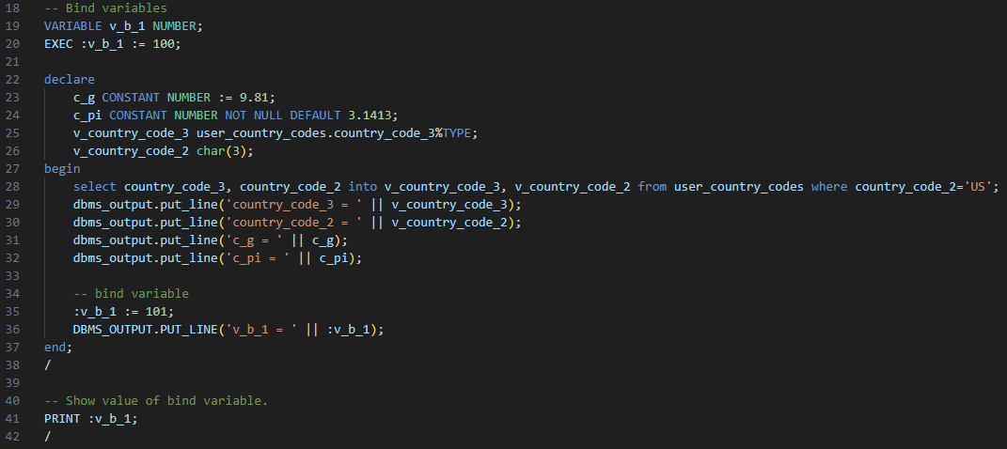
Bind variables

Slide 6
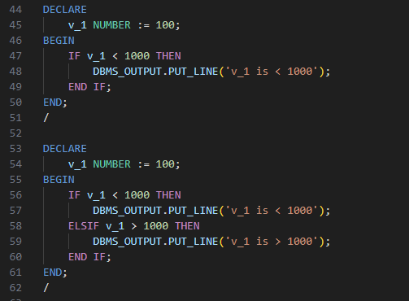
Conditions

Slide 7
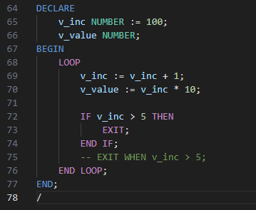
Loops

