Slide 1
Oracle – PL/SQL
Dr. Lakshman Anumolu

Slide 2
Git & VSCode
https://git-scm.com/download/win
https://github.com/exaslate-courses/oracle-sql-plsql-b3
https://code.visualstudio.com/download
Extensions:
Gitlens
Oracle devtools

Slide 3
Current session
Bind variables
Conditional statements
Loops (if time permits)

Slide 4
PL/SQL recap
Sample PL/SQL structure
DECLARE … BEGIN … EXCEPTION … END; /

Slide 5
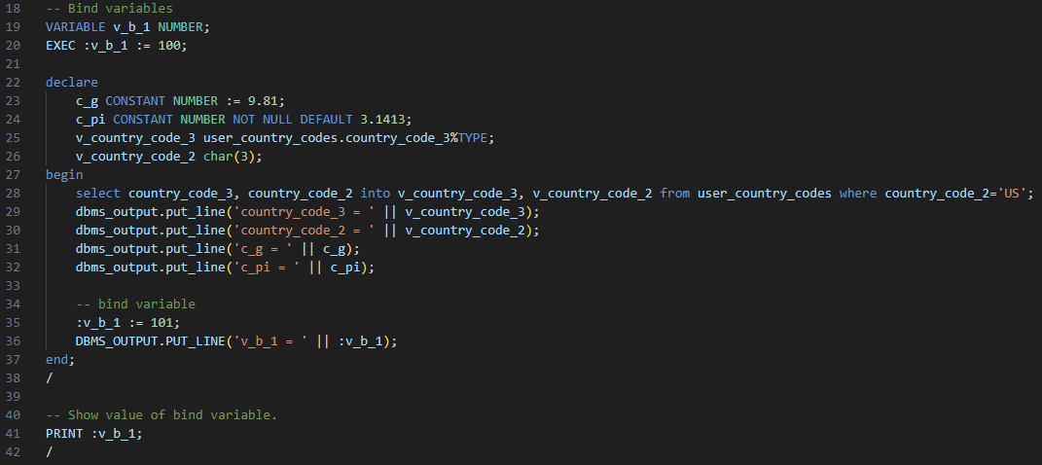
Bind variables

Slide 6
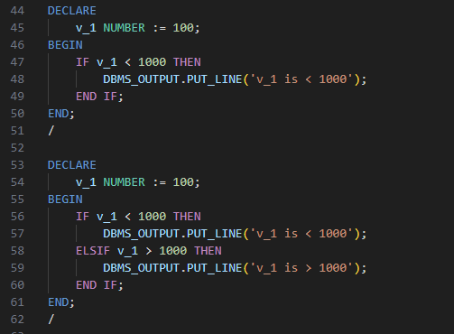
Conditions

Slide 7
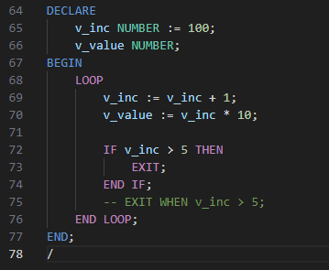
Loops

Slide 8
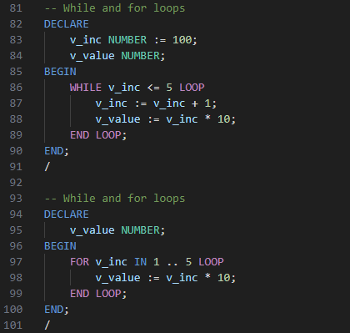
Loops (WHILE, FOR)

Slide 9
Exercise
Write an anonymous PL/SQL block to loop through all characters in a string and print them in reverse using REVERSE keyword.
Rewrite above program without using REVERSE keyword.
(Interview question)

