Slide 1
Oracle – PL/SQL
Lakshman Anumolu

Slide 2
Git & VSCode
https://git-scm.com/download/win
https://github.com/exaslate-courses/oracle-sql-plsql-b3
https://code.visualstudio.com/download
  Extensions:
    Gitlens
    Oracle devtools

Slide 3
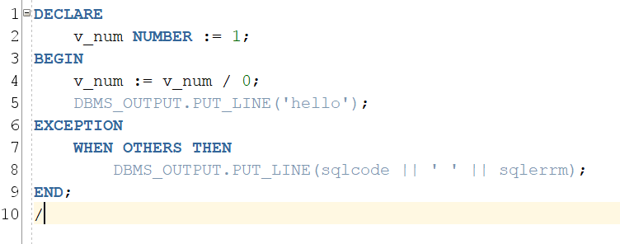
PL/SQL recap
Sample PL/SQL structure
Assignment operator
DECLARE
…
BEGIN
…
EXCEPTION
…
END;
/
Variables
  User assigned name to a memory location

Slide 4
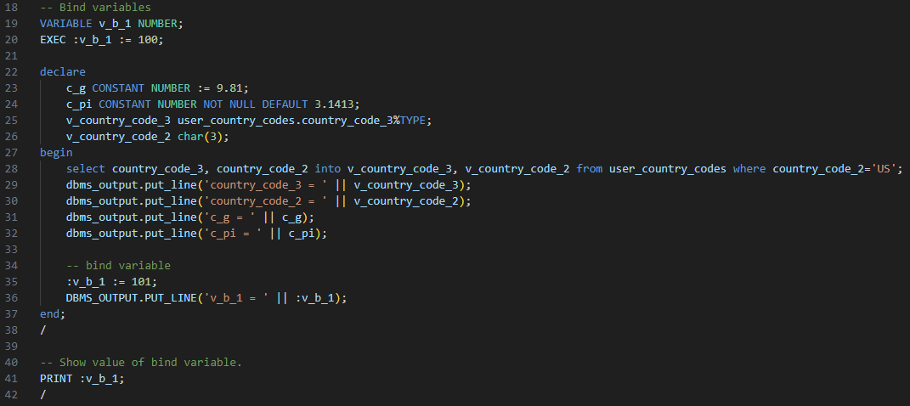
Bind variables

Slide 5
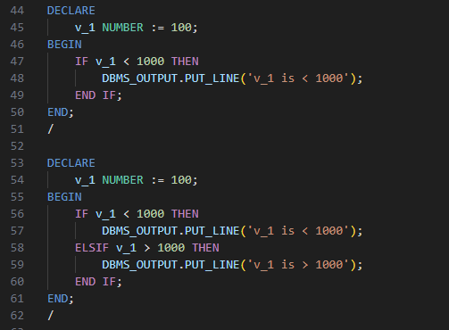
Conditions

Slide 6
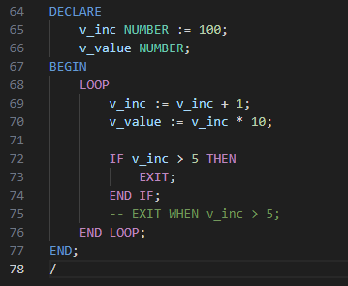
Loops

Slide 7
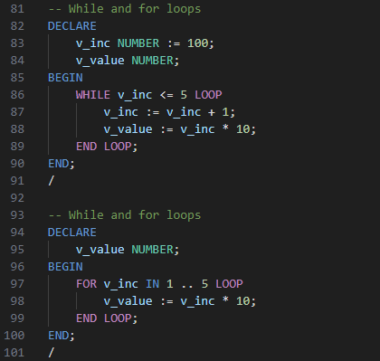
Loops (WHILE, FOR)

Slide 8
Current Session

Slide 9
PRIMARY KEY, FOREIGN KEY
student_id
name
email_addr_id
email_addr_id
email
2301
John
john2301
john2301
john@gmaill.com
2302
Aaron
aaron2302
aaron2302
aaron@gmaill.com
2303
Hari
hari2303
hari2303
hari@gmaill.com

Slide 10
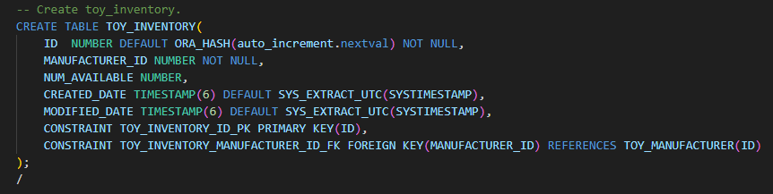
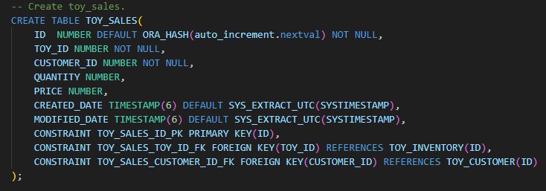
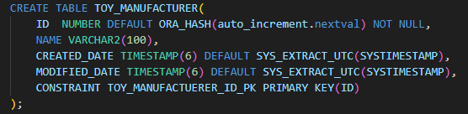
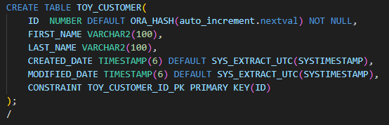
PRIMARY KEY, FOREIGN KEY
TOY_INVENTORY
TOY_MANUFACTURER
TOY_CUSTOMER
TOY_SALES

Slide 11
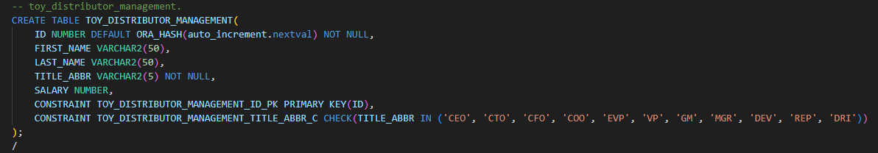
CONSTRAINT
TOY_DISTRIBUTOR_MANAGEMENT

Slide 12
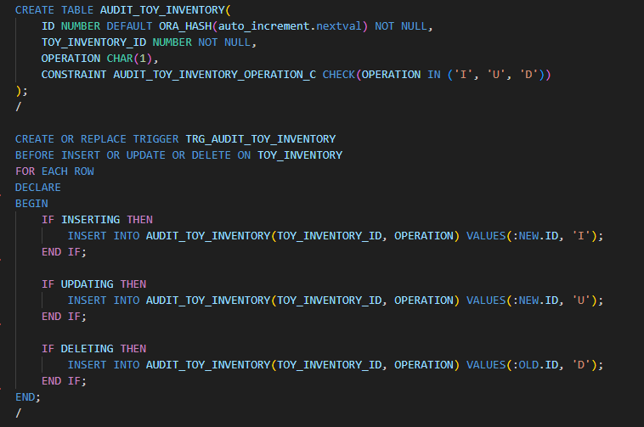
TRIGGER
Why trigger?

Slide 13
Exercise
Create DB for food delivery service
  Table: FDS_RESTAURANTS
    ID, NAME, CREATED_DATE, MODIFIED_DATE
  Table: FDS_ITEMS
    ID, RESTAURANT_ID, NAME, PRICE, CREATED_DATE, MODIFIED_DATE
  Table: FDS_SALES
    ID, ITEM_ID, CUSTOMER_ID, QUANTITY, PRICE, CREATED_DATE, MODIFIED_DATE
  Table: FDS_CUSTOMER
    ID, FIRST_NAME, LAST_NAME, CREATED_DATE, MODIFIED_DATE
  Table: AUDIT_FDS_ITEMS
    ID, ITEM_ID, OPERATION, NEW_PRICE, OLD_PRICE, CREATED_DATE, MODIFIED_DATE
      OPERATION: must be one among ‘I’, ‘U’, ‘D’
  Trigger: TRG_AUDIT_FDS_ITEMS

Slide 14
Exercise (submission)
Create branches with your github usernames and push them to course repository.

