Slide 1
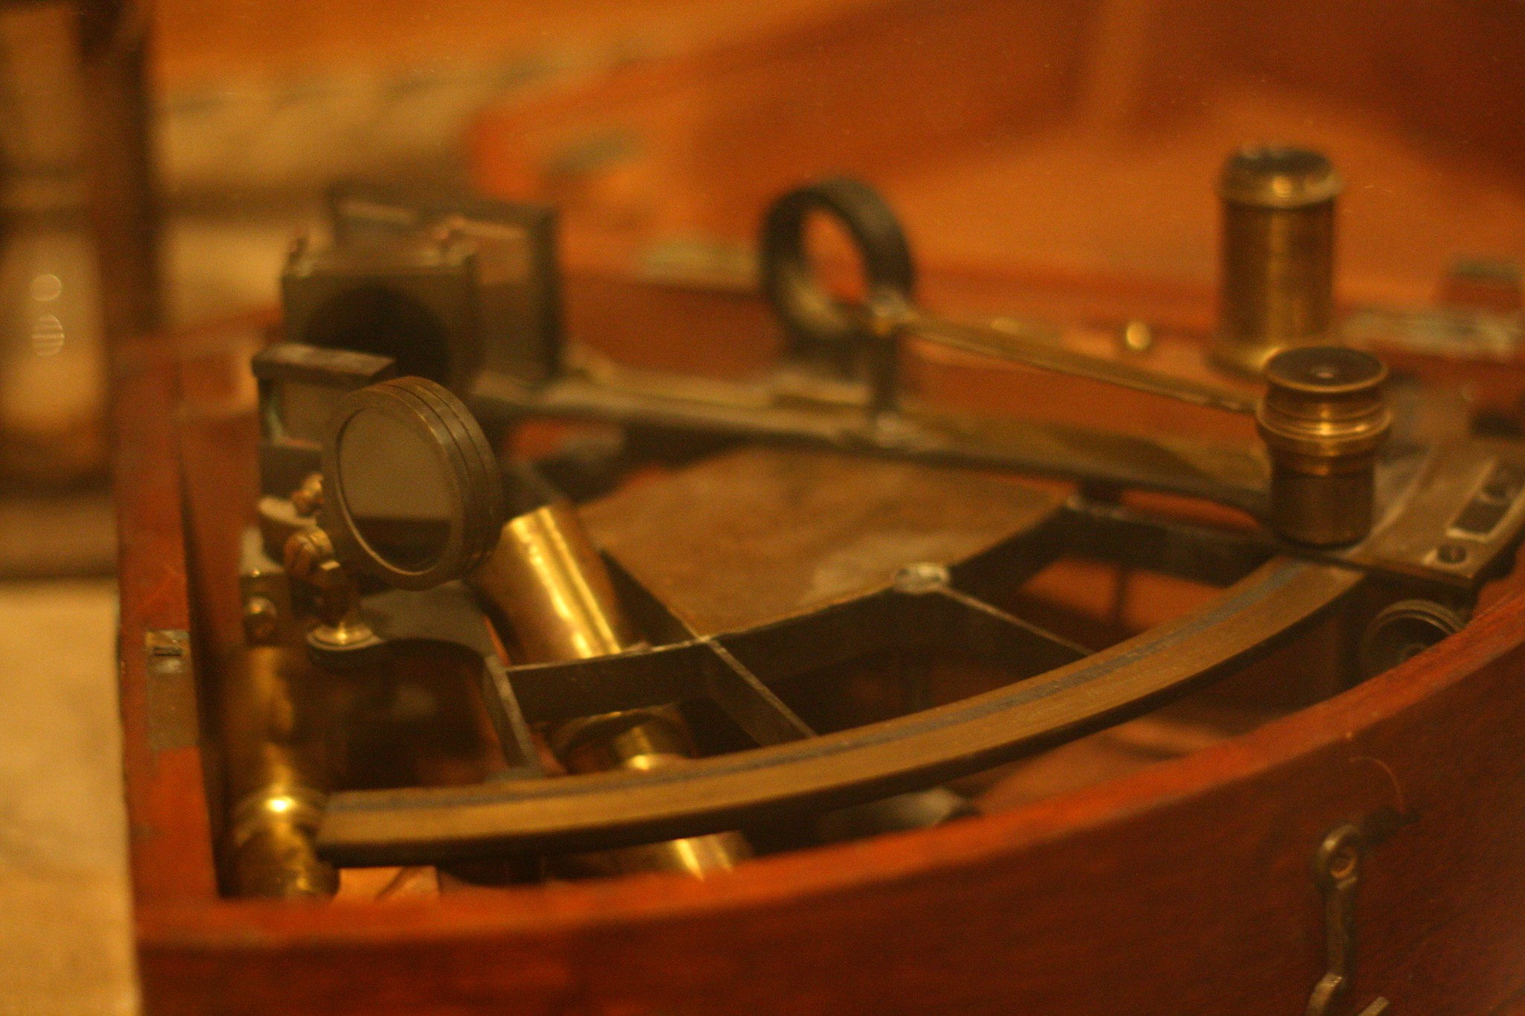
Estimating: smarter guessing
Sebastian Bär
Image: “Sextant”, Blondinrikard Fröberg, CC BY 2.0

Slide 2
Why estimate?
There is always someone who needs an ETA
Estimating fosters work-breakdown and vice-versa
Helps uncover tasks that you might otherwise forget
Allows weighing gain against costs

Slide 3
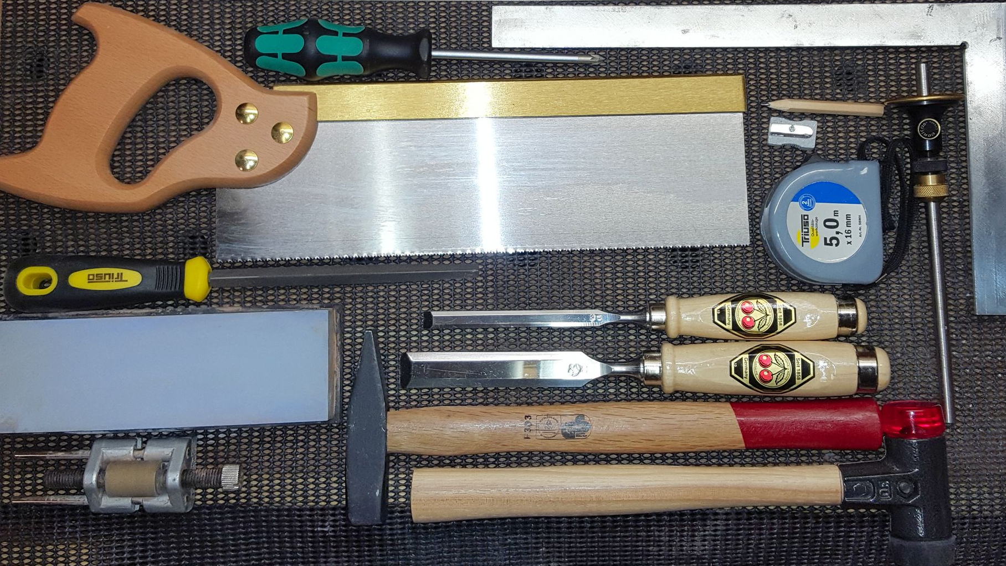

Estimation Basics
Image: “Basic woodworking tools”, (c) Sebastian Bär

Slide 4
Estimation units
Person days or weeks
Complexity points
⊕ Easy to understand for
stakeholders
⊕ Easy to sum up
⊖ Harder to estimate
⊕ Easier to estimate
⊕ Easy to sum up
⊖ Should not be translated to time
Stakeholders will do it anyway.

Slide 5
Expressing uncertainty: Fibonacci numbers

Slide 6
Expressing uncertainty: transparent buffers
Task | Estimation | Buffer | Buffer reason
Exchange unsupported external dependency | 2 | - | Interfaces identical, previous experiments shown good compatibility
Total | 2 | 0

Slide 7
Expressing uncertainty: transparent buffers
Task | Estimation | Buffer | Buffer reason
Exchange unsupported external dependency | 2 | - | Interfaces identical, previous experiments shown good compatibility
Integration test + fix regressions | 1 | 2
Total | 3 | 2

Slide 8
Expressing uncertainty: transparent buffers
Task | Estimation | Buffer | Buffer reason
Exchange unsupported external dependency | 2 | - | Interfaces identical, previous experiments shown good compatibility
Integration test + fix regressions | 1 | 2
Performance test + fix regressions | 1 | 8 | First performance test with new library
Total | 4 | 10

Slide 9
Expressing uncertainty: transparent buffers
Task | Estimation | Buffer | Buffer reason
Exchange unsupported external dependency | 2 | - | Interfaces identical, previous experiments shown good compatibility
Integration test + fix regressions | 1 | 2
Performance test + fix regressions | 1 | 8 | First performance test with new library
Make release | < 1 | - | Fully automatic
Total | 5 | 10

Slide 10
Expressing uncertainty: transparent buffers
Task | Estimation | Buffer | Buffer reason
Exchange unsupported external dependency | 2 | - | Interfaces identical, previous experiments shown good compatibility
Integration test + fix regressions | 1 | 2
Performance test + fix regressions | 1 | 8 | First performance test with new library
Make release | < 1 | - | Fully automatic
Roll out in customer’s environment | 2 | 5 | Customer did not confirm direct access yet. “Remote hands” a lot slower and more error-prone
Total | 7 | 15
Buffer can be reduced by negotiating with customer

Slide 11
Relative estimation: easier than absolute
Filter user list by creation date
harder
8
Implementation
Unit test
UI test
User guide
Change log
Display login name uppercase
about as hard
Turn name into login name with underscores
2
trivial
2
Reference is always 2
Implementation
Unit test
UI test
User guide
Change log
Fix typo in UI
1

Slide 12
T-Shirt Sizes
XXL
XL
L
M
XS
S
Two strategies: single reference (S) or reference per size
Theoretically, T-shirt sizes prevent obsessing over numbers
In reality, people will still translate them in their heads

Slide 13
Exercise
Imagine you need to renovate a house.
Decide if you want to estimate in person days or complexity points
Define a reasonably sized reference story for your tasks
Based on your reference …
… estimate replacing a window
… estimate painting a 20 m² living room
… estimate remodeling the attic into another bed room
Notes:
1.
Example for a BP oil tanker https://nassco.com/products/construction/commercial-construction/commercial-ship-portfolio/bp-tanker-fact-sheet/
crew size of up to 24.
2.
18 total, 11 on the red list according to https://www.birdlife.org/birds/list-of-penguin-species/
3.
26 months according to https://houseunderconstruction.com/blog/how-long-did-it-take-build-eiffel-tower

Slide 14
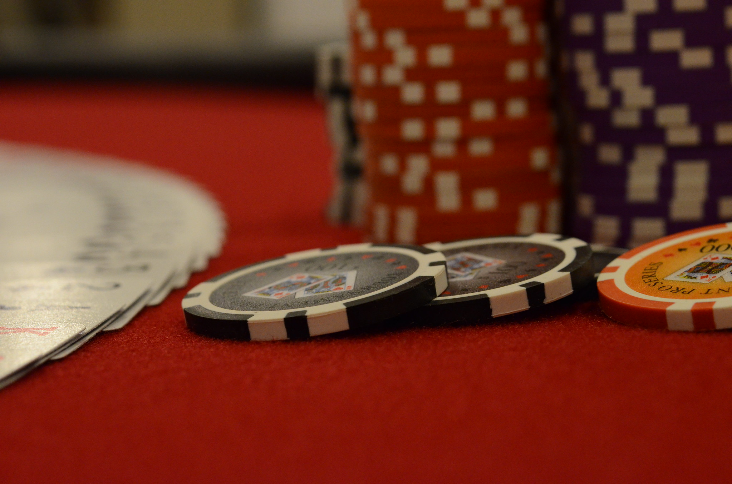
Estimating together
Image: “Poker Chips”, slgckgc, CC-BY-SA 2.0

Slide 15
Planning poker
Add Spanish translation to the UI
8
13
21
5
34
3
55
2
89
1
∞

Slide 16
Planning poker – betting
Your estimation
(hidden)
8
21
5
34
3
55
2
89
1
∞

Slide 17
Planning poker
Everyone flips
their cards at the
same time.
8
34
5
13
8
21
5
34
3
55
2
89
1
∞

Slide 18
Planning poker – negotiation
We need the translation.
Our translation office offers Spanish too.
8
34
5
Spanish has lots of special characters.
13
We use UTF-8. No big deal.
8
21
5
34
3
55
2
89
1
∞

Slide 19
Planning poker – agreement (recommended)
8
Alright I can live with 8.
Player adapts
bet with new
information
8
5
8
13
21
5
34
3
55
2
89
1
∞

Slide 20
Planning poker – quorum (when in a hurry)
8 wins
8
8
5
8
13
21
5
34
3
55
2
89
1
∞

Slide 21
Planning poker – median (when in a hurry)
Median: 8 + 13 / 2 = 10.5
8
34
5
13
Estimation Result: 13
rounded to next higher Fibonacci number
Number of elements | odd | even
Median | Value that splits set in the middle | Sum of two middle values divided by two
Example | 1, 3, 3, 5, 8, 13, 34 →5 | 1, 3, 3, 5, 8, 13, 13, 34 →5 + 8 / 2 = 6.5

Slide 22
Exercise
Use planning poker to estimate the following:
How many crew members can the quarters of a 1.3 million
barrel oil tanker house?
How many penguin species exist?
How many of those penguin species are on the red list?
How many months did it take to build the Eiffel tower?
Notes:
1.
Example for a BP oil tanker https://nassco.com/products/construction/commercial-construction/commercial-ship-portfolio/bp-tanker-fact-sheet/
crew size of up to 24.
2.
18 total, 11 on the red list according to https://www.birdlife.org/birds/list-of-penguin-species/
3.
26 months according to https://houseunderconstruction.com/blog/how-long-did-it-take-build-eiffel-tower

Slide 23
Estimation challenges
Large tasks and complex tasks
Vague specifications
First-of-a-kind tasks & known-unknows
Unknow-unknows

Slide 24
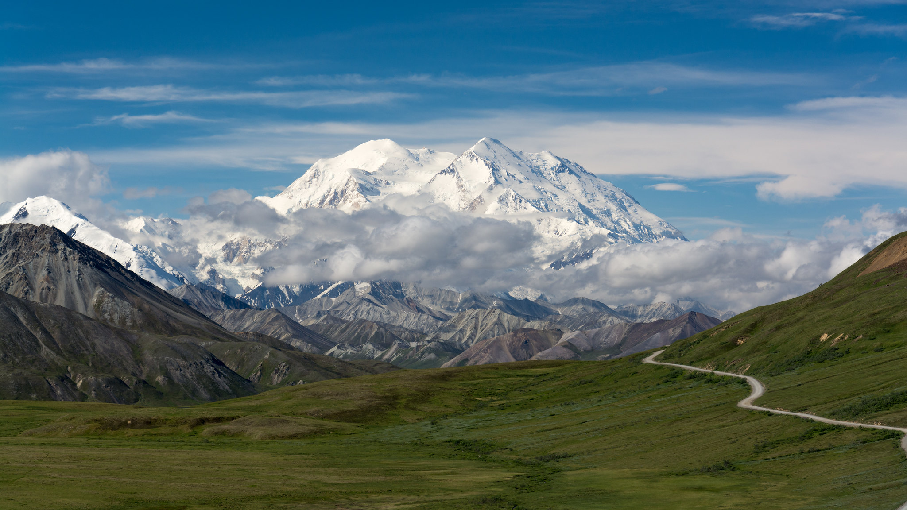
Challenge 1:
Large and complicated tasks
Image: “Mount McKinley”, Christoph Strässler, CC-BY-SA 2.0

Slide 25
Estimating an epic directly
Improve website accessibility
89
Epic
PO needs a quick estimation
The estimation will be very vague
Only useful as first indicator

Slide 26
Task breakdown
Note that it doesn’t say “all tasks”. That is often unrealistic for complex epics.
Improve website accessibility
Compare scanners
Most tasks are considered
Challenges are understood better
More transparency
Compare PO’s view with team’s
Will make progress more visible
Purchase license
Scan website
Fix findings

Slide 27
Task estimation
Improve website accessibility
Compare scanners
8
Complex tasks visible
Shared understanding between PO and team
Purchase license
2
Scan website
1
Fix findings
55

Slide 28
Sub-task breakdown
Improve website accessibility
Compare scanners
8
No more overly complex tasks
Better estimation
Reduced risk
Purchase license
2
Fix images
5
Scan website
1
Text-only variant
13
Fix findings
Σ
Add reader
13

Slide 29
Delimitation
Improve website accessibility
Add screen reader
13
Compare scanners
8
Valuable epic
Manageable size
Next epic cut out
Purchase license
2
Fix images
5
Scan website
1
Text-only variant
13
Fix findings
Σ
Add reader

Slide 30
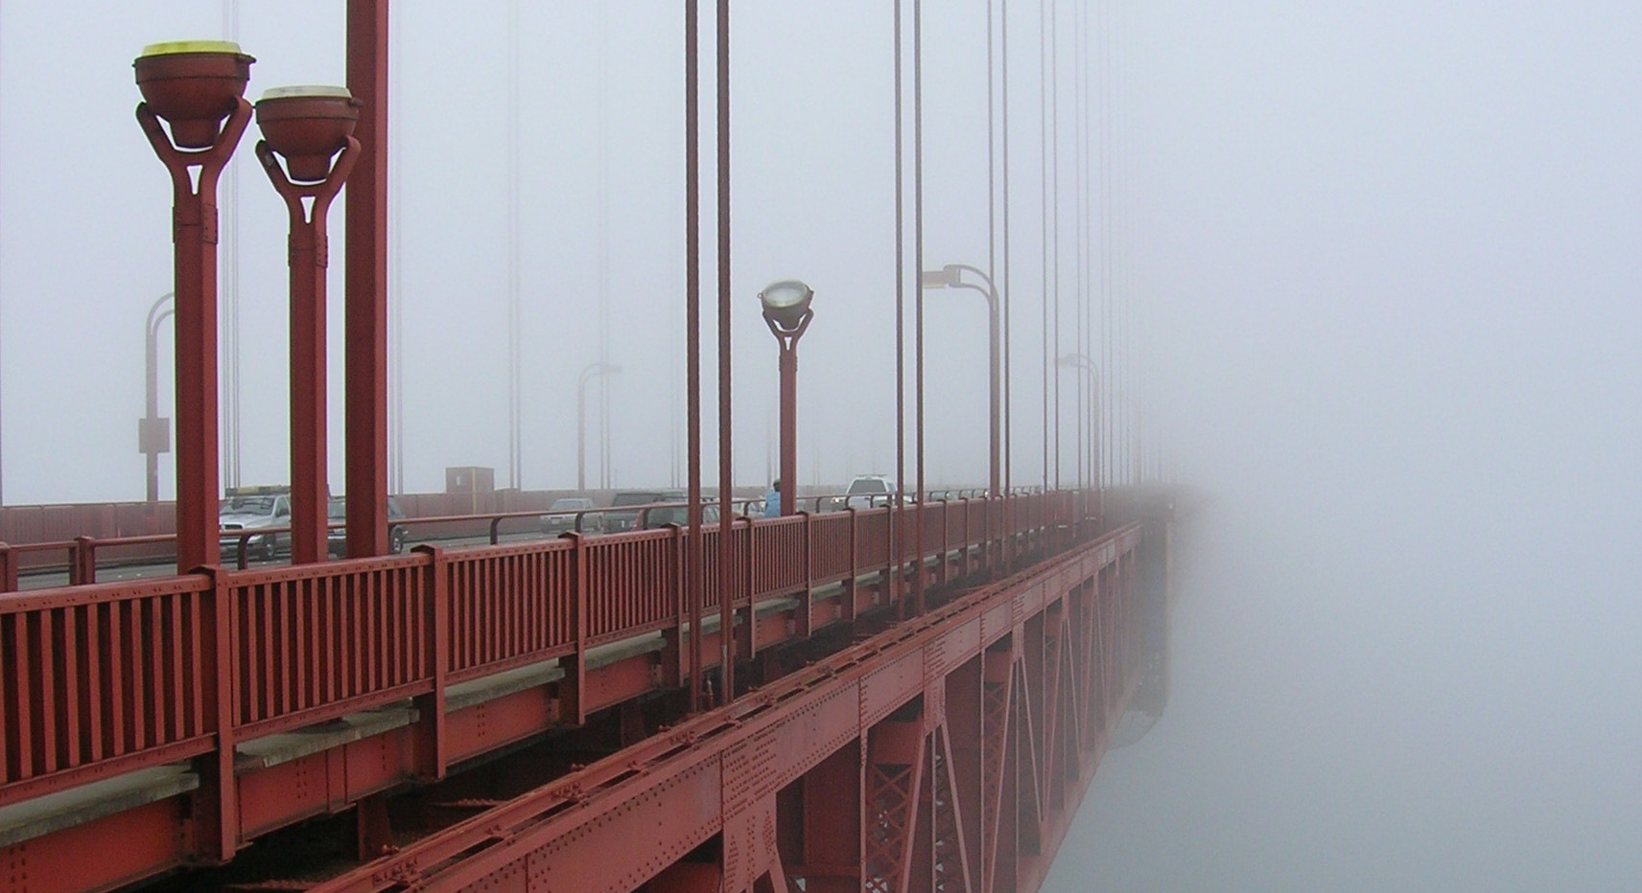
Challenge 2:
Vague
specifications
Image: “Morning Fog on Golden Gate Bridge”, Grombo, CC-BY-SA 2.0

Slide 31
Backlog refinement session
Session 1
Session 2
Session 3
PO picks up user complaint
writes it down
to not forget it
Team estimates high
Team asks PO
to be more specific
PO calls users
Finds out page too slow
PO splits epic
One epic is easier to achieve
Team breaks down large one
PO specifies goals explicitly
Simpler solution available
Improve web page user experience
Improve page load times
Improve shop page load time
Average shop load time ≤ 0.1s
89
55
8
8
Improve report load time
Average report load time ≤ 3s
34
2
Replace database
21
Increase RAM size
2
…

Slide 32
Exercise
Determine how long it takes from firing the 1 o’clock gun on Edinburgh Castle until ships in the harbor hear the signal
Break epic down into tasks
Improve epic specification
Estimate tasks
Stop time while you solve the puzzle
Compare with estimates

Slide 33
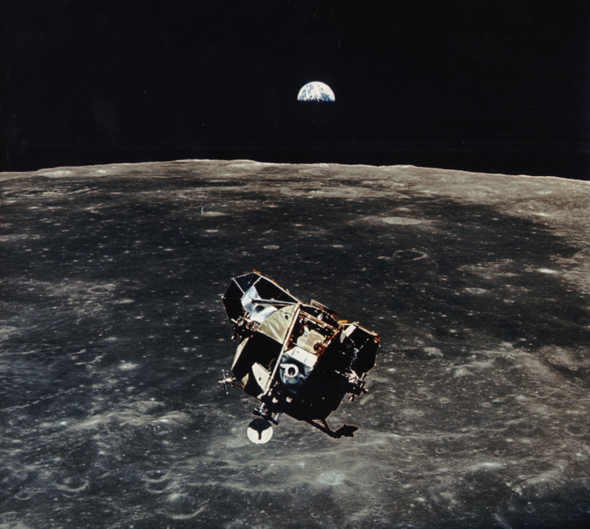
Challenge 3:
First-of-a-kind tasks
&
known-unknows
Image: “AS11-44-6642”, courtesy of the Earth Science and
Remote Sensing Unit, NASA Johnson Space Center

Slide 34
Spikes
Session 1
Spikes
Session 2
PO brings an epic with at least one totally unknown task
Team asks PO
to plan spikes
Team estimates required timebox
PO & team agree on timebox
Team experiments with unknown task
Experiments ranked by risk (descending)
Team applies learning successes to breakdown and estimation
✅
EV battery predictive maintenance
Spike: Import battery data
Spike: Import battery data
Spike: Import battery data
89
[2]
[2]
[2]
✅
Spike: Compare ML algorithms
Network setup
Spike: Compare ML algorithms
[5]
[5]
Risk
Mass data import
EV battery predictive maintenance
EV battery predictive maintenance
55
…

Slide 35
Exercise
Estimate epic directly (person seconds)
Plan a spike to find fast strategy
Time-box the spike
Run the spike (mind the time box!)
Break epic into tasks
Estimate tasks
Stop time while you solve the puzzle
Compare with estimates
Roll 100 D6.
Record rolls.
Sum up.
Notes:
Team needs to realize that estimating with poker cards requires multiplier
During break down the team will need to discuss that “record rolls” is an ambiguous requirement.
They need to agree on what “record rolls” means and write it down.
In the spike they can try multiple strategies. But that is not required. If they agree on what the criteria for “fast” is, one can be enough.
Keeping the time box is important. The trainer should give feedback on time box adherence
Remind the trainees that this should also scale to larger numbers.

Slide 36
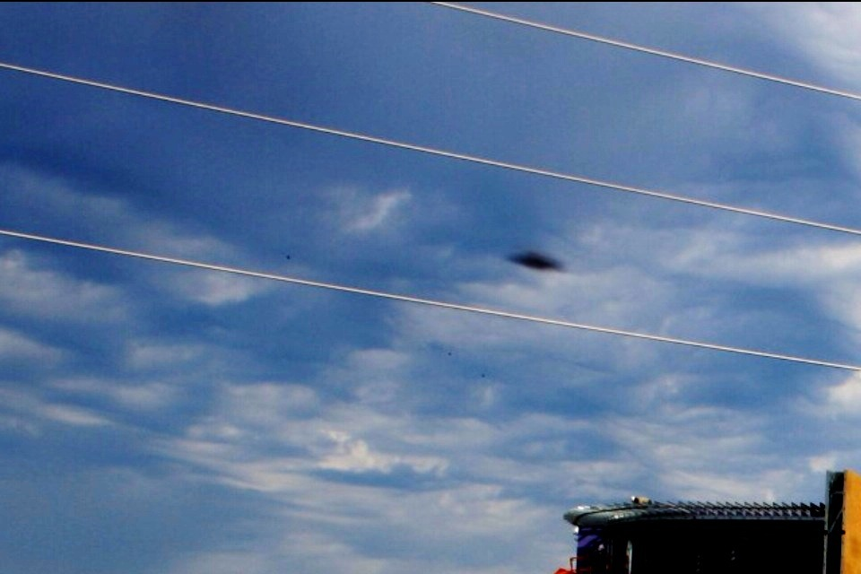
Challenge 4:
Unknown-unknows
Image: “UFO sighting in Louisiana”, DragonRal, CC-BY-SA 2.0

Slide 37
Dealing with unknown-unknows
If you were hoping for a silver bullet, prepare to be disappointed.
Unknown-unknowns are an inherent risk of any complex task.
Repetition helps reducing them.
Otherwise all involved parties need to understand that estimations can an will be off. Sometimes more, at other times less.

Slide 38
Summary
Make the goals concrete and precise
Break down large tasks
Estimate tasks and sum up
Break down further where possible
Use planning poker
Be aware that estimates can be wrong

Slide 39
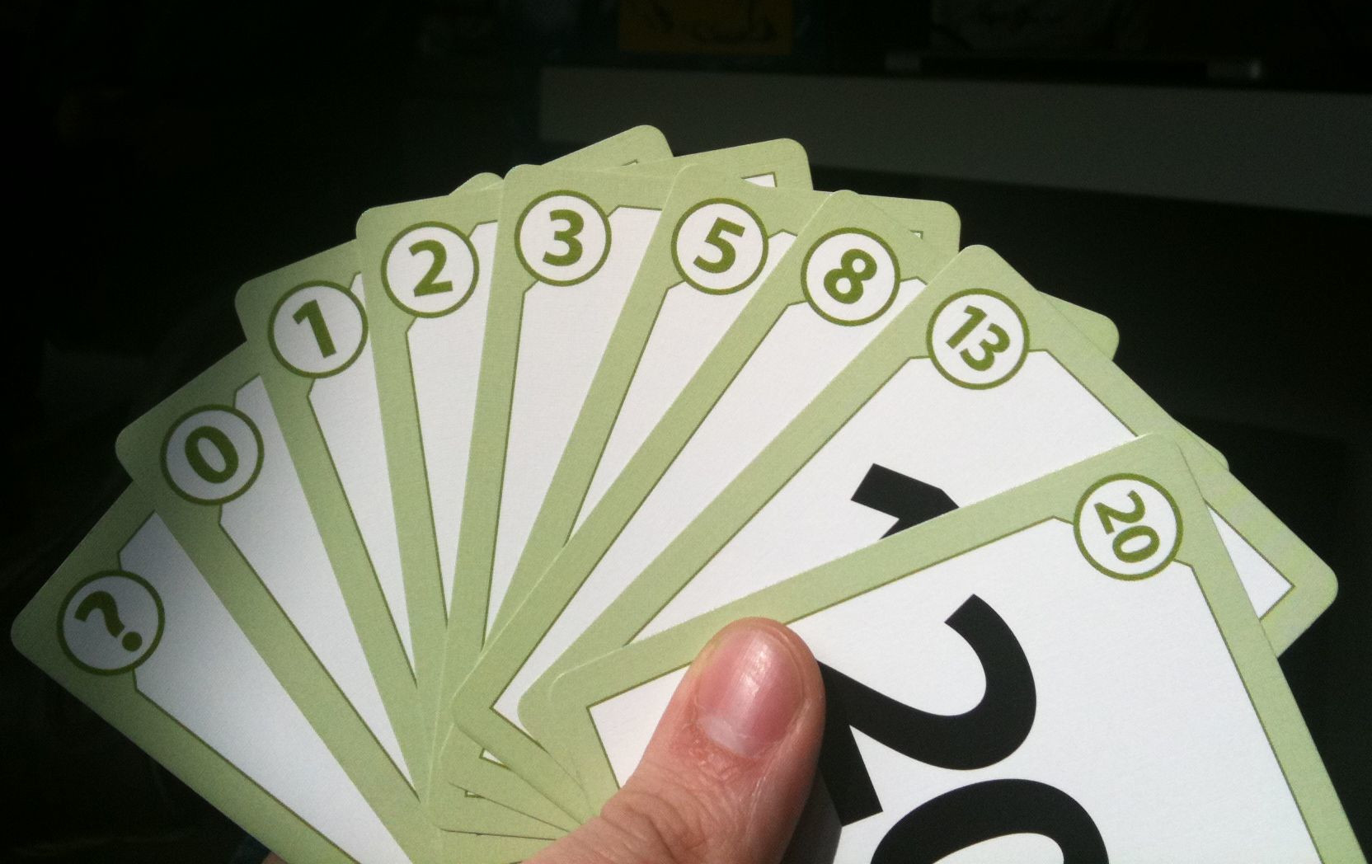
Successful estimation everyone!
Image:
“Estimation Poker Straight Flush”,
Joel Bez, CC-BY

