Slide 1


CI/CD for IaC 【Practice】
※In this Document “Exastro IT Automation” will be written as “ITA”.
Exastro IT Automation Version 1.10.0
Exastro developer

Slide 2
Table of contents
Introduction
1.1 About this document
1.2 Environment
1.3 Scenario
1.4 Preparation
Scenario
2.1 Register Remote repository
2.2 Register Registered account
2.3 Register file link
2.4 Dry run (No.1)
2.5 Edit Playbook
2.6 Dry run (No.2)
2.7 Execute to Target server

Slide 3
1. Introduction

Slide 4
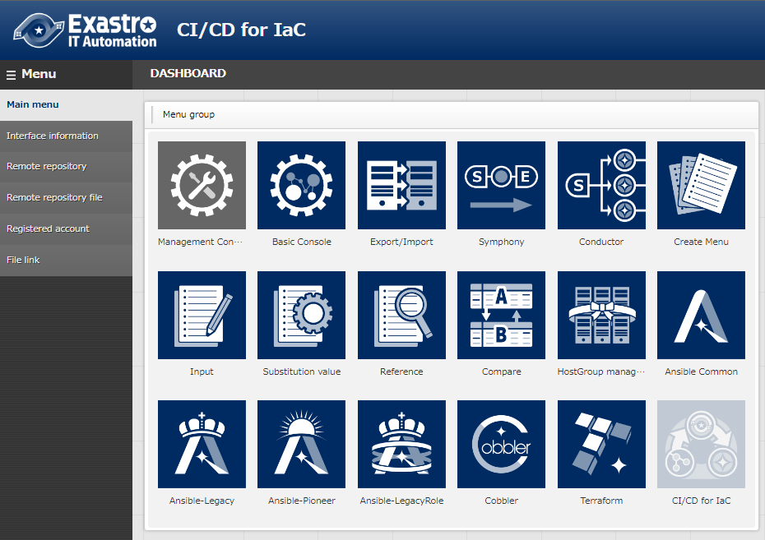
1.1 About this document
Main Menu
This document aims to teach the reader about the CI/CD for IaC function by guiding them through a simple scenario.
This document requires the reader to have finished the scenario in the “Quickstart” guide before they can follow this scenario.

Slide 5

1.2 Environment
Operation environment
The environment used in this document is as follows.
CentOS 7
(ITA server)
CentOS 7
(Target server)
PC
Exastro
IT Automation
V1.10
Ansible
v2.11.7
ITA server ・CentOS 7 (※1) ・Exastro ITA v1.10 ・Ansible 2.11.7 Target server ・CentOS 7
※1 This guide uses CentOS7 for the Host server, but ITA can run on any RHEL7 and RHEL8 type OS.
The user will also need a GitHub account in addition to the environment shown above.

Slide 6


1.3 Scenario
Scenario
The figure below illustrates the steps and contents of this document’s scenario.
①Register remote repository
Exastro ITA server
②Register registration account
CI/CD for IaC
Ansible-Legacy
driver
Git repository
Local repository
Playbook link
③Register file link
File A’
④Dry run(No.1)
File A
File A
Git clone
File link
⑤Edit Playbook file
”Execution”
menu
⑥Dry run (No.2)
⑦Execute to target server
Target server

Slide 7
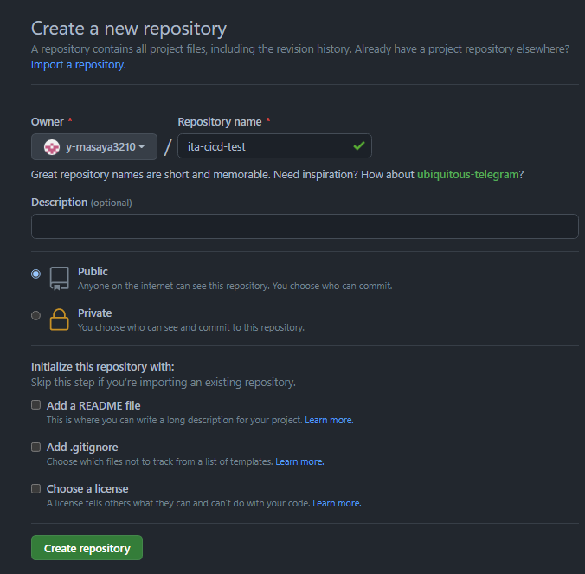
1.4 Preparation(1/3)
Prepare Git repository
In this scenario, we will use GitHub.
Go to Repository and select “New” to create a new repository.
Input a name
Select “Public”
Click “Create repository”

Slide 8
1.4 Preparation(2/3)
Prepare Playbook file
In this scenario, we will use the following Playbook
yum_package_install_check.yml
- name: install the latest version of packages
yum:
name: "{{ item }}"
state: latest
with_items:
- "{{ VAR_packages }} "
- name: Check yum list
shell:yum list installed | grep "{{ item }}"
register: result
with_items:
- "{{ VAR_packages }}"
Point
※The file has an invalid indent here on purpose. We will fix it later as a part of the scenario.

Slide 9
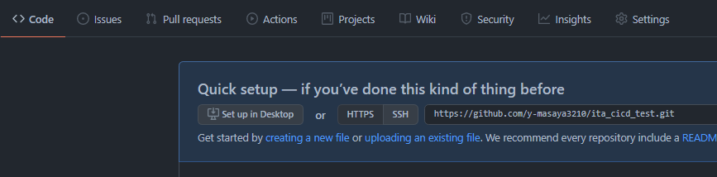
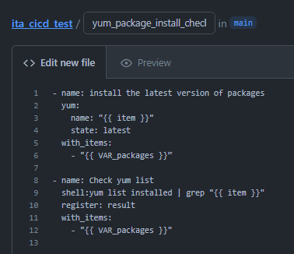
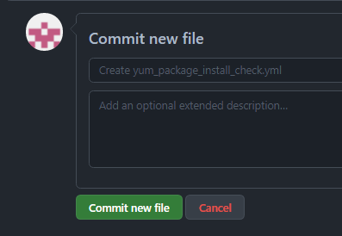
1.4 Preparation(3/3)
Upload Playbook
Upload the Playbook to GitHub. ① Press the “Code” tab and click “Creating a new file” ② Edit a new file and input the contents and name from the previous slide. ③ Press “Commit new file”.
See this page for the contents.
Repository name
yum_package_install_check.yml
Scroll down

Slide 10
2. Scenario

Slide 11
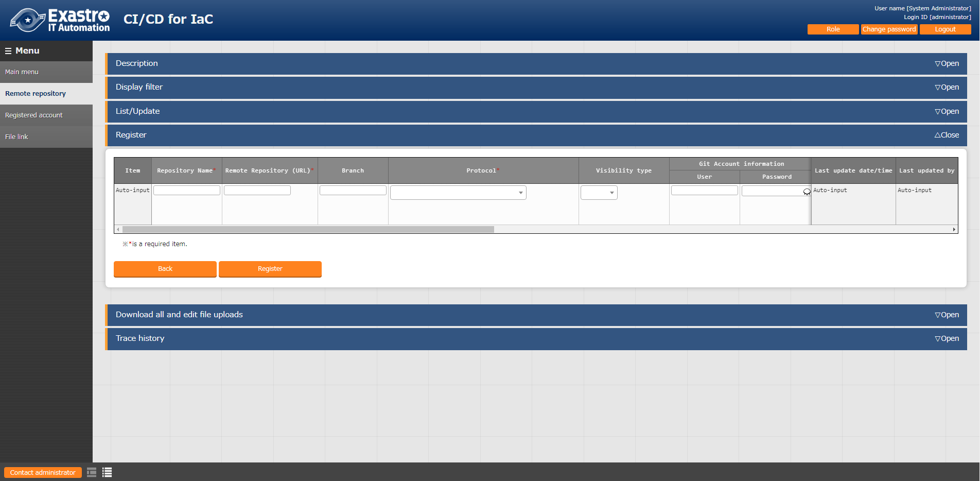
2.1 Register Remote repository
Register the Git repository information.
In this step, we will register the information of the GitHub account we prepared earlier. In ITA, go to the “CI/CD for IaC” menu and click “Remote repository”. Follow the table below and register a new item.
Remote Repository name | Remote Repository (URL) | Protocol | Visibility type | Remote repository sync info(Sync cycle)
(Name of the repository name) | (URL of the repository name) | https | public | Valid

Slide 12
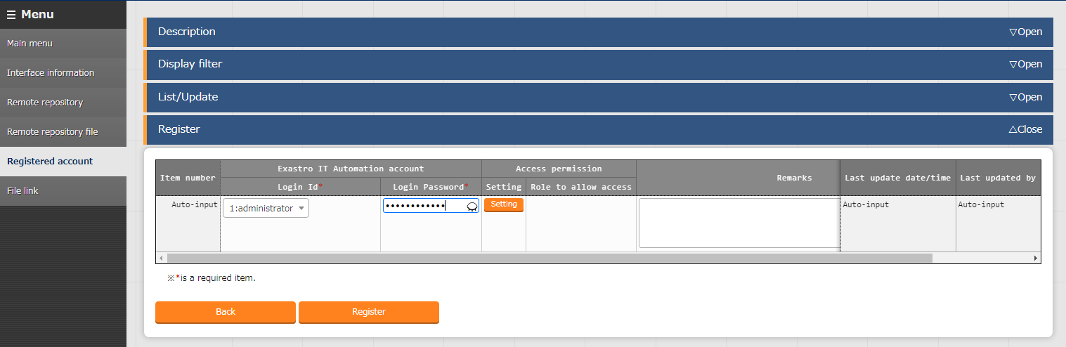
2.2 Register Registered account
Register the account information needed to access the cloned files.
Register a new item with the Exastro ITA account information.
In this scenario, we will use the “administrator” user
Press “Registered account” and follow the table below to create a new item.
Login ID | Login PW
administrator | (Password)

Slide 13
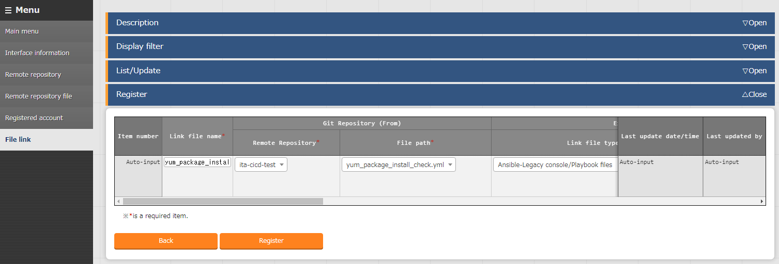
2.3 Register file link(1/2)
Register a file link for the source files and the cloned files.
In this section, we will link the source files and the cloned files and register an Operation and a Movement that will check the validity of the cloned files. Go to the “file link” menu and create a new item using the table below.
Link destination file name | Remote repository | File path | Link destination file type | Execution login ID | Automatic synchronization
yum_package_install | ita_cicd_test | yum_package_install_check.yml | Ansible-Legacy console /Playbook files | 1:administrator | Valid

Slide 14
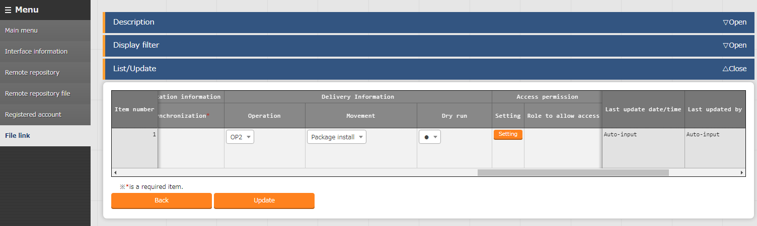
2.3 Register file link(2/2)
Register Operation and Movement and select “Dry run”.
After having filled out the items from the previous slide, scroll to the right and fill out the following 3 items and press “Register”.
Operation | Movement | Dry run
Operation 2 | Package install | ●

Slide 15
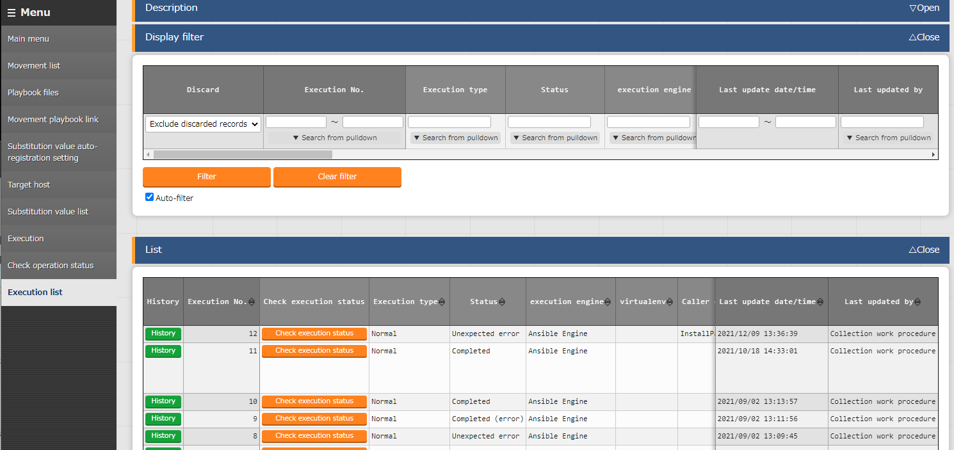
2.4 Dry run (No.1)(1/2)
Check that the operation has dry run.
Linking files will automatically start a dry run.
Go to the Ansible Legacy menu and click “Execution list”. From there, click “Filter” to see all executed operations. Find the operation we dry ran earlier and press the “Operation status check” to see the error contents.

Slide 16
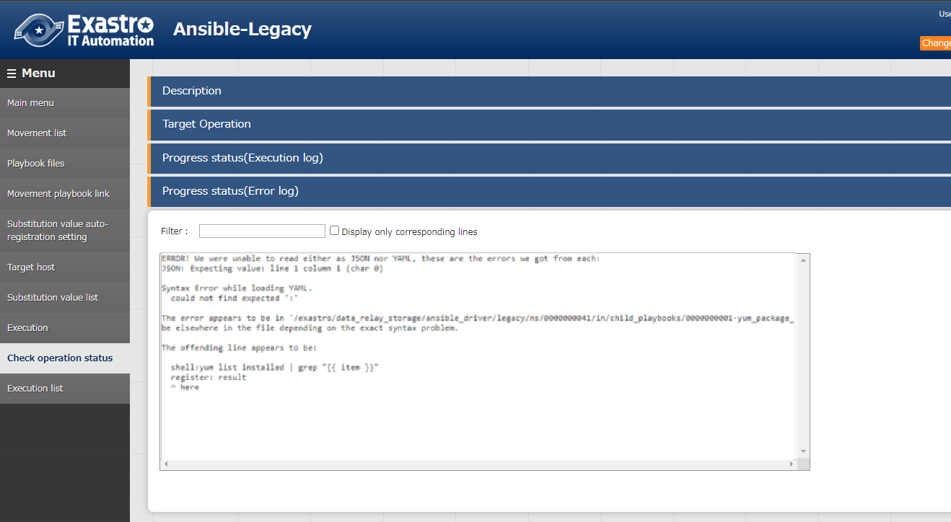
2.4 Dry run (No.1)(2/2)
Check that the operation has dry run.
Scroll down to see the Progress log. Users can use this to see the contents of the error. As mentioned earlier, the file contained an invalid indent which caused the error.

Slide 17
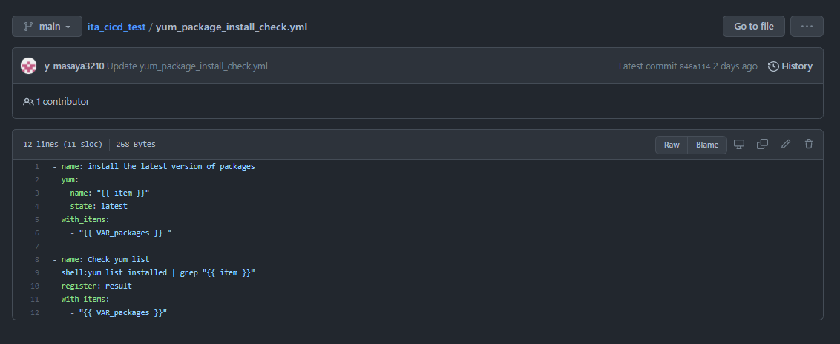


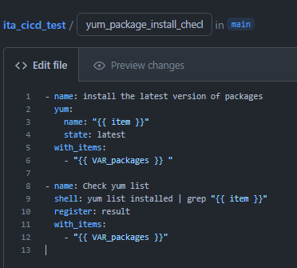
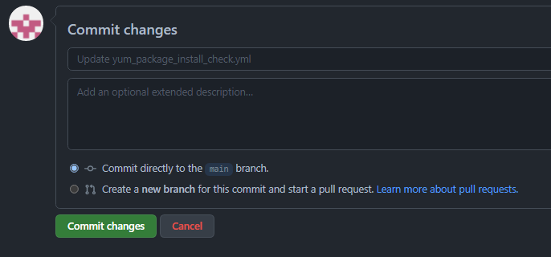
2.5 Edit Playbook
Access GitHub and edit the Playbook file.
In this section, we will fix the error from the previous slide.
Access the GitHub file and press the edit icon. Follow the steps below and press “Commit changes”.
Input a space between “:” and “y”
Scroll down

Slide 18
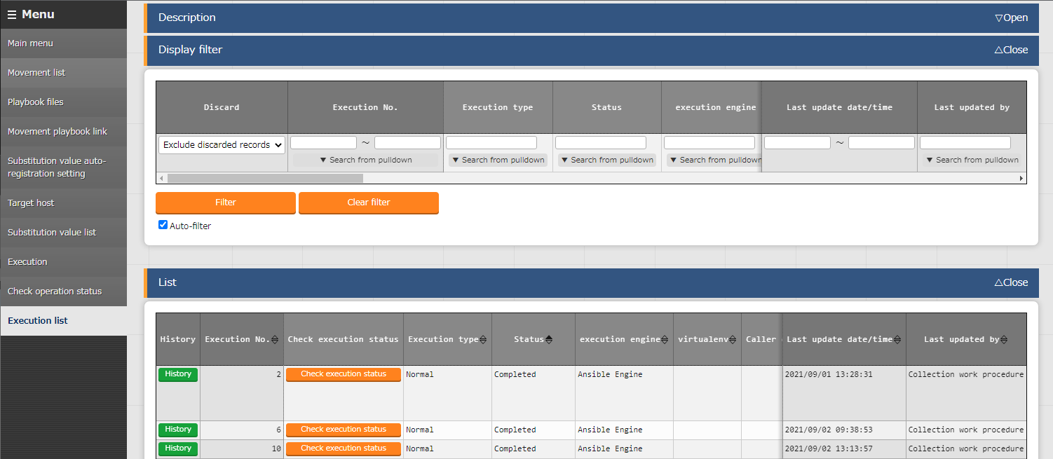
2.6 Dry run (No.2)
Check that the operation has dry run.
Updating the GitHub source file will automatically update and dry run the ITA Playbook clone file. Do the same as Dry run(No.1) and go to “Ansible Legacy”-> “Execution list” and find the operation. The last dry run ended in an error, but this run should end successfully.

Slide 19
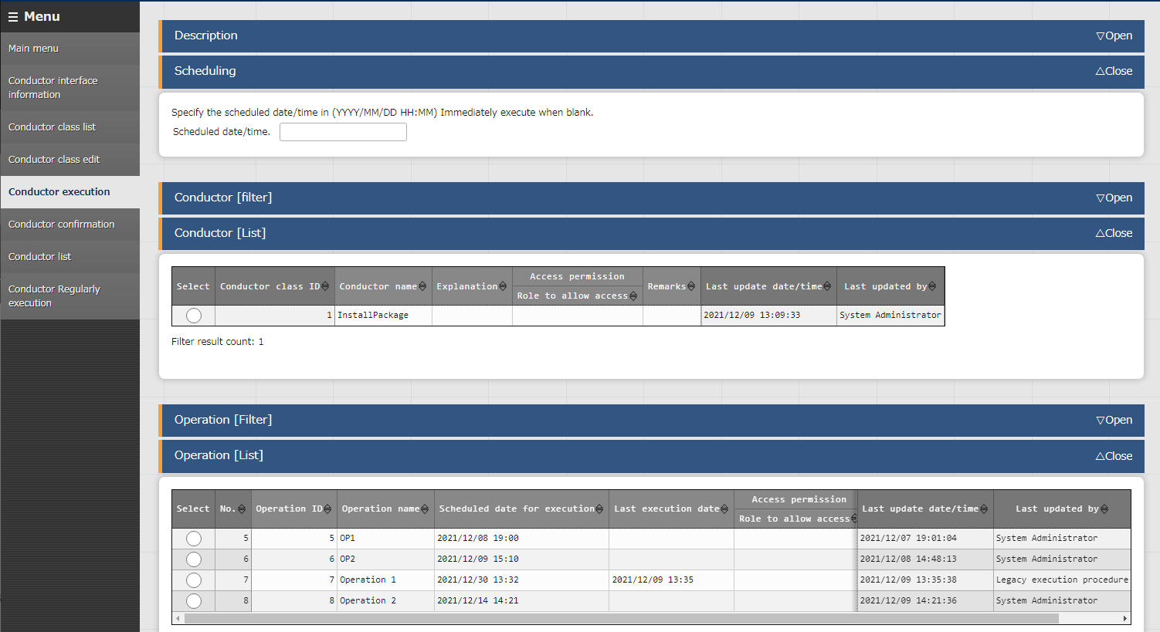
2.7 Execute to Target server(1/2)
Run the operation and apply to the Target server.
Now that we have used the Dry run to see that there are no problems with the Playbook, we can apply it to the target server. Go to Ansible Legacy > Execution. Here we can select what Movement and Operation that we want to run.

Slide 20
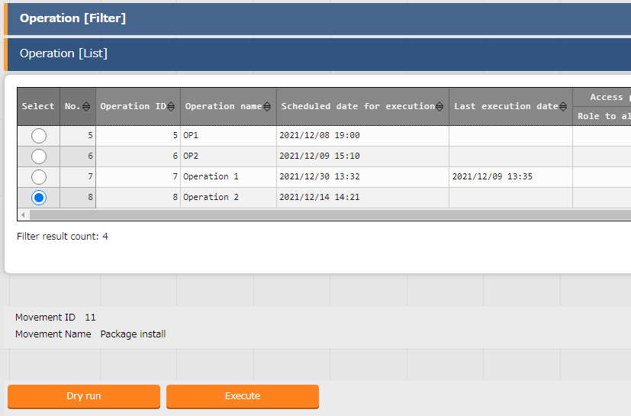
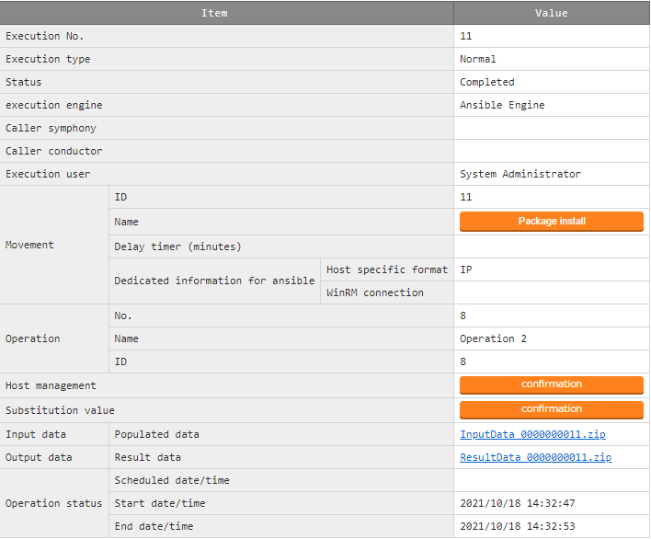
2.7 Execute to Target server(2/2)
Run the operation and apply to the Target server.
After selecting the operation and Movement, press “Execute”. Executing any operation will move the user to a screen where they can see the status of the running operation. If the operation status says “Completed”, the operation has ended successfully.

