Slide 1


Terraform Driver
【Classroom】
In this Document, “IT Automation” will be written as “ITA”.
Exastro IT Automation Ver 1.10
Exastro developer

Slide 2
Table of contents
1. Introduction
2. Terraform Driver
2.1 Terraform Driver
2.2 Registration files
2.3 Policy files
3. ITA×Terraform Application
3.1 What types of Terraform can link with ITA?
3.2 For Terraform Enterprise
3.3 For Terraform Cloud
4. Terraform Driver menu
4.1 Terraform Driver menu overview
4.2 Terraform Link
4.3 Organizations Link
4.4 Workspaces Link
4.5 Applying Modules
4.6 Applying Policies
4.7 Terraform Driver Workflow

Slide 3
1. Introduction

Slide 4
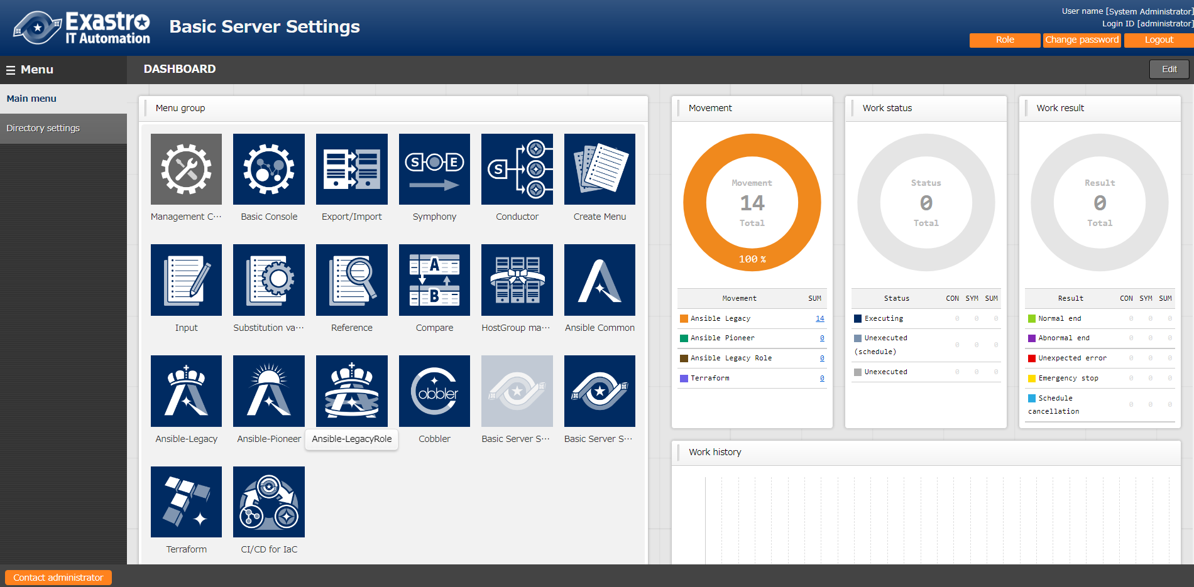
1. Introduction
Main Menu
This document aims to introduce the Terraform functionality in ITA.
The Practice document uses the ITA Screen to provide a hand-on experience, so we recommend reading both.

Slide 5
2. Terraform Driver

Slide 6

2.1 Terraform Driver
Terraform Driver allows us to link System parameters and IaC (Module) variables that are Centrally managed by ITA to Terraform and execute them.
Users can create Organization/Workspaces to ITA linked Terraform Enterprise or Terraform Cloud, as well execute operations (Play/PolicyCheck/Apply) and gather the operation logs. ※We explain more about the differences between ITA + Terraform Enterprise andd Terraform Cloud in Chapter 3,ITA×Terraform Application example.
Any module files and policy files used for policy checks can be turned into parts by ITA and be reused.
ITA
System
Symphony
/Conductor
CMDB
NW
Start
System Parameter
Terraform
Module file
Movement
Terraform Driver
ST
Terraform
Policy file
Terraform
PolicySet
End
SV

Slide 7
2.2 Registration files
Registration file types and their operations
There are two files that are registered to the Terraform Driver. Modules and Policies.
“Modules” are Terraform’s main execution files. They are written in HCL (Hashicop Config Language) and is used for provisioning for environments for Azure, AWS, GCP, Vmware and so on.
Policy files are files that define policies when executing Terraform.
※For more information regarding Policies, please see Chapter 2.3 Policy files.
Terraform follows the following order[Plan]>[PolicyCheck]>[Apply]
Module
Policy
Plan
Policy
Check
Apply
Checks if the Module file is written correctly and if there has been any changes since the previous execution.
Runs Module
Checks if the contents of the Module file fits with the conditions defined in the Policy file.

Slide 8

2.3 Policy files
Policy files(PaC)
PaC(Policy as Code) manages policies as codes and are used in Terraform as “Sentinel”.
By applying coded policies to the environment and limiting the scope of changes, it is possible to ensure that the policies set by the organization (budget, corporate governance, security, laws, etc.) match the actual policies, which prevents errors in places such as setting permissions, etc. It also makes it easier for companies and users to return to old policies.
Production environment
Policy provided by company
Apply
Policy
Policy
Run Policy
Real Policy
Old Policy
×
Policy
Restore
Directly configuring or changing the policy is not allowed
Policy
Policy

Slide 9
3. ITA×Terraform Application example

Slide 10

3.1 What types of Terraform can link with ITA?
Linkable Terraforms
ITA can connect to both “Terraform Enterprise” and “Terraform Cloud”
In this document, we will combine ITA and “Terraform Enterprise”/”Terraform Cloud” and create an application example that creates a system on cloud or on-premise.
IT Automation
System
Cloud
Terraform Cloud
On-Premise
Terraform Enterprise

Slide 11

3.2 For Terraform Enterprise
If you are using Terraform Enterprise, you can construct ITA on on-premise and you can provision systems on cloud/ on-premise.
Additionally, by implementing Ansible, you can configure various settings for the created system.
For more information about Ansible, please refer to Exastro-ITA_User_Instruction_Manual_Ansible-driver.
System
Cloud
On-Premise
Terraform Enterprise

Slide 12
3.3 For Terraform Cloud(1/3)
Create on-premise ITA server.
If the user is creating an ITA Server on on-premise, they can use Terraform Cloud to provision on-premise/cloud systems.
It is possible to provision the on-premise systems by implementing Terraform Cloud Agents.
Users can use on-premise Ansible to configure both on-premise and cloud systems.
System
Cloud
Terraform Cloud
On-Premise
Terraform Cloud
Agents

Slide 13
3.3 For Terraform Cloud(2/3)
Create on-premise ITA server.
If you implemented Ansible to the Cloud system side, you will only be able to provision and configure cloud systems.
It is possible to provision the on-premise systems by implementing Terraform Cloud Agents.
System
Terraform Cloud
Cloud
On-Premise
Terraform Cloud
Agents
×
Cannot connect, meaning that it
Can’t be configured with Ansible.

Slide 14
3.3 For Terraform Cloud(3/3)
Create a cloud ITA server.
If you are creating an ITA Server on cloud, you can use Terraform Cloud to provision cloud systems.
It is possible to provision the on-premise systems by implementing Terraform Cloud Agents.
System
Terraform Cloud
Cloud
On-Premise
Terraform Cloud
Agents
×
Cannot connect, meaning that it
Can’t be configured with Ansible.

Slide 15
4. Terraform Driver Menu

Slide 16
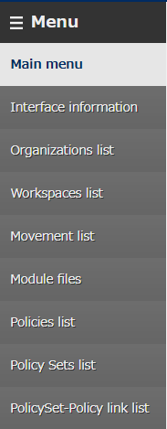
4.1 Terraform Driver Menu overview(1/2)
Menu functions
Interface information
Manages the information of the Terraformed linked to ITA.
Organizations list
Manages the Organization information used in Terraform.
Workspaces list
Manages the Workspaces information used in Terraform.
Movement list
Manages Movements that can register to Symphony/Conductor.
Module files
Manages Module files.
Policies list
Manages Policy files.
Policy Sets list
Manages Policy Sets. By linking Policy Sets to a Policy or a Workspace, users can activate Policy for the target Workspace when executing.
PolicySet-Policy link list
Manages links between PolicySets and Policies.

Slide 17
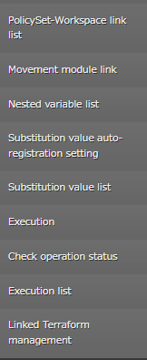
4.1 Terraform Driver Menu overview(2/2)
Menu functions
PolicySet-Workspace link list
Manages links between PolicySets and Workspaces.
Movement-Module link
Manages links between Movement and Module files.
Nested variable list
If the type of the variables inside the tf files registered to the Module file collection are "list" or "set" and "List", "set", "tuple", "object" is defined within said variables, users can use this menu to maintain (see/update) the Member variables maximum amount of repetitions.
Substitution value auto-registration setting
Manages Movements and Variables that links values and items for each operation registered in parameter sheet menus.
Substitution value list
Manages Substitution values.
Execution
Allows the users to select and execute Movement and Operations.
Check operation status
Allows the user to check the operation status.
Execution list
Manages the Execution history.
Linked Terraform management
Allows the user to view and delete Organizations, Workspaces, Policies and PolicySets registered to Terraform.

Slide 18
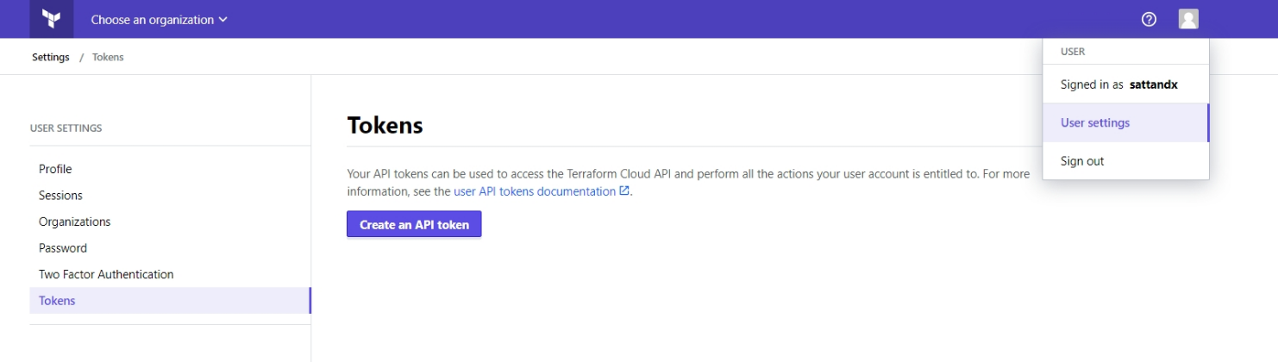
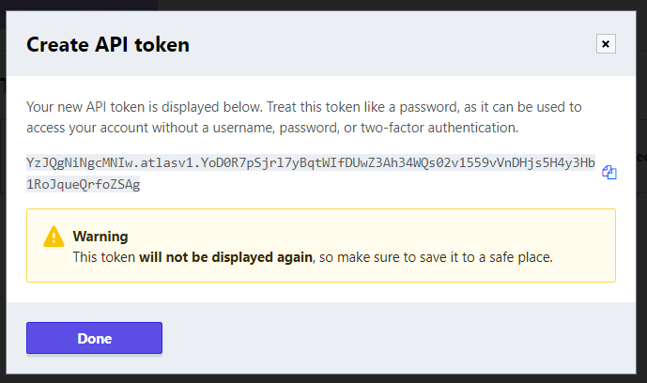
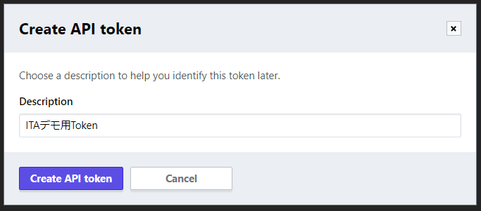
4.2 Terraform link(1/2)
Creating Tokens that we will register to Interface information.
In order to link the Terraform Driver and Terraform, we need to create a user token from Terraform.
Use your browser to log in to Terraform and access the Token page by pressing the following buttons. [User Setting]→[Tokens]→[Create an API token]
①
③
Copy the displayed token to a document
※You will not be able to see it on this site once this page is closed.
②
⑤
④

Slide 19
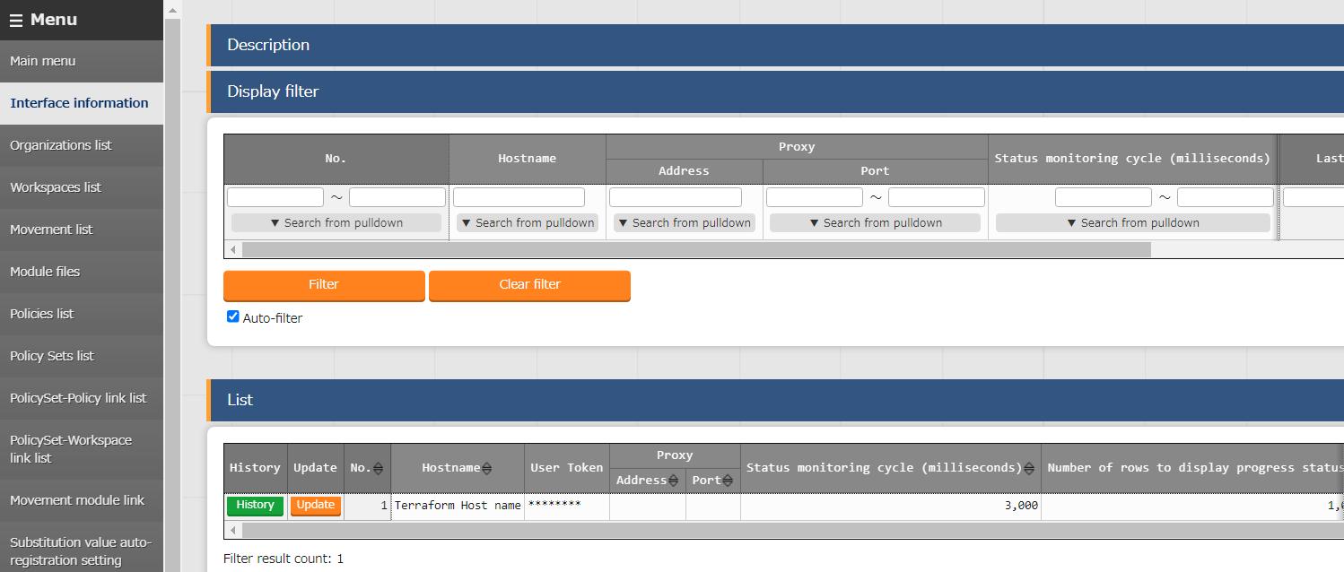
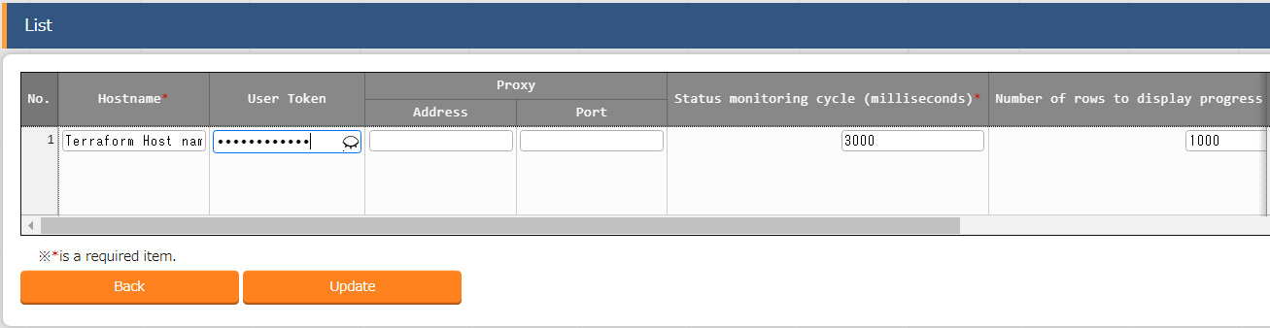
4.2 Terraform link(2/2)
Interface Information
Enter the Terraform Host name and the UserToken you created.
※Only 1 Terraform can be linked to ITA at once, so if you want to change, you will need to update all the items present from when you installed it.
Input the Terraform host name here
Enter the User token you created in Terraform earlier

Slide 20
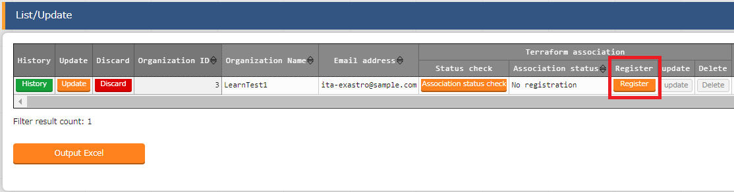
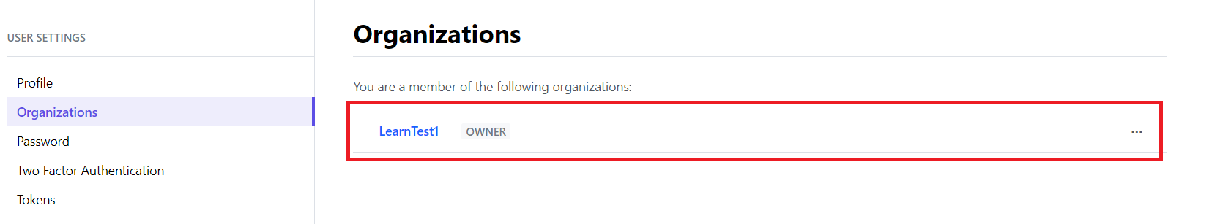
4.3 Organizations link
Organization list
After you have created the Organization item from the Organization list,
You can use the “Check operation status” function to check if the added Organization is in the target Terraform or not.
If it displays “ Nothing registered”, you can press the “Register” button to create an Organization in the Terraform.

Slide 21
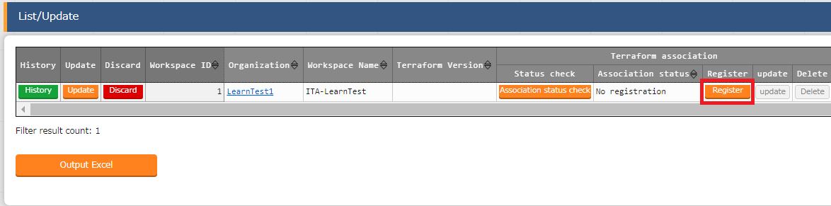
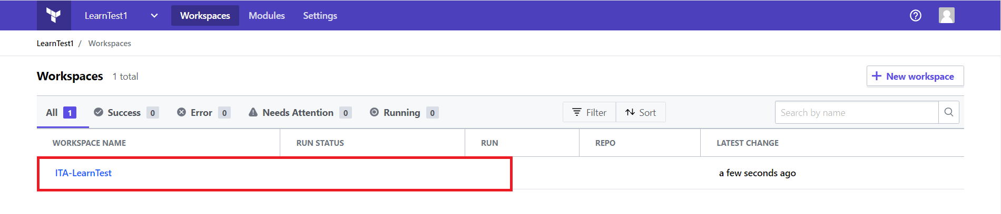
4.4 Workspaces link
Workspaces list
After you have created the Workspace item from the Workspaces list,
You can use the “Check operation status” function to check if the added Workspace is in the target Terraform or not.
If it displays “ Nothing registered”, you can press the “Register” button to create Workspace in the Terraform.
※As Workspaces are created in Organizations, you must create an Organization in Terraform first.

Slide 22
4.5 Applying Modules
Applying Modules
In order to apply a Module to an operation, you will need to register all the settings related to the module and configure the different links.
The Module is applied to the Workspace linked with the Movement when the operation is executed.
ITA
Link settings
Organization
Workspace ①
Movement-Module link
Movement list
Movement①
Terraform
Module file①
Movement①
Workspace①
Terraform
Module file①
Terraform
Module file②
Terraform
Module file②

Slide 23
4.6 Applying Policies
Applying Policies
In order to apply a Policy to an operation, you will need to register all the settings related to Policy and configure different links.
The PolicySet and the Policy linked to is applied to the Workspace linked with the Movement when the operation is executed.
ITA
Link settings
Organization
PolicySets-Policy link list
PolicySets-Workspace link list
Workspace ①
Movement
Policy Set ①
Policy Set①
Terraform
Policy file①
Policy Set①
Workspace①
Workspace①
Terraform
Policy file①
Terraform
Policy file②
Terraform
Policy file②

Slide 24
4.7 Terraform Driver Workflow
① Register Input operation name
② Register Interface information
⑪ Specify Module file to Movement
③ Register and link Organization
⑫ Configure Variable Value
④ Register and link Workspace
⑬ Execute Operation
⑤ Register Work pattern (Movement)
⑭ Check Operation status
⑥Register Module file
⑮ Check Operation history
⑦ Register Policy
⑧ Register PolicySet
⑨ Link PolicySet and Policy
⑩ Link Workspace to PolicySet
【Legend】
Required
Optional

