Slide 1


CI/CD for IaC 【Classroom】
※In this Document “Exastro IT Automation” will be written as “ITA”.
Exastro IT Automation Version 1.10
Exastro developer

Slide 2
Table of contents
Introduction
About this document
CI/CD for IaC
CI/CD for IaC
CI/CD for IaC function
CI/CD for IaC Menus
CI/CD for IaC workflow

Slide 3
1. Introduction

Slide 4
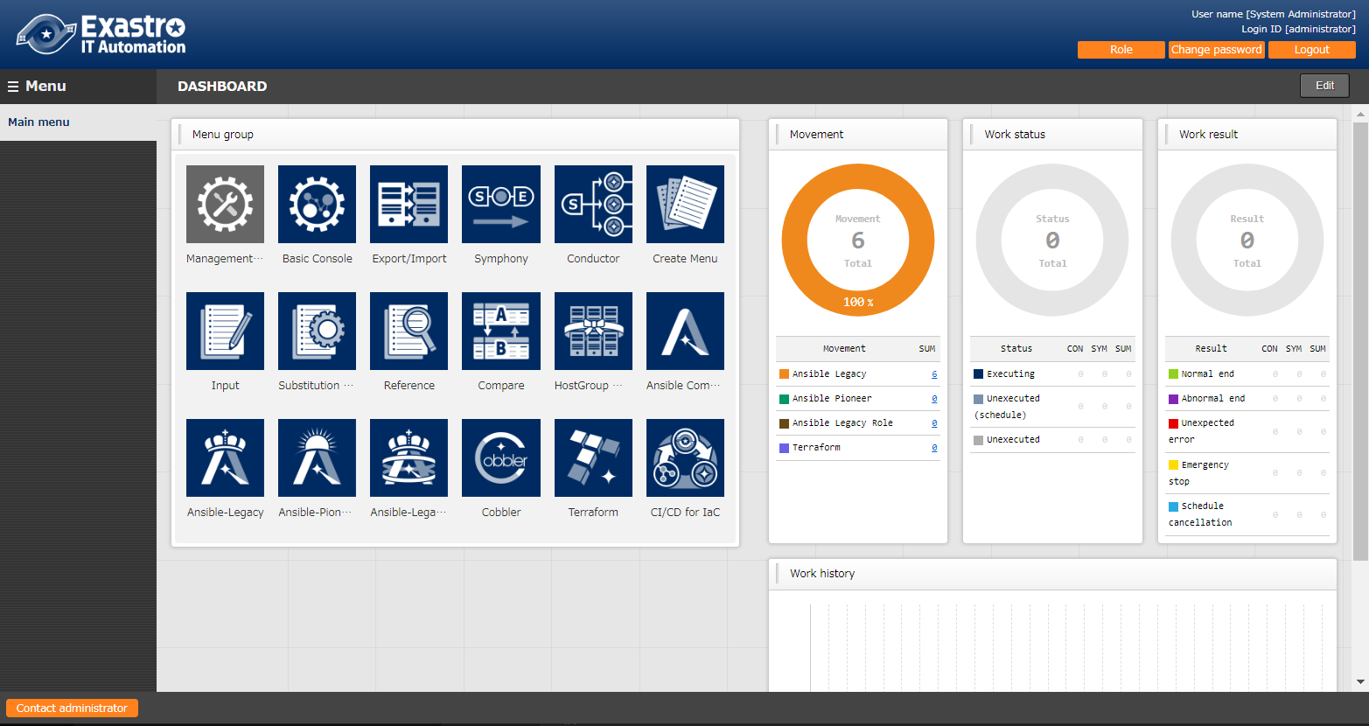
1.1 Ansible driverについて X/X
1.1 About this document
Main Menu
This document aims to explain the CI/CD for IaC Menu group.
The Practice document provides scenarios where users can learn about the CI/CD for IaC function by having first-hand experience.

Slide 5
2. CI/CD for IaC

Slide 6


2.1 CI/CD for IaC
What is CI/CD for IaC?
When using IaC (Infrastructure as Code) files, such as Ansible's Playbook files or Terraform's IaC files, for development, we can use CI (Continuous Integration) to automatically test and build, and CD (Continuous Delivery) to automatically construct environments.
We can have the Git repository's IaC files be automatically applied to the system when they are updated.
As we are linking the IaC files to Git, this allows us to manage versions and check commit histories as well.
Exastro ITA server
CI/CD for IaC
Ansible or Terraform
driver
Git repository
Local repository
Link destination files (※1)
Git clone/update
File A
File B
File A
File B
File A’
File B’
Target system
environment
File link
“Execute” menu
※1 The link destination file types depends on the link destination driver. (E.g. If linking to Ansible-Legacy, use "Playbook file collection")

Slide 7
1.1 Ansible driverについて X/X
2.2 CI/CD for IaC Function
The Ci/CD for IaC menu contains 2 functions.
Git link
Creates a Clone of the Git repository within ITA.
Leverages the clone to regularly detect any changes in the files and registers them to the “Remote repository file” menu.
Files registered to the “Remote repository file” menu can be specified by the”②File link function” as a Link source file.
File link function
Registers a link between the source files and the destination files.
Registers an Operation and a Movement to check if the link destination files are working correctly.
Automatically updates the Link destination files when the Link source files are updated and runs an Operation and Movement to check if they are working correctly.

Slide 8
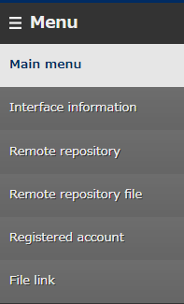
2.3 CI/CD for IaC Menus （1/6）
The main menus for the Ci/CD for IaC function are as following.
①Remote Repository
This menu manages the Git repository information.
②Registered account
This menu manages the account information needed to access the cloned files with ITA’s RestAPI. ③File link
This menu manages the link information between the source files and the cloned files.
①
②
③

Slide 9
2.3 CI/CD for IaC Menus （2/6）
Remote Repository
In the Remote Repository menu, users can register the information of the Git repository they want to link.
URL of the Git Repository used when running Git clone command.
If you are connecting to a remote Git repository with https, select https If you are connecting to a local Git, select Local
Decides if synchronization with the Git repository is done automatically or not. If the “cycle(seconds)” field is blank, it will be set to the default value (60 seconds)

Slide 10
2.3 CI/CD for IaC Menus （3/6）
Registered account
In this menu, users can register the account information needed to access the clones files from ITA’s RestAPI.
Keep in mind that the account must also be registered in the “Management console > User list” menu.
RestAPI Login ID
RestAPI Login Password

Slide 11
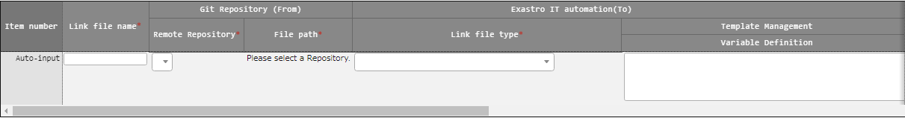
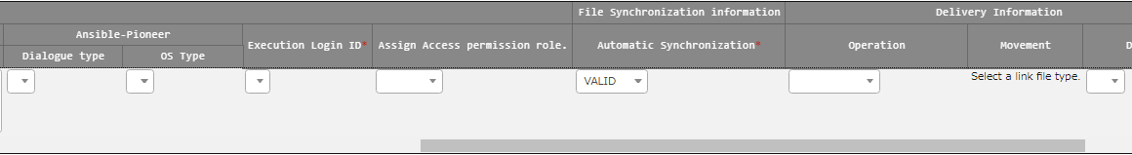
2.3 CI/CD for IaC Menus （4/6）
File link
Registers a link between the Sources file and the destination files.
Registers an Operation and a Movement to check if the destination files works correctly.
Automatically updates the Link destination files when the Link source files are updated and runs an Operation and Movement to check if they are working correctly.
Select the Remote repository/file path
and the link source file
Select file type.
E.g. Ansible-Legacy/Playbook file collection
Specify Operation/Movement to check
if the link destination files are working correctly

Slide 12
2.3 CI/CD for IaC Menus （5/6）
File link
For the "Link destination file name" item, register the file name used when registering to the Link destination menu. The link destination item names that can be used for the "Link destination type list" are as following.
Make sure to follow the restrictions when inputting for the items below. (The restrictions are the same as the ones for "Link destination menu" items)
Link destination file type | Item name
Ansible-Legacy/Playbook file list | Playbook files name
Ansible-Pioneer/Dialogue file list | No item
Ansible-LegacyRole/Role package list | Role package name
Ansible common/File list | File embedded variable name
Ansible common/Template list | Template embedded variable name
Terraform/Module files | Module file name
Terraform/Policy list | Policy name
Input "yum_package_install" into the "Link destination file name“ item
and select "Ansible-Legacy/Playbook file collection" for the "Link destination file type".
E.g.
The "yum_package_install" is used as a registration value for the "Playbook file name" item in the record registrered to the "Ansible-Legacy/Playbook file collection"

Slide 13
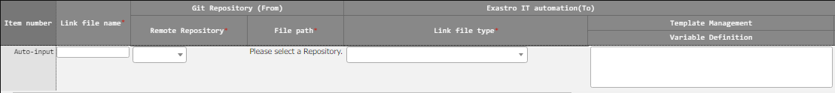
2.3 CI/CD for IaC Menus （6/6）
File link
If the Link destination type is from the Ansible-LegacyRole/RolePackage list menu, refer to “Exastro-ITA_User_Instruction_Manual_CICD_For_IaC” for more information.
Displays registered remote repositories
Displays the source files
Displays the registered ID for the registration account.
Decides if the cloned files are automatically updated when the source files are.

Slide 14
2.4 CI/CD for IaC workflow
The figure below illustrates a standard workflow for the CI/CD for IaC function. Please refer to the Practice document for information regarding operating it.
①Register remote repository
【Legend】
②Register Registration account
Required
③Register file link
Optional
④Register operation+movement info to file link
⑤Check automatic file update and validation

