Slide 1


Conductor【Tutorial】
※In this document, “Exastro IT Automation” is described as “ITA".
Exastro IT Automation Version 1.10 Exastro developer

Slide 2
Table of contents
Introduction
About this document
Conductor
About Conductor
Conductor feature
Conductor Function Description
Conductor workflow

Slide 3
1. Introduction

Slide 4
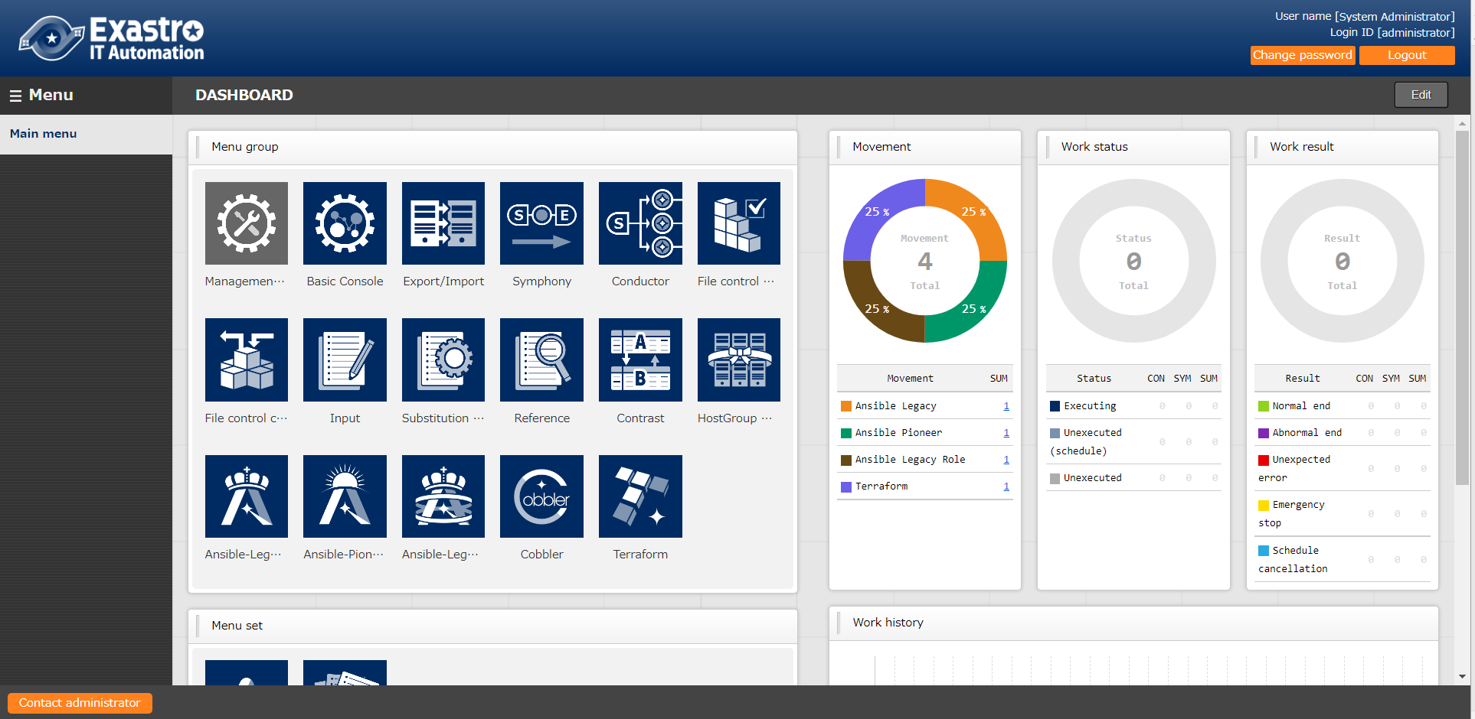
1.1 Ansible driverについて X/X
1.1 About this document
Main menu
This document aims to introduce the reader to the “Conductor” menu group

Slide 5
2. About Conductor

Slide 6
1.1 Ansible driverについて X/X
2.1 About Conductor
Conductor is a function added in ITA Ver. 1.5.0
Conductor allows users to specify multiple Movements into one sequence and links it to an operation before executing it.
Conductor
Movement A
Movement B
Movement C
parameter(variable)
IaC 1
VAR_a
IaC 2
VAR_b
VAR_c
IaC 3
None

Slide 7
2.2 Conductor features
While the Conductor Function has ,in similarity to the Symphony function, an execution function, it also contains the following functions.
Hence, Conductor allows for execution of more complicated jobflows.
Parallel movement executions
Ability to call other jobflows
Conditional branching according to the execution result of movement
Workflow-A
Movement B
call A
Movement A
Movement G
Movement C
Workflow- B
Call A
normal end
Movement E
Movement D
Movement F
error

Slide 8
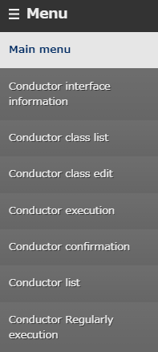
2.3 Conductor Function Description (1/14)
The main menus the Conductor menu group and their functions are as following
①Conductor class edit Create an operation using previously created movement.
②Conductor execution
Execute operations. ③Conductor confirmation Confirm previously created operations. ④Conductor Regularly execution Register operations and configure regularly executed jobflows.
①
②
③
④

Slide 9
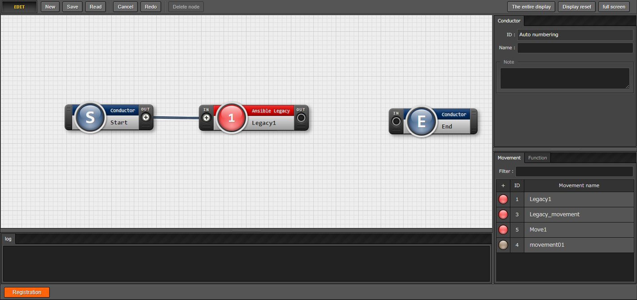
2.3 Conductor Function Description (2/14)
Conductor class edit(1/4)
In the "Conductor class edit" menu, Movements and different functions can be added and deleted.
Movements can be linked by dragging a line between the “in”/”out” circles.
Choose between various Functions.
Arrange Movement by
dragging and dropping.

Slide 10
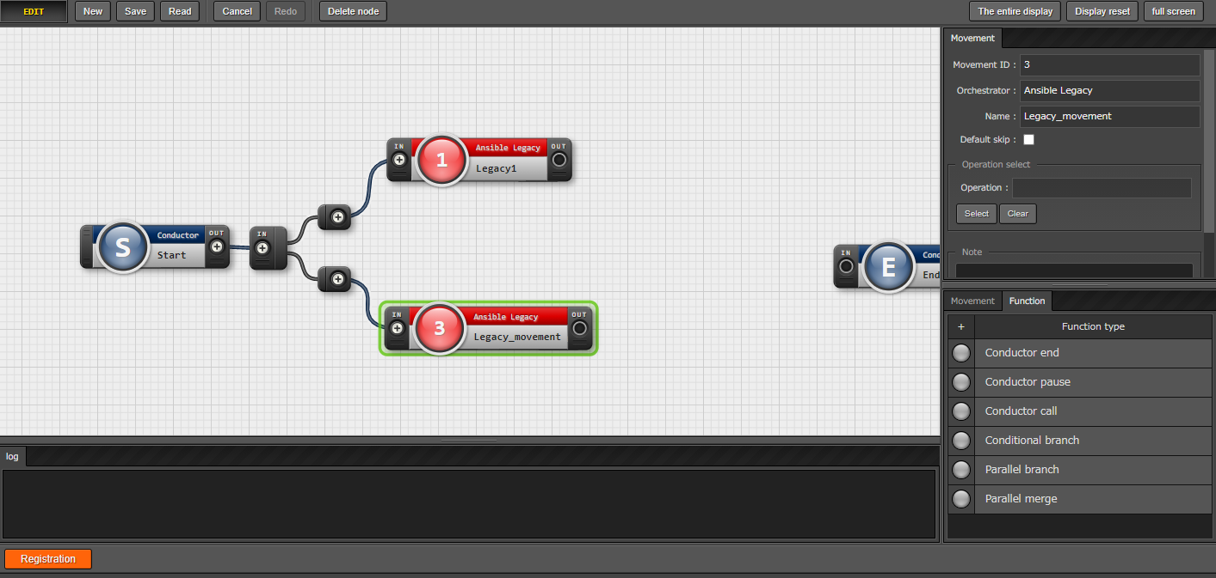
2.3 Conductor Function Description (3/14)
Conductor class edit(2/4)
Users can use the Conditional branch function by selecting it from the “Function” tab on the right side of the screen.
Similar to Movements, Operations can also be linked by dragging a line between them.
The arrangement of the “Function” tab can be changed by dragging and dropping them
Users can choose between different Functions.

Slide 11
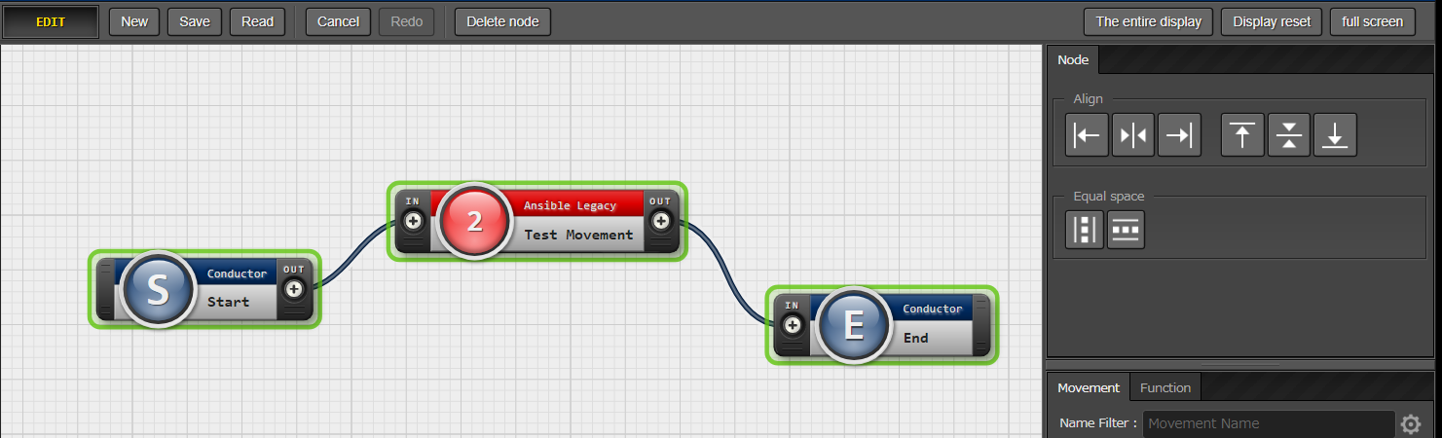
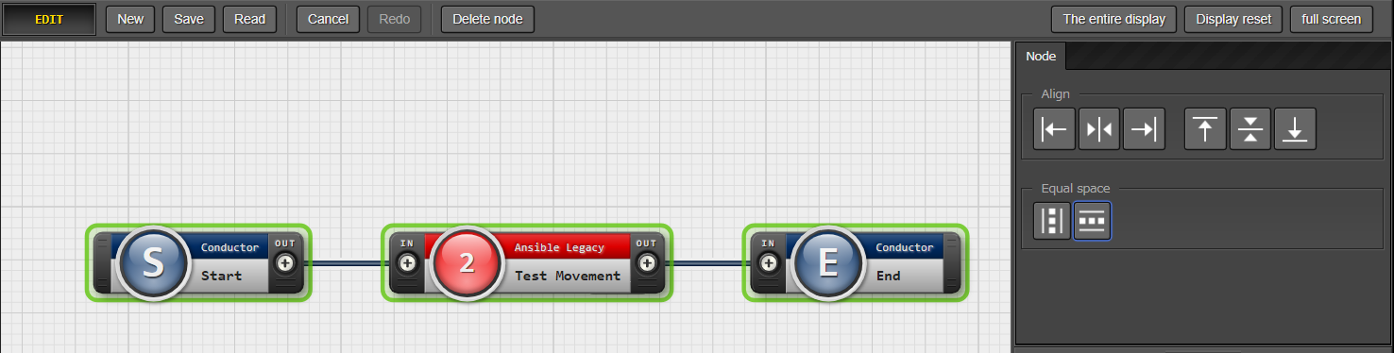
2.3 Conductor function description (4/14)
Conductor class edit(3/4)
By selecting multiple Nodes, users can use the buttons in the menu on the left to align the items. To select multiple Nodes, drag the mouse while holding the mouse button and drag over the Nodes you want to select or hold the shift key and press the Nodes you want selected individually. For more information about the Node tab, please refer to this manual.
Selecting multiple Nodes will
display the Object alignment function.
Use this tab to align the selected objects
to your liking.

Slide 12
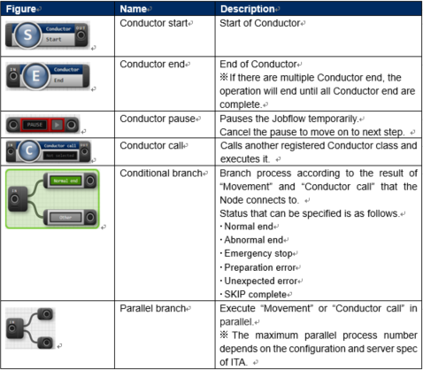
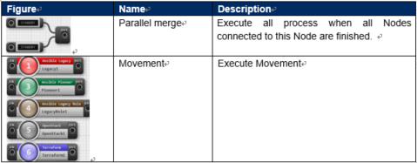
2.3 Conductor menu functions (5/14)
Conductor class edit(4/4)
The following explains the different functions available. For more details, please refer to this manual.

Slide 13
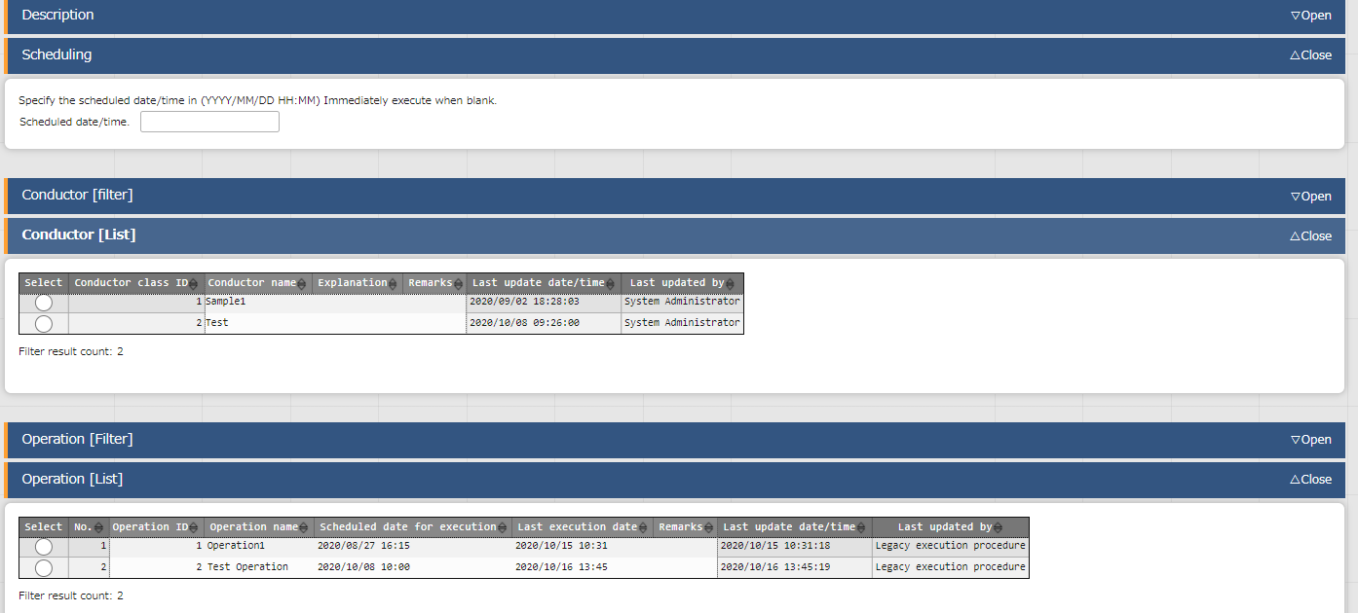
2.3 Conductor Function Description(6/14)
Conductor execution(1/2)
Choose and execute the created Conductor in the "Conductor execution" menu.
Use this box to schedule when you want the Conductor to run.
Select Conductor and Operation.
Select Conductor and Operation.

Slide 14
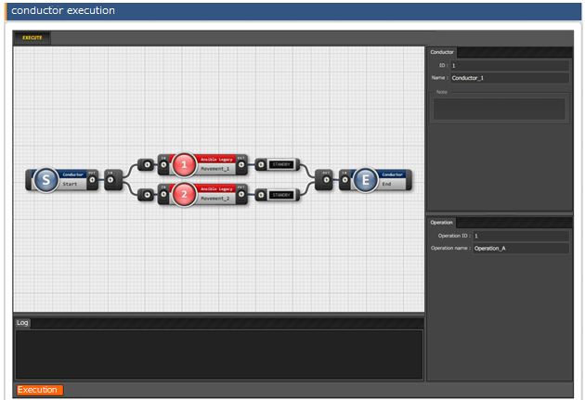
2.3 Conductor Function Description (7/14)
Conductor execution (2/2)
The conductor and operation selected at the top of the page will be displayed.
If there are no problems with the contents, press the
"Execute" button to execute.

Slide 15
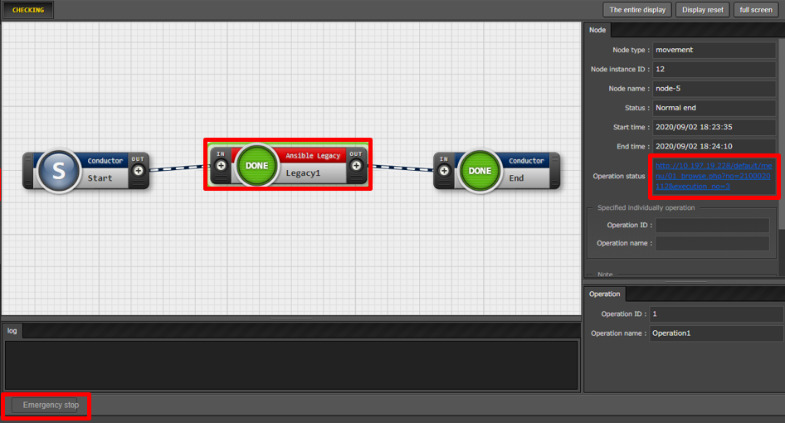
2.3 Conductor (8/14)
Conductor confirmation
Check the execution status from the "Conductor Confirmation Menu“.
Clicking the movement will display a detailed results screen. Click here for more details.
If the Conductor is scheduled to be executed users can cancel it
pressing the " schedule cancelling"
button.

Slide 16
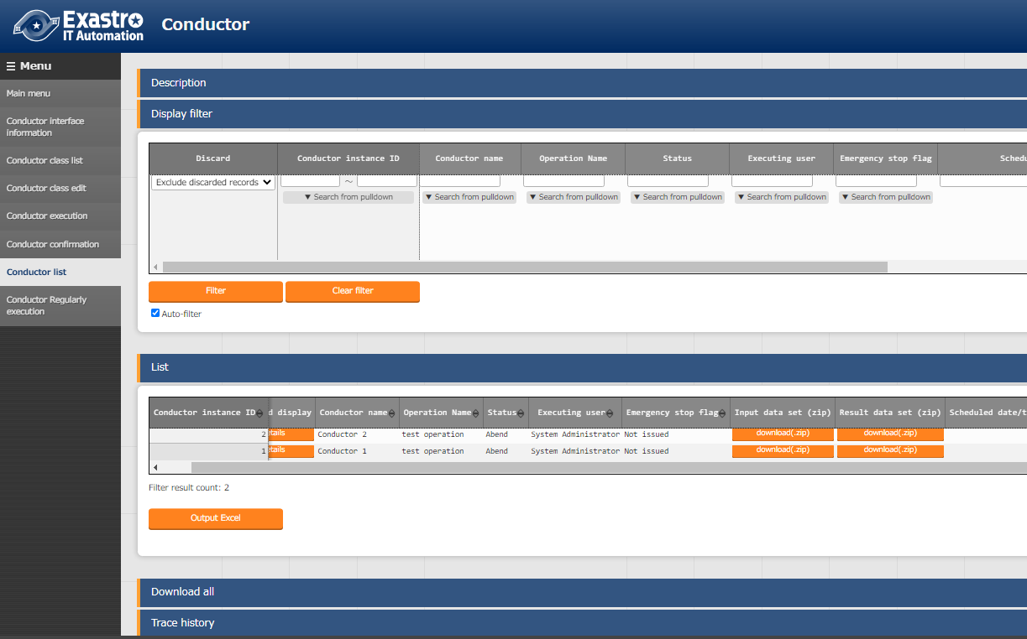
2.3 Conductor Function Description (9/14)
Conductor check(1) In the “Conductor” Menu group -> “Conductor list” menu ->”List” Sub-menu, users can download the input/results data for each Conductor.

Slide 17
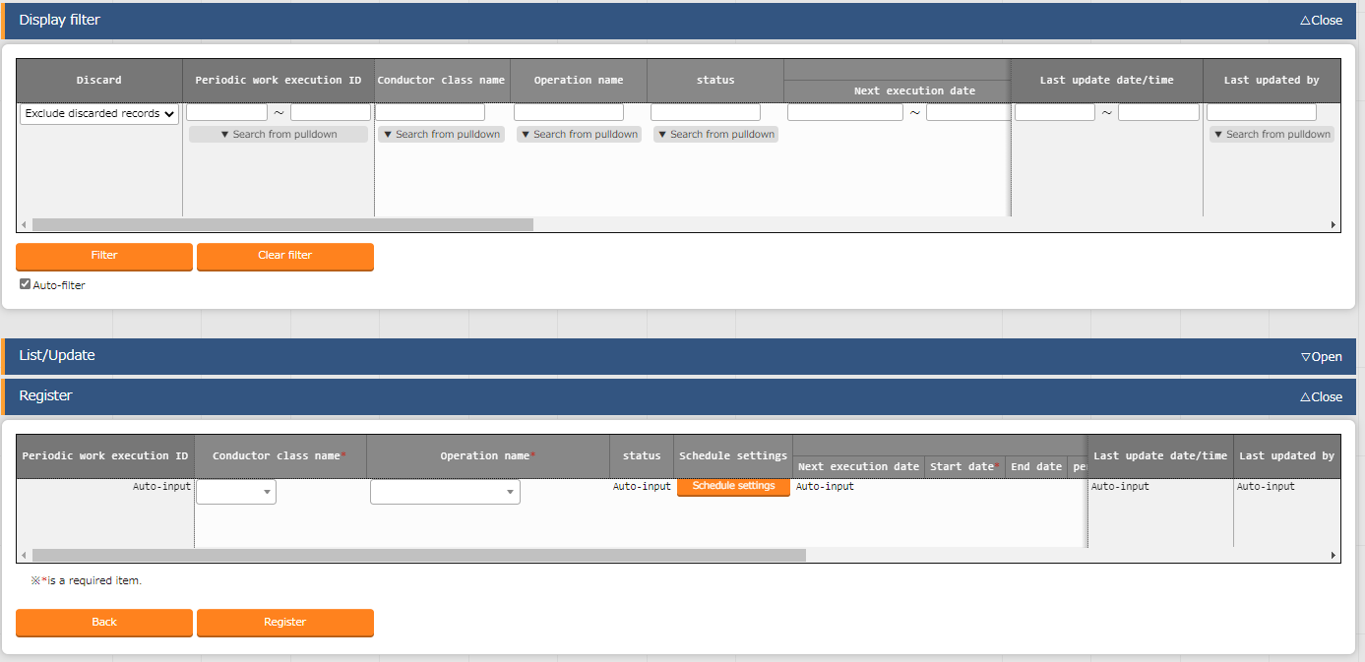
2.3 Conductor Function Description (10/14)
Conductor Routine Executions(1/3)
In the "Conductor Regularly execution" menu, users can manage regularly executed operations.
A detailed schedule can be
set from the" Schedule Settings“ button.

Slide 18
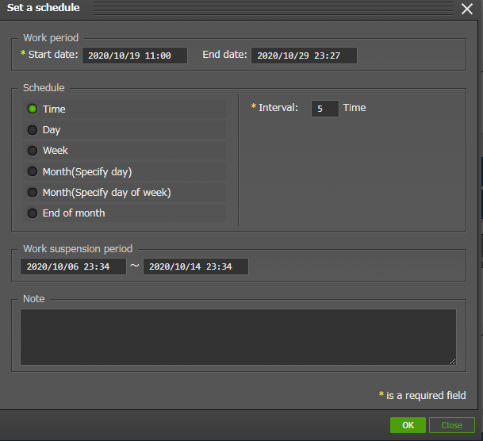
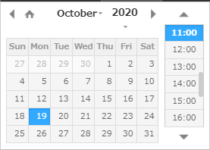
2.3 Conductor Function Description (11/14)
Conductor Routine Executions(2/3)
"Schedule settings“ allows user to set detailed settings such as the regular execution period and the period for stopping work.
Clicking here will display
a calendar.
初回(=次回実行日付) ：2021/09/01 00:00 2回目 ：2021/09/01 08:00 3回目 ：2021/09/01 16:00
現在日時「2021/8/31 00:00」に 左図のようにスケジュール設定した場合 Conductorの実行日時は以下のようになります。

Slide 19
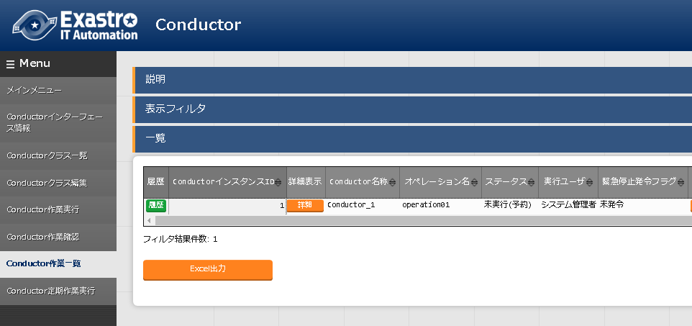
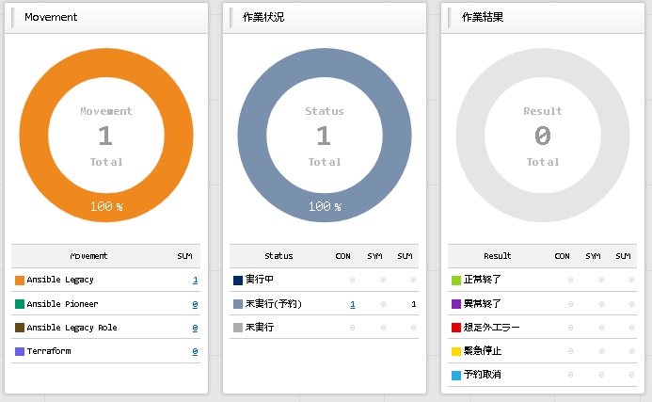
2.3 Conductor Function Description (12/14)
Conductor Routine Executions (3/3)
Any Conductor operations registered with a scheduled routine will display "Not executed (Reserved) when the first interval time before the first scheduled execution date passes. (The default interval (time) value is 3 minutes). The Interval time can be changed by the user in the "Management console" > "System settings" menu. For more information, please see the Management console user manual
Conductor/Symphonies with the status "Unexecuted (Schedule) can be seen in the "Work status" field in the dashboard and in the "Conductor list" menu.
If the next execution date is set to "2021/9/1 18:00" and the interval is set to 3 minutes,
the status will change to "Unexecuted (Schedule))" 17:57 2021/9/1.
Will display when the interval time before the next execution date passes.

Slide 20
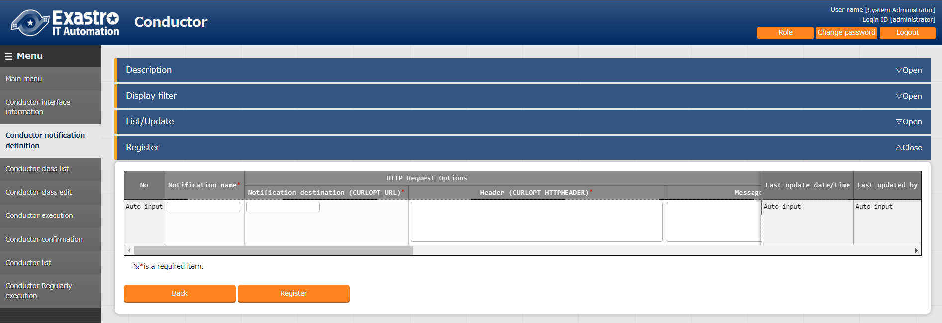
2.3 Conductor Function Description (13/14)
Conductor Notification destination definition(1/2)
This allows users to send Conductor execution results to specified message tools (Teams, Slack) through http requests. Use the "Conductor notification destination definition" menu to configure receiving messaging tools and define notification contents. For more information, see the manual.
This tool is especially helpful for executions with long processing times and for reserved/scheduled operations.
Configure notifications
and their destinations.

Slide 21
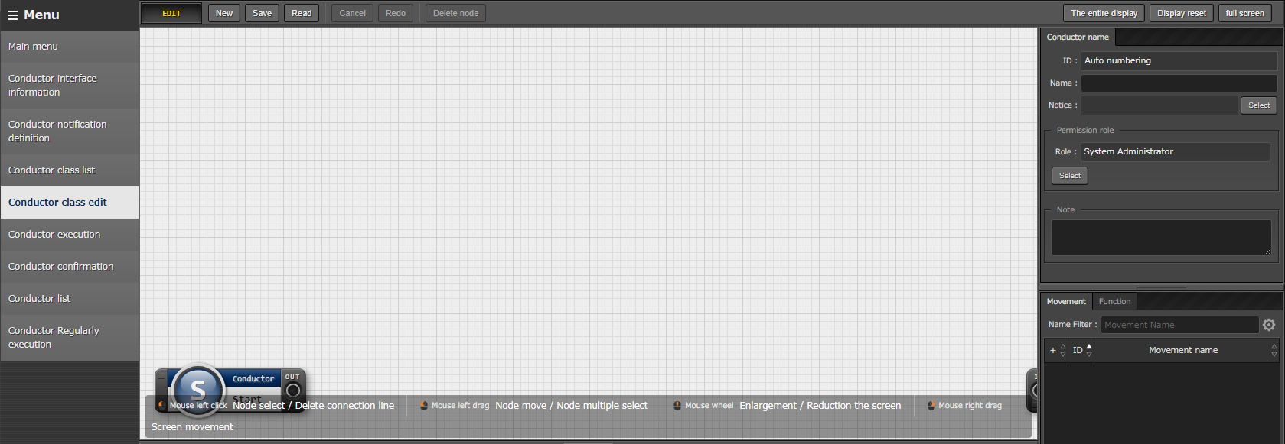
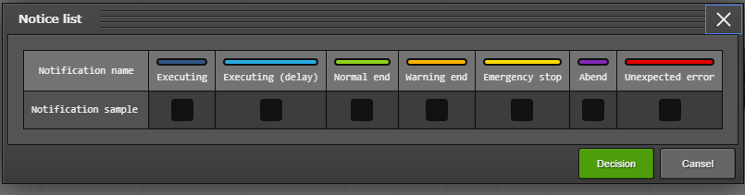
2.3 Conductor Function Description (14/14)
Conductor Notification destination definition(1/2)
Users can specify Conductor notification destination definitions registered in the "Conductor class edit" > "Notice" menu, and select what Conductor status sends notifications.
Click this button to display the “Notice list”.

Slide 22
2.4 Conductor workflow
The Conductor workflow is as follows. Details can be found in the Practice document.
①Register device information
Basic console menu
②Register operation
③ Register Movement
Various driver menus
④Check Movement
⑤Register interface information
Conductor menu
⑥Register Conductor
⑦Check Conductor
⑧Execution Conductor
⑨Check execution result
⑩Check execution history

