Slide 1


BASE 【Classroom】
※“Exastro IT Automation” is written as "ITA" in this document
Exastro IT Automation Version 1.10
Exastro developer

Slide 2
Table of contents
Introduction
1.1 About this document
Management console
2.1 System settings
2.2 RBAC (Role Based Access Control)
Basic console
3.1 Device Management in ITA
3.2 Operation overview
3.3 ER Diagram

Slide 3
1. Introduction

Slide 4
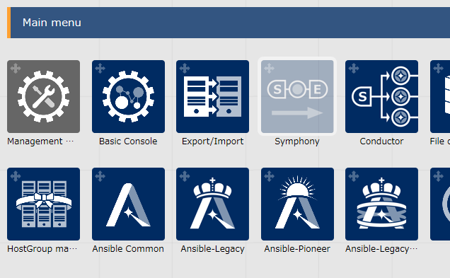
1.1 About this document
Main Menu
This document aims to describe the Management console and the Basic Console menu groups.
Management Console
System settings
RBAC（Role Based Access Control）
Basic Console
Device management in ITA
Operation overview

Slide 5
2. Management console

Slide 6
2.1 System Settings
In the “System Settings” menu, users can register all the necessary information for operating the system. The settings items are as shown below.(See next page)
Item name | Description
IP address restrictions | Choose if access by IP address to be regulated or not
Upload prohibition extension | Extension file names that prohibit upload
Account lock duration (seconds) | Time period(seconds) to maintain locked state from start time of account lock.
Password error threshold (frequency) | Password failure threshold before locking account
Password error count upper limit (frequency) | Max amount of times continuous password errors
Password re-registration prevention period (days) | Time period (days) to prevent registration of same password
Password validity period (days) | Validity period of password (days)

Slide 7
2.1 System Settings
In the “System Settings” menu, users can register all the necessary information for operating the system. The settings items are as shown below.
Item name | Description
Authentication duration: Not operated (seconds) | Session length without any user operations
Authentication duration: Maximum period (seconds) | Maximum session length
Screen design selection | Configures the design of the system
Symphony and Conductor Interval time (minutes) | Interval time between the scheduled Symphonies/Conductors changes their status to "Not executed (Scheduled)" after being registered.
Show / hide the “Role” button | Activates/Deactivates the "Role" button, which displays which role(s) the user belongs to.

Slide 8
2.2 RBAC (Role Based Access Control) (1/4)
About RBAC
RBAC is a method that allows users to assign authority by role.
Since authorization isn't given directly to each user, but by a role basis, the access authority management is allocated by local access.
RBAC per menu
By being able to link each user to a role with permissions, users can control menu access for each user. Users can also choose between two types of access when linking. "Can perform update" and "View only". The "Can perform update" access permission will grant the user the ability to duplicate, update, delete data, as well as see it's history. Users with the permission "View only" will only be able to see the data and it's history.
RBAC per data record
Users can also control access permission for individual data records by linking the data records to the user's respective roles. If you are not using this function, you can change the default access permission / access permission role blank. This will make all the users able to see everything. For more information, please see the user manual.

Slide 9
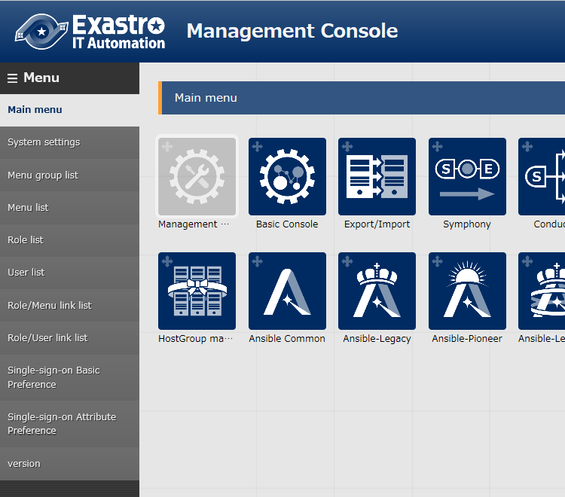
2.2 RBAC (Role Based Access Control) (2/4)
Description of the Menu groups inside “Management Console”
Menu group list
Multiple groups bundled.
Menu list
A Menu is always attached to a menu group.
Role List
Role define access authority to Menus
User list
A user can have multiple roles
It is possible to link with Active Directory and acquire user information.
Role/Menu link menu
Maintain each users access authority to menus
Role/User link menu
Maintain each users affiliation to other users.
Menu
Menu Group

Slide 10
2.2 RBAC (Role Based Access Control) (3/4)
RBAC Example
Can Maintain
User
ITA Role
Spectate Only
User１
Menu A
developers
User２
Menu B
Menu C
User３
operators
■ Menu A・・・
Only User 1 can maintain
■ Menu B・・・
All users can maintain
■ Menu C・・・
User 1 can maintain, user 2 and 3 can only spectate
※ While user 1 has both the authorization “Can Maintain” and ”Spectate Only”, “Can Maintain” will be prioritized.

Slide 11
2.2 RBAC (Role Based Access Control) (4/4)
RBAC per data record example
Has access
User
ITA Role
Menu A
Access permission role settings
Record
User１
・
Record A
developers,operators1
developers
Record B
developers
User２
・
operators1
Record C
(Blank)
User3
・
・・・
・・・
operators2
■ RecordA・・・
developers and operators1 has access
■ RecordB・・・
only developers has access
■ RecordC・・・
the access permission value is blank(all users has access)
※This example is assuming that each role is linked to Menu A.
(Please see the page 7, "RBAC per menu”)

Slide 12
3. Basic Console

Slide 13
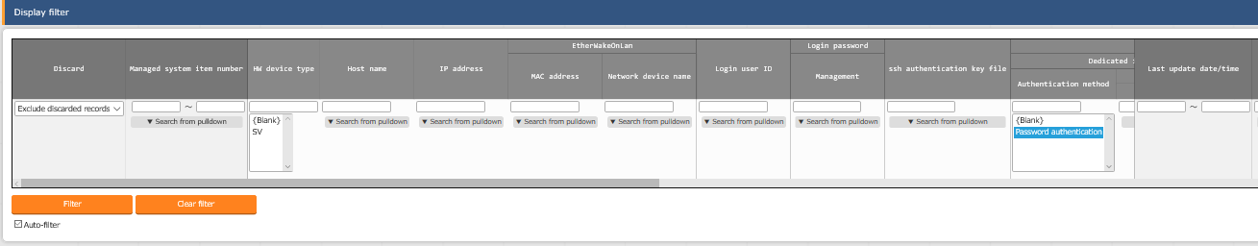
3.1 Device management in ITA (1/2)
Device management in ITA
In the "Basic Console">"Device list" menu, users can register the needed information for the targeted host.
Users can check authorization information settings per host. For authentication, it is possible to choose from Password authentication and Key authentication.
Main registration items
 | ・HW Device type | ・Host name | ・IP Address
 | ・Log-in User ID | ・Log-in Password | ・Authentication method

Slide 14
3.1 Device management in ITA (2/2)
Device management in ITA（２）
in ITA, users can increase the reusability of device information as well as being able to respond flexibly to setting information changes by managing the user information separately.
Movement (original ITA terminology) means a work unit.
Host A
Password Authentication A
Movement A
Host B
Key authentication
Host C
Password Authentication B
Movement B
Host C
Password Authentication B
Host D
Password Authentication C
Movement C
Host C
Password Authentication B
Host E
Password Authentication D
Example: Host C will need to change password and the changes will be carried out
↓
Result: All movements connected to C will be automatically updated to show the updated information

Slide 15
3.2 Operation overview
About Operation
Operation is an execution unit in ITA.
It is possible to manage execution history and execution schedule.
For more information regarding using Operations, please see the Quick start guide.
Symphony Class
Operation X
Target device A/B is set
start
Target Device A/B
Parameter sheet
IaC①
……………………………
…………………
…………………………
 | P1 | P2 | P3 | …
A | - | - | -
B | - | - | -
Movement①
IaC②
……………………………
…………………
…………………………
Movement②
IaC③
……………………………
…………………
…………………………
Operation Y
Target device C is set
Target Device C
Parameter sheet
IaC④
 | P1 | P2 | P3 | …
C | - | - | -
end
……………………………
…………………
…………………………

Slide 16
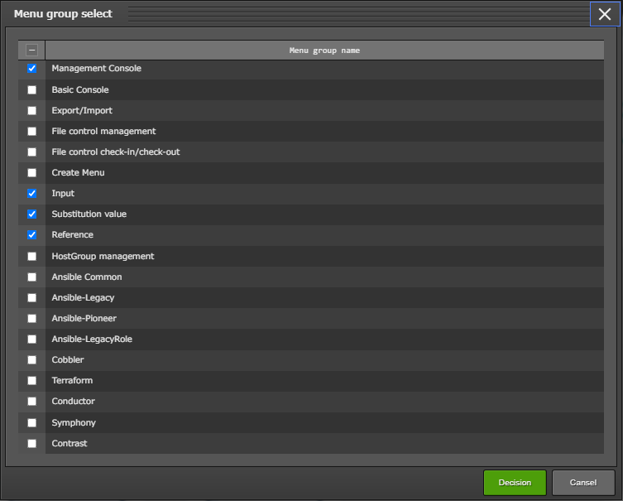
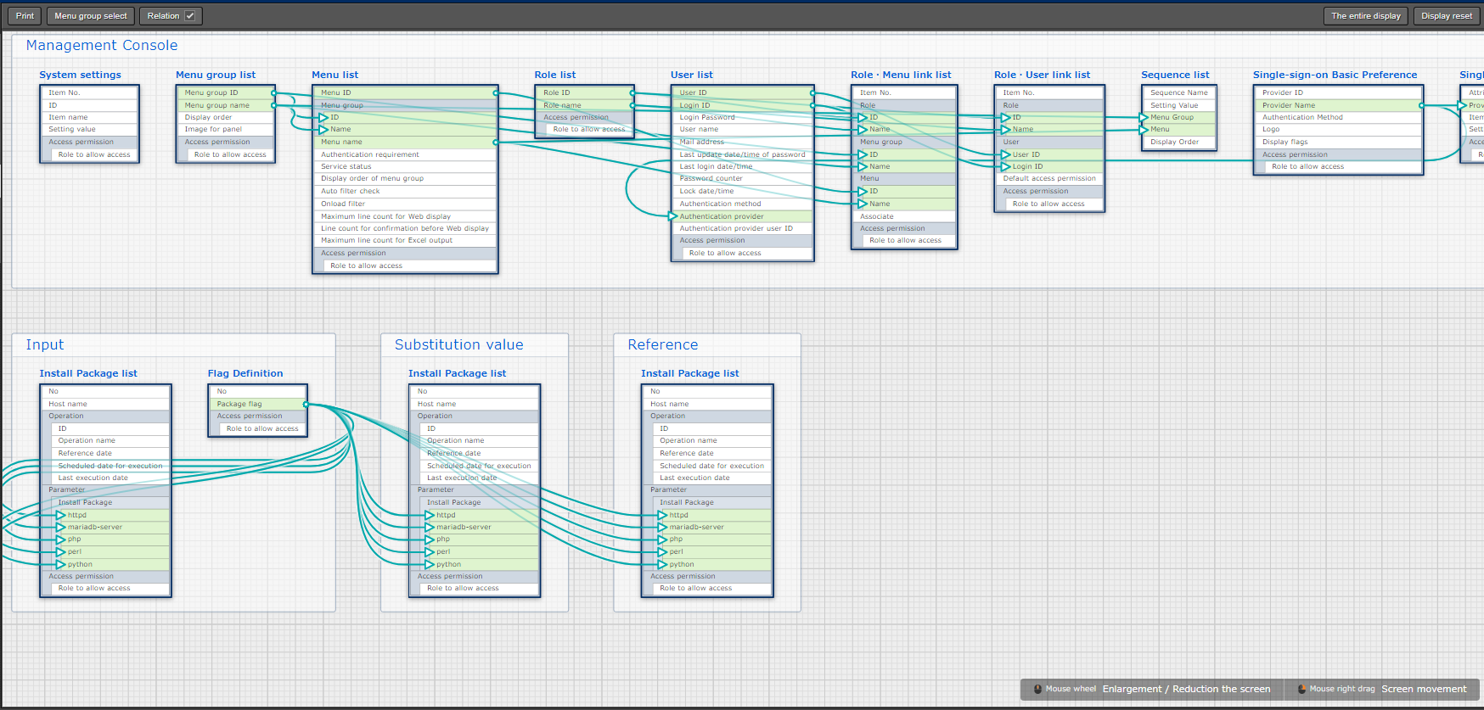
3.3 ER Diagram
ER Diagram
Users can see an ER Diagram by going to the "Basic console" menu group >> "ER Diagram. The ER Diagram is a diagram that displays the relation (reference data, etc.) between each Menu. Users can also print out this diagram. Note that only menus the user has permission to see will be displayed. For more information, please refer to the user manual.

