Slide 1


Collect function / Compare function
【Classroom】
※In this Document “IT Automation” will be written as “ITA”
Exastro IT Automation Version 1.10
Exastro developer

Slide 2
Table of contents
Introduction
1.1 About this document
Collect function
2.1 What is the collection function?
2.2 YAML Variables (FROM) and Parameter Sheet Items (TO)
2.3 Work flow
2.3.1 Collect interface information
2.3.2 Collect item value list
2.4 Check Collect status
Compare function
3.1 Compare function 3.2 Comparison menu group
3.2.1 Standard date/time 3.3 Work flow
3.4 Items for comparing parameter sheets
Collect / Compare function application
4.1 Application example

Slide 3
1. Introduction

Slide 4
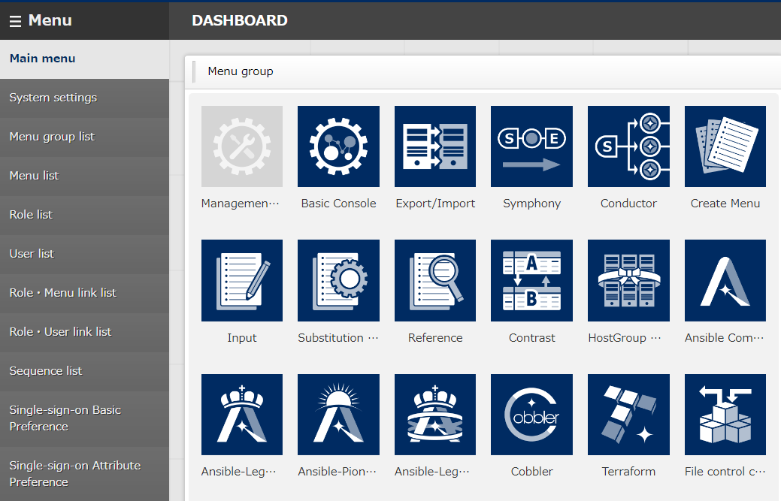
1.1 About this document
This document aims to explain the Collect and Compare function.
In the "Practice document", we will use the ITA Screen to give the user a more hands-on experience, so we recommend reading both of the documents.
Collect function menus
Collection interface information
Collected item value list

Slide 5
2. Collect function

Slide 6

2.1 What is the Collect function?
The Collect function gathers execution result files, aka inventory (source files output as YAML files) , from the system and automatically registers the value to the ITA Parameter sheets.
Overall Diagram
RHEL 7or8
System
Ansible-driver
Ansible
Playbook
Acquire
Device list
Movement
Variable 1
Execute
Operation
Variable 2
Register
Inventory
Parameter sheet
Host name | Operation | Parameter
 |  | Item 1 | Item 2 | Item 3
●●● | ●●● | ●●● | ●●● | ●●●
●●● | ●●● | ●●● | ●●● | ●●●
YAML
Rest
API
Variable 1
Variable 2

Slide 7
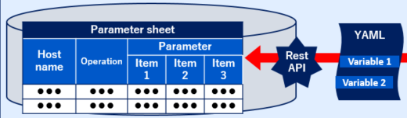
2.2 YAML Variables (FROM) and Parameter Sheet Items (TO)
Associate the variable (FROM) in the YAML file with the item (TO) in the parameter sheet. As a result, the acquired value will automatically be registered in the parameter sheet.
Users can associate in the "Collected item value management" menu. (For more details, please refer to chapter "2.3.2, Collected item value list")
Overall Diagram (Lower left part)
Associate
TO
FROM
Recipient of the acquired value
Acquired value

Slide 8
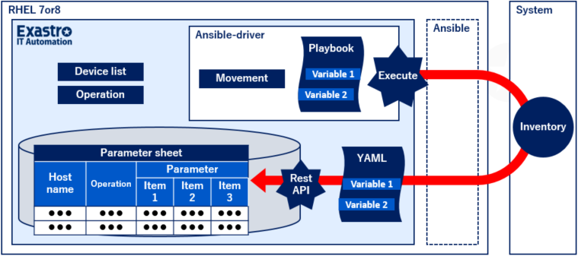
2.3 Work flow (1/2)
The standard work flow of the collect function is shown in the figure below.
The YAML file collected in ⑨ is explained in the practice document.
① | (Optional) Create a user for the collect function
② | (Optional) Create a role for the collect function
③ | (Optional) Role / User link
④ | Update the Collection interface information
⑤ | Create parameter sheet (host/ operation)
⑥ | Register to Collected item value list
⑦ | Preparation
⑧ | Execute
⑨ | Execute Collect function
⑩ | Check collection status
①
②
③
⑦
Management Console
⑤
⑥
⑧
⑨
④
⑩

Slide 9
2.3 Work flow (2/2)
The outline of each work flow is as follows.
For details, refer to the "Collect function User manual".
① | (Optional) Create a user for the collect function | Register the user's User information
② | (Optional) Create a role for the collect function | Register the user's Role information
③ | (Optional) Role / User link | Link the registered User and Role
④ | Update the Collection interface information | Register User name / Password of a user who has permission to run RestAPI Go to " 2.3.1 Collect interface information"
⑤ | Create parameter sheet (host/ operation) | Create a parameter sheet that will receive collected values.
⑥ | Register to Collected item value list | Link YAML variables and Parameter sheet items Go to "2.3.2 Collect item value list"
⑦ | Preparation | Create Movement and Job Flow needed in order to execute.
⑧ | Execute | Select the execution date and time, Input operation, Movement, and job flow and execute the operation.
⑨ | Execute Collect function | Automatically register collection target (Operation No. of executed operations) to Parameter sheets
⑩ | Check collection status | Check the collection status of the executed operation. Go to "2.4 Confirmation of collection status"

Slide 10

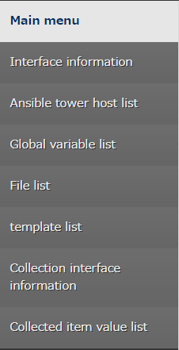
2.3.1 Collection interface information
Register the user name and password of a user that has permission to run RestAPI. (We will need one for accessing with RestAPI when registering values to the ITA CMDB)
User name with execute permission
The user's ITA Password

Slide 11
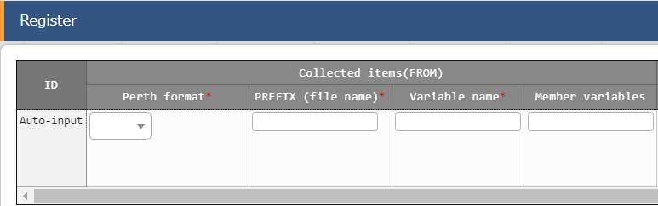
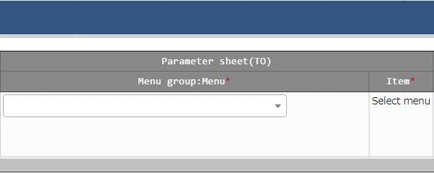
2.3.2 Collected item value list
In the collection item value list menu, users can link the collected item's YAML variable name (FROM) with the Parameter sheet item name (TO).
ITA Screen
Collected items (FROM)
Parameter sheet (TO)

Slide 12

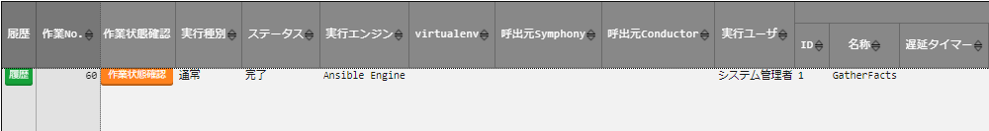
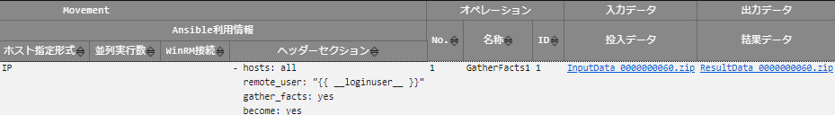
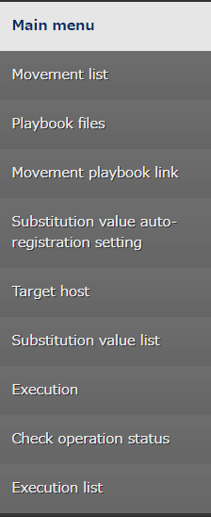
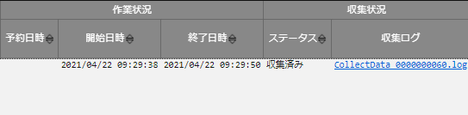
2.4 Check the collection status
From the Ansible-driver "Execution list" menu, check that the collection has ended successfully.
If the "Collection status" displays "Collected", then it has ended successfully. If it displays, it will display "Not target".
Status | Description
Collected | Successfully collected
Collected（notification） | An error occurred while registering/updating
Not target | Failed to collect
Collection error | Something is wrong with the registered operation or target host information

Slide 13
3. Compare Function

Slide 14
3.1 What is the Compare function?
The Compare function compares parameter sheets with each other and checks for differences. By using it together with the Collect function, you can compare the two patterns shown in the figure below.
Overall Diagram
Expected value
Parameter sheet A
Item 1 | Item 2 | Item 3
●●● | ●●● | ●●●
Comparison of values with different base dates(*)in the same menu
* For more information about the base date, refer to chapter "3.2.1 Base date".
Comparisoin
1
Collected value
Parameter sheet B
Item 1 | Item 2 | Item 3
●●● | ●●● | ●●●
●●● | ●●● | ●●●
●●● | ●●● | ●●●
Comparison
2
Comparison of expected value and collected value

Slide 15

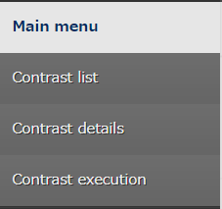
3.2 Compare menu group
The Compare menu group has 3 menus.
Compare definition
Parameter sheet A
Select the 2 menus (parameter sheets) you want to compare.
Run Compare
Select Menu
Parameter sheet B
Compare definition details
Parameter sheet A
Item 1 | Item 2 | Item 3
AAA | BBB | CCC
We will now further narrow down what we will compare by narrowing down to the specific columns from the menus we selected in the "Compare definition" menu.
Select the columns you want to Compare
Parameter sheet B
Item 1 | Item 2 | Item 3
AAA | BBB | DDD
Run Compare
Run the defined Compare.
When comparing parameters with the same menu but different base dates, specify both base dates when executing the comparison.

Slide 16
3.2.1 Base date
The Base date (time) depicts the time and date of the Compare.
The values collected before the specified date will be displayed.
(Example) When the base date 1 is set to "4/1 23:00" and the base date 2 is set to "4/2 02:00"
1st Collection
2nd Collection
3rd Collection
4/1
21:00
22:00
23:00
4-2
00:00
01:00
02:00
03:00
Base date 1
Base date 2
The second collection is the latest
The third collection is the latest
In this case, the second and third collected values are compared.

Slide 17
3.3 Workflow（1/2）
The following figure illustrates a standard workflow for the Compare function
①
① | Create Parameter sheets
② | Register data to the parameter sheets and run Collect function
③ | Create Comparison definition
④ | (Optional) configure detailed information for the comparison definition
⑤ | Run Comparison
②
Parametersheet A
Item1 | Item2 | Item3
AAA | BBB | CCC
③
④
①
②
Parametersheet B
Item1 | Item2 | Item3
AAA | BBB | DDD
⑤
Run Comparison
Items with differences will be marked with red text
Results | Menu name | Parameter /Item1 | Parameter /Item2 | Parameter /Item3
Difference | Parameter sheet A | AAA | BBB | CCC
Difference | Parameter sheet B | AAA | BBB | DDD

Slide 18
3.3 Workflow（2/2）
The overview for the different steps are as following
For more information, please see「User_instruction_manual_CompareFunction」
① | Create Parameter sheets | Create Parameter sheet.
② | Register data to the parameter sheets and run Collect function | Register data to the Parameter sheets. If the user is using the Collect function, run it in this step.
③ | Create Comparison definition | Select what menus (Parameter sheets) to compare.
④ | (Optional) configure detailed information for the comparison definition | Select what column in the menus (Parameter sheets) to compare.
⑤ | Run Comparison | Run the defined comparison. Any differences will be marked in red text.

Slide 19
3.4 Items for comparing parameter sheets
The following Parameter sheet items that can be used are as following.
See Exastro-ITA_User_Instruction_Manual_Collect_Function for more information.
Item type | Restrictions
String | No restrictions
Multi-string | No restrictions
Integer | No restrictions
Decimal | No restrictions
Pulldown selection | Compares the selected list IDs. If the user does not have access permission, the ID conversion will fail and display (X) ※For more information regarding access permissions, see "Exastro-ITA_User_Instruction_Manual_Role-based_access_control_for_data_records".
File upload | When comparing uploaded files with each other, the File name and the contents of the files will be compared. ※ The comparison results will only display whether there are differences or not. It will not display where and what differences are present.
Link | No restrictions

Slide 20
4. Collect function / Compare function application

Slide 21
4.1 Application example
Collection function
By collecting the results of the network device's config output command and AWS EC2 list, users can synchronize the values of the parameter sheets and the values of the actual machine, meaning that work efficiency will improve while mistakes will occur less frequently.
Compare function
We can first use the Compare function to compare [Pre-execution Expected value] and [Post-execution Actual value (collected value)] to have the system show us what places we want to change, aka the differences. After applying the changes, we can use the Compare function again to confirm there are no differences anymore, meaning that the application has been successful.

