Slide 1


Collect/Compare function
【Practice】
※In this document, “IT Automation” will be written as “ITA”,
Exastro IT Automation Version 1.10
Exastro developer

Slide 2
Table of contents
Introduction
(1) About this document
(2) Operation environment
(3) Scenario
1. Scenario１【Collect function】Collect target host OS Information
Scenario 1 Overall diagram
1.1 Register target host
1.2 Register operation
1.3 Register movement
1.3.1 Header section and gather_facts
1.4 Register Playbook
1.4.1 Directory for YAML files and collection
1.5 Movement-Playbook link
1.6 Register target host
1.7 Create Parameter sheet for registering collected values
1.8 Register Collected item value list
1.9 Register Collect interface information
1.10 Run operation
1.11 Confirm the collection results
2. Scenario ２【Compare function】 Compare the values and the expected values of the one collected in Scenario 1.
Scenario 2 Overall diagram 2.1 Register Operation 2.2 Create parameter sheet for expected values 2.3 Register expected values 2.4 Register a Comparison 2.5 Run comparison 【Reference】 Compare details
【Reference】 (1) Register Comparison details

Slide 3
Table of contents
【Reference】 (2) Register Compare details 【Reference】 (3) Run Comparison
3. Scenario３【Collect function】Collect the target host’s SSL certificate file
Scenario３Overall diagram
3.1 Register Target host
3.2 Register operation
3.3 Register Movement
3.4 Register Playbook
3.4.1 File collection directory
3.5 Movement-Playbook link
3.6 Register File name
3.7 Register File name
3.8 Register substitution value auto-registration settings
3.9 Create Parameter sheet for collect values
3.10 Register Collected item value list
3.11 Run operation
3.12 Confirm collection results
4. Scenario４【Compare function】 Compare the file downloaded in scenario 3 with the same file from a different date.
Scenario 4 Overall diagram
4.1 Register operation 4.2 Prepare SSL certificate with different contents
4.3 Register file name
4.4 Run operation
4.5 Confirm comparison results
4.6 Register Comparison definition
4.7 Run Comparison

Slide 4
Introduction

Slide 5
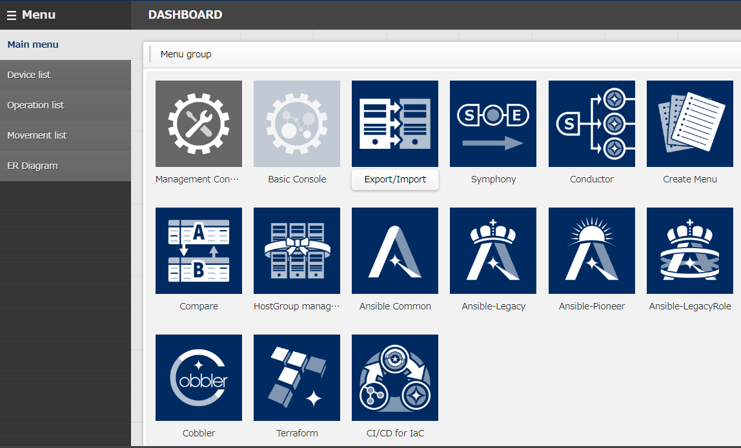
(1) About this document
About this document
This document aims to teach the user about the Compare and Collect function by leading them through a hands-on scenario.
Menus related to the Collect function
Collect interface information
Collected item value list

Slide 6


(2) Operation environment
Environment
The environment used in this document is as follows
CentOS 7
(※1)
CentOS 7
(※２)
Google Chrome
Exastro
IT Automation
v1.10.0
Ansible 2.11.10
Windows 10
※1 ITA can be installed on RHEL7 and RHEL8 type OS.
※2 You can use any OS as long as it is compatible with Ansible.

Slide 7
(3) Scenario
Comparing and collecting parameters and files
Scenario 1 and 2 will be used to collect and compare parameters.
Scenario 3 and 4 will be used to collect and compare files.
More specifically, we will be collecting/comparing the following information: Parameter: OS Information File: SSL Certificate
 | Collect function | Compare function
Collecting/ Comparing parameters | Scenario１ Collect the target host OS information | Scenario２ Compare the values and the expected values of the one collected in Scenario 1.
Collecting/ Comparing files | Scenario３ Collect the target host’s SSL certificate file | Scenario４ Compare the file downloaded in scenario 3 with the same file from a different date.

Slide 8
1. Scenario１【Collect function】 Collect target host OS Information

Slide 9

Scenario１Overall diagram
Scenario１workflow
The numbers in the diagram below indicates the different chapters in this document.
After configuring the different settings, we will start the operation and collect the inventory (OS info) , where it will be automatically registered to a parameter sheet.
Overall diagram
1.5
1.4
RHEL 7 or 8 type
System
1.1
Ansible-driver
Ansible
Playbook
1.6
Run Operation
Device List
1.2
Movement
Var 1
Operation
Var 2
1.7
1.3
1.10
1.8
Inventory
Parameter sheet
Host name | Operation | Parameter
 |  | Item1 | Item2 | Item3
●●● | ●●● | ●●● | ●●● | ●●●
YAML
Rest
API
Var 1
1.11
1.9
Var 2

Slide 10
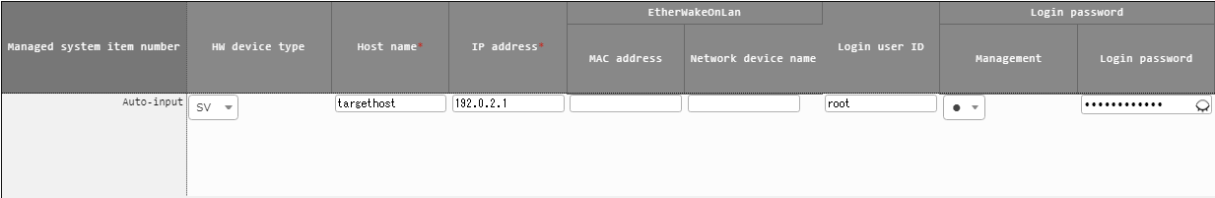
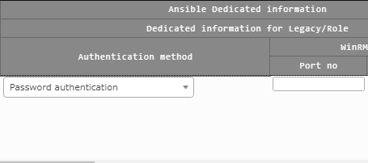
1.1 Register target host
Register the target host connection information
Go to “Device list” and start the registration
Menu：Basic console ＞ Device list
Press “Register” -> “Start registration.
Input the following information and press the “Register” button.
HW device type | Host name (Free space) | IP address (Depends on your environment) | Login user ID (Depends on your environment) | Login password |  | Ansible dedicated information
 |  |  |  | Management | Login password (Depends on your environment) | Dedicated information for Legacy/Role
 |  |  |  |  |  | Authentication method
SV | targethost | 192.0.2.1 | root | ● | ******** | Password authentication

Slide 11
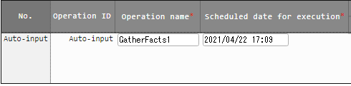
1.2 Register operation
Register the operation we will use in Scenario 1.
In ITA, we call automated operation units for “Operations”.
Hereinafter, we will link all the necessary data to this operation.
Menu：Basic Console ＞ Operation list
Press “Register” -> “Start registration.
Input the following information and press the “Register” button.
Operation name (Free space) | Scheduled date for execution (Free space)
GatherFacts1 | 2021/04/22 17:09
This item indicates the planned date and time for the operation. It is not a timer and will therefore not automatically run the operation after the specified time has passed.
You can name the operation to whatever you want.

Slide 12
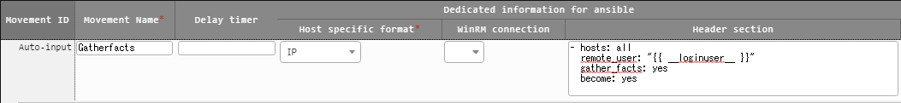
1.3 Register movement
Register Movement in Ansible-Legacy
In ITA, the smallest automatic operation unit (A.K.A a “job”) is called a “Movement”.
After this, we will link a Playbook to it, making it a Movement that collects OS Information.
Menu：Ansible-Legacy ＞ Movement list
Press “Register” -> “Start registration.
Input the following information and press the “Register” button.
Movement name (Free space) | Ansible user information
 | Host specific format | Header section
GatherFacts | IP | - hosts: all remote_user: "{{ __loginuser__ }}" gather_facts: yes become: yes
This activates “gather_facts”.
※ For more information, see chapter『1.3.1 Header section and gather_facts』

Slide 13
1.3.1 Header section and gather_facts
Activate gather_facts The Ansible’s Playbook Header section’s “gather_facts” is deactivated by default when installing ITA.
In this scenario, we will use “gather_facts” to collect the OS information, so we will need to input the following under the header section and activate it.
If you don’t need to change the default value, you can leave the header section blank.
Set gather_facts to “yes”
Default
- hosts: all
remote_user: "{{ __loginuser__ }}"
gather_facts: no
become: yes
- hosts: all
remote_user: "{{ __loginuser__ }}"
gather_facts: yes
become: yes
Input all the necessary lines to the header section and change this value.

Slide 14
1.4 Register Playbook (1/3)
Register Playbook for operations (1/2)
The playbook that we will register in this guide contains a workflow which consists of "Generate YAML file containing gathered OS information under the Target host's /tmp/ directory" → Copy the generated YAML file to the ITA host server's collection directory".
For more information regarding the YAML file and the Collect directory, please see Chapter 1.4.1 Directory for YAML files and collection.

Slide 15
1.4 Register Playbook (2/3)
Register Playbook for operations (1/2)
- name: make yaml file
blockinfile:
create: yes
mode: 0644
insertbefore: EOF
marker: ""
dest: "/tmp/gatherfacts.yml"
content: |
ansible_architecture : {{ ansible_architecture }}
ansible_bios_version : {{ ansible_bios_version }}
ansible_default_ipv4__address : {{ ansible_default_ipv4.address }}
ansible_default_ipv4__interface : {{ ansible_default_ipv4.interface }}
ansible_default_ipv4__network : {{ ansible_default_ipv4.network }}
ansible_distribution : {{ ansible_distribution }}
ansible_distribution_file_path : {{ ansible_distribution_file_path }}
ansible_distribution_file_variety : {{ ansible_distribution_file_variety }}
ansible_distribution_major_version: {{ ansible_distribution_major_version }}
ansible_distribution_release : {{ ansible_distribution_release }}
ansible_distribution_version : {{ ansible_distribution_version }}
ansible_machine : {{ ansible_machine }}
ansible_memtotal_mb : {{ ansible_memtotal_mb }}
ansible_nodename : {{ ansible_nodename }}
ansible_os_family : {{ ansible_os_family }}
ansible_pkg_mgr : {{ ansible_pkg_mgr }}
ansible_processor_cores : {{ ansible_processor_cores }}
- name: copy the make yaml file to local
fetch:
src: "/tmp/gatherfacts.yml"
dest: "{{ __parameter_dir__ }}/{{ inventory_hostname }}/"
flat: yes
File name：GatherFacts.yml

Slide 16
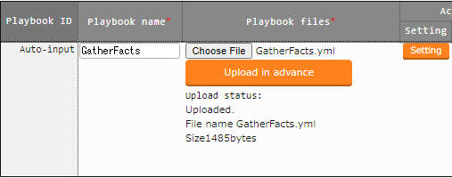
1.4 Register Playbook (3/3)
Register Playbook in Ansible-Legacy
Register the playbook we created in the last slide.
Menu: Ansible-Legacy ＞ Playbook file collection
Press “Register” -> “Start registration.
Input the following information and press the “Register” button.
Make sure to press the “Register” button after you have pressed “Upload in advance”.
Playbook file name (Free space) | Playbook file
GatherFacts | GatherFacts.yml

Slide 17
1.4.1 Directory for YAML files and collection (1/2)
Create directory for YAML files and collecting files.
Since Collect result files in ITA is specified in a YAML file format, we need to create a YAML file.
The generated YAML file will be stored in the Collection directory specified by the ITA reserved variables.
dest: "{{ __parameter_dir__ }}/{{ inventory_hostname }}/"
GatherFacts.yml Line 7
This directory will be specified
Path variables
 | ITA reserved variable | Variable specified contents
Source file storage location | __parameter_dir__ | “_parameters” path under the operation result directory
Collected file storage location | __parameters_file_dir__ | “_parameters_file” path under the operation result directory

Slide 18
1.4.2 Directory for YAML files and collection (2/2)
The following figure displays the file hierarchy for the Collect file directory.
File hierarchy
Directory for Collect result files
Upper directory
_parameters
Collect result directory (Fixed name)
localhost
Host name (Hosts registered in the “Device list”)
SAMPLE.yml
Collect result file
_parameters_file
Directory for Collect result file uploads ( Fixed name )
localhost
Host name ( Hosts registered in the “Device list” )
test.txt
Files for File upload
YAML file with the gathered OS Information

Slide 19
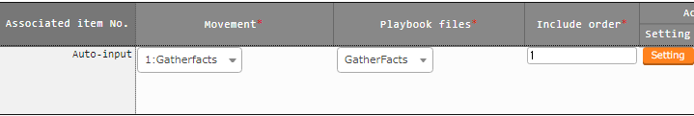
1.5 Movement-Playbook link
Link Movement and Playbook Link the previously registered Movement and Playbook.
Menu: Ansible-Legacy ＞ Movement-Playbook link
Press “Register” -> “Start registration.
Input the following information and press the “Register” button.
Movement | Playbook file | Include order
GatherFacts | GatherFacts | 1
The “Include order” specified the order in which the Playbook will be executed if there are multiple Playbooks linked to the Movement.
In this scenario, we will only link 1 Playbook.

Slide 20
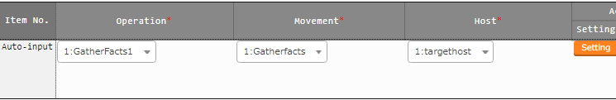
1.6 Register target host
Link Operation, Movement and the Target host.
Link the previously registered Operation, Movement and Target host.
Menu: Ansible-Legacy ＞ Target host
Press “Register” -> “Start registration.
Input the following information and press the “Register” button.
Operation | Movement | Host
GatherFacts1 | GatherFacts | targethost

Slide 21
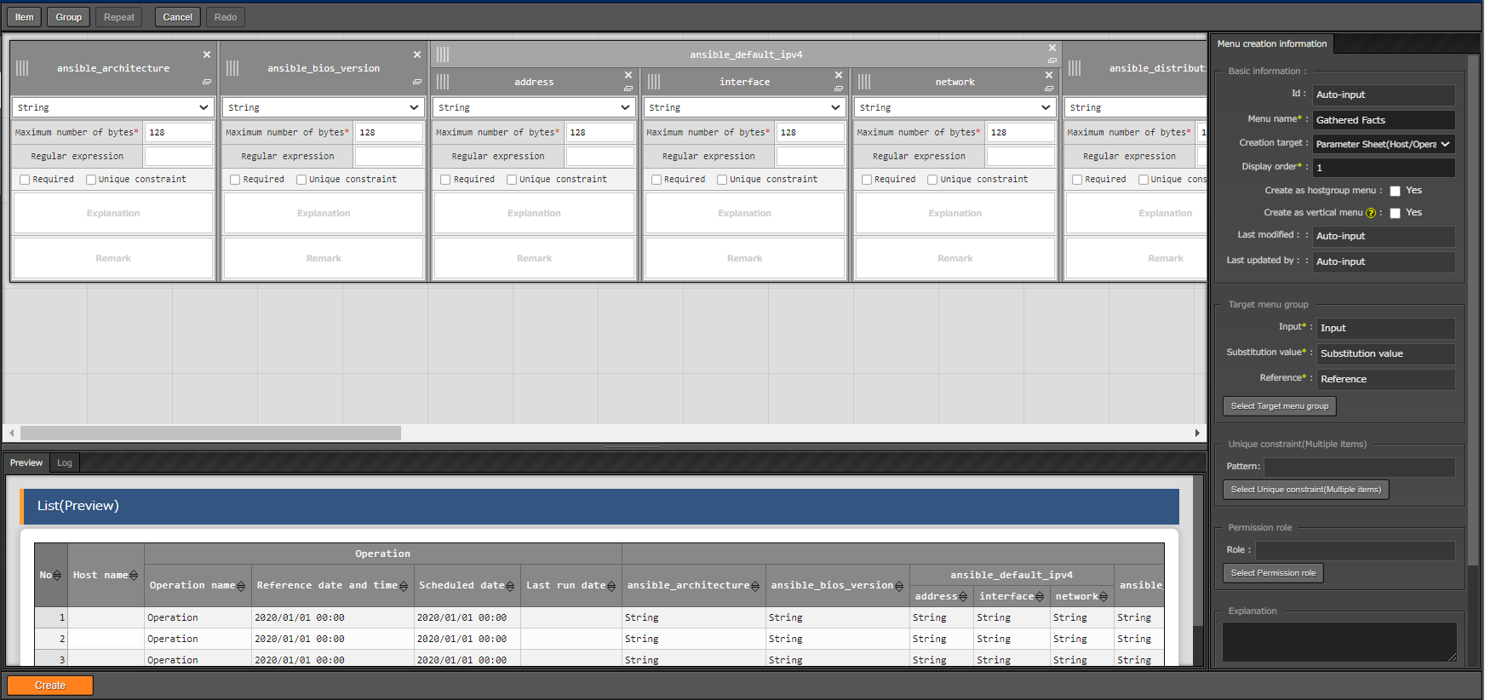
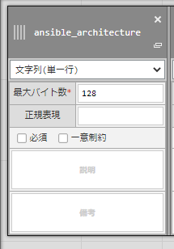
1.7 Create Parameter sheet for registering collected values (1/4)
Create Parameter sheet that registers collected values.
Create a Menu called “Gathered Facts”. This will be a parameter sheet where the collected values will be automatically registered to.
Menu: Create Menu ＞Create/Define menu
Use the table on the next page and fill out the following fields/items.
Press the “Create” button.
1.Basic info
Fill out the following for each item
Item name
Input method
3.Items
Maximum number of bytes
2.Target Menu group

Slide 22
1.7 Create Parameter sheet for registering collected values (2/4)
1.Basic information
Menu name (Free field) | Creation target | Display order
Gathered Facts | Parameter Sheet (Host/Operation) | 1
2.Target Menu group
Input | Substitution value | Reference
Input (Default) | Substitution value (Default) | Reference (Default)
3.Item
Item name (Free field) | Input method | Maximum number of bytes (Free value)
ansible_architecture | String | 128
ansible_bios_version | String | 128
ansible_default_ipv4 ＞ address (※) | String | 128
ansible_default_ipv4 ＞ interface (※) | String | 128
ansible_default_ipv4 ＞ network (※) | String | 128
ansible_distribution | String | 128
ansible_distribution_file_path | String | 128
ansible_distribution_file_variety | String | 128
ansible_distribution_major_version | String | 128
ansible_distribution_release | String | 128

Slide 23
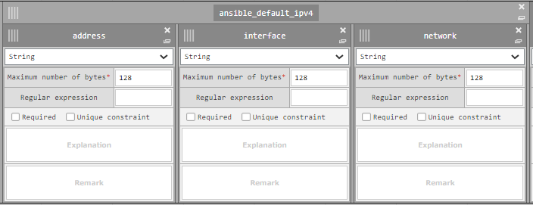
1.7 Create Parameter sheet for registering collected values (3/4)
Item name (Free field) | Input method | Maximum number of bytes (Free value)
ansible_distribution_version | String | 128
ansible_machine | String | 128
ansible_memtotal_mb | String | 128
ansible_nodename | String | 128
ansible_os_family | String | 128
ansible_pkg_mgr | String | 128
ansible_processor_cores | String | 128
※ Change the following item names and group them together
ansible_default_ipv4 ＞ address
ansible_default_ipv4 ＞ interface
ansible_default_ipv4 ＞ network
Create a column group called “ansible_default_ipv4 “ and put the following columns in it.［address］
,［interface］and［network］

Slide 24
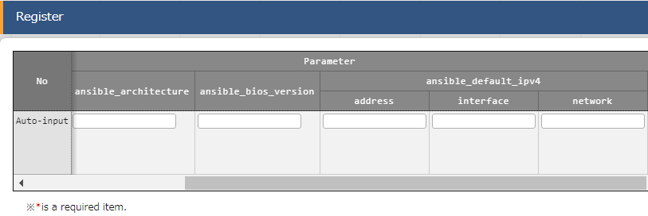
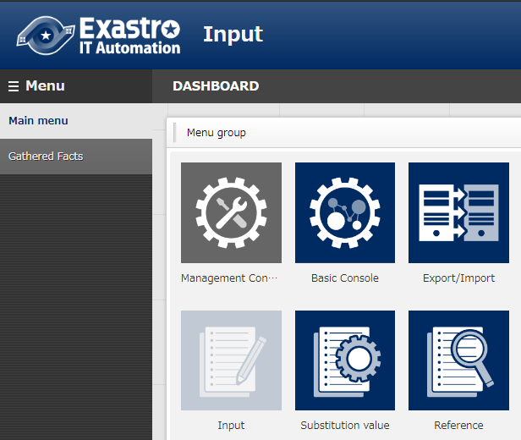
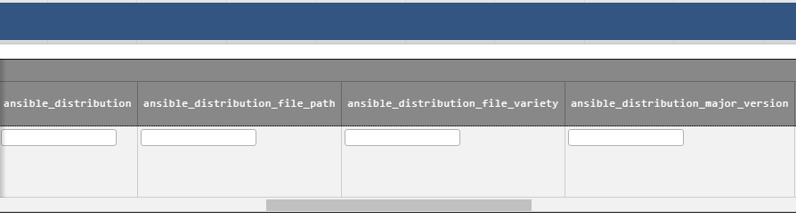
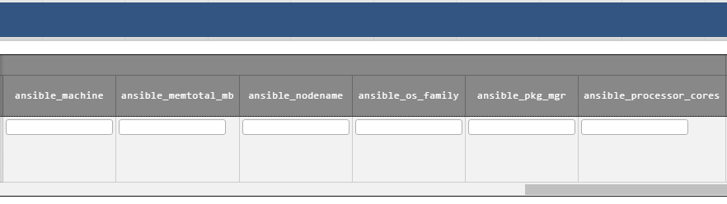
1.7 Create Parameter sheet for registering collected values (4/4)
Created menu
You can check all the different items by pressing the “Register” button.
The menu［Gathered Facts］has been created

Slide 25
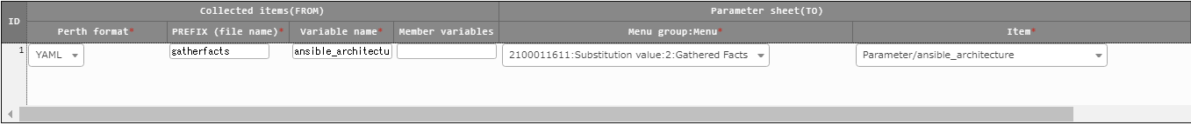
1.8 Register Collected item value list (1/3)
Register Collected item value list
Link the collect item’s (FROM) YAML file name, variable name and the Parameter sheet’s (TO) menu name and Item name.
Use the table on the next page and register each variable and item as a single set.
Menu: Ansible common ＞Collected item value list
Press “Register” -> “Start registration.
Input the following information and press the “Register” button.
Collected item (FROM)
Parameter sheet (TO)

Slide 26
1.8 Register Collected item value list (2/3)
Collected Item (FROM) |  |  | Parameter sheet (TO)
Perth format | PREFIX (File name) | Variable name | Menu group :Menu | Item
YAML | gatherfacts | ansible_architecture | Substitution value: Gathered Facts | Parameter/ ansible_architecture
YAML | gatherfacts | ansible_bios_version | Substitution value: Gathered Facts | Parameter/ ansible_bios_version
YAML | gatherfacts | ansible_default_ipv4__address | Substitution value: Gathered Facts | Parameter/ ansible_default_ipv4/address
YAML | gatherfacts | ansible_default_ipv4__interface | Substitution value: Gathered Facts | Parameter/ ansible_default_ipv4/interface
YAML | gatherfacts | ansible_default_ipv4__network | Substitution value: Gathered Facts | Parameter/ ansible_default_ipv4/network
YAML | gatherfacts | ansible_distribution | Substitution value: Gathered Facts | Parameter/ ansible_distribution
YAML | gatherfacts | ansible_distribution_file_path | Substitution value: Gathered Facts | Parameter/ ansible_distribution_file_path
YAML | gatherfacts | ansible_distribution_file_variety | Substitution value: Gathered Facts | Parameter/ ansible_distribution_file_variety
YAML | gatherfacts | ansible_distribution_major_version | Substitution value: Gathered Facts | Parameter/ ansible_distribution_major_version
YAML | gatherfacts | ansible_distribution_release | Substitution value: Gathered Facts | Parameter/ ansible_distribution_release

Slide 27
1.8 Register Collected item value list (3/3)
Collected item (FROM) |  |  | Parameter sheet (TO)
Perth format | PREFIX (file name) | Variable name | Menu group: Menu | Item
YAML | gatherfacts | ansible_distribution_version | Substitution value: Gathered Facts | Parameter/ Ansible_distribution_version
YAML | gatherfacts | ansible_machine | Substitution value: Gathered Facts | Parameter/ ansible_machine
YAML | gatherfacts | ansible_memtotal_mb | Substitution value: Gathered Facts | Parameter/ ansible_memtotal_mb
YAML | gatherfacts | ansible_nodename | Substitution value: Gathered Facts | Parameter/ ansible_nodename
YAML | gatherfacts | ansible_os_family | Substitution value: Gathered Facts | Parameter/ ansible_os_family
YAML | gatherfacts | ansible_pkg_mgr | Substitution value: Gathered Facts | Parameter/ ansible_pkg_mgr
YAML | gatherfacts | ansible_processor_cores | Substitution value: Gathered Facts | Parameter/ ansible_processor_cores

Slide 28
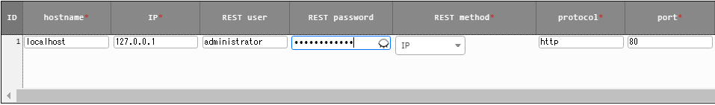
1.9 Register Collect interface information
Register Collect interface information
As REST API access is required when registering the collected values to parameter sheets in ITA, we will need to register a REST user that has execution permission.
Menu: Ansible common ＞ Collection interface information
Press the “Filter” button.
Only 1 line will be displayed in the “List”, so press the “update” button, fill in the information below and press the “register” button.
REST user | REST password
User with execute permission | The password of the user

Slide 29
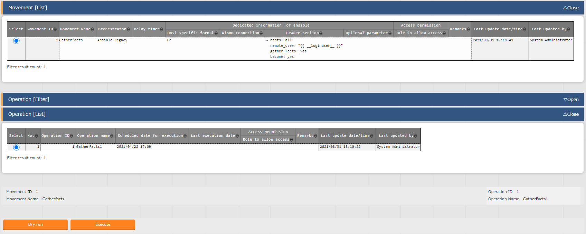
1.10 Run operation (1/2)
Run the operation
Select Movement and Operation and execute them.
Menu: Ansible-Legacy ＞ Execution
Select the Movement we registered from Movement[list]
Select the Operation we registered from Operation[list]
Press the “Execute” button
Movement[list] | Operation[list]
GatherFacts | GatherFacts1

Slide 30
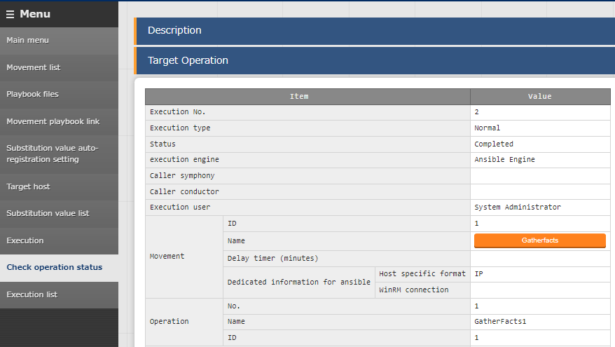
1.10 Run operation (2/2)
Confirm the operation status
The operation ended successfully if the Status in the “Check operation status” menu says “Completed”
Menu: Ansible-Legacy ＞ Check operation status

Slide 31
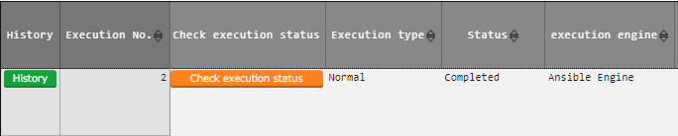
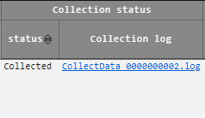
1.11 Confirm the collection results (1/2)
Confirm the collection results
Check if the collection succeeded/failed.
Menu: Ansible-Legacy ＞ Execution list
Press the “Filter” button.
List ＞ Collect status ＞ “Status“ can display the following:
Collected ：The data has been collected
Collected (with notification) ：Something went wrong when updating/registering
Not target ：Failed to collect
Collection error ：There is an error in the registered operation or the target host

Slide 32
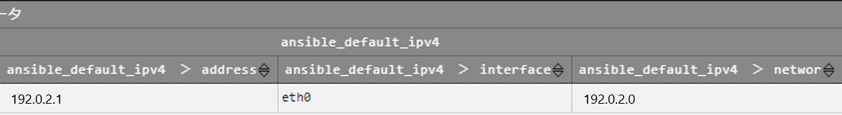
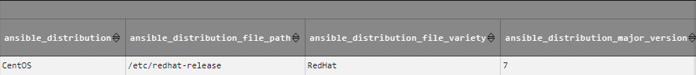
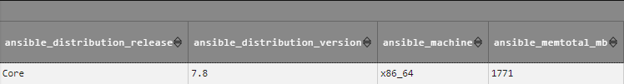
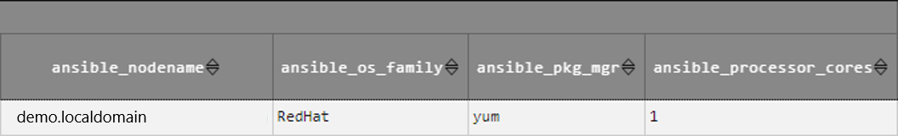
1.11 Confirm the collection results (2/2)
Confirm the parameters
Check that the values has been registered to the parameter sheet.
Menu: Input (or reference) ＞ Gathered Facts
Press the “Filter” button.
Check the list if all the items has values in them.

Slide 33
2. Scenario ２【Compare function】 Compare the values and the expected values of the one collected in Scenario 1.

Slide 34

Scenario 2 Overall diagram
Scenario２workflow
Register expected values to ITA and compare them to the values collected in Scenario 1.
Overall diagram
2.4
RHEL 7 or 8
2.1
Compare list
Operation
Compare details
Ref.
2.2
Compare execution
2.5
Parameter sheet (Expected values)
Host name | Operation | Parameter
 |  | Item1 | Item2 | Item3
●●● | ●●● | ●●● | ●●● | ●●●
2.3
Define comparison items
Parameter sheet (Values from Scenario 1)
Host name | Operation | Parameter
 |  | Item1 | Item2 | Item3
●●● | ●●● | ●●● | ●●● | ●●●
Define comparison menus

Slide 35
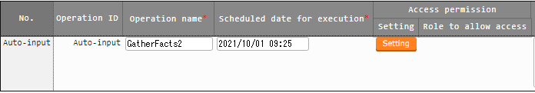
2.1 Register Operation
Register Operation
Register an operation that will compare the values.
Menu: Basic Console ＞ Operation list
Press “Register” -> “Start registration.
Input the following information and press the “Register” button.
Operation name (Free space) | Scheduled date for execution (Free space)
GatherFacts2 | 2021/10/01 09:25

Slide 36
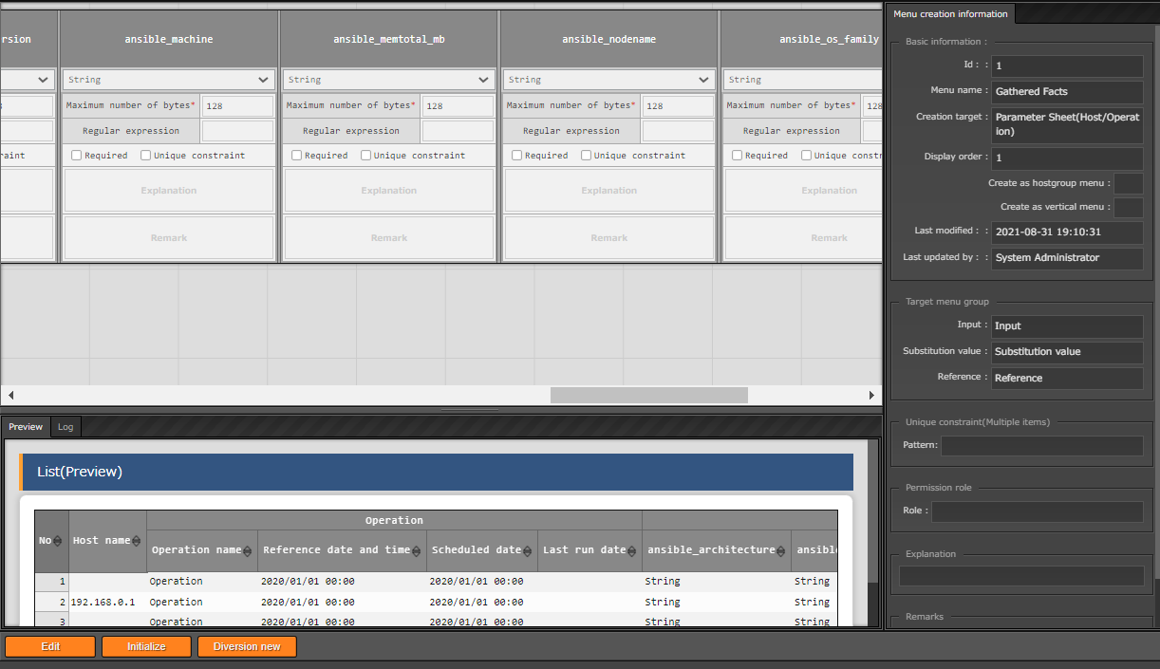
2.2 Create parameter sheet for expected values (1/3)
Create a parameter sheet for registering expected values.
Duplicate the parameter sheet we created in Scenario 1 and change the include order and menu name
Menu: Create menu ＞Menu definition information
Press the “Filter” button and look for the “Gathered Facts” menu under “list”. After that, press the “Menu definition / creation” button.
After the Menu definition screen appears, press the ［Diversion new］button.
Only the “Menu name” and “Display” order will not be duplicated, so use table in the next slide to fill in the items.
Press the “Create” button.
①
②

Slide 37
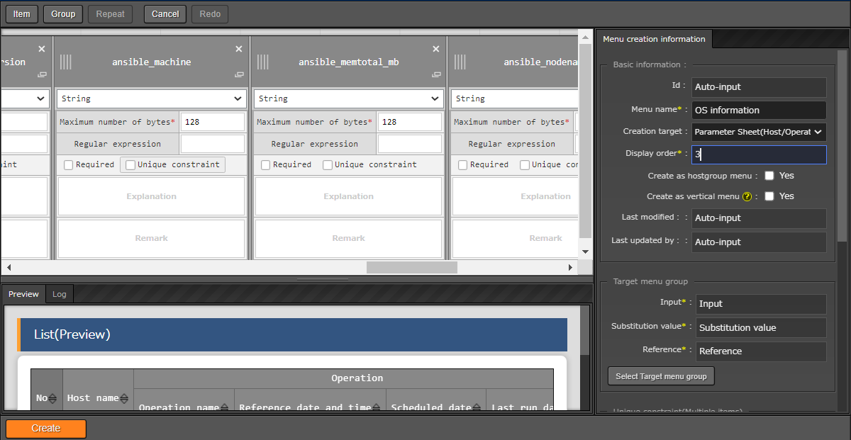
2.2 Create parameter sheet for expected values (2/3)
③
④
Menu name (Free space) | Display order
OS information | 3
The display order can be any number.

Slide 38
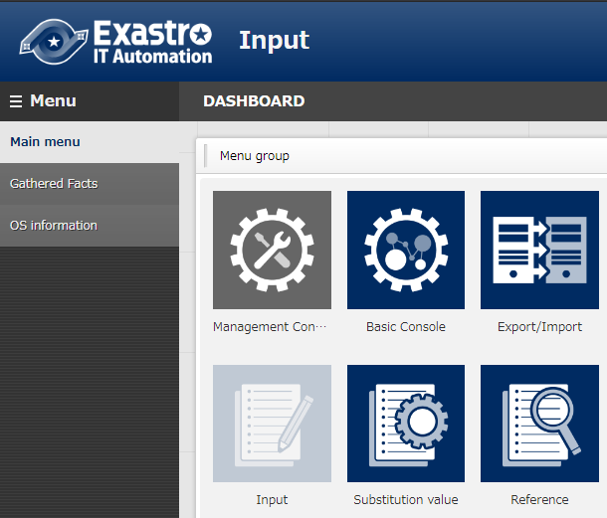
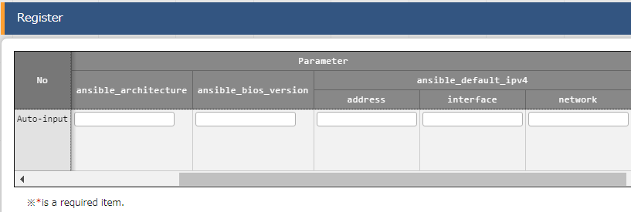
2.2 Create parameter sheet for expected values (3/3)
Created menu
You can press “Start registration” to check if all the items are there.
The “OS Information” menu has been created.

Slide 39
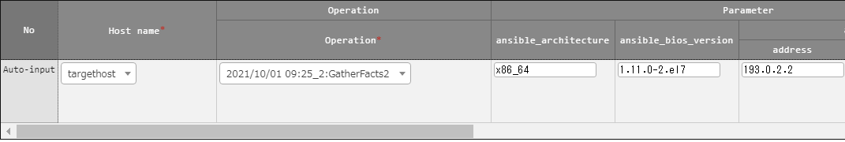
2.3 Register expected values
Register expected values
We will now register the expected values to the “OS information” menu we created. We want to make it so the values are different from the ones we collected in Scenario 1, so change the values in “ansible_default_ipv4__address” to something different.
Menu: Input ＞ OS information
Press “Register” -> “Start registration.
Input the following information and press the “Register” button.
The other items are shortened
Host name | Operation | Parameter/Item name
 |  | ansible_default_ ipv4__address | Other items
targethost | GatherFacts2 | Input a value different from the one collected in Scenario 1 | Input the same values collected in scenario 1.

Slide 40
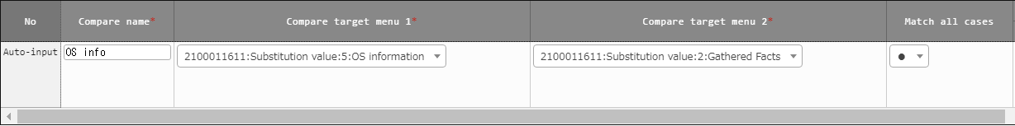
2.4 Register a Comparison
Select the two menus you want to compare
We will now define the comparison that will compare the values.
Menu: Compare ＞ Compare list
Press “Register” -> “Start registration.
Input the following information and press the “Register” button.
Comparison definition name (Free field) | Compare target menu 1 | Compare target menu 2 | Match all cases
OS info | Substitution value:8:OS information | Substitution value:Gathered Facts | ●
Here, we will compare all of the items, so select “●“
※ If you only want to compare select items, please see『【reference】 Comparison details』.

Slide 41
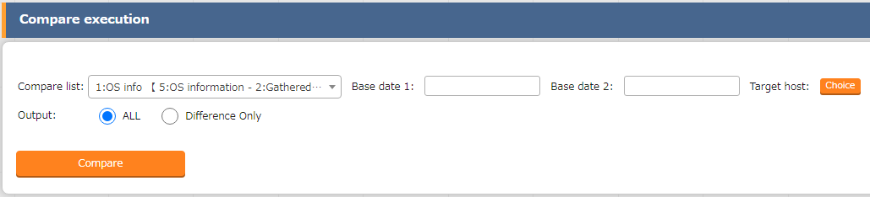
2.5 Run comparison (1/2)
Run the previously defined Comparison
We will now compare the values.
Menu: Compare ＞ Compare execution
Input/Select the following and press the “Compare” button.
The comparison results will be displayed
Comparison definition | Standard date １ | Standard date２ | Output
OS information-Gathered Facts | Blank | Blank | ALL
If you only want the comparison to output the items with differences, select “Difference Only”

Slide 42
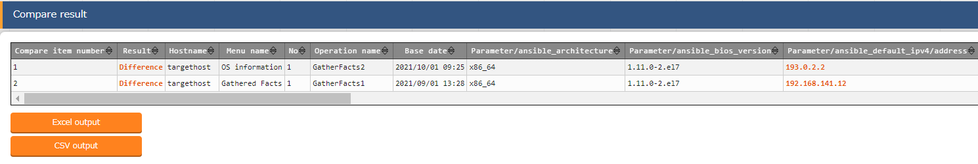
2.5 Run comparison (2/2)
Comparison results
If the records contains an item with a difference, the “result” column will display “Difference”.
The address, which has different values, will be displayed in red.

Slide 43

【Reference】 Compare details
Compare single parameter sheet items.
You can use the “Compare details” menu if you want to compare single items in a certain parameter sheet.
Diagram
RHEL 7or8
Compare list
Operation
Compare details
Compare execution
Parameter sheet (Expected values)
Host name | Operation | Parameter
 |  | Item1 | Item2 | Item3
●●● | ●●● | ●●● | ●●● | ●●●
Define the items you want to compare.
Parameter sheet (Values from scenario 1)
Host name | Operation | Parameter
 |  | Item1 | Item2 | Item3
●●● | ●●● | ●●● | ●●● | ●●●

Slide 44
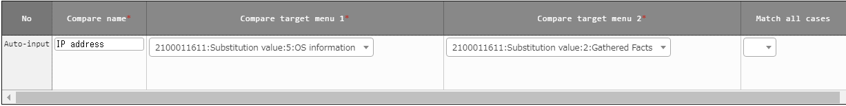
【Reference】 (1) Register Comparison details
Select the 2 menus you want to compare
Select the menus you want to compare. Since we are only comparing select items, make sure that Match all cases is set to “OFF”.
Menu: Compare＞ Compare list
Press “Register” -> “Start registration.
Input the following information and press the “Register” button.
Compare name (Free) | Compare target menu 1 | Compare target menu 2 | Match all cases
IP address | Substitution value:8:OS information | Substitution value:Gathered Facts | -
Make sure that this item is blank.

Slide 45
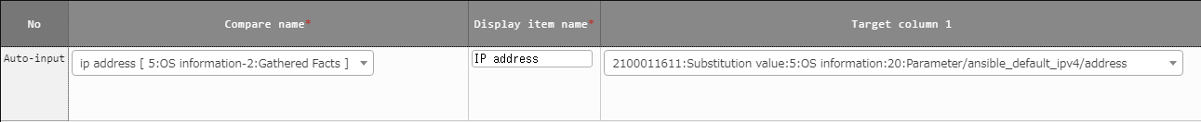
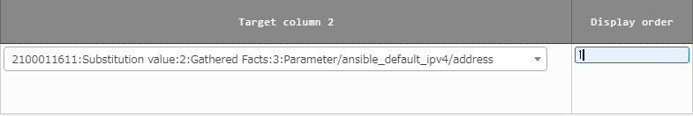
【Reference】 (2) Register Compare details
Select the items you want to compare
Select the items you want to compare from the menus in the Compare details menu.
Menu: Compare ＞ Compare details
Press “Register” -> “Start registration.
Input the following information and press the “Register” button.
Comparison definition name | Display item name | Target column 1 | Target column 2 | Display order
IP address [ Gathered Facts-OS information ] | IP address | Substitution value: OS information:Parameter/ ansible_default_ipv4/address | Substitution value: Gathered Facts:Parameter/ ansible_default_ipv4/address | 1

Slide 46

【Reference】 (3) Run comparison (1/2)
Run the comparison
Now that you’ve configured the Comparison definition details, we can now run the comparison.
Menu: Compare ＞ Run Comparison
Input/Select the following and press the “Compare” button.
The comparison results will be displayed
Comparison definition | Base date１ | Base date２ | Output
IP Address【OS information-Gathered Facts】 | Blank | blank | ALL

Slide 47
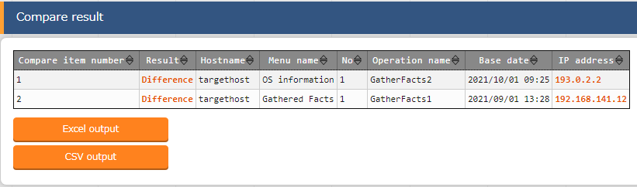
【Reference】 (3) Run Comparison (2/2)
Comparison results
Only the specified item will be displayed.

Slide 48
3. Scenario３【Collect function】 Collect the target host’s SSL certificate file

Slide 49
Scenario３Overall diagram
Scenario３workflow
While the contents are more or less the same as Scenario 1, in this scenario, we will collect a file.
The file collected from the Parameter sheet will be downloadable.
Overall Diagram
3.5
3.4
RHEL 7or8
system
3.1
3.3
Ansible-driver
Ansible
3.2
Playbook
Device List
Run Operation
Movement
Operation
Var 1
3.7
3.11
Parametersheet (For registering file name)
Host name | Operation | Parameter
 |  | File name
●●● | ●●● | ●●●
3.6
3.9
test.crt
YAML
Parametersheet (For collecting values)
Host name | Operation | Parameter
 |  | File name | File
●●● | ●●● | ●●●
3.8
Rest
API
Var 1
Var 2
test.crt
3.12
3.10

Slide 50
3.1 Register Target host
Register target host connection information
You can skip this step if you are using the same host you used in Scenario 1.
Menu: Basic Console＞ Device List
Press “Register” -> “Start registration.
Input the following information and press the “Register” button.
HW device type | Host name (Free space) | IP address (Depends on your environment) | Login user ID (Depends on your environment) | Login password |  | Ansible dedicated information
 |  |  |  | Management | Login password (Depends on your environment) | Dedicated information for Legacy/Role
 |  |  |  |  |  | Authentication method
SV | targethost | 192.0.2.1 | root | ● | ******** | Password Authentication

Slide 51
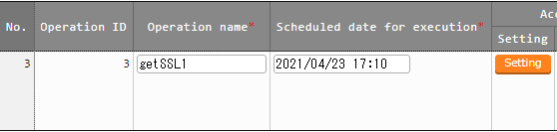
3.2 Register operation
Register operation
Register the operation we will use in this scenario.
Menu: Basic Console＞ Operation list
Press “Register” -> “Start registration.
Input the following information and press the “Register” button.
Operation name (Free space) | Scheduled date for execution (Free space)
getSSL1 | 2021/04/23 17:10

Slide 52
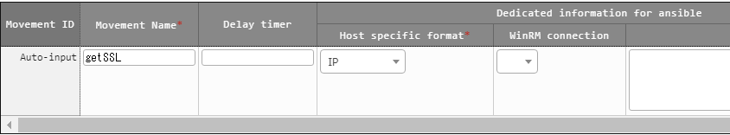
3.3 Register Movement
Register Movement in Ansible-Legacy
After this, we will link a Playbook to it, making it Movement that collects the SSL certificate.
Menu: Ansible-Legacy ＞ Movement List
Press “Register” -> “Start registration.
Input the following information and press the “Register” button.
Movement name (Free space) | Ansible User information
 | Host specific format
getSSL | IP

Slide 53
3.4 Register Playbook (1/3)
Register Playbook for operations (1/2)
The playbook that we will register in this guide contains a workflow which consists of "Generate YAML file which will gather the SSL certificate under the Target host's /tmp/ directory" → Copy the SSL certificate to the ITA host server's collection directory".
For more information regarding the File collection directory, please see chapter 3.4.1 File collection directory
Make sure to create and put the SSL certificate file (test.crt) under the target host’s /etc/pki/tls/certs/ path in advance.

Slide 54
3.4 Register Playbook (2/3)
Register Playbook for operations (2/2)
- name: make yaml file
blockinfile:
create: yes
mode: 0644
insertbefore: EOF
marker: ""
dest: " /tmp/getSSL.yml"
content: |
SSL_file_name : {{ VAR_ssl_name }}
SSL_file : {{ VAR_ssl_name }}
- name: copy the make yaml file to local
fetch:
src: "/tmp/getSSL.yml"
dest: "{{__parameter_dir__ }}/{{ inventory_hostname }}/"
flat: yes
- name: get SSL file
fetch:
src: "/etc/pki/tls/certs/{{ VAR_ssl_name }} "
dest: "{{ __parameters_file_dir__ }}/{{ inventory_hostname }}/"
flat: yes
File name：getSSL.yml

Slide 55
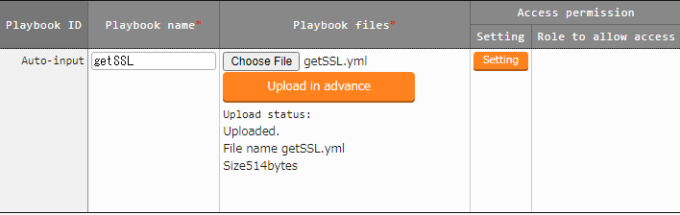
3.4 Register Playbook (3/3)
Register Playbook in Ansible-Legacy
Register the Playbook we created in the last slide.
Menu: Ansible-Legacy ＞ Playbook file
Press “Register” -> “Start registration.
Input the following information and press the “Register” button.
Playbook file name (Free space) | Playbook file
getSSL | getSSL.yml

Slide 56
3.4.1 File collection directory (1/2)
The collected files will be stored in a file collection directory.
The collected file will be stored in the File Collection directory specified by the ITA reserved variables.
dest: "{{ __parameters_file_dir__ }}/{{ inventory_hostname }}/"
getSSL.yml
2 lines from the bottom
This Directory will be specified
Path variables
 | ITA reserved variable | Variable specified contents
Source file storage location | __parameter_dir__ | “_parameters” path under the operation result directory
Collected file storage location | __parameters_file_dir__ | “_parameters_file” path under the operation result directory

Slide 57
3.4.1 File collection directory (2/2)
The following figure displays the file hierarchy for the Collect file directory.
File hierarchy
Upper directory
_parameters
Collect result directory (Fixed name)
localhost
Host name (Hosts registered in the “Device list”)
SAMPLE.yml
Collect result file
_parameters_file
Directory for Collect result file uploads ( Fixed name )
localhost
Host name ( Hosts registered in the “Device list” )
Director where the result file will be stored.
test.txt
Files for File upload
Collected file

Slide 58
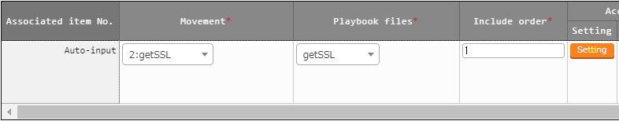
3.5 Movement-Playbook link
Link Movement and Playbook
Link the previously registered Movement and Playbook.
Menu: Ansible-Legacy ＞ Movement-Playbook link
Press “Register” -> “Start registration.
Input the following information and press the “Register” button.
Movement | Playbook file | Include order
getSSL | getSSL | 1

Slide 59
3.6 Register File name (1/3)
Create menu for variable registration
Create a Parameter sheet that we can use to register the File name (test.crt)
Menu: Create Menu＞ Create/Define menu
Use the table below to fill out the following items.
Press the “Create” button
1.Basic Information
Menu name (Free space) | Creation target | Display order
SSL certificate name | Parameter sheet (Host/Operation) | 4
2.Target Menu group
Input | Substitution value | Reference
Input (Default) | Substitution value (Default) | Reference (Default)
3.Item
Item name (Free space) | Input method | Maximum number of bytes (Free value)
File name | String | 128

Slide 60
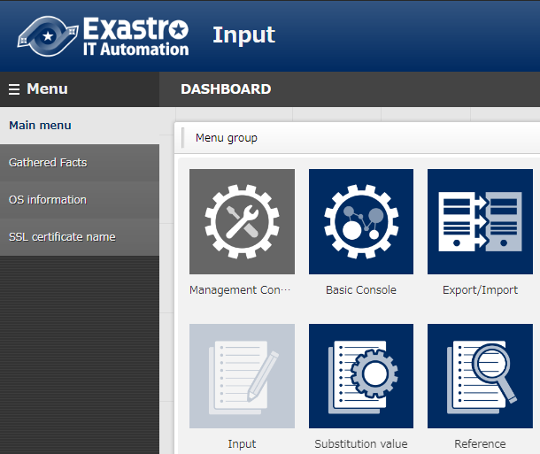
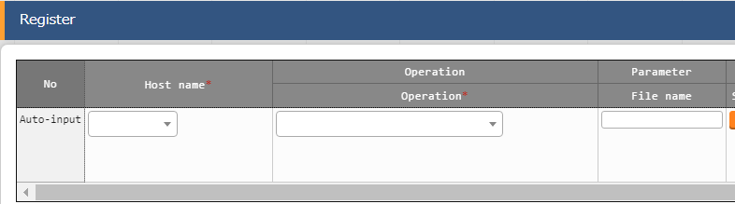
3.6 Register File name (2/3)
Created menu
The menu［SSL certificate name］has been created
You can check all the different items by pressing the “Register” button.

Slide 61
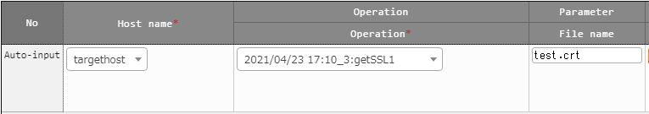
3.6 Register File name (3/3)
Register File name
Register the file name (test.crt) to the parameter sheet you created.
Menu: Input ＞ SSL certificate name
Press “Register” -> “Start registration.
Input the following information and press the “Register” button.
Host name | Operation | Parameter
 |  | File name
targethost | getSSL1 | test.crt

Slide 62
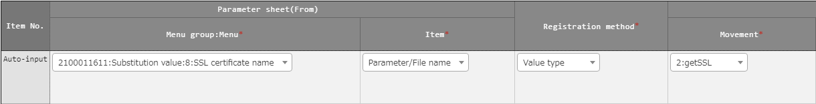
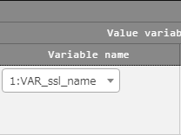
3.7 Register substitution value auto-registration settings
Register Substitute value auto-registration settings
Link the name of the file we will collect (Specific values) with the variables inside the Playbook.name (［File name： test.crt］［Variable name：VAR_ssl_name］)
By registering the file name to a different parameter sheet (already done in chapter 3.6 Register file name) and linking the playbook variable to the parameter sheet's item name in the substitution value auto-registration setting menu, the system can automatically set the variable's specific values.
Menu: Ansible-Legacy ＞ Substitution value auto-registration setting
Press “Register” -> “Start registration.
Input the following information and press the “Register” button.
Parameter sheet (From) |  | Registration method | IaC variable (To)
Menu group：Menu | Item |  | Movement | Value variable
 |  |  |  | Variable name
Substitution value： SSL certificate name | Parameter/File name | Value-type | getSSL | VAR_ssl_name

Slide 63
3.8 Create Parameter sheet for collect values (1/3)
Create a Parameter sheet that registers collected values.
Create a menu called “SSL certificate”
Inside the menu, create 2 items and name them “File name” and “File”. The “File” item will later allow us to download the collected file.
Menu: Create menu ＞ Create/Define Menu
Use the table below to fill out the following fields.
Press the “Create” button.
1.Basic information
Menu name (Free space) | Creation target | Display order
SSL certificate | Parameter sheet (Host/Operation) | 2
2.Target Menu group
Input | Substitution value | Reference
Input (Default) | Substitution value (Default) | Reference (Default)

Slide 64
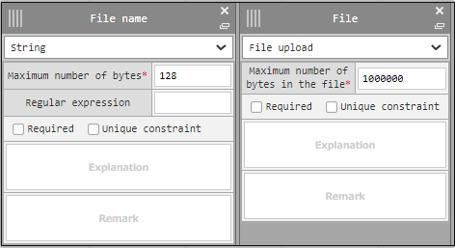
3.8 Create Parameter sheet for collect values (2/3)
3.Items
Item name (Free space) | Input method | Maximum number of bytes (Free value)
File name | String | 128
File | File upload | 1000000
Fill out the following for the items
Item name
Item name
Input method
Input method
Maximum number of bytes
Maximum number of bytes

Slide 65
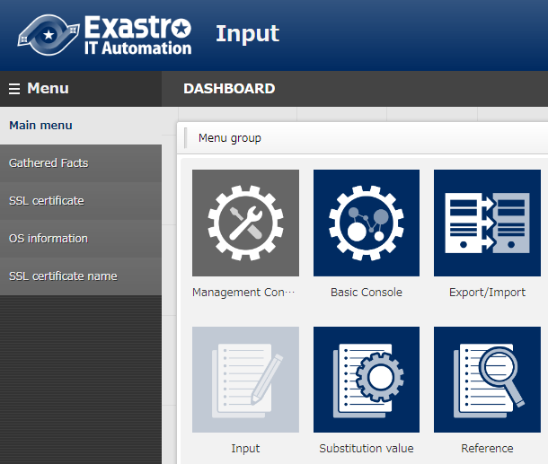
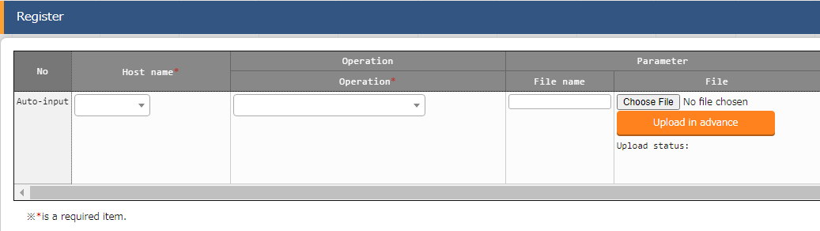
3.8 Create Parameter sheet for collect values (3/3)
Created menu
The menu “SSL certificate” has been created.
You can check all the different items by pressing the “Register” button.

Slide 66

3.9 Register Collected item value list
Register Collected item value list
Configure the parameter sheet so that the collected items will automatically be registered to the parameter sheet.
Link the collect item’s (FROM) YAML file name, variable name and the Parameter sheet’s (TO) menu name and Item name. Do this for both the “File name” and “File” items.
Menu: Ansible common ＞Collected item value list
Press “Register” -> “Start registration.
Input the following information and press the “Register” button.
Collected item (FROM)
Parameter sheet (TO)
Collected item (FROM) |  |  | Parameter sheet (TO)
Parse format | PREFIX (File name) | Variable name | Menu group :Menu | Item
YAML | getSSL | SSL_file_name | Substitution value:SSL certificate | Parameter/File name
YAML | getSSL | SSL_file | Substitution value:SSL certificate | Parameter/File

Slide 67
3.10 Register Collected interface information
Register Collect interface information
As REST API access is required when registering the collected values to parameter sheets in ITA, we will need to register a REST user that has execution permission.
If you are going to use the same Rest user you created in Scenario 1, you can skip this step.
Menu: Ansible common ＞ Collect interface information
Press the “Filter” button
Only 1 line will be displayed in the “list”, so press the “update” button, fill in the information below and press the “register” button
REST user | REST password
User with execute permission | The password of the user

Slide 68

3.11 Run operation (1/2)
Run operation
Select Movement and Operation and execute them.
Menu: Ansible-Legacy ＞ Execution
Select the Movement we registered from Movement[list]
Select the Operation we registered from Operation[list]
Press the “Execute” button
Movement[List] | Operation [List]
getSSL | getSSL1

Slide 69

3.11 Run operation (2/2)
Confirm the operation status
The operation ended successfully if the Status in the “Check operation status” menu says “Completed”
Menu: Ansible-Legacy ＞ Check operation status

Slide 70


3.12 Confirm collection results (1/2)
Confirm the collection results
Check if the collection succeeded/failed.
Menu: Ansible-Legacy ＞ Execution list
Press the “Filter” button.
List ＞ Collect status ＞ “Status“ can display the following:
Collected ：The data has been collected
Collected (with notification) ：Something went wrong when updating/registering
Not target ：Failed to collect
Collection error ：There is an error in the registered operation or the target host

Slide 71
3.12 Confirm collection results (2/2)
Confirm the parameters
Check that the values has been registered to the parameter sheet. You can also download the file.
Menu: Input (or Substitution value) ＞ SSL Certificate
Press the “Filter” button.
Check the list if all the items has values in them.

Slide 72
4. Scenario４【Compare function】 Compare the file downloaded in scenario 3 with the same file from a different date.

Slide 73
Scenario 4 Overall diagram (1/2)
Scenario 4 workflow
Collect a SSL certification file with a different “base date” from the one we collected in Scenario 3 and compare the files.
Overall diagram
RHEL 7or8
system
Ansible-driver
Ansible
4.1
Playbook
Device List
Run operation
Movement
Operation
Var 1
Parameter sheet (For registering file name)
Host name | Operation | Parameter
 |  | File name
●●● | ●●● | ●●●
●●● | ●●● | ●●●
4.4
4.3
test.crt (with differ ence)
YAML
Parameter sheet (For collecting files)
Host name | Operation | Parameter
 |  | File name | File
●●● | ●●● | ●●●
●●● | ●●● | ●●●
4.2
4.5
Rest
API
Var 1
Var 2
test.crt
test.crt

Slide 74
Scenario 4 Overall diagram (2/2)
As we are comparing a file within the same menu, but with different date values, we will change the “Standard date”.
Diagram (Compare function)
4.6
RHEL 7or8
Compare list
Operation
Compare details
Compare execution
4.7
Parameter sheet
Host name | Operation | Base date | Parameter
 |  |  | File name | File
●●● | ●●● | ●●● | ●●●
●●● | ●●● | ●●● | ●●●
Set base date
test.crt
test.crt

Slide 75

4.1 Register operation
Register operation
Register an operation for comparing
Menu: Basic Console＞ Operation list
Press “Register” -> “Start registration.
Input the following information and press the “Register” button.
Operation name (Free space) | Scheduled date for execution (Free space)
getSSL2 | 2021/04/28 12:19

Slide 76
4.2 Prepare SSL certificate with different contents
Prepare an SSL certificate with a difference
In this scenario, we want to check if something is different from the certificate we collected in Scenario 3, so prepare an SSL certificate different to that one.
In order to do so, we will change a part of the contents of the SSL certificate (test.crt) that is in the Target server’s /etc/pki/tls/certs/ directory.test.crt)
System
RHEL 7or8
Ansible-driver
Ansible
Playbook
Device List
Run operation
Movement
Operation
Var 1
Parameter sheet (For registering file name)
Host name | Operation | Parameter
 |  | File name
●●● | ●●● | ●●●
●●● | ●●● | ●●●
test.crt (with differ ence)
YAML
Parameter sheet (For registering values)
Host name | Operation | Parameter
 |  | File name | File
●●● | ●●● | ●●●
●●● | ●●● | ●●●
Rest
API
Var 1
Var 2
test.crt
test.crt

Slide 77

4.3 Register file name
Register file name
Register a new Record in the menu we created in Scenario 3, “SSL certificate name”.
The contents should be the same as the one we created in Scenario 3, but change the operation to the one we created for comparing.
Menu: Input ＞ SSL certificate name
Press “Register” -> “Start registration.
Input the following information and press the “Register” button.
Host name | Operation | Parameter
 |  | File name
targethost | getSSL2 | test.crt

Slide 78

4.4 Run operation
Run operation
Collect the SSL certificate with different contents from the one collected in scenario 3.
Select the same Movement from Scenario 3, “getSSL”. The operation should be the new one we created for comparing, “getSSL2”.
Menu: Ansible-Legacy ＞ Execution
Select the registered Movement from Movement[List]
Select the newly registered operation from Operation[List]
Press the “Execute” button.
Movement[List] | Operation[List]
getSSL | getSSL2

Slide 79

4.5 Confirm comparison results
Confirm Parameter sheet
Check that the “getSSL2” has been collected to the Parameter sheet.
Check the Standard date/time (We will need it in 4.7 Run Comparison)
Menu: Input (or Reference) ＞ SSL certificate
Press the “Filter” button.
Check the updated list that the items has values in them.

Slide 80

4.6 Register Comparison definition
Select the 2 menu you want to compare
As we will compare the same menu, but with different values, choose the same menu for both of the items.
Menu: Compare＞ Compare list
Press “Register” -> “Start registration.
Input the following information and press the “Register” button.
Comparison definition name (Free space) | Compare target menu 1 | Compare target menu 2 | Match all cases
SSL certificate | Substitution value:SSL certificate | Substitution value:SSL certificate | ●

Slide 81

4.7 Run Comparison (1/3)
Run the comparison
Select the “SSL Certificate” Comparison definition and input the standard dates.
The Standard dates should be the most recent for both of them
Please see the next page for more information regarding standard dates.
Menu: Compare ＞ Compare execution
Input the following information and press the “Compare” button.
The Comparison result should be displayed
Comparison definition | Base date １ | Base date２ | Output contents
SSL certificate | 2021/7/28 11:30 | 2021/7/28 12:30 | ALL

Slide 82
4.7 Run comparison (2/3)
The Standard dates are displayed below.
11:25
12:08
getSSL
1
getSSL
2
7/28
11:00
11:30
12:00
12:30
13:00
Base date１
Base date２
getSSL1 is the most recent
getSSL2 is the most recent
Set the base date depending on when the files were collected.

Slide 83

4.7 Run comparison (3/3)
Compare results
Items that are different (different content) are displayed in red text.

