Slide 1


Export/Import 【Practice】
※”Exastro IT Automation” will be shortened to ITA in this document.
Exastro IT Automation Version 1.10
Exastro developer

Slide 2
Table of contents
Introduction
About this document
Scenario ① Menu export/import
Environment
Export/Import procedure
Data registration
Create/Input menu
Environment migration mode Menu export
Environment migration mode Menu import
Time specification mode Menu export
Time specification mode Menu import
3. Scenario ② Excel bulk export/import
Environment
Excel bulk export/import procedure
Excel bulk export
Excel file edit
Excel bulk import

Slide 3
1. Introduction

Slide 4
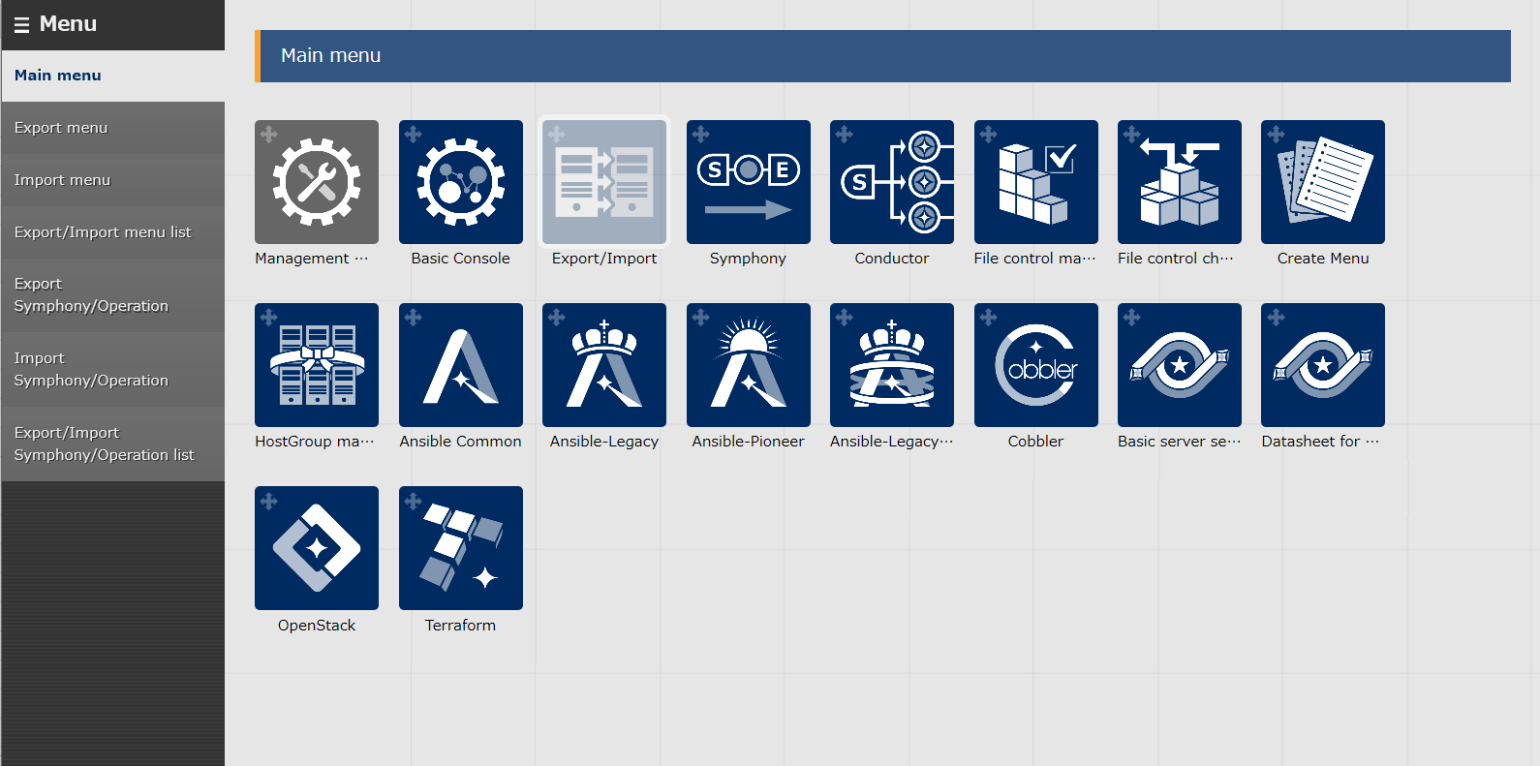
1.1 Ansible driverについて X/X
1.1 About this document
About this document
This document aims to introduce the reader to the Export/Import function by teaching them through a hands-on scenario

Slide 5
2. Scenario ①. Menu export/Menu import

Slide 6

2.1 Environment
Work environment The environment used in this document is as following. The Export/Import function requires 2 systems in order to function (one for export and one for import).
Client machine
・Google Chrome
・Windows10
ITA Server (2) ・CentOS 7 (※1) ・ITA 1.10.0 ・Ansible 2.11.10
Google Chrome
Windows10
CentOS 7
CentOS 7
kym
ITA
1.10.0
ITA
1.10.0
Ansible
2.11.10
Ansible
2.11.10
ITA server(Export)
ITA server(Import)
※1 In this scenario, the host server is running on CentOS7, but ITA can be installed on any RHEL7/RHEL8 type OS.

Slide 7
2.2 Menu export/Menu import procedure(1/2)
Scenario This scenario lets the user use the Menu export function to experience both Environment migration mode and Time specification mode.
① Use the Environment migration function to export the menus specified from the source server and import the data to the destination server, overwriting all data.
② Update/register data in the source server and use the Time specification mode to export/import them to the destination server.
Scenario image
① Environment migration
Source server
Destination server
Both No.1 and No.2 are registered
Create data No.1,No.2
Menu A
Kym file
Menu A
No.1
No.1
No.2
No.2
② Time specification
Destination server
Source server
Specify a time after the No.2 update date.
Update No.1,No.2 in order and register
No.3
No.2 is updated and No.3 registered while No.1 is not updated.
Menu A
Menu A
No.1
Kym file
No.1
No.2
No.2
No.3
No.3

Slide 8
2.2 Menu export/Menu import procedure(2/2)
Scenario
This document’s scenario will proceed as following.
1. Device information
① Register data
2. Operation
3. Create Menu group
② Input/Create menus
4. Create Menu
5. Input data to created menus
6. Start Export procedure
7. Download kym file
③ Environment migration
Export Menu
Import Menu
8. Start Import procedure
9. Check import results
10. Update/Register data
11. Start Export procedure
④ Time specification
Export Menu
Import Menu
12. Download kym file
13. Start Import procedure
14. Check import results

Slide 9
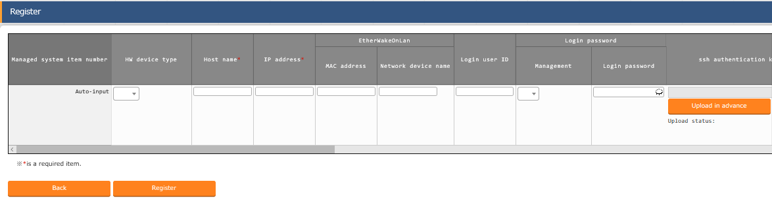
2.2 Data registration (1/2)
Device registration Menu: Basic console> Device list
Click ”Start Registration” under the “Register” sub-menu
Select or input the following information for each item and click “Register”
Data registration
Device info
Operation
Create/Input menu
Environment Migration
Time Specification
2
Item | Input content
HW device type | SV
Host name | (Free value)
IP address | Target device IP Address
Login user ID | (Free value)
Management | ●
Login password | (Free value)
Authentication method | Password authentication

Slide 10
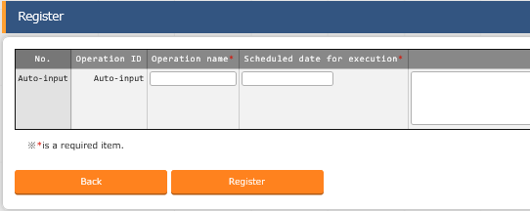
2.2 Data registration (2/2)
Register a new operation Menu: Basic console> Operation list
Click “Start Registration” under the “Register” sub-menu.
Input the following information for each item and click “Register”
Data registration
Device info
Operation
Create/Input menu
Environment Migration
Time Specification
2
Operation name | Scheduled date for execution
OP1 | (Free value)
OP2 | (Free value)
OP3 | (Free value)

Slide 11
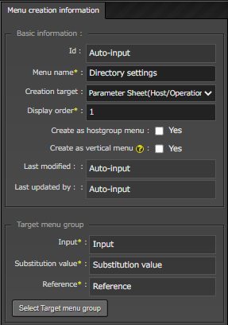
2.4 Create menu/Input data (1/3)
Create Parameter sheet
Menu: Create Menu> Create/Define Menu
Follow the table below and fill in the required items.
Data registration
Create/Input menu
Menu
Created menu
Environment Migration
Time Specification
１
Item name | Contents
Menu name | Directory settings
Creation target | Parameter sheet(Host/Operation)
Display order | 1

Slide 12
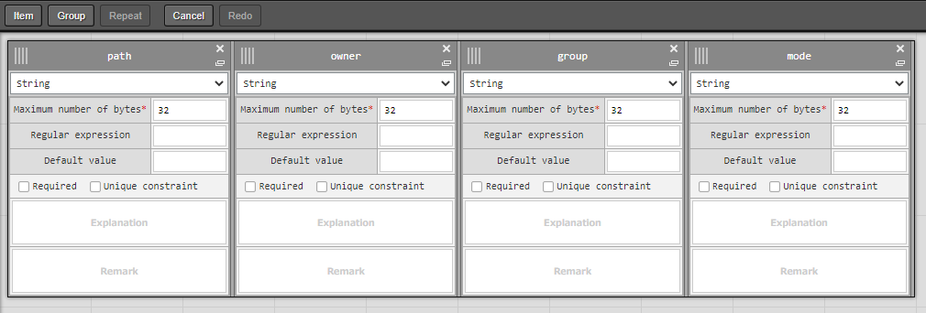
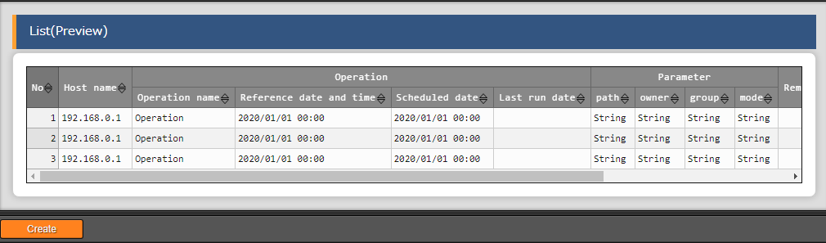
2.4 Create menu/Input data (2/3)
Define Parameter sheet items names
Menu: Create Menu > Define/Create menu
Press the “Item” button and add 3 more items.
Follow the table below and input the following information.
Press the “Create” button on the bottom of the screen.
Data registration
Create/Input menu
Menu
Created menu
Environment Migration
１
Time Specification
2
Item name | Input method | Maximum byte size
path | String | 32
owner | String | 32
group | String | 32
mode | String | 32
３

Slide 13
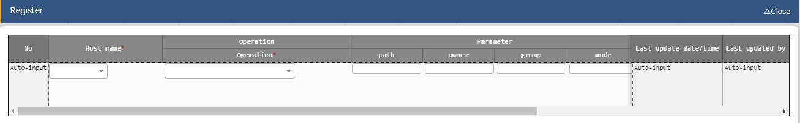
2.4 Create menu/Input data (3/3)
Register data to Parameter sheet
Menu: Input> Directory settings
Press “Register”> “Start registering”.
Input the following information for each item and click “Register”
Data registration
Create/Input menu
Menu
Created menu
Environment Migration
Time Specification
2
Host name | Operation | path | owner | group | mode
Free value | OP1 | /tmp/work1 | root | root | 0644
Free value | OP2 | /tmp/work2 | root | root | 0644

Slide 14
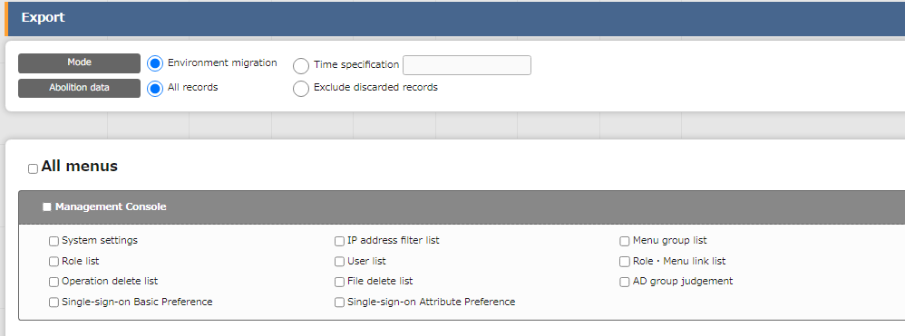
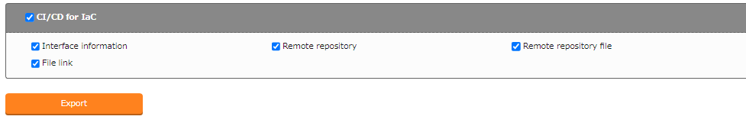
2.5 Environment Migration – Export (1/2)
Start Export process.
Select the previously registered information and start the export process using the “Environment migration” mode.
Menu: Export/Import> Menu export
Data registration
Create/Input menu
Environment Migration
Export
1
Download
Kym file
Select “Environment migration”
Import
Check Import results
Time Specification
２
Check “All menus”
３
Press “Export”

Slide 15
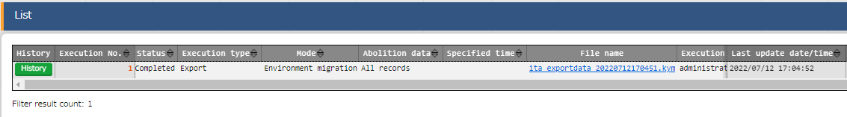
2.5 Environment Migration – Export (2/2)
Download kym file
Download the exported data
Menu: Export/Import>
Menu Export/Import list
Press “Filter”
Open the “List” and download the kym file
Data registration
Create/Input menu
Environment Migration
Export
Download
Kym file
Import
Check Import results
Time Specification
２

Slide 16
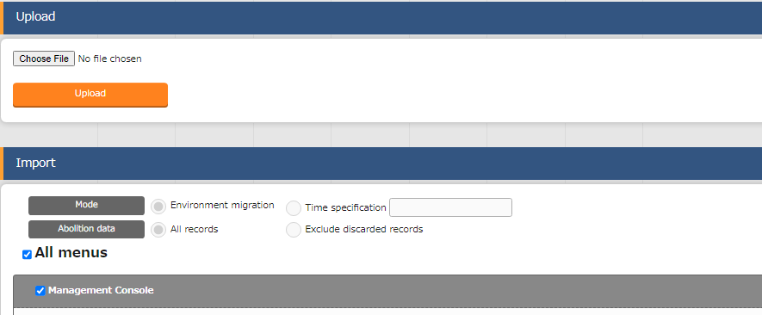
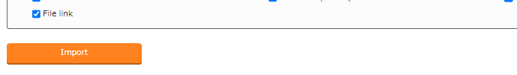
2.6 Environment Migration – Import (1/3)
Import
From this slide on, we will operate using the Destination server. Upload the kym file and start the import process.
Menu: Export/Import> Menu Import
Data registration
Create/Input menu
Environment Migration
Export
Download
Kym file
Import
Check Import results
1
Time Specification
Upload kym file
２
Check “All menus”
Tips
３
Users can also import excluding deleted data.
Press “Import”

Slide 17
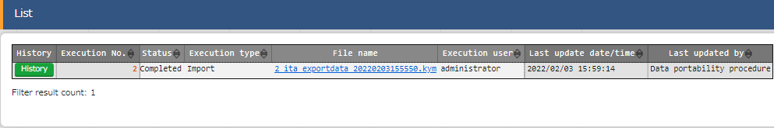
2.5 Environment Migration – Import (2/3)
Check Import status
Let`s check the imported information and see if the status is “Completed”
Menu: Export/Import> Export/Import menu list
Click the “Filter” button.
Check if the status of the executed import is “Completed”
Data registration
Create/Input menu
Environment Migration
Export
Download
Kym file
Import
Check Import results
Time Specification

Slide 18
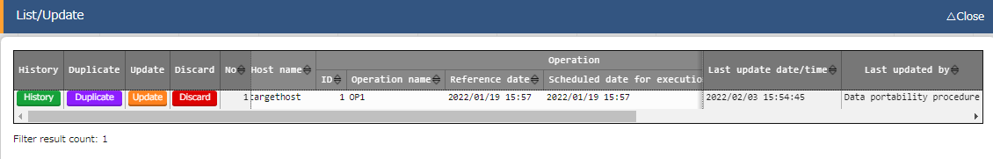
2.5 Environment Migration – Import (3/3)
Check Import results
Lets check the imported menus. All change history for each record should also be moved. Let`s put them together and check them.
Menu: Server Basic Settings> Directory settings.
Click “Filter”
Check if the Menu information has been migrated by “Data Portability Procedure”
Data registration
Create/Input menu
Environment Migration
Export
Download
Kym file
Import
Check Import results
Time Specification

Slide 19
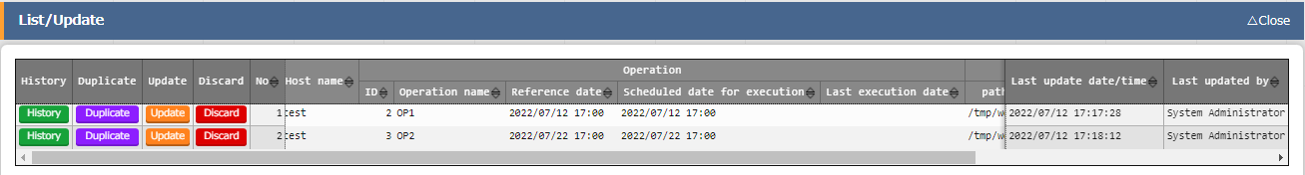
2.7 Time specification – Export (1/3)
Update Parameter sheet data
Return to the source server for this part.
Update the source server data.
Menu: Input> Directory settings
Press Register> Start registering
Follow the tables below and input the necessary data
Press “Update”
Data registration
Create/Input menu
Environment Migration
Time Specification
Update/Register data
Export
Download
Kym file
Import
Check Import results
2
3
Before
After
Operation | path
OP1 | /tmp/work1
Operation | path
OP1 | /tmp/work11
Before
After
Operation | path
OP2 | /tmp/work2
Operation | path
OP2 | /tmp/work22

Slide 20
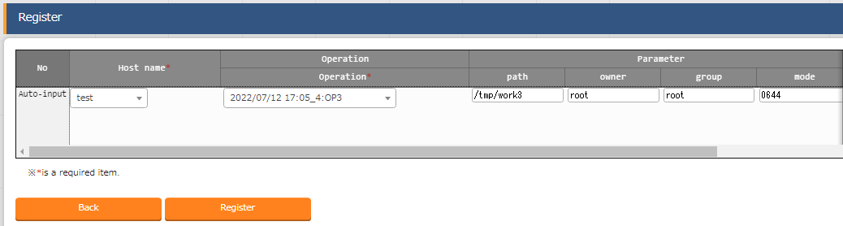
2.7 Time specification – Export (1/3)
Register Parameter sheet data
Use the source server for this part.
Register new data to the Source server
Menu: Input> Directory settings
Press Register> Start registering
Follow the tables below and input the necessary data
Press “Register”
Data registration
Create/Input menu
Environment Migration
Time Specification
Update/Register data
Export
Download
Kym file
Import
Check Import results
2
Host name | Operation | path | owner | group | mode
Free value | OP3 | /tmp/work3 | root | root | 0644
３
Press “Register”

Slide 21
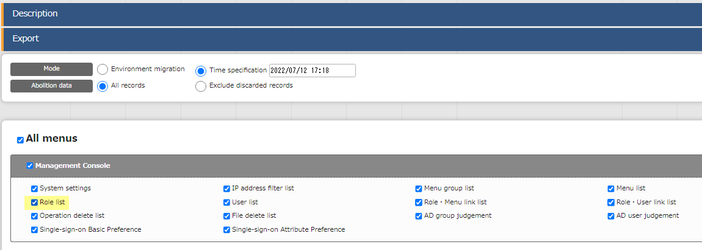
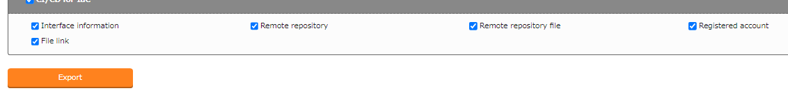
2.7 Time specification – Export (2/3)
Start Export process
Select the registered data and export using the “Time specification” mode.
Menu: Export/Import> Menu export
Data registration
Create/Input menu
Environment Migration
Time Specification
Update/Register data
Export
Download
Kym file
1
Press “Time specification”
Import
Time specification | (The entered time must be later than the last time the second item was updated)
Check Import results
２
Check “All menus”
３
Press “Export”

Slide 22
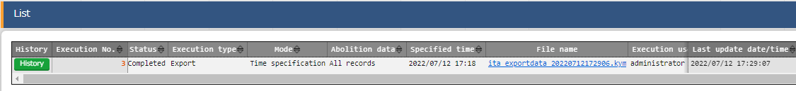
2.7 Time specification – Export (3/3)
Download kym file
Download the exported data.
Menu: Export/Import> Menu export/Import list
Press “Filter”
Open the “List” and download the kym file
Data registration
Create/Input menu
Environment Migration
Time Specification
Update/Register data
Export
Download
Kym file
Import
Check Import results
２

Slide 23
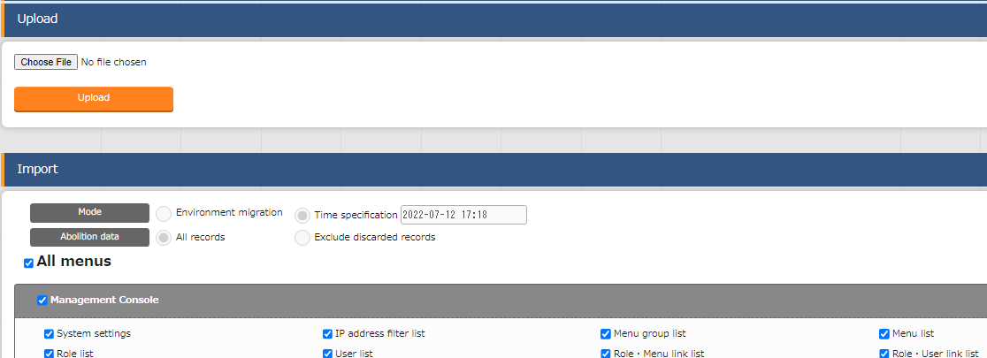
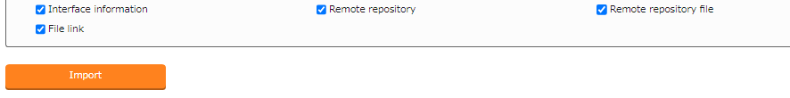
2.8 Time specification – Import (1/3)
Start Import process.
Return to the destination server. Upload the kym file and start the import process.
Menu: Export/Import > Menu import
Data registration
Create/Input menu
Environment Migration
Time Specification
Update/Register data
Export
1
Upload kym file
Download
Kym file
Import
Check Import results
２
Check “All menus”
Tips
３
Users can also import excluding deleted data.
Press “Import”

Slide 24
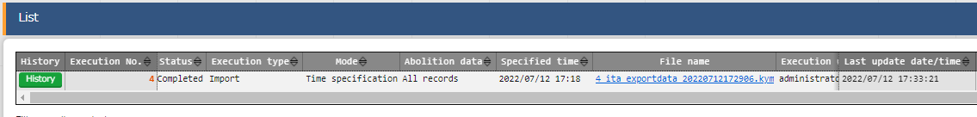
2.8 Time specification – Import (2/3)
Check Import status
Check that the Import status says “Completed”.
Menu: Export/Import >
Menu Export/Import list
Press “List”
Check that the status of the import process is “Completed”
Data registration
Create/Input menu
Environment Migration
Time Specification
Update/Register data
Export
Download
Kym file
Import
Check Import results

Slide 25
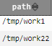

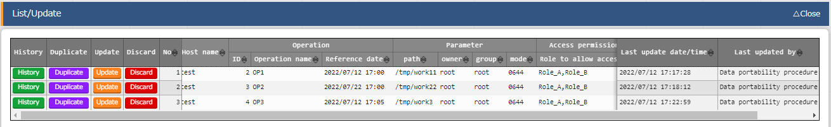

2.8 Time specification – Import (3/3)
Check the Import results
Check the imported menus. Make sure that the correct menus was registered/updated according to the set time specification.
Menu: Input> Directory settings
Press “Filter”
Check that the “last updated by” column says “Data portability procedure”.
Check that only the items that was updated/registered after the set time have been changed
Data registration
Create/Input menu
Environment Migration
Time Specification
Update/Register data
Export
Download
Kym file
Import
Check Import results
３
２

Slide 26
3. Practice ② Excel Bulk export/import

Slide 27
3.1 Environment
Work environment
The following scenario uses the following environment.
The scenario requires one ITA server.
Client device ITA server (x1) ・Windows10 ・CentOS 7 (※1) ・Google Chrome ・ITA 1.10.0
・Ansible 2.11.10
Google Chrome
Download export data
CentOS 7
zip
ITA
1.10.0
Ansible
2.11.10
Windows10
Upload the edited data
ITA server
※1 In this scenario, the host server is running on CentOS7, but ITA can be installed on any RHEL7/RHEL8 type OS.

Slide 28
3.2 Excel bulk export/import procedure
Workflow
This scenario will have the user use the Excel export function to register data to the Role list or the Operation list. The following figure illustrates the workflow.
1. Start export
① Excel bulk export
2. Download zip file
3. Extract files, edit and save them
② Excel file edit
4. Re-zip edited files
5. Start import
③ Excel bulk import
6. Check import results

Slide 29
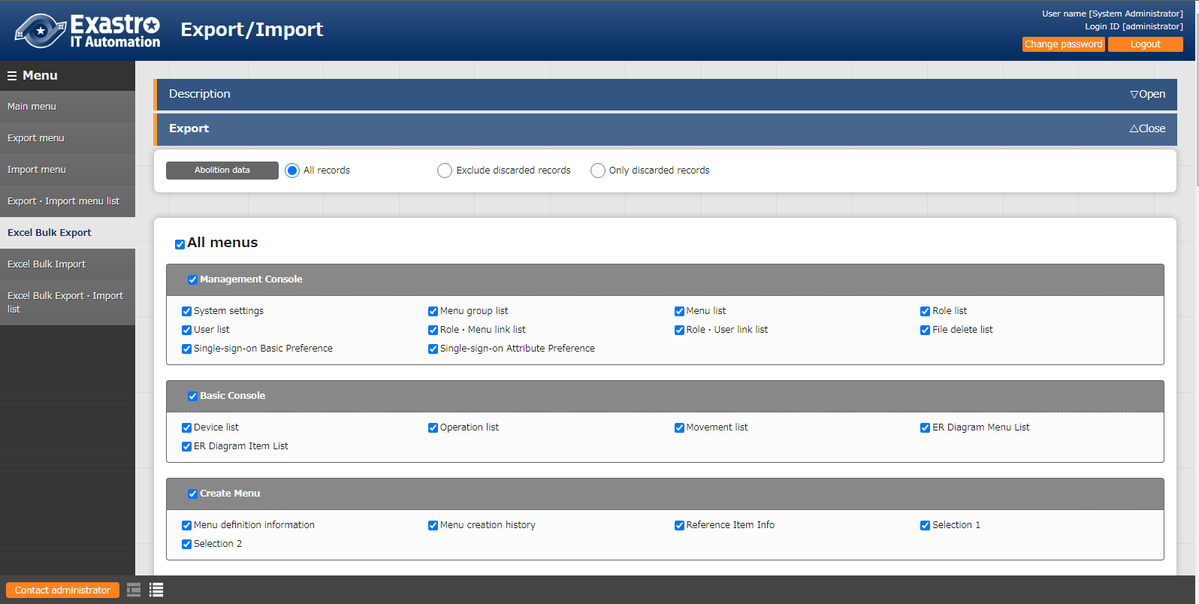
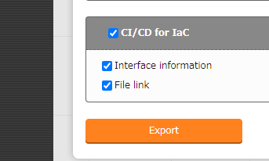
3.3 Excel bulk export (1/2)
Start the export
Start exporting menus.
Menu: Export/Import >Excel bulk export
Export
Start Export
Download Zip file
Edit and save file
Import
1
Check “All menus”
２
Press the “Export” button

Slide 30
3.3 Excel bulk export (2/2)
Download zip file
Download the exported data.
Menu: Export > Excel bulk export/import list
Press “List”
Download the Zip file from the export status list.
Export
Start Export
Download Zip file
Edit and save file
Import
２

Slide 31
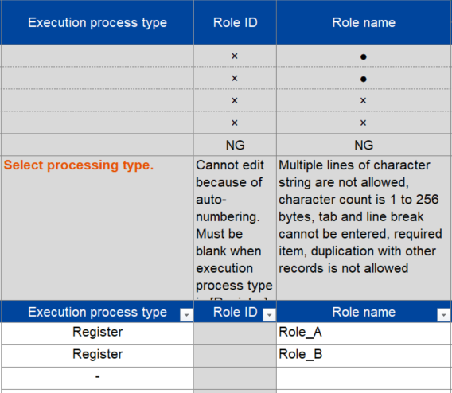
3.4 Excel file edit (1/3)
Extract zip file and edit contents
Extract the downloaded zip file
Open the file and open Management console> role (Excel file)
Edit the file so it matches the picture below and save it.
Export
Start Export
Download Zip file
Edit and save file
Import
Execution process type | Role name
Register | Role_A
Register | Role_B
３

Slide 32
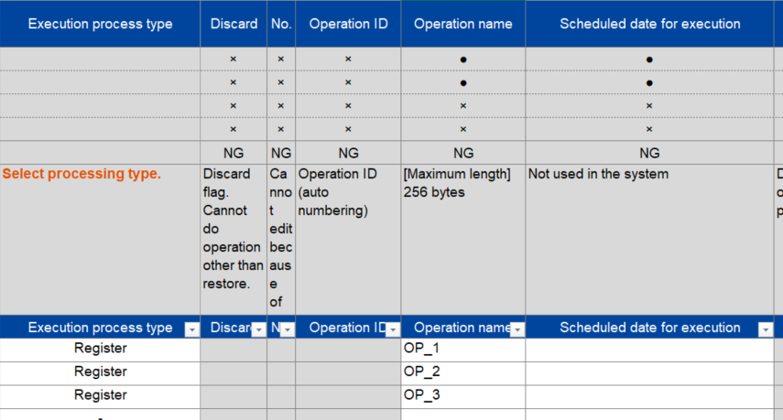
3.4 Excel file edit (2/3)
Extract zip file and edit contents
Edit the contents of the downloaded file
Extract the downloaded zip file
Open the file and open > Basic console >
Operation list (Excel file)
Edit the file so it matches the picture below and save it.
Export
Start Export
Download Zip file
Edit and save file
Import
Execution registration type | Operation name | Scheduled execution date
Register | OP2 | （Free value）
Register | OP3 | （Free value）
Register | OP4 | （Free value）
３

Slide 33
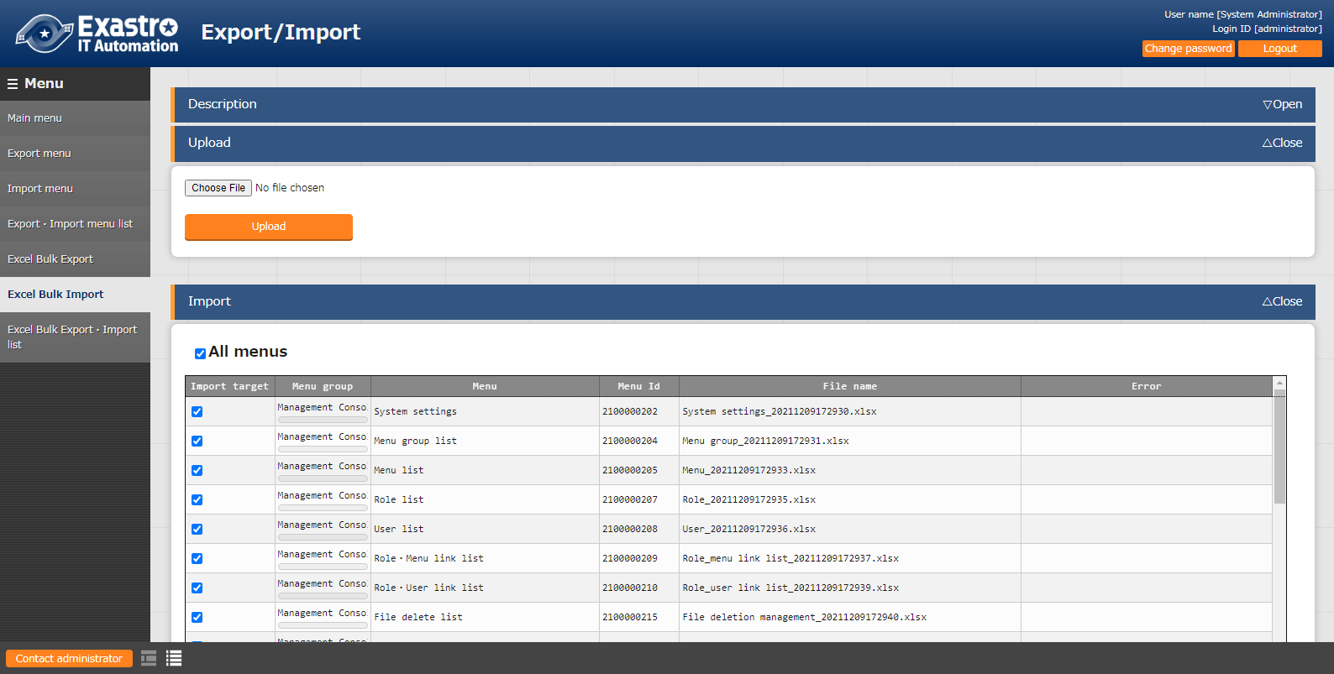
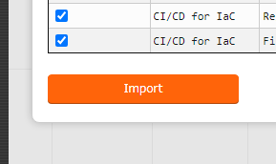
3.5 Excel bulk import (1/3)
Start excel bulk import
Upload the zip file and start importing
Menu：Export/Import > Excel bulk import
Export
Edit and save file
Import
Start Import
Check results
1
Upload the edited zip file
２
Check “All menus”
３
Press the “Import” button

Slide 34
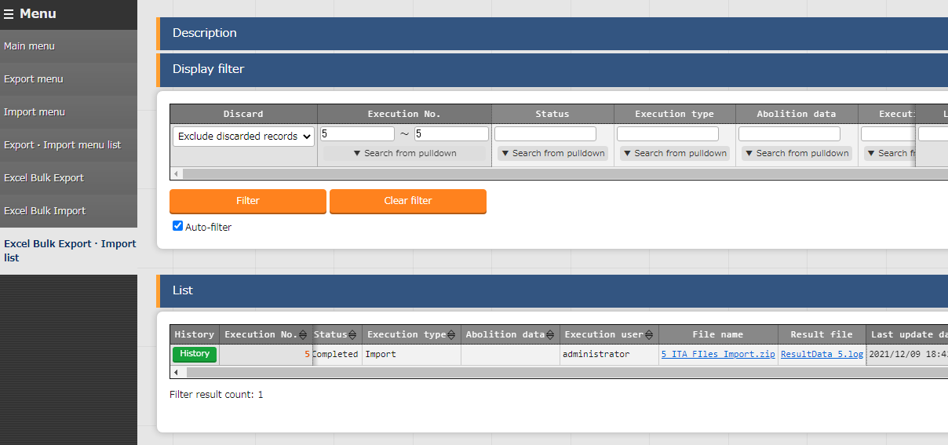
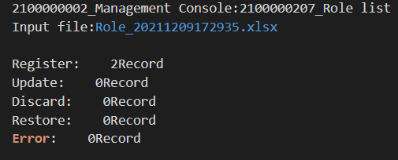
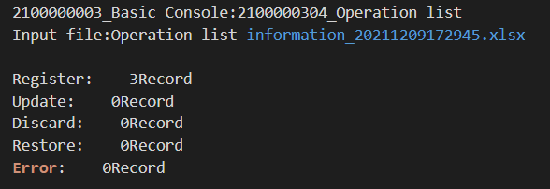
3.5 Excel bulk import (2/3)
Check the Import status and the Registration results
Check that the import has ended successfully and that all of the items has been registered.
Menu：Export/Import >
Excel export/import list
Export
Edit and save file
Import
Start Import
Check results
Inside the Log file
1
Press “Filter
２
３
Check that the status says: Completed
Download Log file
４
Check the number of registrations

Slide 35
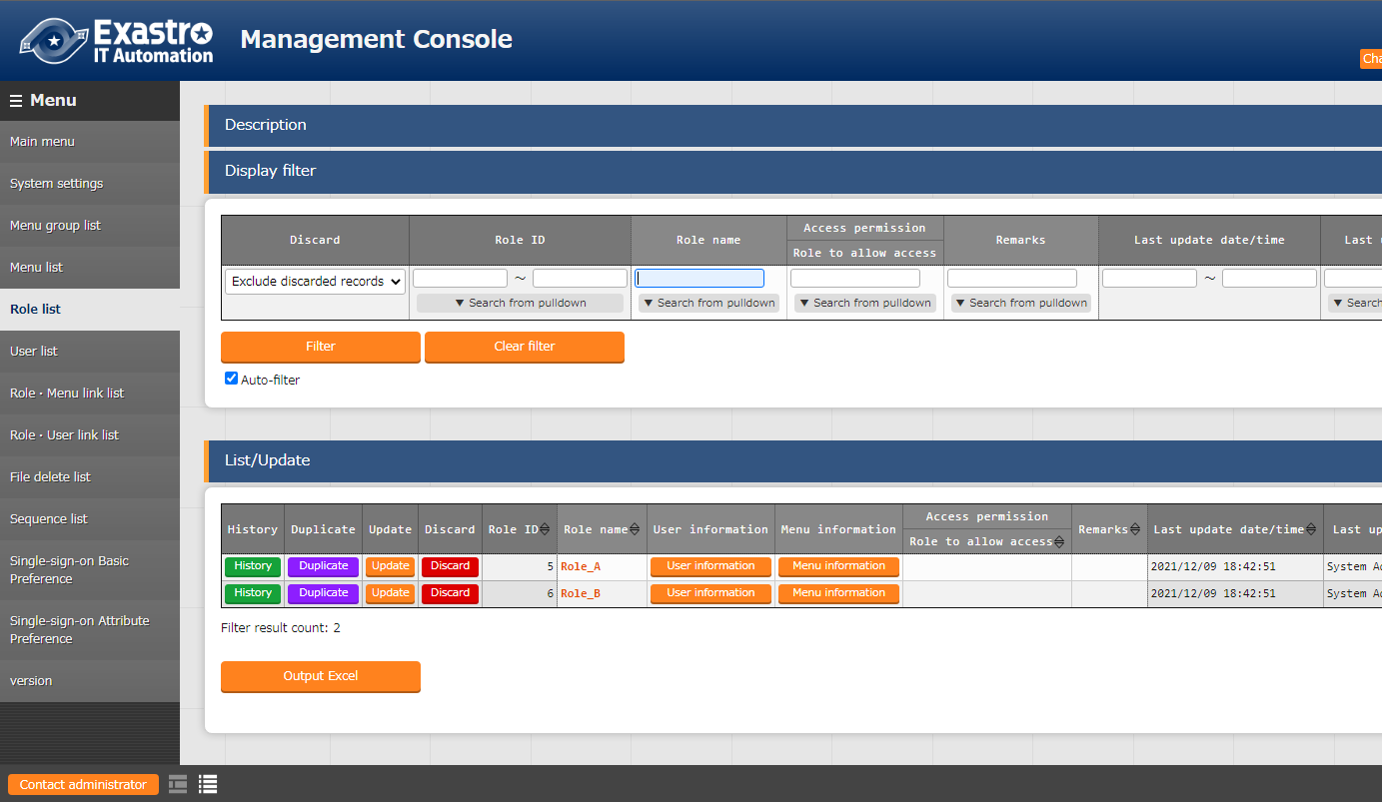
3.5 Excel bulk import (3/3)
Check registered contents
Check that the registered contents are being displayed.
Menu： Management console > Role list
Export
Edit and save file
Import
Start Import
Check results
1
Press “Filter”
2
Check that all the registered items show up

Slide 36
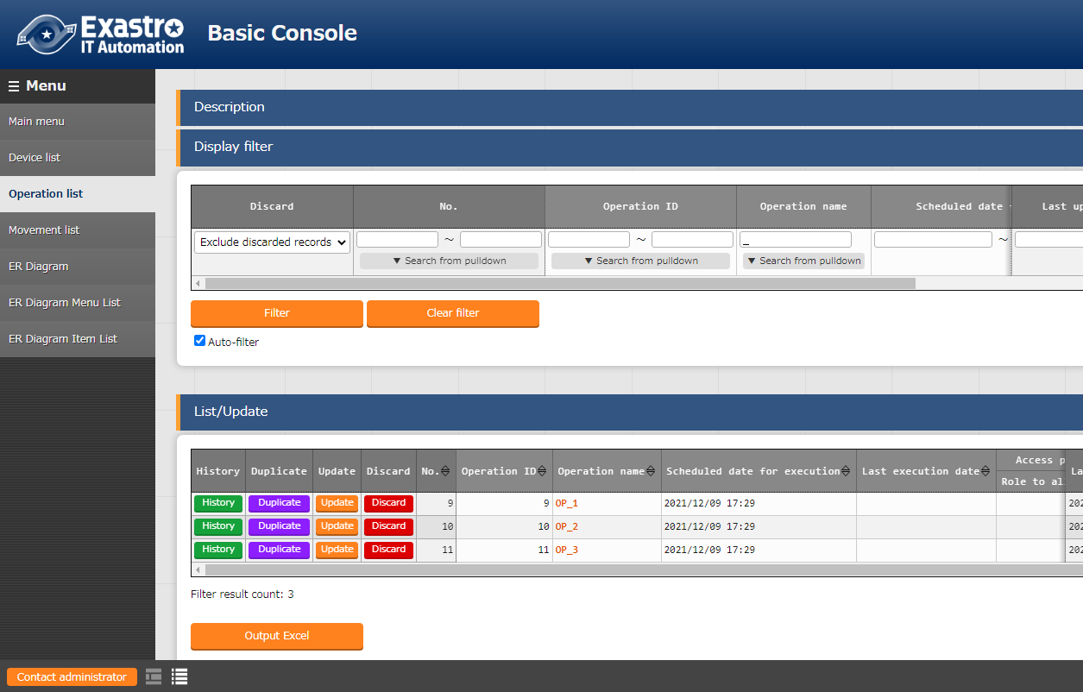
3.5 Excel bulk import (3/3)
Check registered contents
Check that the registered contents are being displayed.
Menu： Management console > Role list
Export
Edit and save file
Import
Start Import
Check results
1
Press “filter”
2
Check that all the registered items show up

