Slide 1


Host group management・
Menu creation
【Tutorial】
※Exastro IT Automation is written as ITA in this document
Exastro IT Automation Version 1.10
Exastro developer

Slide 2
Table of contents
1.Introduction
1.1 About this Document ...................................................................................... 4
2. Host group management
2.1 Menu overview .......................................................................................... 6
2.2 Host group management ................................................................................. 7
2.3 Host group Parent-Child relationship ................................................................. 8
2.4 Succeeding Parameters .................................................................................... 9
2.5 Host group Example ............................................................................... 10
3. Menu creation function
3.1 Menu overview ............................................................................................ 15
3.2 Menu construction ........................................................................................ 16
3.3 Parameter Sheet .......................................................................................... 17
3.4 Data sheet .......................................................................................... 18
3.5 Menu creation procedure ................................................................................. 19
3.6 Editing Menus ....................................................................................... 20
3.6.1 Editing menus ：Edit button .....................................................................21
3.6.2 Editing menus：Initialize button ..................................................................22
3.6.3 Editing Menus：New Diversion ...................................................................23
3.6.4 Editing Menus：Menu creation history ......................................................24
3.7 Host groups and Menu groups .......................................................... 25
3.8 Parameter sheets and Menu groups ...............................................................26
3.9 Using the “Input” and "Reference” menu groups ................................................. 27
3.9.1 “Reference” menu group .................................................................. 28
3.9.2 “Reference” Menu group example ...................................................... 30
3.10 Host groups .................................................................................. 35
3.10.1 Parameter sheet division when host groups are used ............................... 36
3.11 Item registration .......................................................................................... 37
3.11.1 Input method : String ............................................................................. 45
3.11.2 Input method : Pulldown selection ............................................................ 38
3.11.3 Input method : Password ........................................................................ 43
3.11.4 Input method : File upload ............................................................. 44
3.11.5 Input method : Link ................................................................................ 45
3.11.6 Input method : Parameter sheet reference ................................................ 45

Slide 3
1. Introduction

Slide 4
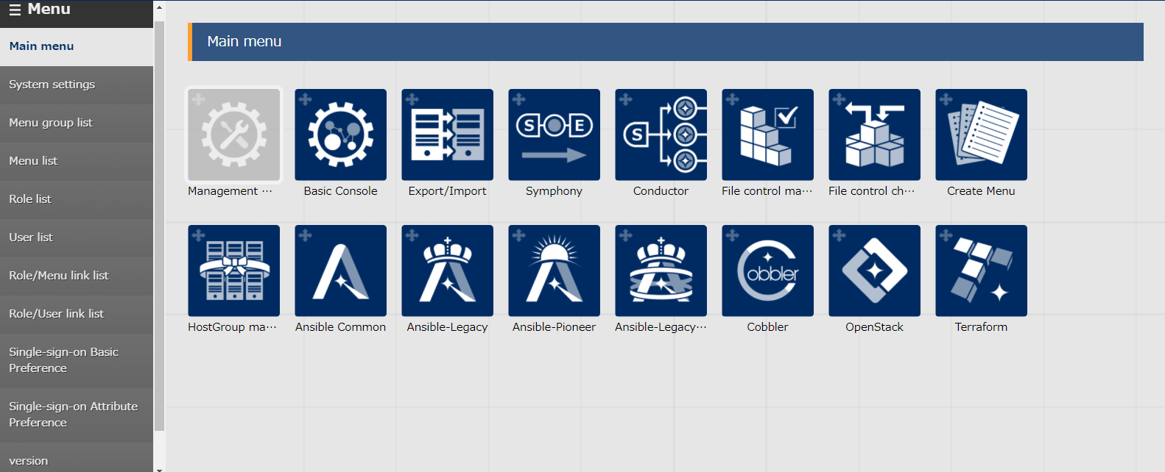
1.1 About this document
This document describes “ Host menu Management” and “ Menu creation”.
This document aims to explain the overview of Exastro IT Automation as well as introducing its functions.
The practice Document uses pictures of the ITA screen to explain, so please look at both documents.
Detailed specifications of each functions are written in their respective user manuals.

Slide 5
2. Host group management

Slide 6
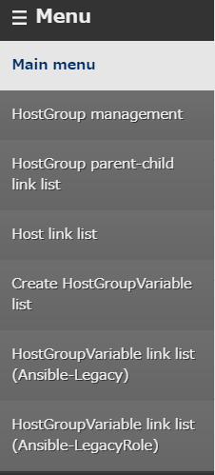
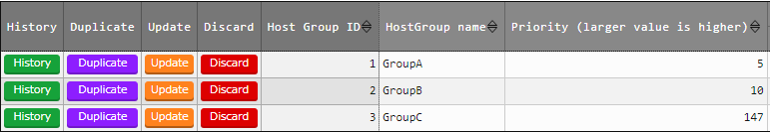
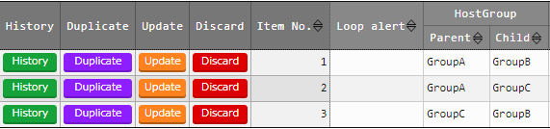
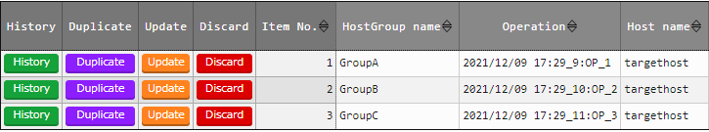
2.1 Menu overview
Main Menus used in this document
①Registering host groups/ Referencing menus
①
②
②Registering parent-child host to host menus
③
③Menu for registering links between Host, Operations and Groups names.
※For more information regarding menus other than ①②③, please refer to Exastro-ITA_User_Instruction_Manual_Host_group_Function

Slide 7
2.2 Host group management
Users can group hosts together and instruct them simultaneously by using the group management function.
This function is necessary to manage multiple hosts in a large scale system.
With host groups
Without host groups
Host group A
Host A
Host B
Host C
Host A
Host B
Host C
Can give instructions to everyone
Must give instruction individually

Slide 8
2.3 Host group Parent-Child relationship
Users can define Parent-Child relationships between Host groups .By doing so, parameters can be succeeded and host management becomes easier.(→Next Page)
Host group Parent-Child relationship
【Legend】
Host Group
ALL
Parent
Child
Group_A1
Group_A2
Group_B1
Group_B2
Group_B3

Slide 9
2.4 Succeeding Parameters.
By succeeding parameters from the Parent to the child, host groups can work more closely together. As a result, it is possible to handle Large scale systems.
Succeeding Parameters
【Legend】
Parameter settings
Host Group
Succeed
ALL
Succeed
Parent
Child
Succeed
Group_A1
Group_A2
Succeed
Group_B1
Group_B2
Settings
Settings
host_A
host_B
host_C
host_D
host_E
Parameters are set to individual hosts

Slide 10
2.5 Host group Example (1/4)
There are 3 hosts groups. “Overall management”, “DB Server group” and “Web server groups”. They are all defined in a parent-child relationship. Right now, there is no value set to the parameters in Host A~D
【Legend】
Overall Management (ALL)
Host Group
Parent
Child
DB Server group(Group_A1)
WEB server group(Group_B1)
Host A
Host B
Host C
Host D
【Parameter for each host】
Host | hostname | nameserver | password | server-admin
Host A | - | - | - | -
Host B | - | - | - | -
Host C | - | - | - | -
Host D | - | - | - | -

Slide 11
2.5 Host group Example (2/4)
Set the parameters for the “Overall Management” host group.
【Legend】
Overall management
nameserver : 8.8.8.8
Host group
Parent
Child
DB Server groups
WEB Server group
Parameter: Value
Host A
Host B
Host C
Host D
【Parameter for each host】
Host | hostname | nameserver | password | server-admin
Host A | - | 8.8.8.8 | - | -
Host B | - | 8.8.8.8 | - | -
Host C | - | 8.8.8.8 | - | -
Host D | - | 8.8.8.8 | - | -

Slide 12
2.5 Host group Example (3/4)
Set the different parameters for Host groups “DB Server group” and “Web server group”.
【Legend】
server-admin : admin@xxx.com
password : password1
Overall Management
Host group
Parent
Child
DB server group
WEB server group
Parameter : Value
Host A
Host B
Host C
Host D
【Parameter for each host】
Host | hostname | nameserver | password | server-admin
Host A | - | 8.8.8.8 | password1 | -
Host B | - | 8.8.8.8 | password1 | -
Host C | - | 8.8.8.8 | - | admin@xxx.com
Host D | - | 8.8.8.8 | - | admin@xxx.com

Slide 13
2.5 Host group Example (4/4)
Set individual parameters for each host.
【Legend】
Overall Management
Host group
Parent
Child
DB Server group
WEB Server group
Parameter : Value
Host A
Host B
Host C
Host D
hostname : host-A
hostname : host-B
hostname : host-C
hostname : host-D
【Parameters for each host】
Host | hostname | nameserver | password | server-admin
Host A | host-A | 8.8.8.8 | password1 | -
Host B | host-B | 8.8.8.8 | password1 | -
Host C | host-C | 8.8.8.8 | - | admin@xxx.com
Host D | host-D | 8.8.8.8 | - | admin@xxx.com

Slide 14
3. Menu creation function

Slide 15
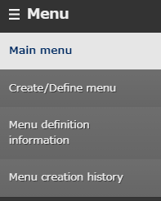
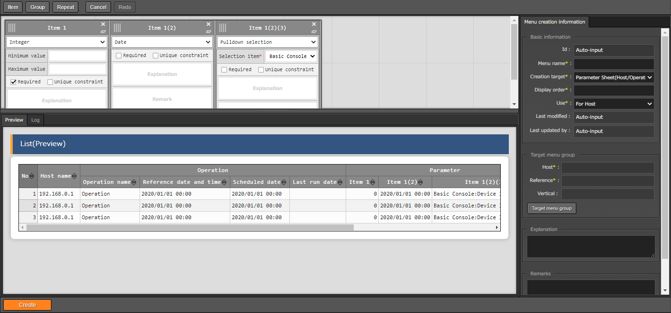

3.1 Menu overview
Main Menus used in this document
①Menu Create/Define Menu
Lets users create menus and menu items
①
②
③
②Menu definition information Menu
Lists all created menus
③Creation history Menu
Displays the creation history of all the menus.

Slide 16
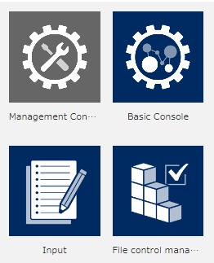
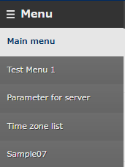
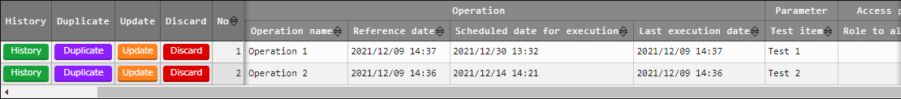
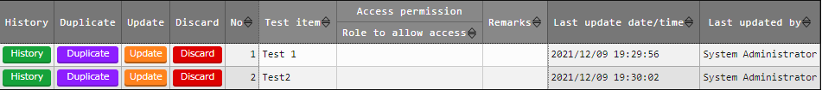
3.2 Menu construction
The Menus that can be created with the Menu creation functions are as follows.
The following two types of menu sheets are creatable
Sheets that manages IaC variable values. →
Sheets that are not linked with specific host and operations. →
Menu group
＞
Menu
＞
Parameter sheet/Data sheet
Parameter sheet
Data sheet
Menu structure
Menu group
Menu
Parameter sheet
Free column
Data sheet
Free column
(※)The menus and menu groups shown above are examples

Slide 17
3.3 Parameter Sheet
In Parameter sheet, manage and register the variable substitute values used in IaC.
Create execution codes from Parameter sheets and IaC.
Image of creating an Execution code
Parameter Sheet
Variable | VAR_x | VAR_y | VAR_z
Value | AAA | BBB | CCC
Execution Code
Create
AAA ・ ・・ ・
・・ BBB ・・ ・
・・ ・・ CCC ・・
IaC
Variable
{{ VAR_x }}・・・ ・
・・ {{ VAR_y }} ・ ・
・ ・ ・ {{ VAR_z }} ・
(※)For linking variables, please take a look at the “practice document”

Slide 18
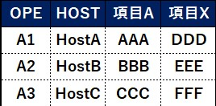
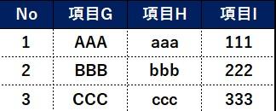
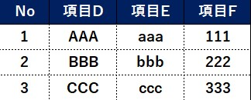
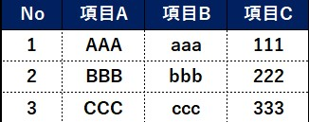
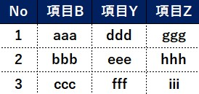
3.4 Data Sheet
Data sheet is managing data as CMDB(Configured Management Data Base).
The figure below displays that it is possible to link Datasheet A with other sheets by use the “Pulldown selection” input method (See chapter “3.12.1 Input method: Pulldown selection” for more information)
Operating data sheets
Register Parameter
ITA
Parameter sheet B
Item A
Item X
Data sheet A
Item G
Item H
Item I
Item D
Item E
Item F
Item A Item B Item C
Other menu references
Data sheet B
Item B
Item Y
Item Z
Users can register parameters from Web menus, Excel files and RestAPI.(Same with Parameter sheets)

Slide 19
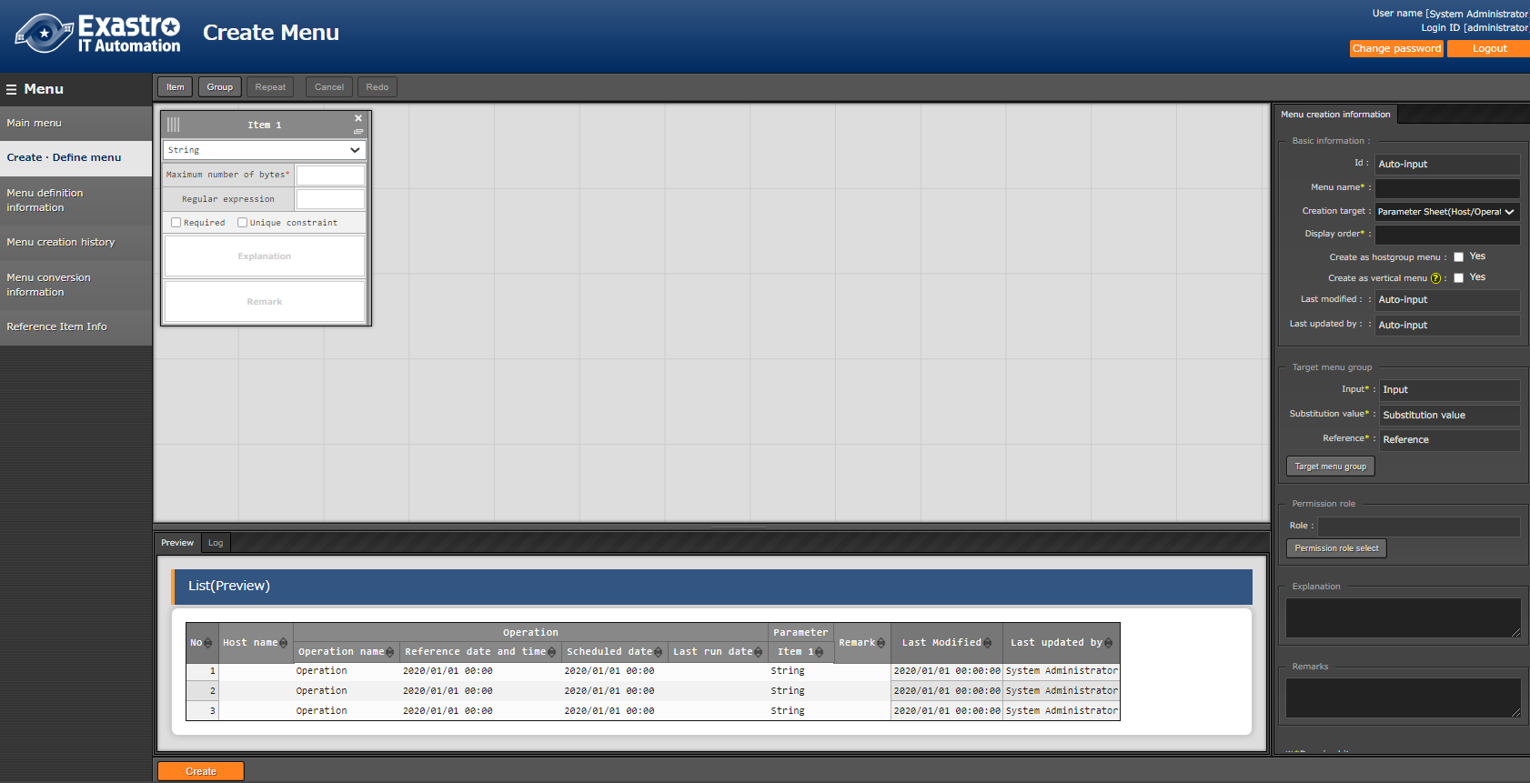
3.5 Menu creation procedure
The menu creating procedure is as shown below.
We recommend following the practice document while operating the system after reading these slides.
① | Input basic Menu information
Select either "Parameter sheet" or "Data sheet" for the "Creation target". If you want to use Host groups, put a check mark in the "Create as Host group menu" box (For more information, please refer to 3.7 Host group and menu groups). For more information regarding vertical menus, please refer to chapter 4 in Exastro-ITA_User_Instruction_Manual_Menu_creation_function
Menu definition/creation screen
③
①
②
② | Select which Menu group the menu is going to belong to
By default, the menu will be created in the "Input", "Substitution value registration" and "Reference" menu groups. Users can also create their own menu groups.( For more information, please see the Practice document).
③ | Create items for the menu.
Please refer to 3.11 Item registration.

Slide 20
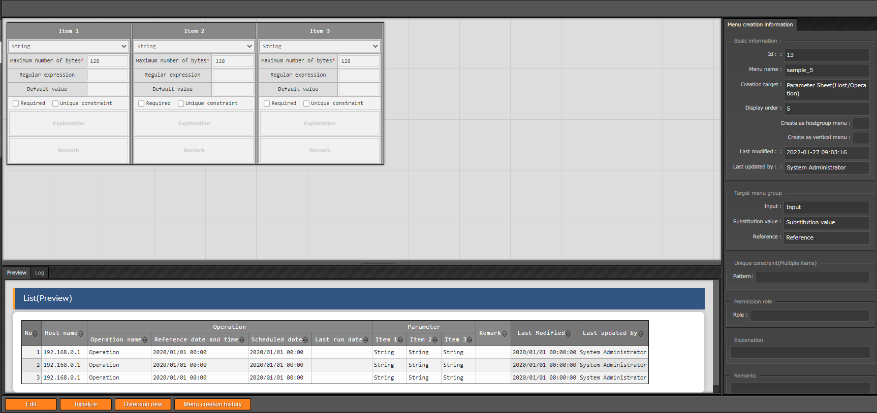
3.6 Editing Menus.
Users can use the buttons on the bottom of the "view" screen to edit the menu or perform various other actions.
The view screen can be accessed by pressing the Menu definition/Creation" button in the "Menu definition information”-> "list/update" menu. It will also be displayed right after the menu has been created.
For more information regarding the different buttons, please see the next page.
View screen
① | “Edit” button
Edits the menu definition. any date registered before the edit will be saved.
② | “Initialize“ button
Edits the menu definition. any date registered before the edit will be deleted.
③ | “Diversion new” button
Duplicates the menu and creates a new menu.
①
③
②
④
If the view screen is accessed from “Menu definition information” menu -> List/Update, Button no.4 will not be displayed.
④ | “Menu creation history” button
Moves the user to the “Menu creation history” menu.

Slide 21
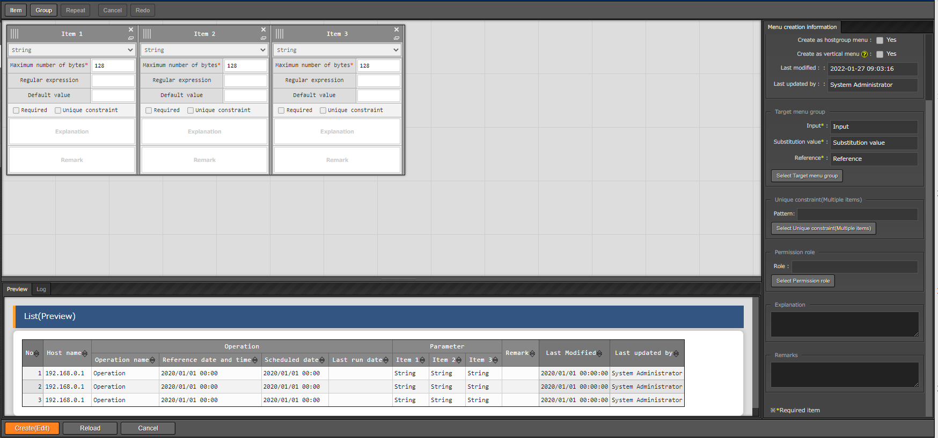
3.6.1 Editing Menus : Edit button
Pressing the "Edit" button will move the user to the "Edit" screen.
Here, users can edit the Menu. That being said, only some parts are editable. see the picture below for editable items.
The data that was registered before the editing will be saved.
※ For more information, please refer to chapter 5.4 in Exastro-ITA_User_Instruction_Manual_Menu_creation_function
“Edit” screen
The areas marked with red can be edited.
① | Create(Edit) button
Saves the menu with the edited contents registered.
Deleting items
Adding items
② | “Reload” button
Deletes the edited contents and returns the edit screen to it's initial state.
Item name
※ Users can also edit the order of the items
③ | “Cancel” button
Deletes the edited contents and returns the user to the "view" screen.
Explanation
①
②
③
Remarks

Slide 22
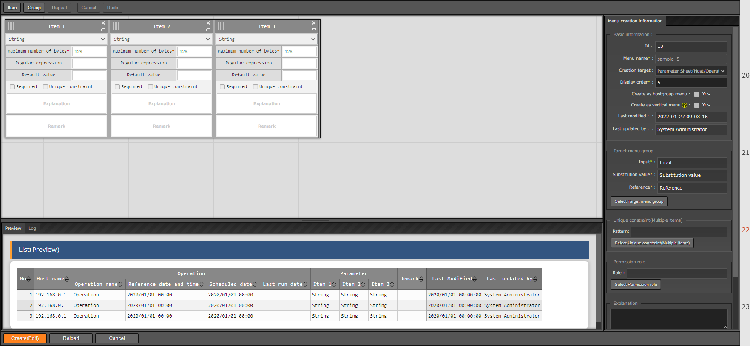
3.6.2 Editing menus：Initialize button
Pressing the "Initialize" button will move the user to the "Initialize" screen.
In this screen, users can edit the Menu. In contrast to the "edit" screen, all items can be edited.
Any data registered before the edit will be deleted. For more information, please refer to chapter 5.4 in Exastro-ITA_User_Instruction_Manual_Menu_creation_function
“Initialize” screen
The area in red can be edited.
① | “Create(Initialize)” button
Saves the menu with the edited contents registered.
② | “Reload” button
Deletes the edited contents and returns the edit screen to it's initial state.
Can edit everything except menu name
③ | “Cancel” button
Deletes the edited contents and returns the user to the "view" screen.
①
②
③

Slide 23
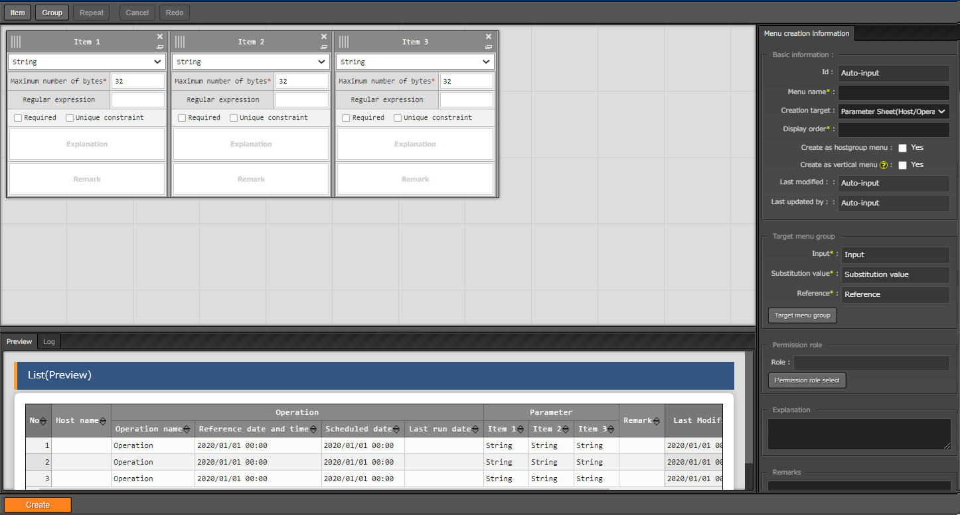
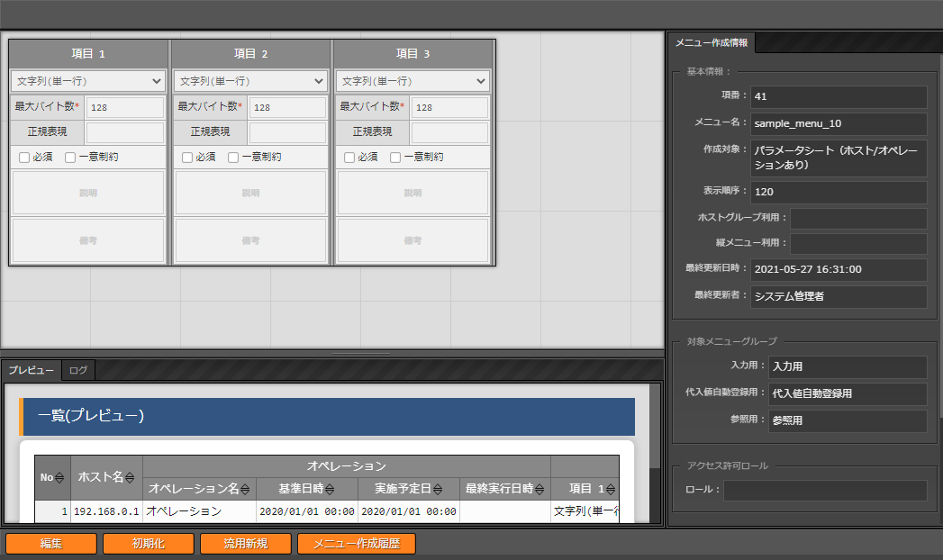
3.6.3 Editing menus：New Diversion
Pressing the "New Diversion" button will move the user to the Diversion screen.
In this menu, the menu displayed in the "view" screen will be duplicated and be created as a new menu.
both "Menu name" and "Display order" will be blank, so the user will need to input new strings. The "Menu name" can not be the same as an existing one.
“New Diversion” screen
The areas marked in red are editable.
Menu name
View screen
Can edit everything
Display order
Reuse
The menu will be cloned with only the "Menu name" and the "Display" order left blank.
Additionally, all columns and boxes are editable.

Slide 24
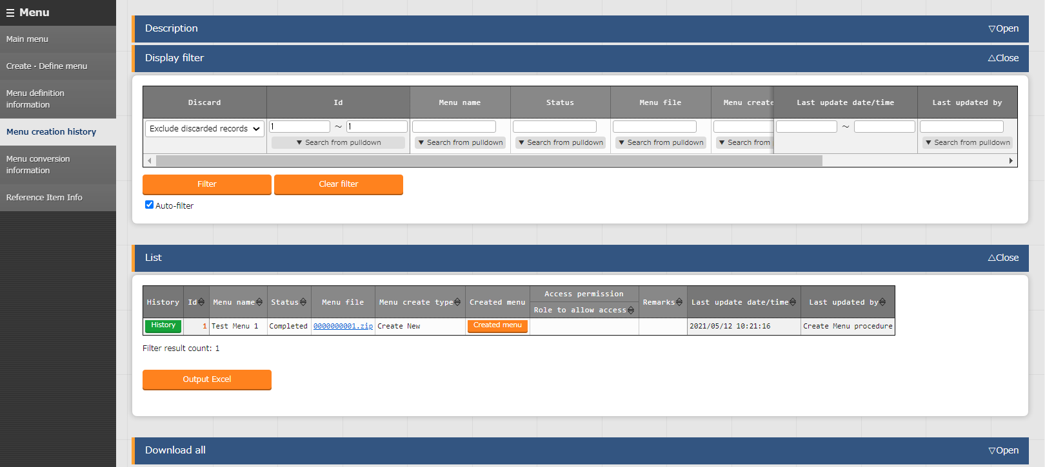
3.6.4 Editing Menus：Menu creation history
Pressing the "Menu creation history" button will move the user to the "Menu creation history" menu.
A list of created menus will be sorted and displayed in the "list" area.
“Menu creation history” menu.
Only the user created menus will be displayed.

Slide 25
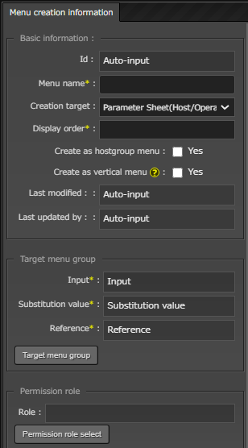
3.7 Host groups and Menu groups
Create as Hostgroup menu
If you are creating a parameter sheet for a Host group, check this checkbox.
(For more information, please refer to 3.9 Hostgroup)
Menu group
Select the Group the menu is going to belong to.
All created menus will have the following selected by default.
(For more information regarding the "Input", "Substitution value " and "Reference" menu groups, please refer to "3.7 Parameter sheet and Menu groups")
Type of sheets | Create as Hostgroup menu | Menu group
 |  | Input | Substitution value | Reference
Parameter sheet | × | 〇 | 〇 | 〇
 | 〇 | 〇 | 〇 | 〇
Data sheet |  | 〇 | × | ×
The parameter sheets written above will not be created as vertical menus. For more information regarding vertical menus, please refer to Exastro-ITA_User_Instruction_Manual_Menu_creation_function

Slide 26

3.8 Parameter sheets and menu groups
The differences between the "Input" "Substitution value" and "Reference" Menu groups are as shown below.
It is also possible to create your own menu groups(See Exastro-ITA_User_Instruction_Manual_Management_console).
ITA
Input
Menu group
Substitution value
Menu group
Reference
Menu group
Used for input
Can register parameters.
Can perform actions such as Registration/Update/delete/revive.
Used for viewing
Links menus to IaC Variables (For information regarding linking, please see the Practice document).
Used for viewing
Refers the Parameter history information.

Slide 27
3.9 Using the “Input” and “Reference” menu groups
The “Input” and “Reference” menu groups can be used as shown below.
ITA
Input
Menu group
Reference
Menu group
Search target
I want to check the parameters that the host should have.
※ I can also see the parameters from the time period I want to check
(More information on the next page).
The parameter settings are done, so I will register them to the parameter sheets.
Register Parameters
Refer Parameters
In charge of settings
In charge of operating
Person in charge of settings does not have to worry about the current parameters
⇒ Can focus on Settings
Person in charge of operating only references the desired parameters
⇒ Can focus on Operating

Slide 28
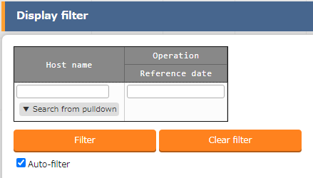
3.9.1 “Reference” menu group（1/2）
In the "Reference" menu, users can use "Host name" and "Reference date" to search for Parameters.
If nothing is input in the reference date field, the newest data will be displayed when you search.
“Reference” Menu group
Input Reference date
Select Host name

Slide 29
3.9.1 “Reference” menu group（2/2)
Reference date
⇒ If the corresponding operation has been executed in the past, the "Reference date" will be the "Last update date/time".
If it hasn't been executed before, the "reference date" will be the "Scheduled date"
Reference date example
No | Target host | Operation name | Scheduled date | Last update date/time | Reference date
1 | Host A | Operation 1 | 9/1 00:00:00 | 9/15 00:00:00 | 9/15 00:00:00
2 | Host A | Operation 2 | 11/1 00:00:00 |  | 11/1 00:00:00
3 | Host A | Operation 3 | 12/24 00:00:00 |  | 12/24 00:00:00
※Operation No2 and No3 has not been executed.

Slide 30
3.9.2 "Reference" Menu group example(1/5)
Pre condition
前提条件
Case 1-4 will be executed on the 10/1(Execution date)
Parameter sheet
Host | Operation | Operation Standard Time/Date | Parameter A | ・・・
Host A | Operation 1 | 9/15 00:00:00 | AAA | ・・・
Host A | Operation 2 | 11/1 00:00:00 | BBB | ・・・
Host A | Operation 3 | 12/24 00:00:00 | CCC | ・・・
Operation set to Parameter A as host.
【Host A`s work schedule】
Operation 1
Operation 2
Operation 3
set “AAA”
Execution date
set “BBB”
set “CCC”
9/15
10/1
11/1
12/24
Standard time/date(Time is shortened)

Slide 31
3.9.2 "Reference" Menu group example(2/5)
Case①
Setting「9/1 00:00:00」and executing search.
【Host A`s work schedule`s standard time and date.】
Set to Standard time/date
Set “AAA”
Execution date
Set “BBB”
Set “CCC”
9/1
9/15
10/1
11/1
12/24
Host | Operation | Operation standard time/date | Parameter A | ・・・
Host A | Operation 1 | 9/15 00:00:00 | AAA | ・・・
Host A | Operation 2 | 11/1 00:00:00 | BBB | ・・・
Host A | Operation 3 | 12/24 00:00:00 | CCC | ・・・
結果
Since no parameter settings are set by now ( 9/1), there will be no corresponding search results

Slide 32
3.9.2 "Reference" Menu group example(3/5)
Case②
ケース②
Setting the standard time/date to「10/2 00:00:00」and executing search.
【Host A`s work schedule`s standard time and date.】
Set to Standard time/date
set “AAA”
Execution date
set “BBB”
set “CCC”
9/15
10/1
10/2
11/1
12/24
Host | Operation | Operation standard time/date | Parameter A | ・・・
Host A | Operation 1 | 9/15 00:00:00 | AAA | ・・・
Host A | Operation 2 | 11/1 00:00:00 | BBB | ・・・
Host A | Operation 3 | 12/24 00:00:00 | CCC | ・・・
７/3の時点では”パラメータA”には“BBB”が設定されているため、“BBB”が検索結果として表示されます。
Since AAA is set to Parameter A now (1/2), AAA Will show up in the search results.

Slide 33
3.9.2 "Reference" Menu group example(4/5)
Case ③
Setting the standard time/date to「12/23 00:00:00」and executing search.
【Host A`s work schedule`s standard time and date.】
Set to standard time/date
set “AAA”
set “BBB”
Set “CCC”
Execution date
9/15
10/1
11/1
12/23
12/24
Host | Operation | Operation standard time/date | Parameter A | ・・・
Host A | Operation 1 | 9/15 00:00:00 | AAA | ・・・
Host A | Operation 2 | 11/1 00:00:00 | BBB | ・・・
Host A | Operation 3 | 12/24 00:00:00 | CCC | ・・・
結果
Since BBB is set to Parameter A by now (12/23), BBB will show up in the search results.

Slide 34
3.9.2 "Reference" Menu group example(5/5)
Case③
ケース
Leaving the standard time blank and executing a search.
【Host A`s work schedule`s standard time and date.】
set “AAA”
Execution date
set “BBB”
set “CCC”
9/15
10/1
11/1
12/24
Host | Operation | Operation standard time/date | ParameterA | ・・・
Host A | Operation 1 | 9/15 00:00:00 | AAA | ・・・
Host A | Operation 2 | 11/1 00:00:00 | BBB | ・・・
Host A | Operation 3 | 12/24 00:00:00 | CCC | ・・・
結果
Searching when the standard time is left blank will display the latest values from when the search was executed as search results. Therefore, AAA will be displayed in the search results.

Slide 35
3.10 Host groups
If you checked the "Create as Hostgroup menu" when you created the menu, the host group can be selected as a registration item inside the menu.
The relationship between the "Registration value" menu and the "Reference" menu is illustrated in the figure below.
ITA
Input
Menu group
Substitution value
Menu group
Reference
Menu group
Divided per host
(See more on the next page)
Register to Host group
Can use Date specification to Refer
Refer per host
Designer
Operator

Slide 36
3.10.1 Parameter sheet division when host groups are used
Parameter sheets with "For host" purposes` Menu group for Host`s parameter will be divided per hosts and automatically registered to parameter sheets for hosts.
Dividing menu groups for host groups` parameter sheets
Parameter sheet for Menu group for Host groups
Host group name | Operation | Parameter 1 | Parameter 2 | Parameter 3
DB server group | Operation A | AAA | CCC | EEE
WEB server group | Operation A | BBB | DDD | FFF
Divide
Host A and B belongs to Host Group DB Server group. Host C and D belongs to Host group Web Server group.
Parameter sheet after division
Host name | Operation | Parameter 1 | Parameter 2 | Parameter 3
Host A | Operation A | AAA | CCC | EEE
Host B | Operation A | AAA | CCC | EEE
Host C | Operation A | BBB | DDD | FFF
Host D | Operation A | BBB | DDD | FFF
Registration
Parameter sheet for Host

Slide 37
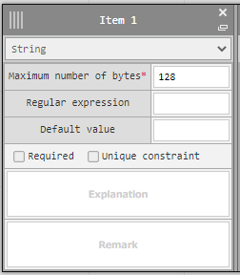
3.11 Item registration
Following functions are available in parameter sheet・data sheet item
Item | Description
Maximum number of bytes | Input maximum number of bytes (8192byte)
Regular expression | Assign regular expression for string and restrict input string pattern.
Default value | When default value is selected, value is already inputted in created menu.
Required | Input is required when checked.
Unique constraint | Input string becomes unique when checked. Unique constraint in multiple item is available.
※ Unique constraint一(multiple item）
Unique constraint is system to control registration of same record in multiple record when registering data in created menu.
Refer to 利用手順マニュアル_メニュー作成機能『 5.2 (B) “menu creation information” tab』for reference.
※ 詳細は「Exastro-ITA_利用手順マニュアル_メニュー作成機能」を参照

Slide 38
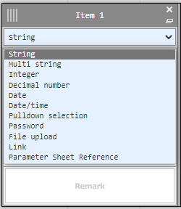
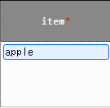
3.11.1 Input method：String
If “String (single/multiple)" is selected, sting can be registered in value input list.
When selecting input method
In the menu
Select String(single/multiple)
Register string

Slide 39
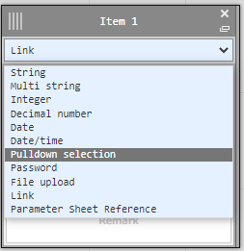
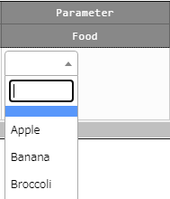
3.11.2 Input method：Pulldown selection（1/5）
If "pulldown" is selected, a pulldown menu will be displayed in the input field. This list can reference values registered in other menus.
When selecting input method
In the menu
Select “Pulldown selection”
A pulldown is displayed, and values registered in other menus can be referenced.
By using a pulldown selection, users can prevent spelling errors and other writing inconsistencies.

Slide 40
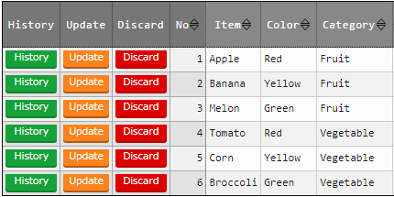
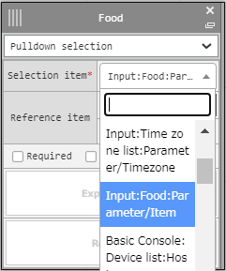
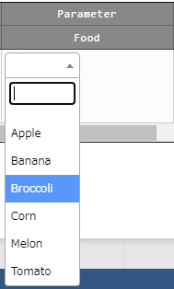
3.11.2 Input method：Pulldown selection （2/5）
Source menu and destination menu
When using Pulldown selection, data registered in the source menu will be referenced and displayed in the pulldown menu.
Both the source menu and the items you want displayed must be selected in the "Reference item" when creating the destination menu.
（Example）
Source menu
Selection Item
In the Selection Item box, select the Item that you want displayed.
The values registered under the "Item" in the source menu are
Destination menu
Displayed in the pulldown selection in the destination menu.

Slide 41
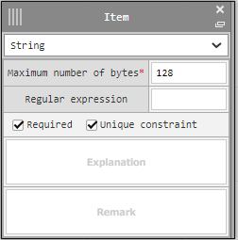
3.11.2 Input method：Pulldown selection （3/5）
“Selection item” field
Menus and items selectable in the "Selection item" field can be both one of the default menus or an user created one.
If you want to select a user created one, make sure that the source menu's item has both "Required" and "Unique constraint" boxes checked (See below).
※ Please refer to chapter 8.5 in Exastro-ITA_User_Instruction_Manual_Menu_creation_function
（Example）
Source menu
The input method can either be "String", "Multi string", "Integer", Decimal Number", "Date", "Date/Time" or "Link".
If both the “Required” and “Unique Constraint” box are checked,
Destination menu
The item will be selectable in the “Selection item” field.

Slide 42

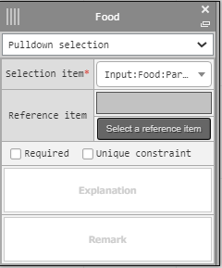
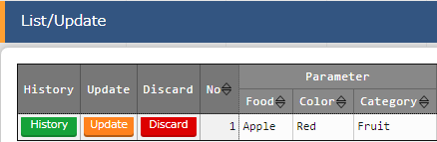
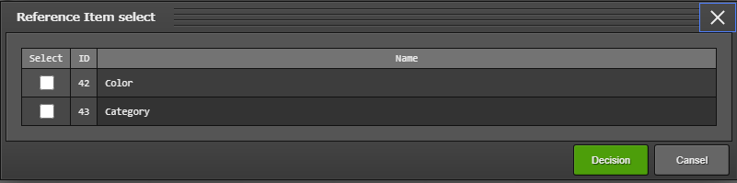
3.11.2 Input method：Pulldown selection （4/5）
Reference Items field
It is possible to have multiple items referenced as a set from the source menu.
Once you have selected an item for the "Selection item", select the other items from the "Reference items" screen.
Selecting an item in the "Selection item" field will automatically display the "Reference items" pop-up window.
If a default menu was selected, the "reference items" will display default items(※) ※ For more information, please refer to Chapter 8.6 in Exastro-ITA_User_Instruction_Manual_Menu_creation_function
（Example）
Source menu
Reference item
Clicking "Select Reference Item"
The item selected in the "Reference Item",
Will display a window where users can select items other than the "Selection item”.
Destination menu
Is displayed in the Destination Menu's "List/Update" field.
Selected item
Reference items

Slide 43
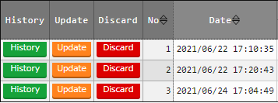
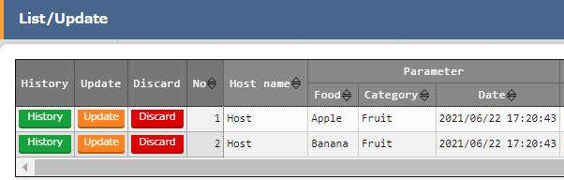
3.11.2 Input method：Pulldown selection （5/5）
Using “Pulldown Selection”
By using "Pulldown Selection", users can manage data like in the example illustrated below.
Make the Source menu a Data sheet and the Destination a Parameter sheet. That way, users can divide fixed records and flexible records if needed.
Link multiple source menus to one destination menu and collect only the necessary data.
When linking multiple items from the source menu, use "Reference Items" to decrease workload and save time.
（Example） Reference one part from both Data sheet A and B to Parameter sheet X with Pulldown Selection.
The "Category" item in Parameter sheet X is displayed by using "Reference item".
Source menu：Data sheet A
Source menu：Data sheet B
Destination Menu： Parameter sheet X

Slide 44
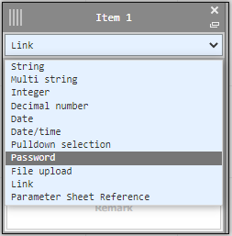
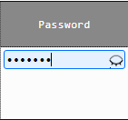


3.11.3 Input method：Password
If "Password" is selected, the item will be an item where input text will be hidden with "●"
(The characters will only be shown if the eye mark inside the text box is pressed.)
When selecting input method
In the menu
Select “Password”
The item is an text box where the text is hidden with "●".
After registration, the item will display "********" and the item cannot be referred.
The text will only be displayed when the eye clicked.

Slide 45
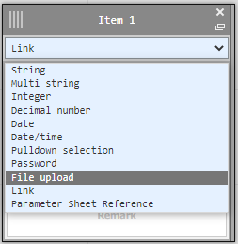
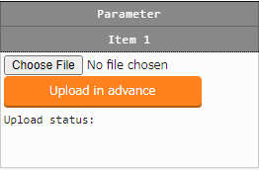

3.11.4 Input method：File Upload
This item allows users to upload files.
If "File upload" is selected, the item will contain 2 buttons. one button for browsing file and one button for uploading it.
When selecting input method
In the menu
Select “File Upload”
Users can their own files. Users can then download the any uploaded files if they are registered.
Press the "Register" button after pressing the "Upload in advance" button.

Slide 46
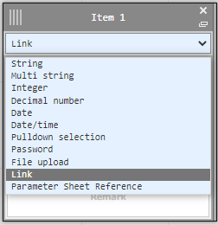
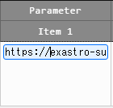

3.11.5 Input method：Link
If "Link" is selected, the item will contain a text box where users can input an URL that can be pressed when registered.
When selecting input method
In the menu
Select “Link”
First input an URL and register. You can now see that the registered record now contains a link.

Slide 47
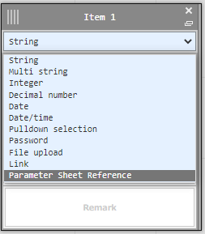
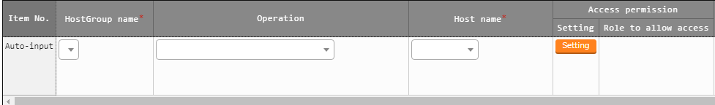
3.11.6 Input method：Parameter sheet reference
Matched record will be referenced when data is registered in created menu “parameter sheet(Operation)”
When selecting input method
In the menu
Select “parameter sheet reference”
When data is registered, operation with matched record value is referenced from selected menu item on parameter sheet

