Slide 1


Host group management
Menu creation
【Practice】
※In this document, “Exastro IT Automation” is described as “ITA".
Exastro IT Automation Version 1.10
Exastro developer

Slide 2
Table of contents
１．Introduction
About this document
Work environment
Scenario
２．Practice Scenario 1
Preparation
Operation registration
Movement configuration
Conductor creation
Host group configuration
Menu list
Data registration
Substitution value automatic register configuration
Check Substitution value・Target host
Execution Conductor
Check reference parameter sheet
３． Practice Scenario 2
Operation registration
Add host to host group
Register data
Check Substitution value・Target host
Conductor execution

Slide 3
1. Introduction

Slide 4
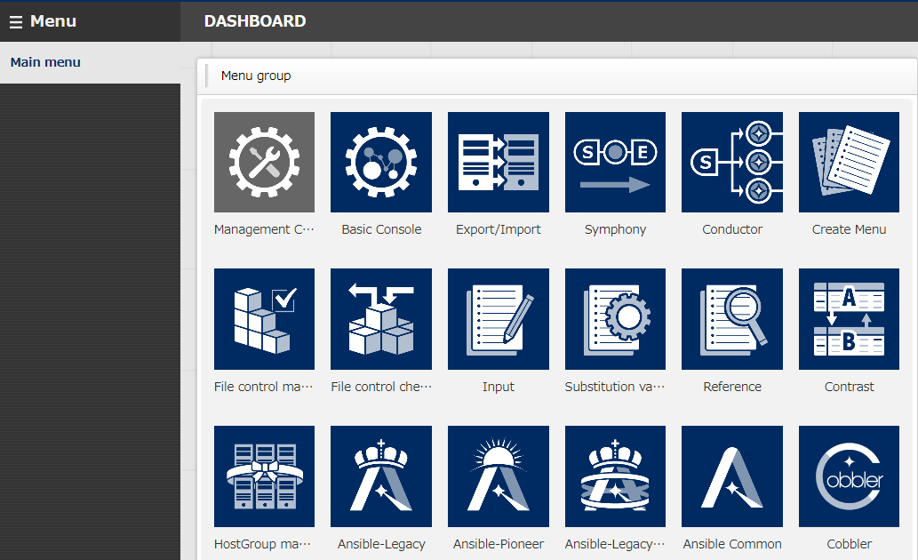
1.1 About this document
About this document This document will guide users through a practice scenario where users will be able to get some hands on experience to get a deeper understanding about the following functions. We will use Ansible Legacy to execute the operations. This document covers the following menu groups:
Host group Management
Create menu

Slide 5


1.2 Work Environment
Work environment
The work environment used in this document is as follows.
Please prepare 5 servers in addition to the ITA Host server.(※1)
CentOS 7
（※2）
CentOS 7（※3）
Target server group
PC
Exastro
IT Automation
v1.10.0
Ansible
※1 While we recommend that you prepare 5 servers in order to get the best experience, it is possible to complete this scenario with 3~4 servers.
※2 ITA can be installed on OS RHEL7 and RHEL8. ※3 Any OS compatible with Ansible can be used.

Slide 6
1.3 Scenario (1/2)
Scenario 1. Set basic settings for the whole server In this scenario, we will use the host group and menu creation functions to do the following:
Set a common time zone for the “ALL_SV” parent host group.
Set different DNS server IP addresses for the “db_SV” and “web_SV” child host groups
Set individual host names for all of the host.
All_SV
timezone: Asia/Tokyo
Inherits
Inherits
db_SV
web_SV
nameserver: 10.15.1.30 or 10.15.1.62
host | timezone | nameserver | hostname
dbA | Asia/Tokyo | 10.15.1.30 | dbA
dbB | Asia/Tokyo | 10.15.1.30 | dbB
webA | Asia/Tokyo | 10.15.1.62 | webA
webA | Asia/Tokyo | 10.15.1.62 | webB
dbA
dbB
webA
webB

Slide 7

1.3 Scenario (2/2)
Scenario 2 - Execute only on the additional server This scenario starts with the assumption that the reader has already completed Scenario 1. If the playbook is idempotent,
1)Add the additional server to host group. 2)Execute the same operation settings one more time.
Note that there are some playbooks that are not idempotent, such as those that adds information to files. If those are repeatedly applied to the same host, errors might occur. Taking that into consideration, all of the operations in scenario 2 will take place on the additional server(s). The contents of the Conductor are the same as the ones in scenario 1.
All_SV
timezone: Asia/Tokyo
Inherits
db_SV
web_SV
nameserver: 10.15.1.62
host | timezone | nameserver | hostname
webC | Asia/Tokyo | 10.15.1.62 | webC
dbA
dbB
webA
webB
webC (Added server)

Slide 8
2. Practice Scenario 1

Slide 9



Scenario 1 - Overview
The figure below illustrates the operations in Scenario 1.
Click here to jump to the scenario
2.2
Target servers
CentOS 7
2.1
(2/2)
Ansible
ITA
2.4
Operation
Ansible-Legacy
2.5
(1/3～2/3)
Device list
2.5
(3/3)
2.1
(1/2)
2.3
(2/3)
Host group
Conductor
2.6
(1/6)
S
2.10
(1/2～2/2)
2.6
(2/6)
2.11
Data sheet
Timezone | UTC | JST
xxxxxx | xxx | xxx
Playbook
Playbook
Movement
2.7
(1/3)
2.6
(3/6)
Playbook
Run
2.6
(4/6)
Variable
Movement
Parameter sheet (With host group)
Host group name | operation | Timezone | Nameserver_ip
xxxxxx | xxxxxx | xxxxxx | xxxxxx
2.7
(2/3)
2.3
(3/3)
Movement
2.6
(5/6)
2.9
E
2.3
(1/3)
2.6
(6/6)
Parameter sheet (Without host group)
Host name | Operation | Hostname | -
xxxxxx | xxxxxx | xxxxxx | -
2.8
2.7
(3/3)

Slide 10
2.1 Preparation (1/2)
Playbook creation
This scenario will use the following three playbooks. Please use the following contents to make 3 different files. [Caution]
Create the yml file with Character code " UTF-8 without BOM", New line code "LF".
Make sure that the indents are valid when copying the source code.
File name: 1-set_timezone.yml
Changes the time zone to the specified value.
In this scenario, all host`s common value will be substituted.
- name: Set Timezone
timezone:
name: "{{ VAR_locale_timezone }}"
File name: 2-set_nameserver.yml Adds postscript to /etc/resolv.conf.
This will only be run once per host, since it is not idempotent.
- name: Add Nameserver
shell: ‘echo nameserver {{ VAR_nameserver_ip }} >> /etc/resolv.conf’
- name: Set Hostname
hostname:
name: "{{ VAR_hostname }}"
File name: 3-set_hostname.yｍl Changes the hosts name.
In this scenario, the hosts will have it’s value substituted.

Slide 11
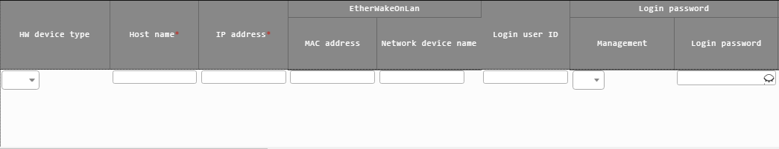
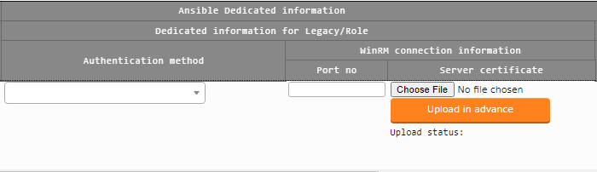
2.1 Preparation (2/2)
Register target host In this step, we will register the host that will execute the operations. For this scenario, we will register 5 servers. ※ webC is used in scenario 2. Menu : Basic Console > Device list
Click Register > Start Registration.
Select or input the following information for each item and click "Register".
Item | HW Device type | Host name | IP Address | Login user ID | Management | Login password | Authentication method
Server1 | SV | webA | Target device IP Address | （Input free value） | ● | （Input free value） | Password authentication
Server2 |  | webB
Server3 |  | dbA
Server4 |  | dbB
Server5 |  | webC

Slide 12
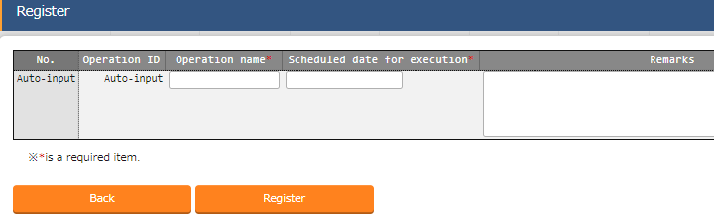
2.2 Register Operation
Register new operation Follow the instructions below and create an Operation.
Menu : Basic Console > Operation list
Click Register > Start Registration.
Input the following information for each item and click "Register".
Operation name | Scheduled date for execution
Basic settings all | (Enter free value)
※ "Scheduled date for execution" is just an item for management. It will not be executed automatically.

Slide 13
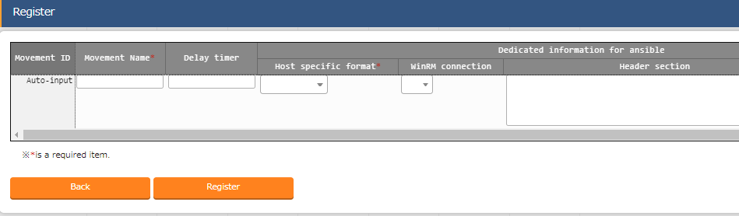
2.3 Configure Movement (1/3)
Create Movement Register the Movements that is going to be linked with the playbooks. Menu : Ansible-Legacy > Movement list
Click Register > Start Registration.
Select or input the following information for each item and click "Register".
Movement name | Host specification format
Set Timezone | IP
Set Hostname | IP
Add Nameserver | IP

Slide 14
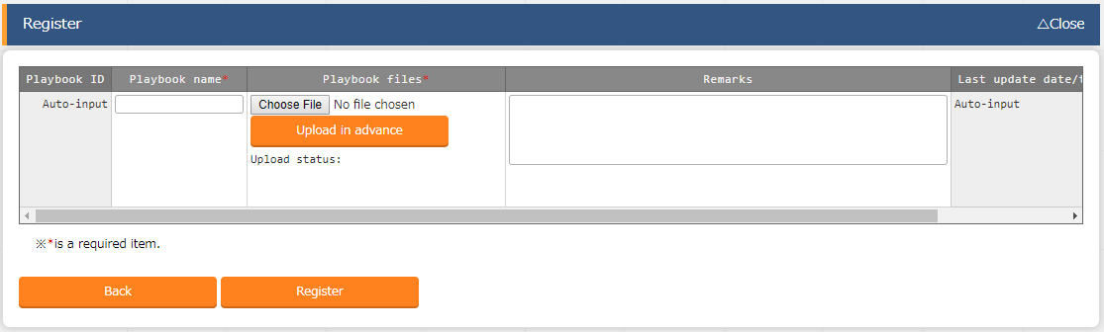
2.3 Configure Movement (2/3)
Register playbook Register the previously created Playbooks to ITA.
Menu : Ansible-Legacy > Playbook files
Click Register > Start Registration.
Select the playbooks from "Browser" and click "Upload in advance".
Input the following information for each item and click "Register".
Playbook file name | Playbook file
set_timezone | 1-set_timezone.yml
add_nameserver | 2-.set_nameserver.yml
set_hostname | 3-set_hostname.yml

Slide 15
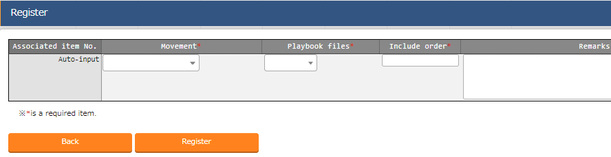
2.3 Configure Movement(3/3)
Register the playbook to Movement. Link the previously created Movement and Playbook files. Menu : Ansible-Legacy > Movement details
Click Register > Start Registration.
Select or input the following information for each item and click "Register".
Related table
Movement | Playbook file | Include order
Set Timezone | set_timezone | 1
Add Nameserver | add_nameserver | 1
Set Hostname | set_hostname | 1

Slide 16
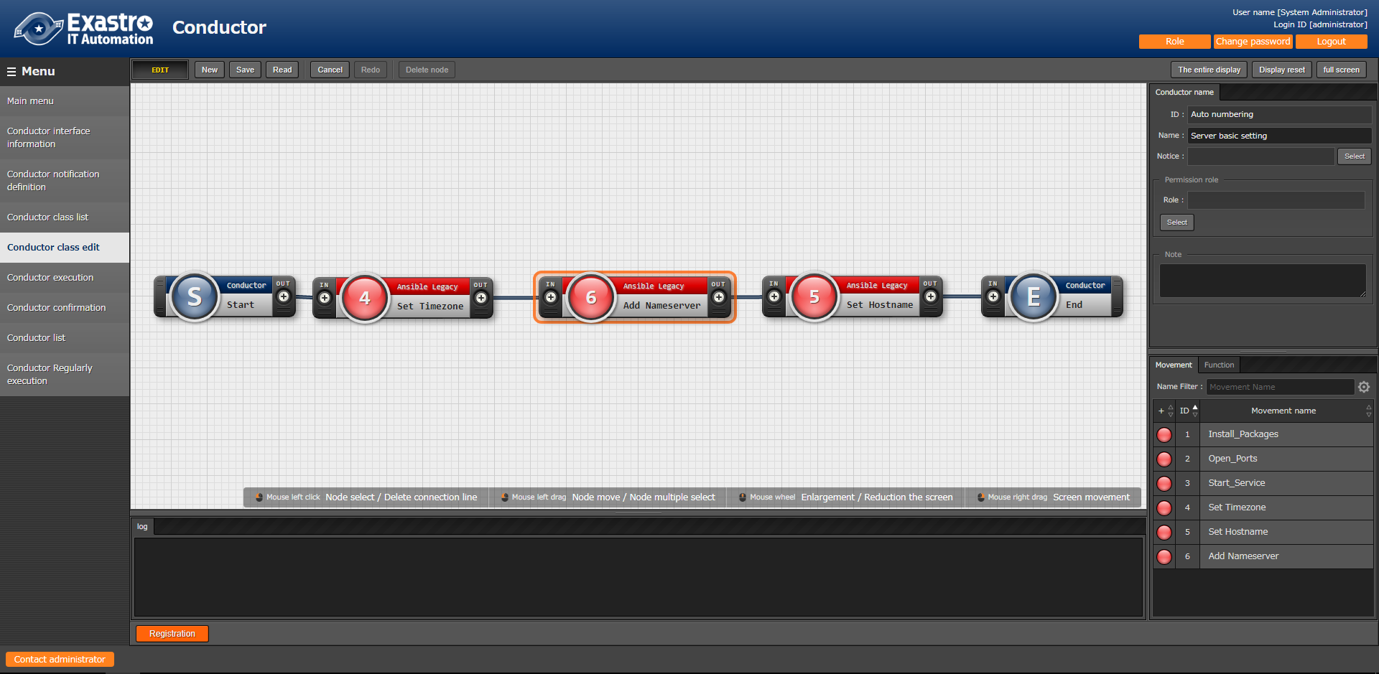
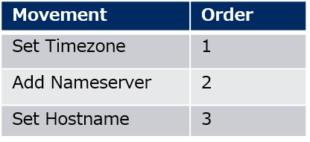
2.4 Create Conductor
Create Conductor Create a Conductor that collects the defined Movements.
Menu: Conductor > Conductor class edit
１
Input Conductor name.
Conductor name
Server basic setting
３
Connect the nodes to each other.
２
Add the required Movements by
dragging and dropping.
４
Click "Registration".

Slide 17
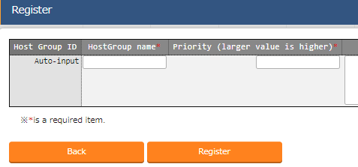
2.5 Configure Host groups (1/3)
Define host groups Follow the steps below and create 3 different host groups. The previously created hosts will be connected to these host groups. Menu : Host group management > Host group management
Click Register > Start Registration.
Select or input the following information for each item and click "Register".
Host group name | Priority order
All_SV | 1
web_SV | 2
db_SV | 3

Slide 18
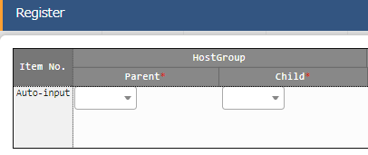
2.5 Configure Host groups (2/3)
Define the parent-child relationship of host groups Define the host groups’ parent-child relationship. Menu : Host group management > Host group parent-child link list
Click Register > Start Registration.
Select the following information for each item and click "Register".
Image
Host group
Parent | Child
All_SV | db_SV
All_SV | web_SV
All_SV
db_SV
web_SV

Slide 19
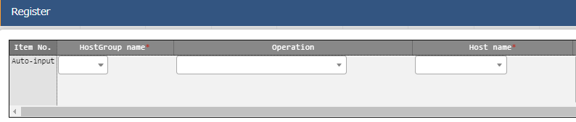
2.5 Configure Host groups (3/3)
Register the hosts to host groups Link the target hosts to the host groups. Menu : Host group management > Host link list
Click Register > Start Registration.
Select the following information for each item and click "Register".
Image
All_SV
Host group name | Operation | Host name
web_SV | Basic settings all | webA
web_SV | Basic settings all | webB
db_SV | Basic settings all | dbA
db_SV | Basic settings all | dbB
db_SV
web_SV
dbA
dbA
webA
webB

Slide 20
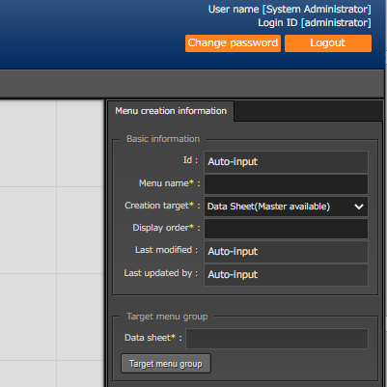
2.6 Menu list(1/6)
Create data sheet Create data sheet. The value registered here will later be selectable from a pull-down menu.
Menu : Create menu > Create/Define menu
Input the following information for each item.
Click "Target menu group“ and then select “Input”.
Item name | Input contents
Menu name | Time zone list
Target operation | Data sheet
Display order | 1

Slide 21
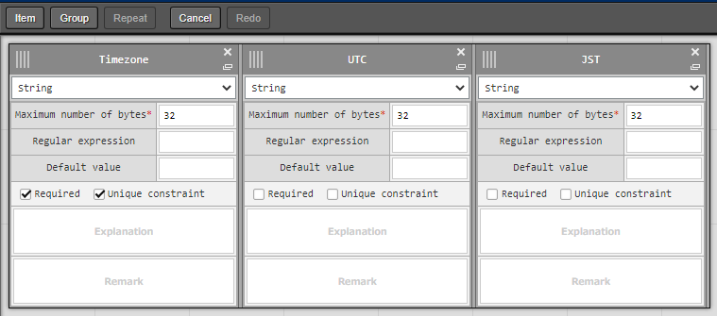
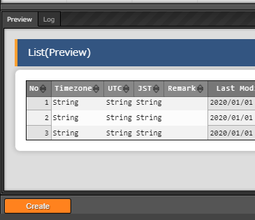
2.6 Menu list(2/6)
Define the item name of the data sheet Continuing from the previous section, define the items on the sheet.
Menu : Create menu > Create/Define menu
Click "Item" and add a new item.
Input the following for each of the items.
Click "Create" at the bottom of the screen.
3
4
5
Item name | Input method | Maximum no. of bytes | Required | Unique constraint
Timezone | String | 32 | ✓ | ✓
UTC | String | 32 | - | -
JST | String | 32 | - | -

Slide 22
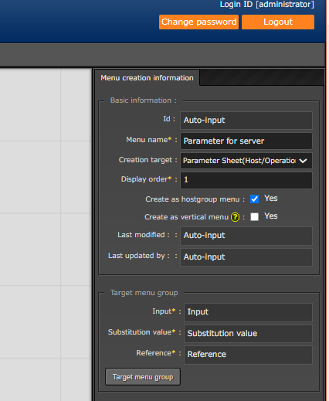
2.6 Menu list(3/6)
Create the menu for the host group Create a parameter sheet for the host group and manage the parameters that apply to your host group.
Menu : Create menu > Create/Define menu
"Basic information" Input the following information for each item.
Leave the Target Menu group as it is with its default values. (Input, Substitution value and Reference)
Item name | Input content
Mnu name | Parameter for server
Creation target | Parameter sheet (Host/Operation)
Display order | 1
Create as Hostgroup menu | ✓

Slide 23
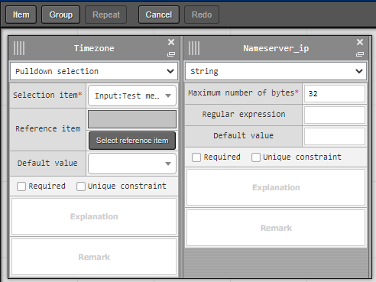
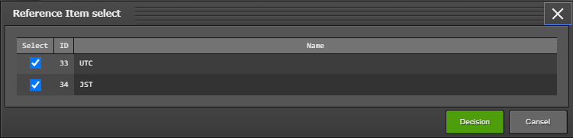
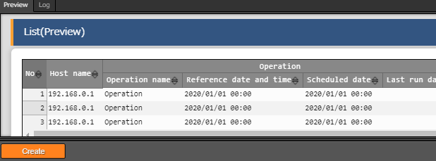
2.6 Menu list(4/6)
Define the item name of the parameters sheet Continuing from the previous section, define the items on the sheet.
Menu : Create menu > Create/Define menu
Click "Item" and add a new item.
Input the following for each of the items.
Click "Create" at the bottom of the screen.
3
4
5
Item name | Input method | Select item | Reference item
Timezone | Pulldown selection | Basic server settings: Timezone list: Parameter/Timezone | UTC,JST
Item name | Input method | Maximum no. of bytes
Nameserver | String | 32

Slide 24
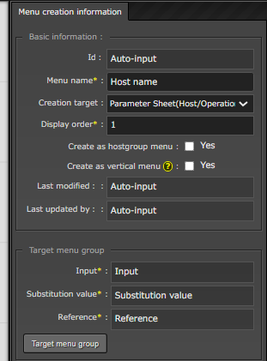
2.6 Menu list(5/6)
Create menu without host group Create a parameter sheet for the host group and manage the parameters that apply to your host group.
Menu : Create menu > Create/Define menu
"Basic information" Input the following information for each item.
Leave the Target Menu group as it is with its default values. (Input, Substitution value and Reference)
Item name | Enter content
Menu name | Host name
Creation target | Parameter sheet (Host/Operation)
Display order | 1

Slide 25
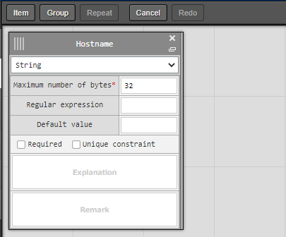
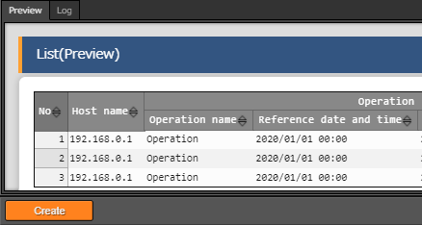
2.6 Menu list(6/6)
Define the item name of the parameters sheet Continuing from the previous section, define the items on the sheet.
Click "Item" and add a new item.
Input the following for each of the items.
Click "Create" at the bottom of the screen.
１
3
2
Item name | Input method | Maximum number of bytes
Hostname | String | 32

Slide 26
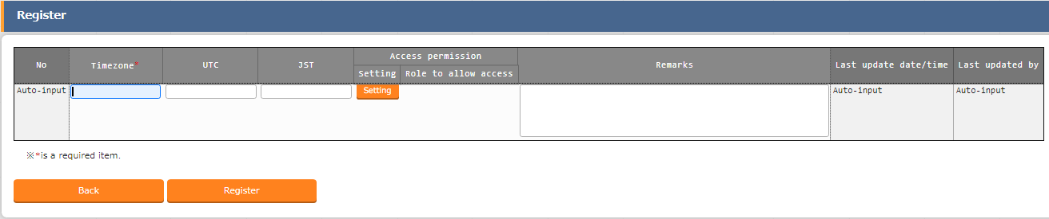
2.7 Data registration(1/3)
Register data to the data sheet. The Data and Parameter sheet are now created. Move to the created menu and input the data.
Menu: Input> Time zone list
Click Register > Start Registration.
Select or input the following information for each item and click "Register".
Timezone
Asia/Tokyo
America/New_York
UTC | JST
+9 | 0
-4 | -13

Slide 27
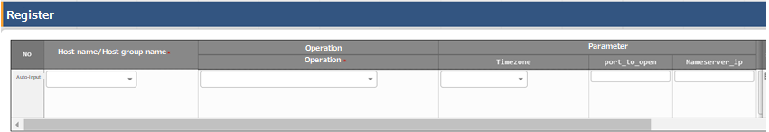
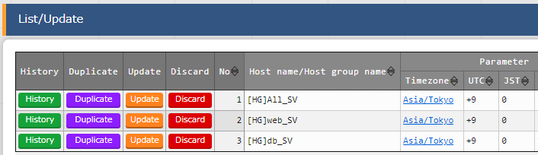
2.7 Data registration(2/3)
Register data to the parameter sheet Move to the created menu and input the data.
Menu: Input> Parameter for server
Click Register > Start Registration.
Select or input the following information for each item and click "Register".
After registering, we can see both of the reference items, UTC and JST
Point
Users can select from the contents entered in
the data sheet in the previous section.
Host name/Host group name | Operation | Timezone | Nameserver
[HG]All_SV | Basic settings all | Asia/Tokyo | 10.15.1.30
[HG]web_SV | Basic settings all | Asia/Tokyo | 10.15.1.62
[HG]db_SV | Basic settings all | Asia/Tokyo | 10.15.1.30

Slide 28
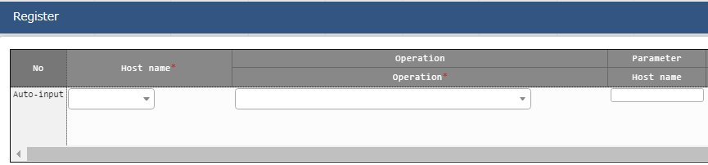
2.7 Data registration(3/3)
Register data to the parameter sheet Next, register the data from the menu created in the menu group for the host.
Menu: Input> Host name
Click Register > Start Registration.
Select or input the following information for each item and click "Register".
Host name | Operation | Hostname
webA | Basic settings all | webA
webB | Basic settings all | webB
dbA | Basic settings all | dbA
dbB | Basic settings all | dbB

Slide 29
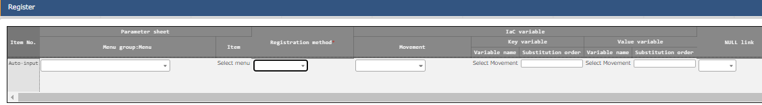
2.8 Substitution Value Automatic Registration setting
Set Substitute Value Automatic Registration settings Connect the variables to each item after entering the data in the parameter sheet.
Menu: Ansible-Legacy > Substitution value automatic registration setting
Click Register > Start Registration.
Select or input the following information for each item and click "Register".
Parameter sheet (from) -Menu group:Menu | Parameter sheet (from) -Item | Registration method | IaC Variable (to) -Movement | IaC variable (to) - Value variable -Variable name
Parameter for server | Timezone | Value type | Set Timezone | VAR_locale_timezone
Parameter for server | Nameserver_ip | Value type | Add Nameserver | VAR_nameserver_ip
Host name | Hostname | Value type | Set Hostname | VAR_hostname

Slide 30
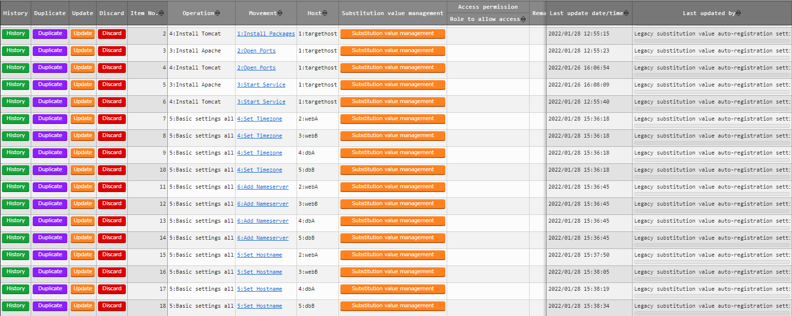
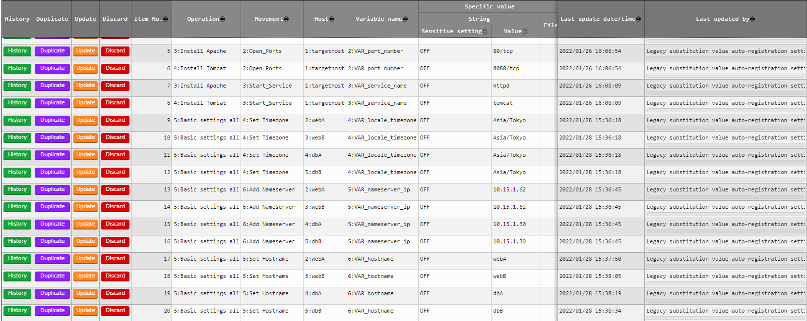
2.9 Check Substitution value・Target host
Check Substitution value and Target host Check the value specified by the substituted value automatic registration and the target host.
Menu: Ansible-Legacy > Target host/Substitution value list
Click "Filter".
Check that the correct value is specified by "legacy substitution value automatic registration setting procedure".
Target host
Substitution value list

Slide 31
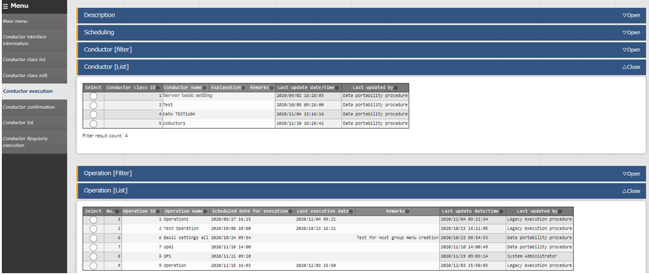
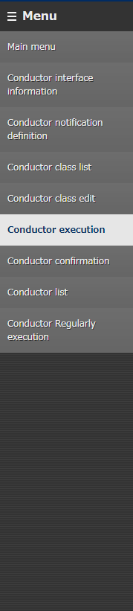
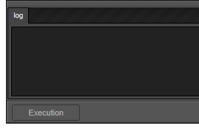
2.10 Conductor execution(1/2)
Execute Conductor If you finished the operations in the previous section, the Conductor should be created and the substitute values should be registered. Finally, execute Conductor and check the result on the target host.
Menu： Conductor > Conductor execution
Select "Server basic setting"
from the Conductor list.
１
Select Operation "Basic setting all“.
２
Tips
The screen will automatically change
to the "Conductor Confirmation"
screen after executing.
Click "Execution" at the bottom
of the screen.
3

Slide 32
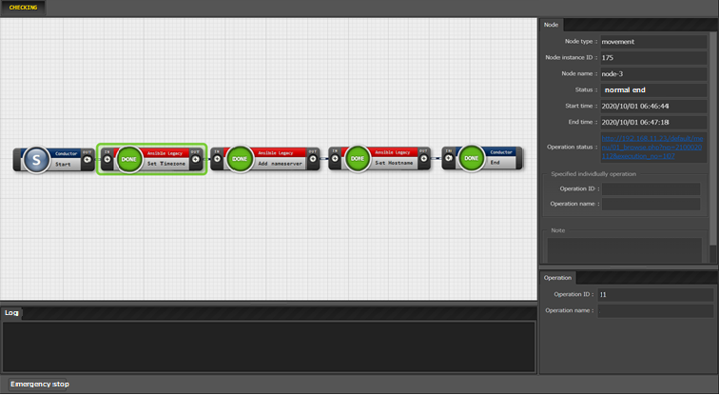
2.10 Conductor execution(2/2)
Check the Conductor Execution results In the work confirmation screen, you can check the results of the whole execution or execution per node. Selecting an inputted Movement will show a link that leads to a more detailed result screen. Users can also press the status circle of the nodes to go to the same result screen.
Menu： Conductor > Conductor confirmation
Select the node you want to check.
２
Link and operation
information is displayed.
１

Slide 33
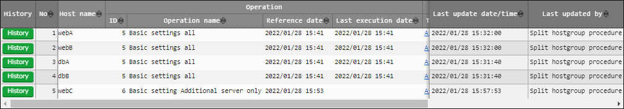
2.11 Reference parameter sheet confirmation
Check contents of the reference parameter sheet By completing the operation in the previous section, the set parameters have now been applied to the target host. Finally, check the reference parameter sheet and confirm that the update date and time etc. are recorded. Menu: Reference > Parameters for server.
Click "Filter".
Confirm that both “Reference date" and “Last execution date" are updated.

Slide 34
3. Practice Scenario 2

Slide 35
Scenario 2 - Overview
The diagram below displays Scenario 1’s procedure.
3.1
Target servers
CentOS 7
ITA
Ansible
Operation
Ansible-Legacy
3.2
Device list
Host group
Conductor
S
3.5
Data sheet
Timezone | UTC | JST
xxxxxx | xxx | xxx
Playbook
Playbook
Movement
Playbook
Execute
Variable
Movement
Parameter sheet (with host group)
Host group name | Operation | Timezone | Nameserver_ip
xxxxxx | xxxxxx | xxxxxx | xxxxxx
3.3
(1/2)
Movement
3.4
E
Parameter sheet (without host group)
Host name | Operation | Hostname | -
xxxxxx | xxxxxx | xxxxxx | -
3.3
(2/2)

Slide 36
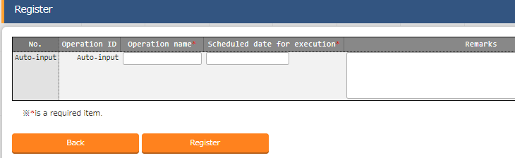
3.1 Operation registration
Register new operation Create an additional operation.
Menu : Basic Console > Operation list
Click Register > Start Registration.
Input the following information for each item and click "Register".
Operation name | Scheduled date for execution
Basic setting Additional server only | (Free value)
※ "Scheduled date for execution" is just used for managing the operation. Any operations with a scheduled execution date will not be executed automatically.

Slide 37
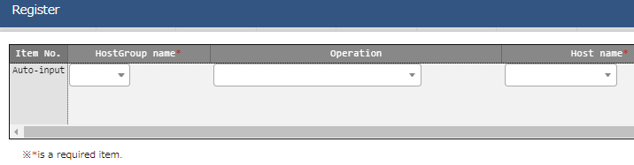
3.2 Add host to host group
Register host to host group Register additional hosts in the host group. Menu: Host group management > Host link list
Click "New register "Register > Start Registration.
Select the following information for each item and click "Register".
Image
All_SV
db_SV
web_SV
Host group name | Operation | Host name
web_SV | Basic settings additional server only | webC
dbA
dbB
webA
webB
webC
Point
The host group, "web_SV" is used for "Basic settings all servers", but this time, we are only adding the operation "Basic settings additional server only".
That is why when we are executing the operation, only webC will be applicable.

Slide 38
3.3 Data registration(1/2)
Register data in the parameter sheet Move to the menu created in scenario 1 and input the following data.
Menu: Input>Parameter for server
Click Register > Start Registration.
Select or input the following information for each item and click "Register".
Users can select from the contents entered in
the data sheet in the previous section.
Host name/Host group name | Operation | Timezone | Nameserver_ip
[HG]web_SV | Basic settings additional server only | Asia/Tokyo | 10.15.1.62

Slide 39
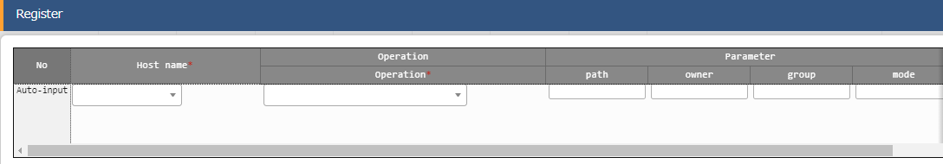
3.3 Data registration(2/2)
Register data in the parameter sheet Next, register the data from the menu created in the menu group for the host.
Menu: Input > Host name
Click Register > Start Registration.
Select or input the following information for each item and click "Register".
Host name | Operation | Hostname
webC | Basic settings additional server only | webC

Slide 40
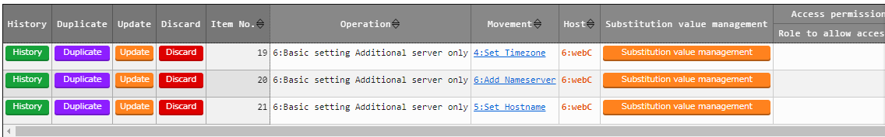
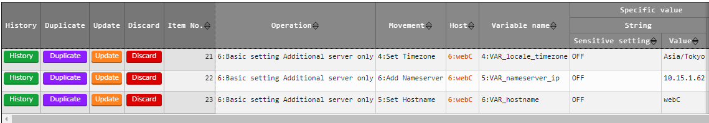
3.4 Check Substitution value・Target host
Check Substitution value and Target host Check the value specified by the substituted value automatic registration and the target host.
Menu: Ansible-Legacy > Target host /Substitution value list
Click "Filter".
Check that only the data of "webC" is added by the "legacy substitution value automatic registration setting procedure".
Target host
Substitution value list

Slide 41
3.5 Conductor execution
Execute Conductor Execute Conductor again. Ensure that the work is reflected only on the host "webC".
Menu: Conductor > Conductor execution
Select "Server basic setting"
from the Conductor list.
１
Select the "Basic setting all“ operation
２
Tips
Executing will move the user to the "Conductor Confirmation" screen.
For more information about the Result
Confirmation screen, please see this slide.
Click "Execution" at the bottom
of the screen.
3

