Slide 1


CI/CD for IaC 【Classroom】
※In this Document “Exastro IT Automation” will be written as “ITA”.
Exastro IT Automation Version 1.8
Exastro developer

Slide 2
Table of contents
Introduction
About this document
CI/CD for IaC
CI/CD for IaC
CI/CD for IaC function
CI/CD for IaC Menus
CI/CD for IaC workflow

Slide 3
1. Introduction

Slide 4
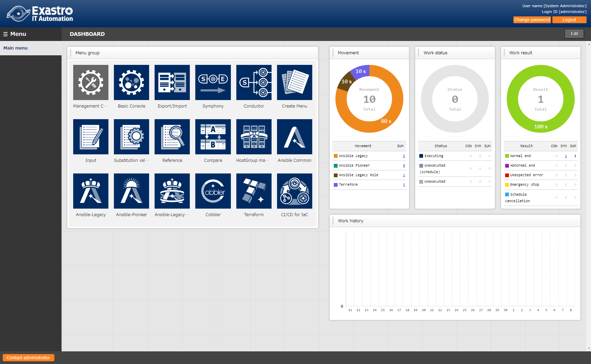
1.1 Ansible driverについて X/X
1.1 About this document
Main Menu
This document aims to explain the CI/CD for IaC Menu group.
The Practice document provides scenarios where users can learn about the CI/CD for IaC function by having first-hand experience.

Slide 5
2. CI/CD for IaC

Slide 6
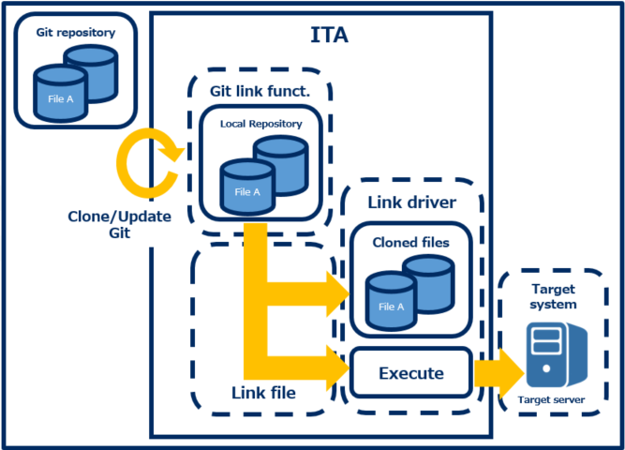
2.1 CI/CD for IaC
What is CI/CD for IaC?
When using IaC (Infrastructure as Code) files, such as Ansible's Playbook files or Terraform's IaC files, for development, we can use CI (Continuous Integration) to automatically test and build, and CD (Continuous Delivery) to automatically construct environments. Connecting to Git allows users to manage files by versions and to see when what user committed what files and so on. By uploading files to Git, users can automatically create environments by configuring some files., meaning that users can now use GitOps with ITA.

Slide 7
1.1 Ansible driverについて X/X
2.2 CI/CD for IaC Function
The Ci/CD for IaC menu contains 2 functions.
Git link
This functions allows users to clone a Git repository to ITA. ITA can then use the clone to check for any updates from the file source on a regular basis, and creates a list of the files in ITA’s “Remote Repository files” menu.
File link
This function allows users to link the source file and the files from the Git clone. It will then register an Operation and a Movement that will check the validity of the copied files. If the source files are updates, the cloned files will then be automatically updated and have their validity checked.

Slide 8
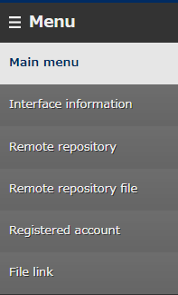
2.3 CI/CD for IaC Menus （1/5）
The main menus for the Ci/CD for IaC function are as following.
①Remote Repository
This menu manages the Git repository information.
②Registered account
This menu manages the account information needed to access the cloned files with ITA’s RestAPI. ③File link
This menu manages the link information between the source files and the cloned files.
①
②
③

Slide 9
2.3 CI/CD for IaC Menus （2/5）
Remote Repository
In the Remote Repository menu, users can register the information of the Git repository they want to link.
URL of the Git Repository used when running Git clone command.
If you are connecting to a remote Git repository with https, select https If you are connecting to a local Git, select Local
Decides if synchronization with the Git repository is done automatically or not. If the “cycle(seconds)” field is blank, it will be set to the default value (60 seconds)

Slide 10
2.3 CI/CD for IaC Menus （3/5）
Registered account
In this menu, users can register the account information needed to access the clones files from ITA’s RestAPI. Keep in mind that the account must also be registered in the “Management console > User list” menu.
RestAPI Login ID
RestAPI Login Password

Slide 11
2.3 CI/CD for IaC Menus （4/5）
File link
In this menu, users can link the source files and the destination files (cloned files).Doing so will automatically register an operation and Movement that will automatically check the validity of the cloned files. If the source files are updated, the Backyard function will automatically update the cloned files to match the update, and will run the Operation/Movement to check the validity of the newly updated cloned files.
The “Link destination file names” are linked by the Link destination file type (See the table below). Keep in mind that there are different restrictions that needs to be followed for the different menu items.
Link destination file type | Item name
Ansible-Legacy/Playbook file list | Playbook files name
Ansible-Pioneer/Dialogue file list | No item
Ansible-LegacyRole/Role package list | Role package name
Ansible common/File list | File embedded variable name
Ansible common/Template list | Template embedded variable name
Terraform/Module files | Module file name
Terraform/Policy list | Policy name

Slide 12
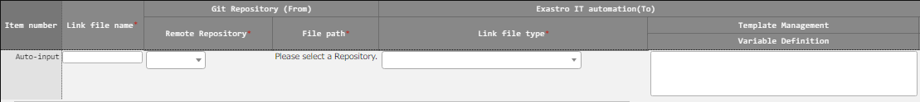
2.3 CI/CD for IaC Menus （5/5）
File link
If the Link destination type is from the Ansible-LegacyRole/RolePackage list menu, refer to “Exastro-ITA_User_Instruction_Manual_CICD_For_IaC” for more information.
Displays registered remote repositories
Displays the source files
Displays the registered ID for the registration account.
Decides if the cloned files are automatically updated when the source files are.

Slide 13
2.4 CI/CD for IaC workflow
The figure below illustrates a standard workflow for the CI/CD for IaC function. Please refer to the Practice document for information regarding operating it.
①Register remote repository
【Legend】
②Register Registration account
Required
③Register file link
Optional
④Register operation+movement info to file link
⑤Check automatic file update and validation

