Slide 1


Conductor【Practice】
※In this document, “Exastro IT Automation” is described as “ITA".
Exastro IT Automation Version 1.8 Exastro developer

Slide 2
Table of contents
Introduction
About this document
Conductor
Scenario
Preparation
Operation
Register Target host
Register operation
Register IaC
Register Movement
Register Movement details
Register Host and Movement connected to the operation
Substitution value list
Register Conductor
Conductor execution
Conductor confirmation

Slide 3
1. Introduction

Slide 4
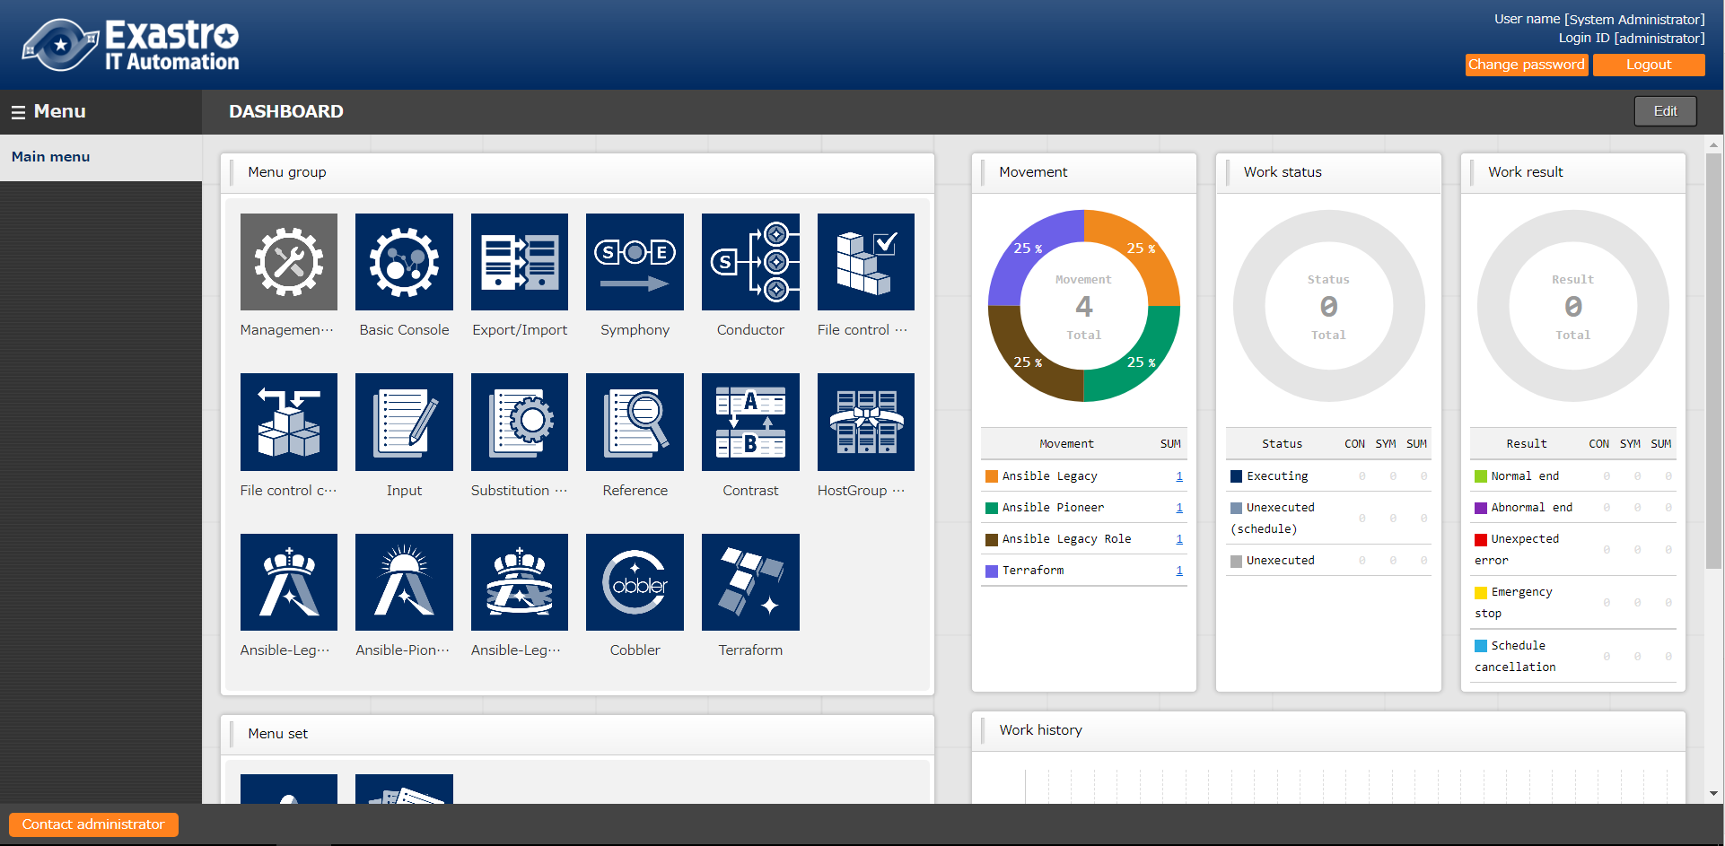
1.1 Ansible driverについて X/X
1.1 About this document
The "Conductor" menu group is explained in this document.

Slide 5
2. About Conductor

Slide 6
2.1 Scenario (1/2)
The Scenario used in this document is as following.
Ansible driver is required to proceed with the scenario, so in this scenario, we will explain using Ansible-Legacy.
①Register device information
Basic console menu
②Register operation
③Register Movement
Various driver menu
④Check Movement
⑤Register interface information
Conductor menu
⑥Register Conductor
⑦Check Conductor
⑧Execution Conductor
⑨Check execution result
⑩Check execution history

Slide 7
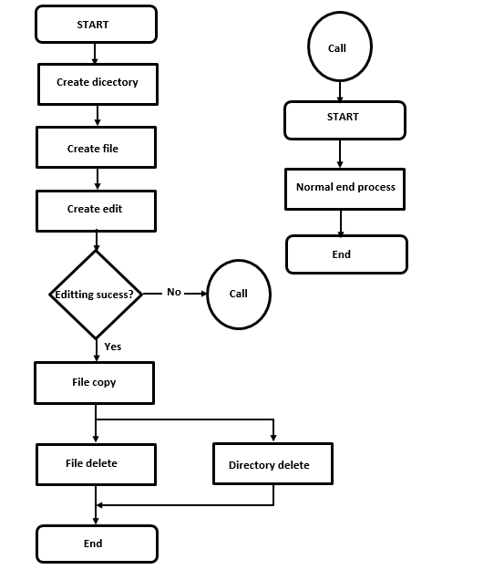
2.1 Scenario (2/2)
In order to experience the Conductor functions in this document, we will create a Conductor similar to the following flowchart.
Flowchart
Point②
Features of Conductor function
Point① Conditional branch function according to the success/end judgment of pre-processing.
Point② Registered Operation/Conductor Call function.
Point③ Movement parallel processing function.
Point①
Point③

Slide 8
2.2 Preparation
Create IaC(1/2)
In this scenario, Ansible-Legacy is explained with the use of an example.
Save the following IaC as an yml file for each module.
※Character code is "UTF-8", Newline code is "LF", file name extension is "yml"format. Please be careful about indents.
- name: create directory
file:
path: /tmp/{{ item.dir }}
state: directory
mode: 0755
with_items:
- { dir: "{{ VAR_dir_name_1 }}" }
- { dir: "{{ VAR_dir_name_2 }}" }
- name: remove directory
file:
path=/tmp/{{ VAR_dir_name_1 }}
state=absent
- name: create file
file:
path=/tmp/{{ VAR_dir_name_1 }}/{{ VAR_file_name }}
state=touch
mode=0755

Slide 9
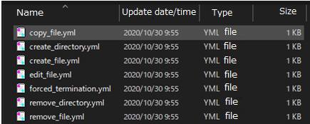
2.2 Preparation
Create IaC(2/2) Similarly, save the following IaC as yml files for each module.
- name: remove file
file:
path=/tmp/{{VAR_dir_name_1 }}/{{VAR_file_name }}
state=absent
- name: copy file
copy:
src=/tmp/{{VAR_dir_name_1 }}/{{VAR_file_name }}
dest=/tmp/{{VAR_dir_name_2 }}/{{VAR_file_name }}
owner=root
group=root
mode=0644
- name: edit file
copy:
dest=/tmp/{{VAR_dir_name_1 }}/{{VAR_file_name }}
content= {{VAR_edit_param_1 }}
- name: forced termination
fail: msg={{VAR_message_text }}
Created image

Slide 10
3. Operation

Slide 11
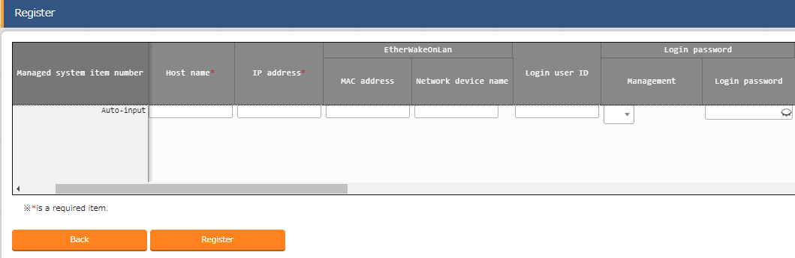
3.1 Register Target host
Register Target host
"Basic Console“ menu group >> "Device list“ menu >> "Register“ submenu >>"Start register“ button.
Enter the following "Host name", "IP address", "Login ID", “Management", "Login password“ and "Authentication method“.
Click "Register" button.
１
Enter value for the item
Item | Value
Host name | testserver
IP address | (Free value)
Login ID | (Free value)
Management | ●
Login password | (Free value)
Authentication method | Password authentication
２
This scenario assumes that you want to have a ssh password connection to the Target host.
Please enter “IP Address”, “Login ID", "Login password”
appropriate to the settings set in the users environment.

Slide 12
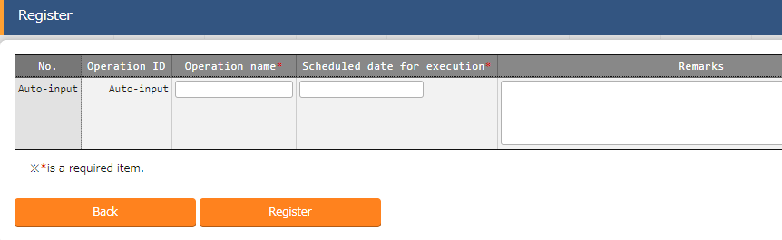
3.2 Register operation
Register operation
"Basic Console“ menu group >> "Input list“ menu >> "Register“ submenu >>"Start register“ button.
Enter "Operation name“, "Schedule date for execution“.
Click “Registration” button.
１
Enter value for item
Item | Value
Operation name | operation1
Schedule date for execution | （Free date/time）
２
The process will not be executed at the
date and time specified here.

Slide 13
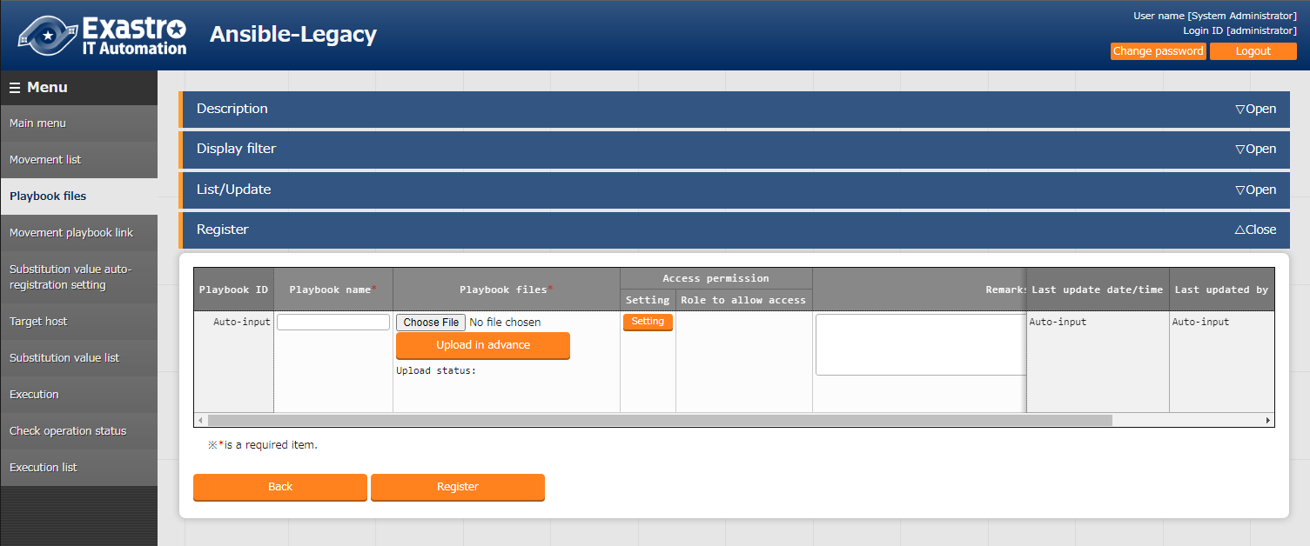
3.3 Register IaC (1/2)
Register IaC
"Ansible-Legacy" menu group >> "Playbook files" menu >> "Register" submenu >> "Start register" button.
Input “Playbook file name“. Click the ”Reference” button in the “Playbook files” column. Upload all previously created yml files. (Click "upload in Advance" button)
Click “Registration” button.
Enter value for item
１
Item | Value
Playbook file name | ＜free＞
Playbook file | ＜free＞.yml
２
Please refer to "2.2 Pre-preparation“. For more information on how to create IaC.

Slide 14
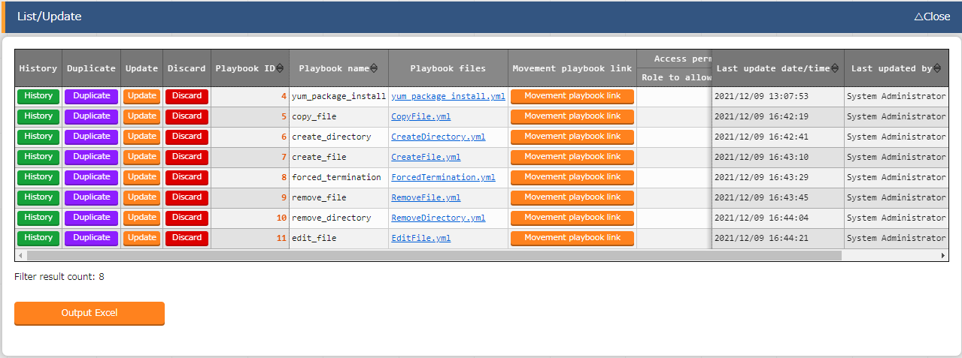
3.3 Register IaC (2/2)
Register IaC
When you’re done registering, the list should be something like this:

Slide 15
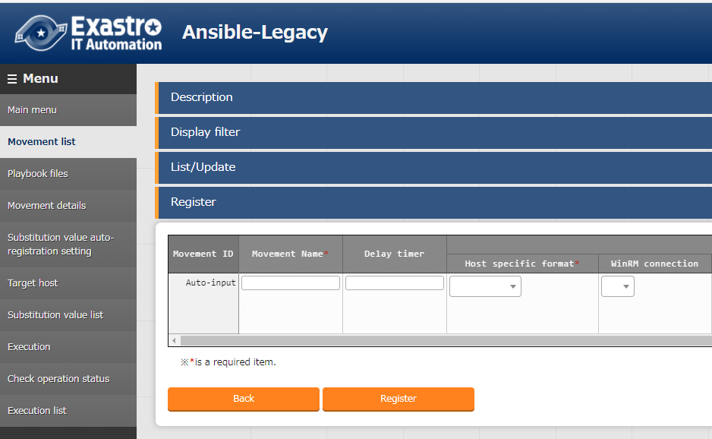
3.4 Register Movement (1/2)
Register Movement
"Ansible-Legacy" menu group >> "Movement list" menu >> "Register" submenu >> "Start register" button.
Input "Movement name" and select ”Host specific format“.
Click “Register” button.
１
Set the value for item
Item | Value
Movement name | ＜Free＞
Host specific format | IP
Please create one Movement for each yml file.
２

Slide 16
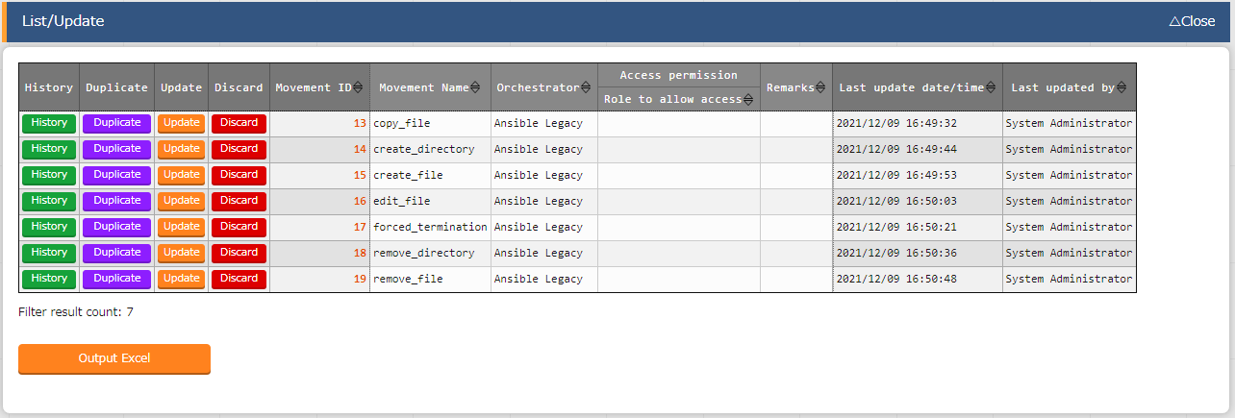
3.4 Register Movement (2/2)
Register Movement
When you’re done registering, the list should be something like this:

Slide 17
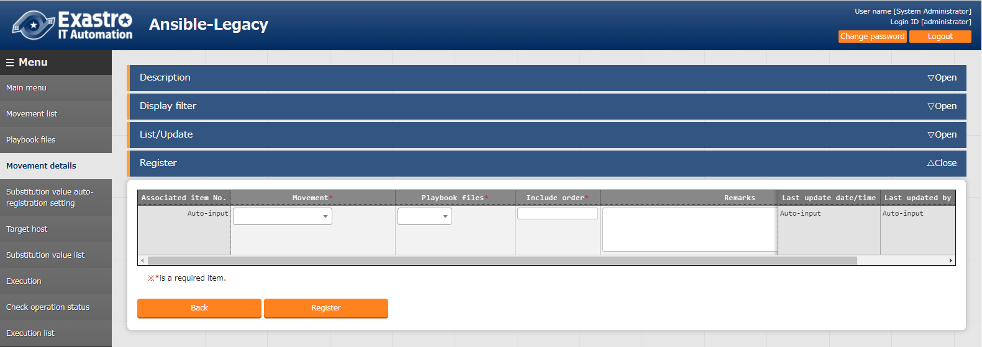
3.5 Register Movement details (1/2)
Register Movement details
"Ansible-Legacy" menu group >> “Movement playbook link" menu >> "Register" submenu >> "Start register" button.
Input "Movement“ , "Playbook files" and "Include order"
Click "Register" button.
２
１
Set the value for item
Item | Value
Movement | Select the create Movement
Playbook file | Select the register playbook
Include order | 1
Please create the same number of
yml files as registered movement information.

Slide 18
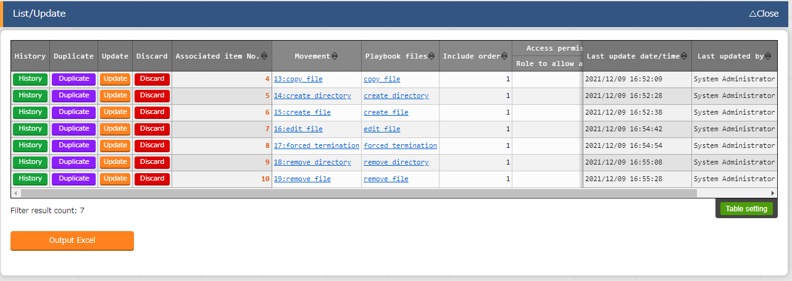
3.5 Register Movement details (2/2)
Register Movement details When you’re done registering, the list should be something like this:

Slide 19
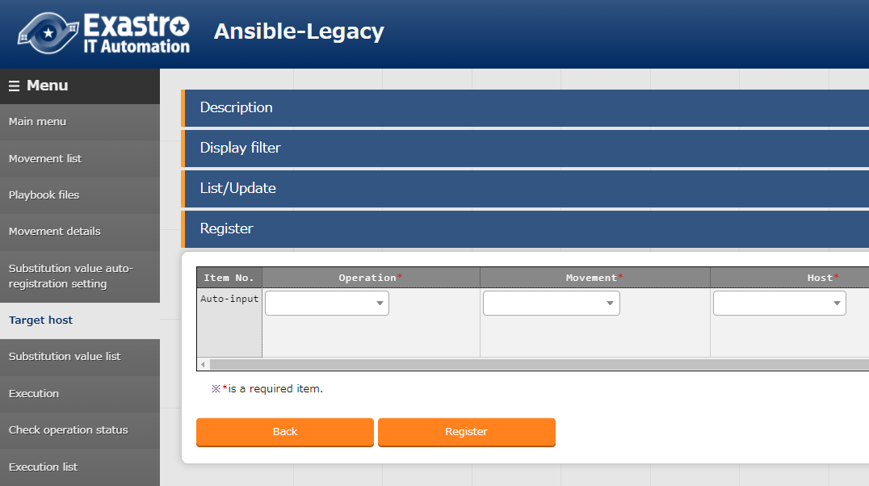
3.6 Register Movement and Host connected to the operation
Register Movement and Host connected to the operation
"Ansible-Legacy" menu group >> "Target host" menu >> "Register" submenu >> "Start register" button.
Input "Operation“ , "Movement" and "Host".
Click “Register” button.
１
Set value to item
２
Item | Value
Operation | operation1
Movement | Created Movement
Host | testserver
Please register all the
created Movements.

Slide 20
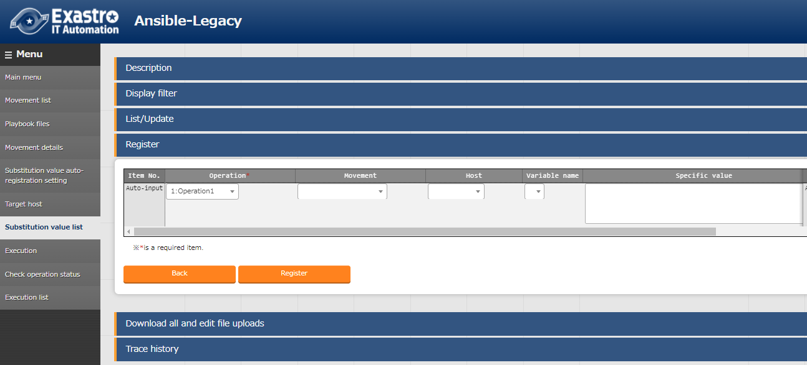
3.7 Substitution value list(1/2)
Substitution value list
"Ansible-Legacy" menu group >> "Substitution value list" menu >> "Register" submenu >> "Start register" button.
Input "Operation“ , "Movement“ , "Host" ,“Variable name" and “Specific value".
Click “Register” button.
１
２

Slide 21
3.7 Substitution value list (2/2)
Substitution value list
Please use the list below for registering substitute values.
Operation | Host | Variable name | Specific value | Substitution order
1:operation1 | 1:Testserver | 3:copy_file:1:VAR_dir_name_1 | dir1
1:operation1 | 1:Testserver | 3:copy_file:2:VAR_file_name | dir2
1:operation1 | 1:Testserver | 3:copy_file:3:VAR_edit_param_1 | testfile
1:operation1 | 1:Testserver | 4:create_directory:4:VAR_dir_name_1 | dir1
1:operation1 | 1:Testserver | 5:create_file:5:VAR_dir_name_1 | dir1
1:operation1 | 1:Testserver | 5:create_file:6:VAR_file_name | testfile
1:operation1 | 1:Testserver | 6:edit_file:7:VAR_dir_name_1 | dir1
1:operation1 | 1:Testserver | 6:edit_file:8:VAR_file_name | testfile
1:operation1 | 1:Testserver | 6:edit_file:9:VAR_edit_param_1 | param1
1:operation1 | 1:Testserver | 7:forced_termination:10:VAR_message_text | testmsg_fail
1:operation1 | 1:Testserver | 8:remove_directory:11:VAR_dir_name_1 | dir1
1:operation1 | 1:Testserver | 9:remove_file:12:VAR_dir_name_1 | dir1
1:operation1 | 1:Testserver | 9:remove_file:12:VAR_dir_name_1 | testfile

Slide 22

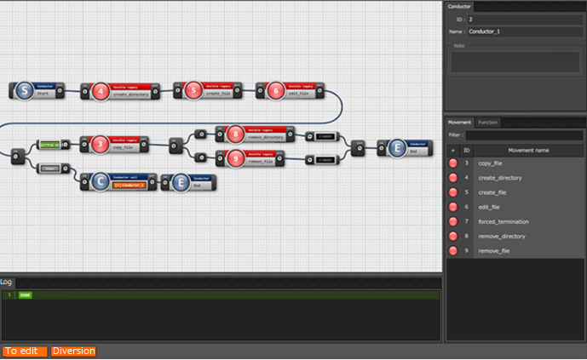
3.8 Register Conductor (1/7)
Register Conductor
Input “Conductor name” in the Conductor menu group>> Conductor Class edit.
Drag and drop “Movements” and “Functions” displayed from the right side of the screen to center of the screen.
Click “Registration” button.
Enter value for item
１
Drag and drop
２
※ The Conductor to be created is on the next page.
３

Slide 23
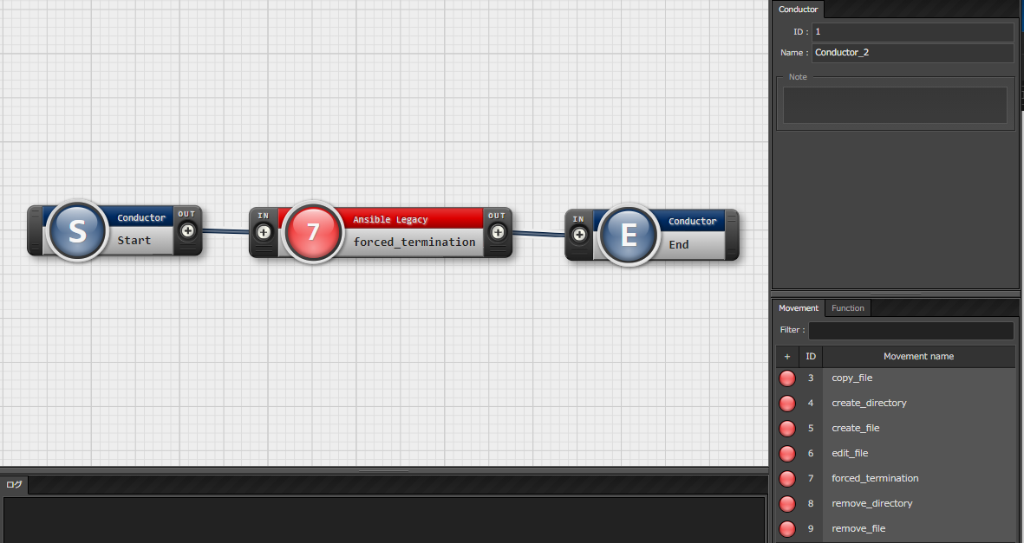
3.8 Register Conductor(2/7)
Register Conductor Please create the Conductor as shown the figure below.
Input "Conductor_2" in "Conductor name.
Drag and drop "forced_termination" from the Movement.
Drag and drop "Conductor" from the Function.
Connect "IN" and "OUT" as shown in the figure.
Click the "Register“ button at the bottom of the screen.

Slide 24
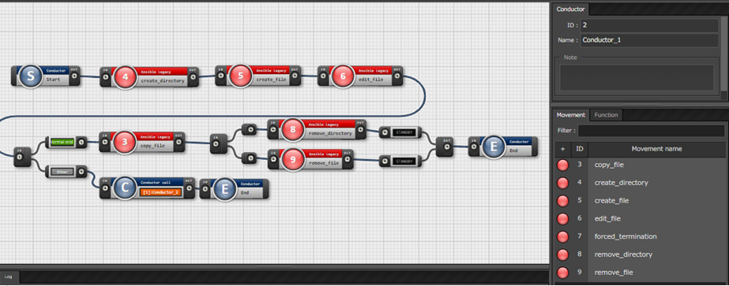
3.8 Register Conductor(3/7)
Register Conductor The overall view of the created Conductor is as follows.
The details are explained on the next pages.
Input "Conductor_1" in Conductor name.
Arrange the various movements referring to the figure.

Slide 25
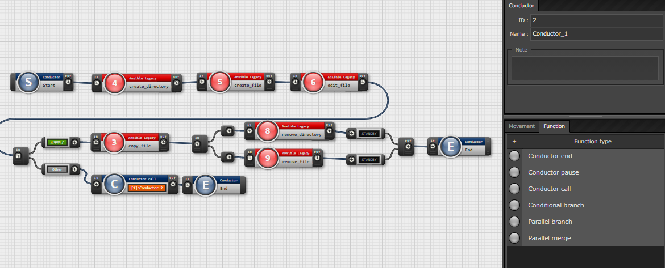
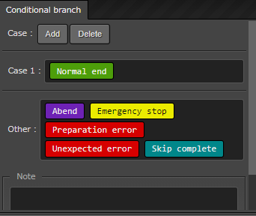
3.8 Register Conductor(4/7)
Register Conductor Please create the Conductor as shown in the figure below.
Drag and drop a Conductor
Branch from the "Function"
tab to arrange it.
Conductor Branches the next process according to the
end result of the Movement immediately before it is
arranged.
For now, set it so subsequent processing only happens when the end status is “Normal end”.

Slide 26
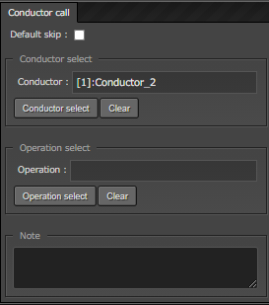
3.8 Register Conductor (5/7)
Register Conductor Please create the Conductor as shown in the figure below.
Drag and drop Conductor Call
from the "Function" tab to
arrange it.
“Conductor call” can call in and execute previously set
Conductors and Operations.
Specify the previously created Conductor_2.

Slide 27
3.8 Register Conductor (6/7)
Register Conductor Please create the Conductor as shown in the figure below.
Drag and drop Conductor end
from the "Function" tab to
arrange it.
・ Conductor end is a function is deployed at the end of a process.. ・ It is also deployed at the end of the branch process introduced in (5/7).

Slide 28
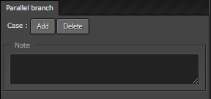
3.8 Register Conductor (7/7)
Register Conductor Please create the Conductor as shown the figure below.
Drag and drop Parallel branch and
Parallel merge from the
"Function" tab to arrange it.
Parallel branch and Parallel merge are executed immediately. Movement and Function can be executed in parallel.
The number of parallel processes can be specified.

Slide 29
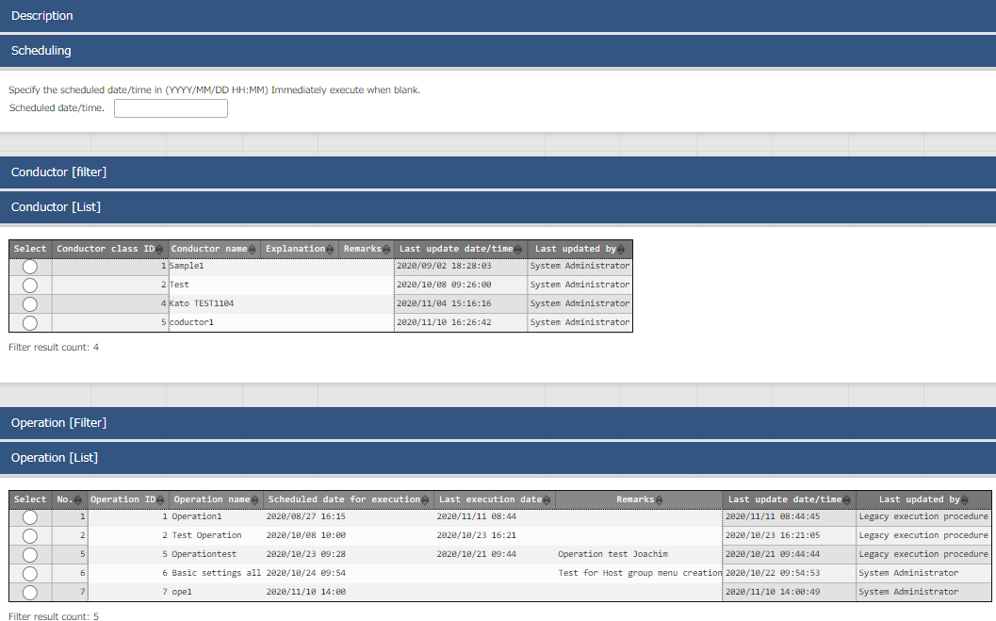

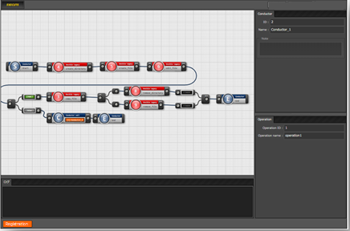
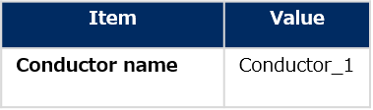

3.9 Conductor execution
Conductor execution
"Conductor“ menu group >> "Conductor execution" menu.
Determine the execution date and time from the "Schedule date/time" item in the "Conductor [list]" submenu.
Select "Conductor_1" in the "Conductor name" , "Conductor [List]" submenu items.
Select "operation" in the "operation name“ , "operation [list]" submenu items.
Click the "Execute" button.
１
Select the value for below
2
Select the value for below
3
Select the value for below
4

Slide 30
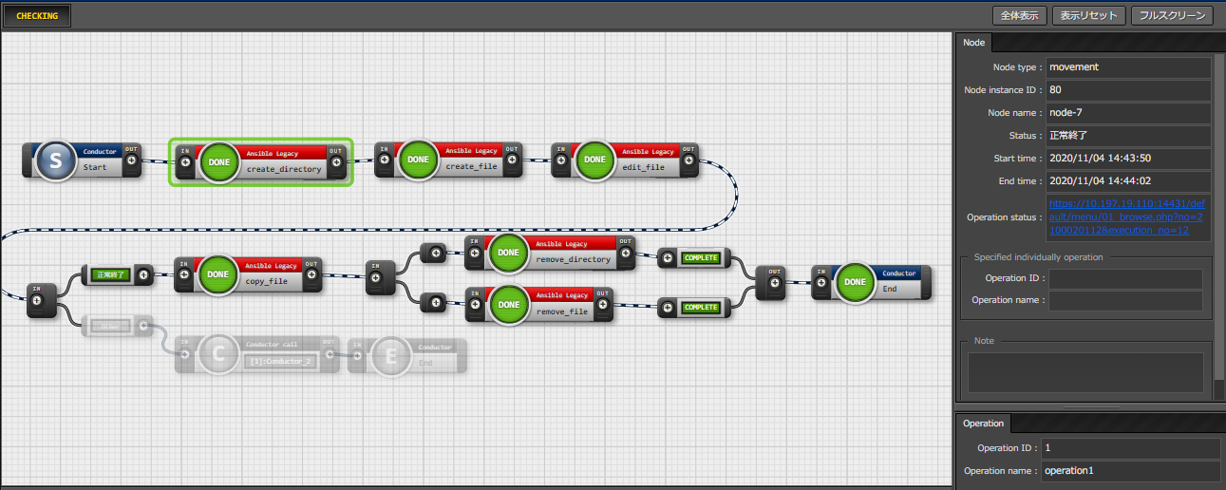
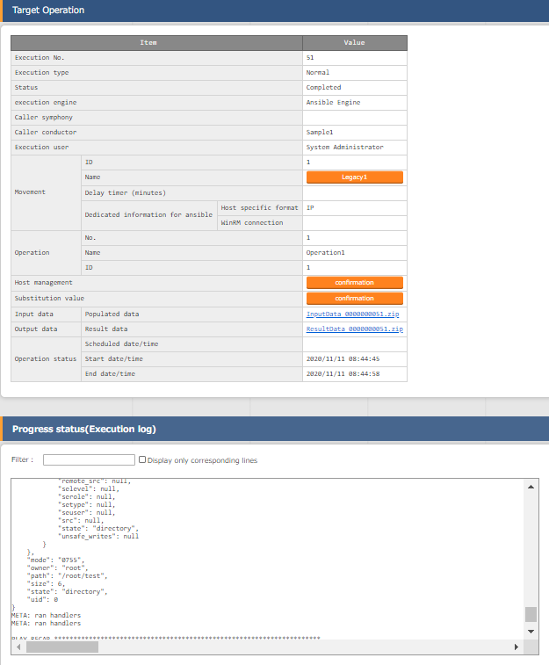
3.10 Conductor confirmation
Conductor confirmation
Selecting a running or an already executed movement will move you to a screen where you can check the logs and the operation status.

