Slide 1


Ansible Driver【Tutorial】
※「Exastro IT Automation」is written as「ITA」in this document.
Version 1.6.1
Exastro developer

Slide 2
Table of contents
Introduction
About Ansible Driver
Associate with Ansible Tower
Description of the 3 modes
Features of each mode
Legacy mode
LegacyRole mode
Pioneer mode

Slide 3
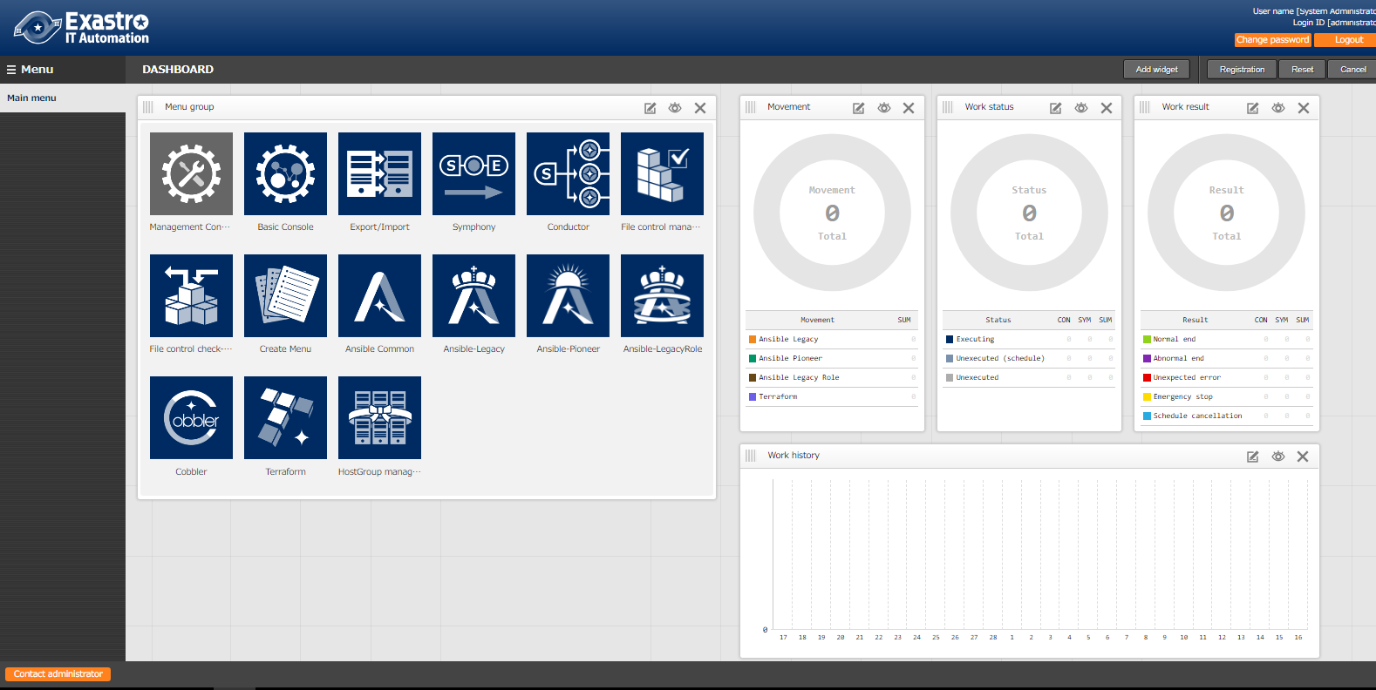
1.1 Ansible driverについて X/X
1. Introduction
Main menu
This manual introduces the concept and function of “Ansible-Legacy”, “Ansible-LegacyRole”, “Ansible-Pioneer” in the main menu.
Please refer to Practice manual (under construction) for the description of ITA screens.
“Ansible common” manages the following Ansible menus ・Interface information
・Ansible tower host list ・Global variable list
・File list ・Template list
・Collection interface information
・Collected item value list.
This manual mainly introduces these 3 menu groups.

Slide 4

2. About Ansible Driver
Ansible Driver links the parameters that are centrally managed by ITA with the variables of IaC(Playbook, etc.), which makes association with Ansible possible.
※For the advantages of using Ansible Tower, please refer to “3. Associate with Ansible tower”.
ITA
System
Symphony
CMDB
Start
Movement
NW
Ansible-Legacy Playbook
component
Ansible-Legacy
System
parameter
Ansible-LegacyRole Package file
Movement
Ansible-LegacyRole
ST
Ansible-Pioneer Dialog file
(Original IaC)
Movement
Ansible-Pioneer
End
SV

Slide 5
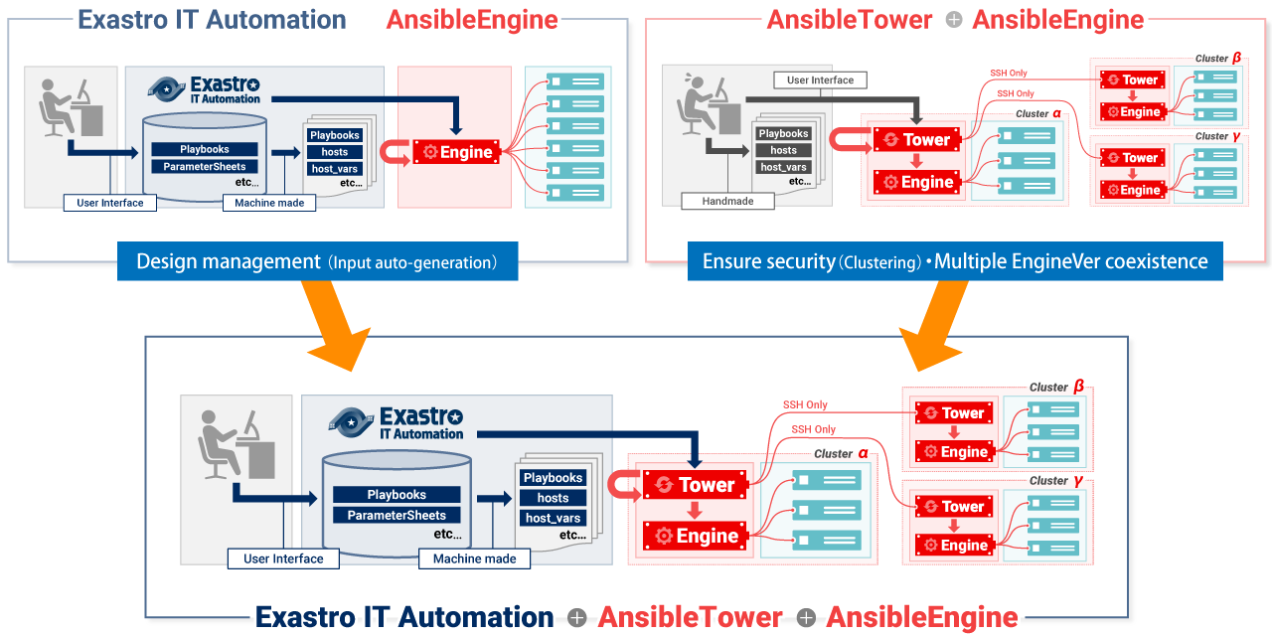
1.1 Ansible driverについて X/X
3. Associate with Ansible Tower
IT Automation store/manages setting data and generates directories, configuration files that are required for Ansible to execute.
AnsibleTower secures communication between clusters and controls different versions of AnsibleEngine
The automated construction system consisting of IT Automation + AnsibleTower + AnsibleEngine, which combines each of their features, realizes efficiency and labor saving of work.

Slide 6
4. The 3 Ansible modes.
There are 3 modes with specific features of Ansible driver,
depending on the usage.
The following is comparison of the features of Ansible-Legacy, Ansible-LegacyRole, and Ansible-Pioneer
◆IaC reuse
Ansible-Legacy
Ansible-Pioneer
Ansible-LegacyRole
◆Know-how utilization
Ansible-LegacyRole
Ansible-Legacy
Ansible-Pioneer
◆Application range
Ansible-Pioneer
Ansible-LegacyRole
Ansible-Legacy
※Legend ◎：Has strength in such function
○：Can be used for such function
×：Difficult to apply to such function/Recommend to use other mode
 | Description | Ansible-Legacy | Ansible-LegacyRole | Ansible-Pioneer
IaC reuse | Modulize created Playbooks and reuse them in Exastro. | ◎ | × | ○
Know-how utilization | Able to utilize variable functions provided by Ansible, and able to utilize published PlaybookRoles such as Ansible-galaxy. | ○ | ◎ | ×
Application Range | The variation of the operation procedure that can be automated. | ○ | ○ | ◎

Slide 7
5. Features of each mode 5.1 Ansible-Legacy mode

Slide 8
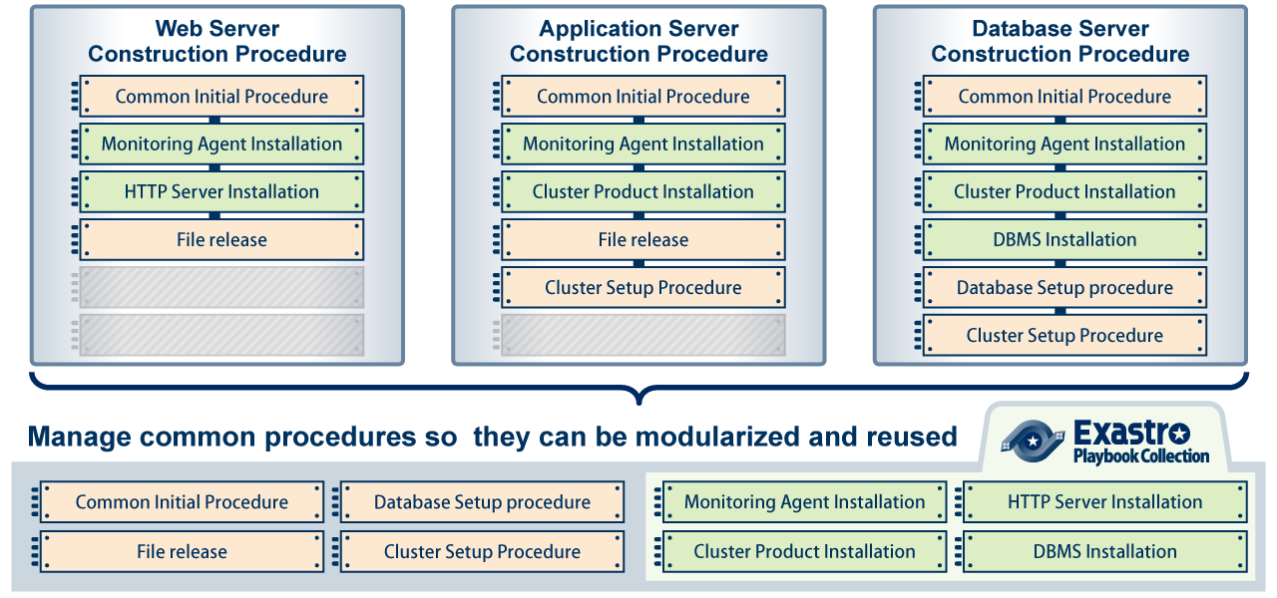
5.1 Ansible-Legacy mode (1/5)
The spice that based on ITA - Ansible-Legacy mode
The main feature of this mode is reusing IaC by modulizing them.
By reusing the registered IaC, it is possible to construct system efficiently.

Slide 9
5.1 Ansible-Legacy mode (2/5)
The relationship between "Movement", a work execution unit in Exastro ITA, and playbook is specified in two layers.
Movement
Movement
Auto-generated
By Exastro ITA
1
A
B
1
- hosts: all
tasks:
- include: aaaa.yml
- include: bbbb.yml
- include: cccc.yml
- hosts: all
tasks:
- include: cccc.yml
- include: dddd.yml
- include: eeee.yml
Playbook to be executed directly
Playbook material collection
1
2
3
1
2
3
aaaa.yml
bbbb.yml
cccc.yml
dddd.yml
eeee.yml

Slide 10
5.1 Ansible-Legacy mode (3/5)
Parameters that are given to variables during operation execution can be managed in the parameter sheets of ITA.
Parameter sheet
Movement
hosts | OPERATON_ID | para1 | para2 | para3 | para4 | …
host_a | 888 | AAAA | 1 | 100 | 1
host_b | 111 | BBBB | 2 | 78 | 0
host_c | 888 | CCCC | 3 | 93 | 0
…
A
- hosts: all
tasks:
- include: aaaa.yml
- include: bbbb.yml
- include: cccc.yml
Playbook to be executed directly
Parameter sheet and variables are linked and set in playbook
Substitution value list
Movement | Parameter | Variable
A | para1 | VAR_1
 | para2 | VAR_2
… | … | …
1
2
3
aaaa.yml
- name: “set aaaa”
debug: msg= “{{ VAR_4 }}”
- command: sleep {{ VAR_2 }}
bbbb.yml
- name: “set bbbb”
debug: msg= “{{ VAR_5 }}”
- command: sleep {{ VAR_3 }}
cccc.yml
- name: “set cccc”
debug: msg= “{{ VAR_1 }}”
- command: sleep {{ VAR_2 }}

Slide 11
5.1 Ansible-Legacy mode (4/5)
Users don’t need to be aware of the behavior of ITA during operation, the following is only for reference of background behavior.
Parameter sheet
Operation execution directory
├─in
│ ├─hosts
│ ├─playbook.yml
│ ├─child_playbooks
│ │ ├─aaaa.yml
│ │ ├─bbbb.yml
│ │ └─cccc.yml
│ ├─host_vars
│ │ ├─host_a
│ │ │ └─main.yml
│ │ ├─host_c
│ │ │ └─main.yml
│ │ ├─host_f
│ │ │ └─main.yml
│ │ ├─
│ │ │
│ │ ├─
│
├─out
│ ├─
hosts | OPERATON_ID | para1 | para2 | para3 | para4 | …
host_a | 888 | AAAA | 1 | 100 | 1
host_b | 111 | BBBB | 2 | 78 | 0
host_c | 888 | CCCC | 3 | 93 | 0
host_d | 222 | DDDD | 10 | 78 | 0
host_e | 333 | EEEE | 5 | 84 | 1
host_f | 888 | FFFF | 4 | 80 | 0
host_g | 111 | GGGG | 3 | 90 | 1
…
Hosts ：The operation target hosts (OPERATION_ID=888)
playbook.yml ： The Playbook to be executed directly.
child_playbooks ：Stores the Playbook materials to be used for this operation.
host_vars ：Stores the Playbooks with different variable definition for each host.
※Please refer to Learn: BASE for details of OPERATION_ID.

Slide 12
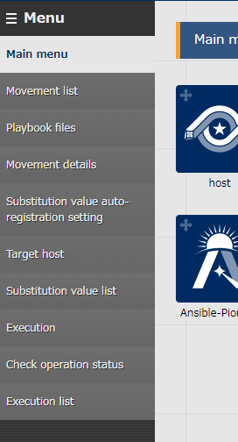
5.1 Ansible-Legacy mode (5/5)
Menu function description
Movement list Create or check the list of Movement
Playbook files Create or check the list of IaC
Movement details Manage the playbooks to be included in Movement
Substitution value list Link registered Operation with the setting value of every item for each host. Manage Movement and variable.
Target host Manage the Movement and host to be linked with Operation
Substitution value list Manage playbook and the substitution value of the “VAR_” variable used in Movements
Execution Execute single created Movement
Check operation status Check the details of the executed Movement.
Execution list Check the execution detail and history of created and executed Movements.

Slide 13
5. Features of each mode 5.2 Ansible-LegacyRole mode

Slide 14
5.2 Ansible-LegacyRole mode (1/4)
Gather the world’s wisdom in your hand - Ansible-LegacyRole mode
The feature of Ansible-Legacy mode is to register and use role package.
Users can use self-created Role or obtain and use Roles from Ansible-galaxy
Ansible-galaxy
Roles
ITA
CMDB
Ansible- LegacyRole
Roles

Slide 15
5.2 Ansible-LegacyRole mode (2/4)
Link “Movement”, the operation execution unit in Exastro ITA, with roles in role package.
Movement
Role0001 ・ ・ ・
Role0005
R
Role package file
Role.zip
Playbook to be executed directly
- hosts: all
roles:
- role: 0001
- role: 0004
- role: 0002
It is possible to select the role to be used from multiple roles.
1
3
2
0005
0001
0002
0003
0004
tasks
main.yml
tasks
main.yml
tasks
main.yml
tasks
main.yml
tasks
main.yml

Slide 16
5.2 Ansible-LegacyRole mode (3/4)
Users don’t need to be aware of the behavior of ITA during operation, the following is only for reference of background behavior.
Operation execution directory
├─in
│ ├─hosts
│ ├─site.yml
│ ├─host_vars
│ │ ├─host_a
│ │ └─host_b
│ └─roles
│ ├─role①
│ │ ├─defaults
│ │ │ └main.yml
│ │ ├tasks
│ │ │ └main.yml
│ │ └template
│ │ └xxxx.yml
│ ├─role②
│ ・
│ ・
│ ・
├─out
│ ├─
Role package file is a zip file of a directory that contains roles folder
Execution role directory is described in site.yml (playbook to be executed)
hosts ：Operation target hosts (Created by ITA)
site.yml ：Playbook to be executed directly(Created by ITA)
host_vars ：Stores Playbooks that defines variable for each host (Created by ITA)
roles ：Directory that stores files for playbook execution of each role
⇒Files under role directory
・defaults ：Describes the parameter for the part to be substituted in playbook
・tasks ：Playbook to be executed
・template ：Text file used in the playbook to be executed
※The figure of directory on the left is only an example.

Slide 17
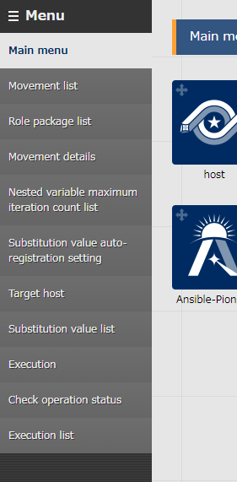
5.2 Ansible-LegacyRole mode (4/4)
Menu function description (Difference between Ansible-Legacy mode)
Role package list Manage created role package file.
Nested variable maximum iteration count list Manage the maximum iteration count of the nested variable array if there is nested array in role package file.

Slide 18
5. Features of each mode 5.3 Ansible-Pioneer Mode

Slide 19
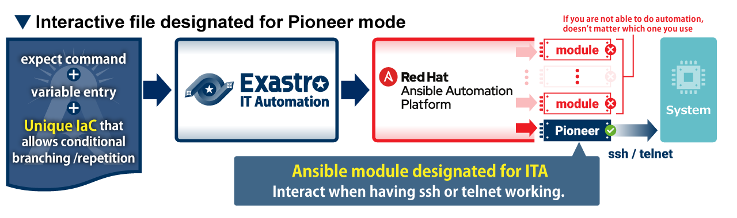
5.3 Ansible-Pioneer Mode (1/5)
The last way to continue automation - Ansible-Pioneer mode
If users can't automate operation by using any of the Ansible drivers, then the benefits of automation will be reduced. Therefore ITA offers Pioneer mode which is the last way to prevent automation from being stopped.

Slide 20
5.3 Ansible-Pioneer mode (2/5)
Ansible-Pioneer executes dialog files(※) in order by using Pioneer module (ITA original module) from the playbook to be executed directly. ※The details of dialog file is described in the next slide.
Movement
Auto-generated
By Exastro ITA
P
- hosts: all
tasks:
- command: pioneer_module {{ dialog file1 }}
- command: pioneer_module {{ dialog file2 }}
- command: pioneer_module {{ dialog file3 }}
Playbook to be executed directly
dialog file1
dialog file2
dialog file3

Slide 21
5.3 Ansible-Pioneer mode (3/5)
In Ansible-Pioneer, it is possible to describe settings for target hosts in interactive(dialog) style. Furthermore, it is also possible to express advanced dialog such as using iterative and conditional branching compared to a simple expect command.
※Please refer to the manual for the details of dialog file.
Example of Dialog file
Login target system and check the status of the services assigned by variable.
If the status is “disable”, the process will end as error. If the status is other than “disable” , then “complete!” will be displayed in prompt.
※The words in red highlight in the dialog file are displayed using the variable in parameter sheet.
01
02
03
04
05
06
07
08
09
10
- expect: 'password:'
exec: “{{ login password }}“
- command: 'systemctl status {{ item.0 }}'
prompt: '{{ login user }}@'
with_items:
- ‘{{ service name 1 }}‘
- ‘{{ service name 2 }}‘
failed_when:
- stdout match(disable)
- command: 'echo complete!'
①
Repeat process by using “with_items”
②
Conditional branching by using “failed_when”

Slide 22
5.3 Ansible-Pioneer mode (4/5)
By setting OS and Dialog file types in Pioneer, users can execute operations without having to worry about difference in OS.
OS type…Configure to dialog file and Target device. Used to select which dialog file to execute.
dialog type… Links with dialog files which has the same purpose.
dialog file A OS type：BigIP
- command: ‘create / ltm node {{VAR_host_ip}} up’
prompt: ‘(tmos)’
When configuring settings
OS Type：BigIP
Movement P
dialog file B OS type：Cisco ACE
- expect: ‘{{ __loginhostname__ }}/Admin(config)’
exec: ‘rserver {{ VAR_group_name }}’
- command: ‘ip address {{ VAR_host_ip }} ’
prompt: ‘{{ __loginhostname__ }}/Admin(config-rserver-host)’
（Registers real server to Load Balancer）
dialog type A
OS Type：Cisco ACE
dialog file C OS type：A10
- command: ‘slb server {{ VAR_server_name}} {{VAR_host_ip}}’
prompt: ‘(config)#’
OS Type：A10
When Executing
Movement P
対話ファイルA
（Registers real server to Load Balancer）
対話ファイルB
dialog type A
対話ファイルC
Since the dialog file is executed according to the OS of the target device, the user executing does not need to worry or be away of the OS type.

Slide 23
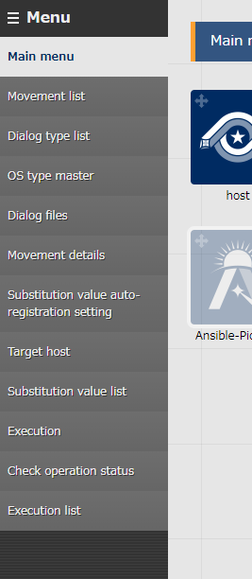
5.3 Ansible-Pioneer mode (5/5)
Menu function description (Difference between Ansible-Legacy mode)
Dialog type list Manage dialog type. (In Ansible-Pioneer, define different dialog file for each OS, so the difference for each OS will be automatically absorbed.)
Dialog files Manage dialog files for each OS type.

