Slide 1

Base【Classroom】
※In this document “Operation Autonomy Support Engine” will be written as “OASE.
Exastro Operation Autonomy Support Engine Version 1.3.1
Exastro developer

Slide 2
Table of contents
Introduction
1.1 Base【Classroom】
1.2 OASE Settings procedure
1.3 OASE Operation flow
OASE Settings procedure screen explanation
2.1 Configure permissions [Access permission]
2.2 Configure permissions [Registration info]
2.3 Configure Action destination
2.4 Create Decision table
2.5 Configure permissions [Decision table]
OASE Operation flow screen explanation
3.1 Create Decision table file
3.2 Register rule
3.3 Determine rules

Slide 3
1. Introduction

Slide 4
1.1 Base【Classroom】(1/3)
Preface
This document uses Exastro Operation Autonomy Support Engine (OASE) to help users better understand the software’s basic functions.
If you want to learn by getting some first-hand experience, we recommend that you see the Exastro OASE Base Practice document, which is a specific step to step guide on how to use it.
For documents with more comprehensive information, please see the official Exastro OASE manual page, OASE docs.

Slide 5
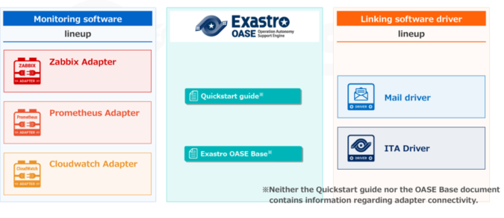
1.1 Base【Classroom】(2/3)
This document will cover the following:
Linking OASE and ITA Driver.
※In this document, "Exastro IT Automation" will be written as "ITA".

Slide 6
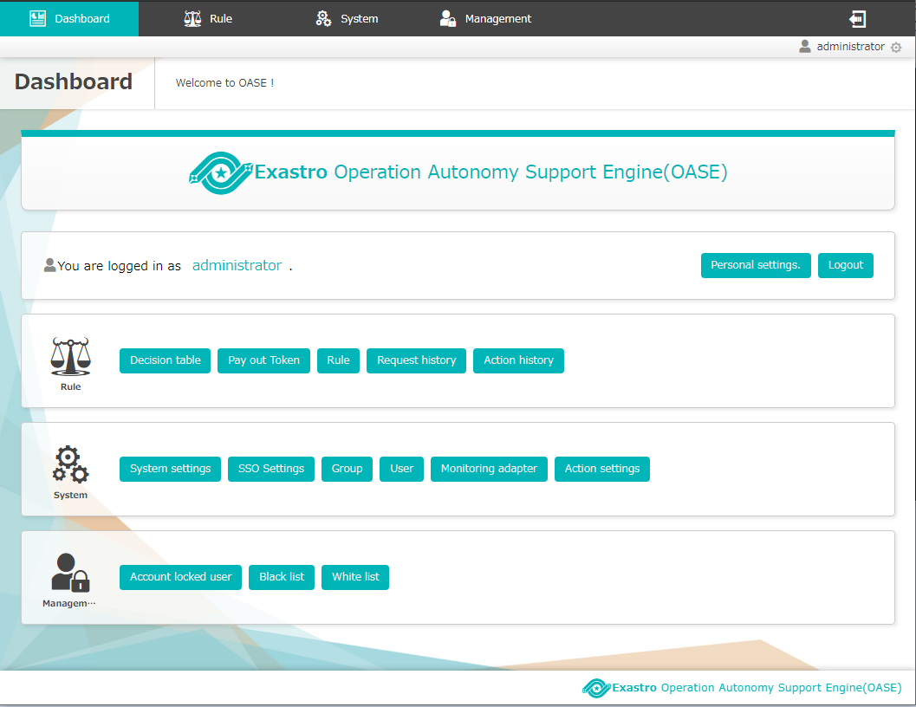
1.1 Base【Classroom】(3/3)
This guide will use the following OASE functions.
Dashboard screen
Category：Rule
Screen
Decision table
Pay out Token
Rule
Request History
Action History
Category：System
Screen
Group
User
Action settings

Slide 7
1.2 OASE Settings procedure
Initial settings and other tasks with low frequency
Settings procedure | Screen | Category
System
Rule
2.1 Configure permissions [Access permission]
Group
User
2.2 Configure permissions [Registration info]
Pay out Token
Action settings
2.3 Configure Action destination
Action settings
2.4 Create Decision table
Decision Table
2.5 Configure permissions [Decision table]
Decision Table

Slide 8
1.3 OASE Operation flow
Tasks with high frequency in the application flow.
Application flow | Screen | Category
Rule
3.1 Create Decision table file
Decision table
3.2 Register rule
Rule
3.3 Determine rules
Request history
Action history

Slide 9
2. OASE Settings procedure screen explanation

Slide 10
2.1 Configure permissions [Access permission] （1/5）
This chapter will cover the part marked with red
Settings procedure | Screen | Category
System
Rule
2.1 Configure permissions [Access permission]
Group
User
2.2 Configure permissions [Registration info]
Pay out Token
Action settings
2.3 Configure Action destination
Action settings
2.4 Create Decision table
Decision table
2.5 Configure permissions [Decision table]
Decision table

Slide 11
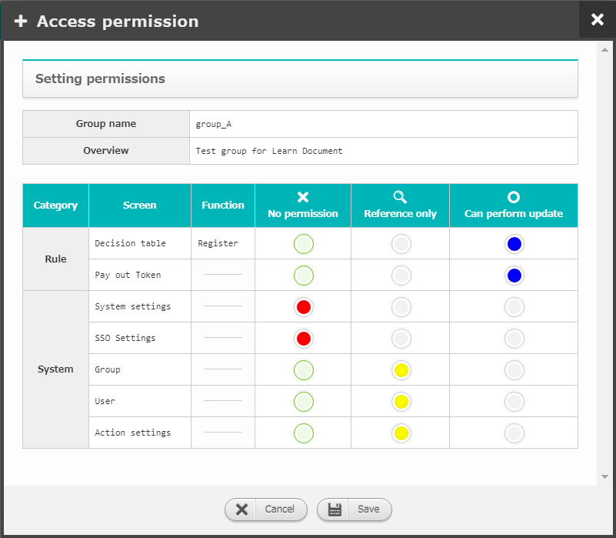
2.1 Configure permissions [Access permission] （2/5）
Assign access permission to groups
You can configure access permission in the “group” screen
Access permission for the following screens can be configured
Decision table
Pay out Token
System settings
SSO settings
Group
User
Action settings
The following permissions are available.
No permission: Users will not be able to see the screen
Reference only：Users will not be able to update, but can see the screen
Can perform update: Users can both update and see the screen

Slide 12
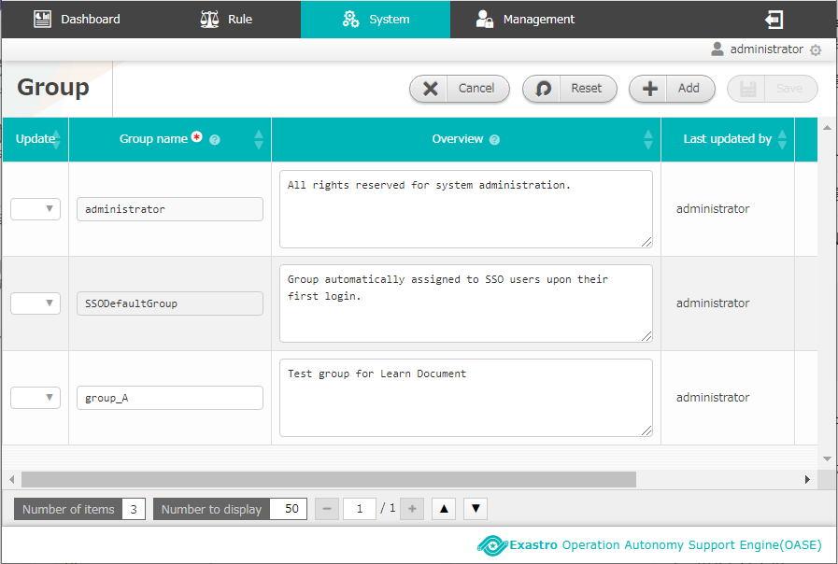
2.1 Configure permissions [Access permission] （3/5）
E.g.) Create "group_A" and "user_A" and set access permissions(1/3)
Log in as “administrator” and create a group called “group_A”
Configure access permissions for group_A
group_A access permissions
2
Screen | Permission
Decision table | Can perform update
Pay out Token | Can perform update
System settings | No permission
SSO Settings | No permission
Group | Reference only
User | Reference only
Action settings | Reference only
1

Slide 13
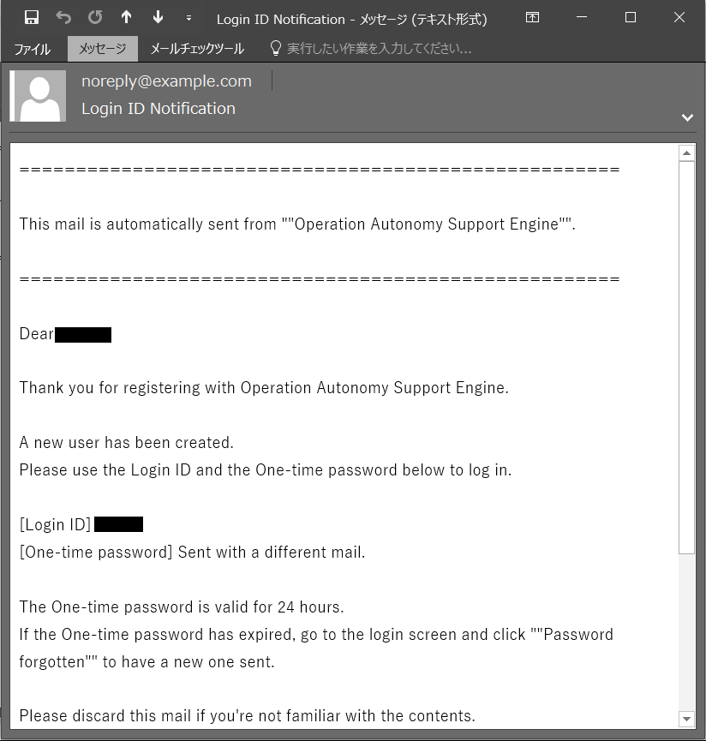
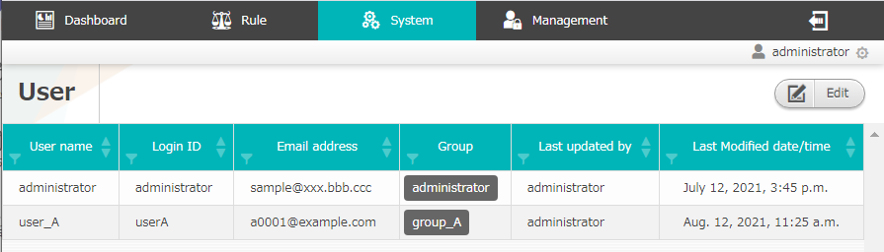
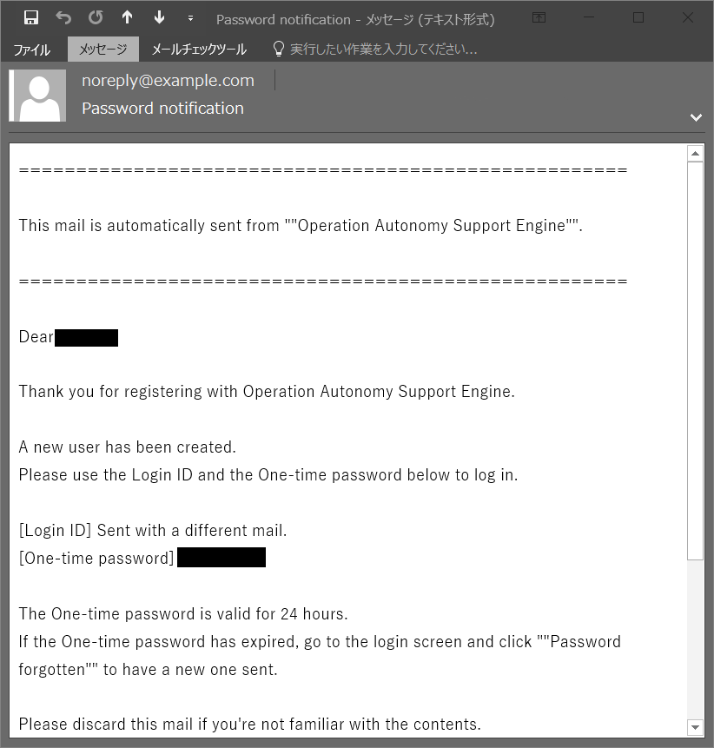
2.1 Configure permissions [Access permission] （4/5）
E.g.) Create "group_A" and "user_A" and set access permissions(2/3)
Create a user called “user_A” and put it in group_A
Use the User ID and one-time-password included in the e-mail sent to you to log in to OASE.
3
Create user_A
A confirmation mail will be sent to the E-mail address.
Make sure to register a mail address that can receive e-mails.
4

Slide 14
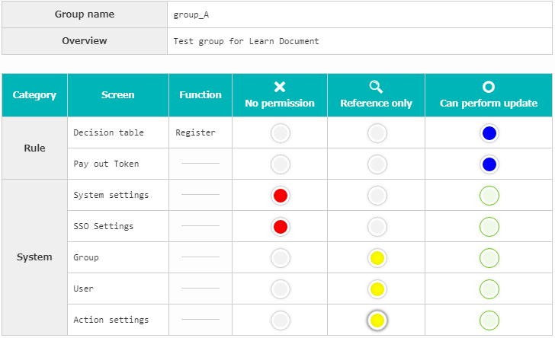
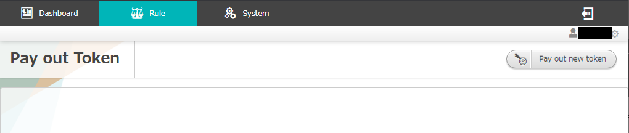
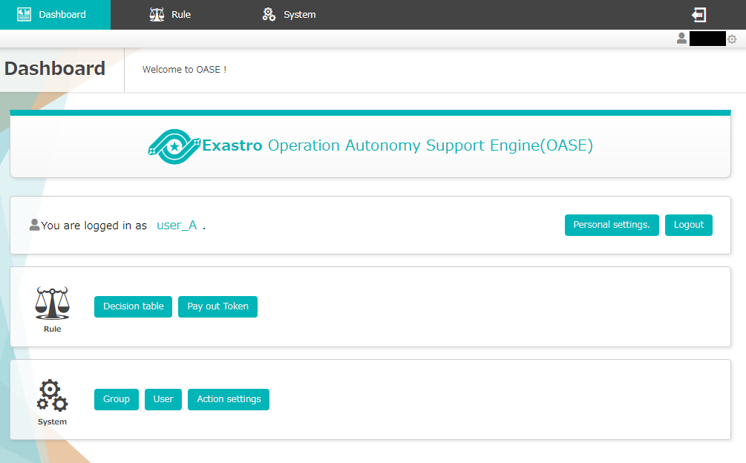
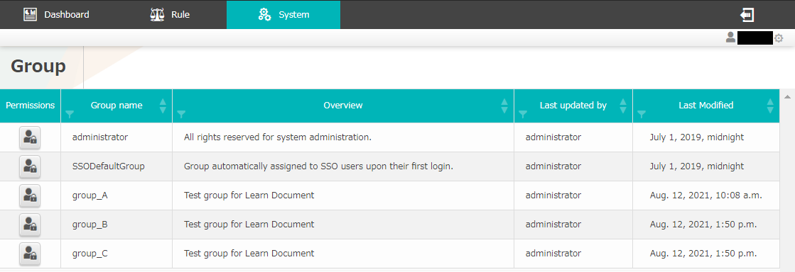
2.1 Configure permissions [Access permission] （5/5）
E.g.) Create "group_A" and "user_A" and set access permissions(3/3)
Different access permission settings displays different screens. Please see below.
group_A
Logged in as user_A
Can update
“System settings” and “SSO settings” are not available
The user can only view （no update button）

Slide 15
2.2 Permission settings [Registration info] （1/4）
This chapter will cover the part marked with red
Settings procedure | Screen | Category
System
Rule
2.1 Configure permissions [Access permission]
Group
User
2.2 Configure permissions [Registration info]
Pay out Token
Action settings
2.3 Configure Action destination
Action settings
2.4 Create Decision table
Decision table
2.5 Configure permissions [Decision table]
Decision table

Slide 16
2.2 Permission settings [Registration info] （2/4）
“Pay out Token” screen
As certification is needed when rule matching the messages received from the monitoring application, we will pay out a token from OASE in advance.
A token will not be needed in the test request we will make in the latter mentioned "rule" screen chapter.
If you want to see an example of a token being used, please see the document below. < RestAPI function user_manual_1 event request >
Flow | Request | Rule matching | Action
Image
Message
Certifi- cation
OASE
Driver
Token is required

Slide 17
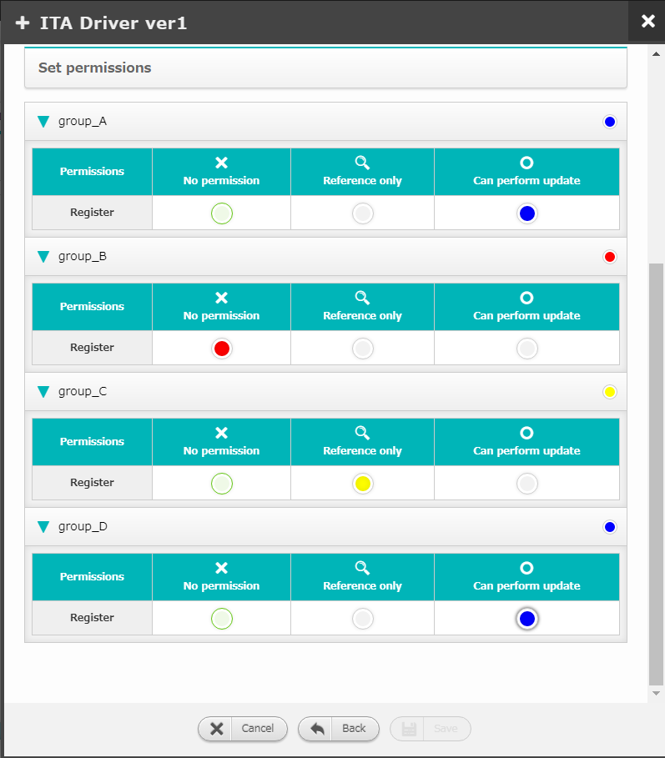
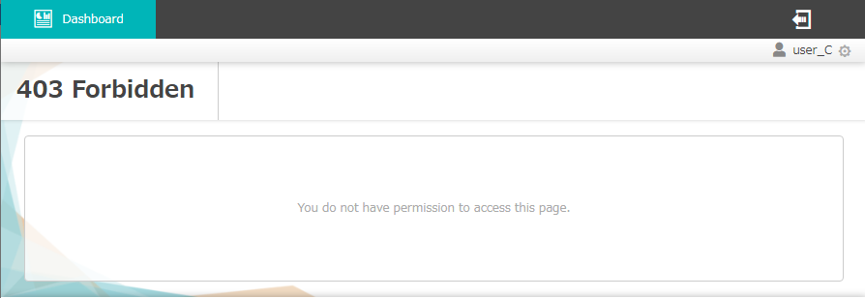
2.2 Permission settings [Registration info] （3/4）
Assign access permission to groups
If an user has the "Can update" access permission, the user can register, update and delete information.
Permission settings regarding registered information can be configured in both the "Action settings" and the "Pay out Token" screen.
The following permissions are available
No permission：Will not be able to see any registered information
Reference only：Can see, but not update registered information
Can update：Can both see and update registered information
If there are no items the user has permission to see, to following will be displayed.

Slide 18
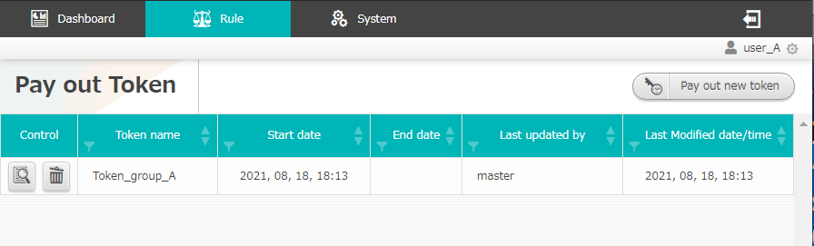
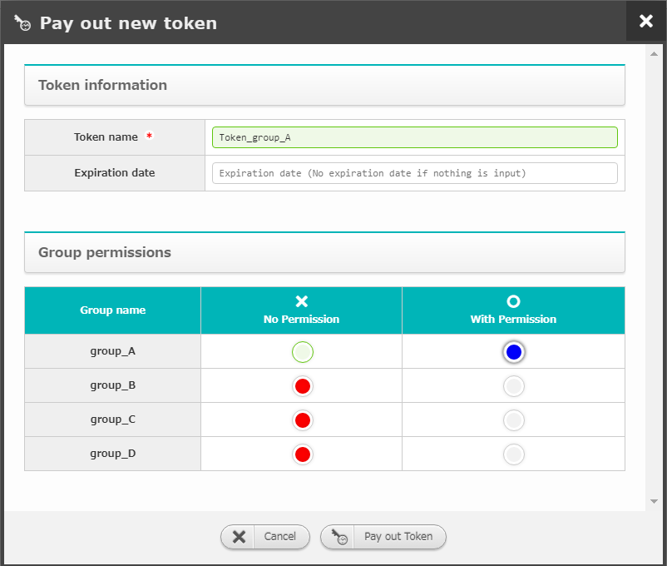
2.2 Permission settings [Registration info] （4/4）
E.g.) Paying out a token when "group_A" has permission while the other groups does not
In this case, only users that belongs in “group_A” can see, create and configure tokens.
「group_A」「group_B」
「group_C」「group_D」
Pay out a token as users in group A,B,C and D
Logged in as a user in group_A
Can both see and update
Logged in as a user in group_C
Does not have permission to see

Slide 19
2.3 Configure Action destination（1/4）
The following chapter will cover the part marked with red
Settings procedure | Screen | Category
System
Rule
2.1 Configure permissions [Access permission]
Group
User
2.2 Configure permissions [Registration info]
Pay out Token
Action settings
2.3 Configure Action destination
Action settings
2.4 Create Decision table
Decision table
2.5 Configure permissions [Decision table]
Decision table

Slide 20
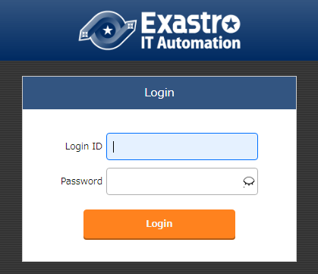
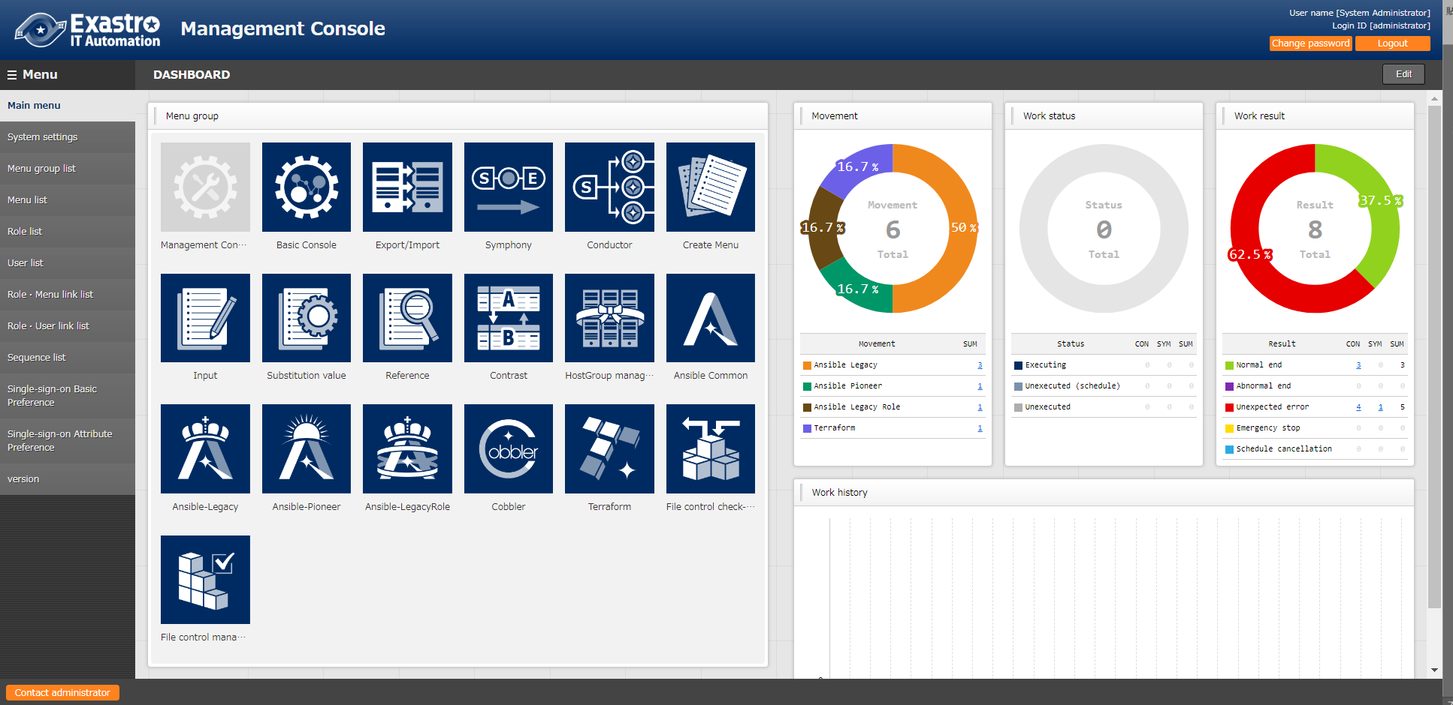
2.3 Configure Action destination （2/4）
Check the ITA you want to link
As we will use the ITA Driver in this document, we will first have to check that we have an ITA environment we can use.
If you don't have an ITA environment available to you, install it and check that you can log in to it
Please see the URL below for the ITA install manual
<ITA Automation Online install>

Slide 21
2.3 Configure Action destination （3/4）
Implement the ITA driver as a software link driver
Install ITA driver to OASE
Unpack the files under the "oase-contents" in the installer you downloaded from GitHub
Using the unpacked files, run the driver install command from the OASE side
Note that A and B are in different hierarchies.
For more information regarding installing drivers, please refer to<Environment construction manual - driver install->
/
├ File directory of files downloaded from GitHub
｜└ oase_install_package
｜ └ OASE
｜ └ oase-contents
｜ ├ ITA_Driver.tar.gz
｜ └ plugins
｜
└ Install directory with "On" specified in the answerfile
└ OASE
└oase-root
Unpack files
A
Storage path of the unpack files
Running the install command for the driver right under the oase-root.
B

Slide 22
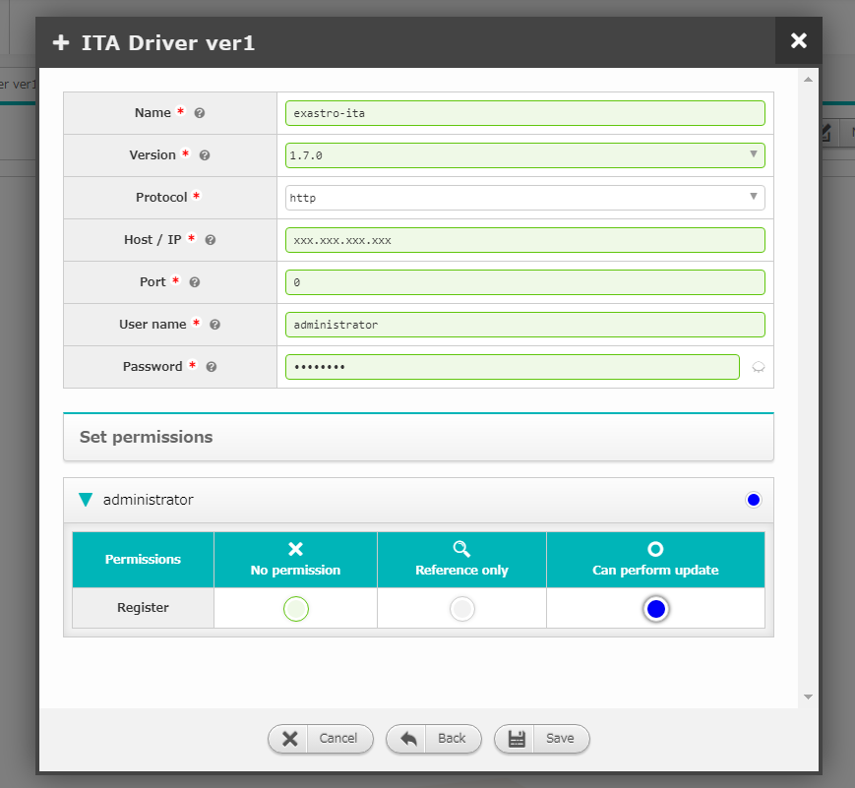
2.3 Configure Action destination （4/4）
Register the information needed to link ITA Driver to OASE.
Add the ITA driver as an action destination
Configure in the "Action settings" screen
Register the ITA information
E.g.）ITA Version, Host name/IP Address, Port, Login User name and Password etc.
※An easy connection test will take place when the user is saving the settings.
OASE “Action settings” screen.
Item name | Setting value
Name | ITA environment name
Version | ITA Version
Protocol | Protocol for when accessing ITA through API (http or https)
Host/IP | ITA Host name or IP Address
Port | ITA Port number when using API
User name | ITA Username when using API
Password | Password for the previously selected user

Slide 23
2.4 Create Decision table（1/6）
The following chapter will cover the part marked with red
Settings procedure | Screen | Category
System
Rule
2.1 Configure permissions [Access permission]
Group
User
2.2 Configure permissions [Registration info]
Pay out Token
Action settings
2.3 Configure Action destination
Action settings
2.4 Create Decision table
Decision table
2.5 Configure permissions [Decision table]
Decision table

Slide 24


2.4 Create Decision table （2/6）
Decision table
OASE includes Decision tables
Decision table : List of rules
Rule：Defined one line at a time in the Decision table
Rule engine： Makes decisions depending on the rules in the rule list.
The following rules are examples. Both of these rules can be defined in decision tables
If a message containing "HDD" with alert level" Error" is received, run action A.
If a message containing "CPU" with alert level "Warning" is received, run action B.
Flow | Request | Rule matching | Action
Image
Example | The system sends and alert | OASE chooses what rules to apply | An action is chosen according to the rules
Message
OASE
Driver
[Error] Disk 0%...
Error ：reboot
Warning：mail
： ：
[Warning] CPU 50%...
[Error] HDD 80%...
Decision table

Slide 25
2.4 Create Decision table （3/6）
Using the "Decision table" screen （1/3）
In order to manage a decision table, you will need to register the following information
“Basic information/permissions” tab
Decision table name
Register the name of the Decision table. This will be the name that will be displayed in OASE.
Make sure that you name it well, as the decision table name will be used multiple times.
Set permissions
It is possible configure permissions per group. （For more information, please see chapter ”Configure permissions [Decision table] ”）
Category | Rule
Screen | Decision table | Rule |  | Request history | Action history
 |  | Staging | Production
Decision table file
Name_dtAAA
Name_dtBBB

Slide 26
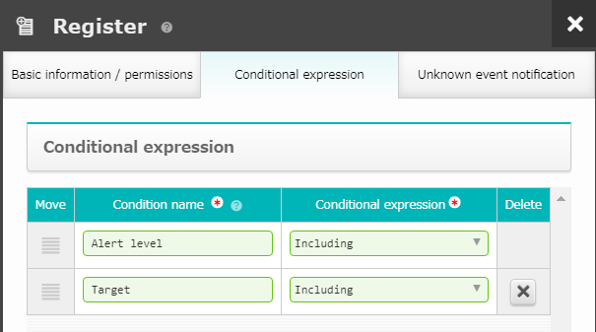
2.4 Create Decision table （4/6）
Using the "Decision table" screen （2/3）
“Conditional expression” tab
Input Condition name and Conditional expression and create rule
E.g.)If a message containing "HDD" with alert level" Error" is received, run action A.
Users can use test requests (explained later) in order to check if the Rule is valid or not
We want to make this a condition in the rule
The action that will be run after the rule matching is written in the "Decision table file".
Configure in the "Conditional expression" tab in the decision table screen
We will describe the condition messages (In this case, "Error" and "HDD" ) as a specific rule in the "Decision table file".

Slide 27
2.4 Create Decision table （5/6）
Using the "Decision table" screen （3/3）
“Unknown event notification” tab
If you select "Send me notification over e-mail", an notification will be sent to you when an unknown event occurs.
“Known” and “Unknown” events
Known events：Rule defined Events with defined actions.
Unknown events：Events that are not defined as Known events
E.g.) When you have "Send notification over e-mail" and the system receives a message with "Error", which is not defined by a rule.
Flow | Request | Rule matching | Action
Image
Message
OASE
Unknown event notification
Error：reboot
Warning：mail
[Error]…
When no rules defines “Error”

Slide 28
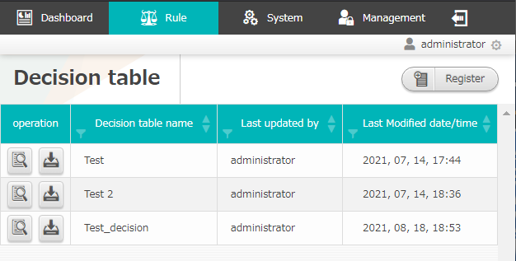
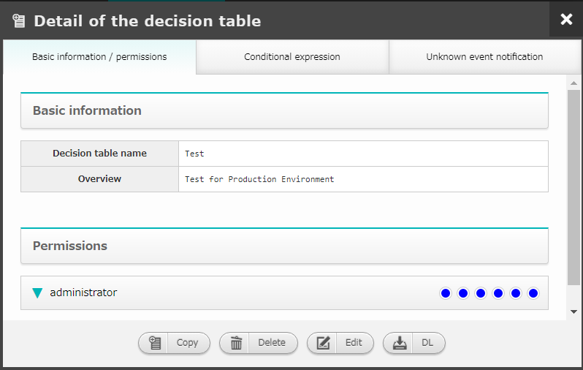
2.4 Create Decision table （6/6）
Caution
The maximum amount of decision tables that can be created depends on the environment
We recommend having around 4, and deleting any tables you don't need
If you do happen to create more than the maximum amount allows, an error might occur
If an error occurred, please refer to the manual below < Environment construction manual - basics- 4. Cautions>
Press the “Delete” button to delete the table
Moves the user to the “Decision table details” screen

Slide 29
2.5 Configure permissions [Decision table] （1/12）
The following chapter will cover the part marked with red
Settings procedure | Screen | Category
System
Rule
2.1 Configure permissions [Access permission]
Group
User
2.2 Configure permissions [Registration info]
Pay out Token
Action settings
2.3 Configure Action destination
Action settings
2.4 Create Decision table
Decision table
2.5 Configure permissions [Decision table]
Decision table

Slide 30
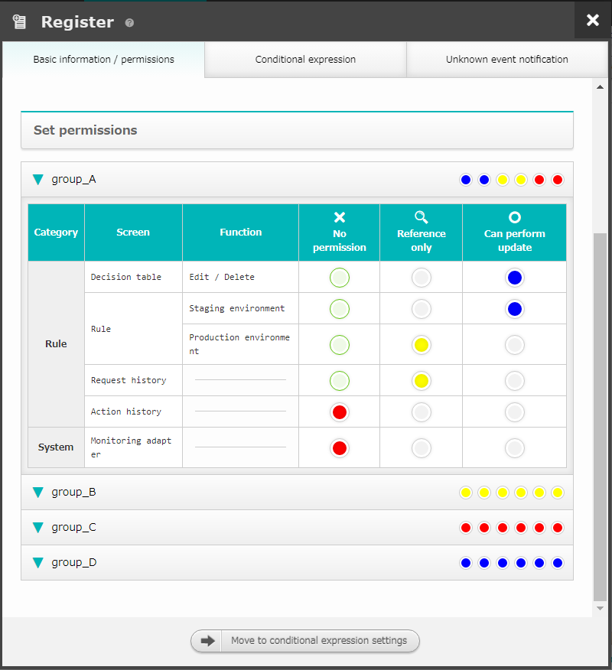
2.5 Configure permissions [Decision table] （2/12）
It is possible to have access permissions set to decision tables
The Decision table access permissions can be configured in the "Decision table" screen
The following permissions are available
No permission：Will not be able to see the decision table
Reference only：Can see, but not update the decision table
Can update：Can both see and update the decision table

Slide 31
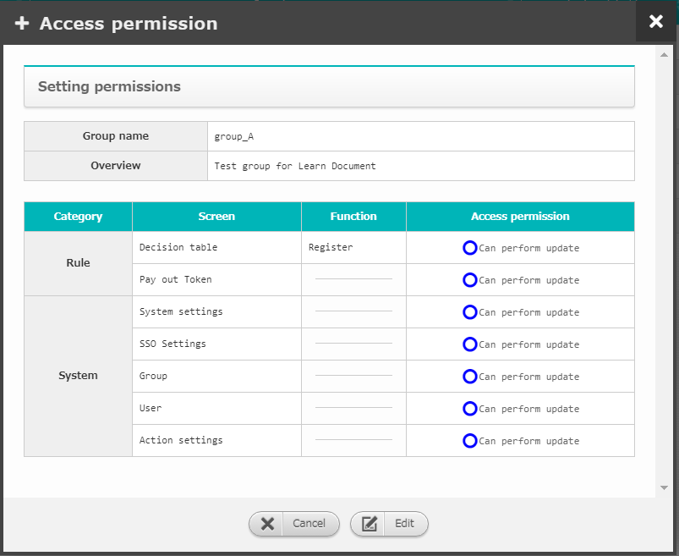
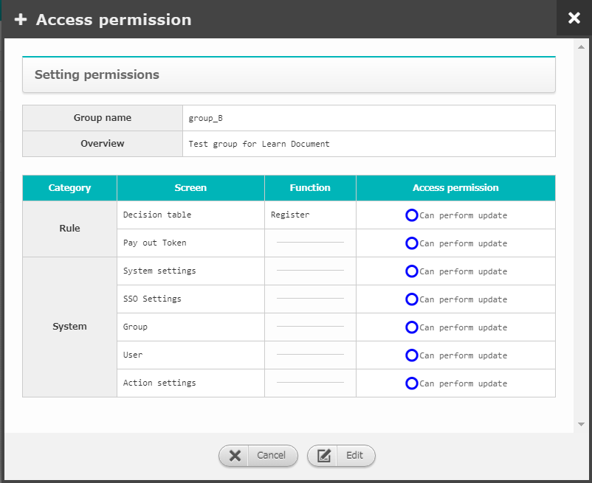
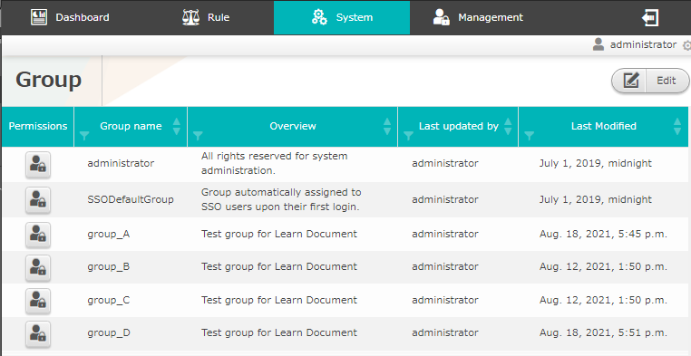
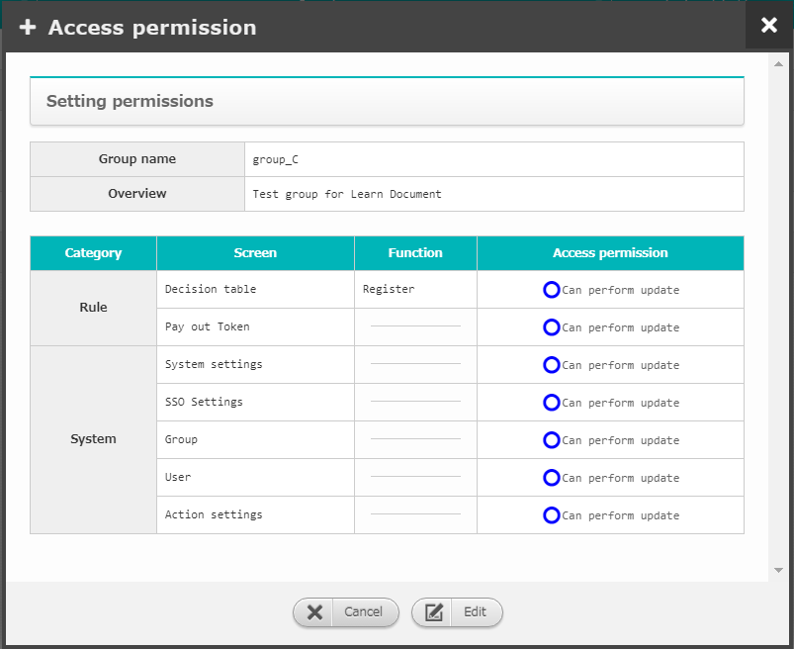

2.5 Configure permissions [Decision table] （3/12）
E.g.) Checking the decision table and related contents as users with different permissions（1/10）
In order to create conditional expressions, we need to access somewhere we don't have permission to. Therefore, you need to first log in as the system administrator and create group_A, group_B, group_C and group_D. After that, we need to configure the permissions so that all of the groups can update.
Log in as “administrator” and start configuring.
group_A
group_B
group_C
group_D

Slide 32
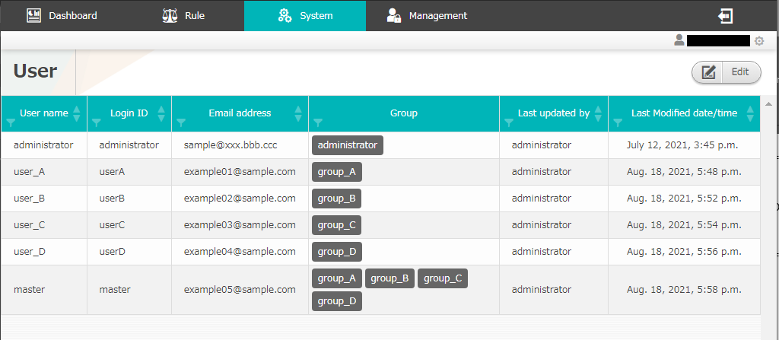
2.5 Configure permissions [Decision table] （4/12）
E.g.) Checking the decision table and related contents as users with different permissions（2/10）
Go to the “User” screen and create the following users: user_A, user_B, user_C, user_D and master
Configure the users so that user_A belongs in group_A, user_B belongs in group_B, user_C belongs in group_C and user_D belongs in group_D. The “master” user belongs to all of the groups.
Configure as Administrator

Slide 33
2.5 Configure permissions [Decision table] （5/12）
E.g.) Checking the decision table and related contents as users with different permissions（3/10）
Log in as the user "master" and go to the Decision table screen. Create a decision table with the name "master_decision_table" and give the following permissions to each of the groups.
group_A
Can perform update：Decision table, Rule（Staging）
Reference only：Rule（Production）、Request history
No permission：Action history, Monitoring adapter
group_B
“Reference only” for everything
group_C
“No permission” for everything
Log in as “master” and configure
group_D
“Can perform update” for everything

Slide 34
2.5 Configure permissions [Decision table] （6/12）
E.g.) Checking the decision table and related contents as users with different permissions（4/10）
The “master_decision_table” access permissions are as follows
Screen |  | Decision table | Rule |  | Request history | Action history | Monitoring adapter
 |  |  | Staging | Production
① | master | Can create, duplicate, delete, edit and download | Can upload and send test requests | Apply button is active. Can apply | Can view | Can control and view | Can view
② | user_A | Can create, duplicate, delete, edit and download | Can upload and send test requests | No apply button. Can’t apply | Can view | Can’t view | Can’t view
③ | user_B | Can create, duplicate, delete, edit and download | Can’t upload, but can send test requests | No apply button. Can’t apply | Can view | Can view | Can’t view
④ | user_C | Can’t view
⑤ | user_D | Can create, duplicate, delete, edit and download | Can upload and send test requests | Apply button is active. Can apply | Can view | Can control and view | Can view
⑥ | Admin | Can’t view
User

Slide 35
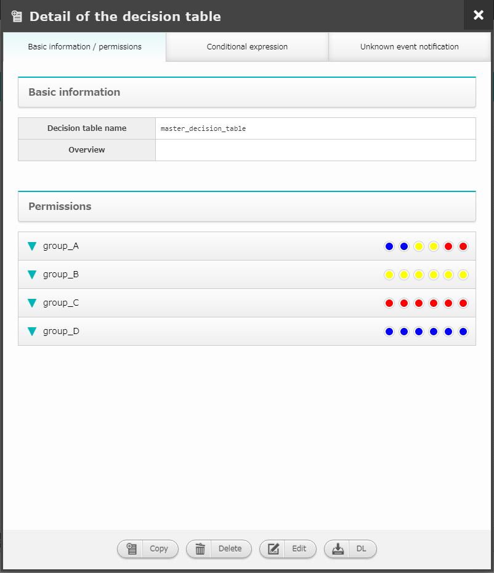
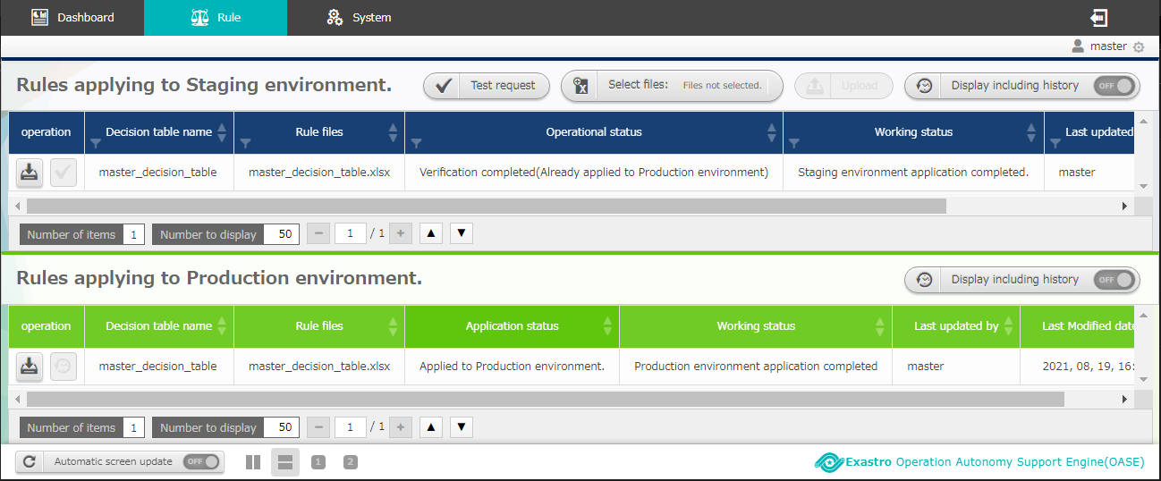
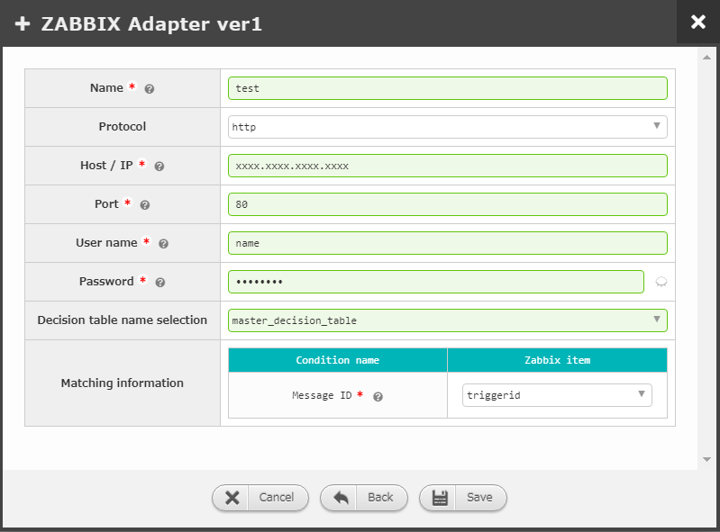
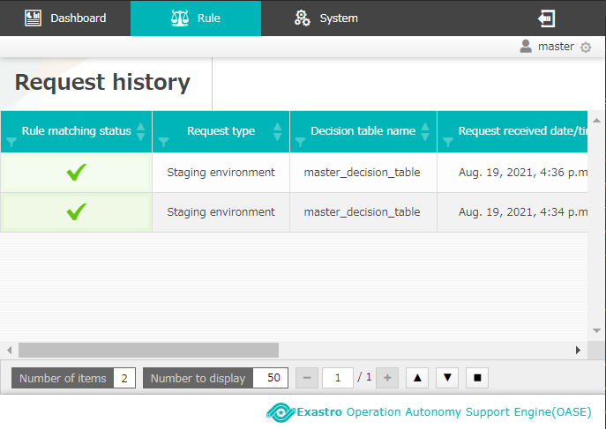
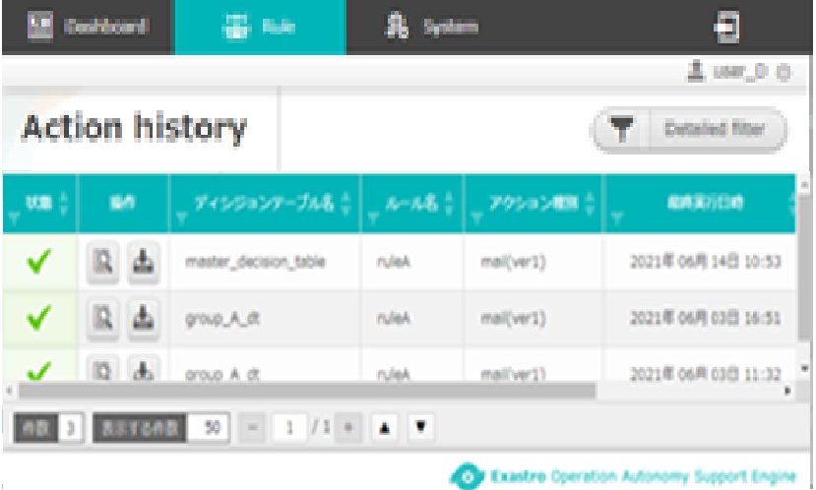
2.5 Configure permissions [Decision table] （7/12）
E.g.) Checking the decision table and related contents as users with different permissions（5/10）
The following screen will be displayed if the user is logged in as "master"
Screen |  | Decision table | Rule |  | Request history | Action history | Monitor adapter
 |  |  | Staging | Production
① | master | Can create, duplicate, delete, edit and download | Can upload and send test requests | Apply button is active. Can apply | Can view | Can control and view | Can view
User

Slide 36
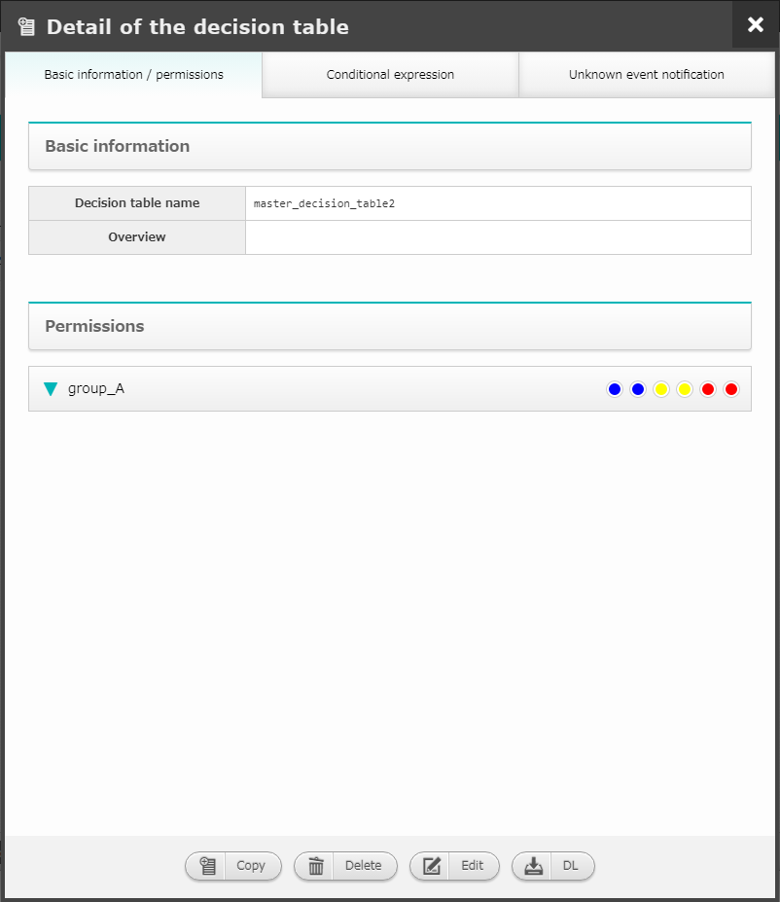
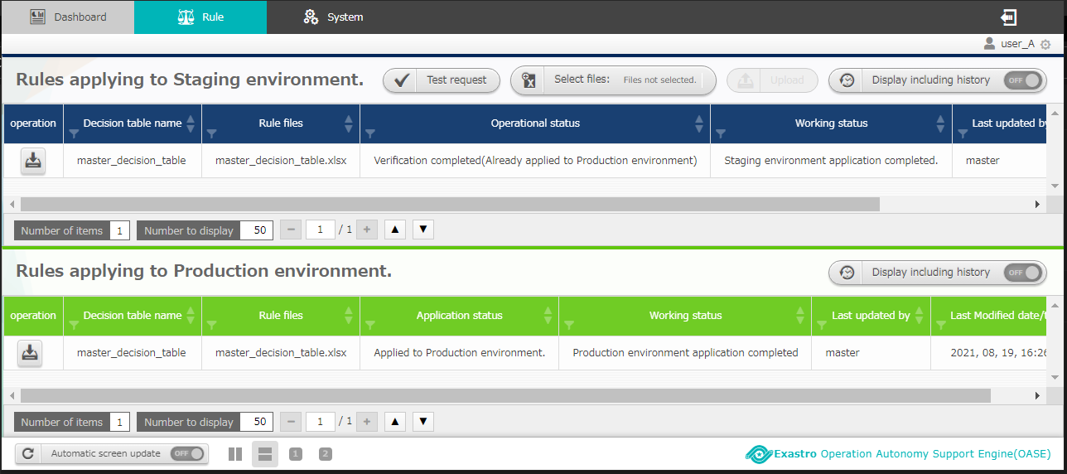
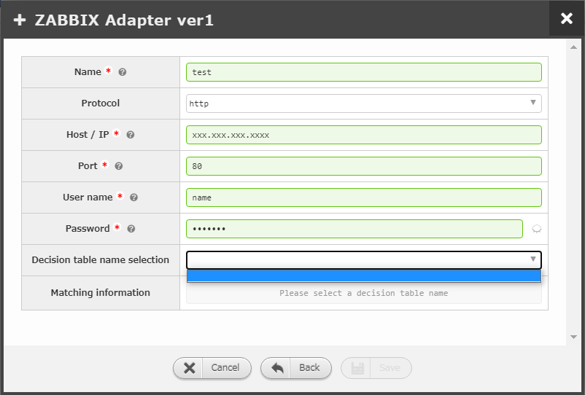
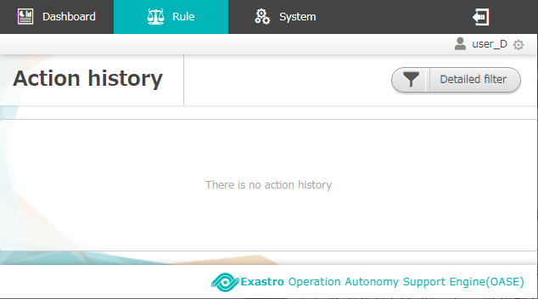
2.5 Configure permissions [Decision table] （8/12）
E.g.) Checking the decision table and related contents as users with different permissions（6/10）
The following screen will be displayed if the user is logged in as "user_A"
Screen |  | Decision table | Rule |  | Request history | Action history | Monitoring adapter
 |  |  | Staging | Production
② | user_A | Can create, duplicate, delete, edit and download | Can upload and send test requests | No apply button. Can’t apply | Can view | Can’t view | Can’t view
User

Slide 37
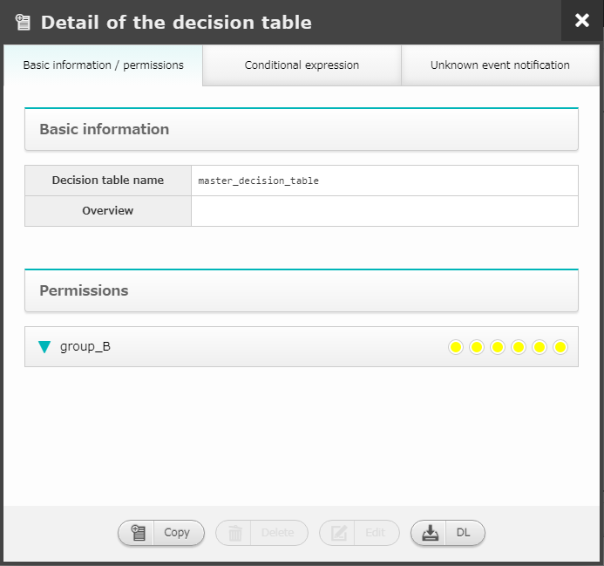
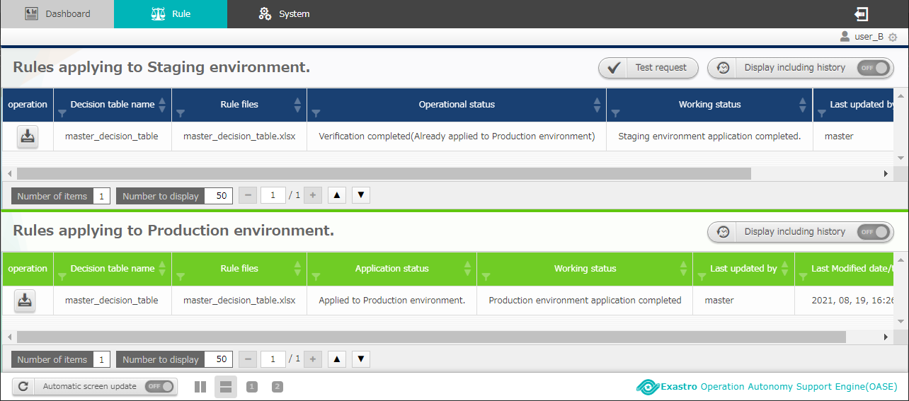
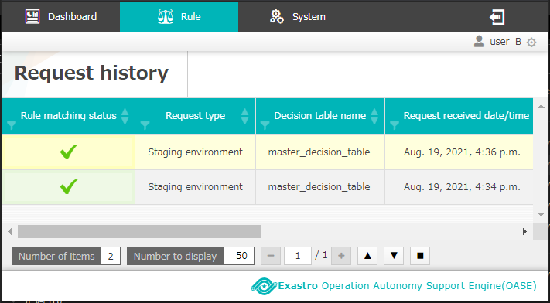
2.5 Configure permissions [Decision table] （9/12）
E.g.) Checking the decision table and related contents as users with different permissions（7/10）
The following screen will be displayed if the user is logged in as "user_B"
Screen |  | Decision table | Rule |  | Request history | Action history | Monitoring adapter
 |  |  | Staging | Production
③ | user_B | Can create, duplicate, delete, edit and download | Can’t upload, but can send test requests | No apply button. Can’t apply | Can view | Can view | Can’t view
User

Slide 38
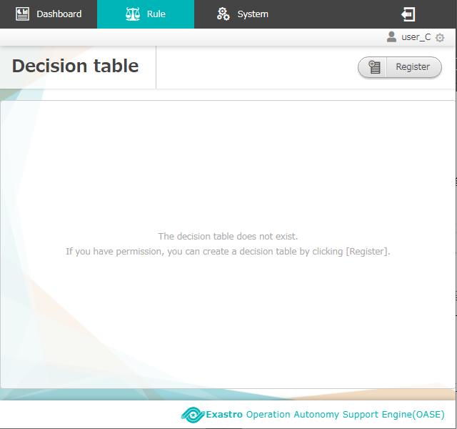
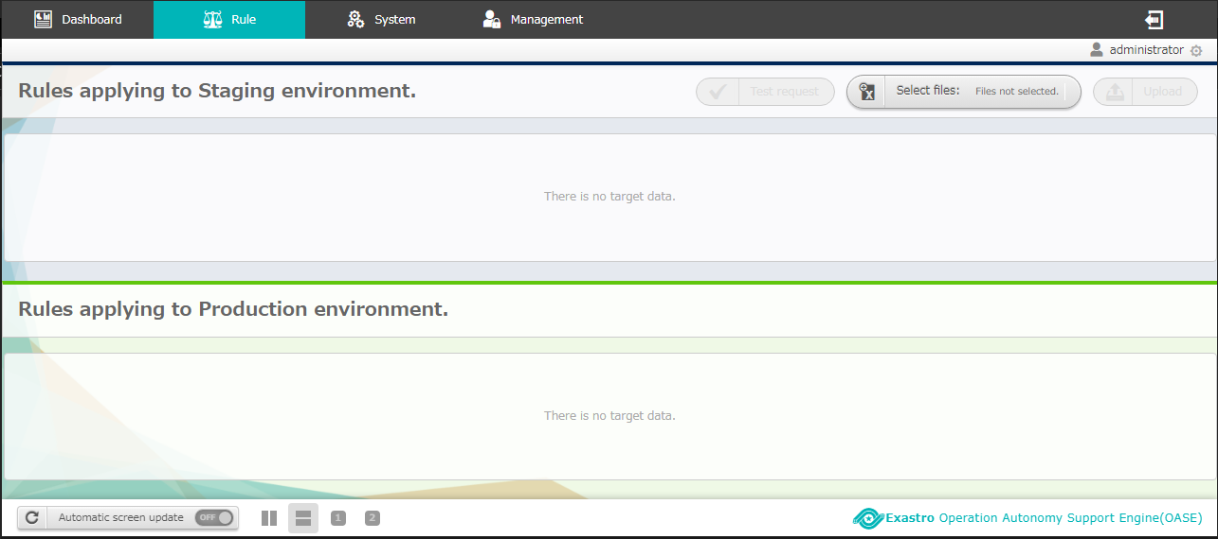
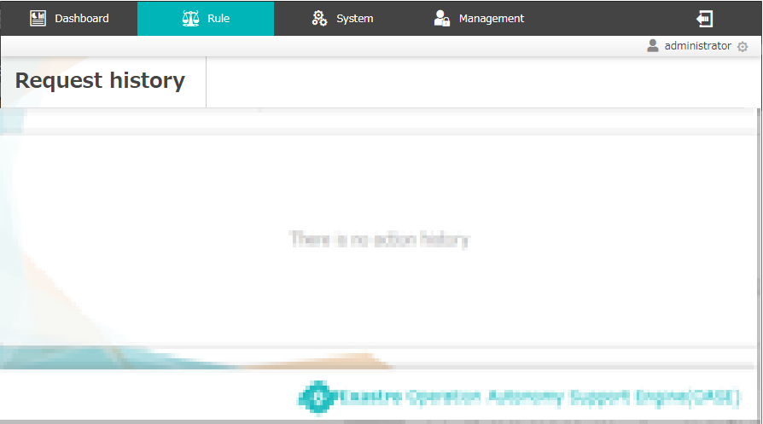
2.5 Configure permissions [Decision table] （10/12）
E.g.) Checking the decision table and related contents as users with different permissions（8/10）
The following screen will be displayed if the user is logged in as "user_C"
Screen |  | Decision table | Rule |  | Request history | Action history | Monitoring adapter
 |  |  | Staging | Production
④ | user_C | Can’t view
User

Slide 39
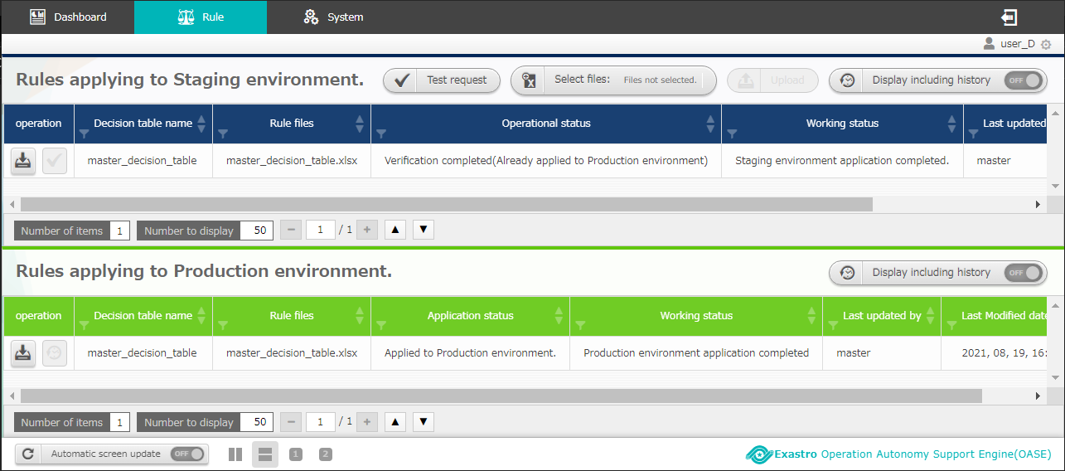
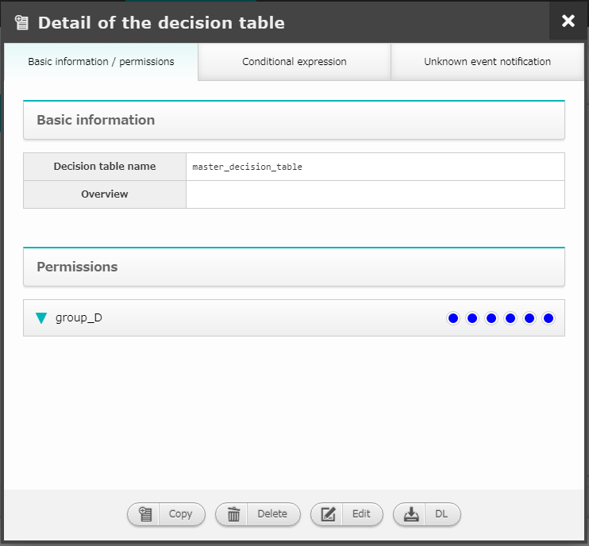
2.5 Configure permissions [Decision table] （11/12）
E.g.) Checking the decision table and related contents as users with different permissions（9/10）
The following screen will be displayed if the user is logged in as "user_D"
Screen |  | Decision table | Rule |  | Request history | Action history | Monitoring adapter
 |  |  | Staging | Production
⑤ | user_D | Can create, duplicate, delete, edit and download | Can upload and send test requests | Apply button is active. Can apply | Can view | Can control and view | Can view
User

Slide 40
2.5 Configure permissions [Decision table] （12/12）
E.g.) Checking the decision table and related contents as users with different permissions （10/10）
The following screen will be displayed if the user is logged in as “administrator"
Screen |  | Decision table | Rule |  | Request history | Action history | Monitoring adapter
 |  |  | Staging | Production
⑥ | Admin | Can’t view
User

Slide 41
3. OASE operation flow screen explanation

Slide 42
3.1 Create Decision table file（1/2）
The following chapter will cover the part marked with red
Operation flow | Screen | Category
Rule
3.1 Create Decision table file
Decision table
3.2 Register rule
Rule
3.3 Determine rules
Request history
Action history

Slide 43
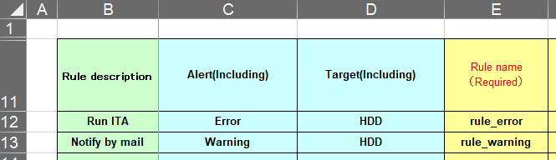
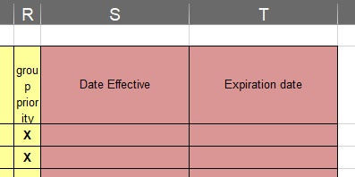
3.1 Create Decision table file （2/2）
Describing specific rules
Write the rules that are used when deciding what to do with the request messages
Comment part ：Free field. Can be used for rule descriptions, etc.
Condition part ：Write a specific condition that fits the conditional expression
Action part ：Configure the action that will happen after the rule matching
Action condition part ：Set the effective and expiration date
If a message with the words "Error" or "HDD" is requested to the decision table above, it will match "rule_error" rule with "Alert: Error" and "Target :HDD".
1
2
3
４

Slide 44
3.2 Register rule（1/4）
The following chapter will cover the part marked with red
Application flow | Screen | Category
Rule
3.1 Create Decision table file
Decision table
3.2 Register rule
Rule
3.3 Determine rules
Request history
Action history

Slide 45
3.2 Register rule （2/4）
“Staging” and “Production”
It is possible to test the requests in a staging environment before applying them to the production environment.
If the rules are verified, the status will change to “Applied to Production” where it can be used in the real environment (the action will not be executed when being verified)
If a message that corresponds to the production applied rule hits OASE, OASE will start the rule matching and run the action described.
Status | Flow | Details
Staging | Test environment | Keeps the verification results and changes status to "Production" Upload Decision table file Start Test request and rule verification
Production | Real environment | Tested rules in the Staging environment gets applied as “Rule applied to Production" Rule matching runs when a request is received If the rule matches the request, the action registered in the decision file will be run
Decision table
Change status
Decision table

Slide 46
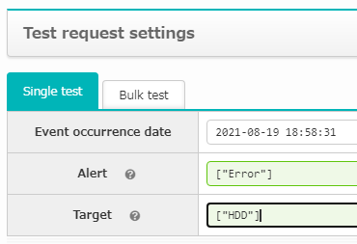
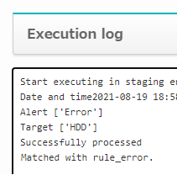
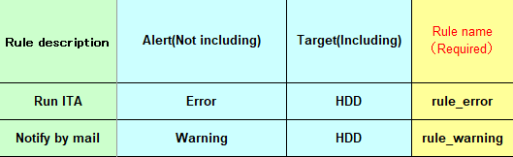
3.2 Register rule （3/4）
Test the created rules in a “Staging” environment
Staging
In staging environments, users can send test requests to the rules they’ve created
However, the action corresponding to the rule will not be carried out
For example, the following figure is an example when a rule that says "Run Action A when a message with the target "HDD" and alert level "Error" is received" is tested
Status | Request | Rule matching | Action
Staging
Production
Test request
Rule matching
（with result log）
Request
Rule matching
Action

Slide 47
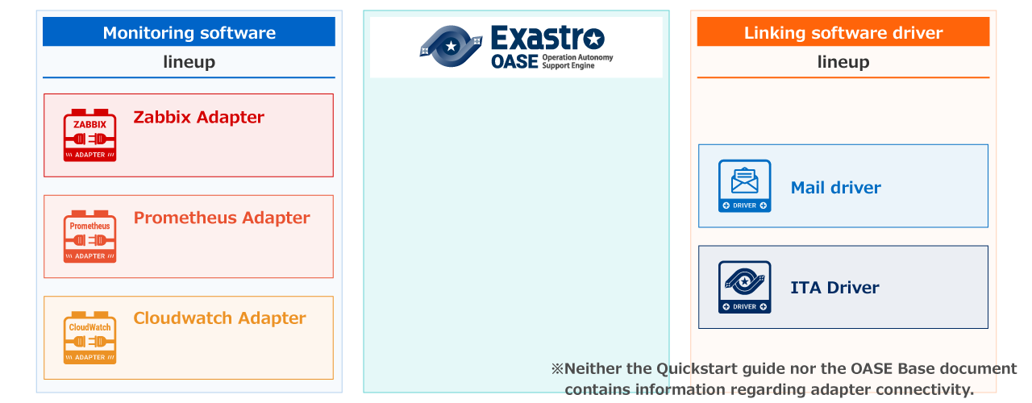

3.2 Register rule （4/4）
Use the tested rules in the Production environment
Production
The decision table can be moved to "Production" only after it's rules has been verified in the staging environment
If a rule has been matched in the production environment, the contents written in the decision table file's "action part" will be executed (in the Base document, the "ITA driver" will be linked)

Slide 48
3.3 Determine rules（1/3）
The following chapter will cover the part marked with red
Operation flow | Screen | Category
Rule
3.1 Create Decision table file
Decision table
3.2 Register rule
Rule
3.3 Determine rules
Request history
Action history

Slide 49
3.3 Determine rules （2/3）
"Request history" and "Action history" screen
If a test request has been sent to correspond to a rule in the "Staging" environment
The request will be added to “Request history”
If a request has been sent to a rule applied to the production environment
The request will be added to “Request history”
If a received request matches a rule, the executed action will be added to "Action history"
Status | Request | Rule matching | Action
Staging
 | Request history
Production
 | Request history |  | Action history
Test request
Rule matching
（with result log）
Request
Rule matching
Action

Slide 50

3.3 Determine rules （3/3）
“Action history” screen
“State” column’s icon
Users can use the icons displayed the check if the action has been executed, if it's waiting for approval, stopped due to an error and more.
“Control” column’s button
Users can see more detailed information regarding the action by pressing either the “Display details" button or the "Download" button
Users can press the "Approve" button in order to restart a paused action or run a stopped one
If the decision table file's “Pre-execution action parameter information" is filled out, users can pause running actions
(For more information, please see “User manual – Action history”)

