Slide 1

Base【Practice】
※In this document, “Operation Autonomy Support Engine” will be written as “OASE”.
Exastro Operation Autonomy Support Engine Version 1.3.1
Exastro developer

Slide 2
Table of contents
Introduction
1.1 Base【Practice】
Scenario description
2.1 Scenario
Preparation
3.1 Create group
3.2 Create and log in as new user
3.3 Pay out Token
3.4 Action settings (ITA driver)
3.5 Create decision table
Operation
4.1 Create decision table file
4.2 Register rules (Upload and test request)
4.3 Judge rules (Send request via curl command)
4.4 Check the Action results
A Appendix
Sample 1

Slide 3
1. Introduction

Slide 4
1.1 Base【Practice】 (1/3)
Preface
This document uses Exastro Operation Autonomy Support Engine (OASE) to help users better understand the software’s basic functions.
If you want to learn more about the overview of OASE, we recommend that you see the< Exastro OASE Base【Classroom】document.
For documents with more comprehensive information, please see the official Exastro OASE manual page, OASE docs.

Slide 5
1.1 Base【Practice】 (2/3)
Prerequisites
This document will have the user run ITA as an action, and will therefore assume that the following are installed/implemented.
Please see the following document for installing ITA.
<ITA Online install manual>
Please see the following document for the IT Automation BASE Practice document
<IT Automation BASE 【Practice】>
Make sure to follow all the slides that comes after the "Scenario" slide, as we will use the settings from them.
Please see the following document for installing OASE.
<OASE Online install manual>
Make sure to include the mail server settings, as we will need them when we are creating a new user.
Please see the following document for OASE Base (Classroom)
<OASE Base【lecture】>
Please see the following document for installing the ITA Driver.
< Environment construction manual -Install drivers->
※In this document, IT Automation will be written as “ITA”
Implementation
Prerequisites
①
ITA is installed
ITA Base【Practice】
Scenario is completed
②
OASE is installed
③
OASE Base【Classroom】has been read
④
The ITA Driver has been installed to OASE
⑤
OASE Base【Practice】

Slide 6
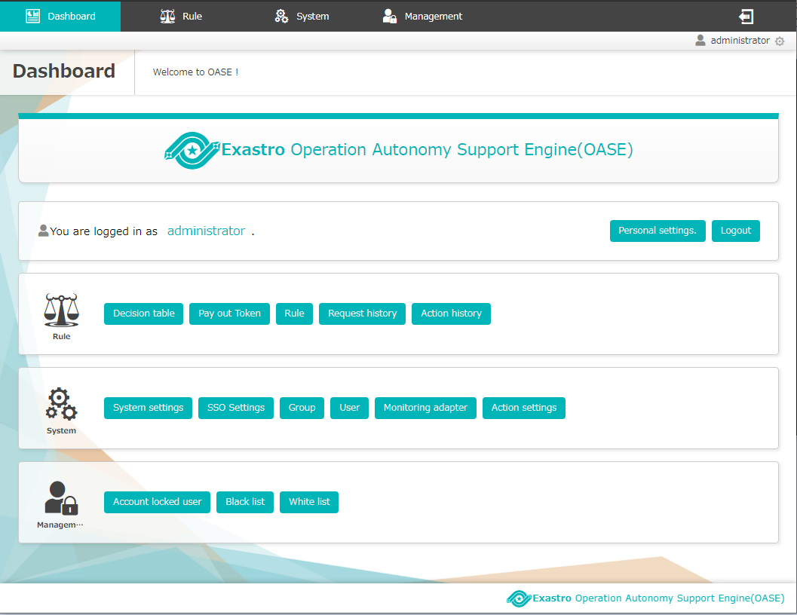
1.1 Base【Practice】 (3/3)
This guide will use the following OASE functions
Dashboard screen
Category：rule
Screen
Decision table
Pay out Token
Rule
Request History
Action History
Category：System
Screen
Group
User
Action settings

Slide 7
2. Scenario

Slide 8
2.1 Scenario description (1/2)
The following illustrates the scenario of this document (After installing OASE)
【Preparation】
Various settings
１
Create group
2
Create and log in as new user.
3
Pay out Token
4
Configure Action (ITA driver)
5
Create decision table
【Operation】
Creating and registering rules
Insert message
Rule matching
and
Executing
6
Create decision table file
7
Register rules (Upload and test request)
8
Judge rules (Send request via curl command)
9
Check the results of the Action (ITA link)

Slide 9
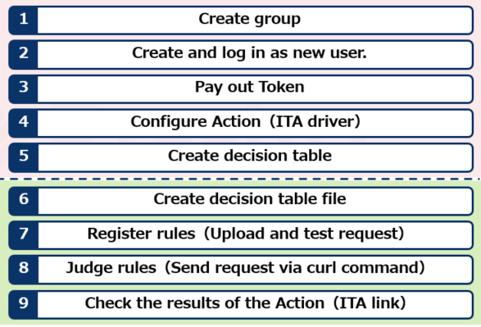
2.1 Scenario description (2/2)
In this scenario, the user will start logged in as the System admin and will then proceed to create a new group and user (test_group, test_user) that will be used for the rest of the scenario.
System admin
Will be used right after installing OASE to create a new group and user.
test_user
(Normal user)
Will be doing most of the preparation and operating.

Slide 10
3. Preparation

Slide 11
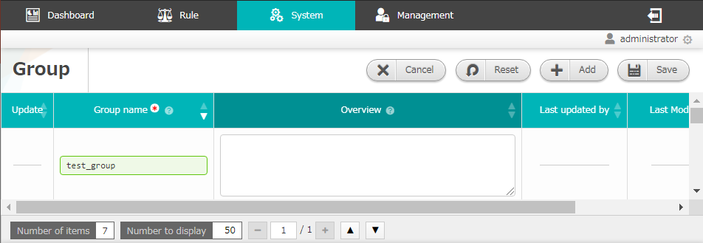
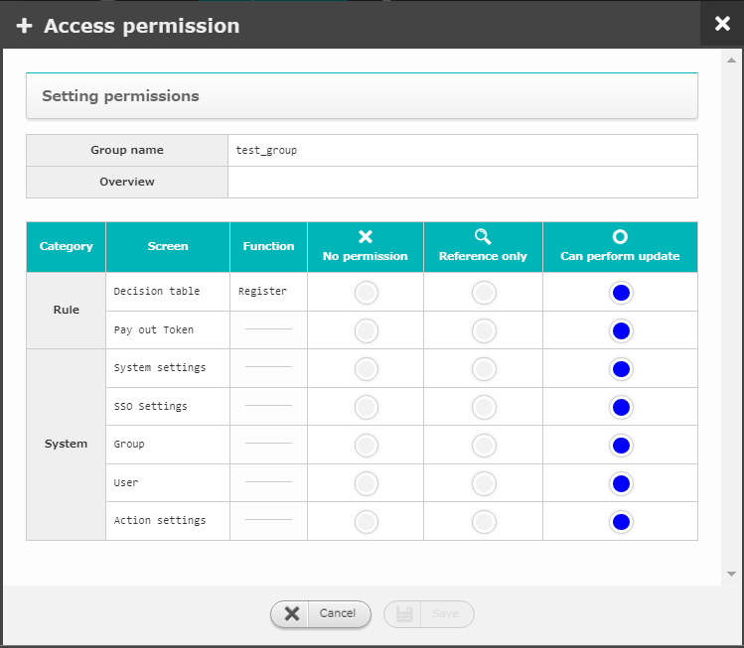
3.1 Create group
Create a new group called “test_group”
Log in as the system administrator
Move to the “group” screen and create a new group called “test_group”
Configure the “test_group”s access permission settings.
Create group
Create and log in as new user
Pay out Token
１
Configure Action (ITA driver)
Create decision table
Create decision table file
2
Register rules
(Upload and test request)
Input the following values
Judge rules
(Send request via curl command)
Item | Setting value
Group name | test_group
Check the Action results
3
Input the following values
Item | Setting value
Access permission | “Can perform update” for everything.

Slide 12
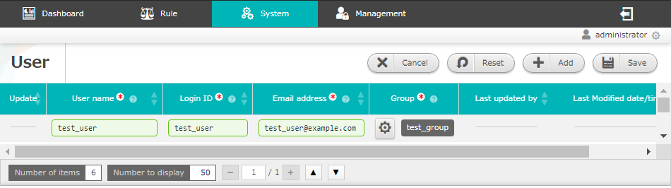
3.2 Create and log in as new user
Create a new user
Move to the “user” screen while logged in as the system admin
Create a new user called “test_user”
Log out from the system admin account and log in as “test_user”
Create group
Create and log in as new user
Pay out Token
１
Configure Action (ITA driver)
Create decision table
Create decision table file
Register rules
(Upload and test request)
2
Judge rules
(Send request via curl command)
Input the following values
Check the Action results
POINT
 | The user will receive two different mails when registering a new user in OASE. “Password notification” and “Login ID Notification”. Use the login ID and password written in said mails to log in to OASE.
Item | Setting value
User name | test_user
Login ID | test_user
Mail address | (A mail address that can receive mail)
Group | test_group

Slide 13
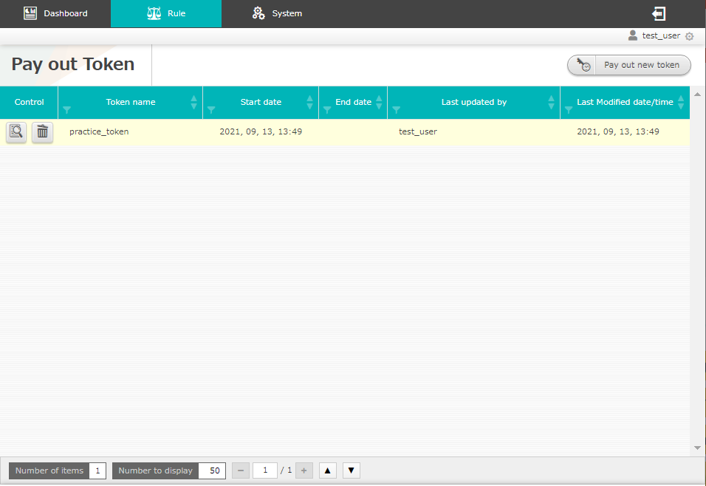
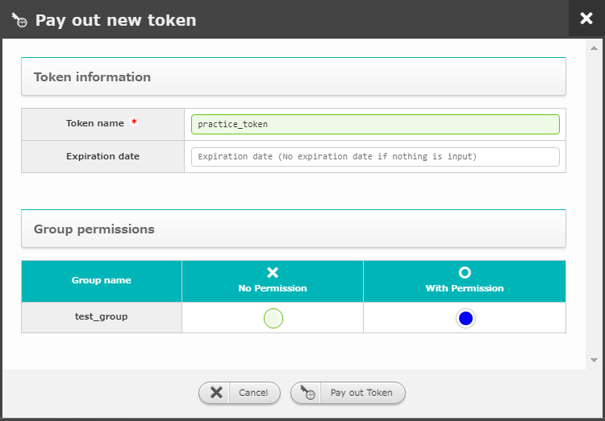
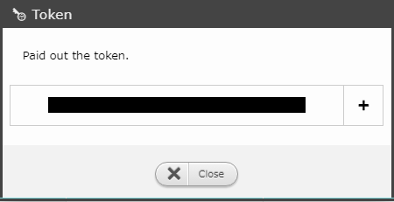
3.3 Pay out Token
Pay out a new Token
Press the “Pay out new token” button
Input all the required information
Press the “Pay out Token” button
Copy the token displayed on the screen
Press the “Close” button
Create group
Create and log in as new user
Pay out Token
Configure Action (ITA driver)
１
Create decision table
Create decision table file
2
Input the following values
Register rules
(Upload and test request)
Item | Setting value
Token name | (Free string)
Group permissions | test_group：With permission
Judge rules
(Send request via curl command)
Check the Action results
POINT
 | We will need a token when we are configuring the settings in chapter "4.3 Judge rules (Send request via curl command) “.
4
3
5

Slide 14
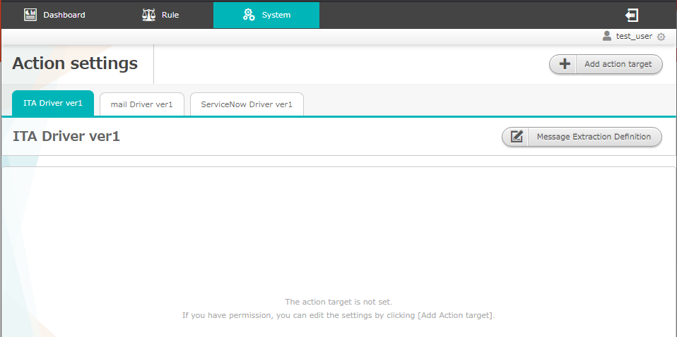
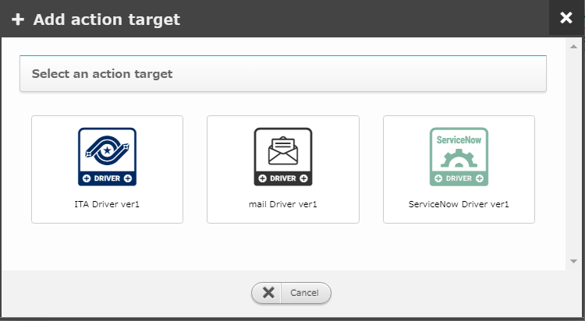
3.4 Action settings (ITA driver) (1/4)
Add Action destination
Go to the “Action settings” screen and press the “Add new action destination” button.
Select ITA Driver ver1.
The screen above will not display if you don’t have any drivers installed.
Create group
Create and log in as new user
Pay out Token
１
Configure Action (ITA driver)
Create decision table
2
Create decision table file
Register rules
(Upload and test request)
Judge rules
(Send request via curl command)
Check the Action results
POINT
 | Make sure to read the following manual and install the Mail driver in advance. <Environment construction manual - Install drivers –>

Slide 15
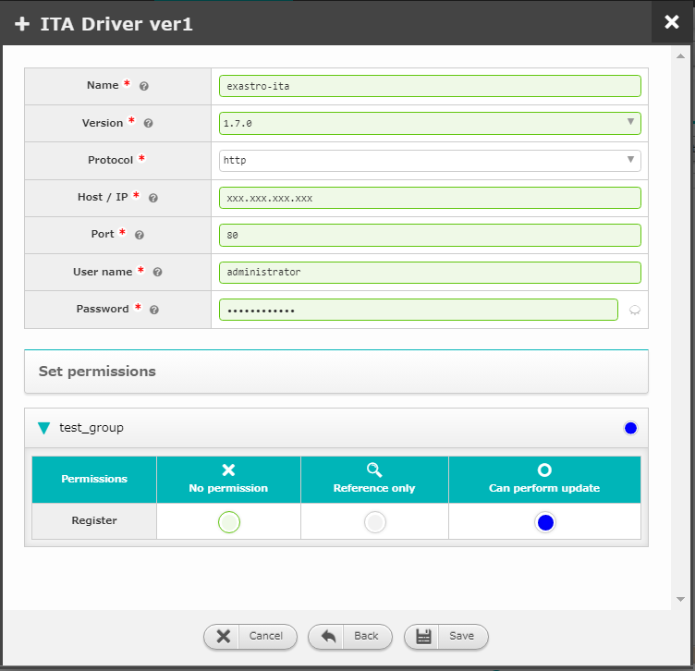
3.4 Action settings (ITA driver) (2/4)
Configure Action destination
Input all the necessary information in the ITA Driver ver1 window.
Press the “Save” button.
Create group
Create and log in as new user
１
Input the following values
Pay out Token
Item | Setting value
Name | (Free string)
Version | 1.7.1
Protocol | http
Host/IP | (IT Host name or IP Address)
Port | 80
user name | administrator
Password | (ITA user password)
Permission settings | test_group： "Can update"
Configure Action (ITA driver)
Create decision table
Create decision table file
Register rules
(Upload and test request)
Judge rules
(Send request via curl command)
Check the Action results
POINT
 | The "Name" will be used later in the <Create decision table file> when we are specifying the destination of the action.
2

Slide 16
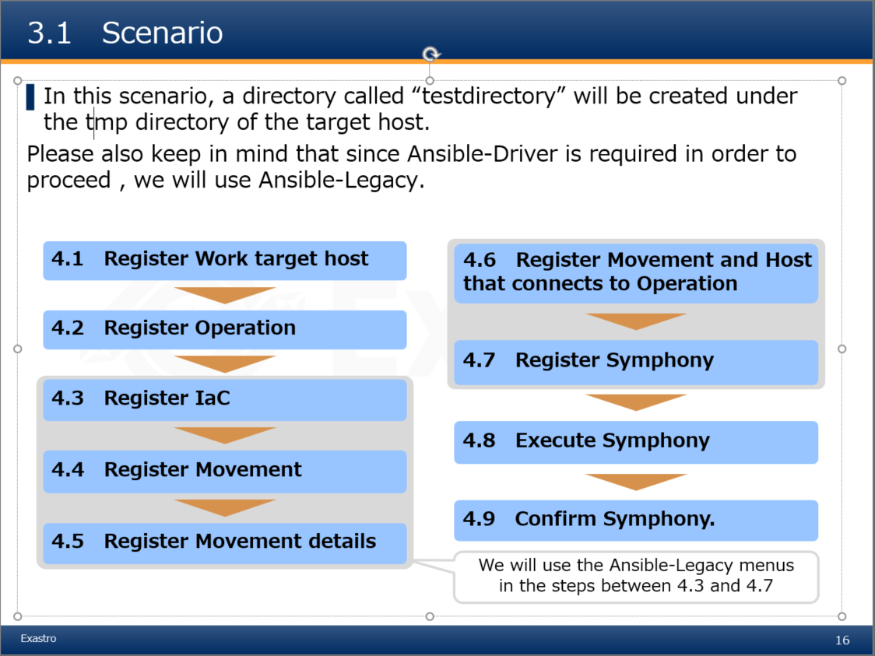
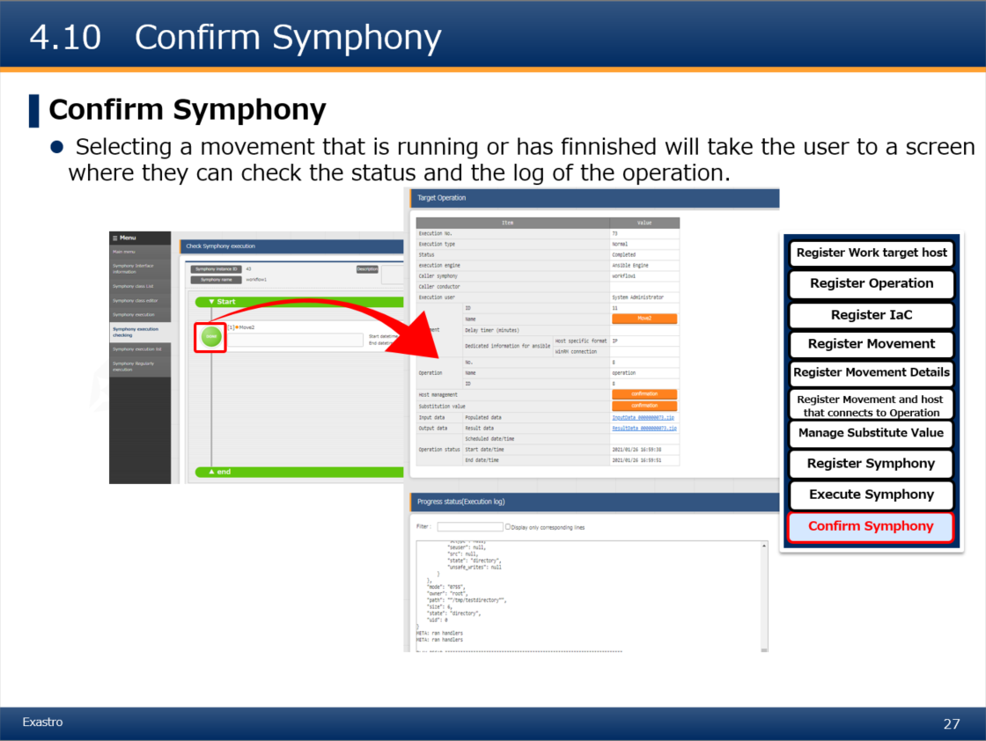
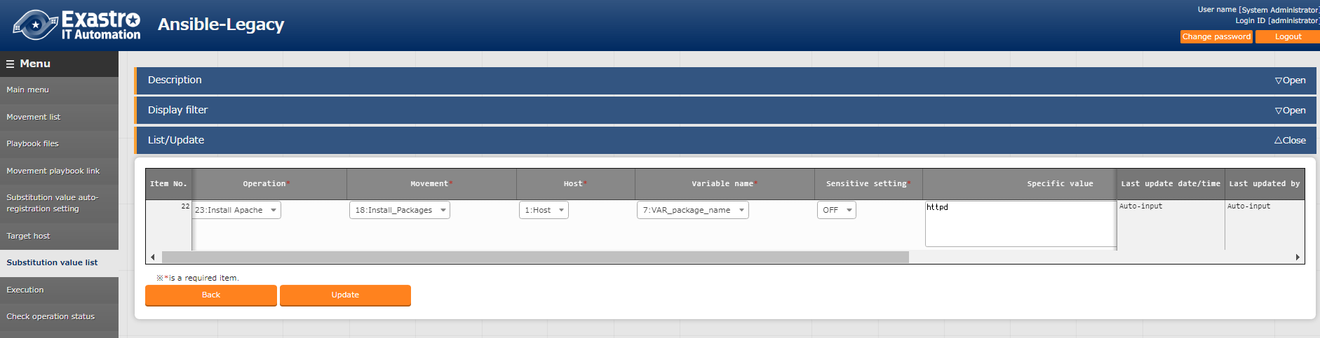
3.4 Action settings (ITA driver) (3/4)
Change the ITA registration settings
Log in to ITA and follow the <Learn ITA_BASE【Practice】>document from the “Scenario” slide to the “Symphony confirmation” slide. ※The chapter name and pages might change.
Go to the ITA ”Ansible-Legacy” menu group > ”Substitution value list” menu > ”List/Update” submenu and change the “specific value”
Create group
Create and log in as new user
Pay out Token
Configure Action (ITA driver)
Create decision table
sample
Create decision table file
Register rules
(Upload and test request)
Judge rules
(Send request via curl command)
Check the Action results
2
Input the following values
POINT
 | The string input for the specific value will be the name for the new directory that will be created.
Item | Setting value
Specific value | (Free string)

Slide 17
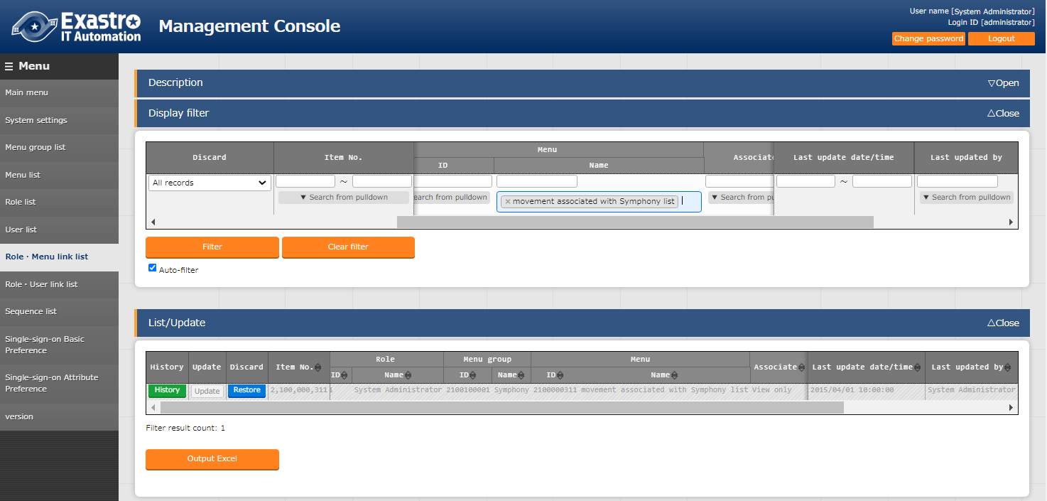
3.4 Action settings (ITA driver) (4/4)
In order to link ITA and OASE, we will need to configure the following settings:
Go to "Management console" Menu group> "Role Menu link list" Menu > "List/Update" Sub menu and revive “Symphony link movement list”.
Create group
Create and log in as new user
Pay out Token
Configure Action (ITA driver)
Create decision table
Create decision table file
Register rules
(Upload and test request)
Judge rules
(Send request via curl command)
Check the Action results
Press the “Restore” button
Movement associated with Symphony list

Slide 18
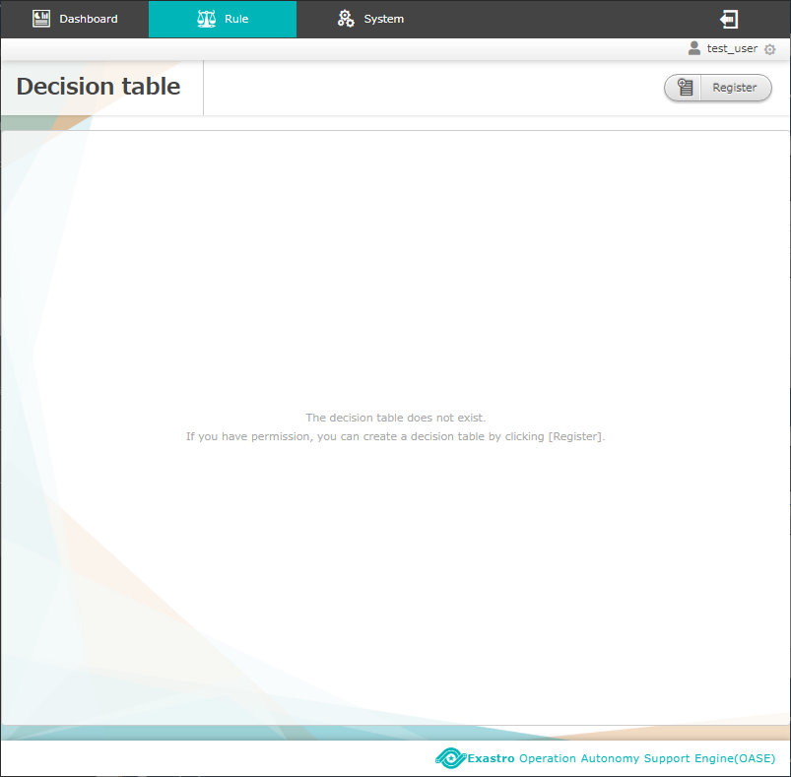
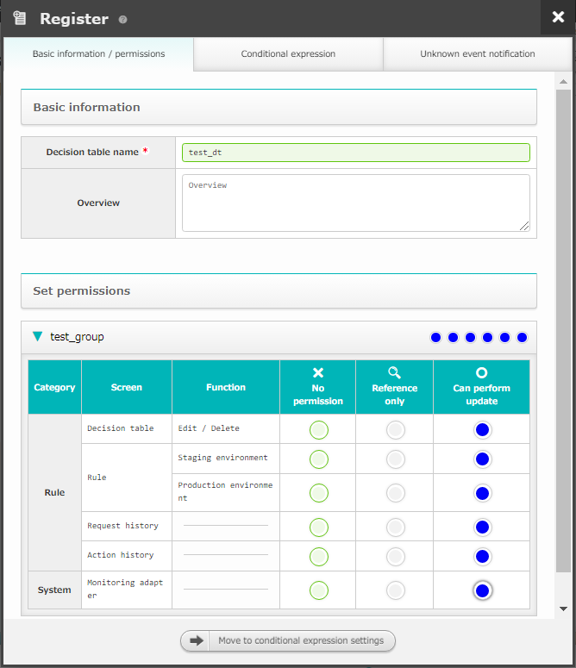
3.5 Create decision table (1/2)
Create decision table
Go to the “Decision table” screen and press “Create new” button
Input all the necessary information in the “Create new” screen-> “Basic information/ permission” tab.
Press the "Condition expression" button
Create group
Create and log in as new user
Pay out Token
１
Configure Action (ITA driver)
Create decision table
2
Create decision table file
Input the following values
Basic information / permission tab
Item | Setting value
Decision table name | (Free string)
Permission settings | test_group：”Can perform update” for all.
Register rules
(Upload and test request)
Judge rules
(Send request via curl command)
Check the Action results
POINT
 | Make sure to configure settings for at least one group in the "Permission settings". You will not be able to make changes to the Decision table if you don't.
3

Slide 19
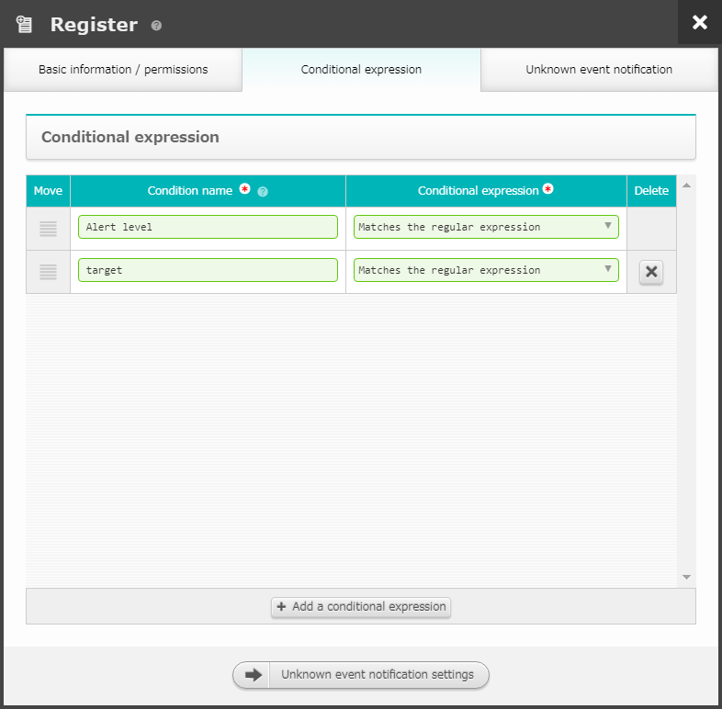
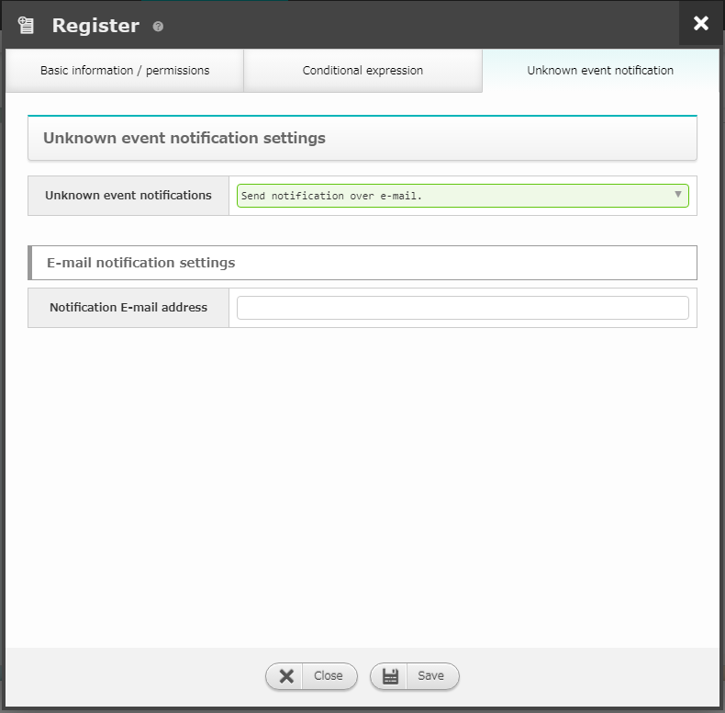
3.5 Create decision table (2/2)
Create decision table
Input the necessary information in the “ Create new “ screen -> Conditional branch tab.
Press the “Unknown event notification” button
Input all the necessary information in the “Unknown event notification” tab
Press the “Save” button
Create group
Create and log in as new user
Pay out Token
上記の値を入力する
上記の値を入力する
Configure Action (ITA driver)
Conditional expression tab
Item | Setting value
Condition name | (Free string)
Conditional expression | Pulldown selection
Unknown event notification tab
Item | Setting value
Unknown event notification | Select “Notify by mail”.
Notification E-mail address | (Mail address that can receive e-mails)
Create decision table
Create decision table file
4
6
Register rules
(Upload and test request)
Judge rules
(Send request via curl command)
Check the Action results
POINT
 | The configured conditional expression will be used later when we are setting specific values in the Decision table file's "Condition part".
5
7

Slide 20
4. Operation

Slide 21
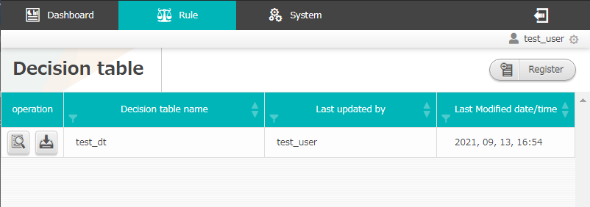
4.1 Create decision table file (1/3)
Download and create the decision table file
Click the download button the right of the decision table we created in chapter 3.2 and download the decision table file
Create group
Create and log in as new user
Pay out Token
Configure Action (ITA driver)
Create decision table
Create decision table file
Register rules
(Upload and test request)
Judge rules
(Send request via curl command)
Check the Action results
POINT
 | The name of the decision table file is automatically generated (E.g.”id00000000000.xlsx”). Note that it will be different from the name of the decision table itself. In the next page, we will explain the contents of the file.

Slide 22
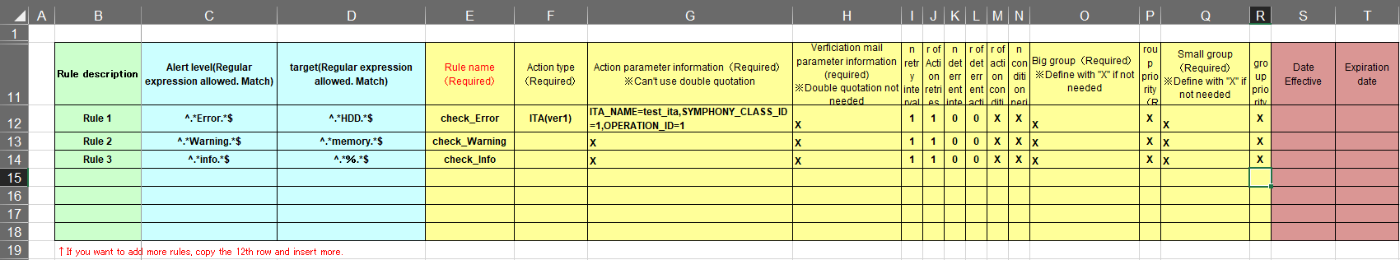
4.1 Create decision table file (2/3)
Fill in the Decision table file
For an exact copy of the following decision table file, please see<A. Appendix Sample1>.
Create group
Create and log in as new user
①
②
③
④
Pay out Token
Configure Action (ITA driver)
Create decision table
Create decision table file
Register rules
(Upload and test request)
①Comment part | Used for comments and descriptions. Can also be blank
②Condition part | Creates the condition that will be matched to the rules.
③Action part | Can set different actions for each rule name. The only type of "Action type" that can be used are the ones that have their drivers installed in the "Action settings" screen. Note that the writing format of the "Action parameter information" depends on the type of action. Can be used to perform an action or to send a validation mail.
④Action condition part | Used to specify the validity period. Can also be blank
Judge rules
(Send request via curl command)
Check the Action results
POINT
 | For all the different values and how to correctly write them, please see the "example" sheet in the excel file. After changing the Decision table file, you can change the name of the file name to your liking.

Slide 23
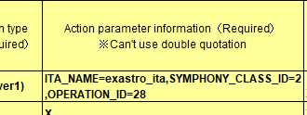
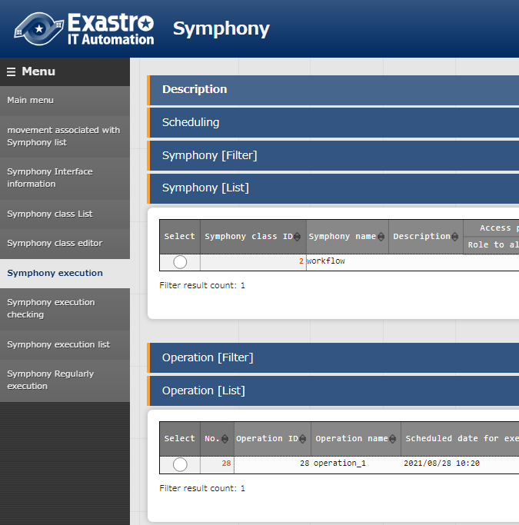
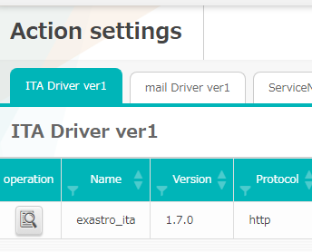
4.1 Create decision table file (3/3)
Input Action parameter information
Use the table below and fill out the Action parameter Information
Create group
No. | Action parameter information | Setting value
１ | ITA_NAME | The name registered in the “ITA Driver ver1” name tab.
２ | SYMPHONY_CLASS_ID | The Symphony class ID (Is found in ITA's "Symphony" menu group -> "Symphony execution" menu -> "Symphony [list]”)
３ | OPERATION_ID | The Operation ID (Is found in ITA's "Symphony" menu group -> "Symphony execution" menu -> "Operation [list]")
Create and log in as new user
Pay out Token
Configure Action (ITA driver)
Create decision table
Create decision table file
Register rules
(Upload and test request)
Judge rules
(Send request via curl command)
Check the Action results
②
①
③

Slide 24
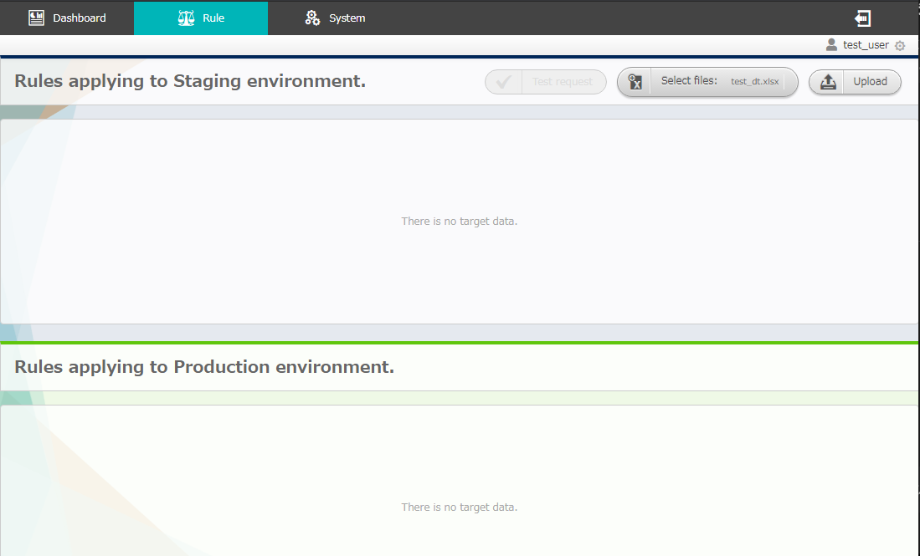
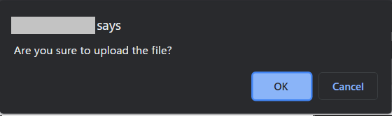
4.2 Register rules (Upload and test request) (1/6)
Select the decision table you want to test
Click the “Upload” button in the Rule screen and select the previously created decision table file
Press the “Upload” button
Press “OK” on the browser dialogue box
Create group
Create and log in as new user
Pay out Token
Configure Action (ITA driver)
Create decision table
１
2
Create decision table file
Register rules
(Upload and test request)
Judge rules
(Send request via curl command)
Check the Action results
3

Slide 25
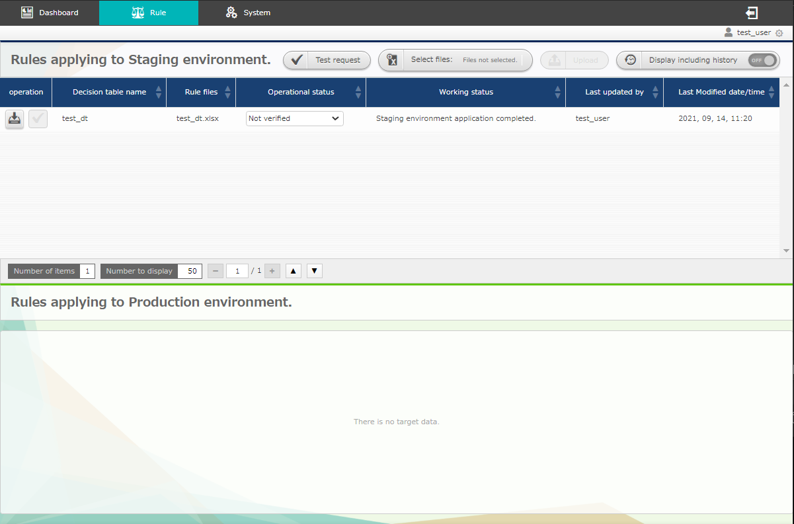
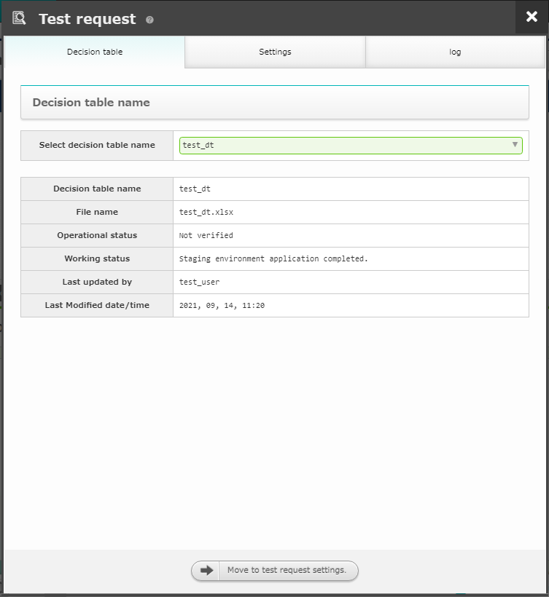
4.2 Register rules (Upload and test request) (2/6)
Select test request target
After the “Operation status” has changed to “Staging environment application completed”, press the “Test request” button.
Select the decision table file you want to test.
Press the “Test request” button.
Create group
Create and log in as new user
Pay out Token
Configure Action (ITA driver)
Create decision table
１
Create decision table file
Register rules
(Upload and test request)
Judge rules
(Send request via curl command)
2
Check the Action results
POINT
 | The Operation status changes automatically every 5 seconds. For more information regarding the different statuses, please refer to <User manual - Rule screen- (1) Rule screen (Staging) >
3

Slide 26
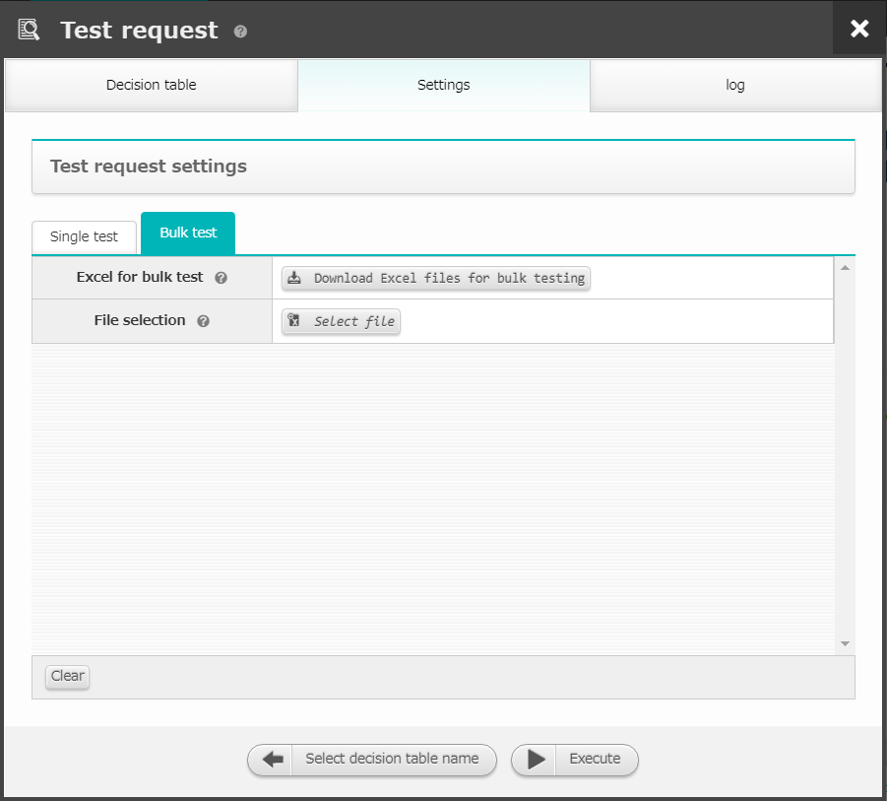
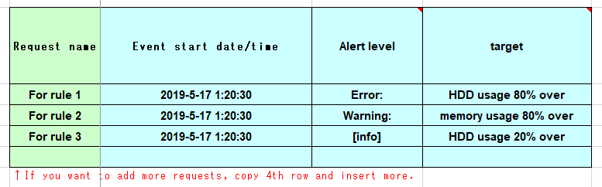
4.2 Register rules (Upload and test request) (3/6)
Input test values and run the test request
In the settings tab, select “Bulk test”
Press the “Download Excel files for bulk testing” button
In the file, input a value that matches the rule you previously created
Create group
Create and log in as new user
Pay out Token
Configure Action (ITA driver)
１
2
Create decision table
Create decision table file
Register rules
(Upload and test request)
3
Judge rules
(Send request via curl command)
Check the Action results
POINT
 | We will test if the values matches the condition part in the decision table file.

Slide 27
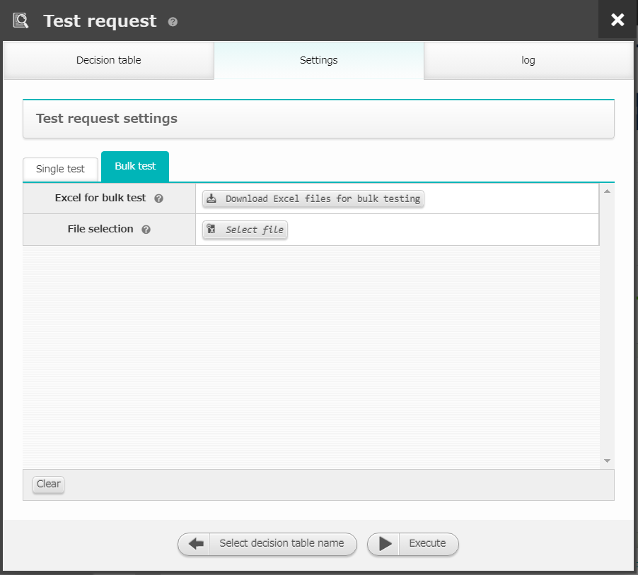
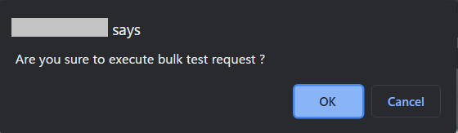
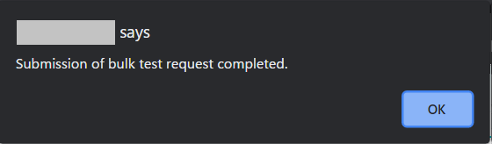
4.2 Register rules (Upload and test request) (4/6)
Input test values and run the test request
Press the "Select file" button and select the updated Excel file xx
Press the “Execute” button
Press “OK” on the browser dialogue box
Create group
Create and log in as new user
Pay out Token
Configure Action (ITA driver)
Create decision table
Create decision table file
6
Register rules
(Upload and test request)
Judge rules
(Send request via curl command)
4
Check the Action results
5

Slide 28
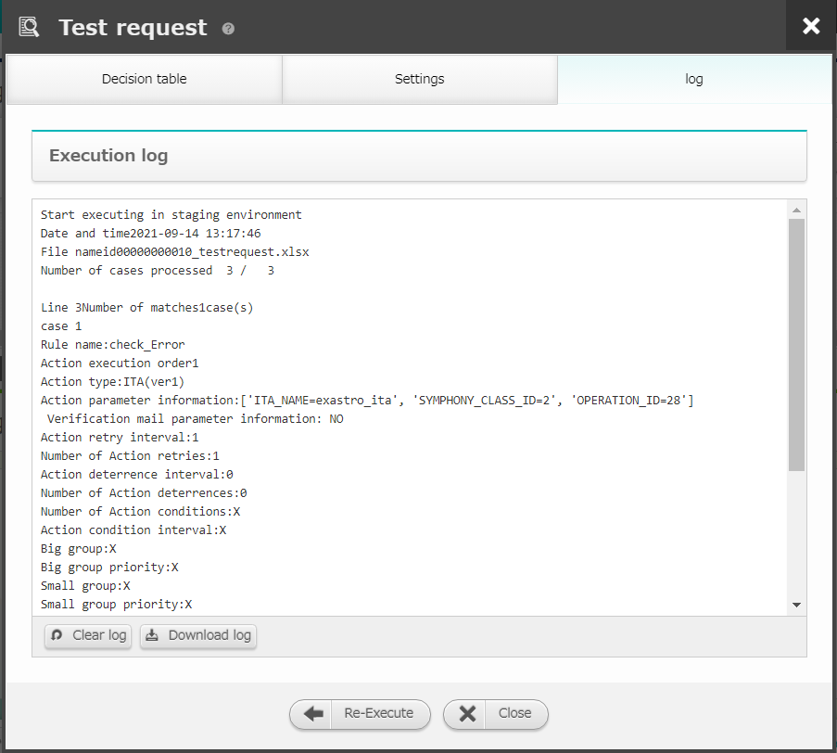

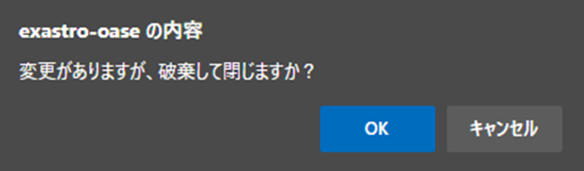
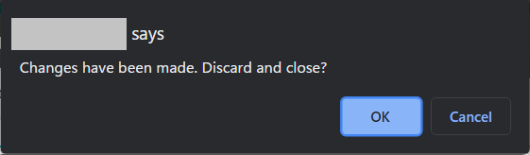
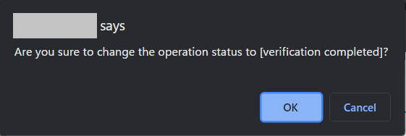
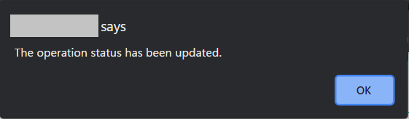
4.2 Register rules (Upload and test request) (5/6)
Check that the rule is active
Check the execution log in the log tab
Press the “Close” button
Press “OK” on the browser dialogue box
If the rule matched
Press “OK” on the browser dialogue box
Create group
Create and log in as new user
Pay out Token
Configure Action (ITA driver)
Create decision table
Create decision table file
2
Register rules
(Upload and test request)
１
Judge rules
(Send request via curl command)
Check the Action results
POINT
 | If test matches the rule we created in chapter 4.1, the execution log will display “Line X Number of matches X case(s)” The decision table will change status to Verification completed when it's rule is hit.

Slide 29
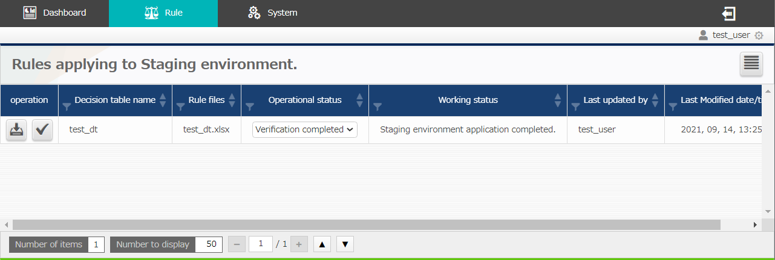
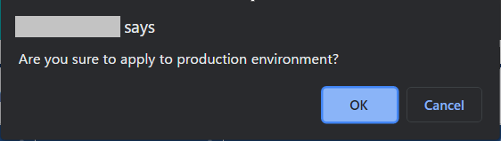
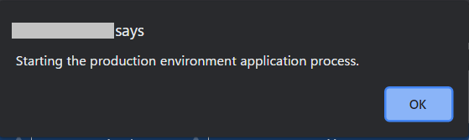
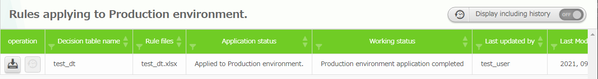
4.2 Register rules (Upload and test request) (6/6)
Make the tested rule valid for production environment
In order to use the rule in the production environment, we will need to change the status from “Not applied” to “Verification completed”
Check that the status has changed status to ”Verification completed”
Press the “Apply” button
Press “OK” on the browser dialogue box
Create group
Create and log in as new user
Pay out Token
Configure Action (ITA driver)
Create decision table
１
If the test request matched the rule successfully, the status will display “Verification completed"
Create decision table file
2
Register rules
(Upload and test request)
Judge rules
(Send request via curl command)
Check the Action results
3
POINT
 | The operation status is automatically updated every 5 seconds. for more information regarding the different statuses, please see <User manual - Rule screen- (2) Rule screen (Production) >
The rule can be applied to the production environment only after the application status has changed to “Applied to Production environment”.

Slide 30
4.3 Judge rules (Send request via curl command) (1/2)
Input a message and match the production applied rule xx
Open the terminal and change the following command to fit your rule and run it.
See "A. Appendix Sample 1" for a more detailed example of the curl command.
Create group
Create and log in as new user
curl -X POST -k "https://<①Host name>/oase_web/event/event/eventsrequest“ \
-H "accept: application/json“ \
-H "Authorization: Bearer <⑥Token>“ \
-d ‘{"decisiontable":"<②Decision table name>","request type":"<③Request type>","eventdatetime":"<④Event start date>","eventinfo":["<⑤Event information>"]}’
Pay out Token
Configure Action (ITA driver)
Create decision table
Create decision table file
Register rules
(Upload and test request)
① | Host name | Input a valid host name or IP address
② | Decision table name | Input a decision table applied to the production environment
③ | Request type | Input the request destination type, "1“ E.g) "requesttype":"1"
④ | Event start date | Input the event start date in the following format: yyyy/mm/dd hh:mm:ss E.g.) "eventdatetime":"2020/01/01 01:01:01"
⑤ | Event information | Specify the event information in a list format. E.g.) "2","AAA"
⑥ | Token | Input the token created at the "Pay out Token" screen
Judge rules
(Send request via curl command)
Check the Action results
POINT
 | For more information regarding HTTPS requests, please see the <REST API Function User manual>

Slide 31
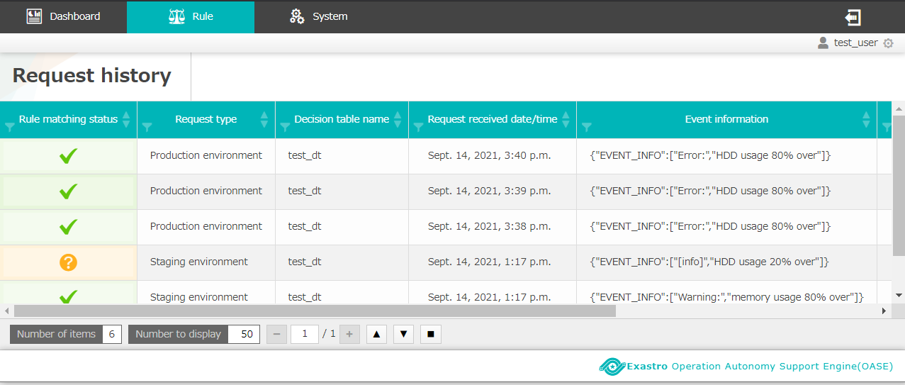
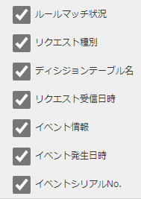
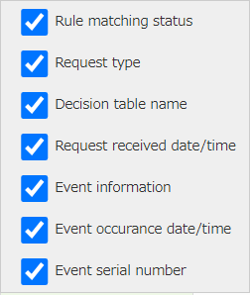
4.3 Judge rules (Send request via curl command) (2/2)
Check the Request history screen
The request sent using the curl command should be displayed
You can choose what items to display by pressing the ■ button.
Create group
Create and log in as new user
Pay out Token
Configure Action (ITA driver)
Create decision table
Create decision table file
Register rules
(Upload and test request)
Judge rules
(Send request via curl command)
Check the Action results

Slide 32
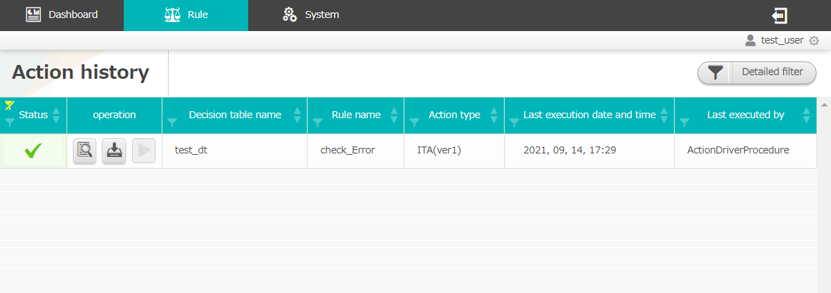
4.4 Check the Action results (1/3)
Run action
If the rule matches, the action will be executed just as we set it to do in the preparation section. You can check the action in the Action history settings screen.
The action is the results of the contents we configured in the action part in chapter 4.1 Create decision table file
Action History
Check that the action executed by the rule matching is being correctly displayed in the action history screen.
Create group
Create and log in as new user
Pay out Token
Configure Action (ITA driver)
Create decision table
Create decision table file
Register rules
(Upload and test request)
Judge rules
(Send request via curl command)
Check the Action results
POINT
 | For more information regarding the different icons and buttons, please see <User manual -Action history->

Slide 33
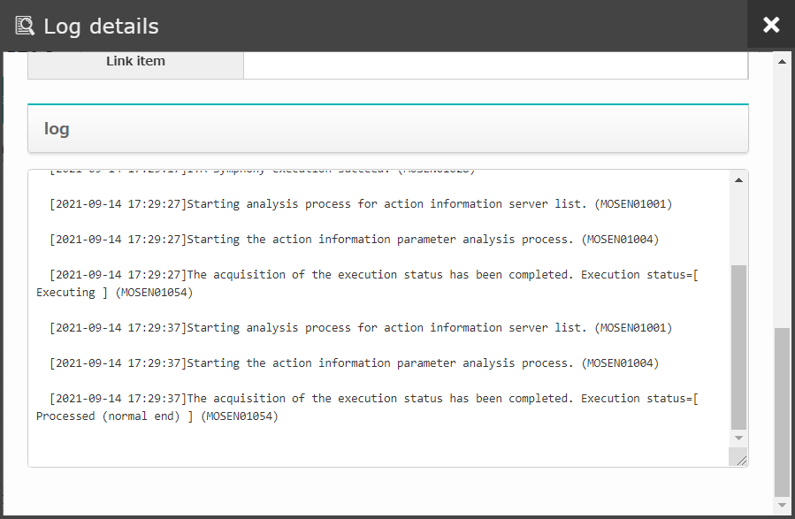
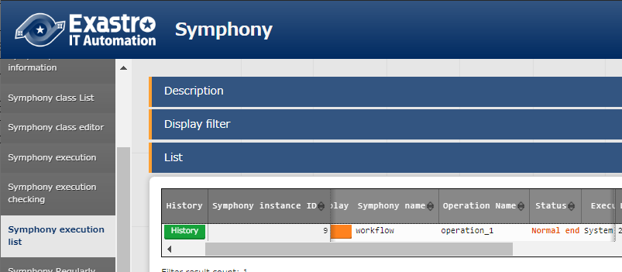

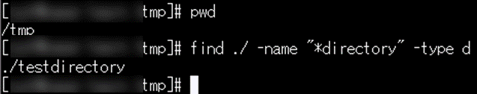
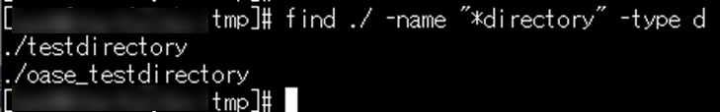
4.4 Check the Action results (2/3)
Check ITA has run the process
Check the OASE log that the process has ended correctly
Go to the ITA Symphony list and check that the status is displaying “Normal end”
Check that a new directory has been created according to the previously set contents
Create group
Create and log in as new user
Pay out Token
Configure Action (ITA driver)
Create decision table
Create decision table file
Register rules
(Upload and test request)
Judge rules
(Send request via curl command)
Check the Action results

Slide 34


4.4 Check the Action results (3/3)
For Unknown events
If a request with contents not defined as a known event is sent, a mail with the subject "OASE Unknown event notification" will be sent.
Create group
Create and log in as new user
Pay out Token
Configure Action (ITA driver)
Create decision table
Create decision table file
Register rules
(Upload and test request)
Rule matching status : No rule detected
Judge rules
(Send request via curl command)
Check the Action results

Slide 35
A Appendix

Slide 36
Sample１ (1/4)
Input sample values and run OASE
The following settings will make it so if a message containing either "Error:" or "HDD", ITA will start and create a directory called "oase_testdirectory"
If a message that is not a known event (contains message: and "SKIP", A mail with the subject "[OASE]Uknown event notification" will be sent. 【Configuration】
① "Pay out Token" screen
③ "Decision table" screen
POINT
 | Used in the following chapters: <3.3 Pay out Token> < 3.4 Configure Action (ITA driver) > and <3.5 Create decision table>
Create token that will be used when sending request through curl command.
 | Token name | practice_token
 | (Register other necessary info.)
Create the decision table file containing conditions the "Alert level" and "Target" will hit.
 | Decision table name | test_dt
 | Permission settings (test_group) | “Can update” for all"
 | Condition name | Conditional expression
 | Alert level | Matches the regular expression
 | target | Matches the regular expression
 | Unknown event notification | Notify by mail
 | (Register other necessary info.)
② "Action settings" screen
Prepare "ITA Driver ver1"
 | name | test_ita
 | Version | 1.7.1
 | (Register other necessary info.)

Slide 37
Sample１ (2/4)
【Operation】
④ "Decision table" file
Save the decision table file and rename it
 | File name |  | test_dt.xlsx
Create a rule that matches with: "Alert level：”Error:”" "Target：”HDD”"
 | Rule description | Alert level |  | Target | Rule name | Action type | Action parameter information
 | Rule 1 | ^.*Error.*$ |  | ^.*HDD.*$ | check_Error | ITA (ver1) | ITA_NAME=test_ita,SYMPHONY_CLASS_ID=1,OPERATION_ID=1
 | Rule 2 | ^.*Warning.*$ |  | ^.*memory.*$ | check_Warning | blank | X
 | Rule 3 | ^.*info.*$ |  | ^.*％.*$ | check_Info | blank | X
 |  | (Use the "Example" sheet in the Decision table file as a reference and fill in the rest of the items)
⑤ "Rule (Stage application rule) " Screen
POINT
 | Used in the following chapters: <4.1 Create decision table file > and <4.2 Register rules (Upload and test request) >
Upload the edited decision table file
 | Select file | test_dt.xlsx

Slide 38
Sample１ (3/4)
⑥Test request screen
Test what rule that gets matched if there are multiple requests sent to the decision table file.
 | Select decision table name |  |  | test_dt
 | Bulk test request
 | Request name | Event start date |  | Alert level | Target
 | For rule 1 | 2019-5-17 1:20:30 |  | Error: | HDD usage 80% over
 | For rule 2 | 2019-5-17 1:20:30 |  | Warning: | memory usage 80% over
 | For rule 3 | 2019-5-17 1:20:30 |  | [info] | HDD usage 20% over
 | Select file |  | id000000000xx_testrequest.xlsx
POINT
 | Used in this chapter: <4.2 Register rules (Upload and test request) >

Slide 39
Sample１ (4/4)
⑦Terminal (Linux server)
Use a curl command to send a request to the rule we created. ※Change red text to fit your rule
 | curl -X POST -k "https://<Hostname>/oase_web/event/event/eventsrequest" -H "accept: application/json“ \ -d ‘{"decisiontable":"test_dt","requesttype":"1","eventdatetime":"2020/01/01 01:01:01","eventinfo":["Error:","HDD usage 80% over"]}‘ -H "Authorization: Bearer <Access_Token>"
⑧Unknown event notification
Check that you've received a mail with the following contents
POINT
 | Used in the following chapters: <4.3 Judge rules (Send request via curl command) > and < 4.4 Check the Action results>
Subject | [OASE]Unknown event notification
Main body | [Decision table name] [Event start time] [Request reception time] [Event Information] [Trace ID]
Mail notification

