Slide 1


Quick Start
※”Operation Autonomy Support Engine” is referred to as “OASE” in this manual.
Exastro Operation Autonomy Support Engine Version 1.3.1
Exastro developer

Slide 2
Table of contents
Introduction
1.1 About this guide
1.2 Login screen
1.3 Screen description （Dashboard screen）
1.4 Screen description （Action setting screen）
1.5 Screen Description（Token pay out screen）
1.6 Screen description （Decision table screen）
1.7 Screen description （rule screen）
1.8 Screen description （Request history screen）
1.9 Screen description （Action history screen）
Scenario description
2.1 Scenario
Preparation before execution
3.1 Setup mail driver and create mail template
3.2 Pay out token
3.2 Create decision table
3.3 Create decision table ※Excel operation
3.4 Upload decision table file
3.5 Test request
3.6 Apply to production environment
Operation execution
4.1 Send request via curl command
4.2 Check the result of action execution
A Appendix
Sample1

Slide 3
1. Introduction

Slide 4
1.1About this guide（1/2）
Prerequisites
In order to follow this guide, the user must have installed OASE and the following functions.
OASE Installer (See the following guides)
<OASE_docs Environment Construction manual-Basics->
<OASE Learn –OASE Offline install->
Mail Driver (See the following guides)
<Environment Construction manual- Driver install->
Make sure that the mail server is running.
e.g.）Checking that postfix.service is running. ※If it isn’t running, run the following command.
Introduction
Prerequisites
①
OASE installed
②
Mail Driver Installed
③
Mail server Running
# ps –ax | grep postfix
You can now use the quick start guide.
# systemctl start postfix

Slide 5
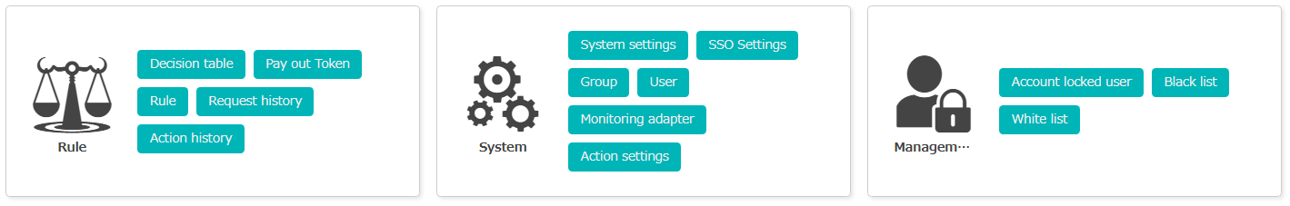
1.1About this guide（2/2）
Functions.
The following OASE functions will be used. (The item no. correlates the upcoming slides.)
Dashboard screen
Item No. | Screen name | Path Location
1.2 | Login
1.3 | Dashboard | DashBoard
1.4 | Action settings | DashBoard > System > Action settings > mail Driver ver1
1.5 | Token Pay-out | DashBoard > Rules > Token Pay-out
1.6 | Decision Table | DashBoard > Rules > Decision Table
1.7 | Rules | DashBoard > Rules > Rules > Staging Application rule
 |  | DashBoard > Rules > Rules > Production Application rule
1.8 | Request History | DashBoard > Rules > Request History
1.9 | Action History | DashBoard > Rules > Action History

Slide 6
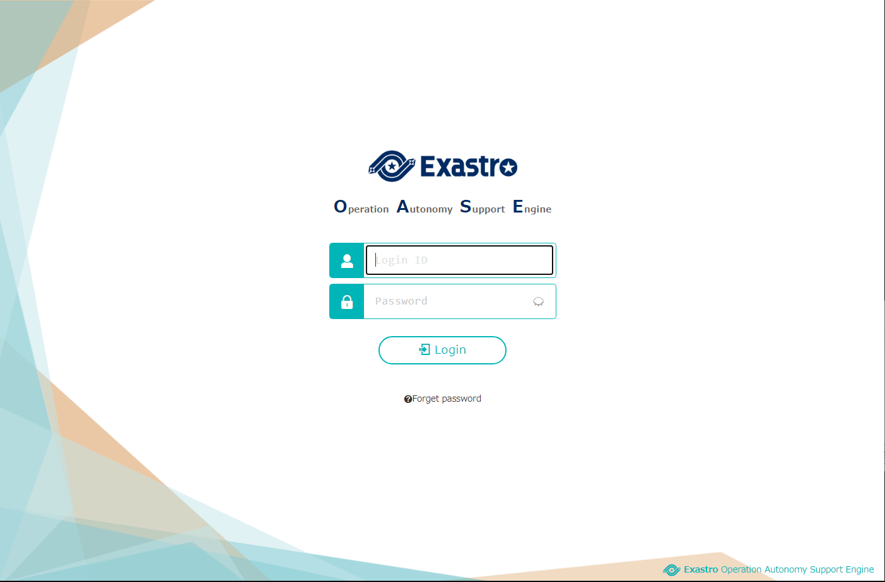
1.2 Screen description（Login screen）
OASE Login
The login screen will be displayed by accessing the following URL. https://exastro-oase/oase_web/top/login
The password will be requested to be changed immediately after login for the first time.

Slide 7
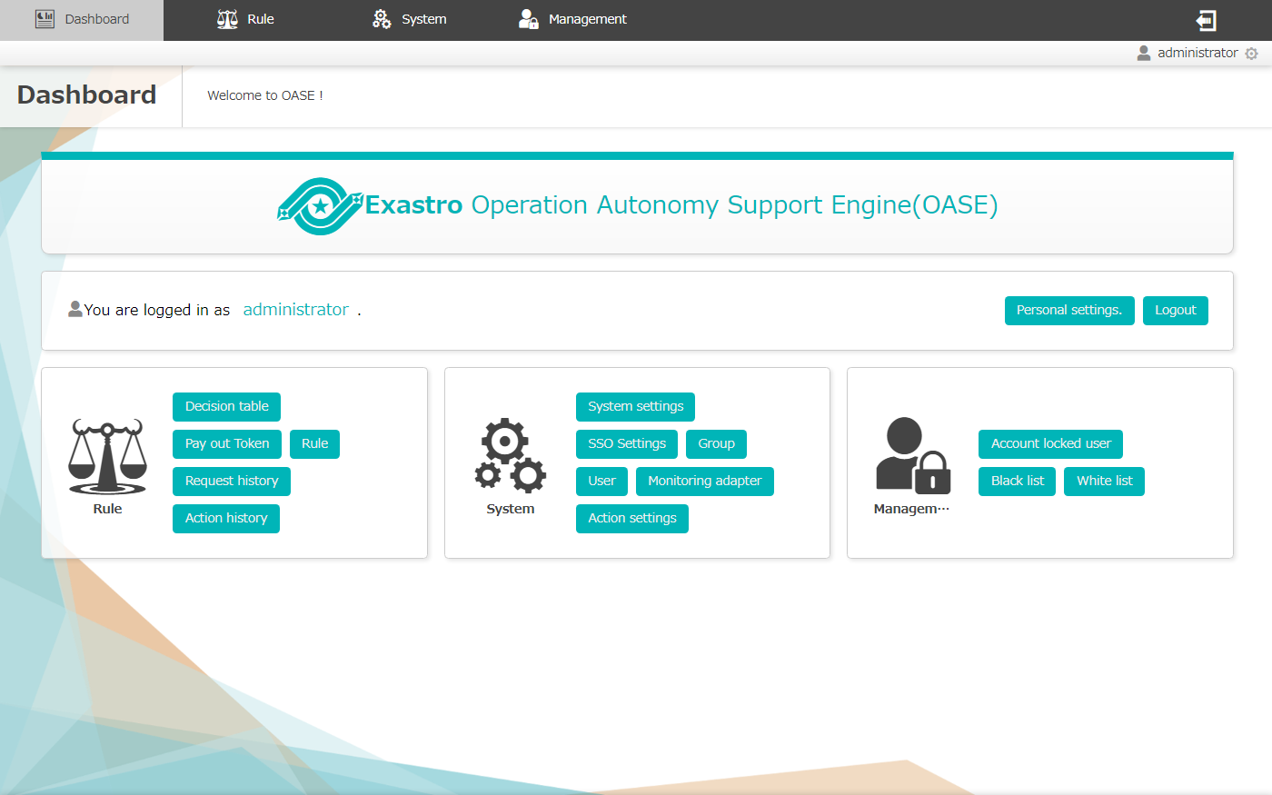
1.3 Screen Description（Dashboard Screen）
The overview of the main menu is as follows.
”Rule “Menu ：Action result management and Rule creation.
”System”Menu ：OASE Settings/Permission management.
“Administrator” Menu ：Security Management.
Menu
Please refer to the manuals for details of the functions in each menu.

Slide 8
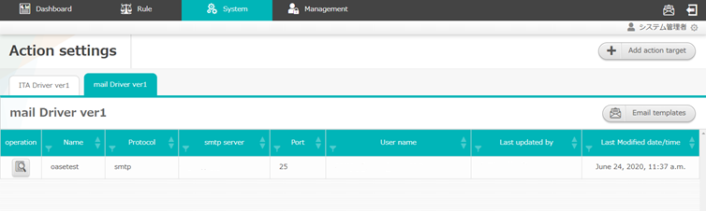
1.4 Screen description（Action setting screen）
Function Description
The name of the driver installed in OASE
The information of the registered action target
The button to add action target information to installed driver
The button to create mail template
③
①
④
②
Please refer to the manuals for details of the functions in each menu.

Slide 9
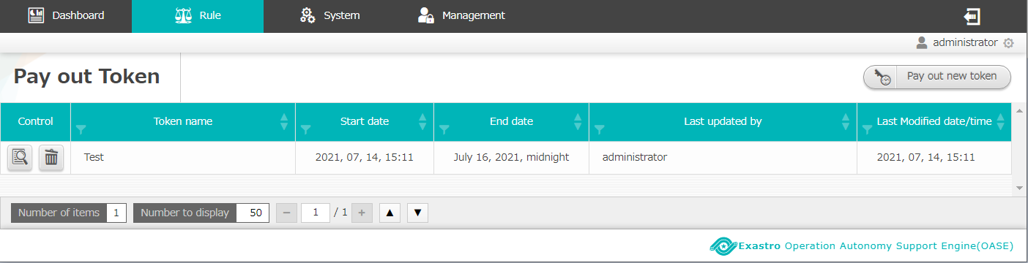
1.5 Screen description（Token Pay-out）
Function Description
List of Tokens registered in OASE.
Button that creates new Tokens.
①
②
For more information regarding the different functions, please see the respective manuals.

Slide 10
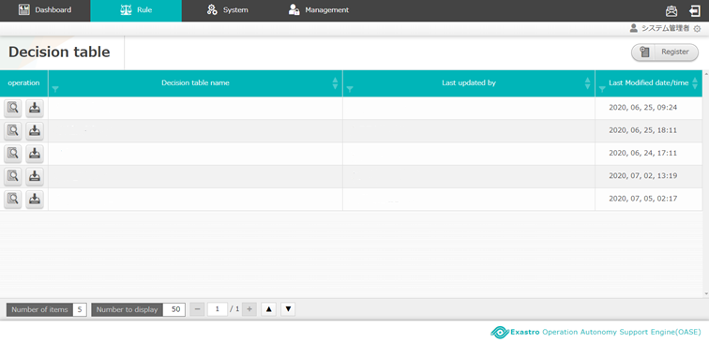
1.6 Screen description（Decision table screen）
Function Description
Decision tables registered to OASE
Button that allows users to download the decision table file
Button that allows users to add/create new decision tables
③
②
①
Please refer to the manuals for details of the functions in each menu.

Slide 11
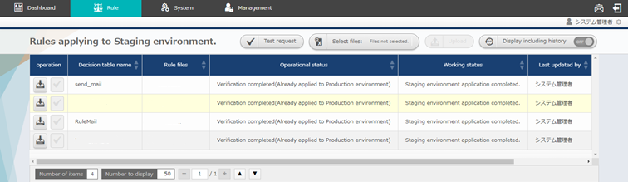
1.6 Screen description（Rule screen）
Function Description
Decision table file operation buttons.
List of uploaded Decision table files and their status.
Production environment application button.
①
②
③
Please refer to the manuals for details of the functions in each menu.
Button ③ becomes available only when a decision table file uploaded to a staging environment is tested.

Slide 12
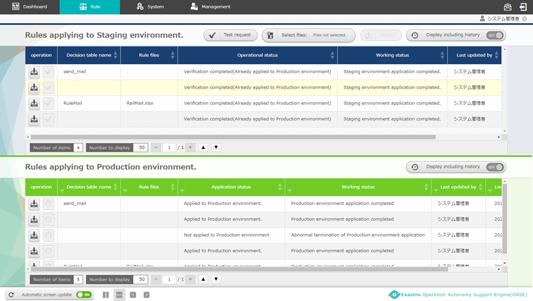
1.7 Screen description（Rule screen）
Function Description
The list of the rules that are practically operated when messages are sent to OASE
①
Please refer to the manuals for details of the functions in each menu.

Slide 13
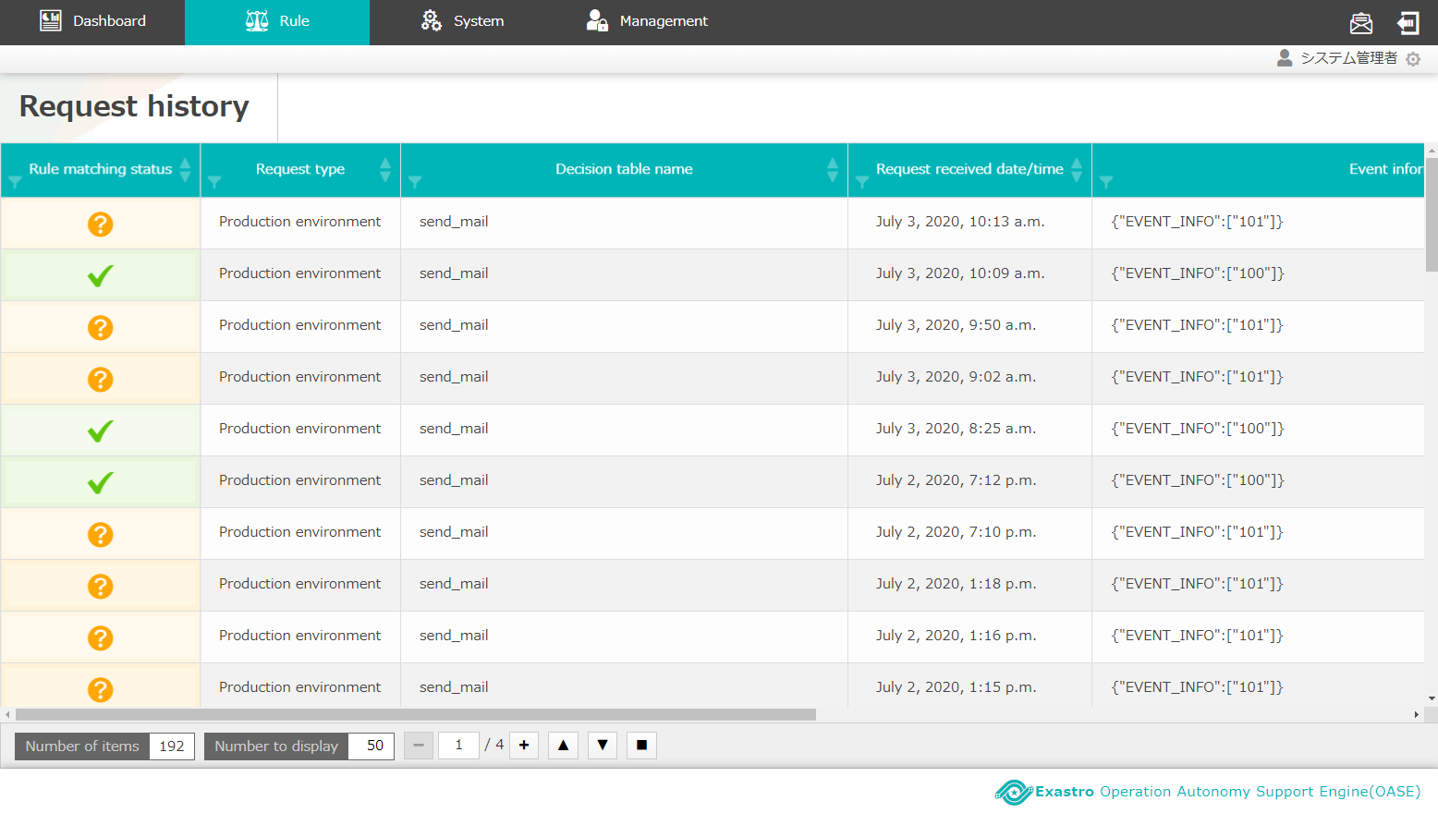
1.8 Screen description（Request history screen）
Function description
The list of the matched rules and their status
①
Please refer to the manuals for details of the functions in each menu.

Slide 14
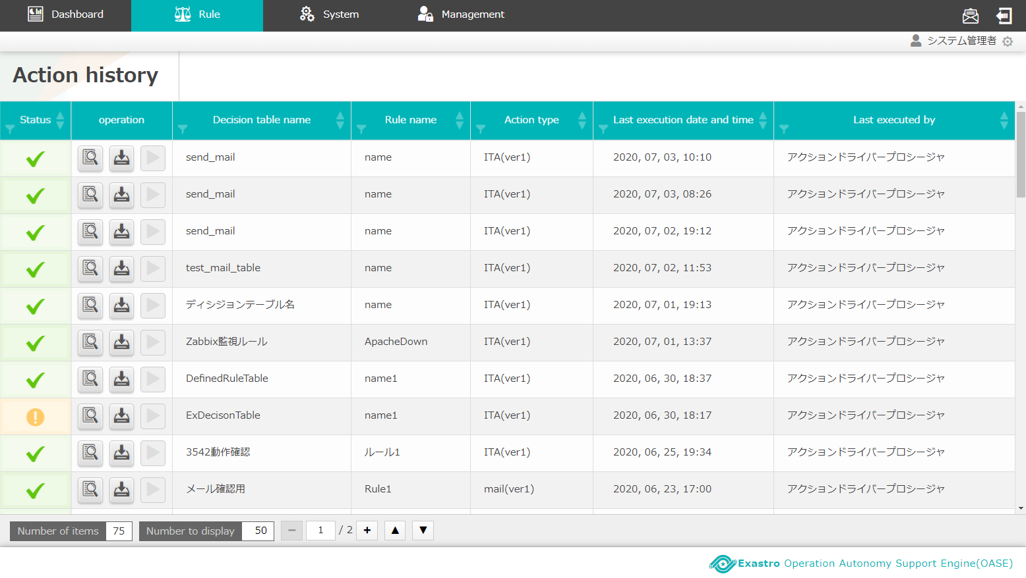
1.8 Screen description（Action history screen）
Function description
The list of the matched rules and their status
①
Please refer to the manuals for details of the functions in each menu.

Slide 15
2. Scenario description

Slide 16
2.1 Scenario
Scenarios after OASE installation until action history being obtained.
【Preparation】
Configuring settings and Registering rules
１
Set mail driver and create mail template
２
Pay out Token
３
Create decision table
４
Create decision table file ※In Excel
５
Upload decision table file
６
Test request
7
Apply to production environment
【Operation】
Inserting messages
Matching rules and Executing Actions.
Send request via curl command
8
Check the results of action execution
9

Slide 17
3. Preparation before execution

Slide 18
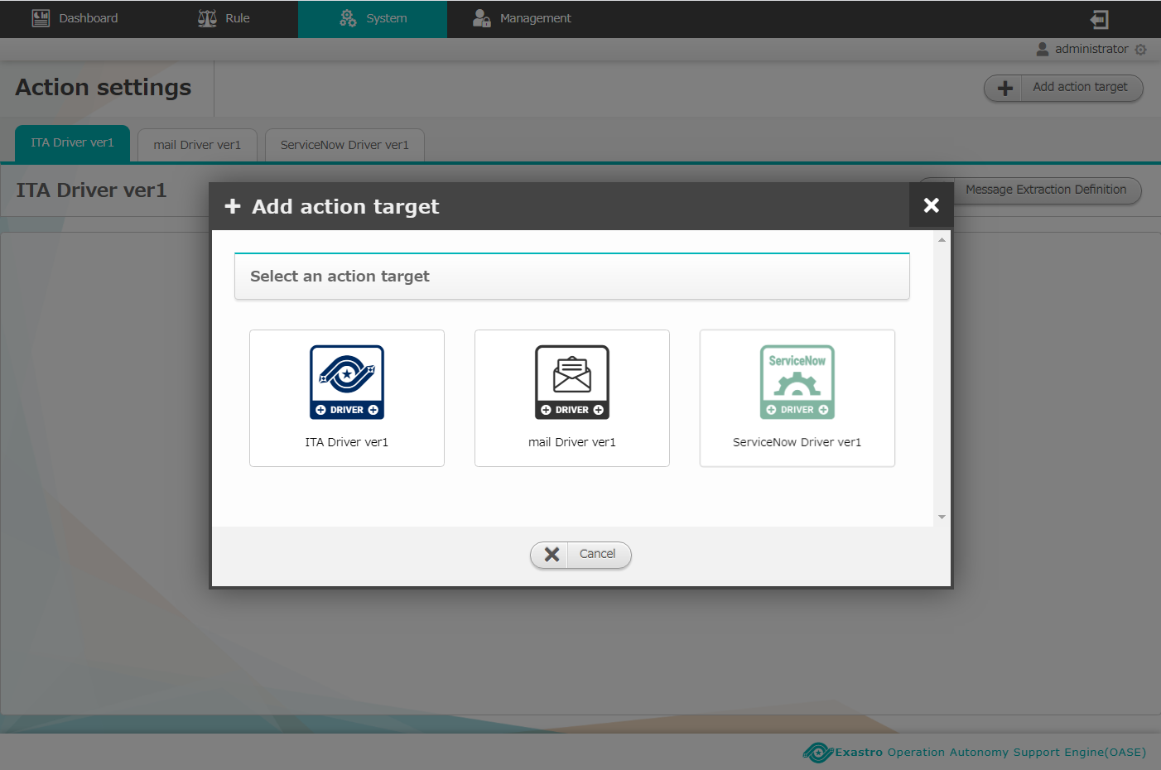
3.1 Set mail driver and create mail template (1/3)
Add action target
Press the “Add action target” button in the “Action settings” screen.
Select “mail Driver ver1”.
The “mail Driver ver1” will not be displayed if you don`t have the driver installed.
Set mail driver and
create mail template
１
Pay out Token
Create decision table
2
Create decision table file
※In Excel
Upload decision table file
Test request
Apply to production
environment
Send request via curl command
Check the result of
action execution
Please refer to <Environment construction manaul -Driver installation->
if the mail driver hasn’t been registered.

Slide 19
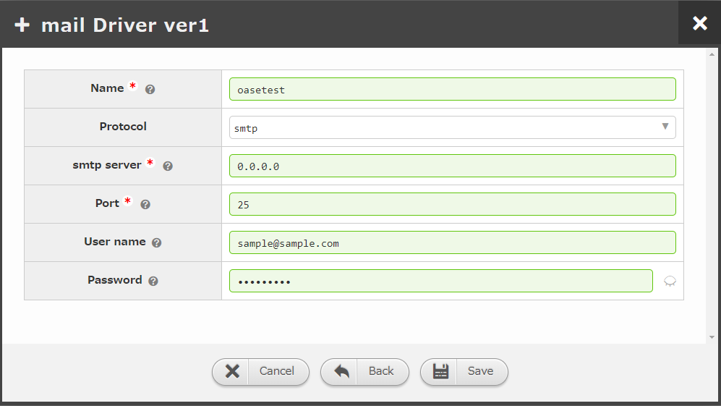
3.1 Set mail driver and create mail template (2/3)
Set action target
Enter required information then click the “Save” button.
Set mail driver and
create mail template
Pay out Token
Create decision table
Create decision table file
※In Excel
“Item:name” is used to specify “Execute action to which action target” when creating the latter mentioned decision table file.
Upload decision table file
Test request
Item | Setting value
Name | Enter your desired action target name.
Protocol | Select either “smtp” or “smtp_auth”
Smtp Server | Enter private IP or global IP ※The SMTP server has to be prepared in advance
Port | Enter the port number used for communication
User name | Enter the user name as the mail sender.
Password | Enter the password required for authentication
Apply to production
environment
Send request via curl command
Check the result of
action execution
“Item:user name” is displayed as the sender of the mail.
Items with * are required items

Slide 20
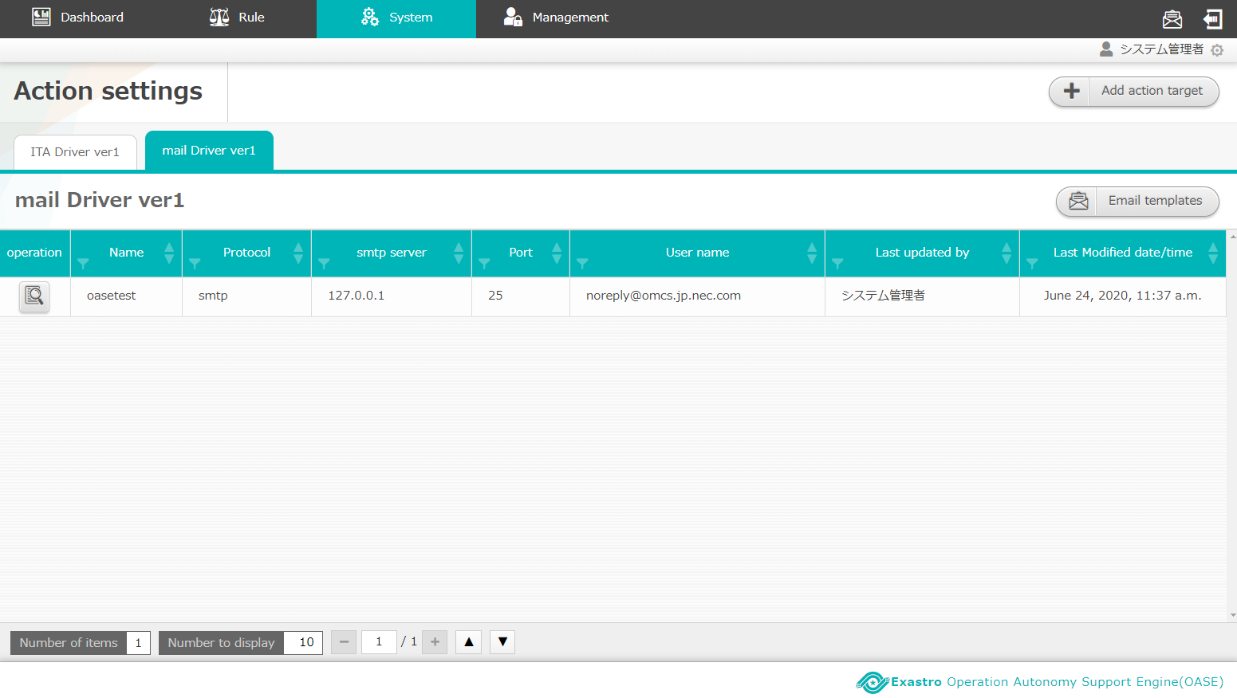
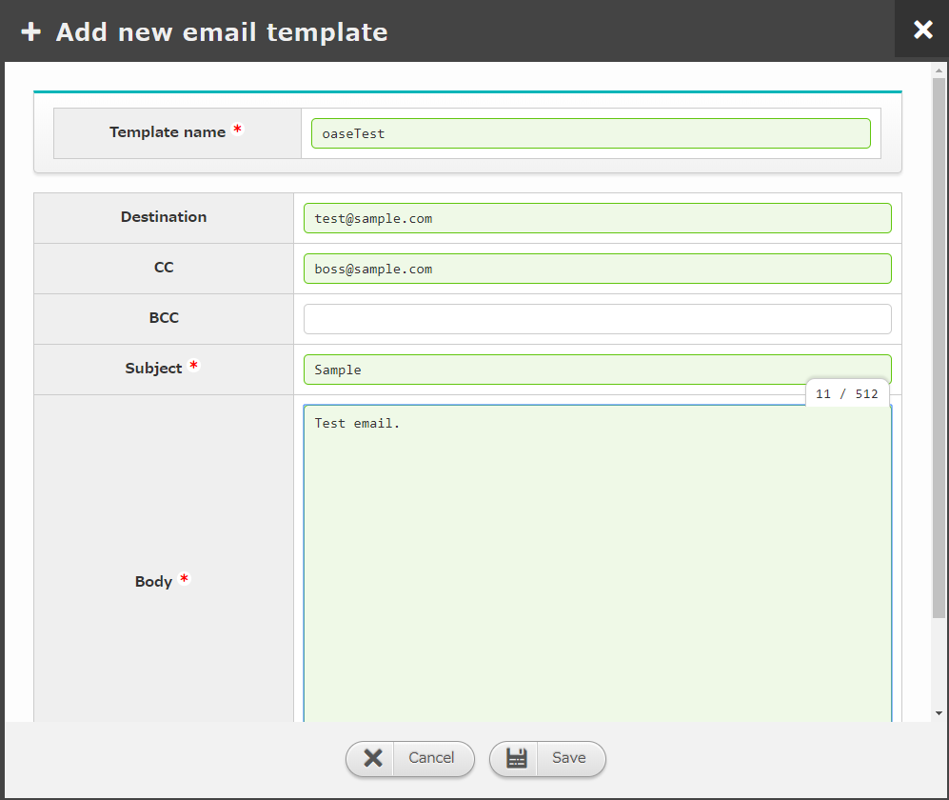
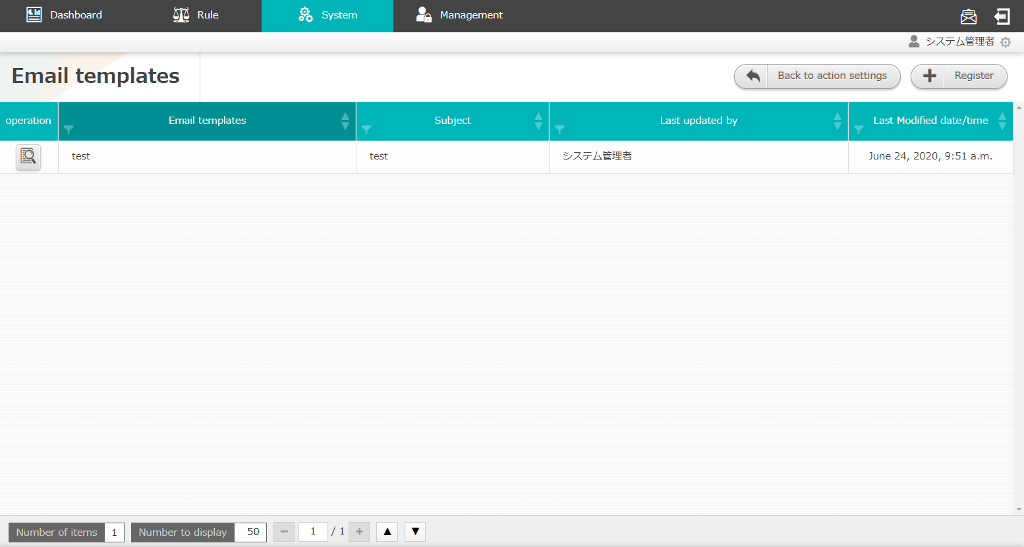
3.1 Set mail driver and create mail template (3/3)
Create mail template
Press the “Email Templates” button
Press the “Register” button
Fill in the required items with the information below
Press the “Save” button.
Set mail driver and
create mail template
Pay out Token
１
Create decision table
Create decision table file
※In Excel
2
Upload decision table file
4
Test request
3
Apply to production
environment
Item | Setting value
Template name | Enter any desired template name
Destination | Enter destination mail address
CC | Optional
BCC | Optional
Subject | Enter any desired subject
Body | Enter any desired body context
The "Template name" is required later when we are creating a decision table file. We will use it to specify what kind of mail template we will use.
By tagging the "Body" with [ACTION_INFO] or[EVENT_INFO] , we can receive mail with request information or event information included.
Send request via curl command
Check the result of
action execution
Items with * are required items

Slide 21
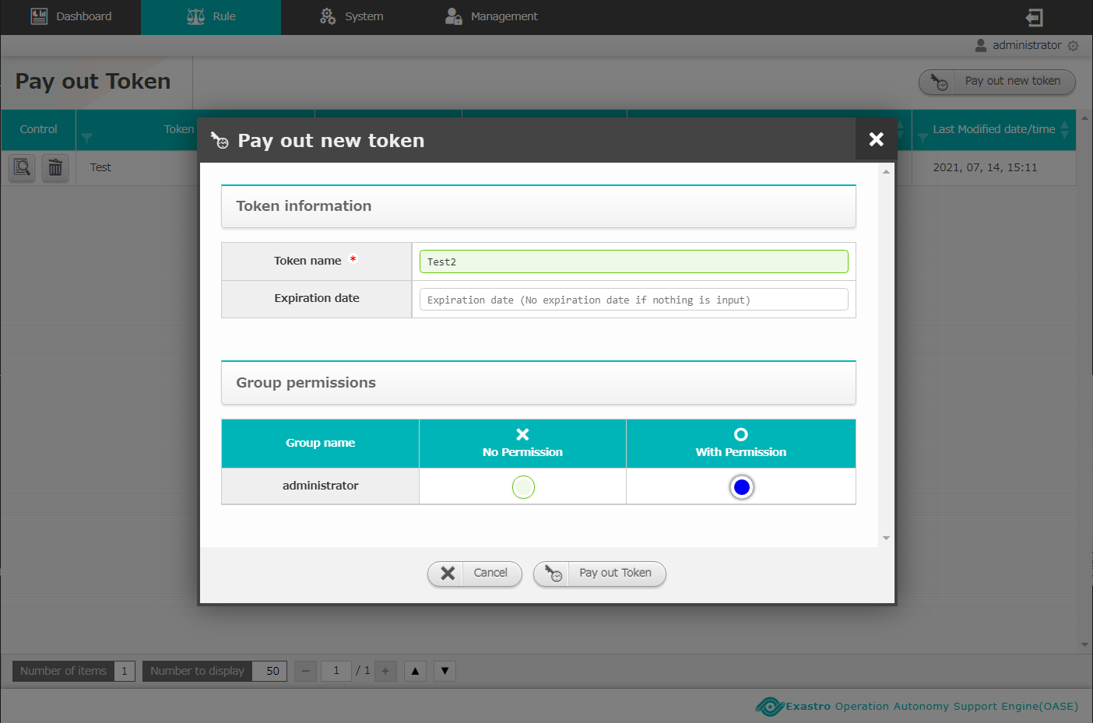
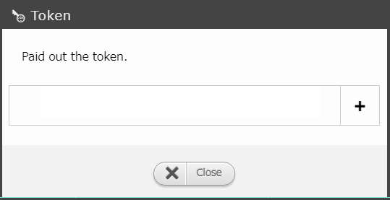
3.2 Token Pay-out
Pay out new token.
Press the “ Pay out new token” button
Input the information found below
Press the “Pay out Token” button
Copy and save the Token displayed in the “Token” screen.
Press the “Close” button.
Set mail driver and
create mail template
Pay out Token
１
Create decision table
Create decision table file
※In Excel
2
Input the following information
Upload decision table file
Item | Setting value
Token name | Free name
Group Permissions | System Administrator :With Permission
Test request
Apply to production
environment
3
Send request via curl command
Check the result of
action execution
4
Token needs to be configured for the curl command requests introduced later in this document.
5

Slide 22
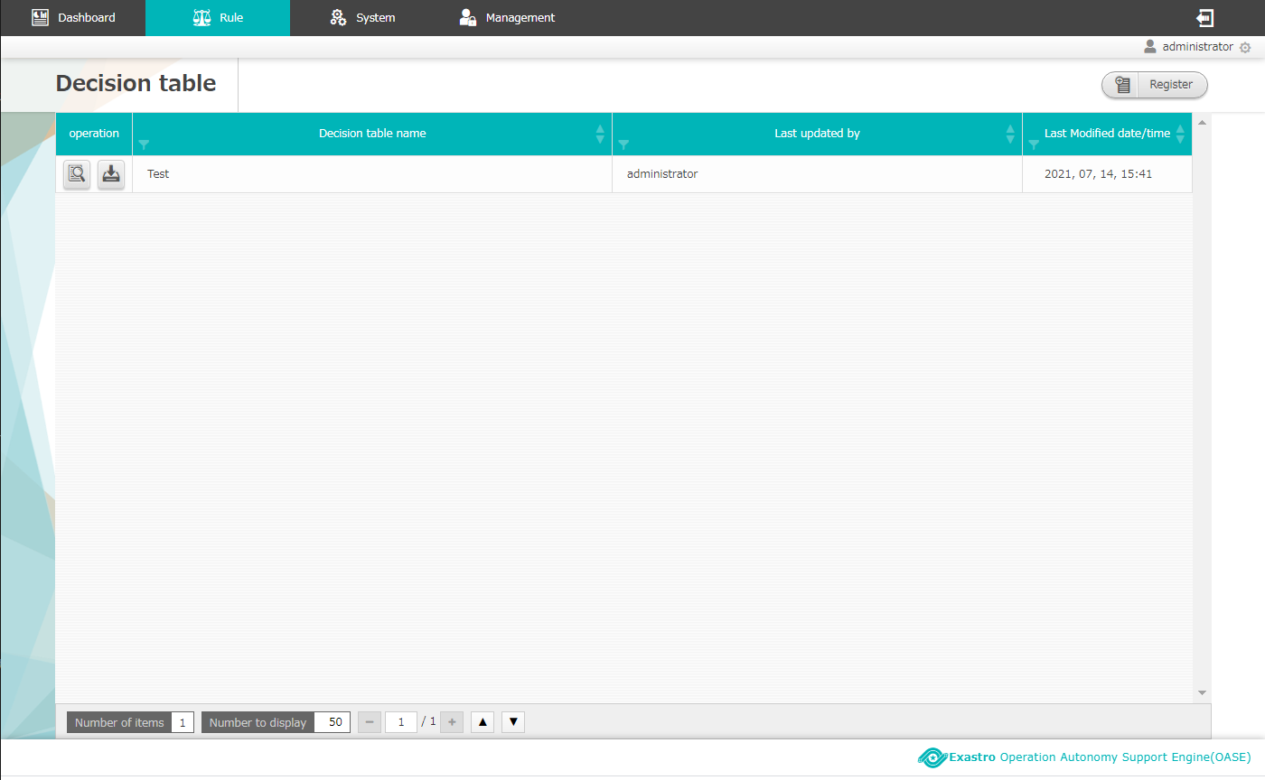
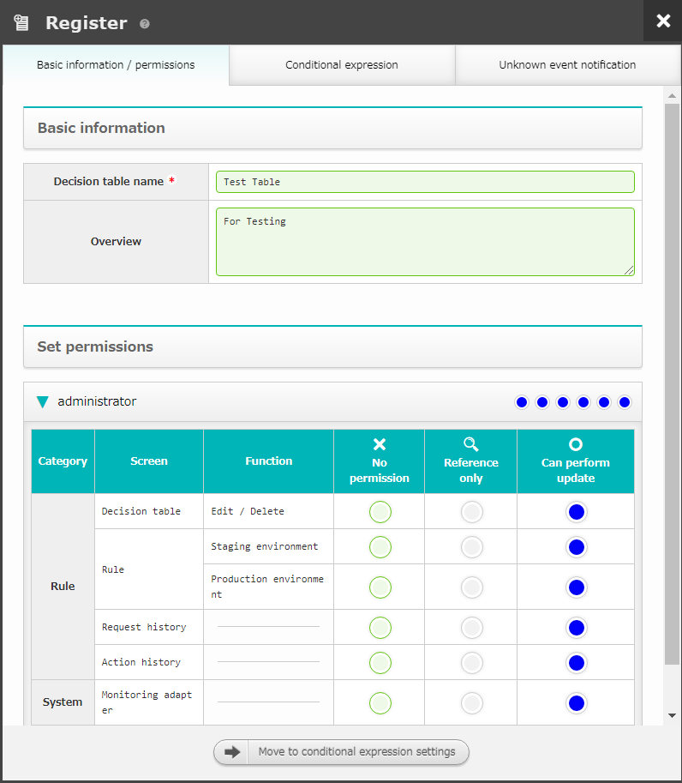
3.3 Create Decision table (1/2)
Create Decision table
Press the “Register” button on the decision table screen.
Fill out the required fields in the “Basic Information/ permissions” tab
Press the “Move to Conditional expression settings” button
Set mail driver and
create mail template
１
Pay out Token
Input the following values
Create decision table
Basic information / permissions tab
Item | Setting value
Decision table name | Free value
Set permissions | System Administrator : “can perform update” on all
2
Create decision table file
※In Excel
Upload decision table file
Test request
Apply to production
environment
Send request via curl command
Check the result of
action execution
The "Permission settings" needs to have at least one group who can "Perform update".
If not, you will not be able to update it.
3
Items with * are required items

Slide 23
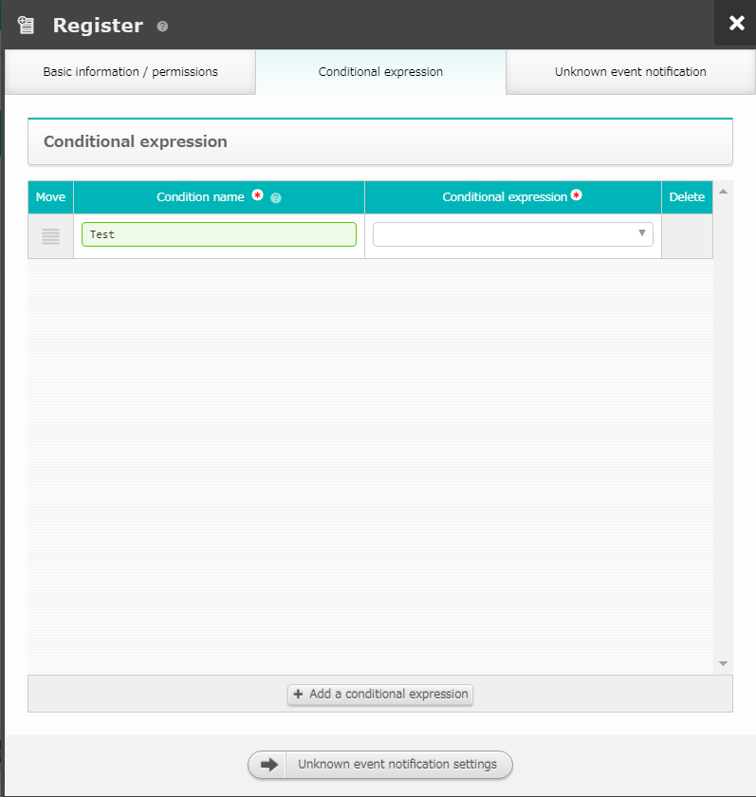
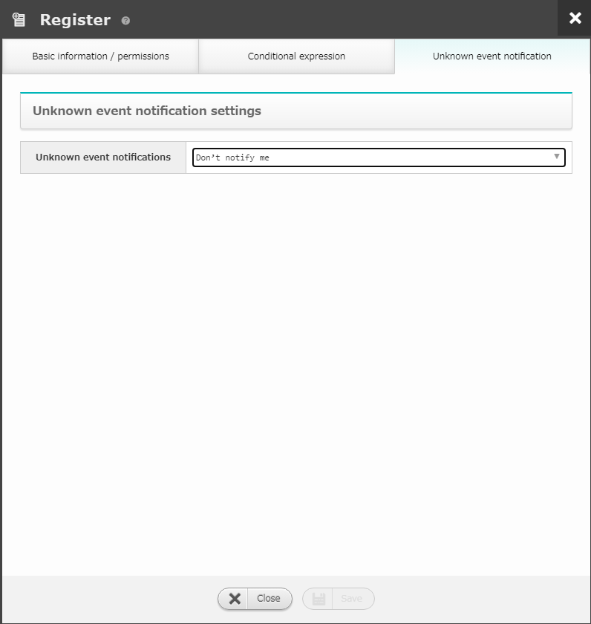
3.3 Create Decision table (2/2)
Create Decision table
In the “Conditional Branch” tab in the “New addition” screen, input the necessary information
Press the “Unknown Event Notification settings” button.
In the “Unknown Event Notification” tab in the “New addition screen”, input the necessary information
Press the “Save” button.
Set mail driver and
create mail template
Pay out Token
Input the values above
Input the value above
“Conditional expression” tab
Item | Setting value
Condition name | Free Character string
Conditional expression | Equal(Number)
“Unknown event Notification” tab
Item | Setting value
Unknown event notifications | Don’t notify me
Create decision table
Create decision table file
※In Excel
Upload decision table file
6
Test request
4
We will set the Decision table file's Conditional part`s specific value to the configured Conditional Branch.
Apply to production
environment
Send request via curl command
Check the result of
action execution
Items with * are required items
5
7

Slide 24
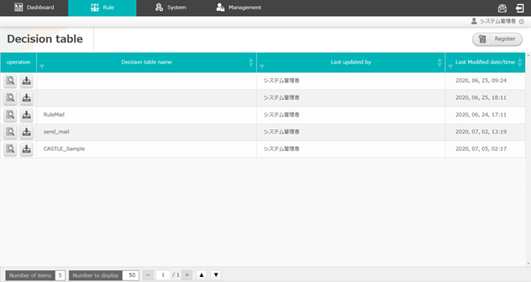
3.3 Create decision table file ※In Excel (1/2)
Download and create decision table file
Download the decision table created in “3.2 create decision table” by clicking the download button.
Set mail driver and
create mail template
Pay out Token
Create decision table
Create decision table file
※In Excel
Upload decision table file
Test request
Apply to production
environment
Send request via curl command
Check the result of
action execution
The name of the Decision table file is created automatically.
(E.g) idid00000000000.xlsx). This is different from the earlier mentioned "Decision table name". More information regarding each item is written on the next page.

Slide 25
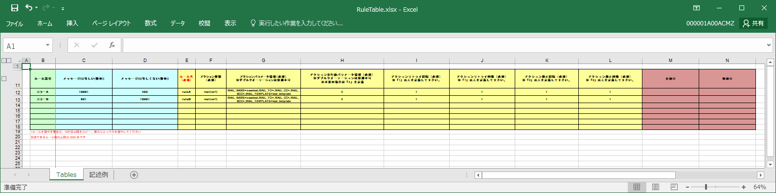
3.3 Create decision table file ※In Excel (2/2)
Enter the following content in the decision table file.
For practical usage example, please refer to “A Appendix Sample1”.
Set mail driver and
create mail template
Pay out Token
①
②
③
④
Create decision table
Create decision table file
※In Excel
①Comment part | Can be empty. Enter description or other desired content.
②Condition part | Enter the condition which matches the rule.
③Action part | Set the action to be executed for each rule name. Users can set to execute action or send approval mail. Only the drivers set in “Action settings” screen can be entered in “action type”. （In this document, “mail Driver ver1” is set.) Please note that the format of “Action parameter information” is different for each action type.
④Action condition part | Can be empty. Users can set the time to enable and disable the rule.
Upload decision table file
Test request
Apply to production
environment
Send request via curl command
Check the result of
action execution
For information regarding describing values, please refer to the "Description example" sheet.
You can change the file name to whatever you want after updating the decision table file.

Slide 26
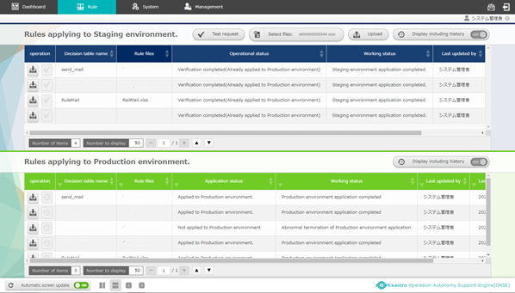
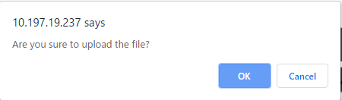
3.4 Upload decision table file
Select the decision table file to perform test request.
Click the “select file” button in the “Rule” screen then select the created decision table file.
Click the “Upload” button.
Press the “OK” button on the Pop-up message.
Set mail driver and
create mail template
Pay out Token
①
②
Create decision table
Create decision table file
※In Excel
Upload decision table file
Test request
Apply to production
environment
Send request via curl command
Check the result of
action execution

Slide 27
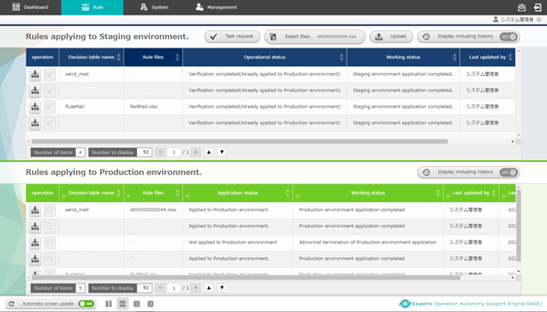
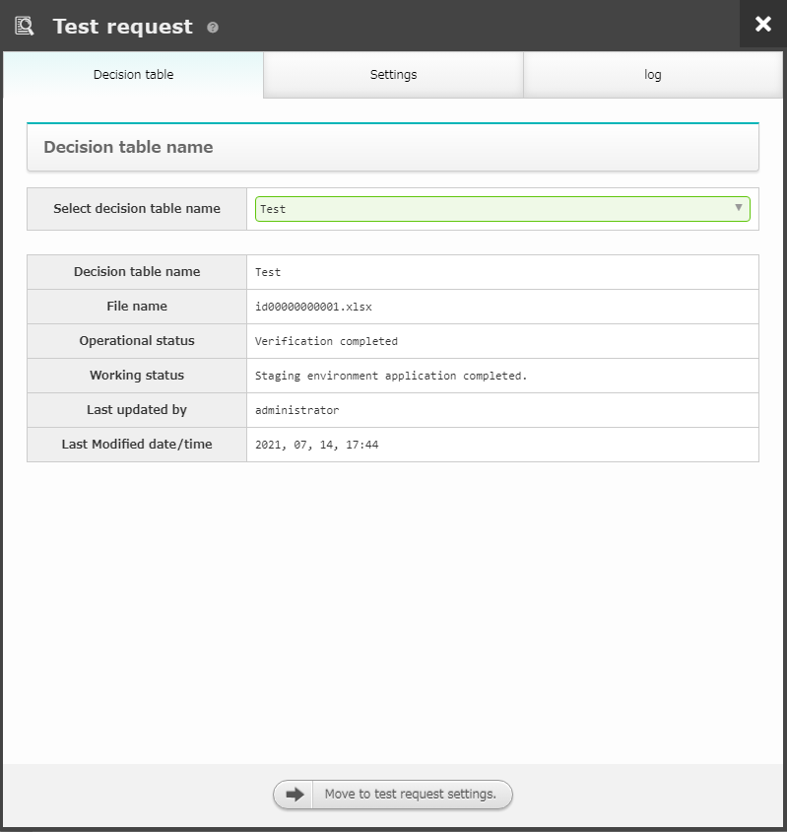
3.5 Test request (1/3)
Select Test Request Target
Click the “Test request” button when the “Working status” column changes to “Applied to Staging Environment”.
In the “Select Decision table name” column, select the Decision table you want to test.
Press the “Test Request settings” button.
Set mail driver and
create mail template
Pay out Token
Create decision table
Create decision table file
※In Excel
１
Upload decision table file
Test request
Apply to production
environment
2
Send request via curl command
Check the result of
action execution
The working status updates automatically every 5 seconds.
Please refer to <Instruction manual –Rule Screen- (1)Rule screen(Staging)> for the details of working status.
3

Slide 28
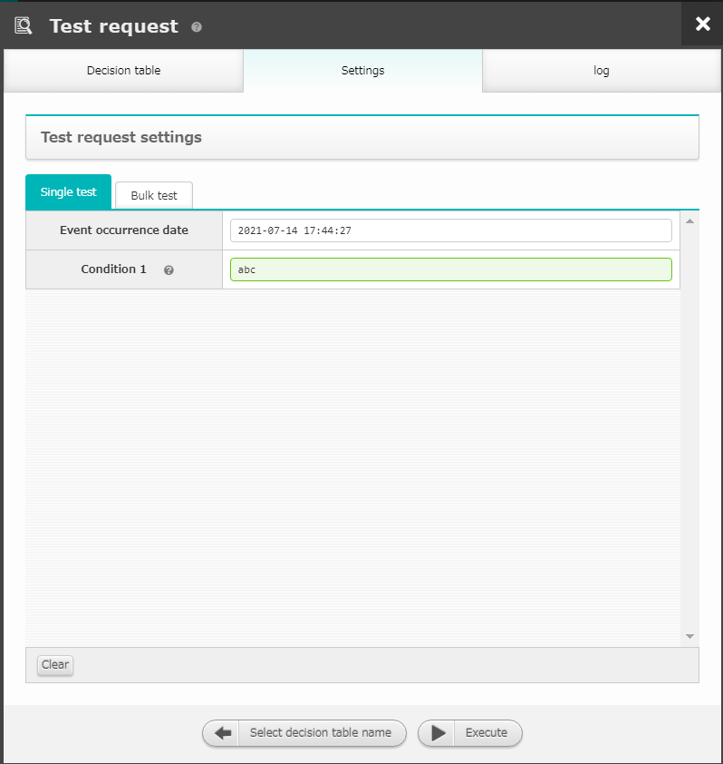


3.5 Test request (2/3)
Enter Test value and execute.
In the "Single test" tab in the "Settings" tab, input a value that matches the rule.
Press the "Execute" button.
Press the "OK" button in the Pop-up message.
Set mail driver and
create mail template
Pay out Token
１
3
Create decision table
Create decision table file
※In Excel
Upload decision table file
Test request
Apply to production
environment
2
Send request via curl command
Check the result of
action execution
When matched the rules created in <3.3 Create decision table (Excel)>,
“Successfully processed” and “Matched” will be displayed in execution log.
When rule matched, “Operation status” will change to next state.

Slide 29
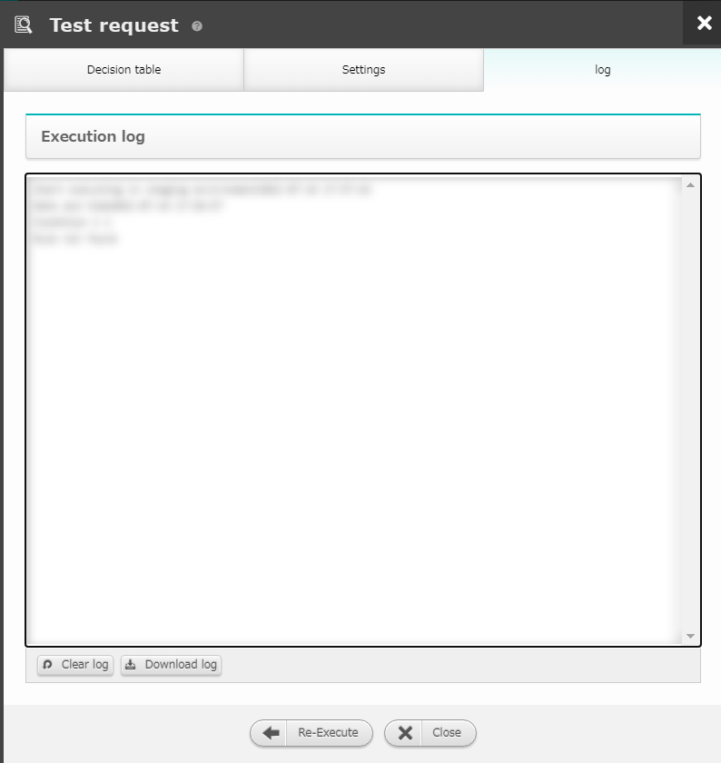
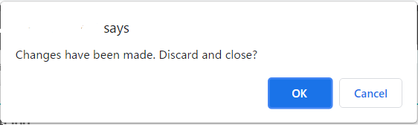
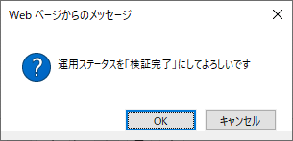
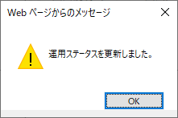
3.6 Test Request (3/3)
Confirm that the Rules are active.
Check the Execution log from the “log” tab.
Press the “Close” button
Press the “OK” button on the pop-up message.
If the rule got hit, press the “OK” button in the dialog box.
Set mail driver and
create mail template
Pay out Token
2
Create decision table
Enlarged
The process ended successfully Rule A got Matched
Create decision table file
※In Excel
Upload decision table file
The previously mentioned "Create Decision table file"
If a rule created in the previous section ,"Create Decision table file" gets hit, the "Execution log" field will display "Successfully processed" or "Matched with XXX".
When a rule match, the "Application status" will move to the next status.
Test request
１
Apply to production
environment
Send request via curl command
Check the result of
action execution

Slide 30
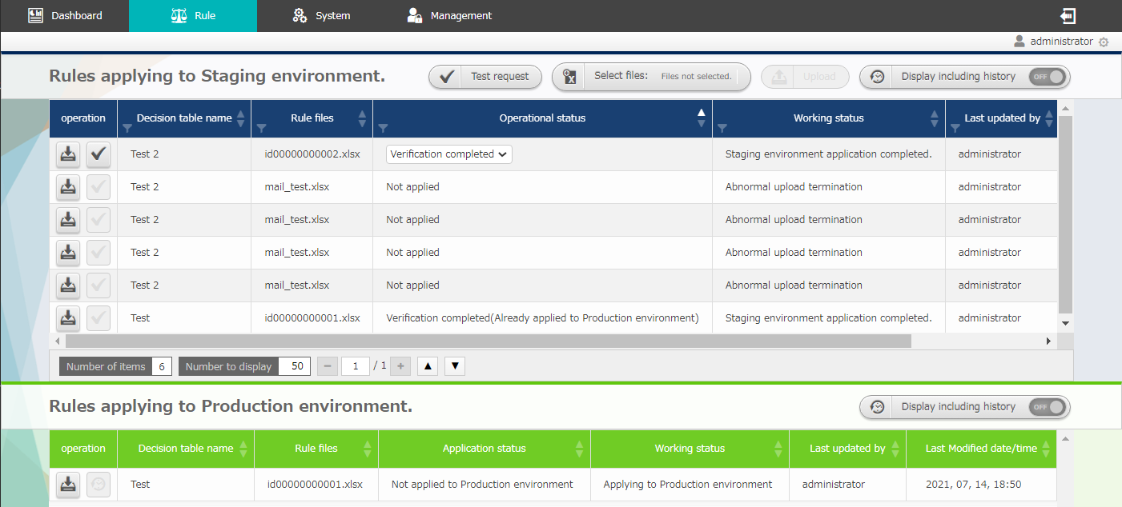
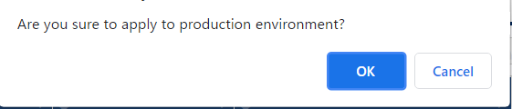
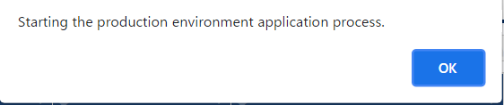
3.6 Apply to production environment
Make verified rules available in production environment.
To enable rule in production environment, apply the rule from “Rules applying to Staging environment” to “Rules applying to Production environment”.
When the test request matched the rule correctly, the operation
status in staging environment will change to “Verification completed”.
Press the “Apply” button
Press the “OK” button in the dialogue window.
Set mail driver and
create mail template
Pay out Token
If the Test request ended successfully, the status will change to “Verification completed”
Create decision table
After the Production environment's Working status has changed to "Production application completed", the decision table can be used in a real environment.
2
１
Create decision table file
※In Excel
Upload decision table file
3
Test request
Apply to production
environment
Send request via curl command
Check the result of
action execution
The operation status updates automatically every 5 seconds. Please refer to
<Instruction Manual -Rule Screen- (2)Rule Screen(Production)> for the details of operation status.

Slide 31
4. Operation execution

Slide 32
4.1 Send request via curl command (1/2)
Send the message and match the rule applied to production environment with the message
Open the terminal and execute after rewriting the following commands according to the rules.
See "A Appendix Sample 1" below for specific usage examples
of the curl command.
Set mail driver and
create mail template
curl -X POST -k “https://<①Host name>/oase_web/event/event/eventsrequest” -H “accept: application/json” -d '{"ruletable":"<②Rule table name>","requesttype":"<③Request type>","eventdatetime":"<④event occurrence datetime>","eventinfo":["<⑤event info>"]}'
Pay out Token
Create decision table
Create decision table file
※In Excel
Upload decision table file
Item | Setting value
①Host name | Enter valid host name, IP address
②Rule Table name | Enter the rule file name applied to production environment(without .xlsx)
③Request type | Enter “1” since the target is “1:production environment” Example）"requesttype":"1"
④Event occurrence datetime | Enter the time in”yyyy/mm/dd hh:mm:ss” format Example）"eventdatetime":"2020/01/01 01:01:01"
⑤Event information | Specify in list format Example）["2","foo"]
Test request
Apply to production
environment
Send request via curl command
Check the result of
action execution
Please refer to <RestAPI Function Instruction Manual> for the details of HTTP request.

Slide 33
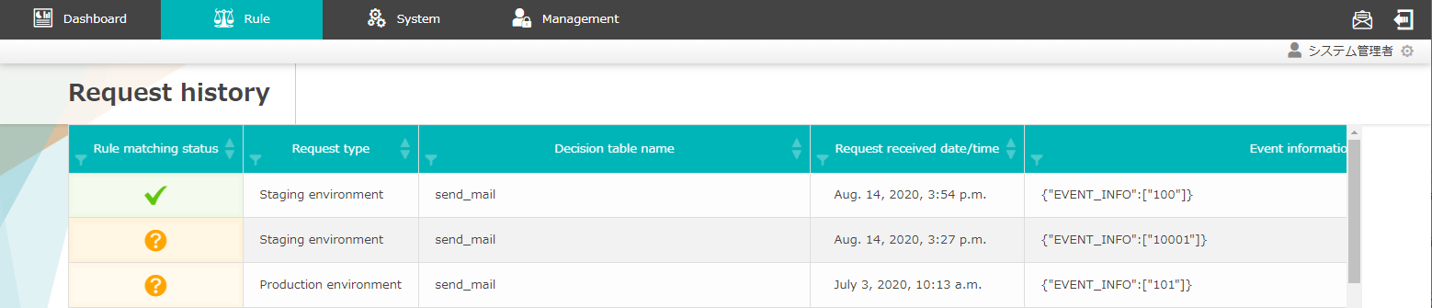
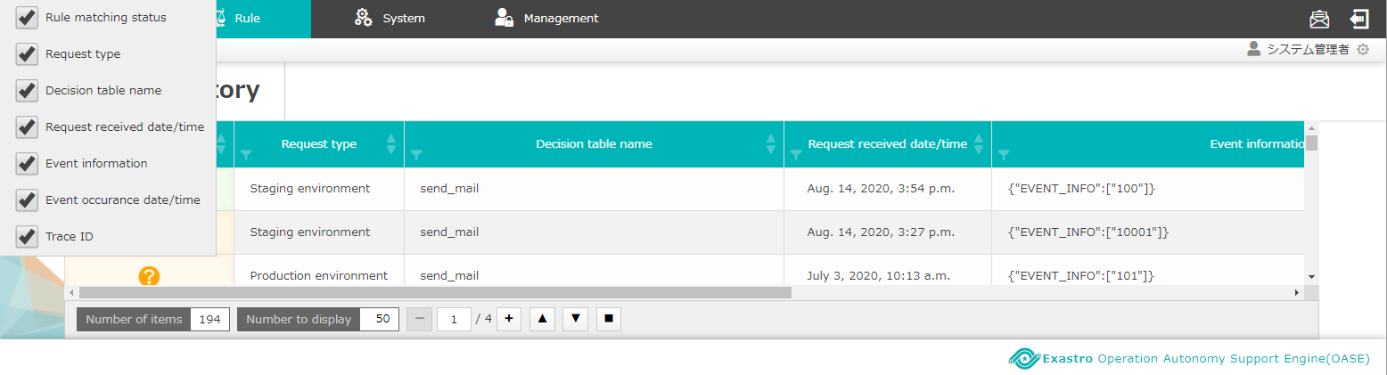
4.1 Send request via curl command (2/2)
Check the “request history” screen
A history of sending a request by specifying parameters with the curl command is added.
Items displayed in the “Request history” screen can be
changed.
Set mail driver and
create mail template
Pay out Token
Create decision table
Create decision table file
※In Excel
Upload decision table file
Test request
Apply to production
environment
Send request via curl command
Check the result of
action execution

Slide 34
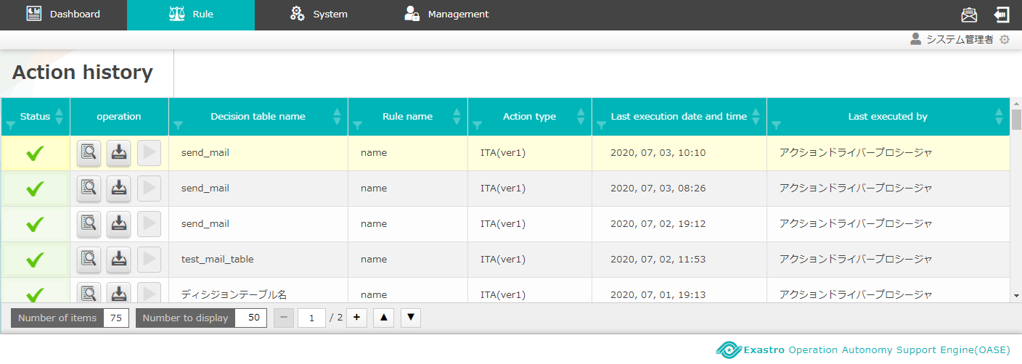
4.2 Check the result of action execution (action history)
Execute action
When rule is matched, action(mail notification) will be executed as users set in preparation before execution, and users can check the result in “Action history” screen.
Action will be executed as the specification in the action part of
<3.3 Create decision table file ※In Excel > （mail Driver will sent notification mail as user’s specification)
Mail notification
Mail with the receiver, title, body set in
<3.1 Set mail driver and create mail template> is sent.
Action history
Check if the rules are matched and executed are displayed in
“Action history” screen.
Set mail driver and
create mail template
Pay out Token
Create decision table
Create decision table file
※In Excel
Upload decision table file
Test request
Apply to production
environment
Send request via curl command
Check the result of
action execution

Slide 35
A Appendix

Slide 36
Sample1(1/4)
Enter Sample value and Execute OASE
Case: When OASE receive “MessageID: 10001”, execute a action to send a mail with information “Title:【OASE】Notification test”, “Body:[Request Info][Event Info]”
【Preparation】
①「Action Settings」Screen
②「Token Pay-out」screen
Prepare「mail Driver ver1」
 | Name | oasetest
 | Smtp Server | 0.0.0.0
 | User name | sample@example.com
 | Password | （blank）
 | （Register other required info）
・ | Create「Mail Template」
 | Template name | test_template
 | Title | 【OASE】Notification test
 | Body | [ACTION_INFO] [EVENT_INFO]
Prepare Token needed when sending request via curl command.
 | Token name | test_token
 | （Register other required info）
This information is used in these parts of this manual:<3.1 Set mail driver and create mail template>
and <3.2 Pay-out token.>

Slide 37
Sample１(2/4)
②「Decision table」Screen
Create a rule that the “MessageID” will hit
 | Decision table name | test
 | Permission Settings（System Administrator） | All「Editable」
 | Conditional name | Message ID
 | Conditional branch | Equal(Number)
This information is used in these parts of this manual <3.3 Create Decision table>and <3.4 Create Decision table *with Excel>.
③「Decision table 」File
Rename and save the “Decision table” file.
 | File name | mail_test.xlsx
Create a rule that “messageID:10001” will hit ※Change the text marked with Red.
 | MessageID（Equal(Numeric Value)） | 10001
 | Action Type | mail(ver1)
 | Action Parameter Information | MAIL_NAME=oasetest,MAIL_TO=<Mail Address>,MAIL_CC=,MAIL_BCC=,MAIL_TEMPLATE=test_template
 | （For the other items, use the "example" sheet in the Decision table file as a reference point.）

Slide 38
Sample１(3/4)
④「Rule（Staging Application Rule)」Screen
Upload the created Decision table file.
 | Select File | mail_test.xlsx
⑤「Test Request」Screen
Test whether when request “MessageID:10001” matches the uploaded decision table or not
 | Select Decision table name | test
 | Message ID | 10001
This information is used in these parts of this manual <3.5 Uploading Decision table file>
And <3.6Test Request>

Slide 39
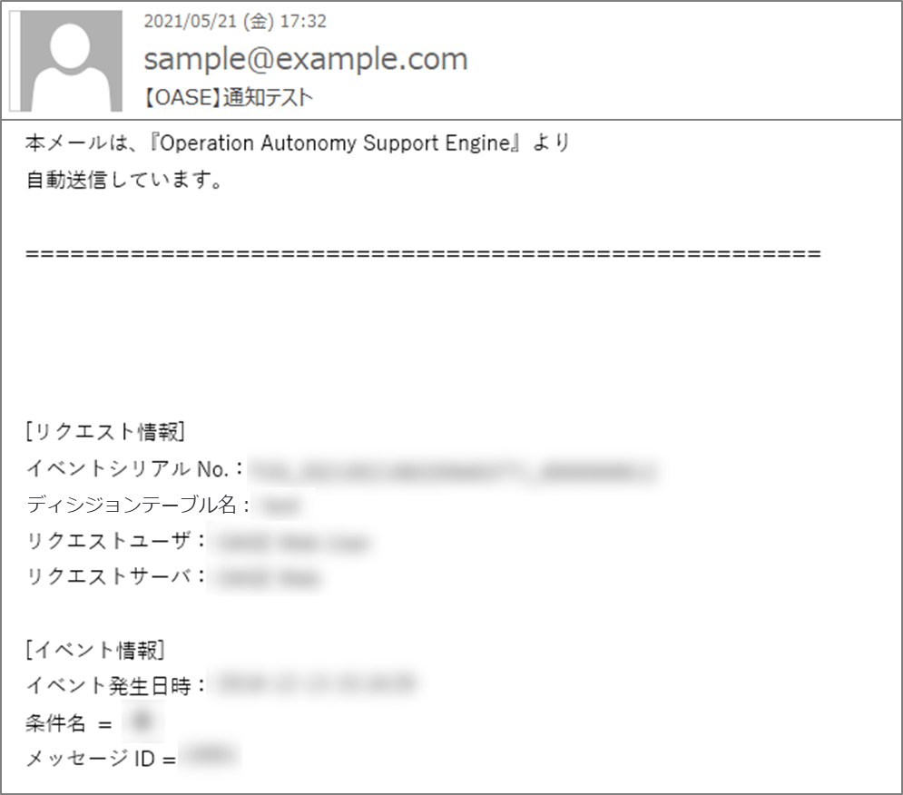
Sample１(4/4)
【Execute Operation】
⑥Terminal Operation（Linux server）
Send request to the prepared rule via curl command ※Please change the text marked with red.
 | curl -X POST -k "https://<HostName>/oase_web/event/event/eventsrequest" -H "accept: application/json" -d '{"decisiontable":"test","requesttype":"1","eventdatetime":"2020/01/01 01:01:01","eventinfo":["10001"]}' -H "Authorization: Bearer <Access_Token>"
⑦Main Notification
Check if the
mail with
information
on the right
is sent.
Title | 【OASE Notification test】
Body | [Request Information] Trace ID Decision table name Request user Request server [Event information] Event Time/Date Condition name Message ID
Notification Mail
This information is used in these parts of this manual <4.1 Send Request via curl command>and
<4.2Check the result of Action execution>

