Slide 1


Version Update
※In this document, ”Exastro Operation Autonomy Support Engine” is written as “OASE”
Exastro Operation Autonomy Support Engine Version 1.3.1
Exastro developer

Slide 2
Table of Contents
Introduction
1.1 About this guide
System configuration
2.1 System requirements
OASE update procedure
3.1 Preparation
3.2 OASE update work flow
3.3 Update（1/11）
3.4 Update（2/11）
3.5 Update（3/11）
3.6 Update（4/11）
3.7 Update（5/11）
3.8 Update（6/11）
3.9 Update（7/11）
3.10 Update（8/11）
3.11 Update（9/11）
3.12 Update（10/11）
3.13 Update（11/11）
OASE Operation check

Slide 3
1. Introduction

Slide 4
1.1 About this document
About this document
This document describes the update procedure of OASE Environments constructed in all-in-one-configurations.

Slide 5
2. System construction

Slide 6
2.1 System requirements
OASE Environment.
The procedure in this document can be done on OASE Environments constructed in all-in-one-configurations
OASE on ver1.1.1 and later can be updated to later versions. Follow the procedure in this document to update it.

Slide 7
3. OASE Update procedure

Slide 8
3.1 Preparation
OASE Update tools
The following table displays the tools used to update OASE.
Description | File | Storage path
OASE installer | oase_installer.sh | /(Installation file path)/oase/oase_install_package/install_scripts/
Answer file | oase_answers.txt | /(Installation file path)/oase/oase_install_package/install_scripts/

Slide 9
3.2 OASE Update flow
Update flow
The update flow is as shown below.
①Back up OASE Environment
②Download file from GtiHub
③Edit Answer file
④Run OASE Installer (Version Update)
Contents
Change DB
Change OASE File

Slide 10
3.3 Update（1/11）
Back up OASE Environment
Make sure to back up the OASE Environment before updating
Download file from GitHub
Use the following command to download the necessary file from GitHub. # curl -OL https://github.com/exastro-suite/oase/releases/download/vx.x.x/exastro-oase-x.x.x.tar.gz ※Please install curl command beforehand.
※Please change the version (x.x.x) accordingly.
Unpack data
Unzip the .tar.gz file. # tar zxf exastro-oase-x.x.x.tar.gz
Edit Answers file
Move the file to the directory where the Answer file and the shell is located.
# cd oase/oase_install_package/install_scripts

Slide 11
3.4 Update（2/11）
Edit Answer file (oase_answers.txt)(1/3)
The Answer file is what configures the OASE update settings. Please create it in advance.
If you want to install new libraries, change the "install_mode" value to "Versionup_All". If you don't want to install any new libraries, change it to "Versionup_OASE".
Item | Required | Initial value | Description
install_mode | ○ | Install_Online | Install mode settings ・Install_Online：Online install ・Install_Offline：Offline install ・Gather_Library：Gather libraries ・Versionup_All：Update OASE to (installs libraries) ・Versionup_OASE：Update OASE (does not install libraries) ・Uninstall：Uninstall OASE
RabbitMQ_username | ○ | administrator | RabbitMQ User name
RabbitMQ_password | ○ | password | RabbitMQ Password
RabbitMQ_queuename | ○ | oase | RabbitMQ Queue name (generated)
RabbitMQ_ipaddr | ○ | - | RabbitMQ IP Address
db_root_password | ○ | password | Maria DB Root Password
db_name | ○ | OASE_DB | OASE Maria DB name
db_username | ○ | OASE_USER | OASE Maria DB Database Username

Slide 12
3.5 Update（3/11）
Edit Answer file (oase_answers.txt)(2/3)
The Answer file is what configures the OASE update settings. Please create it in advance.
If you want to install new libraries, change the "install_mode" value to "Versionup_All". If you don't want to install any new libraries, change it to "Versionup_OASE".
Item | Required | Initial value | Description
db_password | ○ | OASE_PASSWD | OASE Maria DB Database Password
db_erase | ○ | - | Decides whether to delete or leave the Database when uninstalling OASE
jboss_root_directory | ○ | /exastro/WildFly | Jboss Installation location
rhdm_adminname | ○ | admin0000 | RHDM Administrator name
rhdm_password | ○ | password@1 | RHDM Password
dm_ipaddrport | ○ | localhost:8080 | RHDM IP Address and Port
rulefile_rootpath | ○ | /exastro/rule | RHDM Rule settings file path（Generated）
apply_ipaddrport | ○ | 127.0.0.1:50001 | IP and Port started by the ApplyService
mavenrep_path | ○ | /root/.m2/repository/com/oase/ | Maven jar File storage place
oasemail_smtp | ○ | "{'IPADDR':'127.0.0.1','PORT':25,'AUTH':False}" | OASE Mail server settings
oase_directory | ○ | /exastro | OASE Installation path

Slide 13
3.6 Update （4/11）
Edit Answer file (oase_answers.txt)(3/3)
The Answer file is what configures the OASE update settings. Please create it in advance.
If you want to install new libraries, change the "install_mode" value to "Versionup_All". If you don't want to install any new libraries, change it to "Versionup_OASE".
Item | Required | Initial value | Description
oase_session_engine | ○ | - | OASE Session maintenance method
ev_location | ○ | - | IP Address when the clone job is executed while linked to AD.
oase_language | ○ | ja | System Language
oase_os | ○ | - | System OS
oase_domain | ○ | exastro-oase.local | OASE domain name
certificate_path | Optional | － | Specify the path of the file used for the user specified SSL server certificate (Enter only when using a user specified SSL certificate. Specify an absolute path)
private_key_path | Optional | － | Specify the path of the file used for user-specified SSL private keys. (Enter only when using a user-specified SSL private key. Specify an absolute path)

Slide 14
3.7 Update （5/11）
Install modes
The actions of the installer branches depending on the "install_mode" value in the Answer file (oase_answers.txt)Make sure to enter one of the following values when updating.
• Versionup_All： Updates OASE after installing the added necessary libraries through the internet. • Versionup_OASE：Updates OASE without installing any libraries.
If you want to automatically install libraries in an online environment, make sure the "install_mode" value is set to "Versionup_all". For offline environments, or if you don't want to install libraries automatically, please set "install_mode" to "Versionup_OASE".

Slide 15
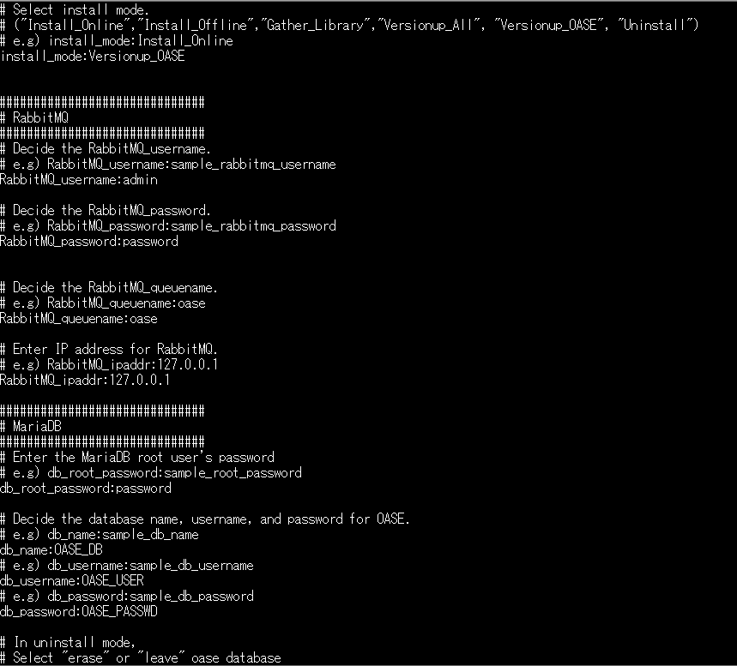
3.8 Update （6/11）
Answer file(oase_answers.txt) example 1/4
The following shows an example of the Answer file(oase_answers.txt)

Slide 16
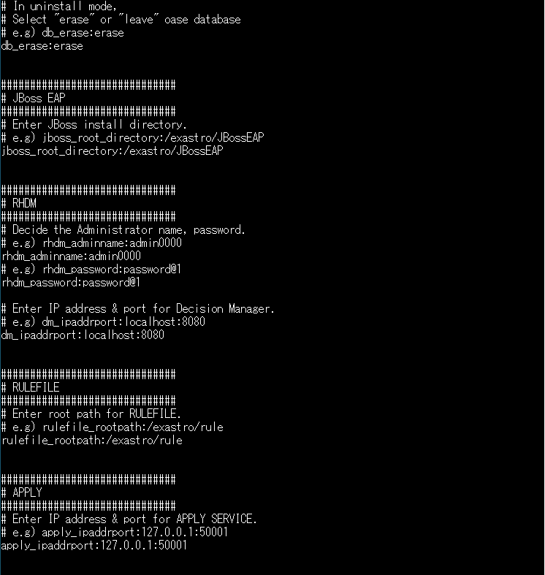
3.9 Update （7/11）
Answer file(oase_answers.txt) example 2/4

Slide 17
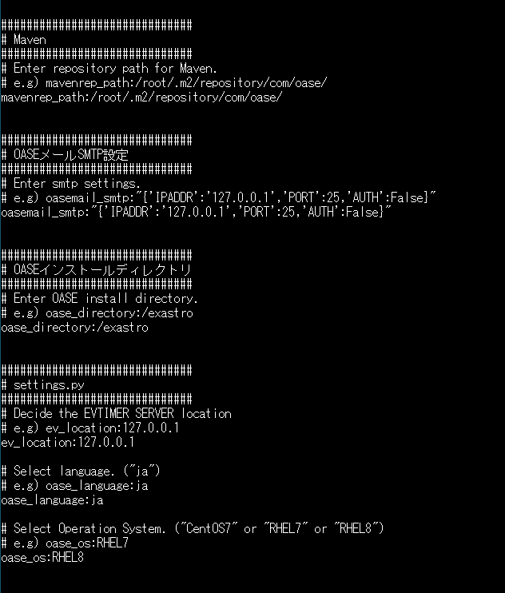
3.10 Update （8/11）
Answer file(oase_answers.txt) example 3/4

Slide 18
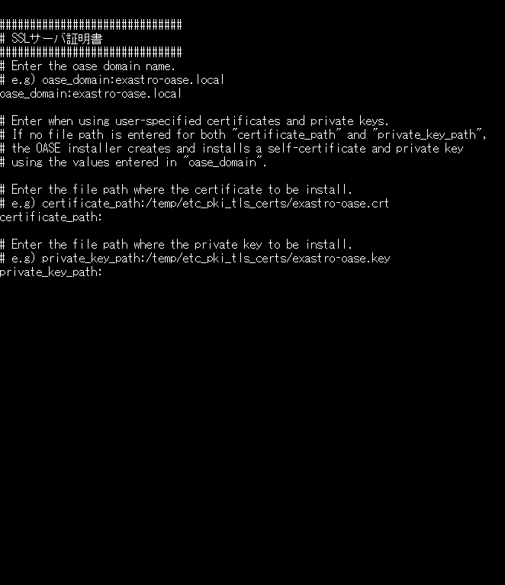
3.11 Update （9/11）
Answer file(oase_answers.txt) example 4/4

Slide 19
3.12 Update （10/11）
Run OASE Installer(Version Update)
Use the command below to run the update tool. # sh oase_installer.sh
If the "install_mode" value in the Answer file (oase_answers.txt) is set to " Versionup_All", the libraries will be installed in the middle of the process. Please see the next page for information regarding the different version's libraries.
Check Process.
If the operation ended normally, the version will be updated to the version of the downloaded file.
The content of the operations executed by the update tool is output to oase_version_up.log
Log storage path /(Installation file extract path)/oase_install_package/install_scripts/log/
End Status
The OASE installer returns the exit statuses listed below depending on the shell process end status.
Normal end：0
Abnormal end：1

Slide 20
3.13 Update （11/11）
List of libraries that will be installed during update
If the "install_mode" in the Answer file (oase_answers.txt) is set to "Versionup_all", the installer will install any new libraries added to the new driver/version.
If it is set to "VersionUP_OASE", please install the libraries manually.
Version | Installed driver | Library name | Install command | Required | Use
1.2.0 | No libraries were added in Version 1.2.0
1.3.0 | No libraries were added in Version 1.3.0
1.3.1 | No libraries were added in Version 1.3.1
1.4.0 | No libraries were added in Version 1.4.0
1.5.0 | No libraries were added in Version 1.5.0

Slide 21
4. OASE Operation check

Slide 22
4.1 Operation check（1/4）
Access URL
Please access the login screen from the following URL.
URL：https://exastro-oase/oase_web/top/login
※Accessing from both HTTP and HTTPS are available after installation.
Since HTTP is insecure, accessing from HTTPS is recommended.
Please check from Operation check(4/4) for the method to access from HTTP.
Login
Please enter the specific Login ID and default password then click the [Login] button when the login screen of OASE is displayed.
・Login ID ： administrator
・Default password： oaseoaseoase
The screen will move to [Change password screen] if it is the first login after installation.
Please change the default password from the change password screen.

Slide 23
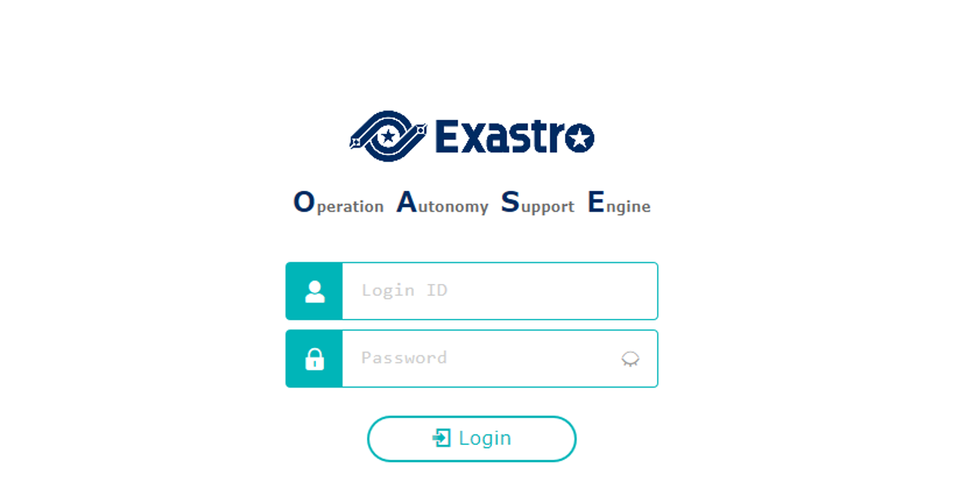
4.4 Operation check（2/4）
OASE login screen
If OASE is installed properly, the following login screen will be displayed.
Login ID： administrator
Default password：oaseoaseoase

Slide 24
4.5 Operation check（3/4）
Check contents according to the display of each menu
Please check if the following menu are displayed after login.
Function | Menu
OASE screen | Dashboard
 | Rule
 | System
 | Management

Slide 25
4.4 Operation check（4/4）
Preparation for accessing with HTTPS.
Register the host set in the Answer file's "oase_domain" to the environment's DNS Server or the operator device's "hosts".
Import the certificate to the Operator device (Windows) If you are not using user specified server certificates, the server certificate can be found in the following path in the OASE install package.
If you are using user certificates, please use the certificate file set in the Answer file's "Certificate_path".
Import the certificate to your Web browser.
Access URL via HTTP
Please access the login screen via the following URL
URL：http://（IP address of server）
※ You can also access through the server's IP Address.
The steps after connection is the same as HTTPS.
Directory | File name
/etc/pki/tls/certs | [Host name set in the Answer file's "oase_domain"].crt

