Slide 1


Version update
※ In this document, “Exastro IT Automation” is described as “ITA".
Exastro IT Automation Version 1.12
Exastro developer

Slide 2
Table of contents
Introduction
1.1 About this guide
System configuration
2.1 System requirement
ITA update procedure
3.1 Preparation
3.2 ITA update workflow
3.3 Update
ITA operation check
4.1 Operation check

Slide 3
1. Introduction

Slide 4
1.1 About this guide
About this guide
This document describes the procedure to update the ITA environment constructed in all-in-one configuration.

Slide 5
2. System configuration

Slide 6
2.1 System requirement
About the environment of ITA to perform update
The procedure in this document can be performed on ITA environment constructed in all-in-one configuration.
The version of ITA that supports version update is 1.4.0 or later. The environment of ITA version 1.4.0 or later can be updated by executing the procedure in this document.

Slide 7
3. ITA construction procedure

Slide 8
3.1 Preparation
ITA Update tool list
The following list contains tools used for updating ITA.
Description | File | Storage path
ITA installer | ita_installer.sh | /(Installation file extract path)/ita_install_package/install_scripts/
Answer file | ita_answers.txt | /(Installation file extract path)/ita_install_package/install_scripts/

Slide 9
3.2 ITA update workflow
Version update work flow
The work flow of version update is as follows.
①Back up ITA environment
②Download file from Github
③Edit answer file
④Execute update tool
Operation content
Install library (optional)
Update database
Update ITA file

Slide 10
3.3 Update（1/11）
*Make sure to start the update as root user.
Back up ITA environment
Please back up ITA environment before update.
Download file from Github
Download file with the following command # curl -OL https://github.com/exastro-suite/it-automation/releases/download/vx.x.x/exastro-it-automation-x.x.x.tar.gz ※ Since v1.10.1, the command is as follows. # curl -OL https://github.com/exastro-suite/it-automation/releases/download/vx.x.x_tag/exastro-it-automation-x.x.x.tar.gz
※Please install curl command beforehand.
※Please change the version (x.x.x) according to the file.
Deploying the materials.
Unzip the .tar.gz file. # tar zxf exastro-it-automation-x.x.x.tar.gz
Change directory
Switch current directory to the directory where the answer file and shell is located. # cd it-automation-x.x.x/ita_install_package/install_scripts
※ Since v1.10.1, the command is as follows.
# cd it-automation-x.x.x_tag/ita_install_package/install_scripts

Slide 11
3.3 Update (2/11)
Edit answer file (ita_answers.txt)
Please edit the answer file to configure the ITA Update.
If the user wishes to install any library when updating to a new version, input “Versionup_All” to the “Install_mode” value. If not, input “Versionup_ITA”.
The only items used when updating ITA are “Install_mode” and “ITA_directory”.
Item | Required | Initial value | Description
install_mode | ○ | Install_Online | Install mode settings ・Install_Online：Install online ・Install_Offline：Install offline ・Gather_Library：Gather library ・Install_ITA：Install ITA ・Versionup_All：Update ITA（With library install） ・Versionup_ITA：Update ITA（Without library install） ・Uninstall：Uninstall ITA
ita_directory | ○ | - | Installation directory Please specify an absolute path for the ITA Installation directory. Make sure the directory can be referenced by all users. If no installation directory exists, one will be created.
ita_language | - | en_US | ITA display language（Japanese（ja_JP）／English（en_US））
ita_domain | ○ | exastro-it-automation.local | ITA domain name specification (used when the ITA installer creates a self-certificate.
certificate_path | Optional | - | Specify the path of the file used for the user specified SSL server certificate (Enter only when using a user specified SSL certificate. Specify an absolute path)
private_key_path | Optional | - | Specify the path of the file used for user-specified SSL private keys. (Enter only when using a user-specified SSL private key. Specify an absolute path)
Not used when updating

Slide 12
3.3 Update（3/11）
Installation modes
Starting from version 1.6.0, the shell executed when the installer is launched is unified to ita_installer.sh only, and the behavior of the installer branches according to "install_mode“ value in the answer file (ita_answers.txt).
Versionup_All：Updates ITA after having installed all of the necessary libraries through the internet. Versionup_ITA：Updates ITA without installing any libraries.
If you are using an online environment and want to automatically install libraries, choose “Versionup_All” for the “install_mode”. If you do not wish to automatically install libraries or are using an offline environment, choose “Versionup_ITA” for the “install_mode”.

Slide 13
3.3 Update（4/11）
Sample of the answer file (ita_answers.txt)
The following shows an example of the answer file (ita_answers.txt)
# Select install mode.
# ("Install_Online","Install_Offline","Gather_Library","Install_ITA",
# "Versionup_All","Versionup_ITA","Uninstall")
# e.g) install_mode:Install_Online
# *This installer operates according to the inputted values below.
# Install_Online: ITA will be installed after the necessary libraries
# has been installed via internet.
# Install_Offline: ITA will start installing using the package created
# in Gather Library.
# Gather_Library: Gathers the necessary libraries via internet and creates
# the package necessary to execute Install_Offline.
# (Execute this before executing Install_Offline)
# Install_ITA: Installs ITA without installing any libraries.
# Versionup_All: Installs ITA after installing the necessary libraries for
# the desired ITA version via internet.
# Versionup_ITA: Updates ITA without installing any libraries.
# Uninstall: ITA Uninstalls ITA.(Libraries will not be uninstalled)
install_mode: Versionup_All
# e.g) ita_directory:/exastro
ita_directory:/exastro
# Select language. ("en_US" or "ja_JP")
# e.g) ita_language:en_US
ita_language:ja_JP
#############################################################
# Enter when using user-specified certificates and private keys.
# If no file path is entered for both "certificate_path" and "private_key_path",
# the ITA installer creates and installs a self-certificate and private key
# using the values entered in "ita_domain".
# Enter the file path where the certificate to be install.
# e.g) certificate_path:/temp/etc_pki_tls_certs/exastro-it-automation.crt
certificate_path:
# Enter the file path where the private key to be install.
# e.g) private_key_path:/temp/etc_pki_tls_certs/exastro-it-automation.key
private_key_path:
#############################################################
The only items used when updating are “install_mode” and “ita_directory”. The other items are not used.
Items in the answer file (ita_answer.txt) does not support full-width characters.

Slide 14
3.3 Update (5/11)
Executing the configuration tool (for online installation)
Execute the ITA installer (updator) with the following command: # sh ita_installer.sh
If the “install_mode” in the answer file (ita_answers.txt) is set to “Versionup_All”, the libraries will automatically be updated during the process. See the next page for information on what libraries are installed with each version.
Check process
If successful, users can update any files acquired.
Running the Update tool will output process contents to the ita_version_up.log file.
Log storage path
/(Installation file extract path)/ita_install_package/install_scripts/log/
Exit status
The ITA installer returns one of the exit statuses listed below depending on the shell process exit status.
Normal exit：0
Abnormal exit：1

Slide 15
3.3 Update（6/11）
List of libraries that will be installed during update
If “yes” is entered for library installation during install, the following libraries will be automatically installed according to the installed driver. If ”no” is entered, please install the libraries manually.
Version | Installed driver | Library name | Install command | Required | Application
1.5.0 | ita_base | php-devel | yum install –y php-devel | 〇 | Used for YAML analysis library (yaml)
 |  | libyaml | yum install –y libyaml | 〇 | Used for YAML analysis library (yaml)
 |  | libyaml-devel | yum install –y libyaml-devel | 〇 | Used for YAML analysis library (yaml)
 |  | make | yum install –y make | 〇 | Used for YAML analysis library (yaml)
 |  | yaml | pecl install yaml | 〇 | Used for YAML analysis library (yaml)
 | ansible-driver | nc | yum install –y nc | - | Used for SSH command option when executing Ansible Playbook by connecting SSH from ITA under proxy environment to external server such as AWS via proxy server.
 |  | paramiko | pip3 install paramiko | - | Required to connect to a network device by specifying network_cli for ansible_connection.
1.6.0 | There are no libraries added in Version 1.6.0.
1.6.1 | There are no libraries added in Version 1.6.1.
1.6.2 | There are no libraries added in Version 1.6.2.
1.6.3 | There are no libraries added in Version 1.6.3.
1.7.0 | ansible-driver | boto | Pip3 install boto | - | Used for community.aws.iam of Ansible module.
1.7.1 | There are no libraries added in Version 1.7.1.
1.7.2 | There are no libraries added in Version 1.7.2.

Slide 16
3.3 Update（7/11）
Version | Installed driver | Library name | Install command | Required |  | Application
1.8.0 | There are no libraries added in Version 1.8.0.
1.8.1 | There are no libraries added in Version 1.8.1.
1.8.2 | There are no libraries added in Version 1.8.2.
1.9.0 | There are no libraries added in Version 1.9.0.
1.9.1 | There are no libraries added in Version 1.9.1
1.10.0 | ansible-driver | git | yum install –y git | - | Used for linking with Ansible Automation Controller.
 | terraform-driver | python-hcl2 | pip3 install python-hcl2 | - | Used for analyzing tf files.
1.10.1 | There are no libraries added in Version 1.10.1
1.10.2 | There are no libraries added in Version 1.10.2
1.11.0 | terraformcli-driver | terraform | yum -y install terraform | - | Used for terraform command execution.
1.11.1 | There are no libraries added in Version 1.11.1
1.11.2 | There are no libraries added in Version 1.11.2

Slide 17
3.3 Update（8/11）
ITA behavior when updating.
Updating ITA will restart all ITA services. This also includes all services that has been stopped manually. If necessary, the user will need to stop said services manually after ITA has been updated.
PHP version
ITA v1.9.1 and earlier versions requires PHP7.2. ITA v1.10.0 and later versions can use both PHP7.2 and 7.4.
If ITA v1.10.0 is installed through the installer, PHP7.4 will be installed. If ITA is updated from v1.9.1(or earlier) to v1.10.0(or later), The PHP version will not be updated to 7.4, but will be left as 7.2 If you wish to update to 7.4, please do so manually.

Slide 18
3.3 Update（9/11）
Ansible Automation Controller4.x
Starting from ITA v1.10.0, ITA will be able to link with Ansible Automation Controller4.x Please see 「 System Configuration/Environment Construction Guide - Ansible-driver」for information regarding linking Ansible Automation Controller
Make note that the process is a bit different from linking with Ansible Tower3.x.
If you want to update ITA to v1.10.0 or later and link with Ansible Tower3.x, make sure to configure the settings found in chapter 5.2 in 「 System Configuration/Environment Construction Guide - Ansible-driver」

Slide 19
3.3 Update（10/11）
Specification change of MariaDB 11.0.2
The "mysql*" command was deprecated in mariaDB 11.0.2 released on June 23, 2023, and the specification was changed so that the following warning is output when the "mysql*" command is executed.
mysql: Deprecated program name. It will be removed in a future release, use '/usr/bin/mariadb' instead
Because the installer up to ITA 1.11.0 uses the "mysql*" command, The installer up to ITA1.11.0 uses the "mysql*" command, so the upgrade will fail under the following conditions, as shown in the error output example on the next page.
・MariaDB 11.0.2 or later is used.
・Upgrading from a certain ITA version to 1.11.0 or earlier.
When upgrading under the above conditions, please make the corrections on the next page before performing the upgrade.
There is no problem when upgrading to ITA1.11.1 or later, since the correction has already been made in ITA1.11.1 or later.

Slide 20
3.3 Update（11/11）
(Reference) Example of error output when upgrading
Fixes for MariaDB 11.0.2 or later and upgrading to version 1.11.0 or earlier
/(installation material deployment location)/ita_install_package/install_scripts/bin/ita_version_up.sh
can be successfully executed by modifying and executing the following
Example of modification for ITA1.11.0
Line 618 (the number of lines may differ depending on the version)
～～～～～～～～（ abbreviation ） ～～～～～～～～
[2023-07-19 17:47:26] INFO : -----MODE[VERSIONUP] START-----
[2023-07-19 17:47:26] INFO : Authorization check.
[2023-07-19 17:47:26] INFO : Reading answer-file.
[2023-07-19 17:47:36] INFO : Version check.
[2023-07-19 17:47:36] INFO : Stopping Apache.
[2023-07-19 17:47:38] INFO : Stopping ITA services.
[2023-07-19 17:47:39] INFO : Updating tables.
[2023-07-19 17:47:39] ERROR : SQL Error. Check logfile[/root/it-automation-1.11.0/ita_install_package/install_scripts/log/1.10.2_base_sql.log].
[2023-07-19 17:47:39] INFO : Abort version up.
env MYSQL_PWD=${DB_PASSWORD} mysql -u${DB_USERNAME} ${DB_NAME} -h ${DB_HOST} < "$SQL_REPLACE" 1>${SQL_LOGFILE} 2>&1
↓
env MYSQL_PWD=${DB_PASSWORD} mariadb -u${DB_USERNAME} ${DB_NAME} -h ${DB_HOST} < "$SQL_REPLACE" 1>${SQL_LOGFILE} 2>&1

Slide 21
4. ITA Operation check

Slide 22
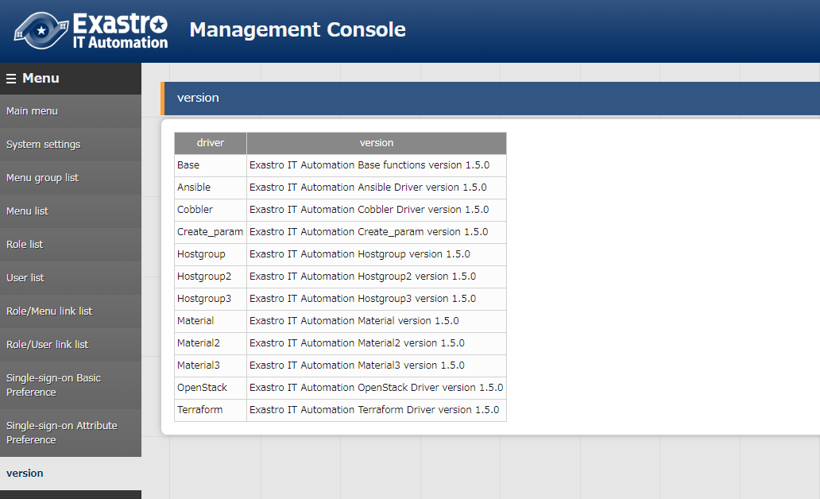
4.1 Operation check（1/2）
Check version
After logging into ITA, check if the version is updated in “Management console” - “Version”.

Slide 23
4.1 Operation check（2/2）
Removed functions
The list below contains deleted functions and what version they were deleted. The functions in the list below will still be there when updated, but there is no guarantee that they will function properly.
Function | Version
DSC-Driver | v1.5.0
OpenStack-Driver | v1.6.1
Construction file management function | v1.8.0

