Slide 1


Offline Installation
※In this document, “Operation Autonomy Support engine” will be written as “OASE”.
Ver 1.2
Exastro developer

Slide 2
Table of contents
Introduction
1.1 About this document
System construction
2.1 Environment・Conditions(1/2)
2.2 Environment・Conditions(2/2)
OASE Environment construction procedure
3.1 Offline installation
3.2 Preparation
3.3 OASE environment construction flow
3.4 Environment Construction（1/16）
3.5 Environment Construction（2/16）
3.6 Environment Construction（3/16）
3.7 Environment Construction（4/16）
3.8 Environment Construction（5/16）
3.9 Environment Construction（6/16）
3.10 Environment Construction（7/16）
3.11 Environment Construction（8/16）
3.12 Environment Construction（9/16）
3.13 Environment Construction（10/16）
3.14 Environment Construction（11/16）
3.15 Environment Construction（12/16）
3.16 Environment Construction（13/16）
3.17 Environment Construction（14/16）
3.18 Environment Construction（15/16）
3.19 Environment Construction（16/16）
OASE Operation check
4.1 Operation Check（1/4）
4.2 Operation Check（2/4）
4.3 Operation Check（3/4）
4.4 Operation Check（4/4）
References
5.1 References

Slide 3
1. Introduction

Slide 4
1.1 About this document
About this document
This document serves as a guide on how to construct an OASE Server in an offline environment.

Slide 5
2. System construction

Slide 6
2.1 Environment・Conditions（1/3）
Environment necessary to use OASE.
For details regarding the environment needed in order to use OASE, please refer to the “Exastro-OASE_Environment_Construction_manual_Basics”

Slide 7
2.1 Environment・Conditions（2/3）
Prerequisites for gathering libraries.
When gathering libraries, the server for gathering libraries (online environment / OASE server (Offline environment both needs to have the same specs ( OS Version and installed packages).
The server for library gathering (online environment) must be able to reference the following repositories.
（See the next page）

Slide 8
2.1 Environment・Conditions（3/3）
Pre-requisites if you want to collect libraries.
Repository references
OS | Repository
RHEL7 | https://dl.fedoraproject.org/pub/epel/epel-release-latest-7.noarch.rpm
 | https://downloads.mariadb.com/MariaDB/mariadb_repo_setup
 | epel
 | rhel-7-server-optional-rpms
 | rhel-server-rhscl-7-rpms
RHEL8 | https://dl.fedoraproject.org/pub/epel/epel-release-latest-8.noarch.rpm
 | https://downloads.mariadb.com/MariaDB/mariadb_repo_setup
 | rabbitmq_rabbitmq-server
CentOS7 | https://downloads.mariadb.com/MariaDB/mariadb_repo_setup
 | epel
 | epel-release

Slide 9
3. OASE Environment Construction Procedure

Slide 10
3.1 Offline installation
Installation procedure
If the OASE server is in an offline environment, please follow the procedure below.
Collect required library from server for library collection (online) via internet, then compress installation package and libraries in to one installation package(for offline).
Use storage media to move installation package (for offline) to OASE Server.
Create local repository from installation package (for offline), install required libraries and then run OASE installer.
Server for library collection
Online
Internet
Repository
Installation packages
(for offline)
Library
OASE server
OASE
JAVA(openJDK)、JBoss、
Python(uWSGI)、 Django
RabbitMQ Server、MariaDB Server、Apache
Local Repository
RHDM、 Maven
Offline

Slide 11
3.2 Preparation
OASE Environment construction tools
The following table lists the tools used for construction OASE.
RHEL Subscription
If you want to collect libraries in an non-cloud environment RHEL7/RHEL8 OS, please make sure that you are subscribed to the environment ITA is going to be installed to in advance.
Descritpion | File | Storage path
OASE installer | oase_installer.sh | /(Installation file extract path)/oase/oase_install_package/install_scripts/
Answer file | oase_answers.txt | /(Installation file extract path)/oase/oase_install_package/install_scripts/

Slide 12
3.3 OASE環境構築フロー
Construction flow（offline）
The construction flow is as follows.
Server for library collection
(offline)
OASE server operations
(offline)
①Download files from Github
⑤Extract installation package (for offline)
②Edit Answer file
⑥Edit answer file
③Run OASE installer (collect libraries)
●Process contents
Configure Yum repository
Collect libraries
Create compressed file for offline installation
③Run OASE Installer (for offline)
●Process contents
Oconfigure OS Environment
Configure Yum repository
Install Maria \DB
Install Apache
Install Python related files
Install RHDM
Install RabbitMQ
Install OASE
④Move installation package (for offline) to OASE server via storage memory

Slide 13
3.4 Environment Construction（1/16）
※Execute in online environment
※Execute as root user
Download file from Github
Download file with the following command # curl -OL https://github.com/exastro-suite/it-automation/releases/download/vx.x.x/exastro-oase-x.x.x.tar.gz
※Please install curl command beforehand.
※Please change the version (x.x.x) according to the file.
Extract file
Extract .tar.gz file # tar zxf exastro-oase-x.x.x.tar.gz
Change directory
Switch current directory to the directory where the answer file and shell is located. # cd Exastro-oase-x.x.x/oase_install_package/install_scripts

Slide 14
3.5 Environment Construction（2/16）
Edit Answer file (ita_answers.txt).
Create the answer file before gathering any libraries.
If you want to collect libraries, change the "install_mode" setting value to "gather_library“.
Item | Required | Initial value | Description
install_mode | ○ | Install_Online | Install mode settings ・Install_Online：Online install ・Install_Offline：Offline install ・Gather_Library：Gather library ・Versionup_All：Update OASE (with library installation) ・Versionup_OASE：Update OASE (without library installation ・Uninstall：Uninstall OASE ※See references for more details.
RabbitMQ_username | ○ | administrator | RabbitMQ user name
RabbitMQ_password | ○ | password | RabbitMQ password
RabbitMQ_queuename | ○ | oase | RabbitMQ queue name（Generated）
RabbitMQ_ipaddr | ○ | - | RabbitMQ IP Address
db_root_password | ○ | password | MariaDB root password
db_name | ○ | OASE_DB | OASE MariaDB database name
db_username | ○ | OASE_USER | OASE MariaDB database username

Slide 15
3.6 Environment Construction（3/16）
Edit Answer file (oase_answers.txt) (2/3)
Edit the OASE Environment Construction setting file (oase_answers.txt) by using the table below.
Item | Required | Initial value | Description
db_password | ○ | OASE_PASSWD | OASE MariaDB Database password
db_erase | ○ | - | Decides whether to delete or leave the DB when uninstalling OASE
jboss_root_directory | ○ | /exastro/WildFly | Jboss installation directory
rhdm_adminname | ○ | admin0000 | RHDM administrator name
rhdm_password | ○ | password@1 | RHDM password
dm_ipaddrport | ○ | localhost:8080 | RHDM IP address and port
rulefile_rootpath | ○ | /exastro/rule | RHDM rule setting file path（generated）
apply_ipaddrport | ○ | 127.0.0.1:50001 | IP and Port that Apply service starts,
mavenrep_path | ○ | /root/.m2/repository/com/oase/ | Maven jar file storage place.
oasemail_smtp | ○ | "{'IPADDR':'127.0.0.1','PORT':25,'AUTH':False}" | OASE Mail server settings
oase_directory | ○ | /exastro | OASE installation path

Slide 16
3.7 Environment Construction（4/16）
Edit Answer file(oase_answers.txt)(3/3)
Item | Required | Initial value | Description
oase_domain | ○ | exastro-oase.local | OASE domain name
certificate_path | Optional | － | File path for user specified SSL server Certificate. (Enter only when using an user specified SSL certificate. Specify an absolute path)
private_key_path | Optional | － | File path for user specified SSL Private keys. (enter only when using an user specified SSL private key. Specify an absolute path)

Slide 17
3.8 Environment Construction（5/16）
Execute library collection script
Execute the following script to execute library collection script.
# sh oase_gather_library.sh
Check operation
After executing library collection script, the content of operation will be output to ita_gather.log
Log storage path
/(installation file extract path)/oase_install_package/install_scripts/log/
Move file
Move installation package (for offline) to OASE server via storage media
※The following command are executed in ITA server (Offline environment)
Extract installation package(for offline)
Extract installation package(for offline) on ITA server
# tar zxf oase_Verx.x_offline_yyyymmddhhmmss.tar.gzx

Slide 18
3.9 Environment Construction（6/16）
Edit answer file(oase_answers.txt)
Please create answer file before collecting any libraries.
If you want to collect libraries, change the "install_mode" setting value to "gather_library“.
Answer file Item list (oase_answers.txt)（1/3）
Item | Required | Initial value | Description
install_mode | ○ | Install_Online | Install mode settings ・Install_Online：Online install ・Install_Offline：Offline install ・Gather_Library：Gather library ・Versionup_All：Update OASE (with library installation) ・Versionup_OASE：Update OASE (without library installation ・Uninstall：Uninstall OASE ※See references for more details.
RabbitMQ_username | ○ | administrator | RabbitMQ Username
RabbitMQ_password | ○ | password | RabbitMQ Password
RabbitMQ_queuename | ○ | oase | RabbitMQ Queue name（Generated）
RabbitMQ_ipaddr | ○ | - | RabbitMQ IP Address
db_root_password | ○ | password | MariaDB root Password
db_name | ○ | OASE_DB | OASE MariaDB database name
db_username | ○ | OASE_USER | OASE MariaDB database username

Slide 19
3.10 Environment Construction（7/16）
Edit answer file(oase_answers.txt)(2/3)
Item | Required | Initial value | Description
db_password | ○ | OASE_PASSWD | OASE MariaDB Database password
db_erase | ○ | - | Decides whether to delete or leave the DB when uninstalling OASE
jboss_root_directory | ○ | /exastro/WildFly | Jboss installation directory
rhdm_adminname | ○ | admin0000 | RHDM administrator name
rhdm_password | ○ | password@1 | RHDM password
dm_ipaddrport | ○ | localhost:8080 | RHDM IP address and port
rulefile_rootpath | ○ | /exastro/rule | RHDM rule setting file path（generated）
apply_ipaddrport | ○ | 127.0.0.1:50001 | IP and Port that Apply service starts,
mavenrep_path | ○ | /root/.m2/repository/com/oase/ | Maven jar file storage place.
oasemail_smtp | ○ | "{'IPADDR':'127.0.0.1','PORT':25,'AUTH':False}" | OASE Mail server settings
oase_directory | ○ | /exastro | OASE installation path

Slide 20
3.11 Environment Construction（8/16）
Edit Answer file(oase_answers.txt)(3/3)
Item | Required | Initial value | Description
oase_domain | ○ | exastro-oase.local | OASE Domain name
certificate_path | Optional | － | Specify the path of the file used for the user specified SSL server certificate (Enter only when using a user specified SSL certificate. Specify an absolute path)
private_key_path | Optional | － | Specify the path of the file used for user-specified SSL private keys. (Enter only when using a user-specified SSL private key. Specify an absolute path)

Slide 21
3.12 Environment Construction（9/16）
User specified server certificates and private keys.
It is possible to use files prepared by users as server certificates and private keys. If you want to use them, please prepare both a server certificate and a private key and input their file paths to "Certificate_path" and "private_key_path" respectively in the answer file. It is not possible to use only either server certificates or private keys.
If the server certificate includes an intermediate certificate, Create a file that connects the two and set the path of the file to "certificate_path"
Example of Creation command #cat(Server certificate file)(Intermediate certificate file)->(Linked server certificate file).
If nothing is input for "certificate_path" and "private_key_path", The ITA installer will use the value of "ita_domain" in the answer file to create and install the self-certificate. （※The "ita_domain" is used as the common name when creating the self-certificate. It is also the file name for the self-certificate and the private key.

Slide 22
3.13 Environment Construction（10/16）
When installing, the server certificate and private key are placed in the (/etc/pki/tls/certs). However, since they will be removed from that directory when uninstalled, please manage the original server certificate and private key files with care when using user-specified server certificates and private keys.
When uninstalling, if both "certificate_path" and "private_key_path" in the answer file (oase_answers.txt) are specified, the specified files will be deleted. If no file is specified, the name specified in “oase_domain" will be used to delete the used file.

Slide 23
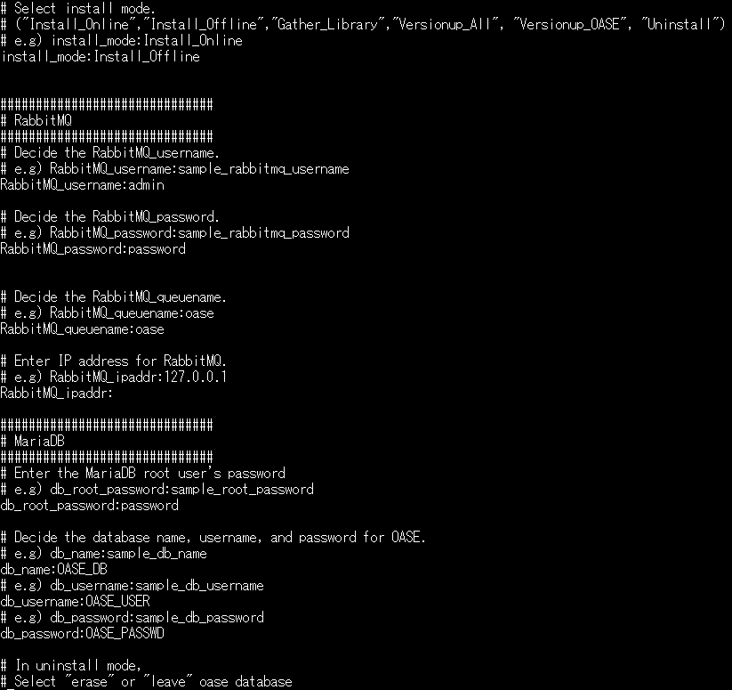
3.14 Environment Construction（11/16）
Answer file example.(oase_answers.txt) 1/4
The following shows an example of the answer file(oase_answers.txt):

Slide 24
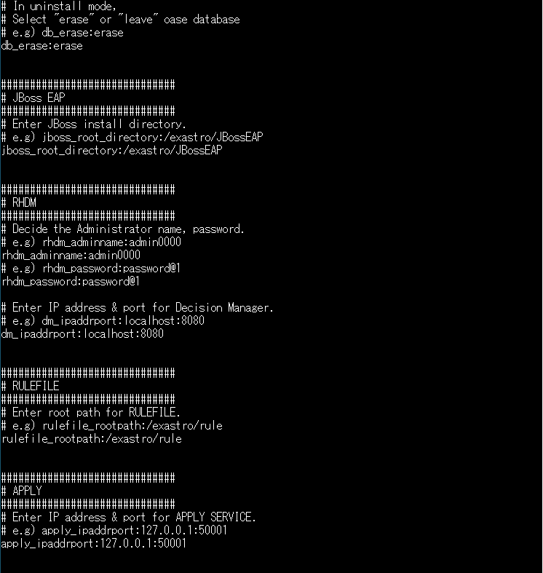
3.15 Environment Construction（12/16）
The following shows an example of the answer file(oase_answers.txt)2/4

Slide 25
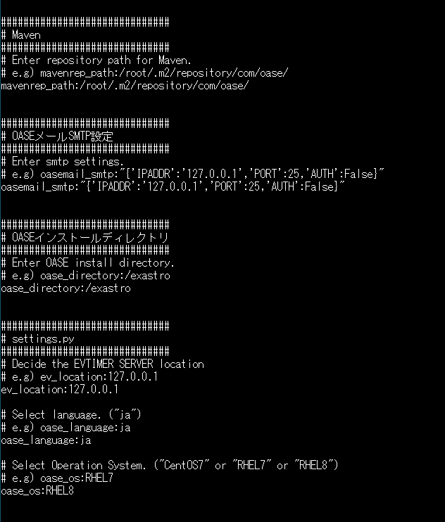
3.16 Environment Construction（13/16）
The following shows an example of the answer file(oase_answers.txt)3/4

Slide 26
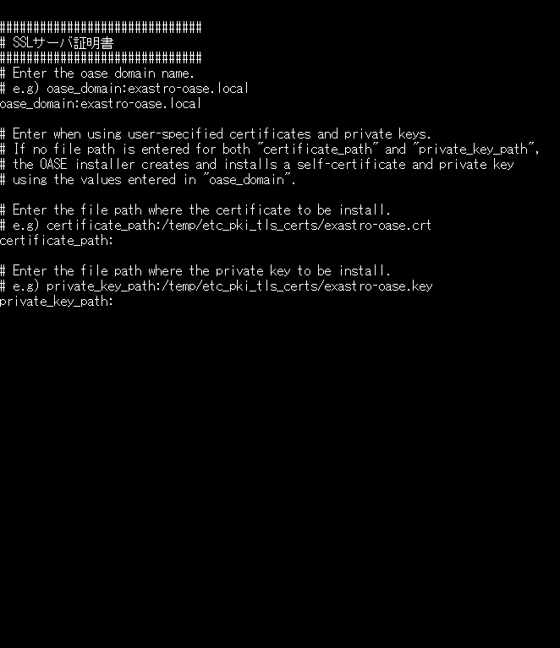
3.17 Environment Construction（14/16）
The following shows an example of the answer file(oase_answers.txt)4/4

Slide 27
3.18 Environment Construction（15/16）
Executing the configuration tool (for offline installation)
Execute the configuration tool with the following command:
# sh oase_installer.sh
Check process
The content of process executed by construction tool is output to ita_builder.log and ita_installer.log
Log storage path
/(Installation file extract path)/oase_install_package/install_scripts/log/
Exit status
The OASE installer returns one of the exit statuses listed below depending on the shell process exit status.
Normal exit：0
Abnormal exit：1

Slide 28
3.19 Environment Construction（16/16）
List of libraries installed during construction.
The following table lists the libraries installed after running the OASE installer (for offline).
Installed driver | Library overview | Library name
OASE | httpd | httpd httpd-devel mod_ssl
 | MariaDB | MariaDB MariaDB-server MariaDB-devel MariaDB-shared expect
 | RabbitMQ | erlang rabbitmq-server
 | python | python36 python36-libs python36-devel python36-pip

Slide 29
4. OASE Operation Check

Slide 30
4.1 Operation check（1/4）
Access URL
Please access the login screen from the following URL.
URL：https://exastro-oase/oase_web/top/login
※Accessing from both HTTP and HTTPS are available after installation.
Since HTTP is insecure, accessing from HTTPS is recommended.
Please check from Operation check(3/7) for the method to access from HTTP.
Login
Please enter the specific Login ID and default password then click the [Login] button when the login screen of OASE is displayed.
・Login ID ： administrator
・Default password： oaseoaseoase
The screen will move to [Change password screen] if it is the first login after installation.
Please change the default password from the change password screen.

Slide 31
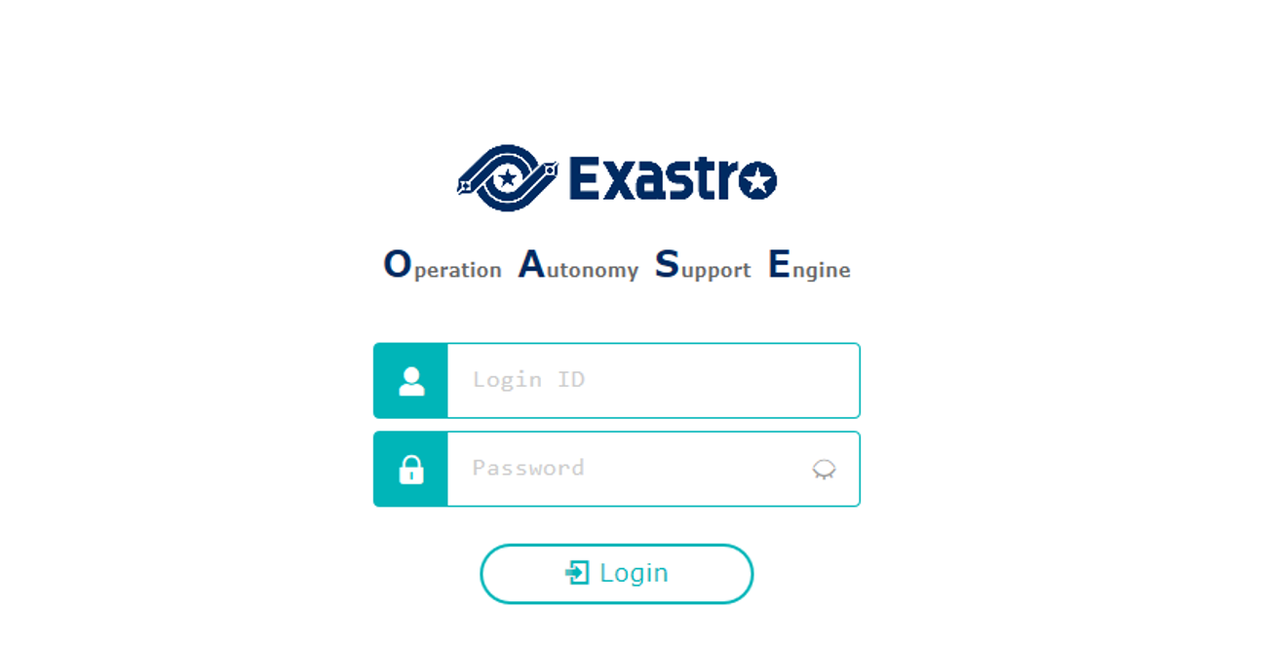
4.4 Operation check（2/4）
OASE login screen
If OASE is installed properly, the following login screen will be displayed.
Login ID： administrator
Default password：oaseoaseoase

Slide 32
4.5 Operation check（3/4）
Check contents according to the display of each menu
Please check if the following menu are displayed after login.
Function | Menu
OASE screen | DashBoard
 | Rule
 | System
 | Management

Slide 33
4.4 Operation check（4/4）
Preparation for accessing with HTTPS.
Register the host set in the Answer file's "oase_domain" to the environment's DNS Server or the operator device's "hosts".
Import the certificate to the Operator device (Windows) If you are not using user specified server certificates, the server certificate can be found in the following path in the OASE install package.
If you are using user certificates, please use the certificate file set in the Answer file's "Certificate_path".
Import the certificate to your Web browser.
Access URL via HTTP
Please access the login screen via the following URL
URL：http://（IP address of server）
※ You can also access through the server's IP Address.
The steps after connection is the same as HTTPS.
Directory | File name
/etc/pki/tls/certs | [Host name set in the Answer file's "oase_domain"].crt

Slide 34
5. Appendix

Slide 35
5.1 Appendix
Install modes
The behavior of the installer branches depending on the “install_mode” value in the answer file (oase_answers.txt)
Install_Online： Installs OASE after installing the neccessary libraries online.
Install_Offline： Installs OASE and libraries using the package created by gather_library offline.
Gather_Library： Uses the internet to gather OASE Libraries and creates a package that can be used for Install_offline.(Use this before install_offline)
Versionup_All： Updates OASE after installing the necessary libraries online.
Versionup_OASE： Updates OASE without installing any libraries.
Uninstall： Uninstalls OASE. (Libraries will not be deleted)

