Slide 1


Online installation
※”Operation Autonomy Support Engine” is referred to as “OASE” in this manual.
Version 1.２
Exastro developer

Slide 2
Table of contents
Introduction
1.1 About this manual
System configuration
2.1 Requirements(1/2)
2.2 Requirements(2/2)
OASE environment construction procedure
3.1 Online installation
3.2 Preparation（1/2）
3.3 OASE environment construction flow
3.4 Environment construction （1/11）
3.5 Environment construction （2/11）
3.6 Environment construction （3/11）
3.7 Environment construction （4/11）
3.8 Environment construction （5/11）
3.9 Environment construction （6/11）
3.10 Environment construction （7/11）
3.11 Environment construction （8/11）
3.12 Environment construction （9/11）
3.13 Environment construction （10/11) 3.14 Environment construction （11/11)
OASE operation check
4.1 Operation check （1/4）
4.2 Operation check （2/4）
4.3 Operation check （3/4）
4.4 Operation check （4/4）

Slide 3
1. Introduction

Slide 4
1.1 About this manual
About this manual
This manual describes the procedure to construct OASE in all-in-one configuration(described later) with installer using external repository.

Slide 5
2. System configuration

Slide 6
2.1 Environment・Conditions
Environment necessary to use OASE.
For details regarding the environment needed in order to use OASE, please refer to the “Exastro-OASE_Environment_Construction_manual_Basics”

Slide 7
3. OASE environment construction procedure

Slide 8
3.1 Online installation
About the installation procedure
If the OASE server is in online environment, the system configuration is performed by installing required library from internet and executing OASE installer.
OASE Server
OASE
OASE installation package
JAVA(openJDK)、Jboss EAP、
Python(uWSGI)、 Django
memcached,
Advance installation
and setting
RabbitMQ Server、MySQL Server、Nginx
Decision Manager、 Maven
Online

Slide 9
3.2 Preparation
OASE Environment Construction tools
The tools used to construct OASE Environments are listed below.
Description | File | Storage path
OASE Installer | oase_installer.sh | /(installation file storage)/oase/oase_install_package/install_scripts/
Answer File | oase_answers.txt | /(installation file storage)/oase/oase_install_package/install_scripts/

Slide 10
3.4 OASE environment construction flow
Environment construction flow (Online)
The flow of environment construction is as follows.
①Download file from Github
②Change privilege of
installation script
③Edit answer file
④Execute environment
construction tool (online version)
Process content
Connect RabbitMQ
Setup MySQL
Install JBoss
Setup other services
Execute OASE installer

Slide 11
3.5 Environment construction（1/11）
Download file from Github
Download file via the following command. $ wget https://github.com/exastro-suite/oase/archive/vx.x.x.tar.gz ※Please install wget command beforehand.
※Please change the version(x.x.x) properly.
Change the privilege of installation script
Extract zip file and change the privilege of installation script $ tar zxf vx.x.x.tar.gz $ find ./oase-x.x.x/oase_install_package/install_scripts/ -type f -name *.sh | xargs chmod 755
Edit answers file
/oase-x.x.x/oase_install_package/install_scripts/oase_answers.txt

Slide 12
3.6 Environment construction（2/7）
Edit answers file(1/3)
The following list shows how to edit the OASE Environment Setting file (oase_answers.txt).
Item | Required | Default value | Description
install_mode | ○ | Install_Online | Choose between one of the following modes. (Install_Online, Install_Offline, Gather_Library, Versionup_All, Versionup_OASE, Uninstall)
RabbitMQ_username | ○ | administrator | Username of RabbitMQ
RabbitMQ_password | ○ | password | Password of RabbitMQ
RabbitMQ_queuename | ○ | oase | Queue name of RabbitMQ (Since it will be generated, any desired name is OK)
RabbitMQ_ipaddr | ○ |  | IP address of RabbitMQ
db_root_password | ○ | password | Root password of MySQL
db_name | ○ | OASE_DB | Name of the MySQL database for OASE
db_username | ○ | OASE_USER | Username of the MySQL database for OASE
db_password | ○ | OASE_PASSWD | Password of the MySQL database for OASE
db_erase | ○ | - | Erase or keep the database when uninstalling OASE
jboss_root_directory | ○ | /Exastro/WildFly | Installation path of Jboss
rhdm_adminname | ○ | admin000 | Administrator name of RHDM

Slide 13
3.7 Environment construction（3/7）
Edit answers file(2/3)
The following list shows how to edit the OASE Environment Setting file (oase_answers.txt).
Item | Required | Default value | Description
rhdm_password | ○ | password@1 | Password of RHDM
dm_ipaddrport | ○ | localhost:8080 | IP address and port number of RHDM
rulefile_rootpath | ○ | /exastro/rule | Root path of RHDM rule setting file (Since it will be generated, any desired path is OK)
apply_ipaddrport | ○ | 127.0.0.1:50001 | IP address and port to start Apply service
mavenrep_path | ○ | /root/.m2/repository/com/oase/ | Storage path of RHDM Maven jar file
oasemail_smtp | ○ | "{'IPADDR':'127.0.0.1','PORT':25,'AUTH':False}" | Setting of OASE mail server
oase_directory | ○ | /exastro | Installation target directory of OASE
oase_session_engine | ○ | - | The way to keep OASE session
ev_location | ○ | - | IP address to execute clone job when connected with ActiveDirectory
oase_language | ○ | en | Language of OASE
oase_os | ○ | - | Environment OS

Slide 14
3.7 Environment construction （4/11）
Edit answers file(3/3)
The following list shows how to edit the OASE Environment Setting file (oase_answers.txt).
Item | Required | Default value | Description
oase_domain | ○ | exastro-oase.local | OASE Domain name
certificate_path | Optional | － | File path for user specified SSL server Certificate. (Enter only when using an user specified SSL certificate. Specify an absolute path)
private_key_path | Optional | － | File path for user specified SSL Private keys. (enter only when using an user specified SSL private key. Specify an absolute path)

Slide 15
3.8 環境構築（5/11）
User specified server certificates and private keys.
It is possible to use files prepared by users as server certificates and private keys. If you want to use them, please prepare both a server certificate and a private key and input their file paths to "Certificate_path" and "private_key_path" respectively in the answer file. It is not possible to use only either server certificates or private keys.
If the server certificate includes an intermediate certificate, Create a file that connects the two and set the path of the file to "certificate_path"
Example of Creation command #cat(Server certificate file)(Intermediate certificate file)->(Linked server certificate file).
If nothing is input for "certificate_path" and "private_key_path", The ITA installer will use the value of "ita_domain" in the answer file to create and install the self-certificate. （※The "ita_domain" is used as the common name when creating the self-certificate. It is also the file name for the self-certificate and the private key.

Slide 16
3.9 環境構築（6/11）
When installing, the server certificate and private key are placed in the (/etc/pki/tls/certs). However, since they will be removed from that directory when uninstalled, please manage the original server certificate and private key files with care when using user-specified server certificates and private keys.
When uninstalling, if both "certificate_path" and "private_key_path" in the answer file (oase_answers.txt) are specified, the specified files will be deleted. If no file is specified, the name specified in “oase_domain" will be used to delete the used file.

Slide 17
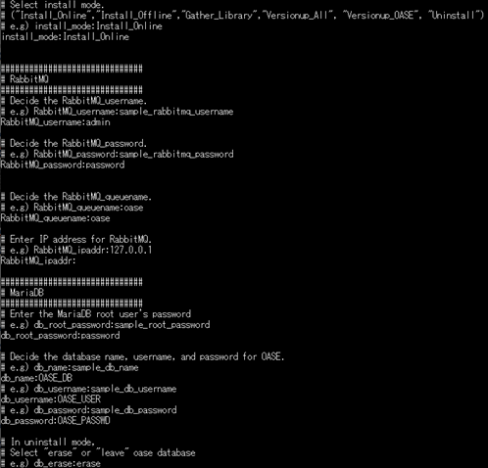
3.10 環境構築（7/11）
Answer file example.(oase_answers.txt) 1/4
The following shows an example of the answer file(oase_answers.txt):

Slide 18
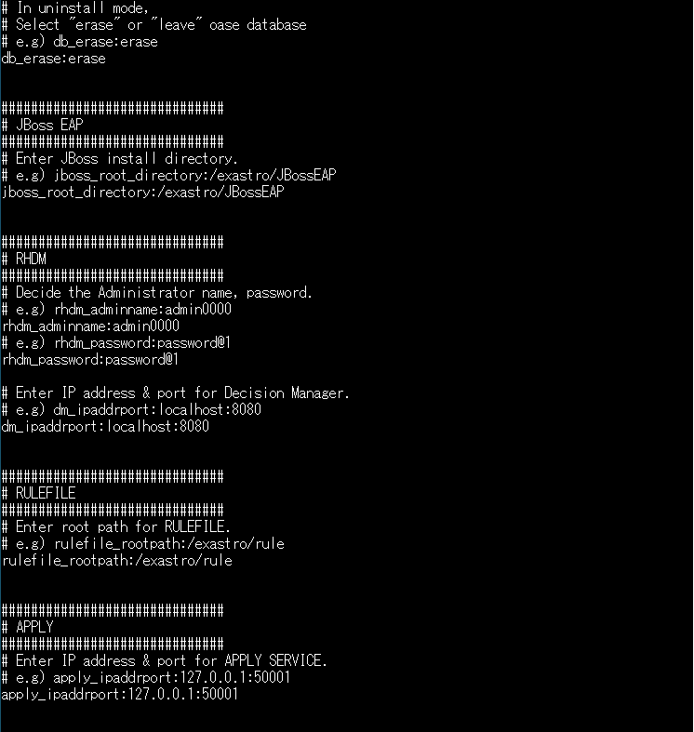
3.11 環境構築（8/11）
Answer file (oase_answers.txt) description sample 2/4

Slide 19
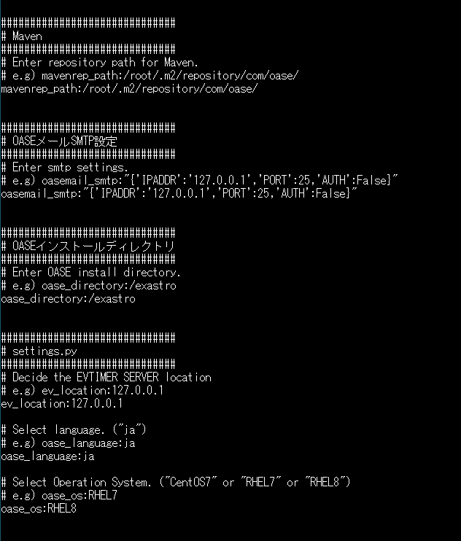
3.12 環境構築（9/11）
Answer file (oase_answers.txt) description sample 3/4

Slide 20
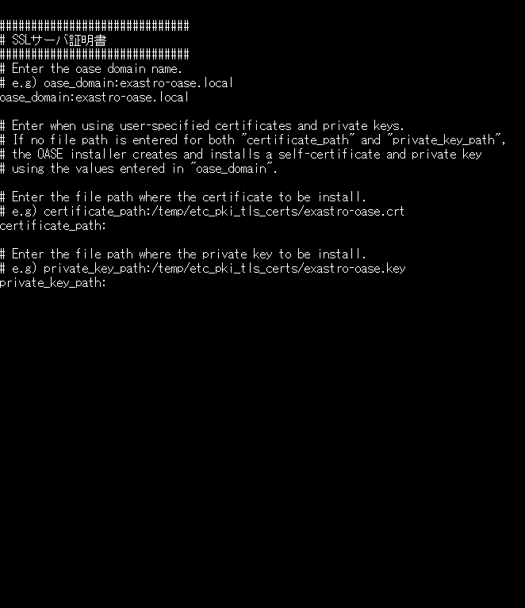
3.13 環境構築（10/11）
Answer file (oase_answers.txt) description sample 4/4

Slide 21
3.11 Environment construction（7/7）
Change directory
Move to the directory which contains the settings file and shell for environment construction $ cd oase-x.x.x/oase_install_package/install_scripts
Execute environment construction tool(online version)
Execute environment construction tool with the following command.
$ sh oase_online_installer.sh
The installation of OASE is completed.

Slide 22
4. OASE operation check

Slide 23
4.1 Operation check（1/4）
Access URL
Please access the login screen from the following URL.
URL：https://exastro-oase/oase_web/top/login
※Accessing from both HTTP and HTTPS are available after installation.
Since HTTP is insecure, accessing from HTTPS is recommended.
Please check from Operation check(3/7) for the method to access from HTTP.
Login
Please enter the specific Login ID and default password then click the [Login] button when the login screen of OASE is displayed.
・Login ID ： administrator
・Default password： oaseoaseoase
The screen will move to [Change password screen] if it is the first login after installation.
Please change the default password from the change password screen.

Slide 24
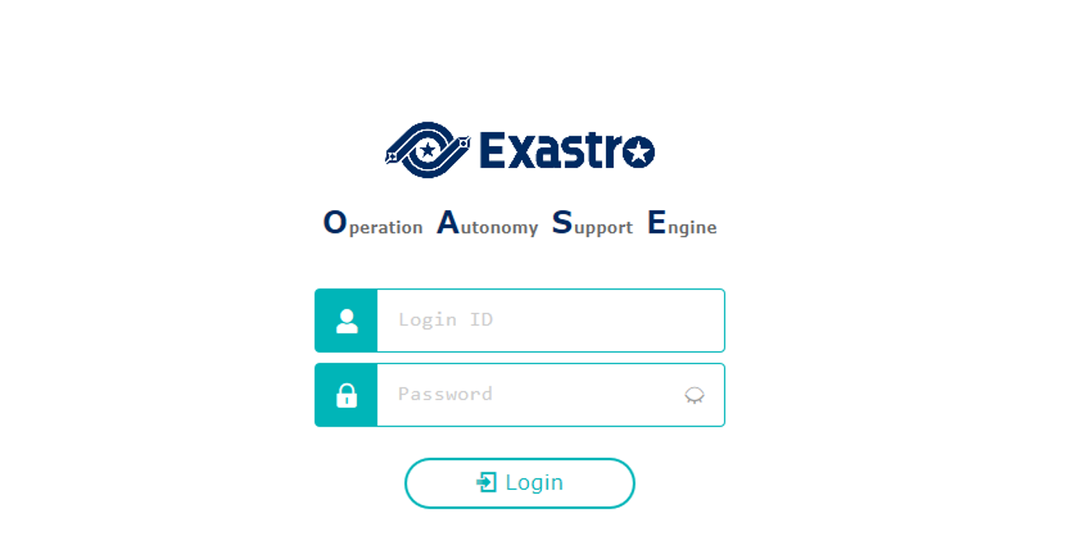
4.4 Operation check（2/4）
OASE login screen
If OASE is installed properly, the following login screen will be displayed.
Login ID： administrator
Default password：oaseoaseoase

Slide 25
4.5 Operation check（3/4）
Check contents according to the display of each menu
Please check if the following menu are displayed after login.
Function | Menu
OASE screen | DashBoard
 | Rule
 | System
 | Management

Slide 26
4.4 Operation check（4/4）
Preparation for accessing with HTTPS.
Register the host set in the Answer file's "oase_domain" to the environment's DNS Server or the operator device's "hosts".
Import the certificate to the Operator device (Windows) If you are not using user specified server certificates, the server certificate can be found in the following path in the OASE install package.
If you are using user certificates, please use the certificate file set in the Answer file's "Certificate_path".
Import the certificate to your Web browser.
Access URL via HTTP
Please access the login screen via the following URL
URL：http://（IP address of server）
※ You can also access through the server's IP Address.
The steps after connection is the same as HTTPS.
Directory | File name
/etc/pki/tls/certs | [Host name set in the Answer file's "oase_domain"].crt

