Slide 1


Slide 2

Extensible Binary Universal Protocol - Introduction
https://xbup.exbin.org
2020/11/01

Slide 3
What it is
A prototype of general purpose multi-layer binary data protocol and file format with primary focus on abstraction and data transformation
Unified block-tree structure
Build-in and custom data types
Transformation framework

Slide 4
Goals
Universal
Independent
Declarative
Normative
Flexible
Efficient

Slide 5
Motivation
Browseable binary content
Flexible modular applications
Strong building blocks
Comprehensive scientific protocol
Long-term storage

Slide 6
Usable for / as
Multimedia files
Serialization protocol
Application API
Filesystem structure
Huge data
Random access
Parallel processing

Slide 7
Format Example – Bitmap Picture
PICTURE
CREATION PROPERTIES
TIME OF CREATION
DIGITAL SIGNATURE
GPS COORDINATIONS
AUTHOR
USED SOFTWARE
POSITION / LOCATION
SCANNING DEVICE
ANGLE OF VIEW
DEVICE NAME
TYPE / SENSOR RESOLUTION
MOVEMENT SPEED
MANUFACTURER
EXPOSURE TIME / SHUTTER
COMMENT
PICTURE DATA
PICTURE RESOLUTION
COMPRESSION
COLOR MODEL
BITMAP DATA
PALLETTE
CRC / CHECKSUM

Slide 8
Universal Data Representation
Any general data can be represented as sequence of bits
Binary encoding could be used (blob), but space size must be specified
Data can be considered as an element of well-ordered countable set
To organize data, sequences are preferred to combined / interleaved values

Slide 9
Variable Unary-Binary Encoding
Length of space first, followed by value
(Similar to UTF-8)
00000000 = 0
00000001 = 1
00000010 = 2
00000011 = 3
...
01111111 = 7Fh = 127
10000000 00000000 = 80h = 128
10000000 00000001 = 81h = 129
...
10111111 11111111 = 407Fh = 16511
11000000 00000000 00000000 = 4080h = 16512
...

Slide 10
Block-Tree Structure
Minimalist bottom-up construction approach
Tree structure is universal (similar to XML)
Possible to insert one document into another
Block as a sequence of values + sequence of child subblocks
Include support for infinite sequences of subblocks

Slide 11
File Structure
FILE HEADER
(6 bytes: FE 00 58 42 00 02)
ROOT DATA BLOCK
TAIL DATA

Slide 12
Data Block
VALUES
VALUE 1
...
VALUE N
SUBBLOCKS OR GENERAL DATA
SUBBLOCK 1
...
SUBBLOCK N

Slide 13
Data Block Detail
VALUES
SPACE SIZE FOR OTHER VALUES
SPACE SIZE FOR DATA
VALUE 1
...
VALUE N
SUBBLOCKS OR GENERAL DATA
SUBBLOCK 1
...
SUBBLOCK N

Slide 14
Examples of Blocks
[ 00 ] - Termination mark (for dynamic blocks)
[ 01 00 ] - Empty block without data
[ 03 00 01 02 ] - Block with values 1 and 2
[ 01 02 12 34 ] - Block with binary data [ 12 34 ]
[ 02 02 05 01 00 ] - Block with value 5 and single empty subblock
[ 02 06 07 03 00 01 02 01 00 ] - ?

Slide 15
Examples of Blocks
[ 00 ] - Termination mark (for dynamic blocks)
[ 01 00 ] - Empty block without data
[ 03 00 01 02 ] - Block with values 1 and 2
[ 01 02 12 34 ] - Block with binary data [ 12 34 ]
[ 02 02 05 01 00 ] - Block with value 5 and single empty subblock
[ 02 06 07 03 00 01 02 01 00 ] - ?

Slide 16
Examples of Blocks
[ 00 ] - Termination mark (for dynamic blocks)
[ 01 00 ] - Empty block without data
[ 03 00 01 02 ] - Block with values 1 and 2
[ 01 02 12 34 ] - Block with binary data [ 12 34 ]
[ 02 02 05 01 00 ] - Block with value 5 and single empty subblock
[ 02 06 07 03 00 01 02 01 00 ] - Block with value 7 and two subblocks

Slide 17
Data Type Definition
First two values specifies block type (similar to XML namespace + tag)
Basic types are defined in catalog of types
Other types can be defined even externally
Type is defined as a sequence and/or merge of other existing types
It‘s possible to define functions/methods (API)

Slide 18
Example of Block Type
BITMAP
Resolution:
DIMENSION (X,Y)
2 INTEGER NUMBERS
Real Width:
LENGTH IN METERS
REAL NUMBER
UNIT : METER
UNIT OF DISTANCE
Real Height:
LENGTH IN METERS
Array of Pixels:
3 ADDITIVE COLORS (RGB)
RED LIGHT
WAVELENGTH FREQUENCY
GREEN LIGHT
BLUE LIGHT

Slide 19
Data Transformations
Provided as library and OS background service
Application requests specific data types / reports supported types
Service converts data bidirectionally
Multiple available transformations can be chained for data conversion
Application can be extended to support new data types which it is not aware of

Slide 20
Example Use of Service
BITMAP EDITOR
OPEN BITMAP FILE AS RAW
RAW BITMAP DATA
RAW BITMAP DATA
SAVE FILE
SERVICE
DECOMPRESSION
COMPRESSION
COMPRESSED BITMAP
PARSING / STRUCTURE BUILDER
FILE WITH COMPRESSED BITMAP IMAGE

Slide 21
Execution Nodes
Transformations can be executed remotely
User can create personal home network of multiple execution/computation nodes
Can also support external processing resources (including cloud etc.)

Slide 22
Next Steps
Create reference implementation of protocol libraries
Catalog of types
Create reference implementation of OS service
Create proof-of-concept application
Create programming language for transformations/chaining (dataflow / ETL)

Slide 23
Editor
View / edit document as tree structure
Data visualization (pictures eg.)
Editing document as text whenever syntax is defined
Support for multiple syntaxes and languages
Support for transformation handling (compression…)

Slide 24
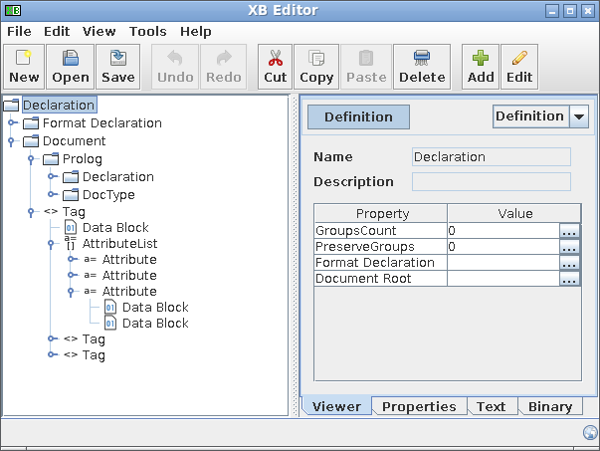
DEMO

