Slide 1

Exbitron.Digital Token (EXTO)
EXTO Whitepaper v1.0

Slide 2
Table of contents
01
Introduction
03
Usage
04
Roadmap
05
Team Overview
Exbitron Digital Token Introduction
02
Features
What EXTO offers?
Where you can use EXTO?
Our future steps!
Meet the Team!

Slide 3
Exbitron Digital Token (EXTO)
Exbitron Digital Token is the native cryptocurrency of Exbitron exchange. It belongs to a group of cryptocurrencies often referred to as „exchange tokens“. Exbitron Digital Token was issued in October 2021 and will be distributed in upcoming months to Exbitron users through pre-sale, airdrops and giveaways which will be done on our social channels. After the pre-sale or giveaway, users will be able to trade it and benefit from the opportunities that Exbitron Token made available on the Exbitron exchange.

Slide 4
Features
Blockchain
Fast blockchain
Secure
Decentralization
Built on TRON blockchain, Smart Contract Platform.
Fast and low cost transactions.
All the EXTO transactions are public, which makes them easily trackable in case of any dispute.
Next-generation DeFi ecosystem

Slide 5
100,000,000
8
October 2021
Total Supply (EXTO)
Decimals
Issue Date

Slide 6
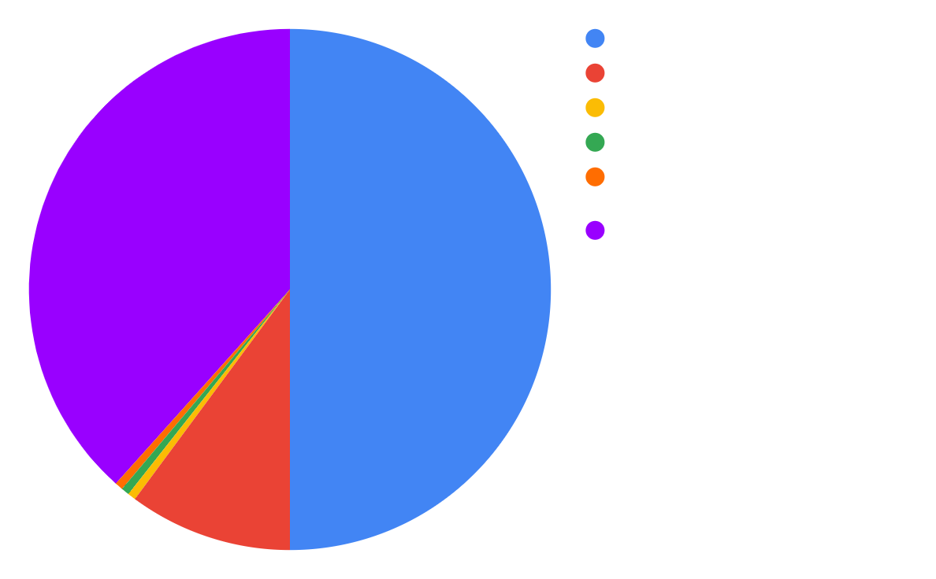
Supply division
3M max. unlocked every year, = 25 and half years fixed for coin distribution

Slide 7
Usage
Exchange token
Coin Voting / Shared Listing
Exbitron Fees
EXTO will have its own trading section on Exbitron exchange.
It will be able to use EXTO, to vote for your favorite coin from coin voting list! And pay listing fee with EXTO also!
New EXTO market with zero maker / taker fee.

Slide 8


Roadmap
Q3 2021
Q1 2022
Q2 2022
Q3 2022
Exbitron Digtal Token was born!
Make Coin Voting possible on Exbitron with EXTO.
Implement EXTO to other popular blockchains.
DeFi stage.

Slide 9
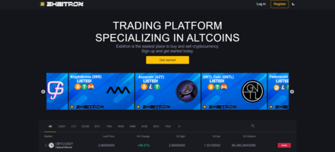
Exbitron Exchange
Dont forget to check our Exbitron exchange, where will you will be able to trade EXTO!

Slide 10



Meet the Team!
Lukas (arzzen)
Viktor (eskal)
Matus (HyperAlly)
Lead Developer
Support Developer
Community Manager

Slide 11




@exbitron
discord.io/exbitron
t.me/exbitron_en

