Slide 1
an Easy Functional Testing tool
A better approach to test Windows application

Slide 2
A simple, easy to use yet powerful tool for
Windows application functional testing

Slide 3
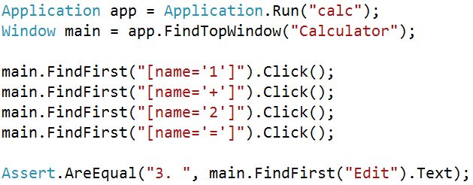

Slide 4
Everything in a Window application is an Element

Slide 5
Find Element using CSS syntax selector

Slide 6
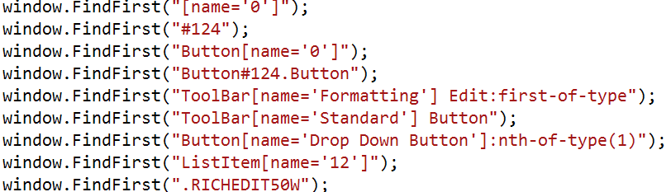

Slide 7
How to find a window?

Slide 8


Slide 9
pattern matching

Slide 10
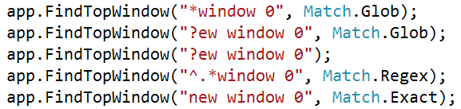

Slide 11
You can do anything you want on an Element

Slide 12
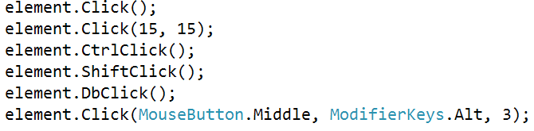

Slide 13
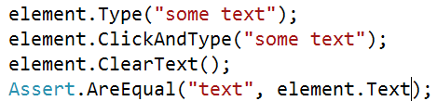

Slide 14
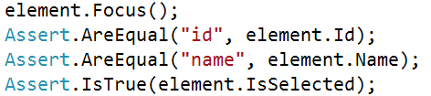

Slide 15
How about Controls

Slide 16
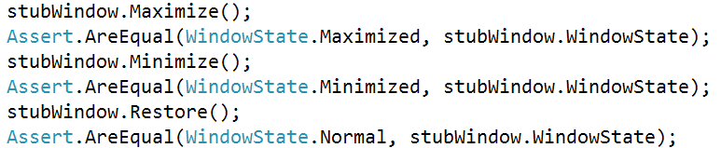

Slide 17
will have more controls if necessary:
Table
…

Slide 18
Wait…

Slide 19


Slide 20
Control mouse and keyboard in a more flexible way

Slide 21
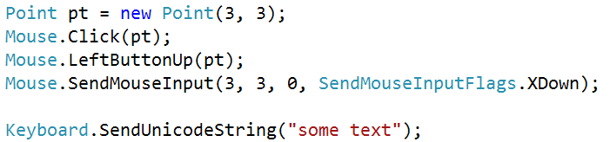

Slide 22
Future work…

Slide 23
How do you feel about this code:

Slide 24
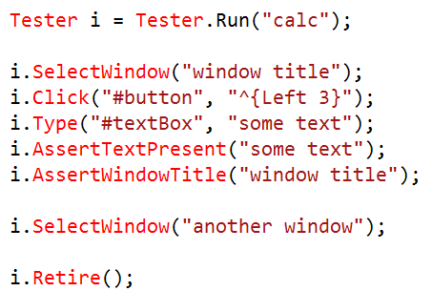

Slide 25
Support more operations on Element and Controls
Support command line testing
A scripting language and interpreter
Recorder

Slide 26
Need your help to test Eft for :
* different Windows version
* different hardware environment
* virtual machine
* stability
* ...

Slide 27
http://code.google.com/p/eft

