Slide 1
Spring Boot Basics
Kenneth Russell

Slide 2
Inversion of Control (IoC)
Before IoC
API
Components are responsible for bringing in dependencies.
Commonly used resources cannot be shared since they’re defined by the components.
Implementations cannot be swapped based on the environment.
Testing is difficult; true unit tests are difficult to build because this pattern makes it difficult to mock.
Main
RecordService
PersonService
RecordDao
PersonDao
PersonDao

Slide 3
Inversion of Control (IoC)
With IoC
Spring API
Loosely coupled code.
Much easier to test; injected dependencies can be mocked and true unit tests can be made.
Resources / implementations are reusable and can be shared by multiple components.
Implementations can be swapped based on the environment.
Main
Spring IoC Container
RecordService
PersonService
RecordDao
PersonDao

Slide 4
Spring Beans
Spring API
bean /bēn/
noun
an edible seed, typically kidney-shaped, growing in long pods on certain leguminous plants.
an object that is instantiated, assembled, and otherwise managed by a Spring IoC container.
Main
Spring IoC Container
RecordService
PersonService
RecordDao
PersonDao
These are beans!

Slide 5


Component or Bean?
Objective: you need to build a city (Spring app).
A component is the blueprint for a bean.
A bean is the building built from the blueprint.

Slide 6


Components
Spring Boot does a component scan, searching for blueprints (components).
After Spring Boot collects the blueprints, it creates the infrastructure for the city (beans).

Slide 7



Components
You define components by adding an annotation to a class.
There are 3 basic types of components.
REQUEST
@Controller
@Service
@Repository
DB
A controller routes requests to ensure the application responds to the request with the right information.
A service is typically where business logic lives. You’ll find things like validations and calculations here.
A repository is the middleman between the database and the application. It sends / retrieves data from the database.
If you need a bean to be created and it doesn’t match the use cases above,
just use the @Component annotation.

Slide 8
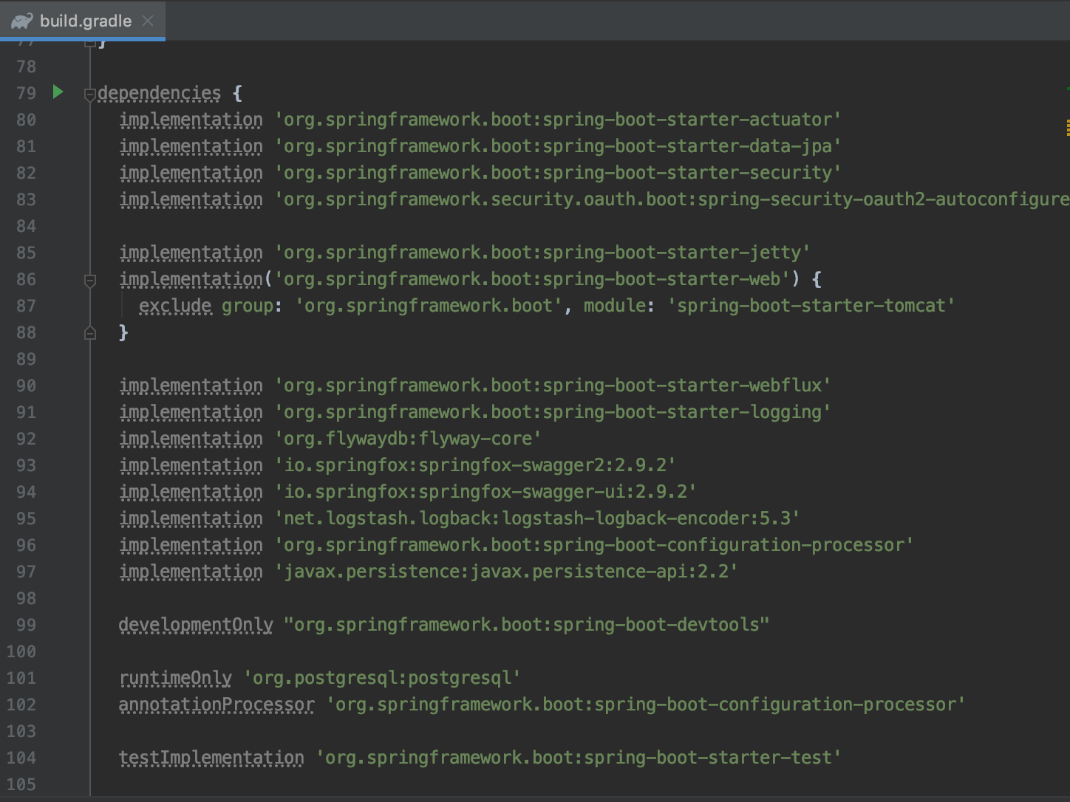
Configuration
Dependencies and tasks are found in the build.gradle file.
Dependencies may include useful libraries that have objects / methods that can be used in your code.
Dependencies that have “spring-boot-starter” have a default implementation and don’t require much setup.

Slide 9
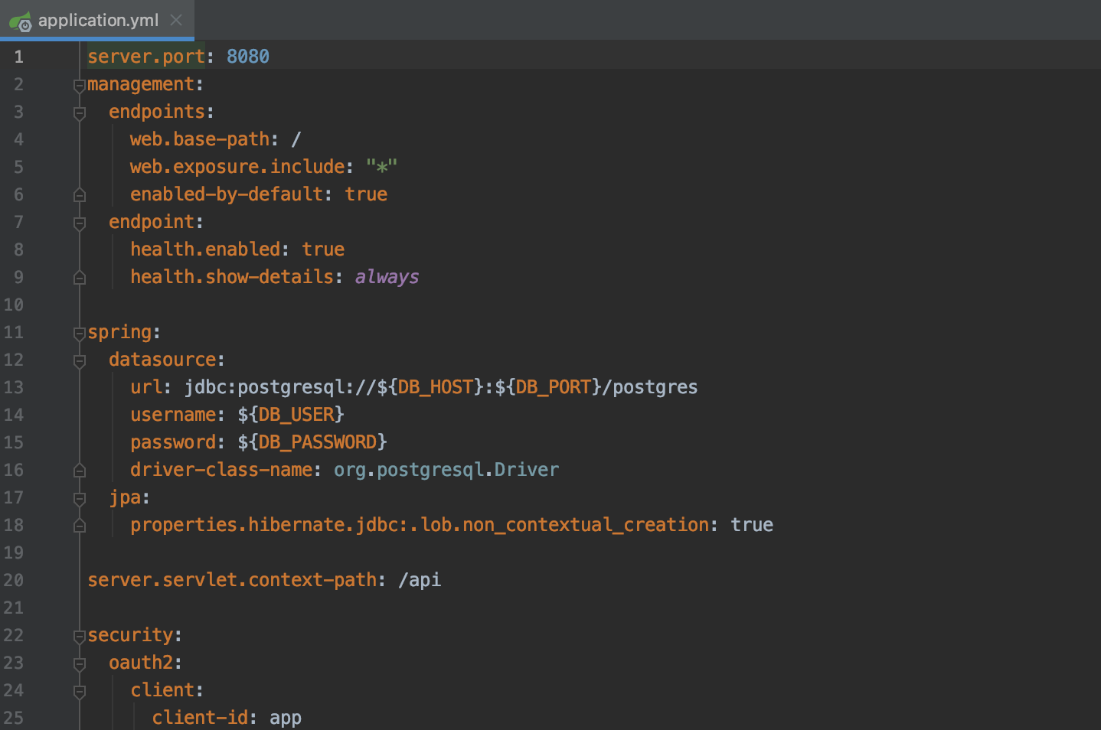
Configuration
The application.yml allows developers to customize your application without adding configuration files.
Other variables can be added here as well and can be injected into components using the @Value annotation.

Slide 10
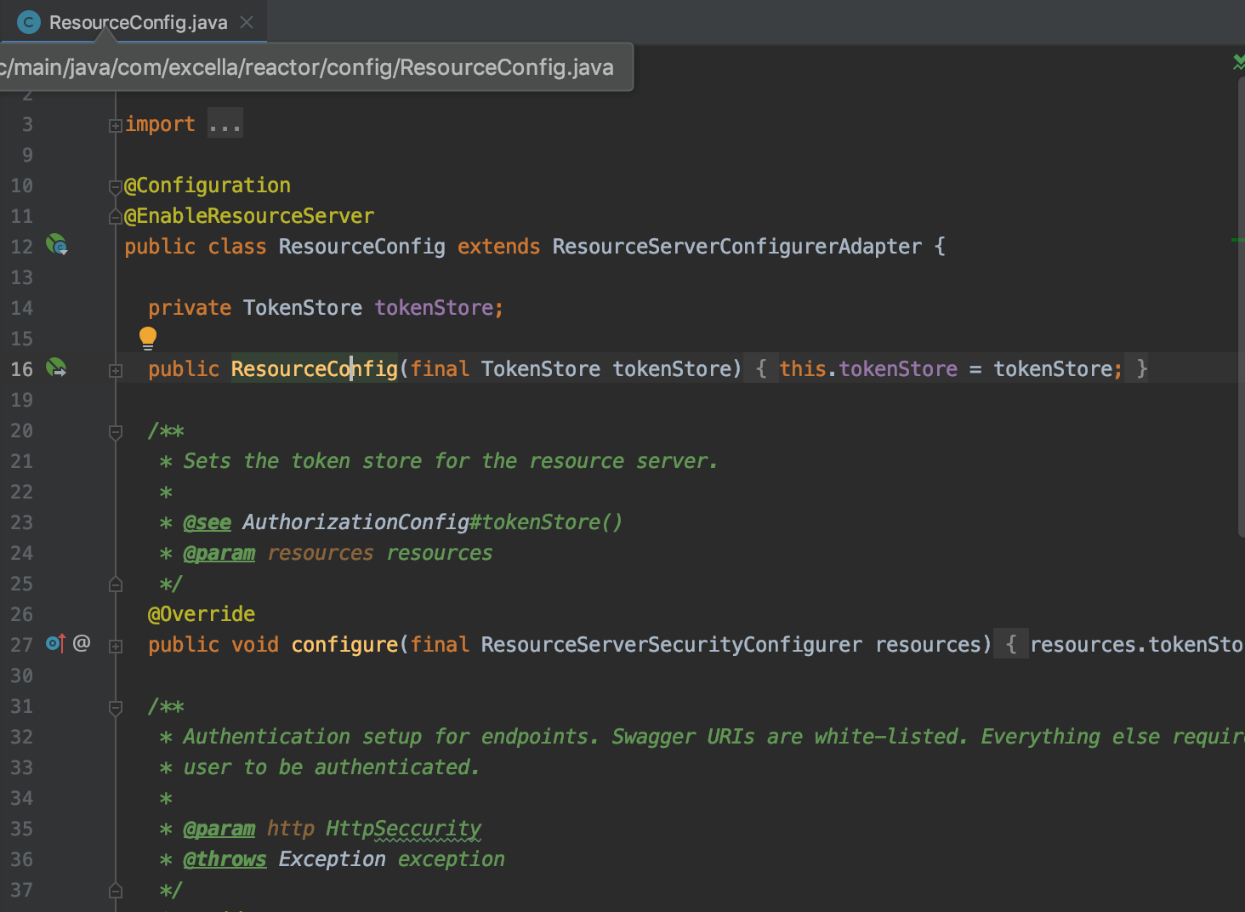
Configuration
Sometimes, we need to setup additional configurations in order for our application to integrate with other microservices.
You would create a config file to override default beans created by Spring / dependencies. You can define a configuration file with the @Configuration annotation.
You can create and override beans by adding the @Bean annotation on a method in a configuration file.

