Slide 1
Excella Badging System
Presented by: Matt Ratliff and Nick Kipouros

Slide 2

What is Badging?
The badging system is a new initiative of the Software Development Capability Area team to build a fun way of communicating interests, capabilities, and skill levels in various ways, through the use of digital badges

Slide 3






Potential Benefits
A way for employees to objectify their proficiency and competency in the various technologies that we use
Motivation for employees to learn new skills and enhance current skills
A fun and interesting way for enhancing skills
Could be used by staffing as a means of better understanding the skillsets of employees
An opportunity for the capability team to engage with employees and guide the learning track for their progression
Objectifies learning to assist during annual reviews for progression through consulting tracks.

Slide 4




Objectives
Provide an easy way for employees to learn and achieve success in one or more identified areas.
Provide a way that the capability team can help to guide employees through learning objectives, by providing a clear learning path for the different technologies.
Provide a fun and engaging way for explore and share achievements and successes.
Provide a way for Excella to objectify the skills and skill levels.

Slide 5
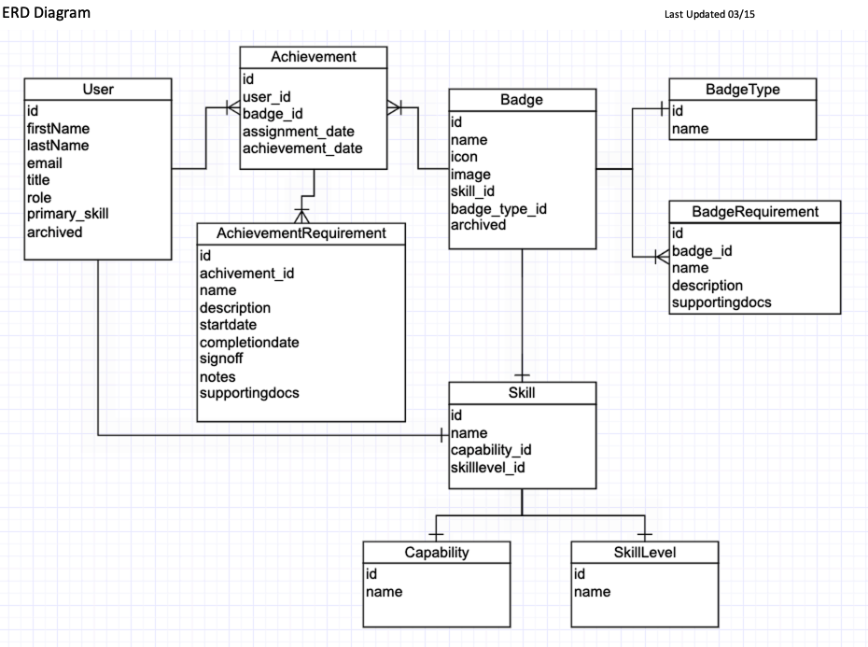
ERD Diagram

Slide 6
Initial Categories for Badges
.Net
Python
Ruby/Ruby on Rails
Java
React
Angular
Node
Git
SQL
Database Design

Slide 7
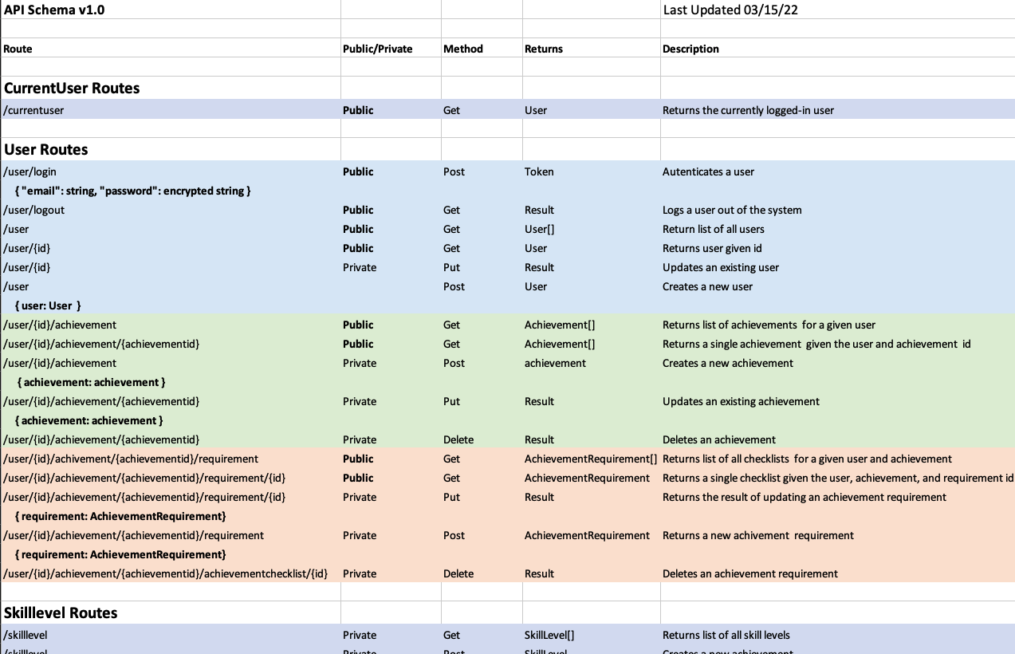
API Schema

