Slide 1

Filesystem in Linux
it’s abstractions all the way down

Slide 2
We will talk about
What are Kernel Modules
We will talk about each layer, bottom up:
The block-device layer
The volume manager layer [in a word]
The file-system layer
The VFS layer
EXT* file-system basics
inodes
Hardlinks, symlinks

Slide 3
Kernel Modules
The linux kernel can be extended in run time
To do that, one can write a piece of code, compile it and insert it to the kernel
These are called Kernel Modules
A kernel module is written in C code and is compiled to object files
The kernel contains a runtime linker that links the kernel module to the running kernel
Hence, once inserted, the kernel module can call every function inside the kernel
A kernel module has a “main” function that is called once inserted
In it, it can call various kernel functions

Slide 4
Can someone remind us
What is the key concept of abstraction?
Let’s try to think ourselves - You are implementing a kernel and you want to support several different hard drives hardwares. How would you do that?
Notes:
key word: abstraction. We have abstract interfaces and specific implementations.

Slide 5
Device Drivers
A kernel module can register to certain interfaces in the kernel, i.e.
The kernel defines various interfaces
A kernel module can implement an interface
During module init, it can notify the kernel about it (register)
For example, it can be registered as a mouse device driver
Then, the kernel will use it to set the mouse pointer location

Slide 6

The Storage Drive
On the lowest level, we have a storage drive
Just a bunch of bits (JBOB)
Every byte has an address
There are two common types of storage devices used:
Solid state drives, usually with flash storage
Hard-disks with magnetic disks
For disks, usual transfer rate of sequential read/write is 50MB/s
Solid state drives are usually 10x faster than hard-disks
Can you think why?
To cope with the latency, many caches are indtrocued
Notes:
Why? no moving parts. the fact that we get to 50MB/s is some kind of a wander as far as am I concerned: the fact that the needle actually makes the travel of several centimeters and finds the right place with resolution of micro-meters in a split second does amaze me, but still, flash is much faster.

Slide 7
The Storage Drive
On Linux, any storage device is represented as block device
Not all block devices have an actual hardware!
Block devices drivers export certain functionality inside the kernel
A block device has a queue of Block IO (BIO) requests
Block device can be seen as an abstraction of a storage drive
And like many other things in Linux, a block device has a file
Notes:
You can have a block device that uses the RAM as its storage, or an existing file in another FS (the loop device).

Slide 8
The Storage Drive
The block device file allows referring to the specific block device
For example, in the mount syscall (see soon)
Things you can do with the block device file:
$ hexdump /dev/sda1
$ cat /dev/cdrom > ~/install_disk.iso
$ cat ~/some.iso > /dev/sdb1
$ cat /dev/sda > /dev/sdb
Keep in mind: the block device driver has a more complicated interface then read/write
The block device entry file is nothing more than a syntactic sugar
Notes:
You can have a block device that uses the RAM as its storage, or an existing file in another FS (the loop device).

Slide 9
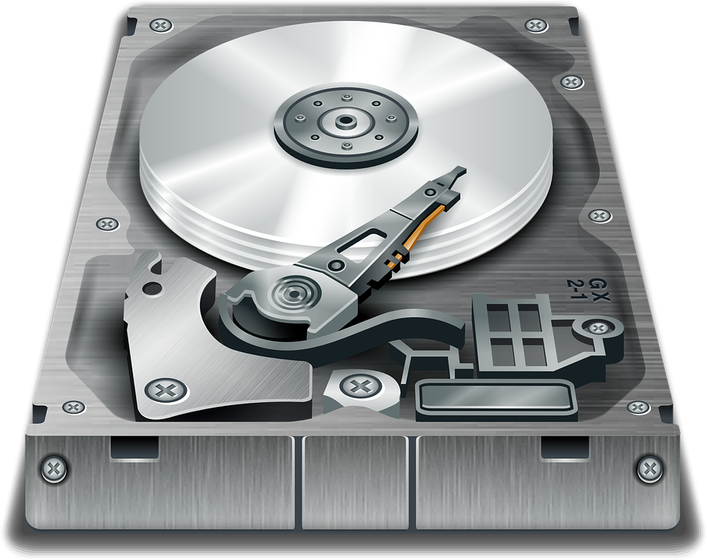
Block Device Driver
Kernel
file: blk-mq.h
/**
* struct blk_mq_ops - Callback functions that
* implements block driver behaviour.
*/
struct blk_mq_ops {
blk_status_t (*queue_rq)([...]);
int (*init_request)(struct request *, [...]);
void (*complete)(struct request *);
[...]
};
struct blk_mq_ops *curr;

Slide 10
Block Device Driver
Kernel
my_blkdev module
void my_init_request() {
[...]
}
struct blk_mq_ops my_blkdev {
.init_request = my_init_request;
};
void module_init() {
[...]
register_blkdev(&my_blkdev);
}
struct blk_mq_ops *curr;

Slide 11
Block Device Driver
open/read/write
Kernel
my_blkdev module
void my_init_request() {
[...]
}
struct blk_mq_ops my_blkdev {
.init_request = my_init_request;
};
void module_init() {
[...]
register_blkdev(&my_blkdev);
}
struct blk_mq_ops *curr;

Slide 12
The Storage Drive
A storage device can be splitted to several partitions
At the beginning of a storage device there is a partition table
This table format is known to the block device driver
For every partition a new block device instance is added
/dev/sda, /dev/sda1, /dev/sda2...
You can manipulate a storage device with the fdisk command
mostly used for adding/removing partitions

Slide 13
Logical Volume Manager (LVM)
The Logical Volume Manager provides basic abstraction of HDs
It is not a necessary layer, but is used by default in most distros
Its features:
Combining several storage drives into one logical volume
Splitting one HD into several logical volume
Providing RAID
It creates a block device for each logical volume

Slide 14
Logical Volume Manager (LVM)
We use the pv* commands to manipulate physical volumes
We use the vg* commands to create volume groups
We use vgcreate to create new volume group with several physical volumes
We use vgextend to enlarge a volume group with new physical volume
we use lv* commands to control logical volumes
We use lvcreate to create new logical volume
we use lvresize to resize existing logical volume
We use pvs, vgs, lvs commands to get the status
We use pvmove command to move data out of a physical volume
Together with vgreduce, one can safely remove a physical device from a volume group

Slide 15
Why FS?
The next layer is filesystem
So, why would we need it?
It lets us organize the bits in files and directories
Without it, we would be accessing blocks by their address
Common filesystems are:
On Windows: NTFS, FAT32
On Linux: EXT*
On Solaris: ZFS
Network filesystems: NFS, SMBFS, AFS,...
To create filesystem on a block device, use the mkfs command
It works on regular files too!

Slide 16
Why FS?
Over which criteria a filesystem is measured?

