Slide 1
General Architecture
Customers
WhatsApp Web
Program (Python, Selenium)
Database (MongoDB)
Hub Phone
Sales Team

Slide 2
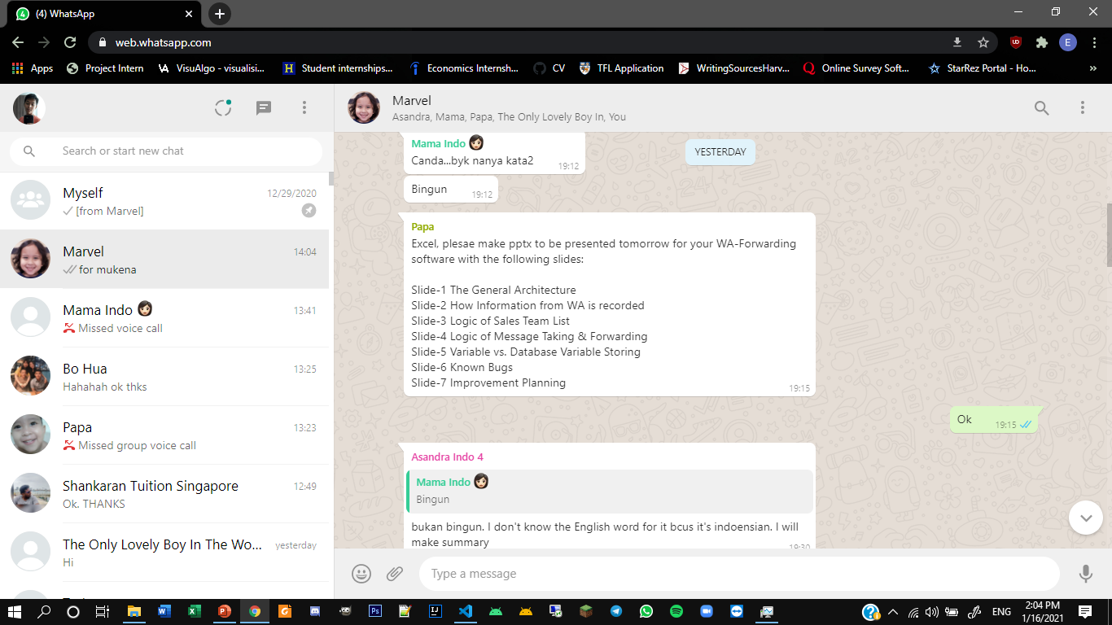
How information from WA is recorded

Slide 3
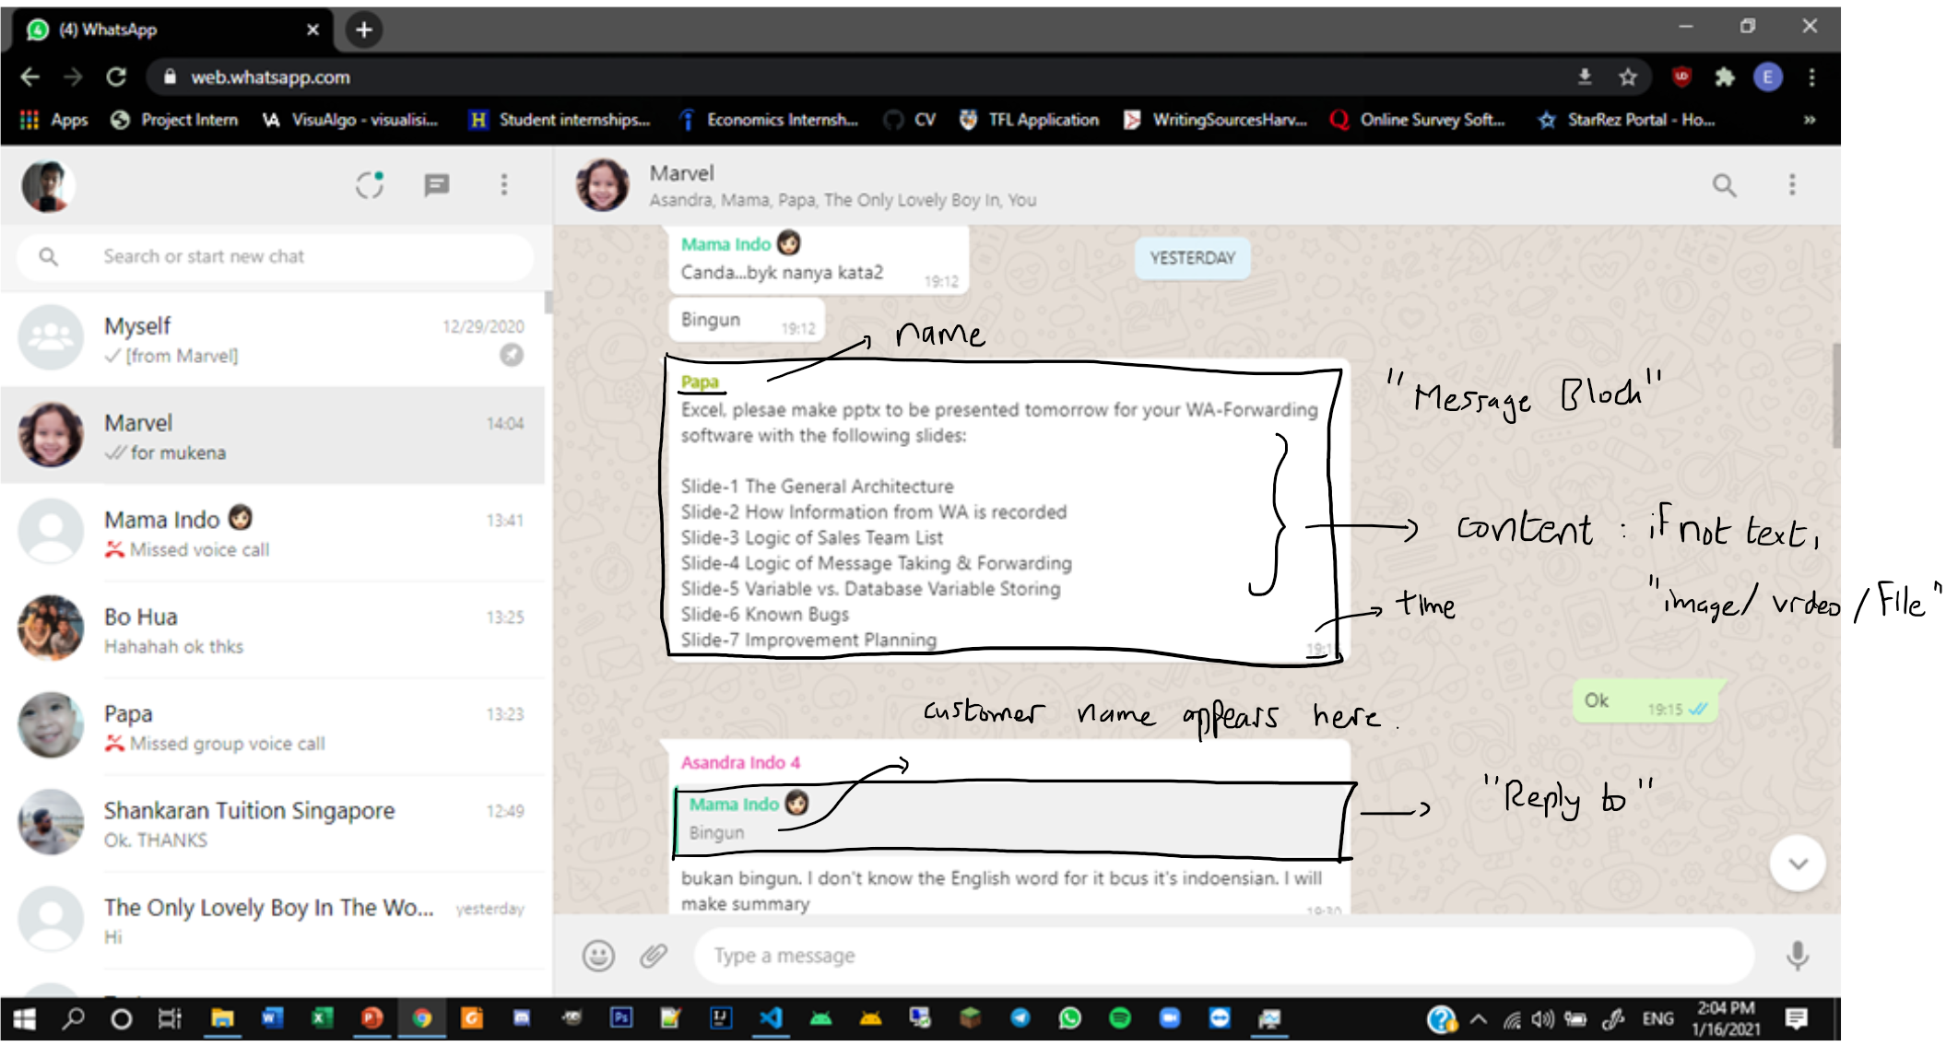
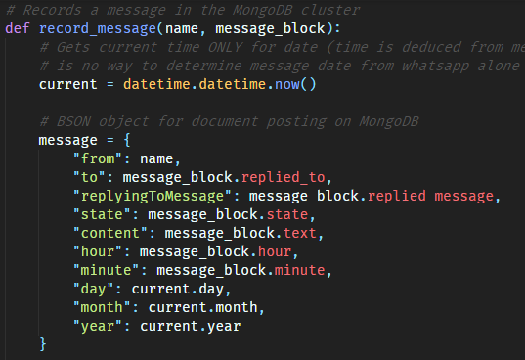
How information from WA is recorded
Message Block
MongoDB BSON Object

Slide 4
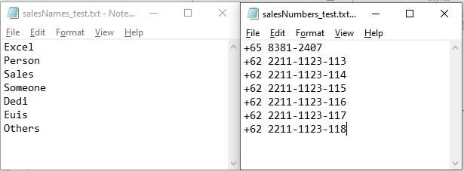
Sales Team List
Two text files, one for sales names and one for numbers

Slide 5
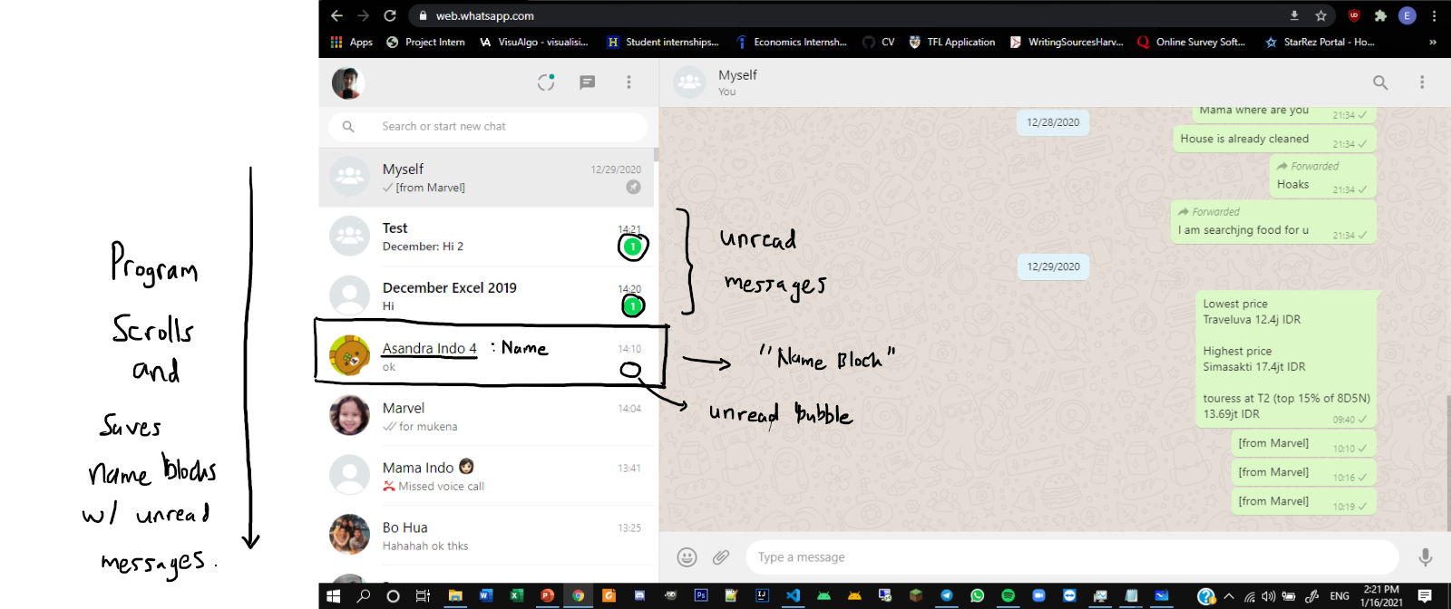
Message taking and forwarding

Slide 6
Message taking and forwarding
If unread message found, forward the number of incoming messages found (dictated by the amount in the unread bubble).
Different forwarding functions if incoming is sales team (means it’s a reply to a customer) or incoming is customer (means it’s a question).
Record every message in the MongoDB collection (MongoDB collection ≈ mySql database)

Slide 7
Message taking and forwarding
If unread message not found, no incoming message is found, program resumes.
Program scans name blocks every minute.
Top 2 chats are scanned for new messages (compare with MongoDB database) – if a new message is detected, means the message was sent manually (by user of hub phone). Deal with message accordingly.

Slide 8
Variable vs Database variable storing
Program variables:
Unread messages (stored in a list – remove message once message forwarded)
If program crashes, these messages will not be forwarded on next start
Fix: store unread messages in a separate MongoDB collection, then refer to that collection instead of local variable
Database variables:
Message objects (for storing chats, and for crosschecking with the program)
Can be exported in .csv or .json formats
Will add the above fix (unread messages) to the database (so all variables are database which makes sure that the program will forwards messages more reliably)

Slide 9
Known bugs & Improvements
Deleted messages will stop the forwarding process and cause an infinite loop
Improvement: Skip deleted messages
When not the first message in a chat, large videos/images/files will cause an infinite loop
Improvement: Load up the messages before forwarding
“Stale reference to element” – Chrome/Selenium bug, happens sometimes when network disconnects leaving the WhatsApp web page to be blanked out (so there are no elements loaded on the page) – need to find a way to keep the WhatsApp window open even when disconnected.

