Slide 1
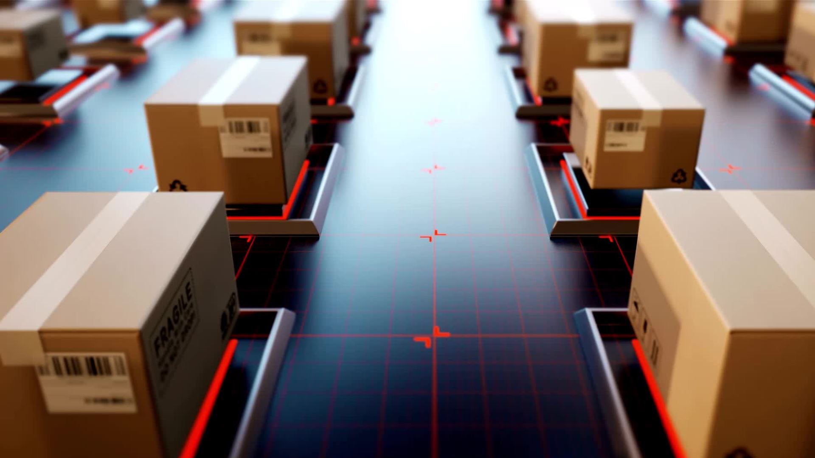
High-Resolution Image Synthesis with Latent Diffusion Models
2022 Conference on Computer Vision and Pattern Recognition (CVPR)
Speaker: Hansen

Slide 2
Outline
Motivation and Fundamentals
Introduction
Method:
Perceptual Image Compression
Latent Diffusion Models
Conditioning Mechanisms
Experiments and Ablation Study
Conclusion
Overview

Slide 3


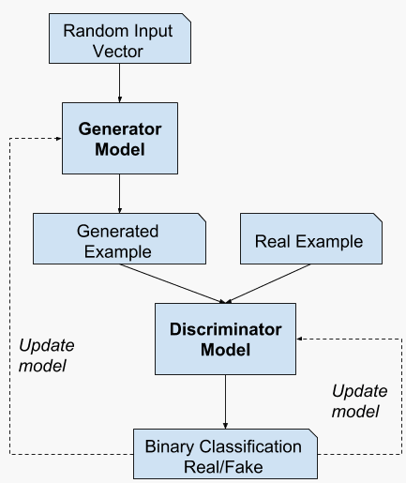
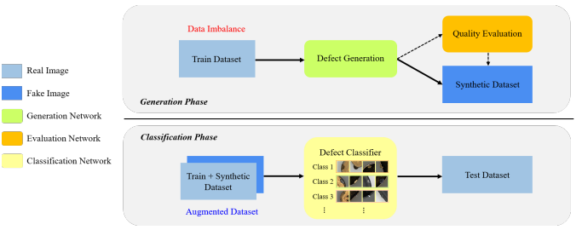
Motivation
Since, researches around GAN produces more than 500 named GAN models. (e.g. cGAN, WGAN , SAGAN , CycleGAN (pix to pix), etc.)
Applications include industrial defect image synthetization to overcome imbalance dataset.
Conditional embeddings (cGAN)
add Self-attentions QKV (SAGAN)
Replace 0/1 with critic score (WGAN)
Cho, Eunhee et al. “Synthesizing Industrial Defect Images Under Data Imbalance.” IEEE Access 11 (2023): 111335-111346.
Notes:
GAN one of the most influential paper published on 2014, with more than 25k citations
Some modify input for conditions
Some modify loss function WGAN: an alternate way of training the generator model to better approximate the distribution of data observed in a given training dataset.
Wgan for stability
Wgan loss :
Critic loss = [average critic score on real images] – [average critic score on fake images]
Generator loss = -[average critic score on fake images]
Some modify the model architectures like introducing the self attention module
Some even introduce different training scheme, like CycleGAN for pix to pix image translation
One of the application of GAN is to synthesize defect image for industrial anomaly detection
Since defect images are so few, we can make use of GAN to help synthesizing defect images to train our classifier
In industrial domain, the defect image generation in even the newest paper still considered GAN as the base model

Slide 4
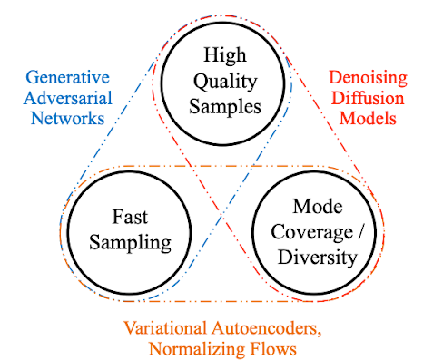
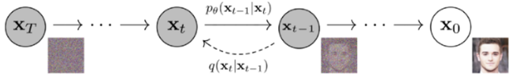
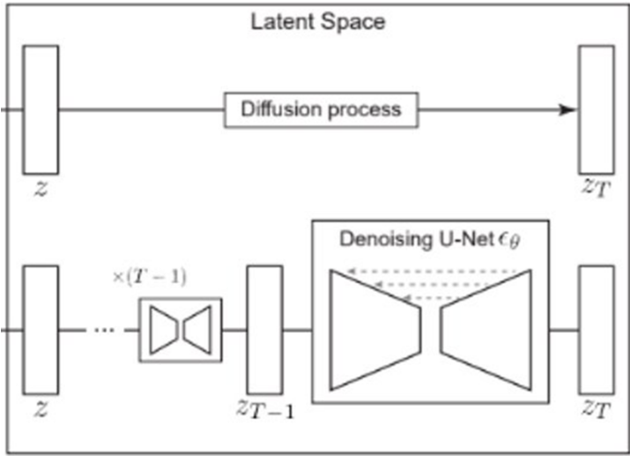
Motivation
GAN issues includes:
Vanishing gradients: discriminator being too good could cause generator to fail
Model collapse: generator being too good makes it reproduce output
Convergence almost never the purpose
Solution: DDPM (Denoising Diffusion Probabilistic Model)
Involves forward process (noise perturbation with noises)
And backward process (predict noise given step t-1, and do denoise)
Notes:
Explaining the 3 issues
The problem is GAN adversarial training strategy gives some issues making it hard to train and doesn’t fit to our scenario where defect occupies so many form
One of the solution which produces high resolution image which is also easy to train and produces image with high diversity is DDPM
This is also very popular in the past 3 years.
Forward process: perturb each pixel in the image independently by adding some coefficient beta * noise that tells how much we are distorting the image in that step. (1e-4 - 0.02, T=1000)
Backward process: Given a perturbed image x and time step t, we want to predict the noise added during forward process and denoise the image.
One of the disadvantages is high computational cost, here's where the latent diffusion concept come into play

Slide 5
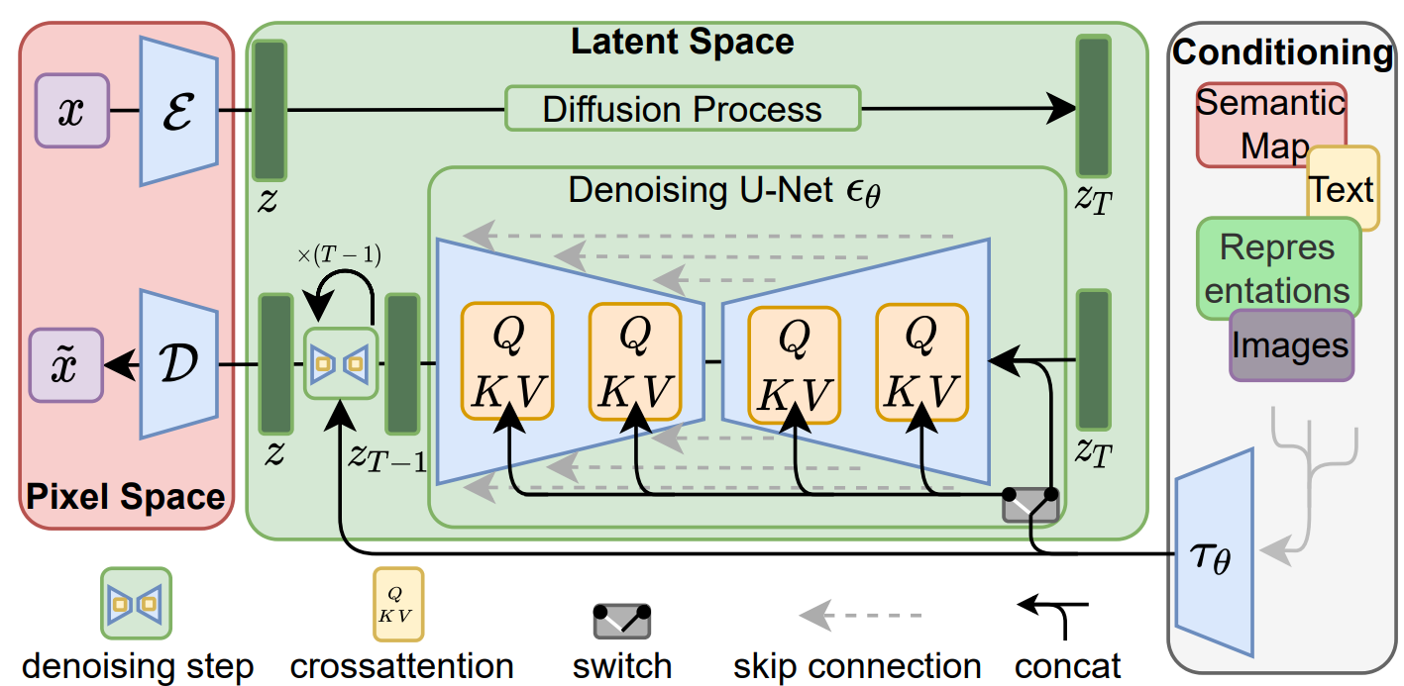
Latent Diffusion Overview
Key innovation: apply this diffusion process not to the raw pixel values of an image but instead to an encoded latent representation of the image. (lower computational cost and more controlled, details preservation)
Flexible conditioning with text/ images/ segmentation map's latent introduction using the cross attention.
Vast key applications:
Super-Resolution
Inpainting
Text-to-image generation
Image manipulation
Random Generation
Rombach, Robin et al. “High-Resolution Image Synthesis with Latent Diffusion Models.” 2022 IEEE/CVF Conference on Computer Vision and Pattern Recognition (CVPR) (2021): 10674-10685.
Notes:
The main innovation of the paper is by using the diffusion process on the latent representation resulting in more efficient computational cost
2nd important part is the flexibility of the conditioning
Explain the model achitecture
Thanks to the design, this model has diverse applicability
Of course there are more to this paper, for the architectural innovations and training/ inference tricks, but wont talk about that today.

Slide 6
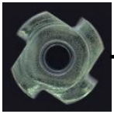
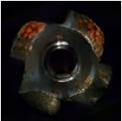
Conclusion
DDPM provides all around solution to defect generation diversity, trainability, and produces high resolution image; latent diffusion further make up for the computational cost efficiency and improves input flexibility.
Make use of the text conditional to control defect type to be generated by the DDPM model.
Normal image
Latent Diffusion
Defect type
(e.g. "corrosion")
Defect Image
Notes:
Highlighted advantages
Of course the conditions could be of any form (its flexibles as discussed in the previous page)

Slide 7
Quick Shout-Out
Our-Paper:
Tri-VAE: Triplet Variational Autoencoder for Unsupervised Anomaly Detection in Brain Tumor MRI
Published under:
CVPR 2024 Workshops (VAND 2.0: Visual Anomaly and Novelty Detection - 2nd Edition)
Notes:
Paper will be published later this year and will be open under IEEE xplore
If its of any help, please cite :)

Slide 8
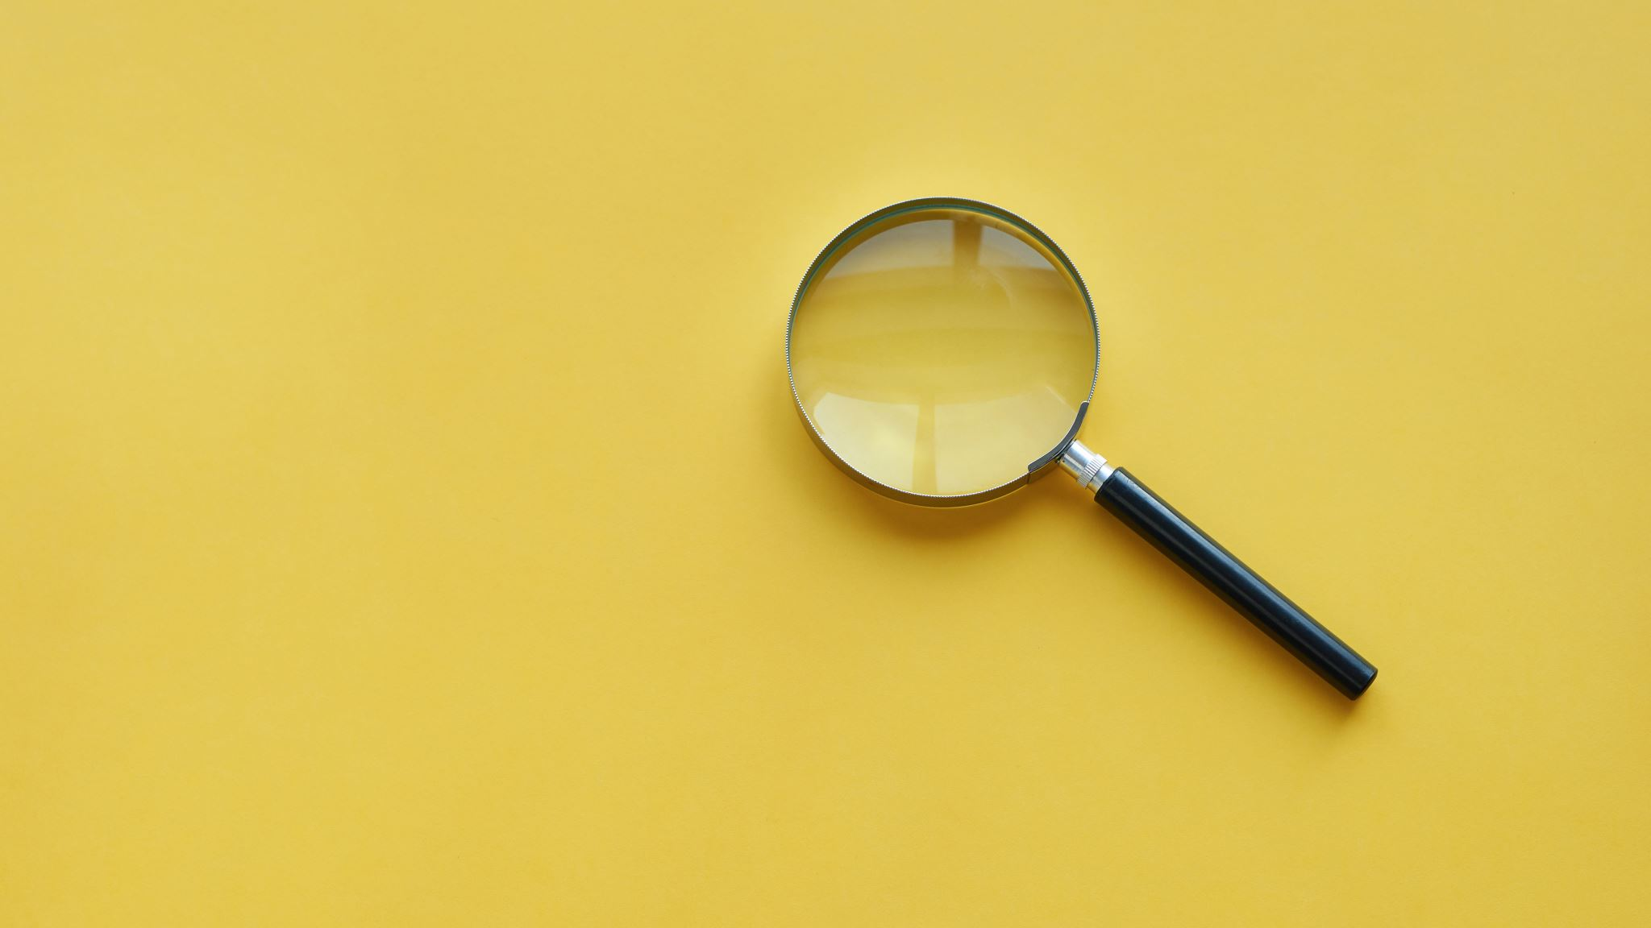
Thank You :D

