Slide 1
Scale-Space Autoencoders for Unsupervised Anomaly Segmentation in Brain MRI
Christoph Baur [1] , Benedikt Wiestler [4] , Shadi Albarqouni [1] , [2] , and Nassir Navab [1] ,[3]
1 Computer Aided Medical Procedures (CAMP), TU Munich, Germany 2 Computer Vision Laboratory, ETH Zurich, Switzerland 3 Whiting School of Engineering, Johns Hopkins University, Baltimore, United States 4 Department of Diagnostic and Interventional Neuroradiology, Klinikum rechts der Isar, TU Munich, Germany
MICCAI – 23 June 2020 (23 citations)

Slide 2
Outline
Introduction
Methodology and Anomaly Detection
Experiments and Results
Conclusion

Slide 3
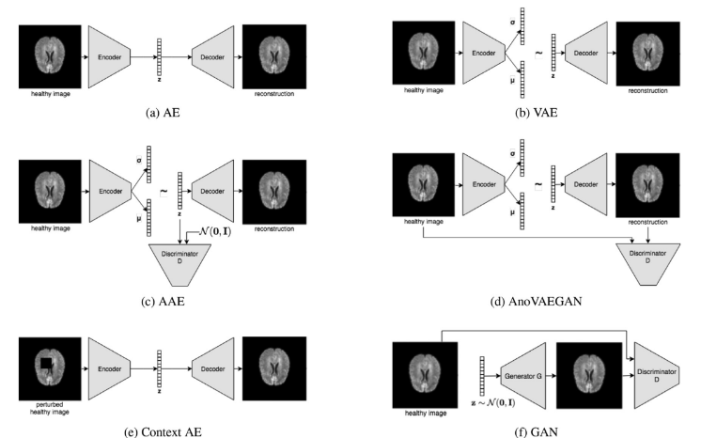
Introduction
In the context of brain imaging, VAEs, AAEs, and combination of GANs and VAEs have been proposed to model the distribution of healthy brain MRI
Important aspects addressed in this paper:
sizes of the pathologies might call for different image resolutions.
at high resolution, reconstruction fidelity is paramount to be able to delineate small lesions with precision
Image from :
Autoencoders for unsupervised anomaly segmentation in brain MR
images: A comparative study
Notes:
Encoder decoder architecture is commonly used in brain imaging to simulate the distribution of healthy brain MRI.
And in this context, the anomalies should have gone in the reconstructions of input data since they are not part of the predicted distribution.
The authors intend to address the following issues in this study. The first is that various diseases emerge at different sizes and may necessitate different picture resolutions.
This leads to the following issue: at high resolution, reconstruction accuracy is critical for accurately delineating tiny lesions, yet frameworks like VAEs can only provide blurry, coarse reconstructions.

Slide 4
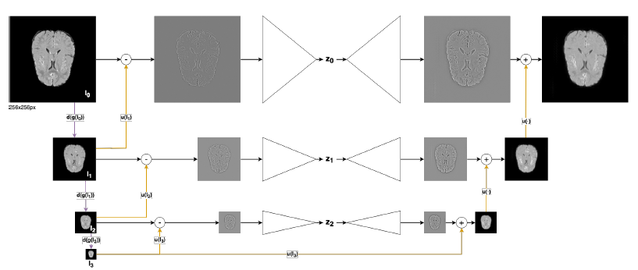
Introduction
Unsupervised anomaly segmentation based on the Laplacian Pyramid, tailored around the family of Autoencoders.
The multi-scale structure of the Laplacian pyramid allows us to segment anomalies at different resolutions and aggregate the findings, which increases performance and reveals which resolution is best for diseases.
Notes:
To address the issues raised in the preceding slide, the author suggested a framework for unsupervised anomaly segmentation based on the Laplacian Pyramid and built around the Autoencoder family.
So, rather than actual image pixels, they model the distribution of the scale-space representation of healthy brain MRI.
The multi-scale structure of the laplacian pyramid enables us to segment anomalies at several resolutions and aggregate the results, increasing performance and revealing which resolution is best for diseases.

Slide 5


Methodology
Learning to compress and reconstruct the Laplacian pyramid of healthy brain MRI.
In this paper they use K=3
Separate AE on each level
The overall loss is a weighted sum of losses at all scales.
Notes:
Similarly, the encoder decoder network still aim to localize anomalies from reconstruction residuals but, instead of the direct intensities distribution, the input frequency band is first split and let the model learn to compress and reconstruct the laplacian pyramid.
The laplacian pyramid saves the difference image of the blurred versions between each levels. This technique usually used in image compression.
The left section is a Gaussian pyramid with k repeated downsampling applications, while the right part is a Laplacian pyramid. Where the Laplacian pyramid L(I) is formed at level k by taking the difference between neighboring levels in the Gaussian pyramid and upsampling the smaller one with u(.) so that the sizes are consistent.
The smallest level is not a difference image to enable reconstruction of the high resolution image using the difference images on higher levels, but here instead of using the laplacian pyramid we got from the subtracted Gaussian pyramid, we use the one reconstructed by the model.
Each level use a different AE to compress and reconstruct the high frequency components.
To accommodate for upsampling errors, they do not immediately minimize the reconstruction error on the high frequency residuals. As a substitute, they minimize the difference between Image k and their reconstructed counterpart.
The overall loss is a weighted sum of losses at all scales. The paper does mentioned that the multiplier were used in a one-hot fashion to train every stage of pyramid separately (starts from the lowest level)

Slide 6
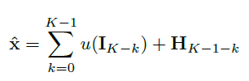


Methodology
Notes:
Given the recursive relation on how we obtain the reconstruction image recursively, it can also be applied to obtain an aggregated residual image at full resolution.

Slide 7
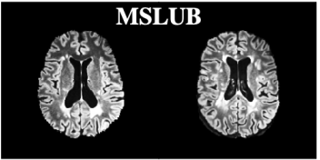
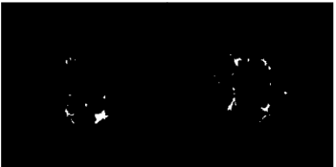
Experiments and Results
Datasets :
Train : FLAIR images from a dataset D-healthy of 100 healthy subjects from clinical partner. (Philips Achieva 3T MR scanner)
Testing : - D-MS containing FLAIR scans of 49 subjects with MS (Philips Achieva 3T MR scanner/ non-public)
- D-GB containing 26 subjects with Glioblastoma (Siemens scanner/ non-public)
- DMSLUB containing 30 subjects with MS(Siemens scanner/ open)
Image from: “Challenging Current Semi-Supervised Anomaly Segmentation Methods for Brain MRI”
Notes:
The MS stands for Multiple Sclerosis
Image size starts from 256x256

Slide 8
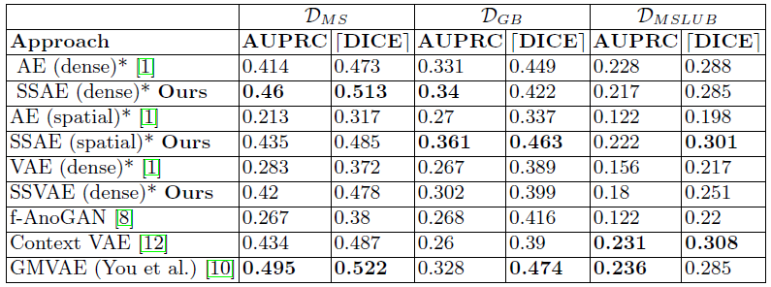
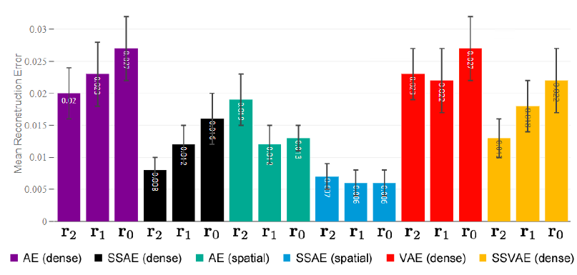
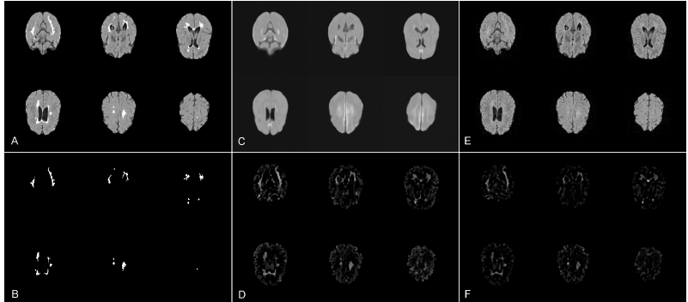
Experiments and Results
Scale-space models always show improvements over their traditional counterpart.
Costly, iterative restoration-based approach shows the best overall performance.
Notes:
Variants of the scale-space approach compared to SOTA methods in terms of AUPRC and dDICEe (higher is better). Top-2 methods in each column are bold-faced.
A: input; B: ground-truth segmentation; C: reconstruction from a normal AE; D: median-filtered residuals from C; E: reconstruction from the SSAE; F: median-filtered residuals from E. The high fidelity facilitated by the scale-space approach leads to fewer unwanted residuals.
To measure the reconstruction fidelity, the author also collect the pixel-wise l1 errors among all the healthy validation input slices and their reconstructions. The graph shows Normalized Reconstruction-Errors at different resolutions using different AE and SSAE models. R0=256 x 256 r1=128x128 r2=64x64
In comparison their AE counterpart, Scale space models show substantially lower reconstruction error at all scales. The lowest error is achieved by spatial SSAE which reconstructs data almost perfectly due to the low level of compression in its bottleneck.

Slide 9
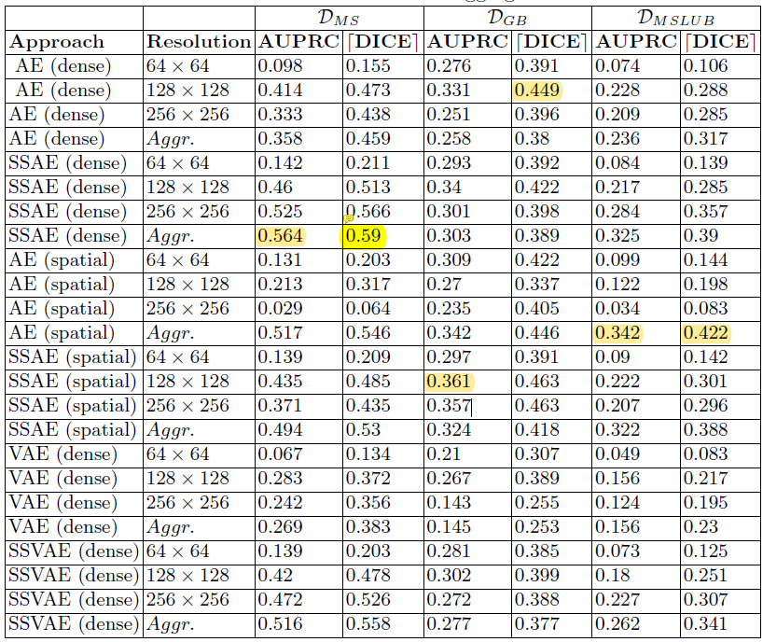
Experiments and Results
Resolution and multi scale aggregation of residuals
Best AUPRC achieved by SSAE at native resolution.
Segmentation of tumors works best at 128 x 128 with the majority methods and the proposed multiscale aggregation shows no gains (in contras to the MS lesions)
Notes:
The paper also compare the different scale-space and traditional AE variants by
their segmentation performance on the three datasets at different resolutions and investigate the benefits of the proposed multi-scale aggregation of residuals.

Slide 10
Discussion and Conclusion
The proposed scale space formulation leads to considerably better reconstructions across all dataset
Multi-scale aggregation also beneficial as the lesions can vary in shape and size (like MS).
For large lesions such as Glioblastoma a resolution 128x128 turns out to be preferable.
The proposed method turned out to be beneficial in most scenarios, it gives a high fidelity reconstructions and improved segmentation performance
Notes:
In this context, scale-space approach not to provide much benefits as it generates undesirably good reconstructions of large homogeneous lesions.

Slide 11
Thank You

