Slide 1
Traffic and Weather Conditions in D.C.
Traffic and inclement weather tend not to mix. My goal is to observe interactions between the two, by attempting to determine which factors in the weather have the most significant impacts on the number of crashes.

Slide 2
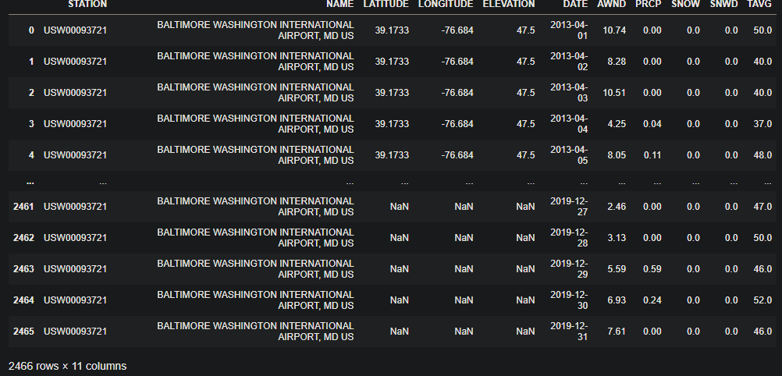
Weather Data
Obtained from https://www.noaa.gov/
2466 entries (2013-04 to 2019)
Some of the data isn’t particularly useful (but may be nice to have)
AWND - Average wind speed
PRCP - Precipitation
SNWD - Snow Depth
SNOW - Snowfall
TAVG - Average temperature
I originally gathered data from 2012-2019, but the 2012 data and some of the 2013 data was missing the predictors I was looking for, so I cut it out, along with repeat dates (since there are multiple observation areas, I just took the first unique one per day).

Slide 3
Weather Data (cont.)
Dropped Latitude, Longitude and Elevation due to there being missing values in over half of the data
Isolated one station to have a consistent reading per day, since crashes were “in D.C.” rather than in any specific area
Dropped Name for a similar reason
Dropped date, as it’s represented in the crash data

Slide 4
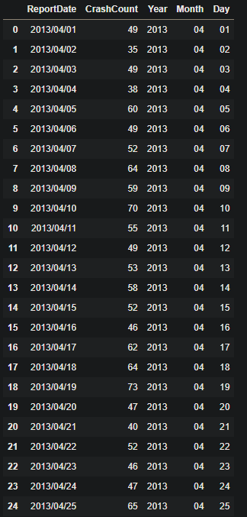
Crash Data
Obtained from opendata.dc.gov/datasets/
Fully cleaned data
Removed data prior to 2013/04/01 and after 2019/12/31
Derives year/month/day from ReportDate
Derives CrashCount through a groupby on ReportDate
Removes 59 columns
Dropped ReportDate, as it’s represented in individual columns

Slide 5
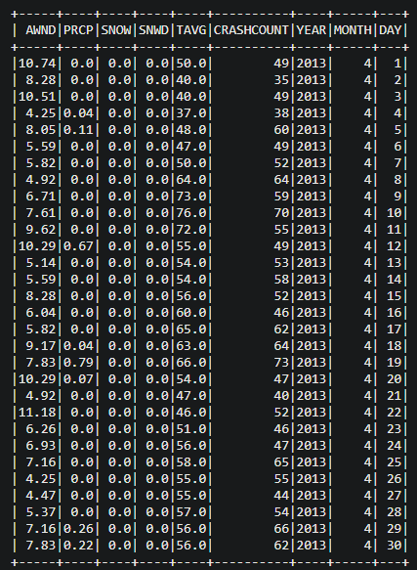
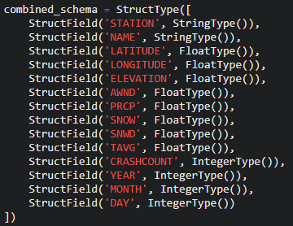
Merging Data
Merged data
Pulled data into spark using the following schema, resulting in the following dataframe

Slide 6
Linear Regression
To see how each of the features (average wind speed, precipitation, snow depth, snowfall, average temperature, year, month, day) affected the crash count, I created a linear regression model
Created a vector of the data, and separated my target column from the the features
Split the data 80/20 training/testing
Created the model using the vector

Slide 7
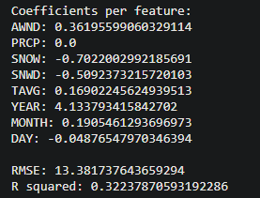
Results
Coefficients per feature
Each feature has either a negative or positive relationship with the target variable, causing the model to predict higher or lower, depending on the coefficient
RMSE of 13.38
R^2 (or, the amount of variation in crashes that can be explained by the model), was .32, which would say the correlation is low, given my features

Slide 8
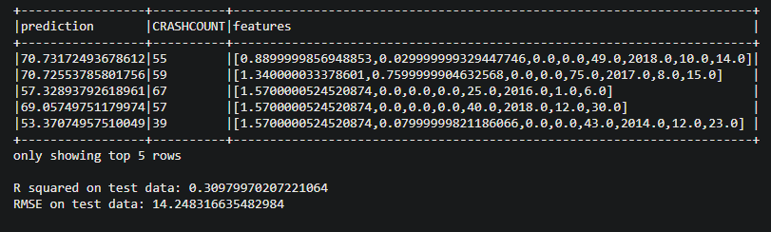
Results (cont.)
Pictured below is the first 5 results of predictions on the testData, with corresponding statistics on the predictions
R^2 is slightly lower, but similar to the trainingData, which means the model is consistent (consistently poor, but…)
Similar RMSE as well
Overall, slightly worse when using testing data

Slide 9
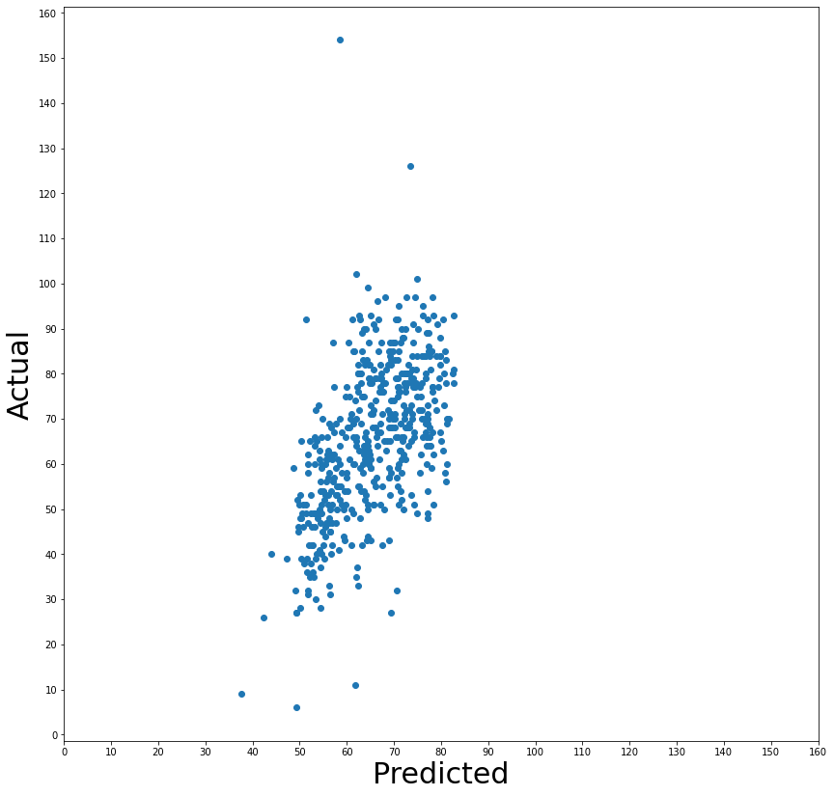
Results (cont.)
Graphed predicted crashes vs actual crashes using the same scaling on axes
If the model was good, we would expect to see something relatively close to a straight line from the bottom left to top right. As it is, it seems like the model is underfitting, since the predictions are relatively localized compared to the actual

Slide 10
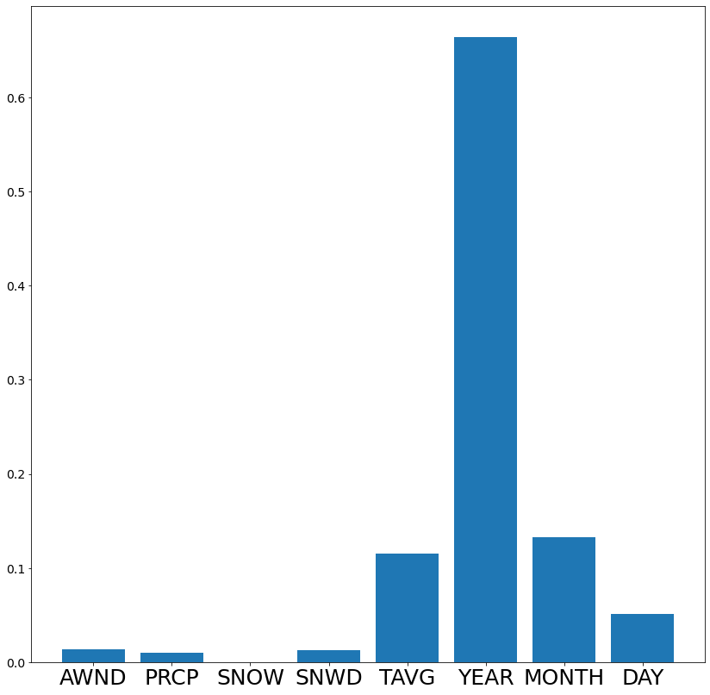
Results(cont.)
Then, I decided to use a decision tree regressor to look at feature importances
This result seems strange to me - year is by far the best predictor in this dataset. This could possibly be explained by specific years having extreme incidents that caused more crashes, although it could be for any number of reasons.

Slide 11
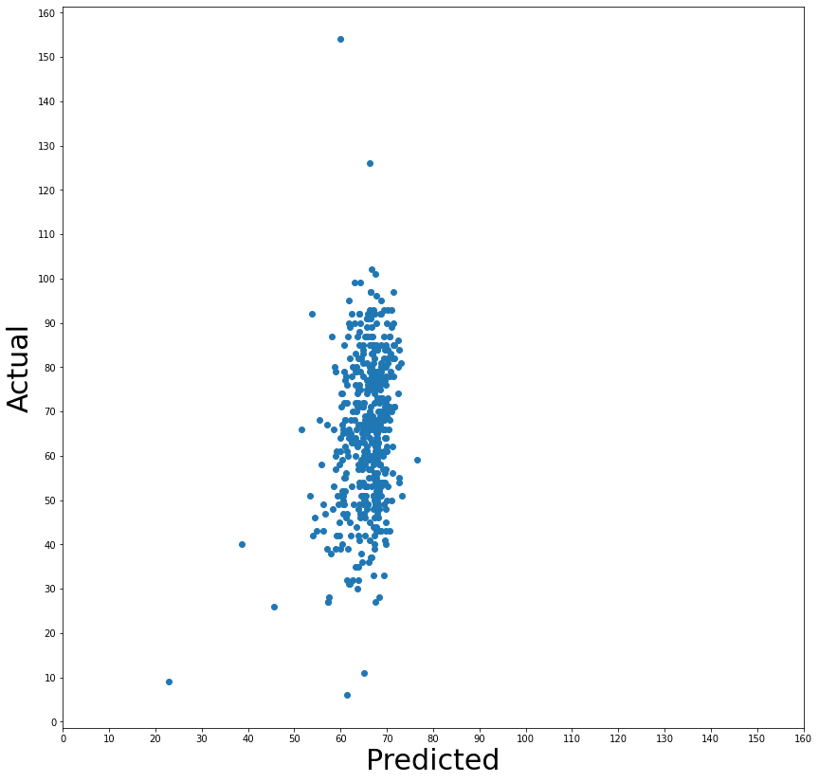
Results(cont.)
Given that year was such a strong predictor for the model, I removed it to see what happened
As may be expected, it results in far more extreme underfitting
increased RMSE by ~2 points on both testing and training data
Reduced R^2 to .067 on training and .075 on testing, so an incredibly poor model

Slide 12
Conclusions
It seems that this data cannot be used to effectively predict crashes
Possibly because driving habits change with worse weather?
We would either need more data or better data to determine if these features are truly poor predictors for crash count, given that my model was underfitting
No effective conclusions can be drawn other than the need to look more deeply into what data there is, if there is something to be learned

Slide 13
Questions?

