Slide 1
STM32 Course
First Project – GPIO Ports
PRESENTED BY:
Johan Svensson

Slide 2
Content
Components: Resistor, Capacitor, LED, Button
General Purpose Input Output (GPIO) – Input, Output
Reset and Clock Controller (RCC), Debug
Electrical schematic: STM32, Resistor, LED, Button
First project

Slide 3
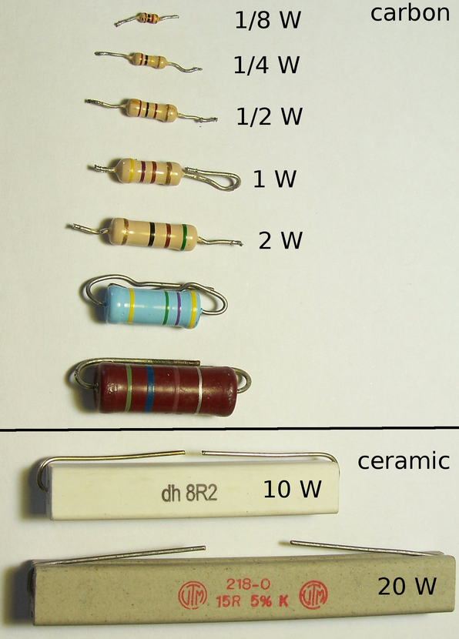
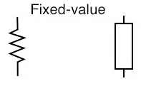
Components: Resistor
Measured in [Ohm]
Many application, example:
Voltage dividers
Control the current
Filters
Source: wikipedia.org

Slide 4
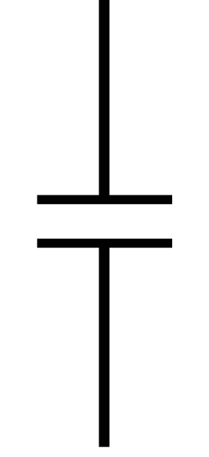
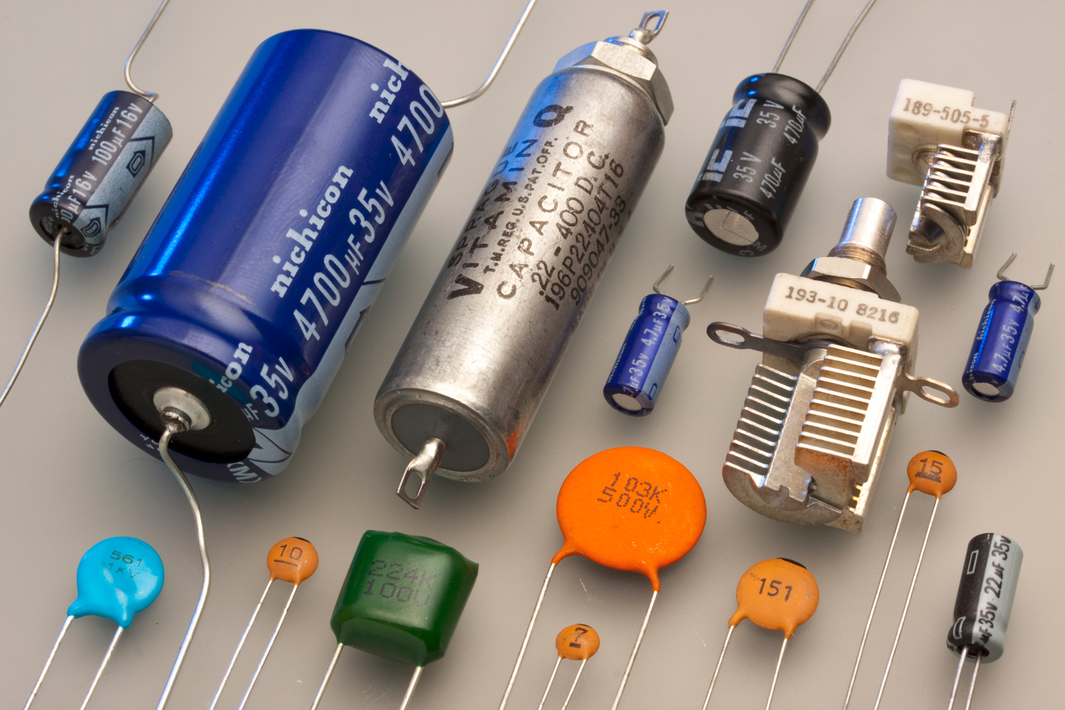
Components: Capacitor
Measured in [Farad]
Applications:
RC-filter
Button bouncing
Bypass capacitor
Source: wikipedia.org

Slide 5
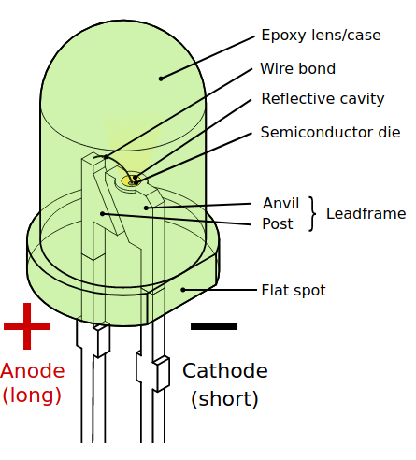
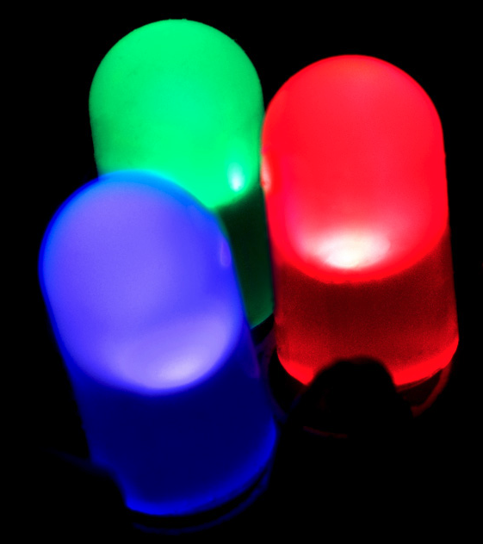
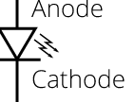
Components: LED
Light Emitting Diode
Anode (+)
Cathode (-)
Source: wikipedia.org

Slide 6
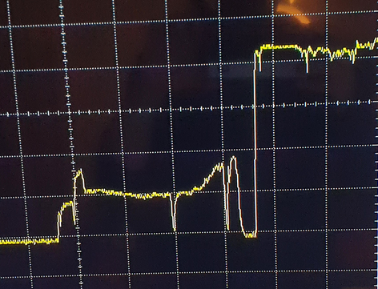
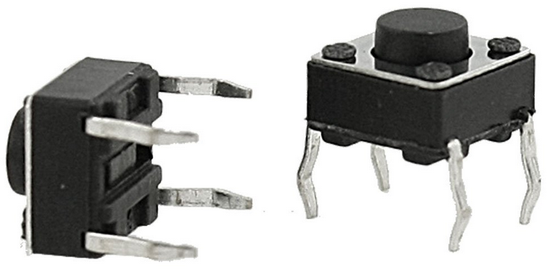

Components: Button (Switch)
Used to open and close a path
Button bouncing, see graph
Hardware, add capacitor
Software, add delay to suppress the transient

Slide 7
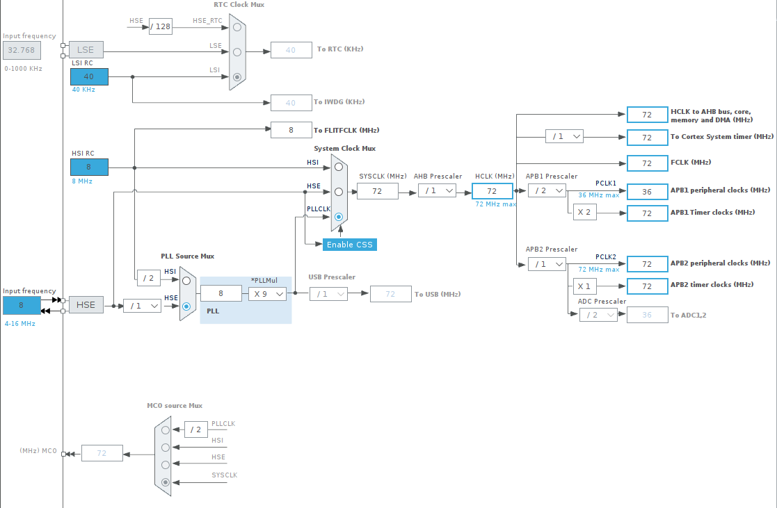
RCC
Sets the system and peripheral clocks

Slide 8
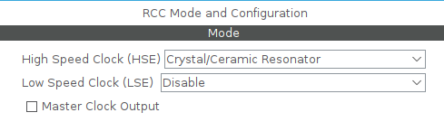
RCC
High Speed Clock
Low speed Clock
Master clock output

Slide 9
Debug
Debug: No debug, <serial wire>, JTAG (4 pins), JTAG (5pins), Trace as Asynchronous Sw
HW breakpoints

Slide 10
GPIO – Input
IRQ: get a notification when the input has changed state
Polling: checking if the input has changed state

Slide 11
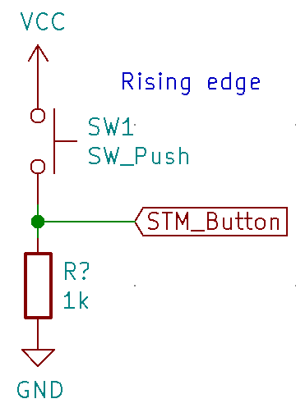
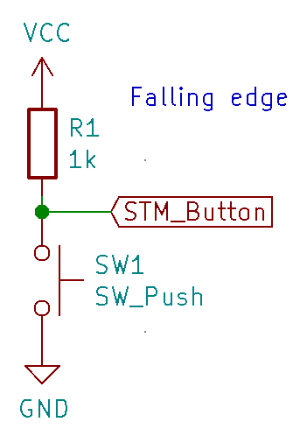
GPIO – Input
Pull-down(rising edge), Pull-up (falling edge)

Slide 12
GPIO – Input (IRQ)
GPIO mode:
External IRQ mode with rising edge, falling edge or both
External Event mode with rising edge, falling edge or both
GPIO pull-up/pull-down: No pull-up and no pull-down, pull-up, pull-down
User label:

Slide 13
GPIO – Input
GPIO mode: Input mode
GPIO pull-up/pull-down: No pull-up and no pull-down, pull-up, pull-down
User label:

Slide 14
GPIO – Output
GPIO Output level: Low, high
GPIO Mode: Output push, pull and Output open drain
GPIO pull-up/pull-down: No pull-up and no pull-down, pull-up, pull-down
Maximum output speed: Low, medium, high
User label:

Slide 15
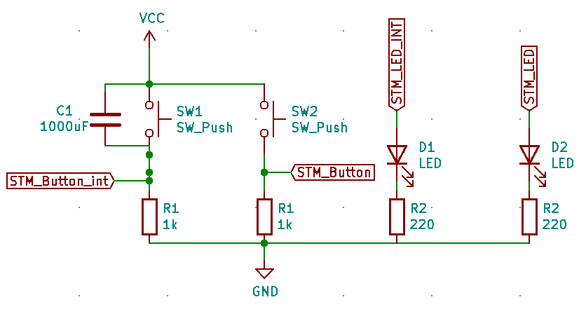
Electrical schematic

Slide 16
First project
Read from one GPIO (Polling) and change state on one LED.
Interrupt from one GPIO (IRQ), When the switch is closed the LED will change state.

