Slide 1
Project 1 - GPIO
STM32 Course

Slide 2
Content
Components: LED, Resistor, Capacitor, Button
RC Filter, Button Bouncing, Pull-up, Pull-Down Resistor
General Purpose Input Output (GPIO)
Reset and Clock Controller (RCC), Debug
Electrical schematic
First project

Slide 3
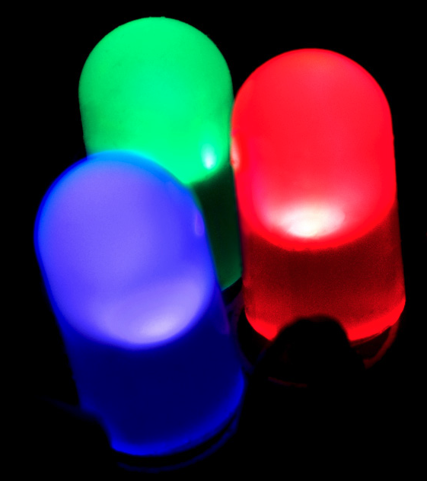
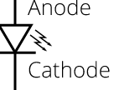
Components: LED
Light Emitting Diode

Slide 4
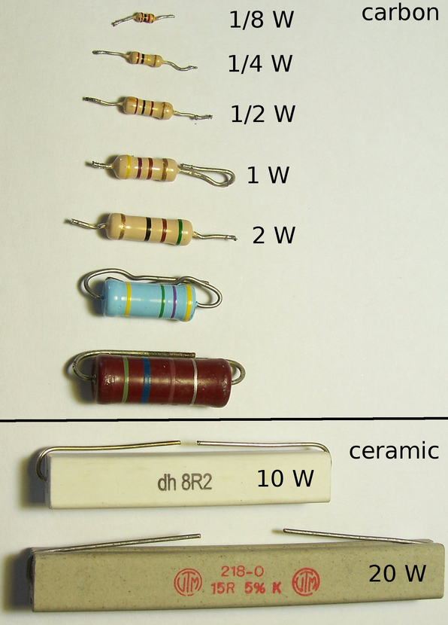
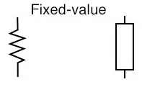
Components: Resistor
Measured in [Ohm]
Applications:
RC Filters
Control the current

Slide 5
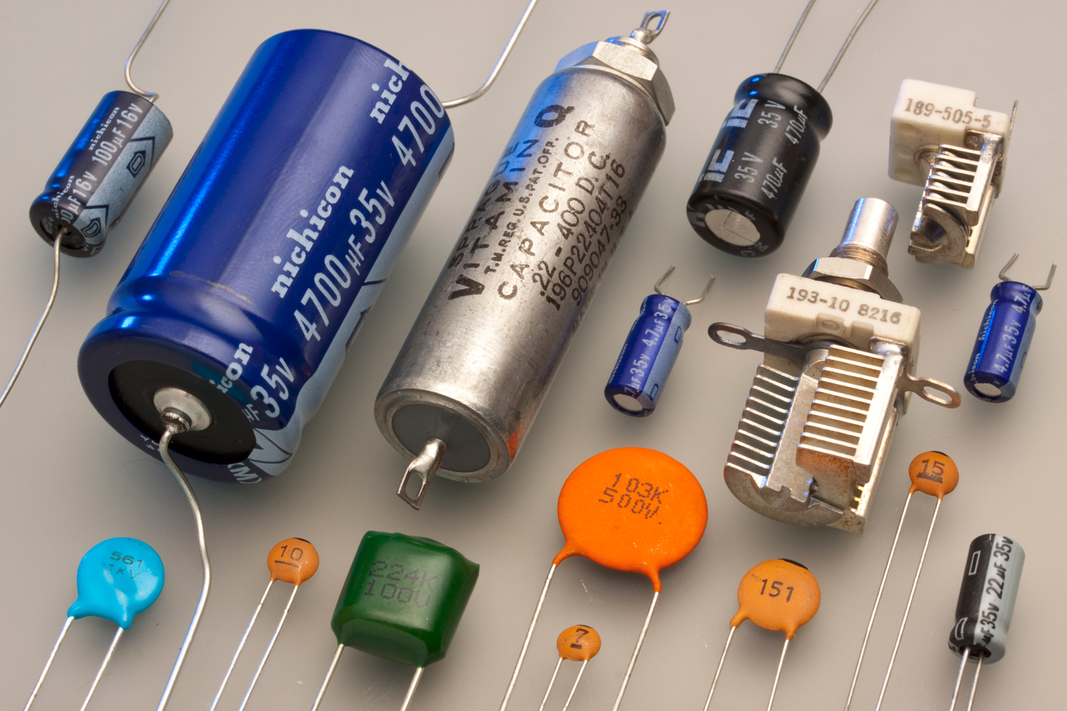
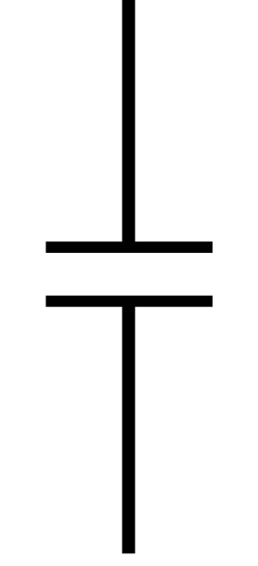
Components: Capacitor
Measured in [Farad]
Applications:
RC-filter
Button Bouncing

Slide 6
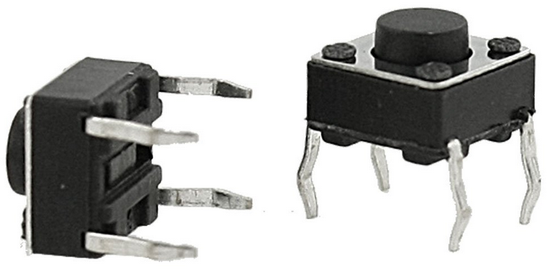

Components: Button (Switch)
Used to open and close a path
Button bouncing

Slide 7
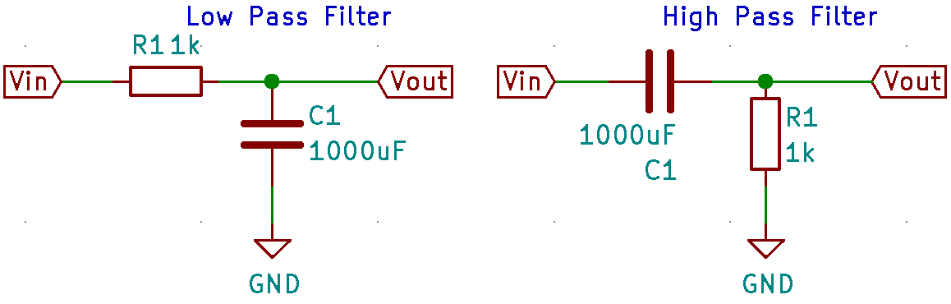
RC Filter

Slide 8
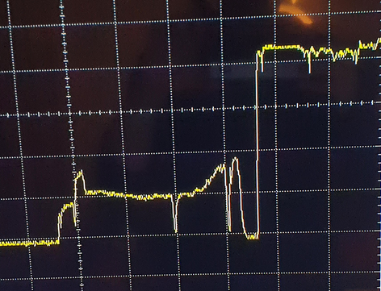
Button Bouncing
Hardware
Software

Slide 9
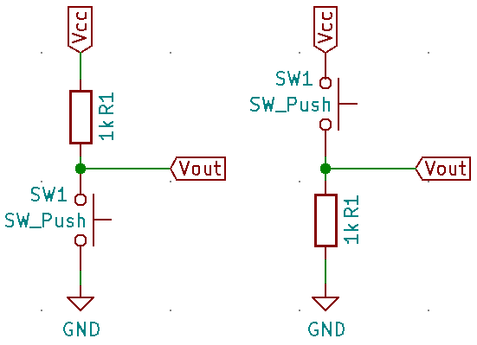
Pull-up, Pull-Down Resistor

Slide 10
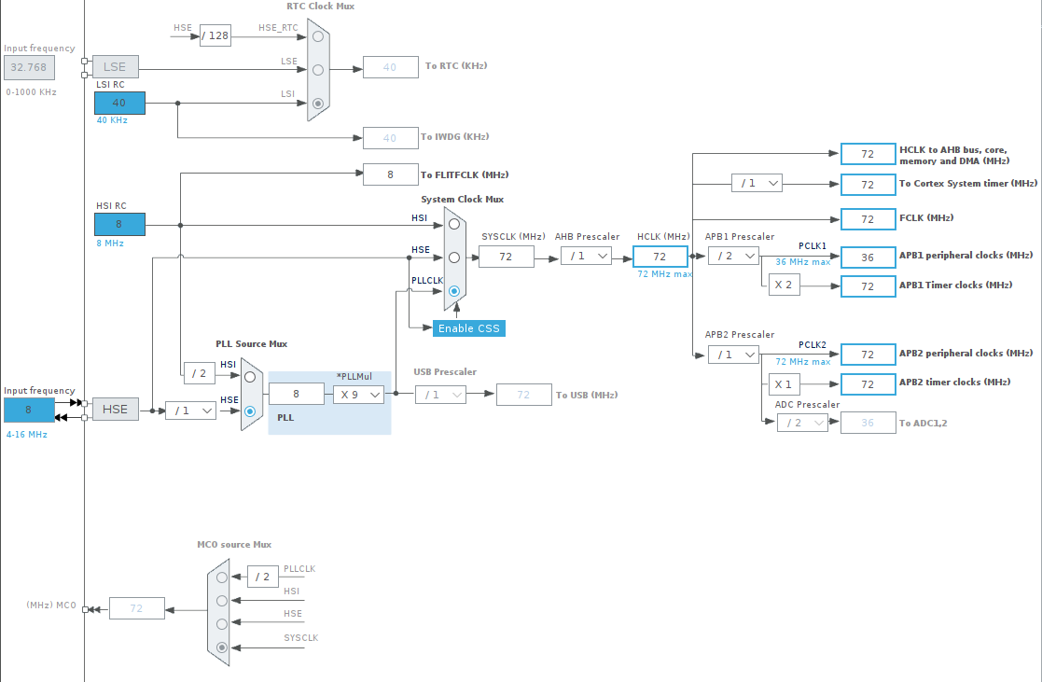
RCC
Set the system and peripheral clocks

Slide 11
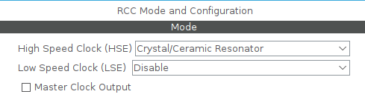
RCC
High Speed Clock
Low speed Clock
Master clock output

Slide 12
Debug
Debug: Serial Wire, JTAG (4 pins), JTAG (5pins), Trace as Asynchronous Sw
HW breakpoints

Slide 13
GPIO – Input
Interrupt: get a notification when the input has changed state
Polling: check if the input has changed state

Slide 14
GPIO – Input (Interrupt)
GPIO mode:
External IRQ mode with rising edge, falling edge or both
External Event mode with rising edge, falling edge or both
GPIO pull-up/pull-down: Pull-up-, Pull-down- resistor, none
User label

Slide 15
GPIO – Input
GPIO mode: Input mode
GPIO pull-up/pull-down: Pull-up-, Pull-down- resistor, None
User label

Slide 16
GPIO – Output
GPIO Output level: Low, High
GPIO Mode: Output push, pull and Output open drain
GPIO pull-up/pull-down: Pull-up-, Pull-down- resistor, none
Maximum output speed: Low, Medium, High
User label

Slide 17
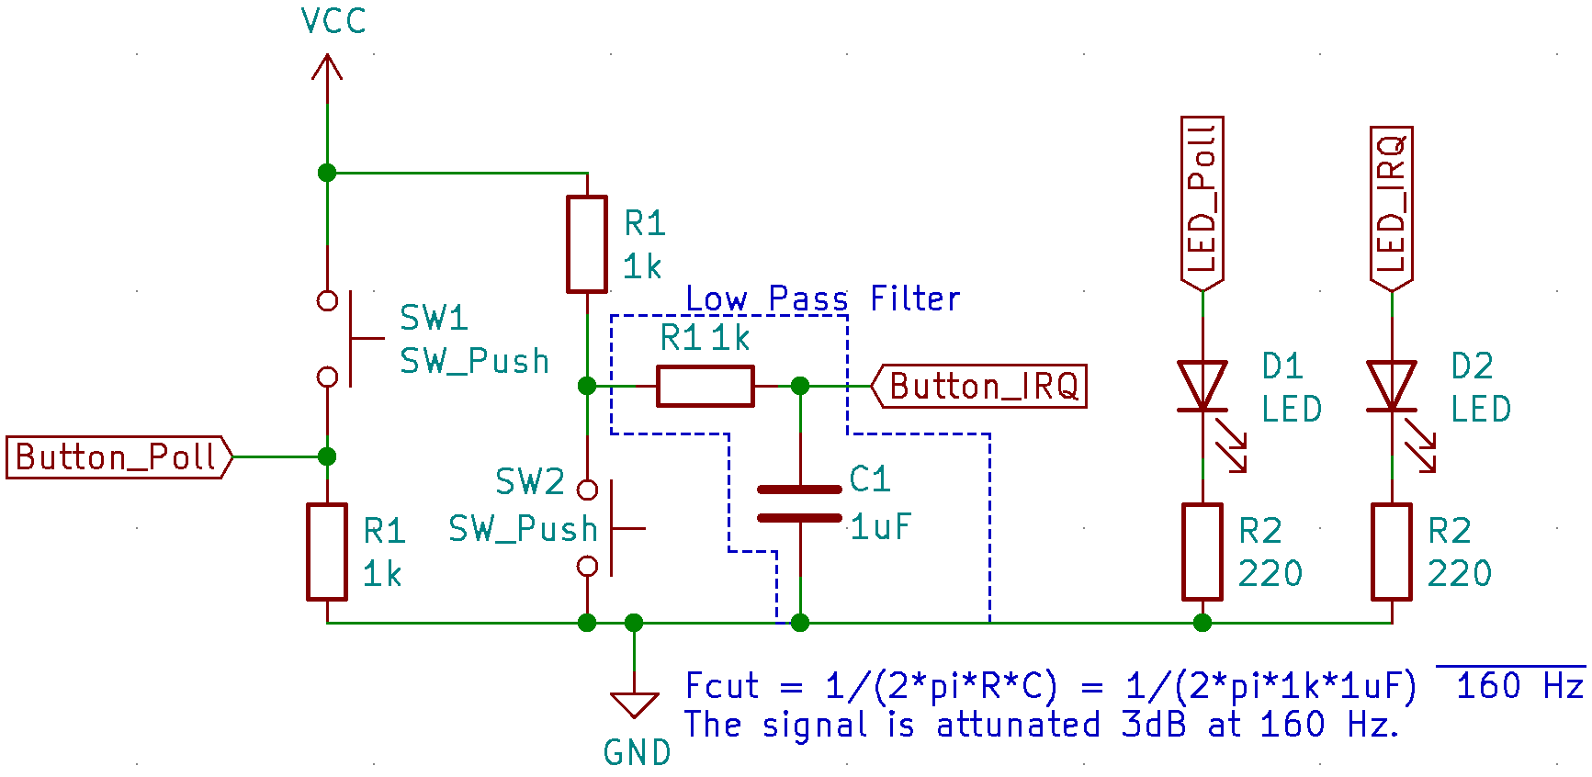
Electrical schematic

Slide 18
First project
Read from one GPIO (Polling) and change state on the LED.
Interrupt from one GPIO, when the interrupt occurs, toggle the output state of the pin.

