Slide 1
First Project
STM32 Course

Slide 2
Contents
Components: Resistor, LED, Button
GPIO – Input, Output
STM32: Reset and Clock Controller (RCC), Debug
Electrical schematic: STM32, Resistor, LED, Button
Eclipse shortcuts
First project

Slide 3
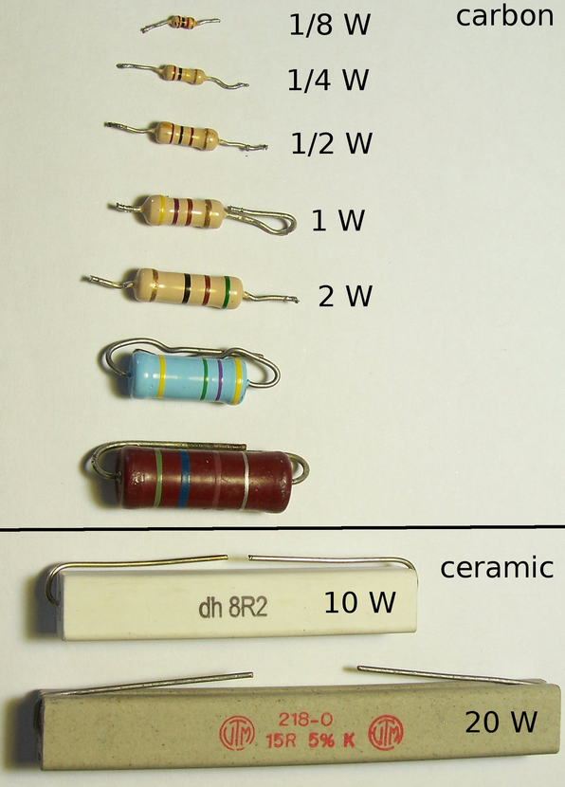
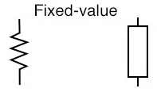
Components: Resistor
Resistors are measured in [Ohm]
Can be used for voltage dividers
Used with LED to control the current
Filters
Source: wikipedia.org

Slide 4
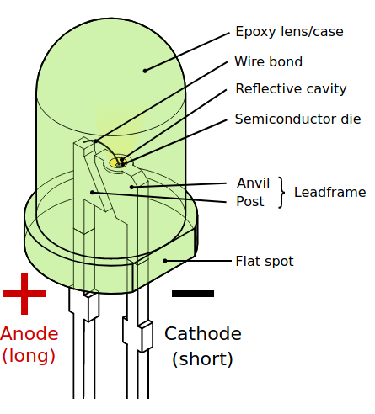
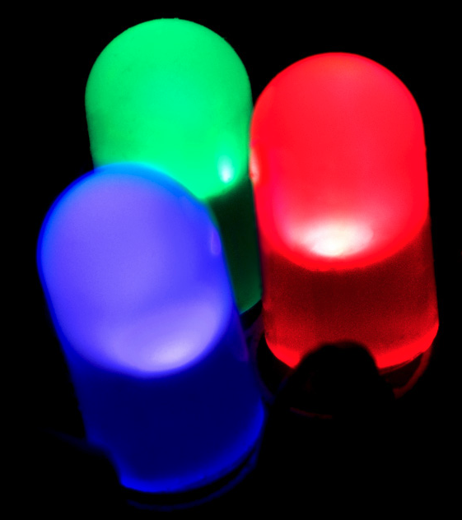
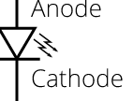
Components: LED
Light Emitting Diode
Anode (+)
Cathode (-)
Source: wikipedia.org

Slide 5
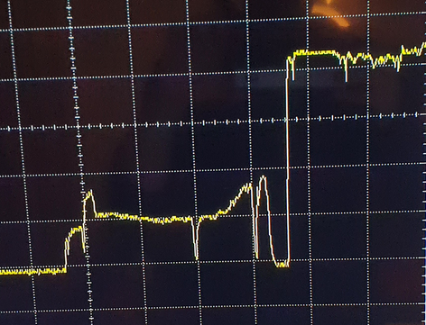
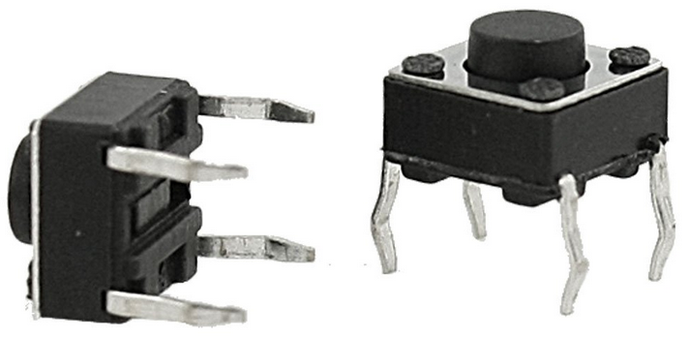

Components: Button (Switch)
Used for open and closing a path
Button bouncing, see graph
Hardware, add capacitor
Software, add delay to suppress the transient

Slide 6
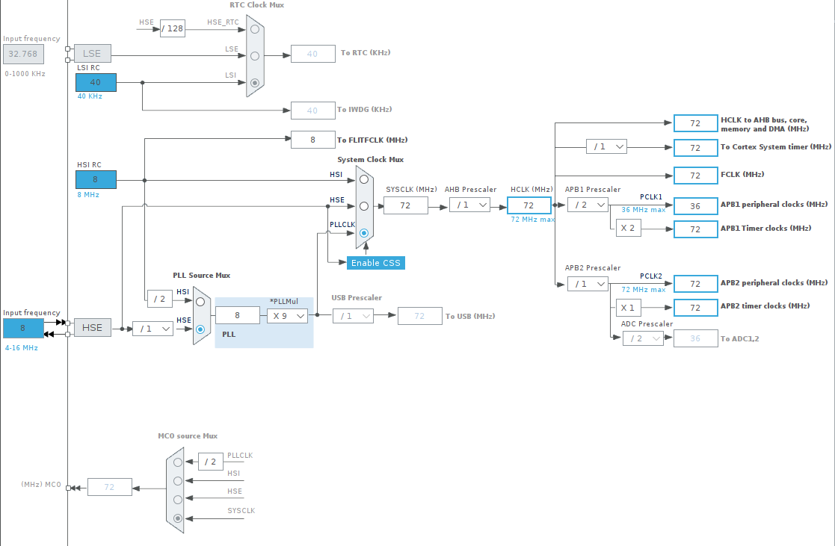
STM32: RCC
Sets the system and peripheral clocks

Slide 7
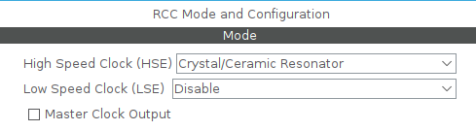
STM32: RCC
HSE
LSE
Master clock output
If we want to have a clock that acts as a master for other devices

Slide 8
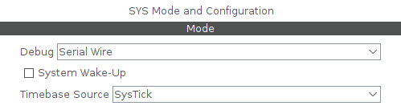
STM32: Debug
Debug: No debug, <serial wire>, JTAG (4 pins), JTAG (5pins), Trace as Asynchronous Sw
System wake-up, assigns a GPIO for wake-up
Timebase source: <Systick>, TIM1, TIM2, TIM3, TIM4 – Sets

Slide 9
GPIO – Input
Polling: checking if the input has changed state
IRQ: get a notification when the input has changed state

Slide 10
GPIO – Input (polling) stm32
GPIO mode: Input mode, no pull-up and no pull-down
GPIO pull-up/pull-down: No pull-up and no pull.-down, pull-up, pull-down
User label: Choose a name for the pin

Slide 11
GPIO – Input (IRQ) stm32
GPIO mode:
External IRQ mode with rising edge, falling edge or both.
External Event mode with rising edge, falling edge or both.
GPIO pull-up/pull-down: No pull-up and no pull.-down, pull-up, pull-down
User label: Choose a name for the pin

Slide 12
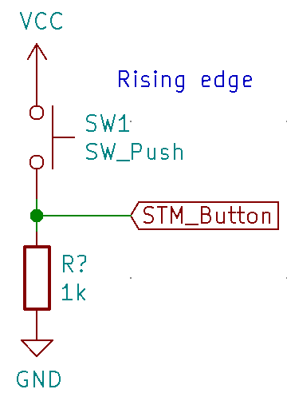
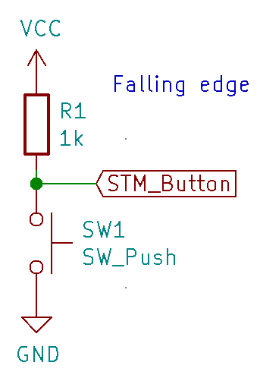
GPIO – Input (IRQ)
Rising or falling edge

Slide 13
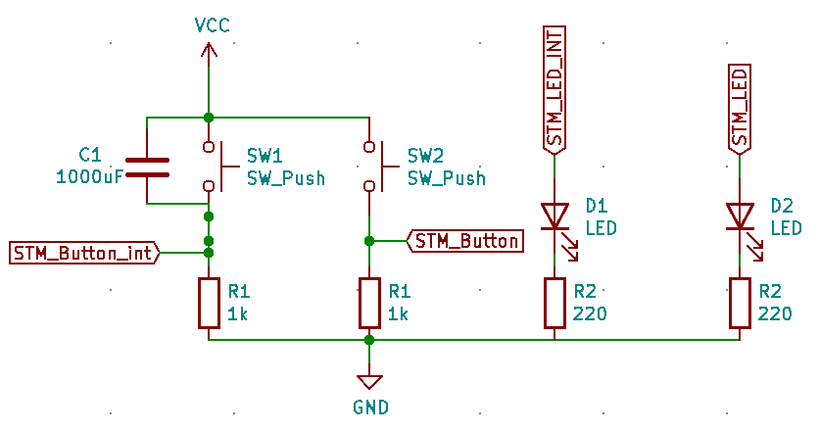
Electrical schematic

Slide 14
Eclipse shortcuts
ctrl+tab: go between header and source file
ctrl+shit+r: open resource
F3: open declaration
ctrl+space: Show proposals, auto complete
ctrl+shift+g: When a function, object or var is selected : find all occurences of it in the project.
...

Slide 15
First project
Read from one GPIO (Polling) and change state on one LED. If switch is closed, LED is turned on. If switch is open, LED is turned off.
Interrupt from one GPIO (IRQ), When the switch is closed the LED will change state. If the LED is turned on, it will be turned off and vice versa.

