Slide 1
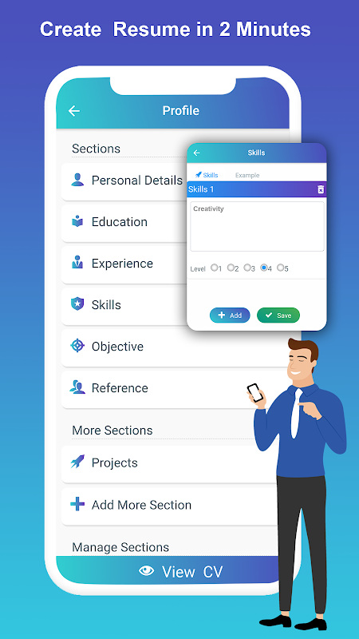
ResumeCraft: AI-Powered Resume Builder
ResumeCraft is your AI-powered resume builder. Create a professional and effective resume in minutes with our AI-driven technology.
Submitted to :-
Submitted by :-
Mr. Ajeet Singh
Dr. Sachin Singh
Abhishek Rajpoot
(2100820100011)

Slide 2


AI Approach: Personalized Resume Generation
1
Personalized Resume
2
Tailored Content
3
Time-Saving
ResumeCraft analyzes your experience and skills to create a unique resume tailored to your career goals.
Our AI generates impactful language and highlights your achievements in a compelling way.
Let the AI handle the formatting and writing, freeing up your time for more important tasks.

Slide 3
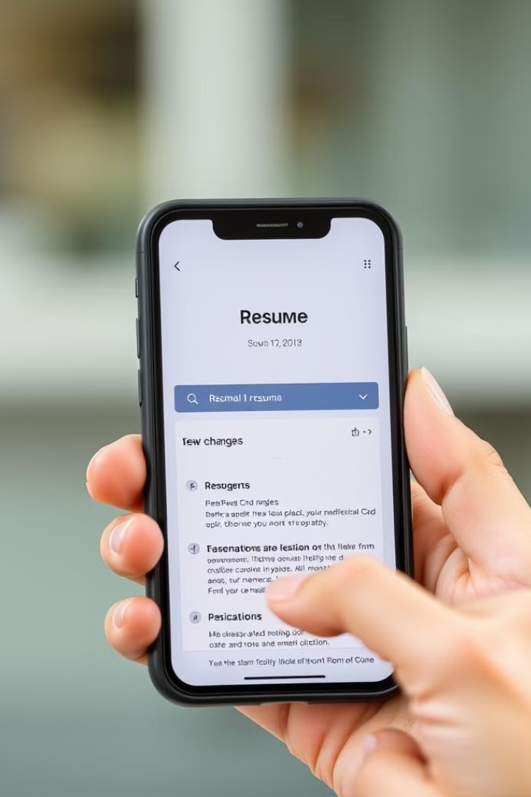



What AI Optimize in your Resume
Improved Readability
AI ensures your resume is easy to read and understand by recruiters and hiring managers.
Increase Ats Score
ResumeCraft suggest language aligned with ATS requirements.
Optimized Content
AI optimizes content by suggesting impactful language, ensuring resume content are clearly highlighted.

Slide 4

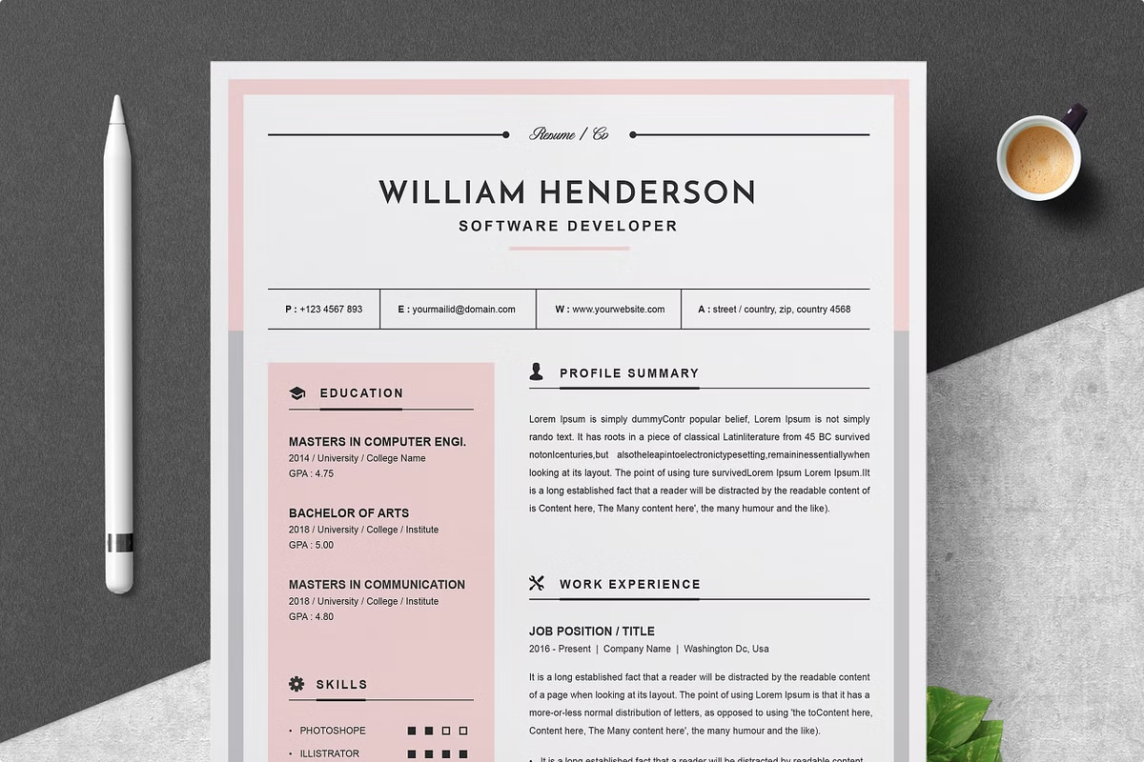
Custom Templates: Personalize Your Look
Professional Designs
Easy to Edit
Choose from a variety of customizable templates to match your career field and personality.
Adjust layouts to create a visually appealing and unique resume.
Stand Out
Make a positive first impression by showcasing your skills and experience in a visually appealing way.

Slide 5




Real-Time Editing: Update With Ease
Instant Updates
Edit your resume on the go, saving your changes automatically as you type.
Cloud-Based Platform
Access your resume from any device, ensuring you have the internet available.
User-Friendly Interface
Easily navigate and make changes to your resume with our intuitive platform.

Slide 6
Export to PDF: Polished Resumes, Always
Professional Formatting
Print-Ready Files
Future-Proof Format
Maintain consistent formatting and prevent any layout issues when sending your resume.
Ensure your resume looks crisp and clear when printed, making a lasting impression.
PDF ensures your resume is accessible and easily viewed on any device.

Slide 7
