Slide 1
Discovering panoramas in web videos
Apoorva Bansal
Jay Patel
Vivek Gokuladas

Slide 2
Problem statement & Motivation
There is no viable method for extracting panoramas from web videos.
Research currently focusses on panorama stitching rather than discovery.
Videos are a rich source of panoramas as each shot consists of a sequence of images constituting a scene.
With YouTube, Vimeo, and various other video hosting sites, there are many potential sources of panoramas.

Slide 3
Previous work
Discovering panoramas in web videos.
Feng Liu, Yu-hen Hu ,Michael L. Gleicher, Proceedings of the 16th ACM international conference on Multimedia, October 26-31, 2008, Vancouver, British Columbia, Canada
Comparison of automatic shot boundary detection algorithms.
Lienhart, Rainer
Blur detection for digital images using wavelet transform.
Tong, Hanghang, et al. Multimedia and Expo, 2004. ICME'04. 2004 IEEE International Conference on. Vol. 1. IEEE, 2004.
No-reference perceptual quality assessment of JPEG compressed images.
Wang, Zhou, Hamid R. Sheikh, and Alan C. Bovik. Image Processing. 2002. Proceedings. 2002 International Conference on. Vol. 1. IEEE, 2002.

Slide 4
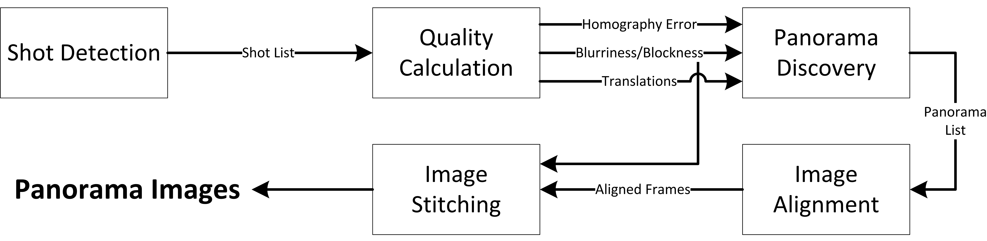
methodology
Below is a high-level diagram of our application:
* Blurriness and Blockness are types of visual distortion quality measures that render a frame unusable if they are too high.

Slide 5
Implementation challenges
Shot detection algorithm.
Identifying a contiguous set of frames comprising continuous camera motion.
Panorama discovery algorithm.
Identifying the best panoramas from a single shot.
Blending algorithm.
Correctly aligning and blending individual frames into a single image.

Slide 6
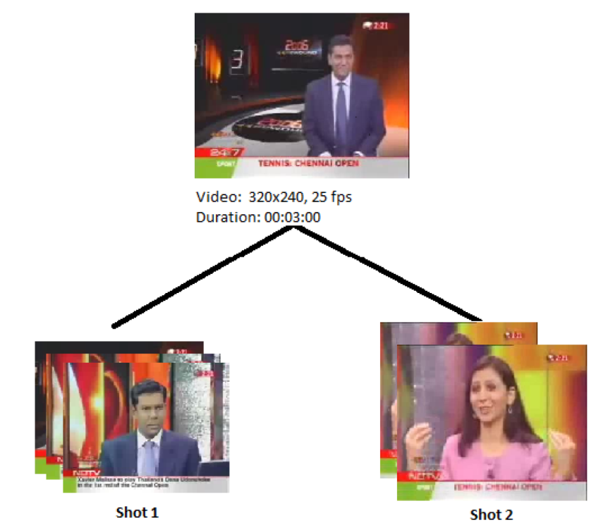
Shot detection
The video clip is divided into a sequence of shots.
A shot is a continuous frame sequence recorded by a camera setting.
A edge detection based method is used for implementing shot boundary detection.

Slide 7
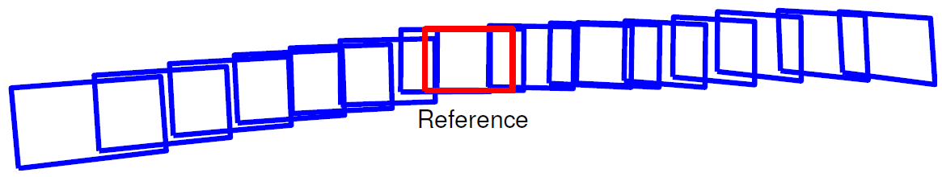
Panorama discovery
Optimization problem solving for best combination of frames that constitute a panorama.
Balance between maximizing visual quality and scene extent.
Computationally difficult to solve.

Slide 8
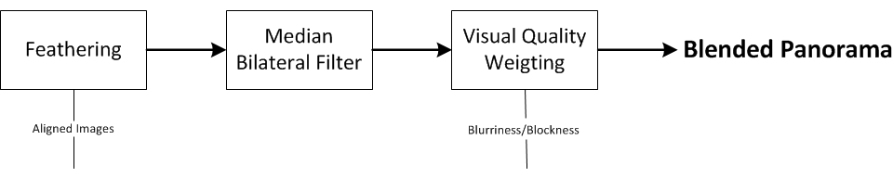
blending
Three step algorithm:
Constants used to tune the result.
Assumed there was no rotation or skew in homographies.

Slide 9
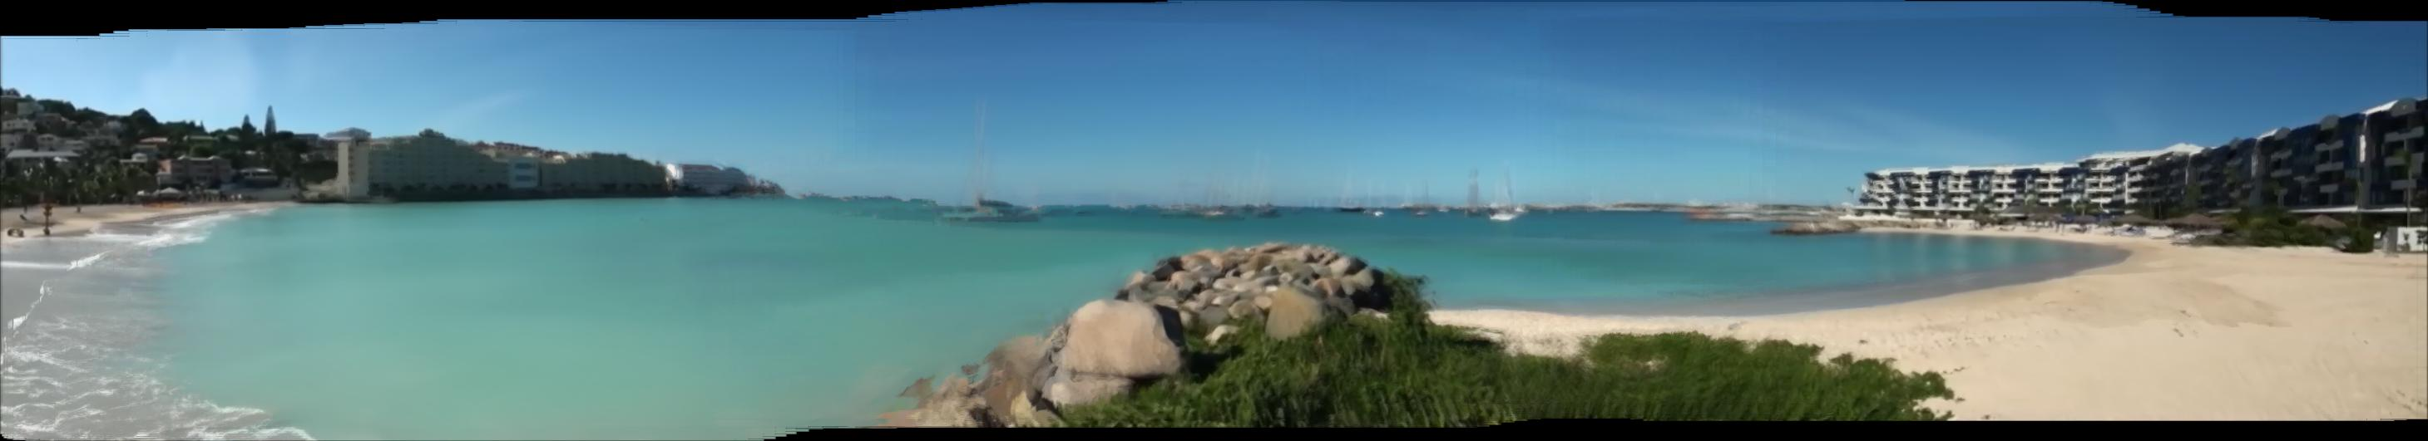
Results I
Testing for multiple shots.
Panorama #1:

Slide 10
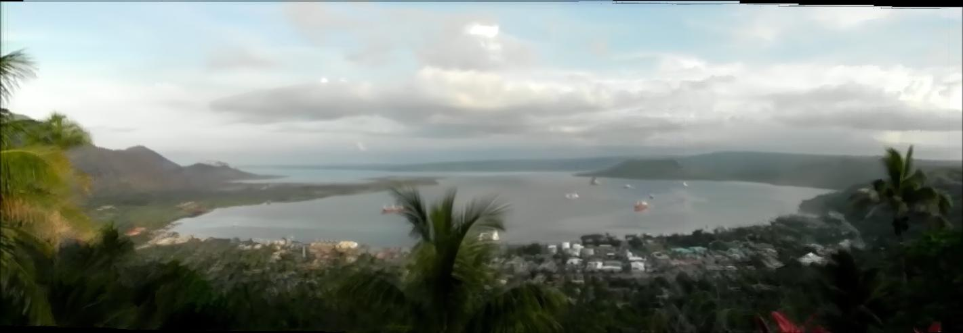
RESULTS I
Testing for multiple shots.
Panorama #2:

Slide 11
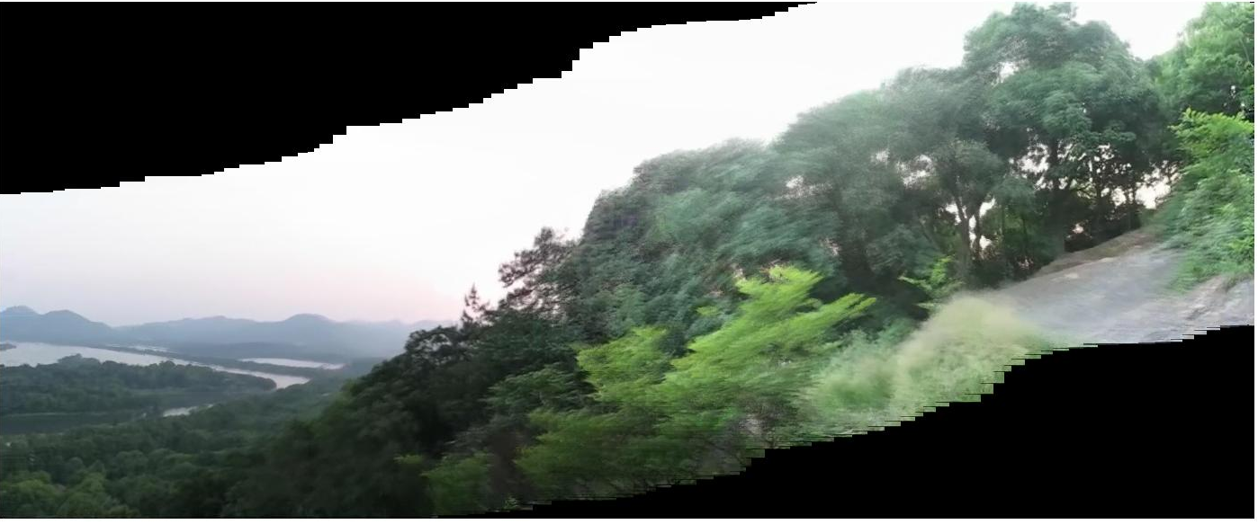
Results ii
Panorama #1:

Slide 12
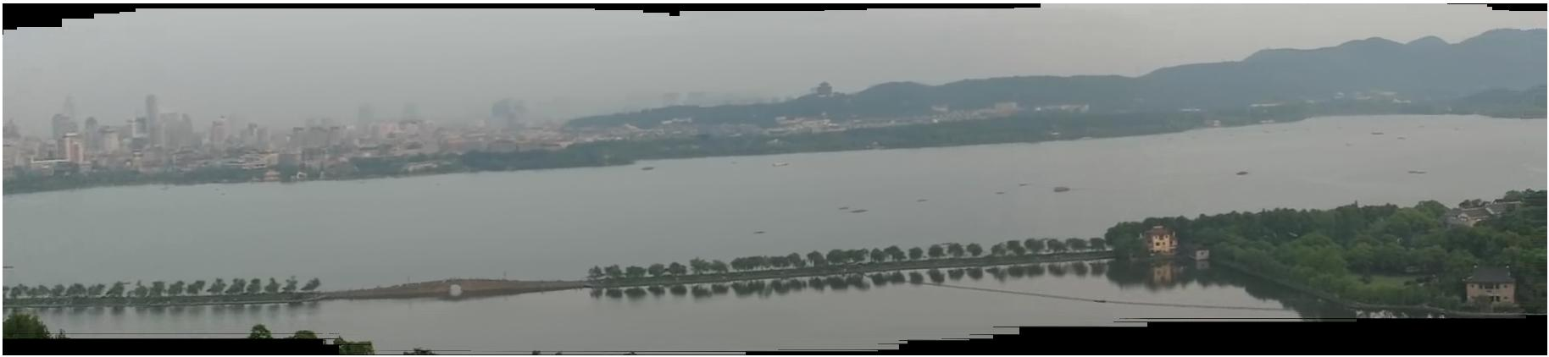
Results ii
Testing for multiple panoramas in one shot.
Panorama #2:

Slide 13
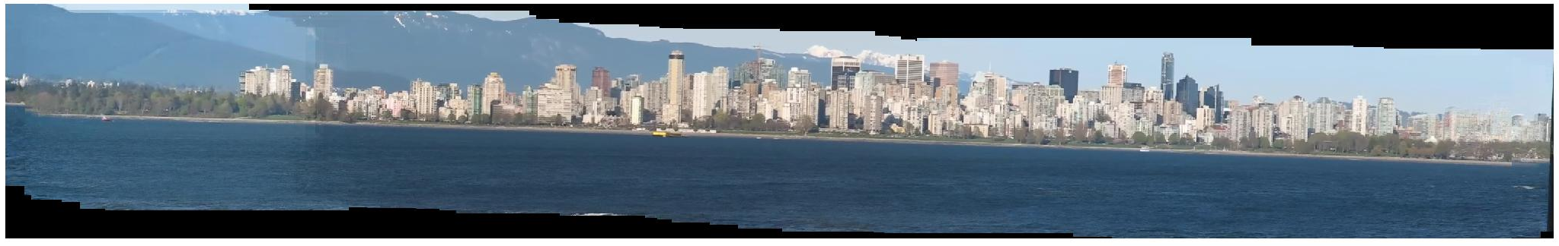
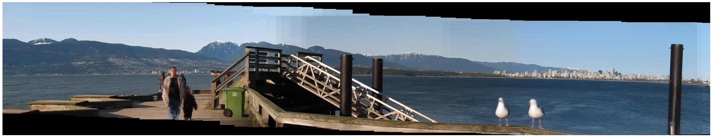
Results iii
Testing for blending method in panorama.
Panorama #1:
Panorama #2:

Slide 14
Conclusions & improvements
Accommodate sources with skew and rotation.
Eject bad frames with no feature points/obfuscated image.
Integrate optical flow.
Introduce basic automatic tuning.
Color correction in blending.

Slide 15
questions

