Slide 1
Capstone Project
Team 3 | Movies Data
Training Head
Mentor
Team Member
Jayanth P Reddy
Jayita Mandal
Akshat Singh
Raj Kumar
Utsav Lakhani
Sambangi Hima Bindu

Slide 2
Agenda
Objective
Understanding Data
Approach Architecture
Amazon Web Services (AWS) Environment
Simple Storage Service(S3)
Lambda
Glue (ETL Job)
Simple Notification Service (SNS)
Redshift
Implementation of AWS Architecture
Visualization

Slide 3
Objectives
Store all these data files in an AWS S3 bucket. Do the entire data profiling to understand the trends in data. Build QC checklist based on the data profiling done. Create data catalogs preferably using glue
Build custom data processing scripts to clean, process & aggregate data. The scripts should have failure alerts and should also provide a summary report over email
The processed can be loaded in S3 or moved to a data warehouse. The processed data should be able to be directly consumed by the visualization tool
Build a live dashboard to show the various trends. You can create any visualizations that might be able to actor/character/platform comparison

Slide 4
Understanding Data
We have 5 input files
-credit(contain information about the cast and crew of the movie)
-keywords(contain information about which movie will be shown on searching a particular keyword)
-movie_metadata(contain information about the movie genres ,budget, revenue, production companies etc.)
- ratings(contain information of user ratings of a movie)
-links(contains unique ID of movies across platforms like IMDB and TMDB)
Some input file has some columns in which information is stored in JSON string format.
Our main file is movie_metadata.
Other files are linked with movie_metadata through movie ID.

Slide 5
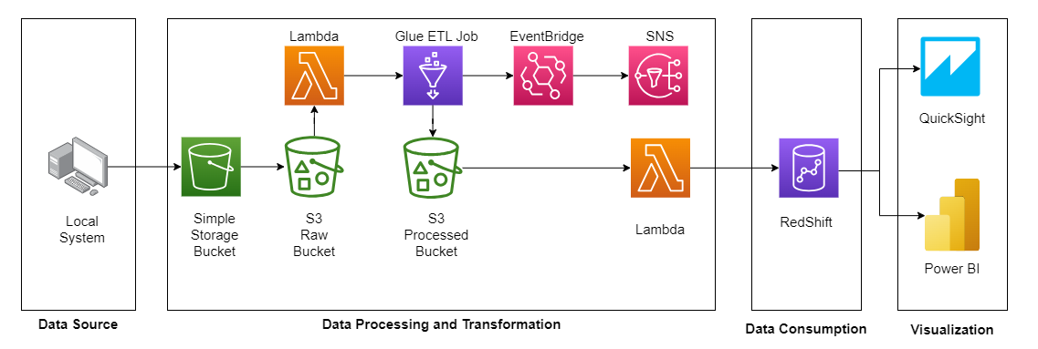
Approach Architecture

Slide 6




Amazon Web Services (AWS) Environment
 | Simple Storage Service (S3):
 | Amazon Simple Storage Service (Amazon S3) is an object storage service that offers industry-leading scalability, data availability, security, and performance.
 | Lambda:
 | AWS Lambda is a compute service that lets you run code without provisioning or managing servers.
 | AWS Glue:
 | AWS Glue is a serverless data integration service that makes it easy for analytics users to discover, prepare, move, and integrate data from multiple sources.
 | Simple Notification Services (SNS):
 | Amazon SNS is an affordable cloud service for mass delivery of messages.

Slide 7




Amazon Web Services (AWS) Environment
 | Amazon RedShift :
 | Amazon Redshift is a fully managed, petabyte-scale data warehouse service in the cloud.
 | Identity and Access Management :
 | Identity and Access Management (IAM) is a directory service designed for tracking system users and providing ways of keeping track of information about how they get authenticated.
 | CloudWatch :
 | Amazon CloudWatch is a service used for monitoring and observing resources in real-time .
 | EventBridge :
 | EventBridge is a serverless service that uses events to connect application components together.

Slide 8
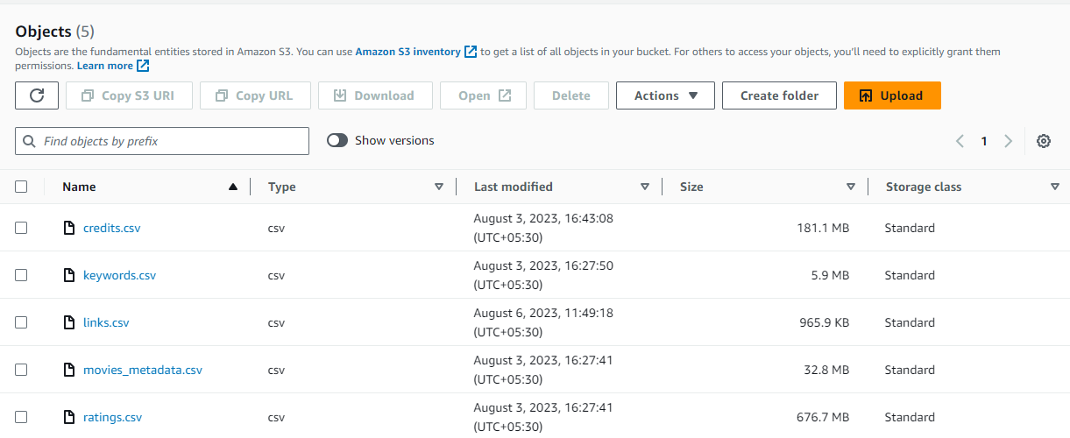
Implementing Approach Architecture
Moving files from external source to input folder of our S3 bucket.
Fig : Objects inside Input Folder of capstone-grp3-bucket

Slide 9
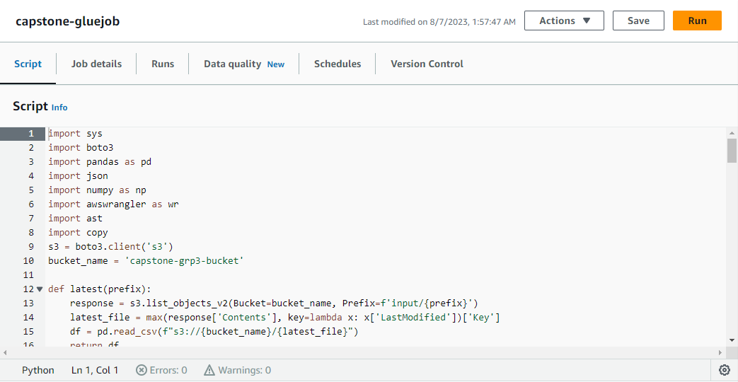
Implementing Approach Architecture (2/6)
Creating a GLUE job using python shell script editor and writing python codes in it for data cleaning and saving back to output folder of s3 bucket

Slide 10
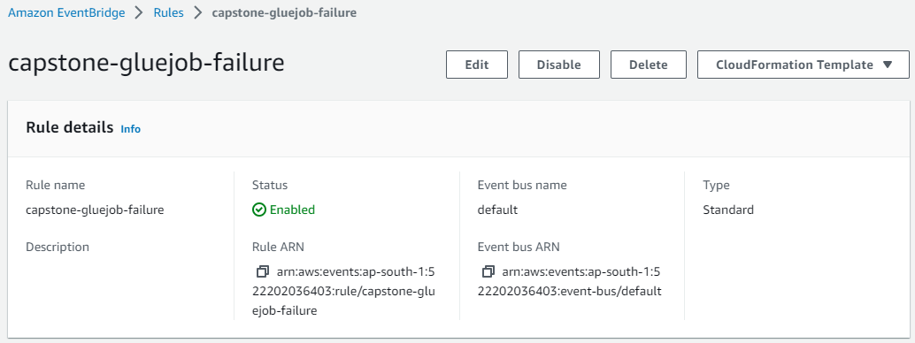
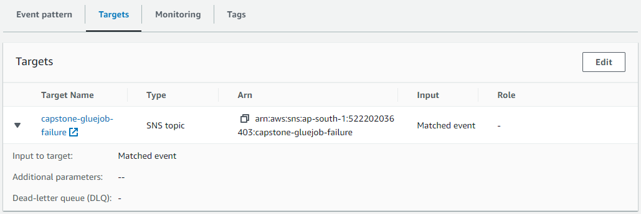
Implementing Approach Architecture (3/6)
Created two rule in EventBridge with targets as SNS topic for the success and failure of GlueJob.

Slide 11
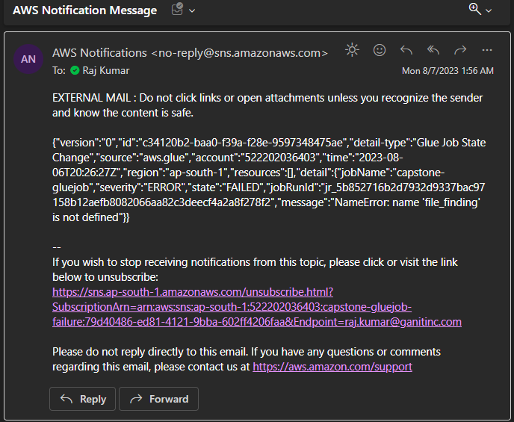
Implementing Approach Architecture (4/6)
Notification if the Job Fails.

Slide 12
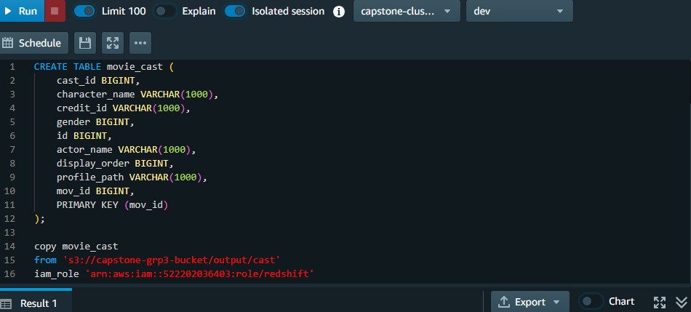
Implementing Approach Architecture (5/6)
Copying data from S3 to RedShift

Slide 13
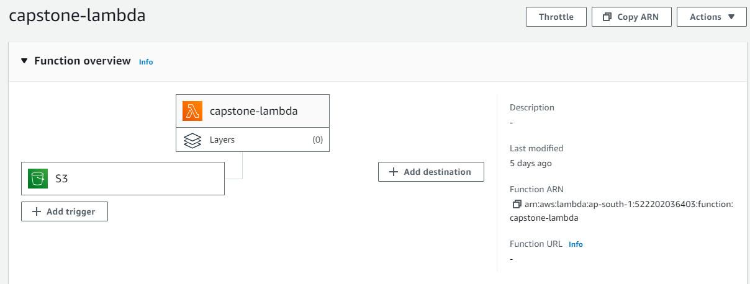
Automation using Lambda Functions
First lambda get triggered whenever there is an input file in folder name input which further starts our GlueJob.

Slide 14
Exploratory Data Analysis
Exploring dataset & distributions for columns.
Diving deep into analysis by inspecting relations between the columns.
Visualizing using different charts/graphs.

Slide 15
Visualization

Slide 16
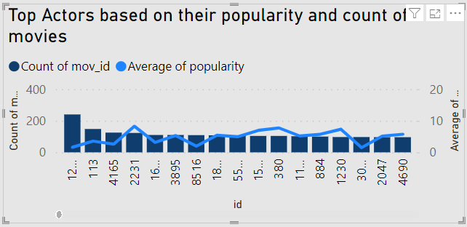
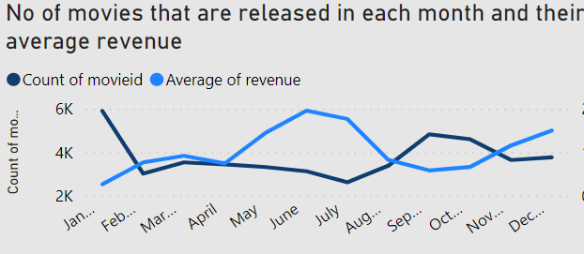
Key Insights
The above image shows the Actors with their experience and their popularity .
This will help us in figure out which actor to choose
The above image shows the number of movies released in moth and the average revenue generated in that month .
This will help us to figure out when to release a movie where we will get less competition and more revenue .

Slide 17
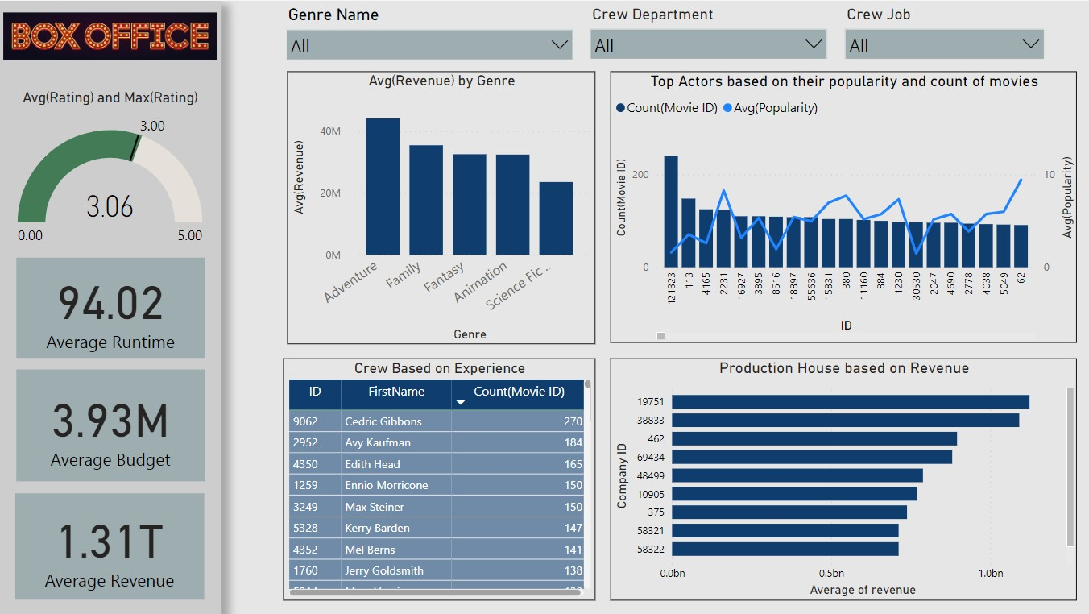
BI Dashboard (1/2)
Redshift to Power BI

Slide 18
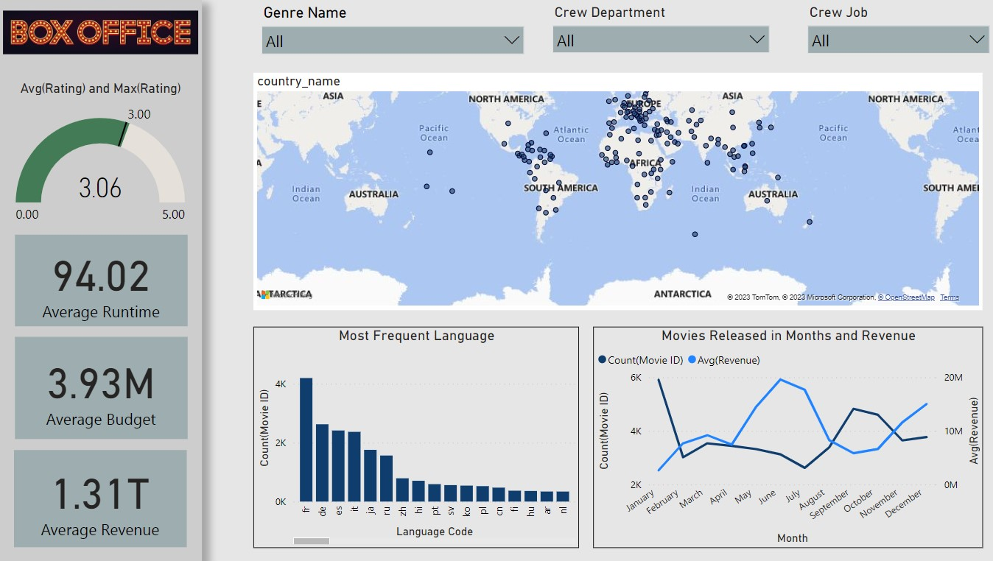
BI Dashboard (1/2)
Redshift to Power BI

Slide 19
Links
Documents/Dashboard | Link
PowerBI Dashboard | PowerBI
GitHub Repository | GitHub

