Slide 1
Crime Data Analysis
A Los Angelos Centric Analysis

Slide 2
Table of Content
Questions & hypothesis
Approach & Analysis
Technical Challenges
Crimes analysis by year
Crimes analysis by neighborhoods
Gender and Descent analysis
New metric: Total LA population
Average late reported crimes

Slide 3
Questions
Which year had the greatest number of crimes
Which areas had the most crimes.
Are there more crimes at night? what are the most common ones?
Which gender/descent is more likely to become a victim?

Slide 4
Hypothesis
2020 might have had the greatest number of crimes due to the unrest caused by the COVID-19 Pandemic
The areas which are the most densely populated are likely to have a higher crime rate
Yes
Women from the racial group with the largest population are more likely

Slide 5
Approach and Analysis
Download the data from “catalog.data.gov/dataset/crime-data-from-2020-to-present” (Primary Source)
Standardized, clean and compiled the data
Columns Area, Date Occ, Date Rpdt, Vict Sex, Vict Desent etc will be considered
Statistical inference, feature engineering and graphical visualizations will be employed

Slide 6
Technical Challenges
Dataset being clean enough, it had many irrelevant and missing-values columns
Column data were not in a standardized format
Required a lot of feature analysis
For deep analysis feature engineering was done

Slide 7
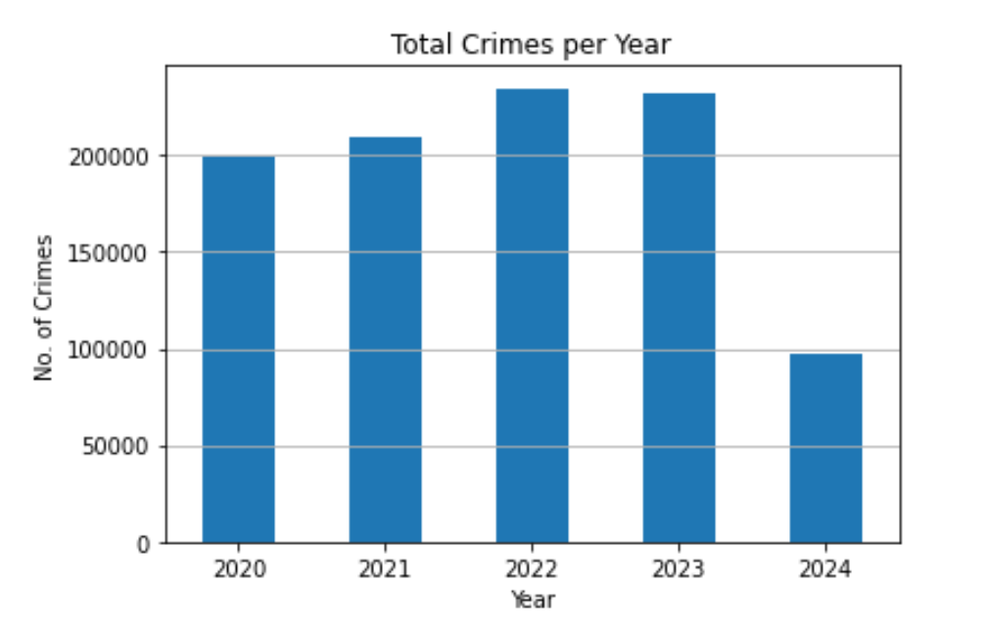
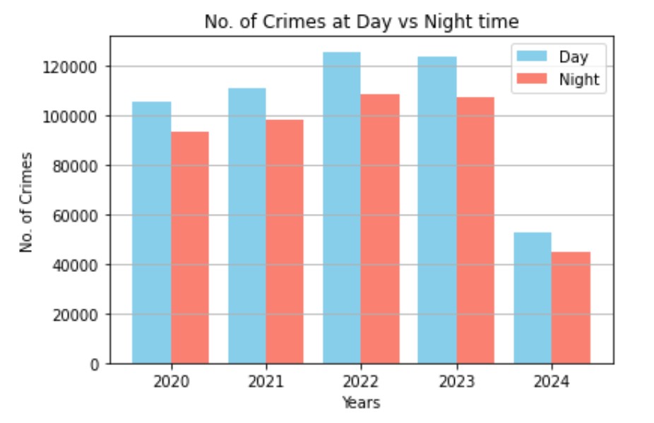
Crime analysis per year
Note: Data is only till the 2nd Sept of 2024.
It seems that the number of crimes had peaked in 2022 with a 12% increase since 2021, while most of the crimes in the day time throughout the years.

Slide 8
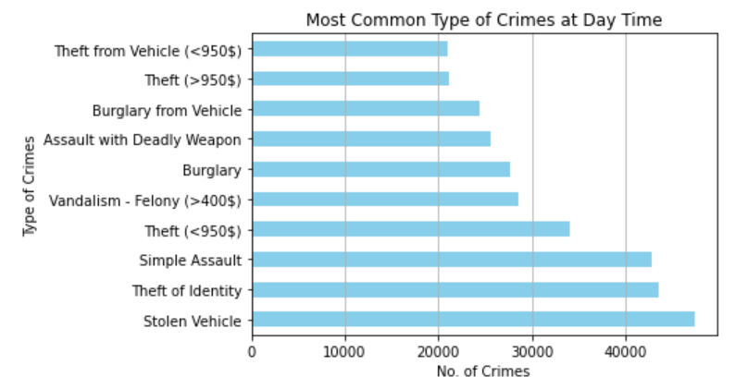
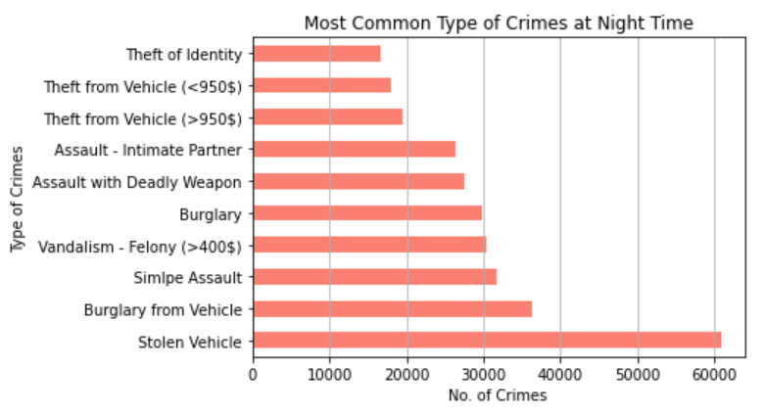
Crimes at Day vs Night

Slide 9
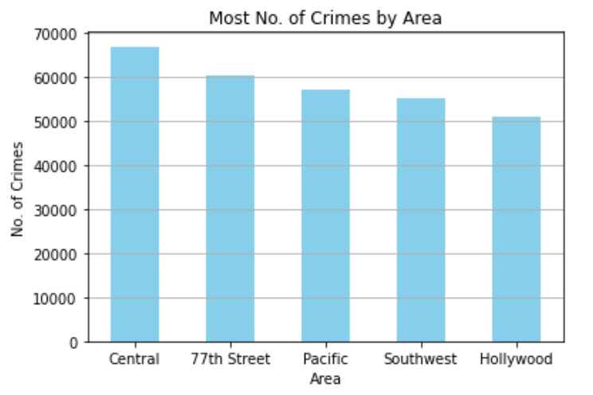
Highest No. of Crimes
Central LA
77th Street
Pacific.

Slide 10
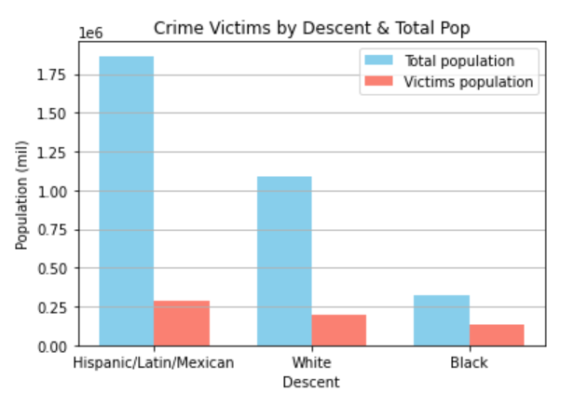
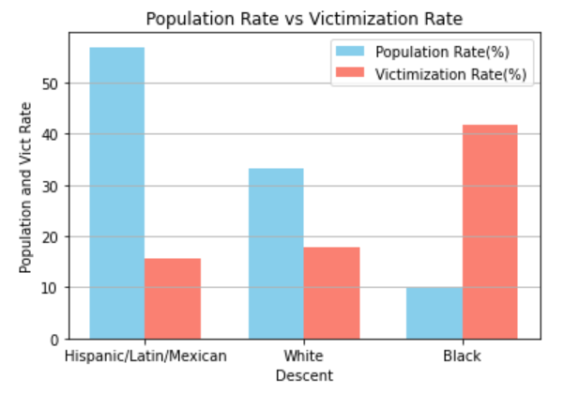
Deep Analysis: Gender & Descent
By adding a new metric of Total Population of LA
Individuals of Hispanic descent have the largest segment of the population (57%), yet they experience the lowest victimization rate (16%). In contrast, those of Black descent have the lowest population rate (10%), but face the highest victimization rate (42%).

Slide 11
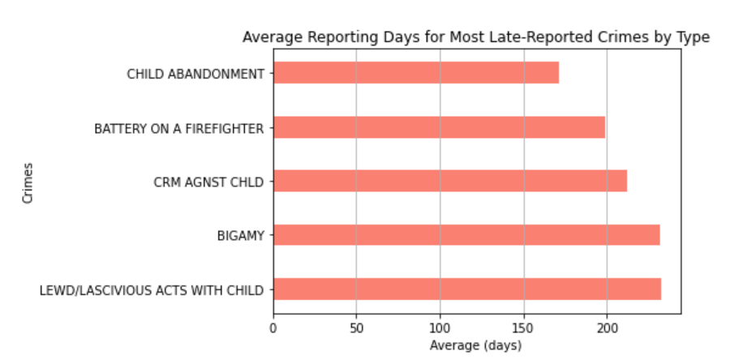
Average delay of most late reported crimes
Three out of five late-reported crimes involve victims who are children, while the second being Bigamy (act of marrying one person while still legally married to another).

Slide 12
Crimes at Day vs Night

Slide 13
Final Results
The year 2022 has the highest crime rate, a 12% increase since the previous year
In general, more crimes are committed in daylight than night throughout the years.
Central LA, 77th Street and Pacific have the most No. of crimes
Even though, Black descent have the lowest population rate of 10%, they face the highest victimization rate of 42%.
Three out of five late-reported crimes involve victims who are children, while the second being Bigamy

