Slide 1
Threat Modeling
Using the Leach-Pyzh methodology

Slide 2

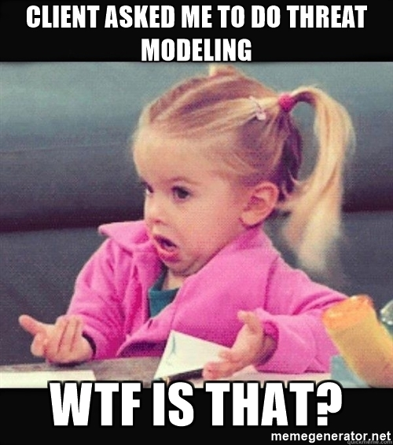

Slide 3
What is a Threat Model?
Put simply: It's a way to define and lay out security risks to your application
What it includes:
Some sort of visual diagram
A list of potential threats to be aware of
What should be done to avoid or mitigate these threats

Slide 4







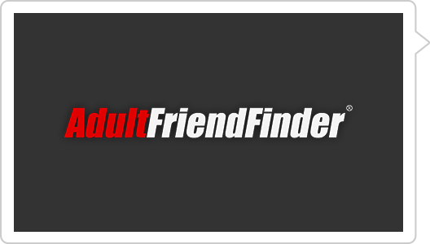









Why Do We Need to Threat Model?
3 Billion
147.9 Million
76 Million
412.2 Million
600,000
110 Million
145 Million

Slide 5
Don’t get pwned Don’t get sued

Slide 6
Existing Threat Model Methodologies that we drew from
Microsoft's Threat Modeling
STRIDE
Spoofing, Tampering, Repudiation, Information Disclosure, DoS, Elevation of Privileges
Deciding on the technical scope to consider
PASTA
Process for Attack Simulation and Threat Analysis
Definition of the application and its purpose
VAST
Visual, Agile, and Simple Threat modeling
Separation of application's functionality from the architecture implementation
Synopsys Threat Modeling
The Threat Matrix to list threats in a clear, organized fashion

Slide 7
The Leach-Pyzh Methodology

Slide 8
The steps
Define
Define the Scope and Objectives of the Application
Decompose
Decompose the Application
Identify
Identify the Assets of the Application
Analyze
Identify the Threats and Analyze their Risk

Slide 9
Defining the Scope and Objectives
List the scope(s) that will be considered when threat modeling
Define the Purpose of the Application
Define Business Objectives of the Application
Define the Application's Security Tier
OWASP’s ASVS
Application Verification Security Standard
Bare minimum security objectives for the application to be considered "secure"
Define Any Compliance Requirements

Slide 10
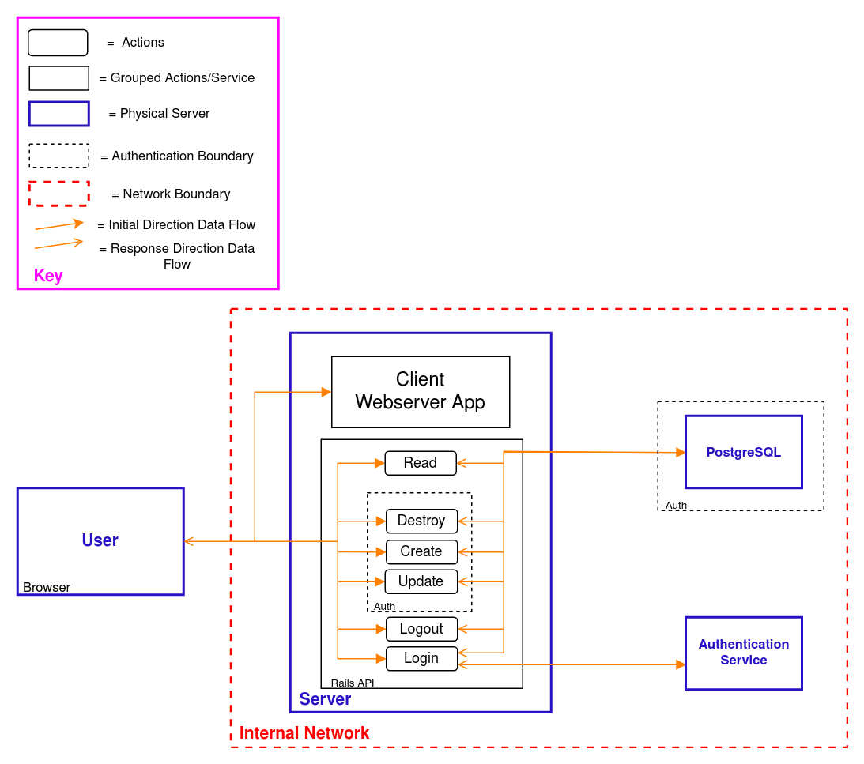
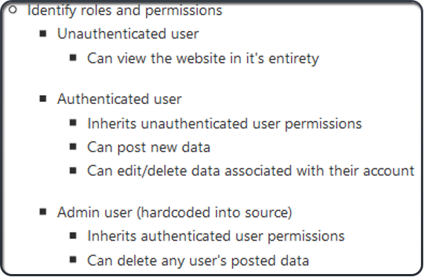
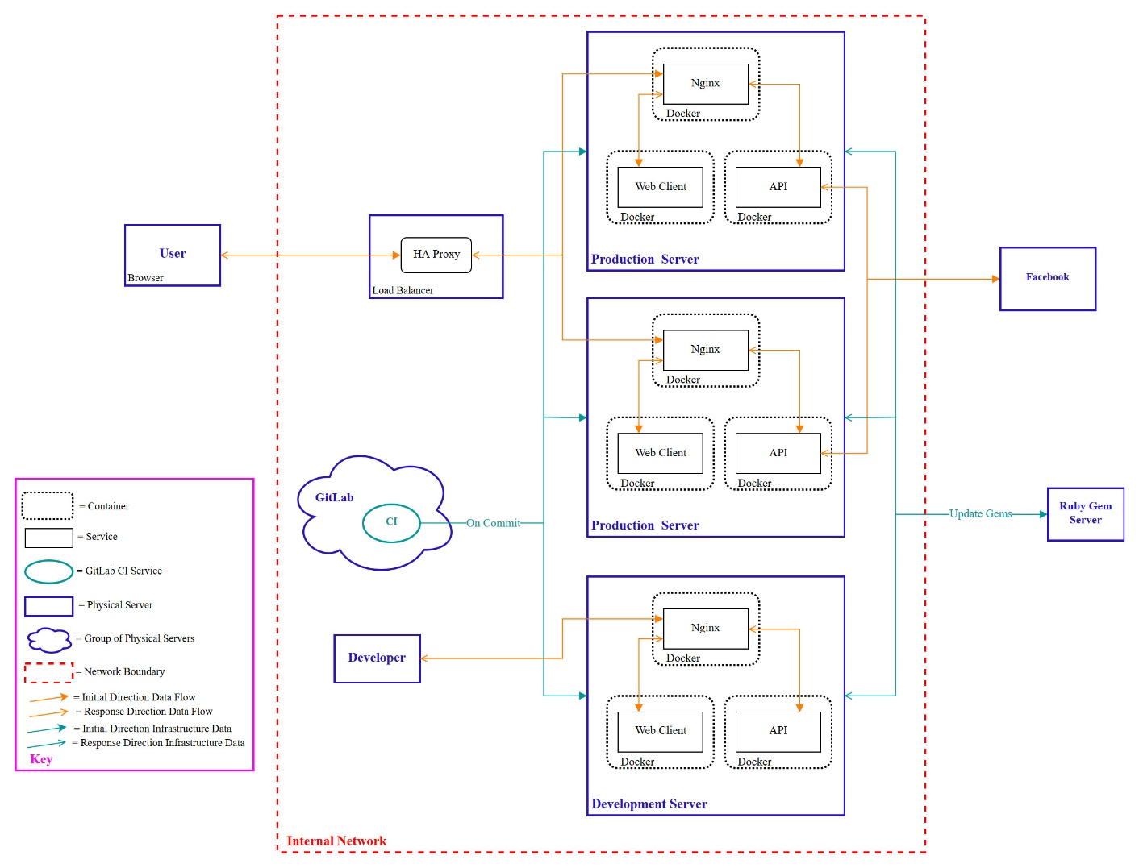
Decomposing the Application
Draw diagrams of the application
Diagram the application's functionality
Data Flow Diagram
Diagram the application's infrastructure
List the user roles and associated permissions

Slide 11
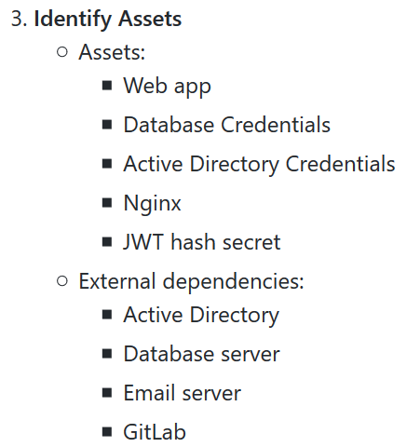
Identifying the Assets
Identify the assets of your application
Items/areas of interest to an attacker
The things that this application needs to secure
Identify External Dependencies the application relies on

Slide 12
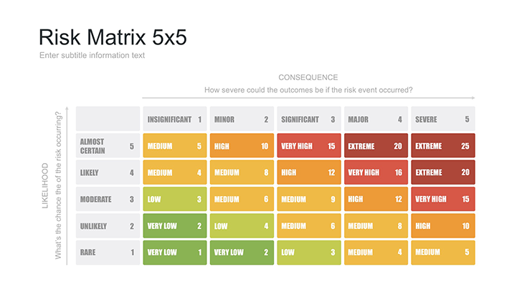
Identifying the Threats and Analyzing their Risk
Go over the diagram and produce threats the application could potentially fall victim to
Elevation of Privilege card game
STRIDE
Fill out the threat matrix for these threats
Categorize with STRIDE
Show the interaction in consideration
Describe the exploit and what could go wrong
List the attack surface(s) for this threat
Impact
Describe a mitigation strategy to avoid the attack
Depending on the tier of the application rank the threats
Tier 1
Rank threats relative to each other to get a comparative list
Tier 2
Rank threats numerically with the 5x5 Risk Matrix
Tier 3
Rank threats using the CVSS standard

Slide 13
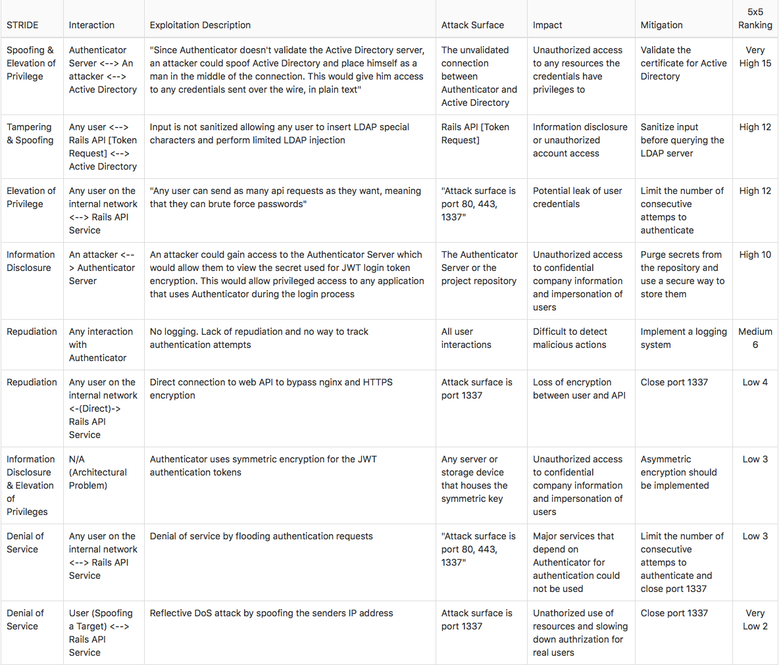
Threat Matrix Example

Slide 14
Questions?

