Slide 1
LP Threat Modeling
Trevor Leach
Bogdan Pyzh

Slide 2

Agenda
Leach-Pyzh Threat Modeling Methodology
Threat Model Example
Threat Modeling Exercise
Wrap-up

Slide 3
Threat Modeling Goals
Provide answers to the following questions:
What are we building?
What can go wrong?
What are we going to do about it?
How did we do?

Slide 4
Steps
Define
Decompose
Decompose the Application​
Identify
Identifythe Assets of the Application​
Analyze
Identify the Threats and Analyze their Risk​
Define the Scope and Objectives of the Application​

Slide 5
Defining the Scope and Objectives
List the scope(s) that will be considered when threat modeling​
Define the Purpose of the Application​
Define Business Objectives of the Application​
Define the Application's Security Tier​
Coincide with OWASP’s ASVS​
Application Verification Security Standard​
Tier 1 (lowest) through Tier 3 (highest)​
Define Any Compliance Requirements

Slide 6
Decomposing the Application
Draw diagrams of the application​
Diagram the application's functionality​
Diagram the application's infrastructure​
List the user roles and associated permissions​

Slide 7
Identifying the Assets
Identify the assets of your application
Items/areas of interest to an attacker
The things that this application needs to secure
Identify External Dependencies the application relies on

Slide 8
Identifying the Threats and Analyzing their Risk
Go over the diagram and come up with threats the application could potentially fall victim to​
Fill out the threat matrix for these threats​
Depending on the tier of the application rank the threats​
Tier 1​
Rank threats relative to each other to get a comparative list​
Tier 2​
Rank threats numerically with the 5x5 Risk Matrix​
Tier 3​
Rank threats using the CVSS standard​

Slide 9

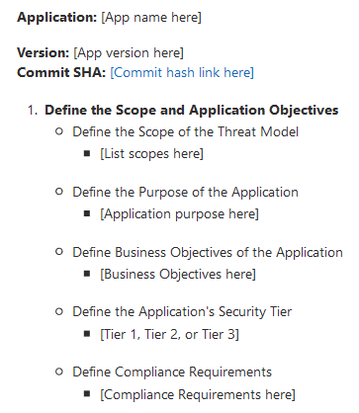

Hive Threat Model Walkthrough

Slide 10
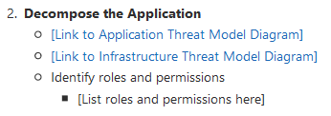

Hive Threat Model Walkthrough

Slide 11
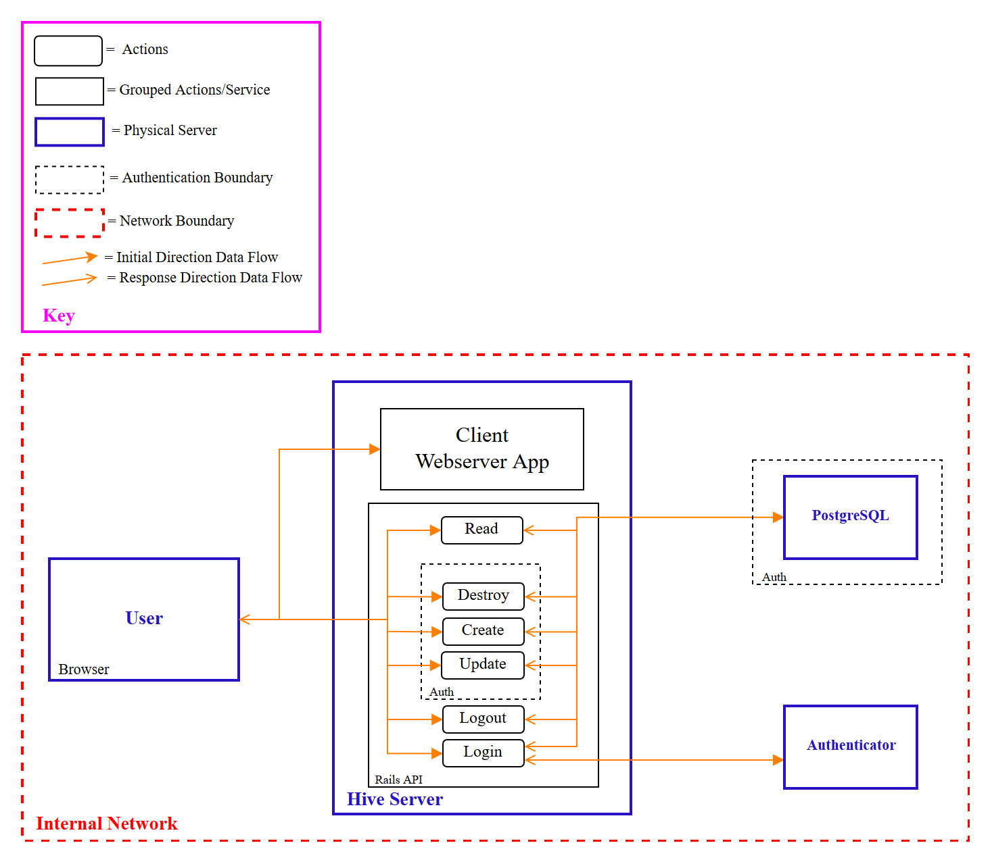
Hive Threat Model Walkthrough

Slide 12
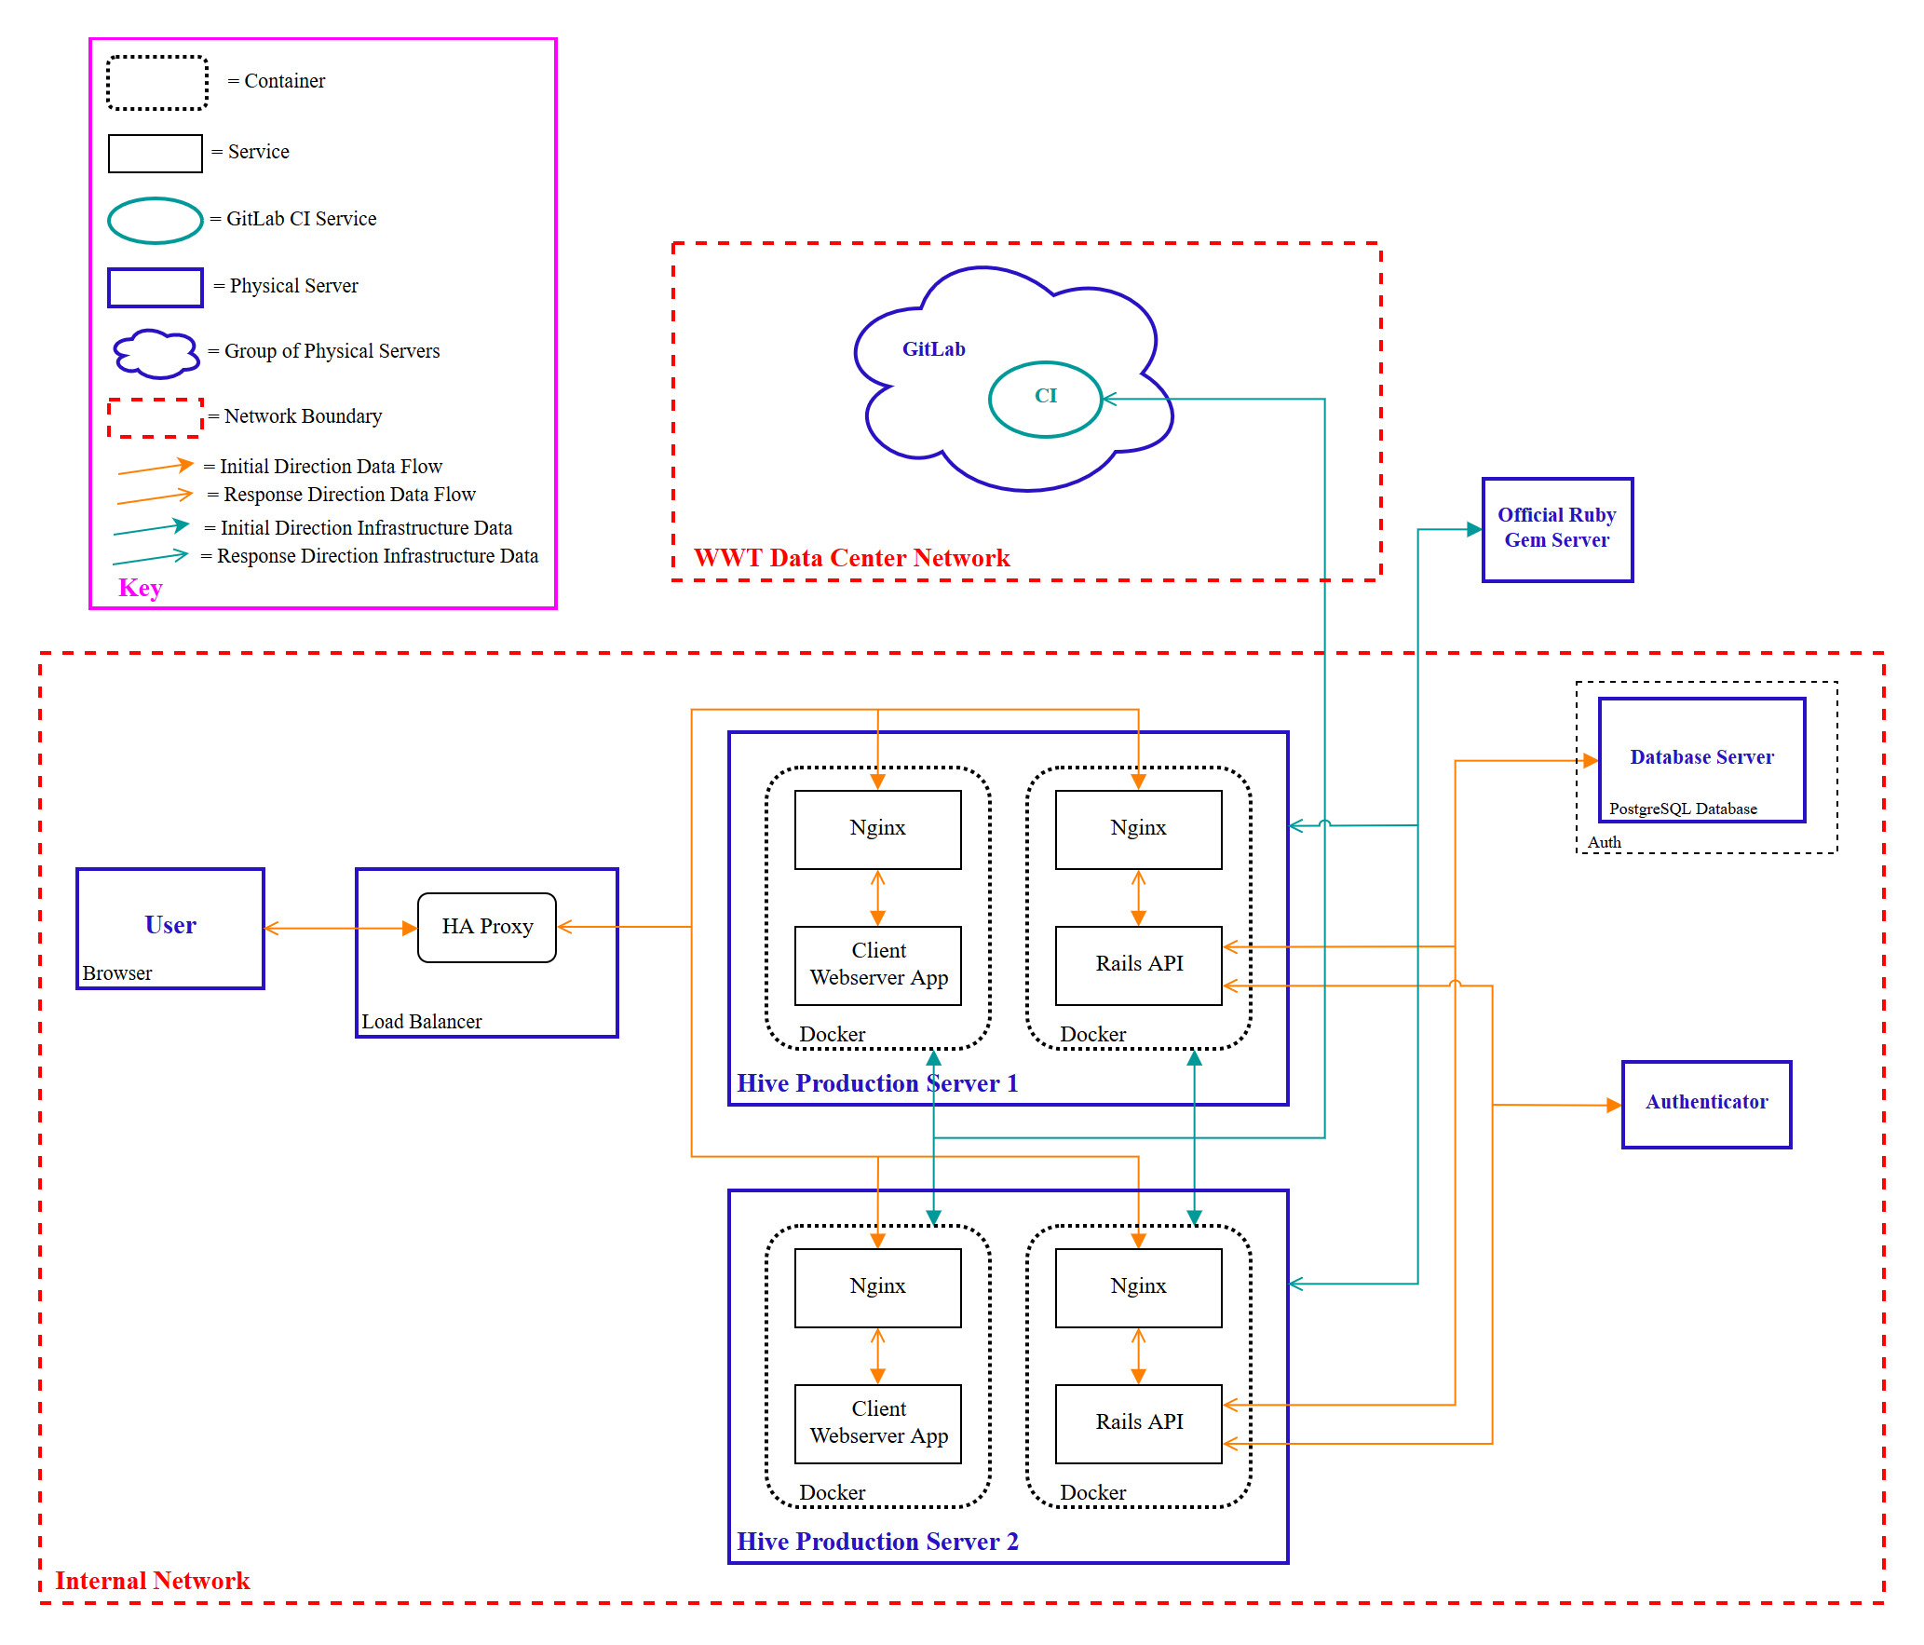
Hive Threat Model Walkthrough

Slide 13
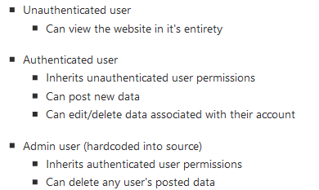
Hive Threat Model Walkthrough

Slide 14
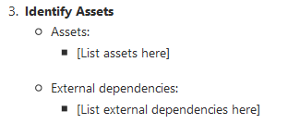
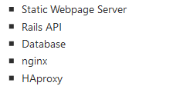
Hive Threat Model Walkthrough

Slide 15



































Hive Threat Model Walkthrough

Slide 16
Threat Modeling Exercise
Simple Blogging Webapp
Project Requirements
The product owner wants you to build a blogging webapp, in which users can register for an account with an email. Without an account users are able to view articles and comments and search for recent articles and search by author. Once registered, the user can post articles, comment on other user's articles, and/or subscribe to an author for email updates when they post a new article. Admins should be able to delete any user's articles and comments.
More Details
Blogging website will be a server-sided HTML application
There will only be one production server
There needs to be a CI/CD pipeline from GitLab

Slide 17
Define
Step 1
List the scope(s) that will be considered when threat modeling​
Define the Purpose of the Application​
Define Business Objectives of the Application​
Define the Application's Security Tier​
Coincide with OWASP’s ASVS​
Application Verification Security Standard​
Tier 1 (lowest) through Tier 3 (highest)​
Define Any Compliance Requirements

Slide 18
Decompose
Step 2
Diagram the application's functionality​
Diagram the application's infrastructure​
List the user roles and associated permissions​

Slide 19
Identify
Step 3
Identify the assets of your application
Items/areas of interest to an attacker
The things that this application needs to secure
Identify External Dependencies the application relies on

Slide 20
Analyze
Step 4
Go over the diagram and come up with threats the application could potentially fall victim to​
​
Depending on the tier of the application rank the threats​
Tier 1​
Rank threats relative to each other to get a comparative list​
Tier 2​
Rank threats numerically with the 5x5 Risk Matrix​
Tier 3​
Rank threats using the CVSS standard​

Slide 21
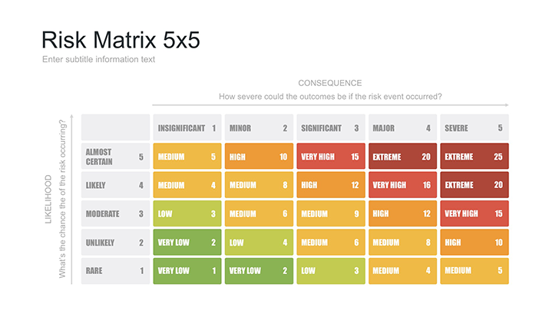

Slide 22
Answering the Question: How did we do?
Depends on the security tier of the application
Tier 1
General reflection on the artifacts generated
Tier 2
Similar reflection as Tier 1 and additional self-performed penetration tests
Tier 3
Professional penetration test

Slide 23
Why is Threat Modeling important?
Promotes building secure code
Helps developers catch things that they wouldn’t have
Makes developers consider security throughout the development cycle
Avoids bolt on security

Slide 24
Questions?

