Slide 1
Building a Recurrent Neyral Network with tensorflow

Slide 2

Recap
DNN: $h=f\left(WX+b\right)$
CNN: $h=f\left(W∗X+b\right)$

Slide 3
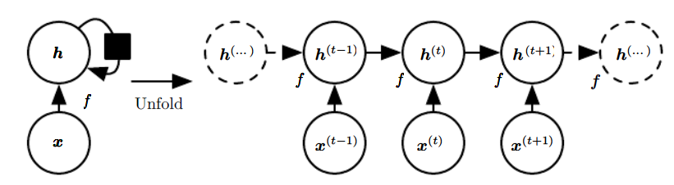

Recurrent Neural Network
$h^{t}=f\left(h^{\left(t−1\right)}, x^{t}; θ\right)=f(b+Wh^{\left(t−1\right)}+UX)$
Ref:Deep Learning Book, Goodfellow, I., Bengio, Y., Courville, A.

Slide 4
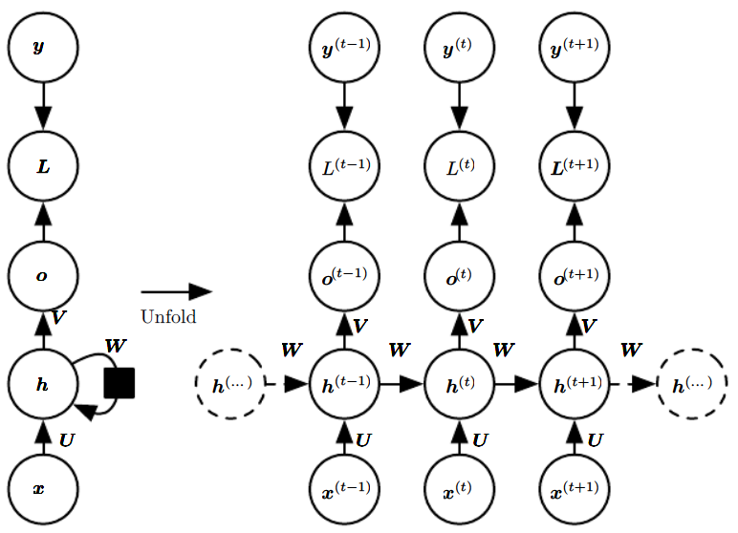

Recurrent Neural Network
$o^{(t)}=c+Vh^{(t)}$
$\hat{y}=softmax(o^{(t)})$
Ref:Deep Learning Book, Goodfellow, I., Bengio, Y., Courville, A.

Slide 5
Recurrent Neural Network
對於有次序性的資料有很好的效果
句子、文章、對話……
Word embedding、機器翻譯、對話機器人、聽寫

Slide 6
訓練資料
MNIST
28 pixel * 28 pixel
28*28 matrix

Slide 7
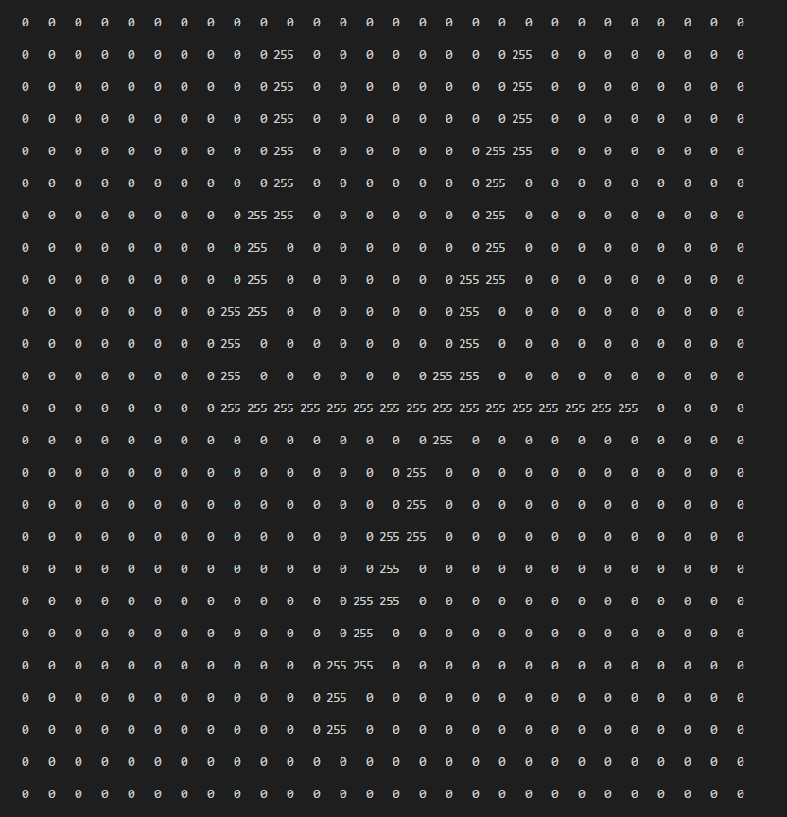

Slide 8
訓練資料
RNN用於處理有”時序性”的資料
時序→順序
Row 0 → t = 0
Row 1 → t = 1
Row 2 → t = 2
......
Row 28 → t =28

Slide 9


模型架構
1
y_pred
10
Fully Connected Layer
h
RNN Module
1
$$x_{t=0}$$
‧‧‧‧‧‧
$$x_{t=27}$$
28

Slide 10
實作
讀懂程式碼之後完成rnn.py中”#TODO”部份的程式碼
比較兩種不同的RNN模型(Vanilla RNN, LSTM) 的結果並討論其差異

Slide 11
API for constructing RNN
tf.contrib.rnn.static_rnn (cell, inputs, initial_state=None, dtype=None, sequence_length=None, scope=None)
tf.contrib.rnn.BasicRNNCell (num_units, activation=None, reuse=None, name=None)
tf.contrib.rnn.BasicLSTMCell (num_units, forget_bias=1.0, state_is_tuple=True, activation=None, reuse=None, name=None
tf.contrib.rnn.GRUCell (num_units, activation=None, reuse=None, kernel_initializer=None, bias_initializer=None, name=None)
*Copied from tensorflow’s document

Slide 12
RNN相關學習資源
https://www.youtube.com/watch?v=hhJIztWR_vo&list=PL2-dafEMk2A7YdKv4XfKpfbTH5z6rEEj3&index=13
https://medium.com/@erikhallstrm/hello-world-rnn-83cd7105b767

