Slide 1
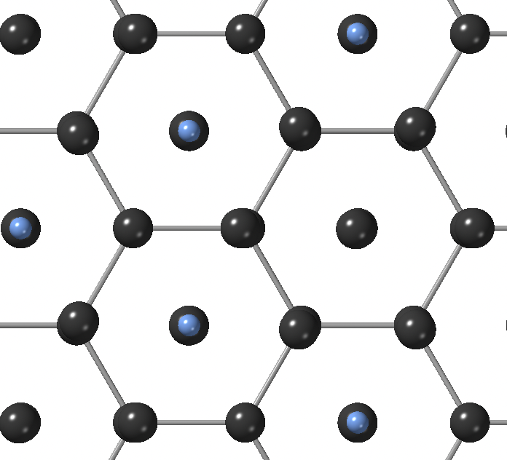
Diffusion barrier of Li on Li₃N (001) surface
0.136 eV

Slide 2
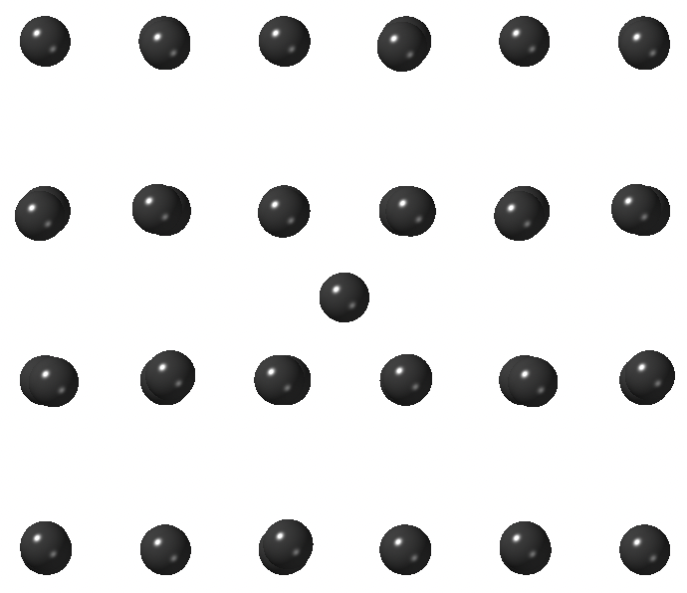
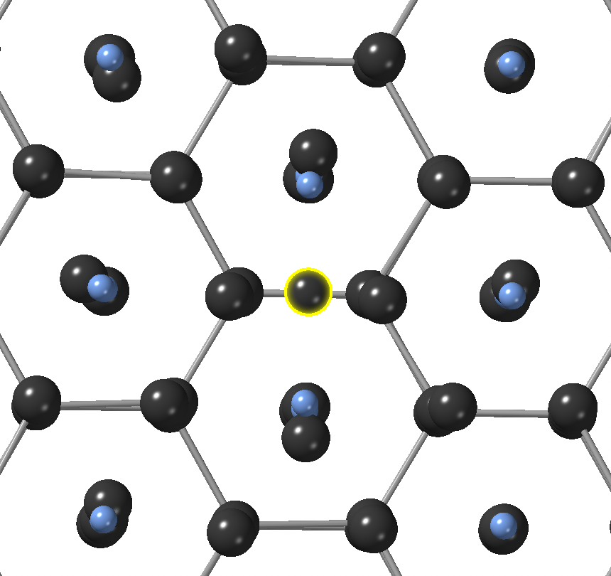
Adsorption of Li on Li (110) surface
Adsorption of Li on Li₃N (001) surface
adsorbed Li
adsorbed Li
E_{ads} = -1.593 eV
E_{ads} = -3.440 eV

