Slide 1
From Industry Signal to Strategic Analysis
<div class="metric metric--stat"><strong>$94.3bn</strong><span>CAPEX represented in the original visual</span></div>
<div class="metric metric--stat"><strong>17</strong><span>Independent sources consulted</span></div>
<div class="metric metric--stat"><strong>4</strong><span>Amounts independently verified as development CAPEX</span></div>
<p class="lead">A LinkedIn post became a professional industry analysis in under an hour.</p>
A simple ranking of the largest FPSO projects became a structured examination of:
project scope
CAPEX comparability
development status
omitted projects
ownership models
phased versus integrated development
and the strategic assumptions hidden inside the ranking
The input was a LinkedIn post. The output was an industry perspective. In under an hour, a simple ranking of the largest FPSO projects became a structured examination of project scope, CAPEX comparability, development status, omitted projects, ownership models, phased versus integrated development, and the strategic assumptions hidden inside the ranking.
<p class="caption">The input was a LinkedIn post. The output was an industry perspective.</p>

Slide 2
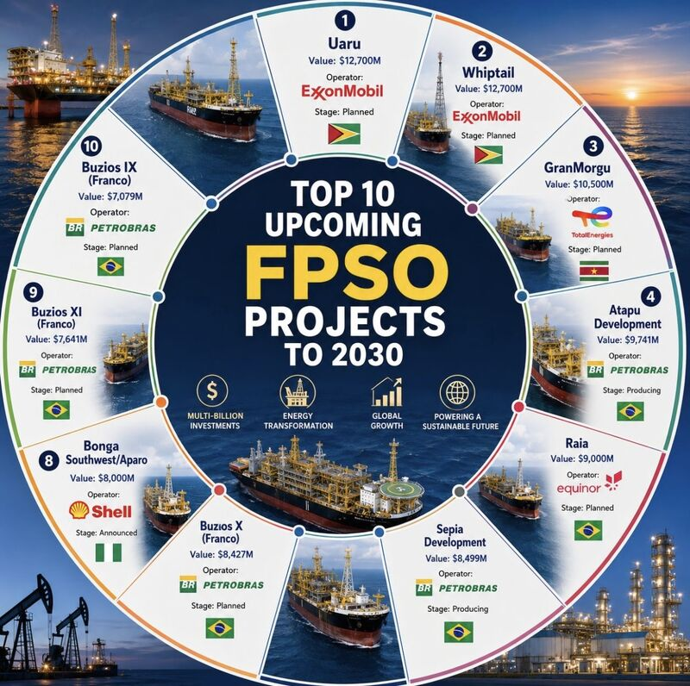

Start with the LinkedIn visual
Giacomo Prandelli’s post makes a sharp geographic argument: nine of ten highest-CAPEX FPSO projects shown sit in the South Atlantic.
Source: linkedin.com/posts/prandelligiacomo…
Scan to open the original LinkedIn post and visual.
Original ranking visual from Giacomo Prandelli’s LinkedIn post
Uaru and Whiptail lead at US$12.7bn each. Petrobras supplies five entries. Only Bonga Southwest/Aparo sits outside the South Atlantic cluster.
We begin with the original LinkedIn visual. Giacomo Prandelli’s post claims the top ten FPSO projects through 2030 are worth about ninety-four billion dollars. Scan the QR code to open the source post. The chart concentrates capital in Guyana, Suriname, Brazil, and one Nigerian project.

Slide 3
Capital clusters across the Atlantic margin
{"type":"markers","entity":"data.capex_ranking.prandelli-top10-fpso-to-2030.projects","label":"project_name","location":"offshore_area","latitude":"latitude","longitude":"longitude","order":"startDate","strategy":"chronological","color":"operator_name","size":"claimed_capex_m","limit":10,"projection":"natural-earth","callouts":["Uaru","GranMorgu","Atapu Development","Raia","Bonga Southwest/Aparo"],"flag":"country_id","colormap":"operator.display_colors","zoom_to_data":true}
Marker area is proportional to stated CAPEX; color identifies operator. Coordinates are representative offshore project positions for portfolio visualization, not navigation.
Geography sharpens the ranking's central signal. Nine projects cluster along the South Atlantic margin, from Guyana and Suriname to Brazil, while Bonga is the sole West African entry. Marker area follows stated CAPEX and color identifies the operator, revealing both geographic and operator concentration at a glance.

Slide 4
What do the numbers actually include?
<blockquote><p>Those values are including which investments, besides the FPSOs per se?</p></blockquote>
<p class="label">Luciano Jorge de Carvalho Junior · LinkedIn comment</p>
<p>A precise-looking ranking can still mislead if FPSO vessel prices are mixed with full-field development costs. Until primary sources define a common cost boundary, the visual’s figures are treated as stated project values — not FPSO-only CAPEX.</p>
A comment under the post asked the decisive question: which investments, besides the FPSOs themselves, are included in these values? That question sets the research agenda. Without a shared cost boundary, the ranking can look exact while comparing unlike scopes.

Slide 5
Separate claims before reconciling them
Step 01
Step 02
Step 03
Preserve the trigger
Capture discussion
Seek primary sources
Transcribe the LinkedIn ranking and ten project rows into their own provenance file. Do not rewrite the published visual.
Store comment-proposed projects — Wisting, Tangkulo, Bay du Nord, Venus, PAJ — as discussion mentions, not silent inserts into the top ten.
Match each amount against operator, regulator, and contract disclosures from ExxonMobil, TotalEnergies, Equinor, Petrobras, ANPG, and others.
Step 04
Step 05
Step 06
Classify evidence
Refuse false precision
Publish the reconciliation
Label each row verified development CAPEX, identity-only, conflicting scope, or not ranked — keeping currencies and horizons intact.
Do not convert CAD or NOK, or promote lower-bound estimates, into a new ordinal league table without a common basis.
Keep original, comment, and independent values in separate fields so downstream analysis cannot silently substitute one layer for another.
The method is deliberate. First preserve the trigger visual. Then capture LinkedIn discussion separately. Next consult primary sources. Classify what each source actually proves. Refuse false precision when currencies or horizons do not match. Finally publish a reconciliation that keeps every evidence layer distinct.

Slide 6
What the sources establish
Verified · full development
Identity only · amount open
Uaru, Whiptail, GranMorgu, Raia
Atapu 2, Sépia 2, Búzios 9–11
Published amounts match operator disclosures — as whole-development investment, including FPSO, not vessel-only prices. Luciano’s scope question is answered for these four.
Petrobras materials confirm project identity and naming (P-80 to P-85), but the visual’s CAPEX figures remain unverified. Ranks are retained provisionally.
Conflicting scope · flagged
Not ranked · discussion layer
Bonga Southwest/Aparo
Bay du Nord, Wisting, Greater PAJ, Tangkulo, Venus
Visual shows US$8bn. Newer reporting points to roughly US$10bn CAPEX and up to US$20bn total investment including life-cycle opex. Flagged, not re-ranked.
Comment additions expand geography, but stay NR until currency, horizon, and cost boundary are comparable to the visual’s USD top ten.
Independent sources verify four of the original amounts — Uaru, Whiptail, GranMorgu, and Raia — as full development investments. Petrobras rows are identity-confirmed but amount-open. Bonga conflicts in scope and is flagged. Comment projects remain unranked rather than forced into the table.

Slide 7
Same order. Clearer evidence.
Original US$94.287bn visual reconciled with independent findings · 19 July 2026
Independently matched development CAPEX · Original visual value, scope not established · Newer finding conflicts in scope or value
The updated ranking keeps the visual’s original order. Green marks independently matched development CAPEX. Grey marks amounts whose scope is still unresolved. Orange marks Bonga’s conflicting newer headline. Five discussion projects sit below as not ranked, with native currencies preserved.

Slide 8
From industry signal to trusted perspective
<p>A single industry post became the starting point for a structured analysis of the FPSO market — combining source research, project reconciliation, cost-scope analysis, and strategic interpretation.</p>
<p class="pull">The result is not simply a fact check.</p>
<p>It is a <strong>professional industry perspective</strong> built from the evidence available.</p>
<p class="caption">The input can be a single industry signal.<br>The output is a trusted perspective on the industry.</p>
<div class="metric"><strong>Rapid synthesis</strong><span>Move from an emerging industry signal to a structured analytical view in hours, not weeks.</span></div>
<div class="metric"><strong>Evidence-led judgment</strong><span>Combine public disclosures, company materials, government sources, contractor information, and industry context.</span></div>
<div class="metric"><strong>Strategic interpretation</strong><span>Go beyond what is stated to understand what the data reveals about capital deployment, development models, ownership, risk, and opportunity.</span></div>
<p class="label">Exergy xFrame Insights</p>
<p class="pull">Turn fragmented information into a decision-quality view of the industry.</p>
A single industry post became the starting point for a structured FPSO market analysis. The result is not simply a fact check, but a professional industry perspective built from the available evidence. Exergy xFrame Insights combines rapid synthesis, evidence-led judgment, and strategic interpretation to turn fragmented information into a decision-quality view of the industry.

Slide 9
Original ranking visual from Giacomo Prandelli’s LinkedIn post

Slide 10
Original US$94.287bn visual reconciled with independent findings · 19 July 2026

