Slide 1
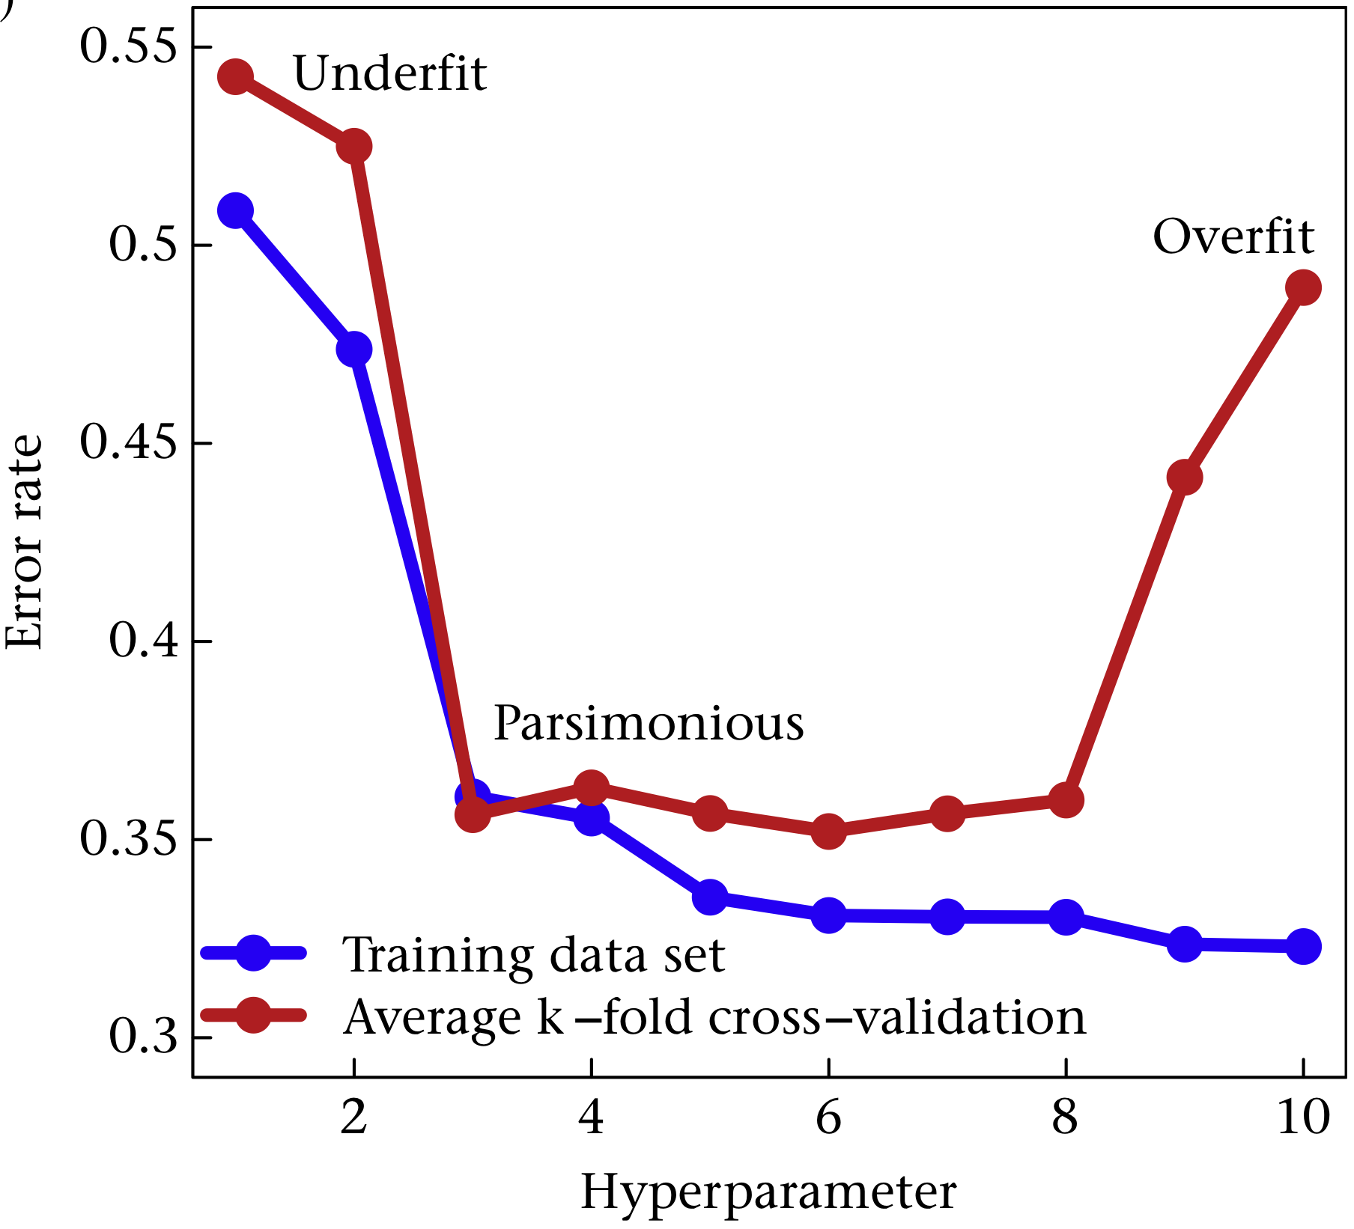
High bias
High variance
Model complexity
(extra features absorb variance)

